Slide 1
Policy & Compliance
Process Implementation Workshop
Yokohama Release
Speaker Name
March 2025
Asset number: 0003621

Slide 2
User instructions
PLEASE REMOVE THIS SLIDE BEFORE PRESENTING
Who: This deck is built for delivery of a ServiceNow product/capability. The delivery of this deck may be undertaken by Customers, ServiceNow Partners and ServiceNow Expert Services. Assigned Business Process Analysts, Business Process Consultant, Technical Consultants and/or Developers will normally be responsible for its delivery.
Why: We want to make it easier for you by spending more time on the implementation and build, not creating workshop materials. The purpose of this presentation is to outline the baseline process explaining the configurable options with the objective of determining the to-be process and corresponding configuration requirements, usually in the form of user stories

Slide 3
User instructions
PLEASE REMOVE THIS SLIDE BEFORE PRESENTING
How:
Customers (self–implementation) – use the deck as it is or add to your corporate template. Alternatively, utilize individual slides to enhance your internal communications
Partner or Co-Delivery implementations - use the deck and add your logo, following the instructions on a following slide.
ServiceNow Expert Services
remove the PartnerLogo using the Slide Master (View > Slide Master > select the vertical line and the PartnerLogo at the bottom of the Master Slide and delete. If you see any other instances of PartnerLogo just follow the same process from that slide). If you have any issues, please contact the Now Create Team via the Teams channel
Tailor the presentation for the needs of your specific implementation

Slide 4
FAQs
PLEASE REMOVE THIS SLIDE BEFORE PRESENTING
How can I provide feedback on this asset or other parts of Now Create? Now Create has several feedback buttons throughout the portal, using the thumbs up/thumbs down buttons. Click on those icons and a small form will appear for you to leave specific feedback regarding the asset you are accessing.
If we use this deck, or slides from this deck, are we breaking any copyright? No. We designed this deck to be used by our whole ecosystem.
What should I do if I don’t need all of the content contained within this, or other assets? You can either hide or delete the slide(s). You may also want to move the slide(s) to the end of the presentation, review it when you have finished updating the asset for your own use, and then deleting any content you don’t need. Remember to regularly check Now Create to make sure you have the most up-to-date asset.

Slide 5
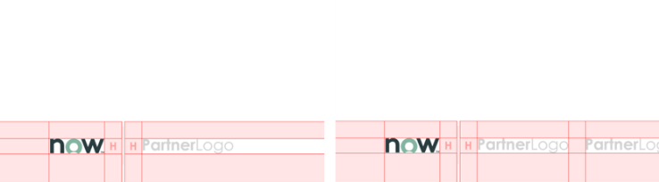
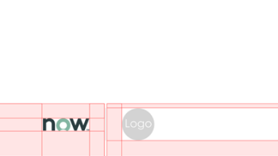
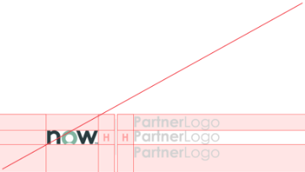

Adding your Logo
PLEASE REMOVE THIS SLIDE BEFORE PRESENTING
To provide credibility to ServiceNow documents, the ServiceNow and your logo should be visible, but not domineering.
Click View > Slide Master > Slide > Select Page 1
What to do:
Download logos from the Brand Center site.
Scale logos to an exact height of 0.45cm.
Place your logos after the ServiceNow logo, divided by a grey bar.
The same rule should be applied when more than one partner logo is required.
What not to do:
Do not scale logos beyond 0.45cm height
Do not stack ServiceNow and Partner logos

Slide 6
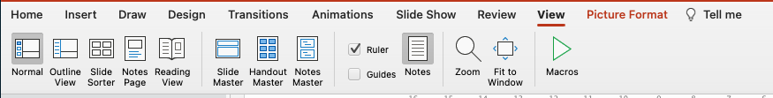
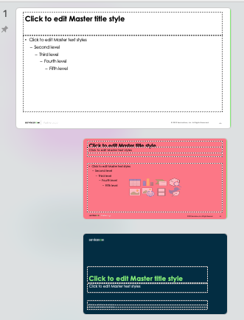

Deleting the PartnerLogo
1.
PLEASE REMOVE THIS SLIDE BEFORE PRESENTING
2.
What to do:
Click ‘View’ at the top of the screen
Click on ‘Slide Master’ - this takes you to the slide master for the slide you are looking at
Scroll up to Slide 1 in the master view. You may have to pull out the view on the left slide, so you can see all of the slides. Slide 1 will be the slide that looks larger than all the rest. It’s kind of the master of that group of slides.
At the bottom of the slide there are 2 shapes that you can highlight. A small vertical grey line and the PartnerLogo text.
Once highlighted, simply press delete. That should remove the PartnerLogo from the slides.
3.
4.
5.

Slide 7
Housekeeping

Slide 8
Housekeeping
For virtual/hybrid workshops. Update depending on which application you are using to run your workshop
Time
Presence
Collaboration
We’ll aim to start and finish on time
Breaks will be taken as needed; approximately every 1-2 hours
Please return from breaks and lunch promptly; if late, please catch-up during breaks or after the workshop
If you are comfortable, please keep your Webcam on
Please let the host know if you need to leave the workshop, via the chat
Avoid temptation to multitask while in the workshop
More than 3 second’s silence = concurrence with the point made
All phones on vibrate and make sure you mute your microphone when not contributing to the discussion
Maintain a positive atmosphere – everyone’s ideas are valued
Please wait for one speaker to finish. Feel free to raise your (virtual) hand if you would like to make a point
Discussion topics needing greater detail will be recorded in a “Parking Lot” for later resolution
Everyone’s ideas are valued
Have fun! ☺
Notes:
** USE THIS SLIDE IF DELIVERING THE WORKSHOP IN A VIRTUAL OR HYBRID FORMAT **
Explain and discuss
Review the housekeeping with workshop participants.
Key points to highlight:
If participants come back late from a break or lunch, you will not be able to repeat what they missed during the session. They need to catch up on another break or after workshop.
Silence phones and step away if you need to use the phone.
Try to stay focused. Emails, phone calls, texting, working on other things, etc. can cause missed, unclear, or un-agreed requirements which leads to additional time to deploy.
There are no titles in the room. Everyone’s opinions, challenges, and ideas should be shared if it could be a input to a requirement.

Slide 9
Housekeeping
For in-person workshops. Update depending on your location, e.g. you may have to add fire exit information
Time
Presence
Collaboration
We’ll aim to start and finish on time
Breaks will be taken as needed; approximately every 1-2 hours
Please return from breaks and lunch promptly; if late, please catch-up during breaks or after the workshop
In the case of an emergency…..
All phones on vibrate. Please leave the room if you must take a call
Avoid temptation to check email. Please keep laptops closed unless taking notes or working on something for the Workshop
More than 3 second’s silence = concurrence with the point made
Maintain a positive atmosphere – everyone’s ideas are valued
Active participation and listening
Discussion topics needing greater detail will be recorded in a “Parking Lot” for later resolution
Everyone’s ideas are valued
Have fun! ☺
Notes:
** USE THIS SLIDE IF DELIVERING THE WORKSHOP IN A MORE TRADITIONAL MEETING ROOM ENVIRONMENT **
Explain and discuss
Review the housekeeping with workshop participants.
Key points to highlight:
If participants come back late from a break or lunch, you will not be able to repeat what they missed during the session. They need to catch up on another break or after workshop.
Silence phones and step away if you need to use the phone.
Try to stay focused. Emails, phone calls, texting, working on other things, etc. can cause missed, unclear, or un-agreed requirements which leads to additional time to deploy.
There are no titles in the room. Everyone’s opinions, challenges, and ideas should be shared if it could be a input to a requirement.

Slide 10
Agenda

Slide 11
Policy and compliance agenda
Date​ | Session​ | Time​ | Date​ | Session​ | Time​
​ | Welcome​ Welcome and meeting cadence​ Introductions​ Workshop overview​ | 0.5hr​ | ​ | Processes definition​ Control attestations​​ Policy, control, and policy exception processes and notifications​ Continuous monitoring, integration​ | 2hrs​
​ | High level overview and discussion of the business requirements ​ Understand policy & compliance current and future states​ Understand need for integration / data uploads​ | 1.5hr​ | ​ | Roles and responsibilities​ Compliance Admin, Compliance Manager, Compliance User​ | 1hr​
​ | Policy and compliance management structure and architecture​ Entity framework, authority document, citations, control objectives, controls, policies, policy acknowledgement​ | 2hrs​ | ​ | Reporting and analytics​ Base dashboards and reports​ | 0.5hr​
​ | Break​ | 1hr​ | ​ | Requirements review​ Run-through of user stories documented to date​ Next steps​ | 0.5hr​

Slide 12
Introductions

Slide 13

Introductions
Name
Role
Involvement in the project/implementation
Experience with ServiceNow and/or other related experience
Notes:
During introductions, include experience level with ServiceNow, the product/capability, and expectations from the workshop
If the workshop is being held in-person, and there are a large number of participants, consider writing people’s names on card and standing in front of each individual

Slide 14
Objectives

Slide 15
Implementation guiding principles
Use out-of-the-box (OOB) leading practice as the baseline
Focus on configuration, not customization
Challenge current practice
Don’t break current business; look for opportunities
Eliminate pain points
Be lean, be agile – embrace change!
Notes:
USE: Confirm the Guiding Principles of the Implementation Project.
You may find it valuable to define the terms:
Administration – Ongoing Maintenance activities (e.g. User, Group, and Role Administration)
Configuration – Expected configuration changes to the out of the box (e.g. Table changes, Workshops, UI Policies)
Customization – Changes to business logic (e.g. Advanced Business Rules, Integrations)
Platform Changes – Changes that would impact upgrades (e.g. Changes to out of the box UI Pages)

Slide 16
Business objectives
What are your high-level business objectives and strategic drivers that must be considered when configuring the incident management process?
For example:
Reduce repetitive, routine work
Route the right work to the right person
Streamline collaboration across the enterprise
Enable visibility to prioritize work and monitor performance against service level agreements (SLO/OLA/SLAs)
Notes:
Explain and discuss
Explain that although we do not walk through the customer’s existing process or ask for a list of requirements, we do need to understand the high-level business objectives or strategic drivers as this will inform decisions taken during the workshop
Decisions to make
Identify and document the business drivers that will impact functional process decisions

Slide 17
Workshop deliverables
Workshop outcomes:
Definition of the GRC processes
High level architecture of the solution (including any integrations)
Process workflow definition to be used within the Now Platform®
Development lifecycle strategy for the project
Defined requirements that can be loaded into user stories
Parking Lot list of post workshop activities
Workshop Exclusions:
Detailed training on how to use the Now Platform®
Creation/modification of forms, reports, workflows, or other ServiceNow application components during the workshop (except for demos)
Notes:
USE: Review the outcomes.
It may be useful to discuss the use of Epics and Stories to manage the requirements

Slide 18
Entity Framework & Scoping

Slide 19
Entity framework
The entity framework makes up the foundation data of the GRC / IRM solution and is made up of multiple components such as:
Entities
Entity Types
Entity Classes
A mature entity framework helps an organization create an integrated risk management program with automatic workflows and informed, data driven decision-making.
In ServiceNow, the process of creating the entity framework is called entity scoping.
It is important that when scoping entities, the organization should use high-quality and reliable data (e.g., from the CMDB) with the organizational layer built correctly in the relevant ServiceNow tables. These tables are the data source for the entity scoping process.

Slide 20


Entity Framework Components
ServiceNow uses entities, entity types, and entity classes to build and organize people, places, objects or things that need to be monitored for risk and compliance.
Entity
Entity Type
Entity Class
Entities are people, places, objects, or things that are tracked for GRC activities such as managing risks and tracking control compliance etc. | Entity types are dynamic categories containing one or more entities of a similar type that match conditions against tables within ServiceNow. | An entity class is a tag for entities and allows GRC managers to add business context to entities and organize them for reporting.
Created automatically from entity types or manually. Mapped to control objectives and risk statements to create risk and control instances. Can be associated to multiple entity types but only one entity class. | Creates entities using entity filters. Mapped to control objectives and risk statements to create risk and control instances automatically for all associated entities. | Tags entities across multiple entity types. Can be tagged to individual entities manually. Can be associated with entity tier.
Mandatory for associating risks and controls in ServiceNow. | Optional but highly recommended. | Mandatory from San Diego release.
Finance (department), ServiceNow (business application) | Critical IT Assets, All IT Assets | Department, Business Application, Business service
What is it?
How does it work?
Optional / Mandatory?
Examples

Slide 21



Entity Framework Components
ServiceNow uses entities, entity types, and entity classes to build and organize people, places, objects or things that need to be monitored for risk and compliance.
Entity Filter
Entity Class Rule
Entity Tier
An Entity Filter enables you to find and create entities that match a set of filter conditions for an Entity Type. | A rule that maps what class should be assigned to the entity when created from a specific table within ServiceNow. | An entity tier assigns a level to the entity class hierarchy.
Select the relevant ServiceNow tables to filter on and any other filter conditions required. Select an owner. Entities that match the filter conditions are created and linked to the Entity Type. | Define the table name and entity class that are to be associated. When an entity is created for a specific table, the class associated with that table automatically gets assigned to the entity. | A tier can be associated to several classes N.B. this is specific to the entity class hierarchy. More information has been provided for entity hierarchy (required for risk / compliance) roll-up in this presentation.
Optional, but highly recommended. | Optional but recommended (create entity class and entity class rules before entity types) | Optional
Table = cmn_location Region = EMEA | Table = cmn_location Class = Location | Business Tier 1, Application Tier 2, IT Asset Tier 3
What is it?
How does it work?
Optional / Mandatory?
Examples

Slide 22
Entity Framework Architecture
Notes:
An entity can belong to many entity types, but it can have only one entity class. One entity type can have entities that belong to different entity classes.
Entity classes can roll up to each other, leading to the development of the Dependency Model.
Entity tiers are a way for an organization to logically group entity classes and then filter reports by those groupings. They are used for building entity hierarchy between various entity classes. For example, the database and server entity classes can be grouped together under the IT Asset entity tier.

Slide 23
Entities
Entities are people, places, objects, or things that need to be monitored in order to manage risks, track control compliance, or review as part of audit engagements. Examples of entities include:
Entity Type
Example Entity
Entity Type
Example Entity
Business Unit
Corporate Functions
Utilities
Air Conditioning
Department
Finance
Business Applications
SAP
Region
EMEA
Services
HelpDesk
Country
Brazil
Suppliers
ServiceNow
Location
Boston Site
Customers
Any consumer
Building
Head Office 1
Processes
L1 Procurement

Slide 24
Entity Types
Three questions to consider when creating entity types. Are multiple entities in the company...
1
Subject to a similar risk?
For example, all company cars run the risk of being involved in a car accident. Thus, company cars can be an entity type that is applied to the risk statement, risk of accident.
2
Monitored by a similar control?
For example, company laptops is selected as an entity type because all company laptops are subject to the control: limit permitted applications and require virus monitoring.
3
Governed by a similar policy?
For example, all employees are governed by an expense reimbursement policy. Thus, an entity type can be employees and it is applied to the expense reimbursement policy.
Notes:
Use this slide to help make decisions regarding which entity types to setup

Slide 25

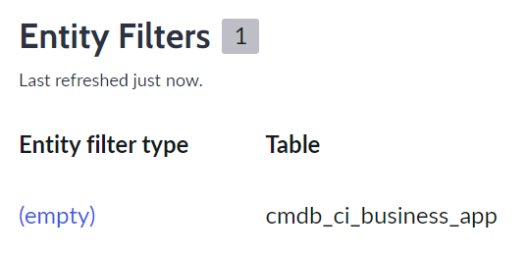
Entity Types and Entity Filters
Business logic automates the process of creating entities using existing data in ServiceNow tables that meets entity type conditions, as defined in entity filters.
Entity filters are defined in the Entity Type record.
In the entity filter record, select the ServiceNow table which will be used as the source for generating entities. Records on that table are the master data points.
All regions
Departments
Applications
Entity Types
Regions
Departments
Business Applications
ServiceNow Tables
EMEA
APAC
AMERICAS
Finance
Sales
Marketing
ServiceNow
SAP Finance
MS Office
Entities
N.B. Entities that span multiple entity types are automatically identified by the system and will not be duplicated. These entities will be linked to all relevant entity types.
Notes:
Master data should exist in the relevant ServiceNow tables to better support organizational changes.

Slide 26
Entity Types and Entity Filters
Filter conditions are added on top of the table to further specify which records should generate entities e.g. specific category, criticality rating, parent etc.
Entity Type
Finance Departments
ENTITY FILTER
Table: Department
Filter conditions:
Parent is Finance
Entities
Tax
Payroll
Accounts
Revenue
Please note any amendments made to the entity or deletion in the IRM/GRC application will not be reflected in the original source table.
Notes:
In order to take advantage of the entity filter, attribute data is required in the ServiceNow tables e.g. if there is a requirement to filter on critical business applications, a criticality field in the business applications table is required to have data in otherwise the filter will not work as expected.
This is the recommended method of populating entity types with entities as this is a dynamic relationship. If a new record is created in the ServiceNow table and meets the requirement of the entity filter, it will be automatically added as an entity in the entity framework. Similarly, if the filter is amended, the relevant entities will be automatically updated.
Entities can be manually added to entity types as well but will require to be maintained manually.

Slide 27
ServiceNow Tables
More information on ServiceNow’s common service data model is available here.
Example tables where organization data should be entered / uploaded:
Best Practice: Use these tables as the single source of truth for entity data
Table name | Table Label | Table Description
core_company | Company | Company details
sys_user | Users | List of users in the organization
business_unit | Business Unit | Business units within the organization
cmn_department | Department | All departments
cmn_location | Location | Includes location data such as; Region, Country, State, City, Site, Building/Structure, Floor, Room
cmdb_ci_business_app | Business Application | A purchased or internally developed application.
cmdb_ci_business_process | Business Process | A process that is owned and carried out by the business and contributes to the delivery of a product or business service.
cmdb_ci_service | Business Service | IT Service that directly supports a Business Process (ITIL).
cmdb_ci_datacenter | Data Center | Facility used to house computer systems and associated components, such as telecommunications and storage systems.
Notes:
It is not recommended to organize data outside of tables e.g. directly into the entity framework or custom tables.
This becomes challenging to manage and the following issues are commonly seen:
Out of date entity information
Duplication
Incorrect entity hierarchy
Time consuming to update entities

Slide 28
Example As a GRC Program Administrator, I want to document all processes in the organization so that process / risk owners can assess the risk.
Entity Class: Processes
Entity Type: HR Processes
Table: cmdb_ci_business_process
Filter: Parent is HR
Recruitment
Onboarding
HR Compliance
Learning & Development
Entity Type: Operations Processes
Table: cmdb_ci_business_process
Filter: Parent is Operations
Procurement
Product / Service Quality
Product / Service Delivery
Market Research
Entities
Entity Type: Finance Processes
Table: cmdb_ci_business_process
Filter: Parent is Finance
Revenue
Payroll
Tax
Accounts

Slide 29
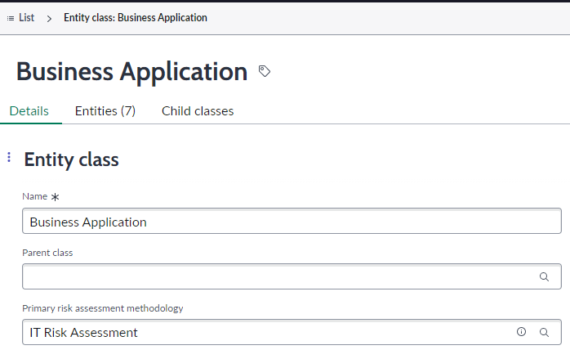
Entity Class
An Entity Class is a tag and is mandatory* for all entities. Entity Classes are critical as they allow GRC managers to distinguish between entities and organize them meaningfully for reporting.
They serve a very different purpose to Entity Types, which are used for the creation of entities and associated risks and controls in bulk.
In advanced risk, when defining the context of a Risk Assessment Methodology (RAM), the applicable entity classes must be selected e.g. for an IT Risk Assessment RAM, the applicable entity classes may include;
IT asset
Business application
Server etc.
When advanced risk assessments are then created, and a RAM is selected, the applicable entities for assessment are automatically filtered based on the classes linked to the RAM. This makes the process of creating risk assessments more efficient.
Once configured, the RAM becomes visible on the
Entity Class details page. If linked to multiple RAMs, the
primary can be selected.
*from San Diego release

Slide 30
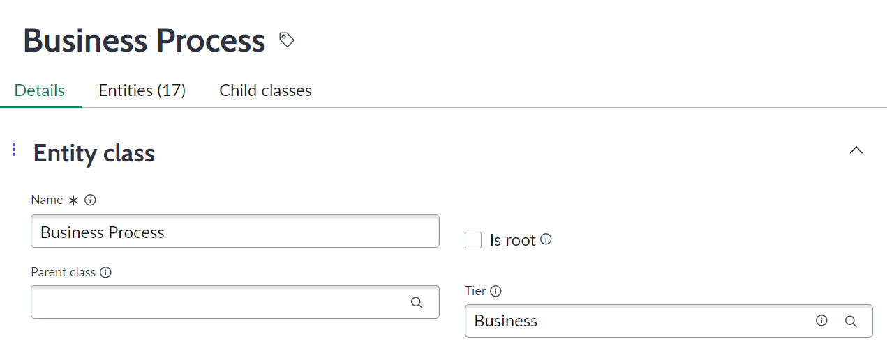
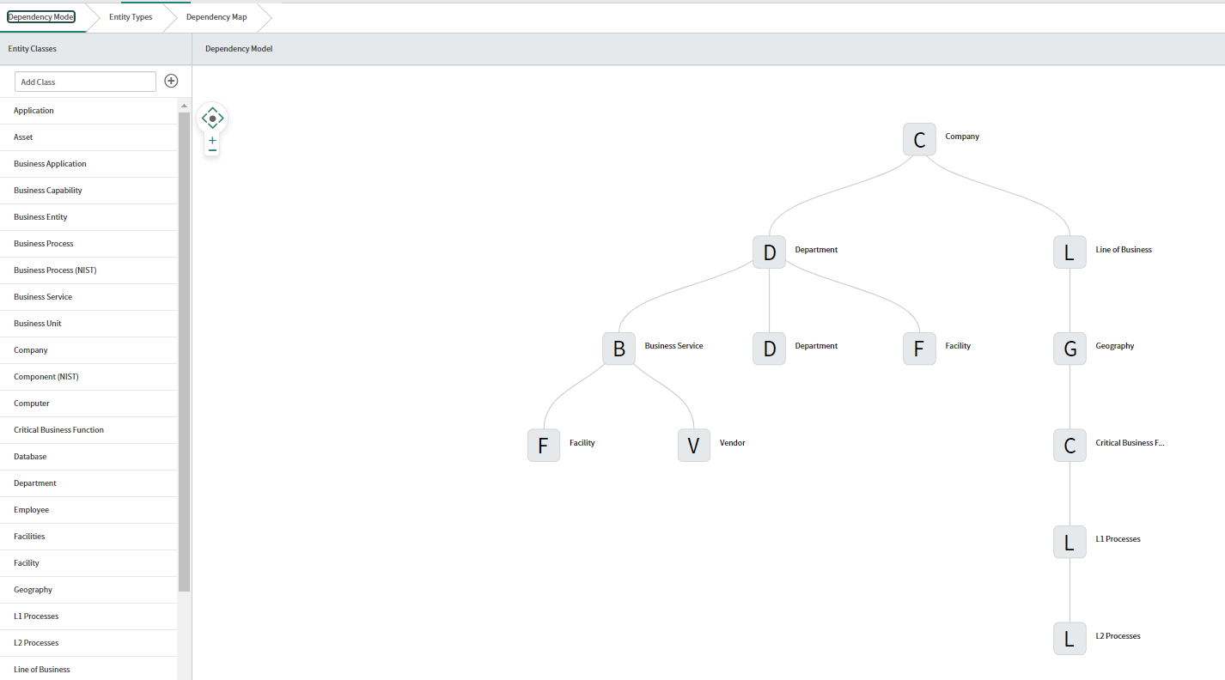
Entity Class Hierarchy
Entity Class hierarchies can be created using the ‘Parent class’ field on the Entity Class as well as the entity ‘Tier’ field. Please note this does not impact the risk score roll-up.
Additionally, the GRC workbench can be used to map the Entity Class hierarchy using the Dependency Model tab.
Notes:
https://docs.servicenow.com/bundle/sandiego-governance-risk-compliance/page/product/grc-common/concept/grc-workbench.html

Slide 31
Entity Class Hierarchy Example
Acme. Corp
Shared Services
HR
IT
Finance
Business Unit 2
Business Unit 3
Payroll
Tax
Accounts Payable
Entity Class: Company
Entity Class: Business Unit
Parent Class: Company
Entity Type: All BUs
Entity Class: Department
Parent Class: Business Unit
Entity Type: All Departments
Entity Class: Process
Parent Class: Department
Entity Type: Finance Processes

Slide 32
How does it all fit together?
Tiers
1
Business
2
Applications
3
IT Assets
Class: Departments
1
Entity Type: Departments & Vendors
Customer Support
Finance
HR
IT
Class: Business Services
1
Class: Business Applications
2
Entity Type: Applications & Business Services
Workday Enterprise
SAP Application
Linux Application
Windows Application
3
3
Class: Databases
Class: Servers
Entity Type: Databases & Servers
SAP HANA
MSFT SharePoint
MSFT Exchange

Slide 33
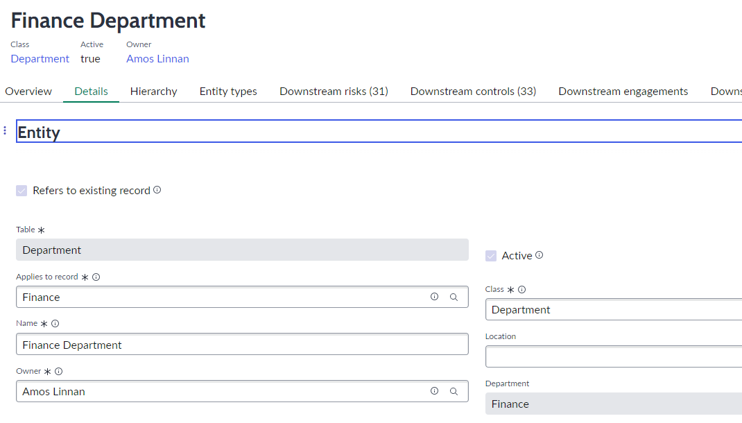
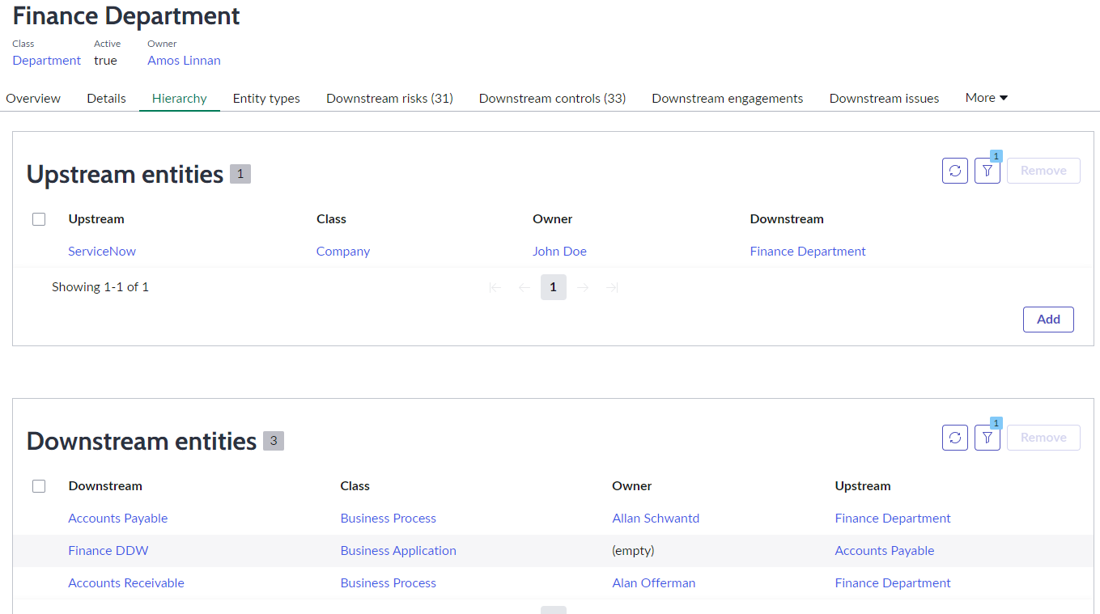
Entity Hierarchy
Entity hierarchies are created using the ‘Hierarchy’ tab on the Entity record.
Upstream and downstream entities can be added which are required for risk score roll-up. The risk roll-up occurs via advanced risk assessments* (covered later in this presentation).
*advanced license required

Slide 34
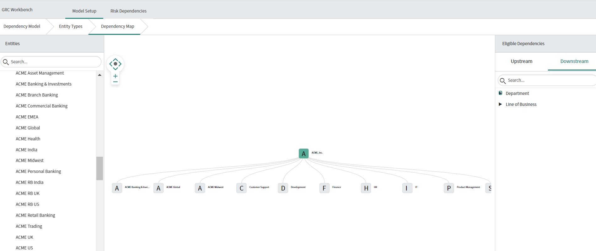
Entity Hierarchy
Additionally, the GRC workbench can be used to visualize and edit the Entity hierarchy using the Dependency Map tab.
Notes:
Eligible entity dependencies are driven by the entity class hierarchy e.g., downstream entities can only come from downstream entity classes that are defined in the entity class hierarchy
Drag the entities from the left-hand side panel and select applicable dependencies from the right-hand side panel
https://docs.servicenow.com/bundle/tokyo-governance-risk-compliance/page/product/grc-common/task/visualize-edit-profile-dependencies.html

Slide 35
Creating Risks and Controls
Once an entity type is associated with a control objective or risk statement, controls and risks are generated for each entity in an entity type automatically when the “Creates controls/risks automatically” checkboxes are selected.
Risks and controls can also be manually created in the following ways:
when associated with an entity from the ‘All Controls’ module
when associated with an entity from the ‘All Risks’ module
Adding from the controls related list on a control objective
Adding from the risks related list on a risk statement
Policies
Risk frameworks
Control objective
Risk statements
Entity types
Entity types
Entity types
Controls
Risk
Audit
Notes:
The entity owner is the default control owner
Controls can be created when an entity type is associated with a policy. Controls will be created for every control objective related to this policy.
Note: Relating entity types to a policy is rarely done. Although it is technically possible, in the real world, it is uncommon for all control objectives for a policy to be scoped with the same entity type.

Slide 36
Entity Framework Implementation Sequence
1
Upload quality, ‘single source of the truth’ data into the ServiceNow tables e.g. departments, business applications, etc. Avoid creating stand alone entities, this will save time later in reconciling data to other areas.
Create Entity Tiers to build the levels within the entity class hierarchy (optional)
Create Entity Classes to distinguish entities and organize them for reporting and associate to entity tiers.
Create Entity Class Rules to map tables to entity classes for automatic assignment of entities to entity classes
Create Entity Types with Entity Filters to create entities as well as automatically create risk and control instances in bulk for similar entities e.g. critical IT assets
Manually create additional Entities that do not require an entity type
2
3
4
5
6
Notes:
Manually created entities should still link to the relevant ServiceNow table.

Slide 37
Entity scoping approach
Entity scoping approaches vary based on the organization’s risk and compliance area of focus.
Operational
Strategic
Scoping is completed at the specific object level such as user, project, CI level
Entities may fall into many entity type categories and have many controls and risks applied.
Approach useful for industries or scenarios that are highly regulated.
Scoping at a higher level, such as business process or service with less entities
Less accountability for responding to attestations and/or risk assessments
Lower level of assurance found compared to the operational level
Most organizations use a combination of approaches

Slide 38
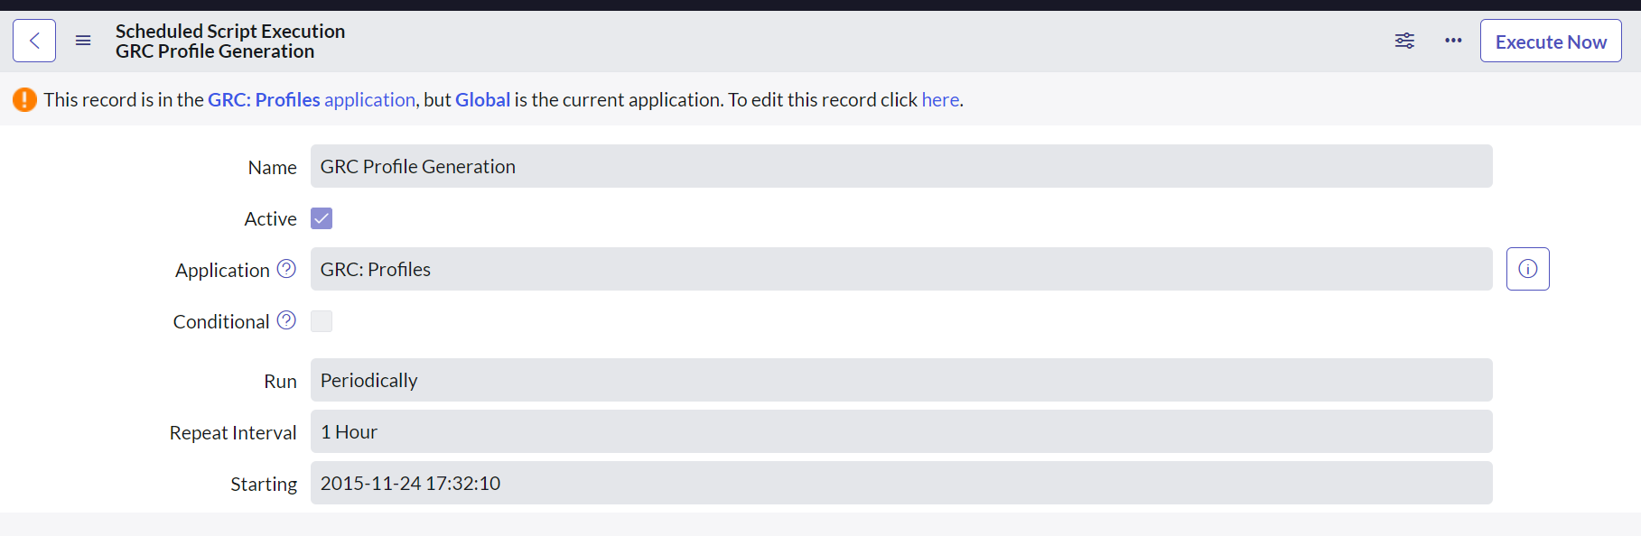
Cascading updates
The relationships created between GRC components help in cascading updates to records. For example, if an entity is deactivated, all associated controls, risks, indicators, and test plans are retired.
If the entity ever gets reactivated again, the associated controls and risks revert to the Draft state. Cascading updates provide automation.
There is a scheduled job that runs every hour called ‘GRC Profile Generation’ that will update entity records. This job can be manually executed: navigate to System Definition > Scheduled Jobs and select ‘Execute Now’.

Slide 39
Entity maintenance and performance tuning
On a regular basis, review your existing entity architecture to determine if it needs performance tuning:
Are entity type filters and entity class rules identifying proper entities?
Does a change need to be made to the existing entity architecture?
Is ServiceNow the single source of truth for entity architecture?
Are there entities which have unintentionally been orphaned?
Would a functional enhancement to your entity architecture be helpful?
Are your use cases achieved?
Notes:
It is recommended that you review your entity architecture on a regular basis to determine whether any performance tuning needs to be performed. If you determine a change is required or desired, decide whether the change is a minor one or a major one.
Additionally, consider utilizing out-of-box automation to help determine entity issues, such as orphaned entities, by using Indicators and Dashboard. Using the indicators and dashboards has the additional benefit of improving proper governance. Learn more about functional enhancements: https://docs.servicenow.com/bundle/tokyo-governance-risk-compliance/page/product/grc-common/concept/enhancements-for-entities.html

Slide 40
Changes to entity architecture
If adjustments are needed to your entity architecture, consider how the change will affect the following items in the Entity Framework:
Entity Types and related filters
Entity Classes and related rules
Risks, controls and policies
Approvers and reviewers
Business rules
Flow designer actions
Custom scripts
Notes:
Minor changes might include one entity being split into two or an entity being renamed or removed. A reorganization would be a major change where you may want to consider engaging with ServiceNow or a preferred partner for advice.
If in doubt as to whether an entity architecture change is minor or major, err on the side of caution and treat it as a major change.
Changing an entity can create an issue if items related to the entity are not appropriately updated.

Slide 41
IRM Structure

Slide 42
IRM Solution Structure
Key
Strategic org. data
Continuous monitoring
Core IRM data
1st line inputs
Integrated operational data
Task
Inherent exposure, weaknesses & threats
Risk Framework
Entity Type
(Classes: Vendor, Service, etc.)
(Entity filters used to pull from CMDB)
Audit Plan
Outcome
Risk Statements
Risk
Statements
Risk Identification questionnaire
Resource plan
Budget plan
Timecards
Risk Indicator Template
Metric definitions
Risk Indicator Template
Metric definitions
Audit Engagement
Entity
Entity
Issues/ observations
Evidence
Entity
Assessment methodology
Assessment methodology
Regulations & Policies
Controls
Walkthrough
Employee Center/ first line experience
Mobile experience
Risk statements
Test plans
Control Test
My risks
Internal goals and objectives
Policy Acknowledgement campaigns
Risk
(unique iteration of risk statement per entity)
Risk assessment
Risk Score
Risks
Indicator results
Interview
My controls
Policies
(Standards, Procedures)
Risk response
My vendors
Audit result & Audit report
Risk assessment
Risk indicator
Regulatory alerts:
Source Documents or Regulatory Event
(pulled in from Regulatory feeds)
Citation
Control attestation
Control Objectives
Control Objectives
Policy acknowledgement
Issue
Acceptance/ remediation
Policy Exception
Control Indicator template
Control Indicator template
Impact assessment
Policy exception request
Risk metric
Evidence submission
Change task
Impact assessment
Enterprise regulations
Authority Documents/ Regulations
Control
(Unique iteration of control objective per entity)
Control attestation
Compliance status
Control indicator
Action task
Citation
Citation
Issue
Acceptance/ remediation
Issue

Slide 43
Policy & Compliance Management Structure

Slide 44
Policy and Compliance architecture
Regulatory Agency
Authority
Document
Policy
Policy
Exception
Citation
Control
Objective
Test
Template
Indicator
Template
Risk Statement
Control
Control Test
Indicator
Test Plan
Risks

Slide 45
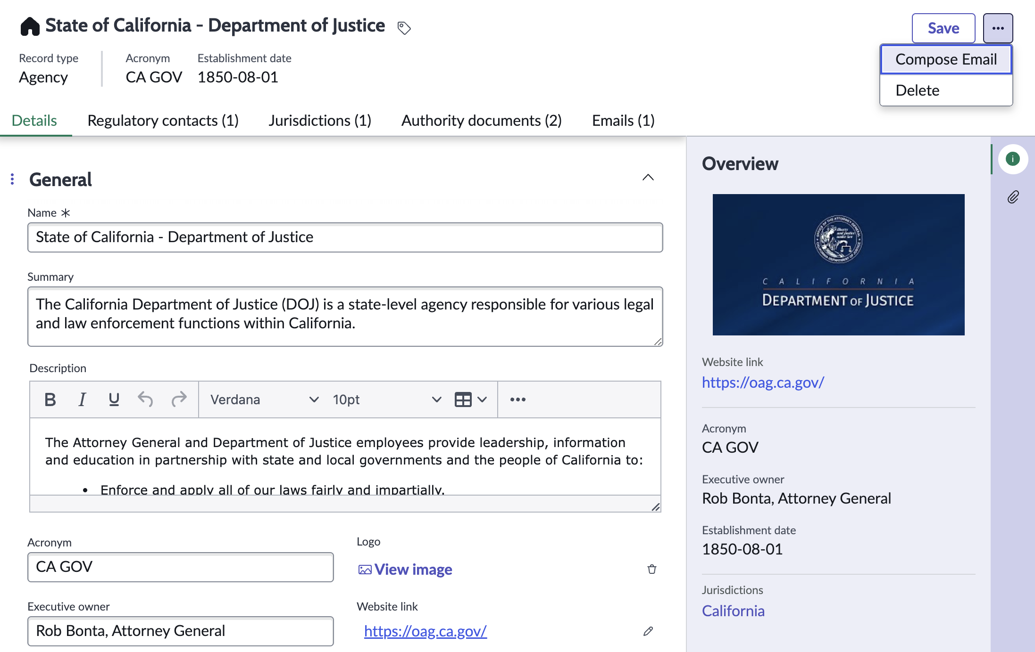
What is an agency?
A Regulatory Agency is an independent agency responsible for exercising laws or standards or guidelines in a specific field or activity or business operations.
The Regulatory Agency Library establishes a centralized library of agencies for identifying relevant regulatory authorities that are responsible for overseeing specific industries or sectors within each jurisdiction.
The centralized library consolidates all regulatory communications via emails and implements notification rules for data privacy or security breaches for any reported compliance cases.

Slide 46
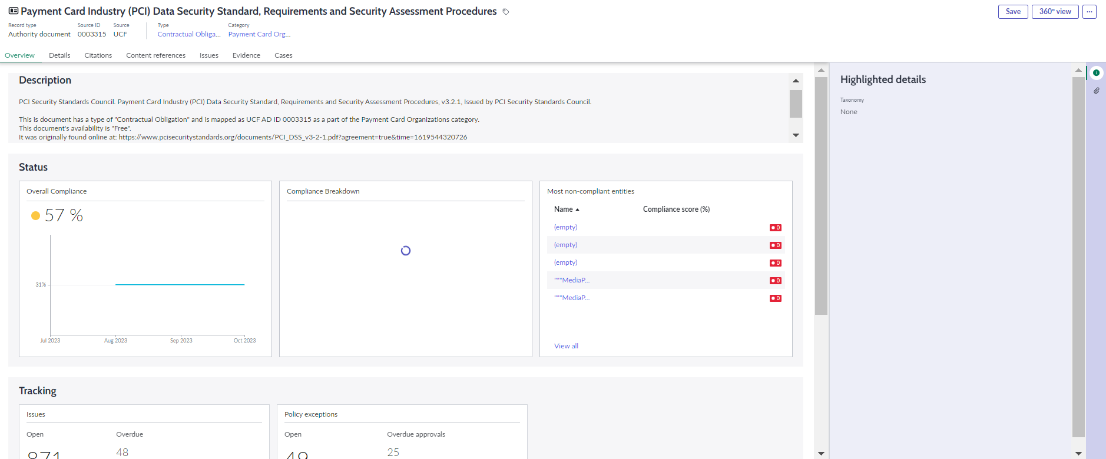
What is an authority document?
Authority documents are the statutes, frameworks, standards, and best practices that an organization chooses or are required for compliance with regulations. Authority documents are the top of the compliance hierarchy in ServiceNow.
Notes:
Authority documents compile the regulatory content that business processes follow for compliance.
Authority documents are housed in the ServiceNow instance as the top level of the compliance framework hierarchy. Citations map to the authority document, and control objectives map to the citations.
e.g. the PCI DSS authority document includes over 400 associated citations.

Slide 47
Authority document
Name
Common Name
Source
Category
Version
Valid from
Valid to
Description
URL
Compliance score (%)
Type
Audit guideline
Best practice
Bill or act
Contractual Obligation
International or National Standard
Not set
Organization directive
Regulation or Statute
Safe Harbor
Self- Regulatory Body Requirement
Vendor Documentation
Notes:
Table name: sn_compliance_authority_document

Slide 48
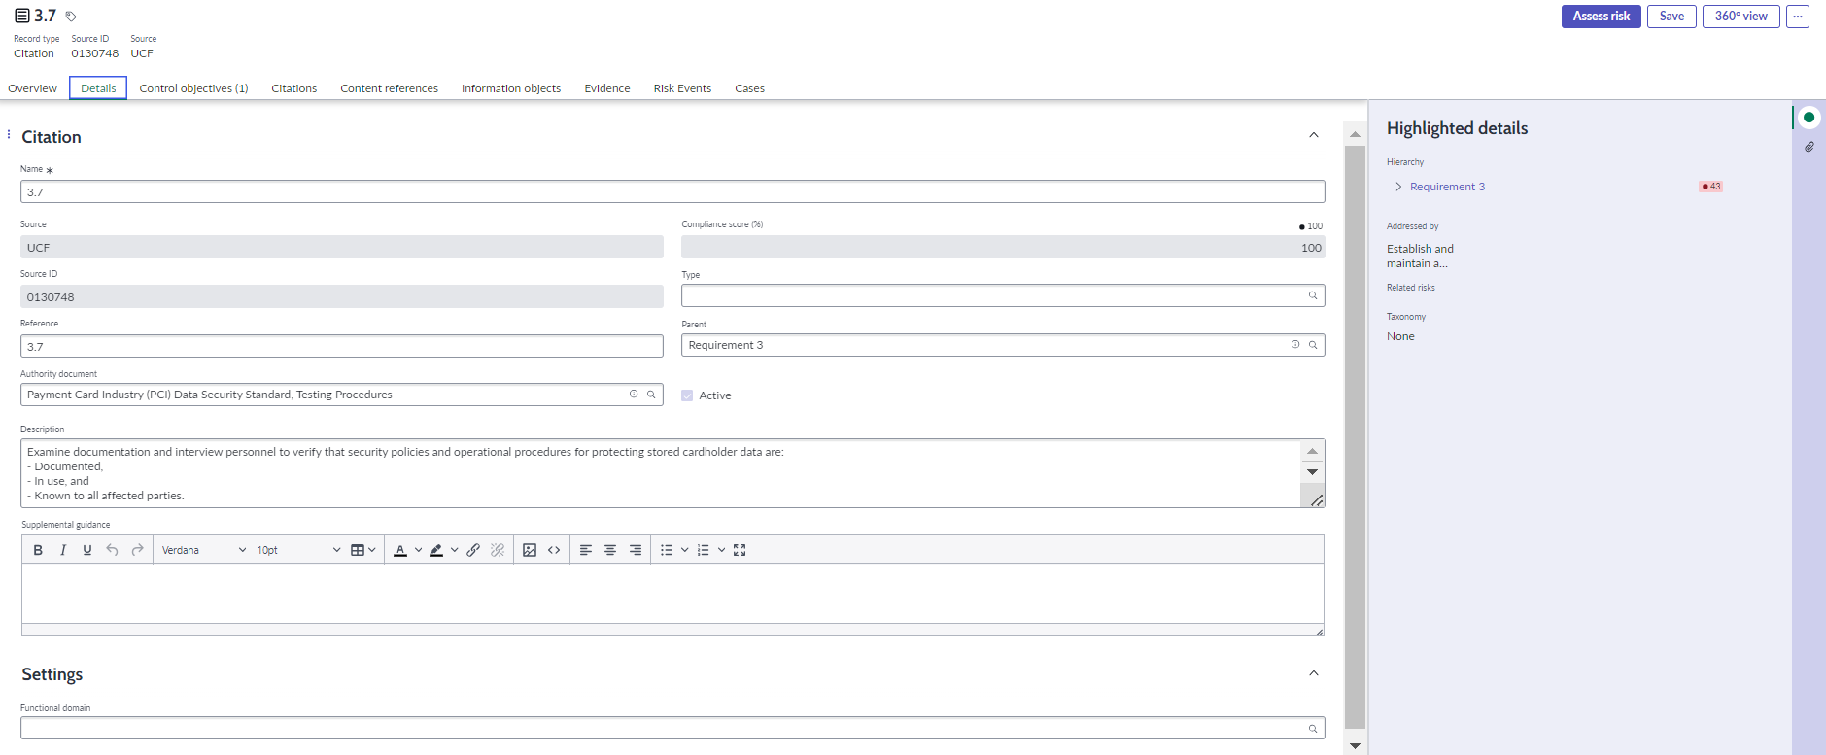
What is a citation?
Citation records are the specific requirements cited by an authority document, which connects the authority document to its' applicable controls.
Notes:
A citation defines a section of an authority document to which an organization must comply.
A citation maps to one authority document
Citations can be part of hierarchical, parent-child relationships
Citations can be mapped to one or many control objectives. Citations are mapped to control objectives so that compliance is measured as a control is tested.

Slide 49
Citation fields
Name
Reference
Source
Source ID
Parent
Description
Compliance score (%)
Type
Control objective
Control
Supporting information
Process
Core topic
Authority document
Notes:
Table name: sn_compliance_citation

Slide 50
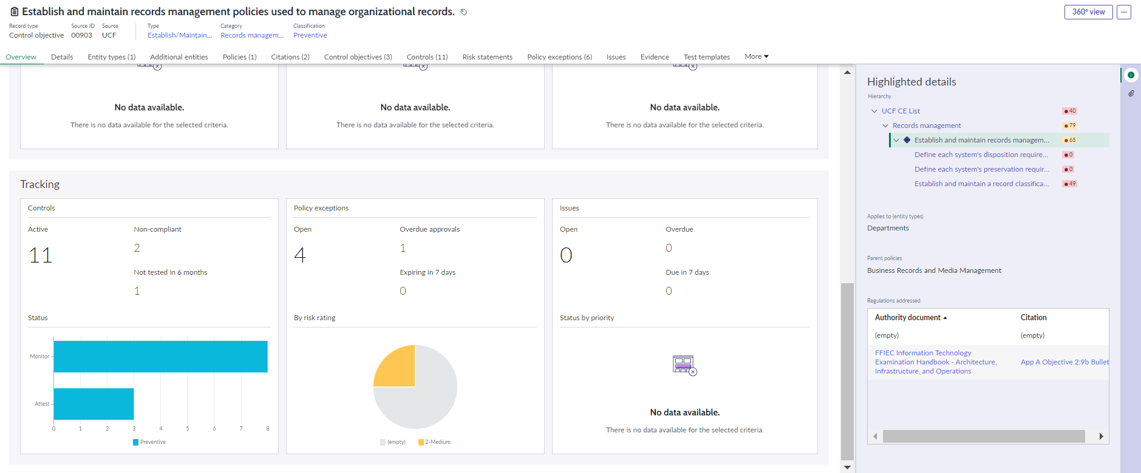
Control objectives
A control objective is an objective, direction, or standard that acts as guidance for company interactions and operations. Control objectives can be categorized, classified, and related to other GRC components, such as policies and risk statements.
Notes:
A control objective is an objective, direction, or standard that acts as guidance for company interactions and operations. Control objectives can be categorized, classified, and related to other GRC components, such as policies and risk statements.
Control objectives can be sorted into manageable, reportable groups through category, classification, and type fields. None of these fields are mandatory in the baseline.
Control objectives can reference multiple policies.
Control objectives can be arranged in a parent-child hierarchy.
Control objectives can be imported from a content provider or added manually. Each control objective is a record in the control objective [sn_compliance_policy_statement] table.
Control objectives may be connected to one or more citations.
Compliance score percentage: based on percentages: 80 or higher in green, 50 to 80 in yellow, below 50 in red, read-only field calculated based on the compliance of the downstream controls.
Control Objectives do not have a lifecycle workflow – they are either active or inactive. When linked to a Policy and the Policy is published, the Control Objective will be automatically set to active.

Slide 51
Control objective fields
Name
Source
Source ID
Reference
Policy
Parent
Compliance Score (%)
Description
Supplemental Guidance
Attestation
Classification
Preventative
Corrective
Detective
IT Impact Zone
Notes:
Table name: sn_compliance_policy_statement

Slide 52
Control objectives - Type
Acquisition/Sale of Assets or Services
Actionable Reports or Measurements
Audits and Risk Management
Behavior
Business Processes
Communicate
Configuration
Data and Information Management
Duplicate
Establish Roles
Establish/Maintain Documentation
Human Resources Management
Investigate
IT Impact Zone
Log Management
Maintenance
Monitor and Evaluate Occurrences
Physical and Environmental Protection
Process or Activity
Records Management
Systems Continuity
Systems Design, Build, and Implementation
Technical Security
Testing
Training

Slide 53
Control objectives - Category
Acquisition or sale of facilities, technology and services
Audits and Risk Management
Compliance and Governance Manual of Style
Human Resources management
Leadership and high-level objectives
Operational management
Physical and environmental protection
Privacy protection for information and data
Records management
System hardening through configuration management
Systems continuity
Systems design, build, and implementation
Technical security
Third party and supply chain oversight
Root
Deprecated

Slide 54





Relationship Summary Agency - Authority Document – Citation – Control Objective
Citation
Citation
Control objective
Citation
Authority document
Citation
Citation
Agency
Control objective
Citation
Authority document
Citation
Citation
Control objective

Slide 55
Relationship summary example Agency - Authority Document – Citation / Control Objective
Agency
Authority document / Regulation
Citations / Control Objective
State of California
Consumer Rights
CCPA
Disclosure
Personal Information
CPRA
Disclosure
European Union
Data Subjects Rights
GDPR
Accountability
Incident Reporting
DORA
Incident Response
High-Risk AI Systems
EU AI Act
Prohibited AI Practices

Slide 56
What are controls?
A control is a specific activity performed by people, or systems designed, to ensure that business objectives are met.
Specific ACTIVITIES
Performed by People or SYSTEMS
Designed to ENSURE
Business OBJECTIVES ARE MET

Slide 57
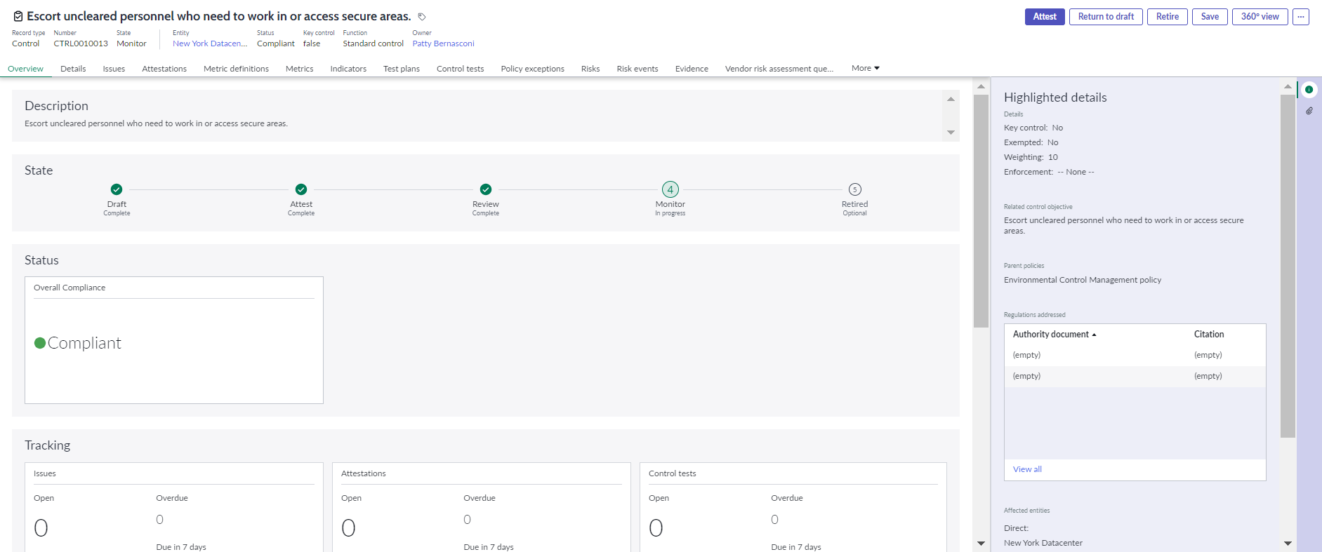
Controls
Controls are the actual control activities that are to be performed by your organization. Control records include basic required information about the control (e.g., control owner, control activity, frequency, etc.).

Slide 58
Standard Controls
A standard control is the implementation of a control objective for a scoped entity.
Once an entity type is associated with a control objective, standard controls are generated for each entity in an entity type automatically when the “Creates controls automatically” checkbox is checked.
Standard controls can also be manually created when associated with an entity from the ‘All Controls’ module or from the Controls related list on a control objective.
Standard controls can be created when an entity type is associated with a policy. Standard controls will be created for every control objective related to this policy.
+
=
Entity Types
Control Objective
Control Objective
Entity
Control Objective
Entity
Entity
Control Objective
Entity
Entity
Control Attestation
Entity
Control Attestation
Control Attestation
Notes:
The entity owner is the default control owner
Note: Relating entity types to a policy is rarely done. Although it is technically possible, in the real world, it is uncommon for all control objectives for a policy to be scoped with the same entity type.

Slide 59
Common Controls: test once - comply many
Standard Controls can be converted to ‘Common Controls’ and associated to one or more entities
Entities can inherit the result of the common control without implementing or testing that control, reducing the number of controls required and the time and effort spent on managing controls.
Control test, Attestation, Indicator
Testing Results
Common Control
Primary Entity
Entity implementing and managing the control
Entity 1
Entity 2
Entity 3
Entity 4
Reliant entities on the common control
The testing result of the Common Control is automatically inherited by the entities.
Notes:
New for Utah release
GRC: Compliance Management Workspace required

Slide 60
Common Controls Use Case
Single sign-on for business applications can rely on the same identity and access management (IAM) solutions and therefore do not need to individually self-assess / test the control.
The controls are managed and tested by a shared service function, with business applications such as Miro, Teams, Outlook and Zoom automatically inheriting the testing results from Okta.
Testing Results
Single Sign-on
(Common Control)
Shared Service (Okta)
Primary Entity implementing and managing the control
Miro
Teams
Outlook
Zoom
The testing result of the Common Control is automatically inherited by these reliant entities.
Notes:
New for Utah release
GRC: Compliance Management Workspace required

Slide 61
Monitoring control compliance
Leveraging scoped controls allows an organization to monitor compliance at an individual, operational level and identify which areas within an organization need additional attention, documentation, and/or support based on control compliance.
Compliance and non-compliance is managed at the control record level. Compliance scoring is the percentage of controls that are compliant for a specific control objective.
Compliance scores are captured on individual controls, enabling an organization to proactively monitor and collect evidence at the operational level. Compliance scores roll up to the control objective, allowing an organization to quickly assess compliance posture. Overall areas of compliance and non-compliance are available as well as the granular view of which controls, and therefore which entities, are passing or failing.

Slide 62
Control fields
Name
Entity
Control Objective
Owning group
Owner
Key control
Weighting
Description
Additional Information
Enforcement
Mandatory
Voluntary
Frequency
Event driven
Daily
Weekly
Monthly
Quarterly
Semi-annual
Annually
Classification
Preventative
Corrective
Detective
IT Impact Zone
Status
Compliant
Not Compliant
Not Applicable
State
Draft
Attest
Review
Monitor
Retired
Notes:
Table name: sn_compliance_control

Slide 63
Control - Types
Acquisition/Sale of Assets or Services
Actionable Reports or Measurements
Audits and Risk Management
Behavior
Business Processes
Communicate
Configuration
Data and Information Management
Duplicate
Establish Roles
Establish/Maintain Documentation
Human Resources Management
Investigate
IT Impact Zone
Log Management
Maintenance
Monitor and Evaluate Occurrences
Physical and Environmental Protection
Process or Activity
Records Management
Systems Continuity
Systems Design, Build, and Implementation
Technical Security
Testing
Training

Slide 64
Controls - Category
Acquisition or sale of facilities, technology and services
Audits and risk management
Compliance and Governance Manual of Style
Human Resources management
Leadership and high-level objectives
Operational management
Physical and environmental protection
Privacy protection for information and data
Records management
System hardening through configuration management
Systems continuity
Systems design, build, and implementation
Technical security
Third party and supply chain oversight
Root
Deprecated

Slide 65
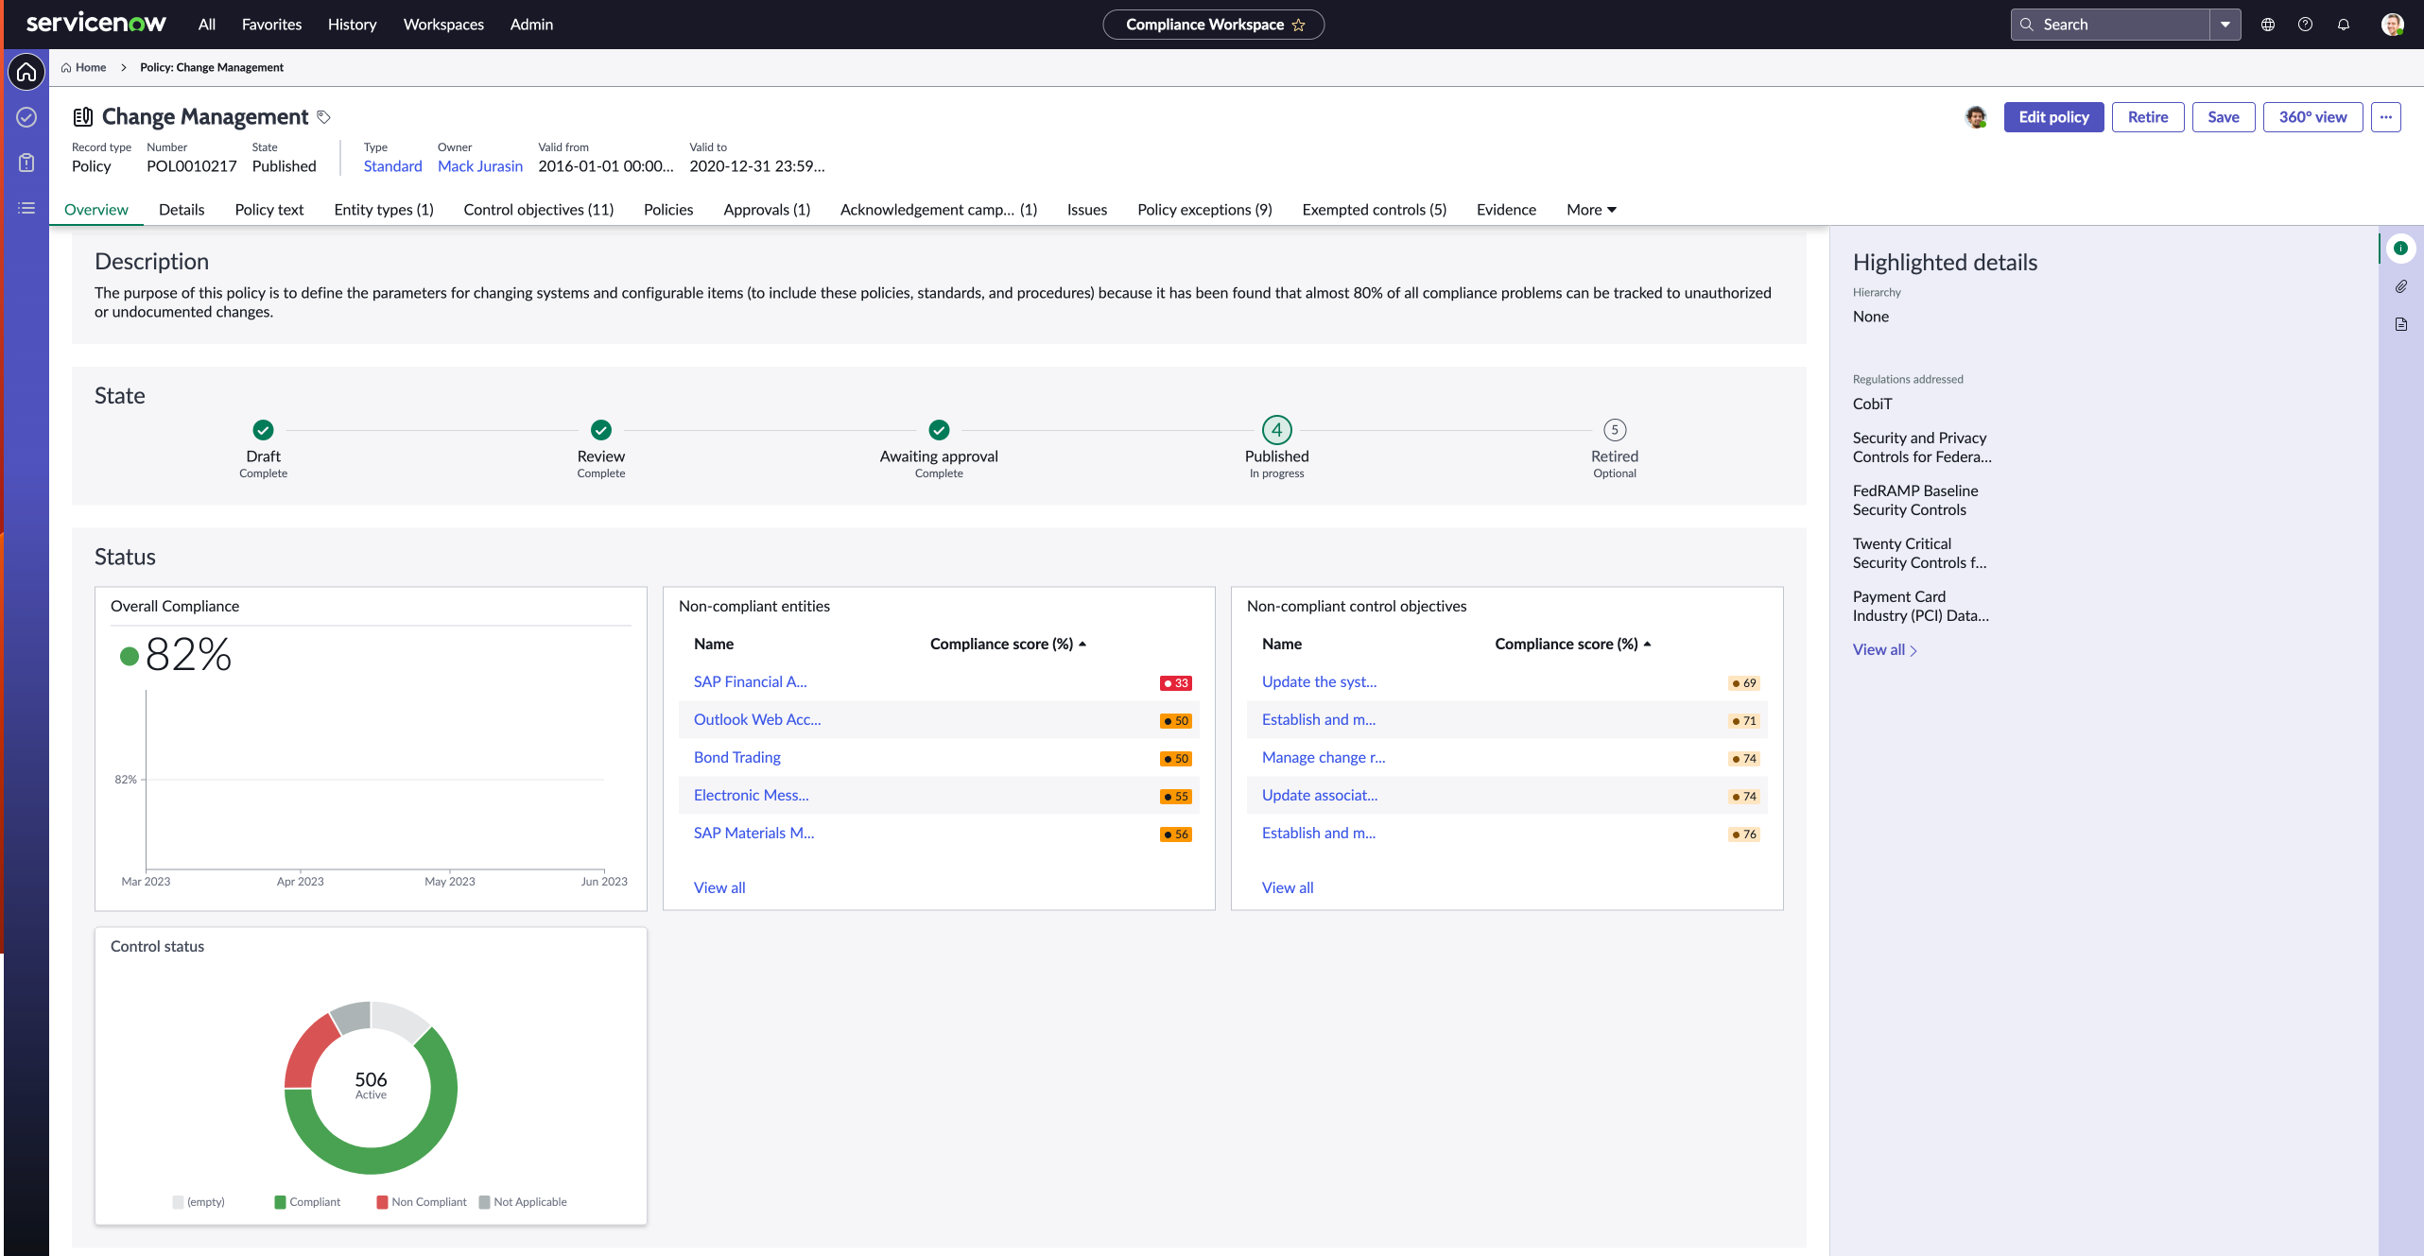
Policies
A policy defines an internal practice that an organization or business process must follow to ensure compliance and reduce risk exposure. Policies can be categorized and related to control objectives.
Notes:
Policies can be created manually or imported using a ServiceNow transform map.
Policies can be arranged in parent-child hierarchical relationships with other policies and with control objectives.
Policies can be sorted into manageable, reportable groups through type and category fields.
Policies can be related to multiple control objectives.

Slide 66
UCF
The GRC: Compliance UCF (com.sn_comp_ucf) plugin is available as a separate subscription.
Configure the source of your control library using an API key supplied by UCF (recommended method)
Every authority document already imported into the ServiceNow instance must be in any shared list you wish to import from the UCF CCH. This prevents inconsistencies between what is in the UCF CCH (which may have changed) and what you’ve already imported.
Authority documents in the UCF content are organized and mapped to their proper citations, which in turn are mapped to a common set of controls. Please see terminology mapping below:
UCF | Policy & Compliance Application
Authority Document | Authority Document
Citation | Citation
Control | Control Objective
Notes:
All > Policy and Compliance > Administration > Unified Compliance Integration.
https://docs.servicenow.com/bundle/utah-governance-risk-compliance/page/product/grc-ucf-import/concept/manage_compliance_frameworks.html
Please note from Yokohama release, fix has been applied to remove duplicate citations within the same authority document. Any control objectives from duplicate citations will move over to the retained citation.

Slide 67
Policy fields
Name
State
Draft
Review
Awaiting approval
Published
Retired
Type
Policy
Procedure
Standard
Plan
Checklist
Framework
Template
Owning group
Owner
Valid from
Valid to
Approvers
Reviewers
Description
Policy text
Knowledge base
Article template
KB article
Compliance score (%)
Notes:
Table name: sn_compliance_policy

Slide 68
Policy Hierarchy
Provides the ability to define a hierarchy of policies, control objectives, procedures, plans, standards, etc. to help define, measure and attain their business, operational and IT objectives
The hierarchical structure allows control objectives to be related to more than one policy
Enables calculation and roll-up of compliance scores across a hierarchy of policies
Example:
Company IT security policy
AMS IT security policy
EMEA IT security policy
APAC IT security policy
If required, associate a control objective to multiple policies
Calculate compliance scores across the hierarchy of policies and roll it up to the parent level policy

Slide 69
Options for data upload
Manual Entry
Import
Content Providers
Accelerators
Manual Entry
HTML
Transform Maps
Multiple source types such as JDBC, HTTP/FTP, excel, CSV, XML
Customer provided spreadsheets, data sources
Usually requires 3rd party subscription
Integrations use import transform maps or APIs
UCF, LexisNexis, Thomson Reuter
Provide content and can provide functionality for activities performed on the content
E.g., SOX Content Pack, Cyber Security Controls etc.
Notes:
Import sets allow administrators to import data from various data sources and then map that data into ServiceNow tables.
Accelerator Information: https://docs.servicenow.com/bundle/utah-governance-risk-compliance/page/product/grc-common/reference/grc-use-case-accelerators.html
Content Pack: https://docs.servicenow.com/bundle/utah-governance-risk-compliance/page/product/grc-sox-compliance-content-pack/concept/sn-store-SOX-governance-risk-compliance.html

Slide 70
Policy Management Processes

Slide 71
Policy Management Lifecycle
The Policy management lifecycle process encompasses the end to end management of an organization’s policies including:
AUTHORING
PUBLICATION
CONTINUAL REVIEW
COMMUNICATION
MONITORING COMPLIANCE

Slide 72
Policy authoring
Draft
Awaiting Approval
Published
Review
Retired
Policies are created in Draft by default | While in Review, reviewers can send the policy back to draft, edit the policy, can add additional comments | Approvers receive the approval task in Awaiting approval Approvers can send the policy back to Review | Policy is published after approval KB article is created in the KB identified on the policy record Associated control objectives set to active | When a policy is retired, the KB article also retires
Requires sn_compliance.user to create policies and move policies into review | Only policy owner can move the policy into ‘Awaiting approval’ sn_compliance.manager or admin roles alone cannot make this move unless they are policy owners | Approval(s) are required and validated at this state Listed approvers receive approval notification All approvers listed must approve before the policy is published |  | sn_compliance.manager or the policy owner can manually retire the policy

Slide 73







Policy authoring
DRAFT: Start drafting a new Policy / edit existing published policy
DRAFT: Once draft is ready, request review
REVIEW: Refine the policy draft based on the review comments
REVIEW: Submit the policy for approval
Policy Owner
REVIEW: Review the policy draft and provide edits, comments and changes
Policy Reviewer
Can send back to draft if not satisfied
AWAITING APPROVAL: Review and approve the policy
PUBLISHED: Policy set to published and knowledge article published to GRC Knowledgebase
Policy Approver
Can reject and send back to Review stage

Slide 74
Policy authoring with O365
Integrating with O365 OneDrive enhances the policy management experience:
Ability to create new policy Word document or connect to existing Word document on OneDrive
Enables collaborative editing, review and approval of the policy in MS Word using O365 OneDrive integration
Ability to view different versions and history of the policy
Ability to sync policy text from Word on OneDrive to the policy record
Enabling PDF conversion of the policy text
Notes:
Required plugins:
GRC: Compliance Management Workspace (com.sn_compliance_workspace)
GRC: Policy and Compliance Management (com.sn_compliance)
GRC: Common Workspace Elements (com.sn_grc_workspace)
Other spokes and plugins to be installed:
Multiple Provider Document Services Framework
Microsoft Azure AD Spoke version 3.5.0
Microsoft OneDrive Spoke for Document Service Framework version 1.0.5
Microsoft OneDrive Spoke version 2.1.1

Slide 75
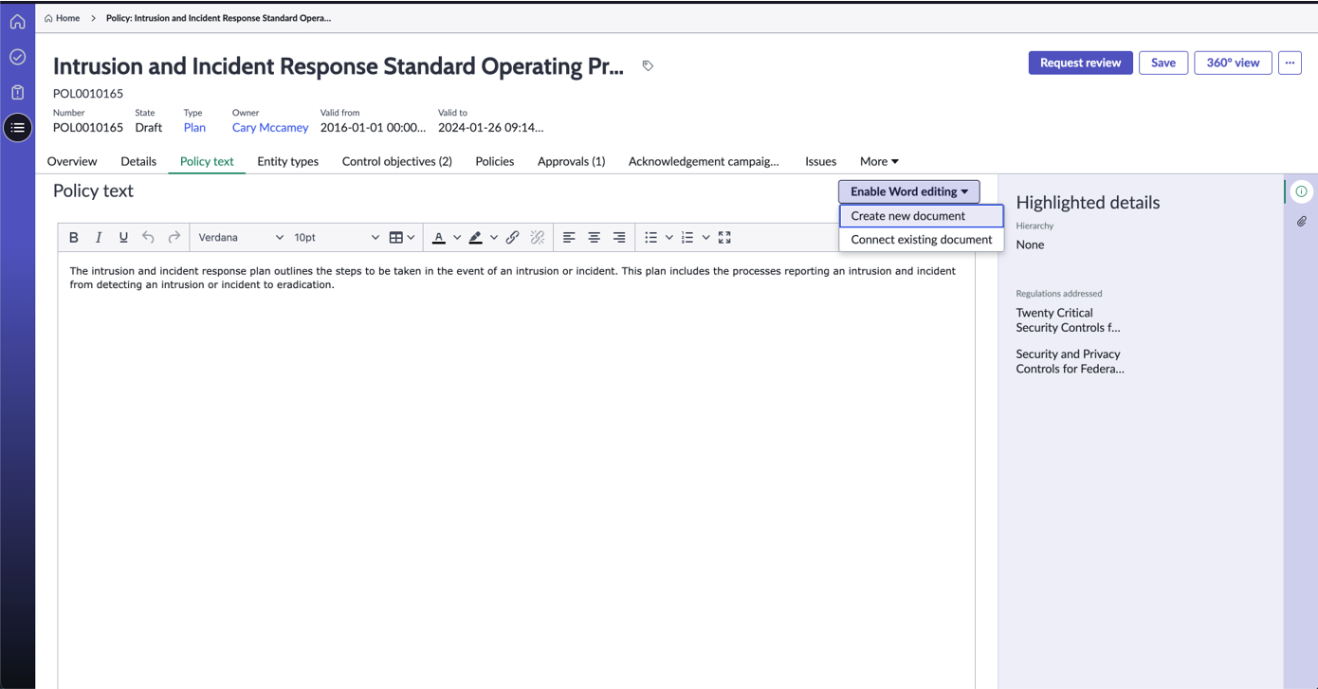
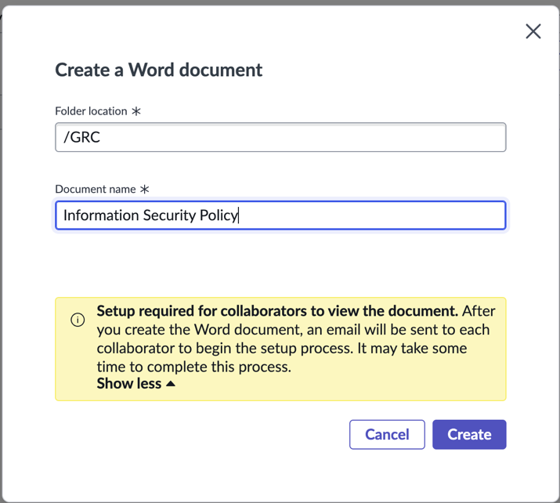
Policy authoring with O365 integration: New Document
Notes:
Once all plugins are installed the enable word editing will be available where new documents can be created or existing can be created
Ability to create new document on OneDrive by providing name and folder location
Auto refresh of page and establishing connection with the new document created on OneDrive

Slide 76
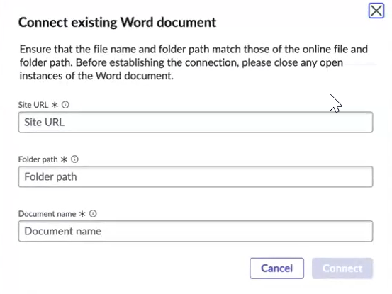
Policy authoring with O365 integration: Connect Existing
Notes:
Ability to connect to an existing Word document on OneDrive by providing name and folder location of the file without attaching copy of the document​
Auto refresh of page and establishing connection with the new document created on OneDrive
Able to change the document linked to the policy record and replace it with a different document stored on OneDrive​

Slide 77

Policy authoring with O365 integration
Start drafting a new Policy / Edit existing published policy (Annual review cycle)
Once draft is ready, send it to reviewers for review
Refine the policy draft based on the review comments
Complete the publishing checklist and request approval
Policy Owner
Change in workflow – Before requesting approval, owner needs to finalize policy using the publishing checklist
Policy Contributor
Invite Contributors to collaborate on policy drafting and review
New user persona –Collaborates with owner on policy drafting in O365 Word on OneDrive
Review the policy draft and provide edits, comments and changes
Policy Reviewer
Can send back to draft if not satisfied
Policy Approver
Review and approve the policy
Published policy
Can reject and send back to Review stage

Slide 78
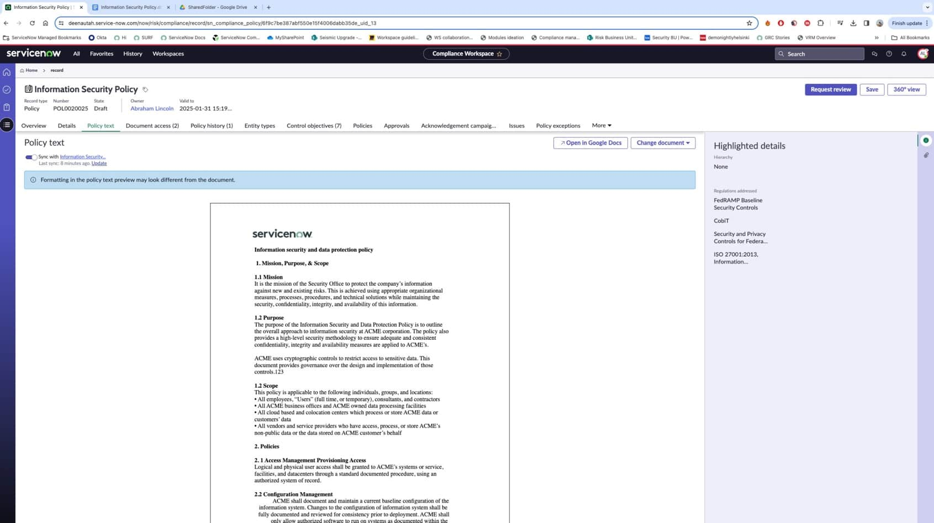

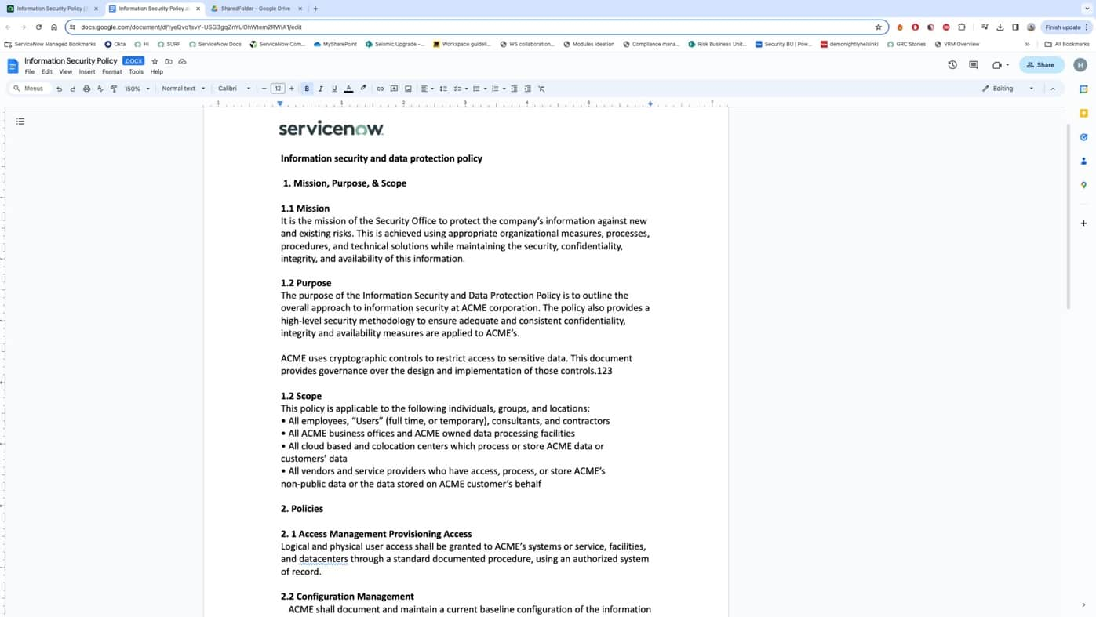
Policy authoring with Google Drive integration
Notes:
Enable policy redlining with Google Drive​
Ability to create a new policy document on Google Drive​
Ability to connect to existing Word document on Google Drive​
Ability to perform policy editing, redlining, review and approval with policy workflow​
Ability to collaborate on policy document with Google Drive​

Slide 79
Policy authoring with Google Drive
Integrating with Google Drive enhances policy authoring workflow by enabling collaborative editing using Google Drive integration.
Create a new policy Word document or connect to existing Word document on Google Drive​
Policy owner, contributors (SMEs), reviewers can collaborate on policy editing and review on Google Drive​
Approvers able to review policies on Google Drive and approve before they are published​
View different versions and history of the policy​
Sync policy text from document on Google Drive to the policy record by retaining the format​
Enable PDF conversion of the policy text​
Guide user through the end-to-end policy authoring, redlining and publishing process by simplifying their user experience​
Notes:
Required plugins:
GRC: Policy and compliance management​​
GRC: Compliance management workspace​​​
Other spokes and plugins to be installed:
Document Services framework for Google Drive Spoke

Slide 80
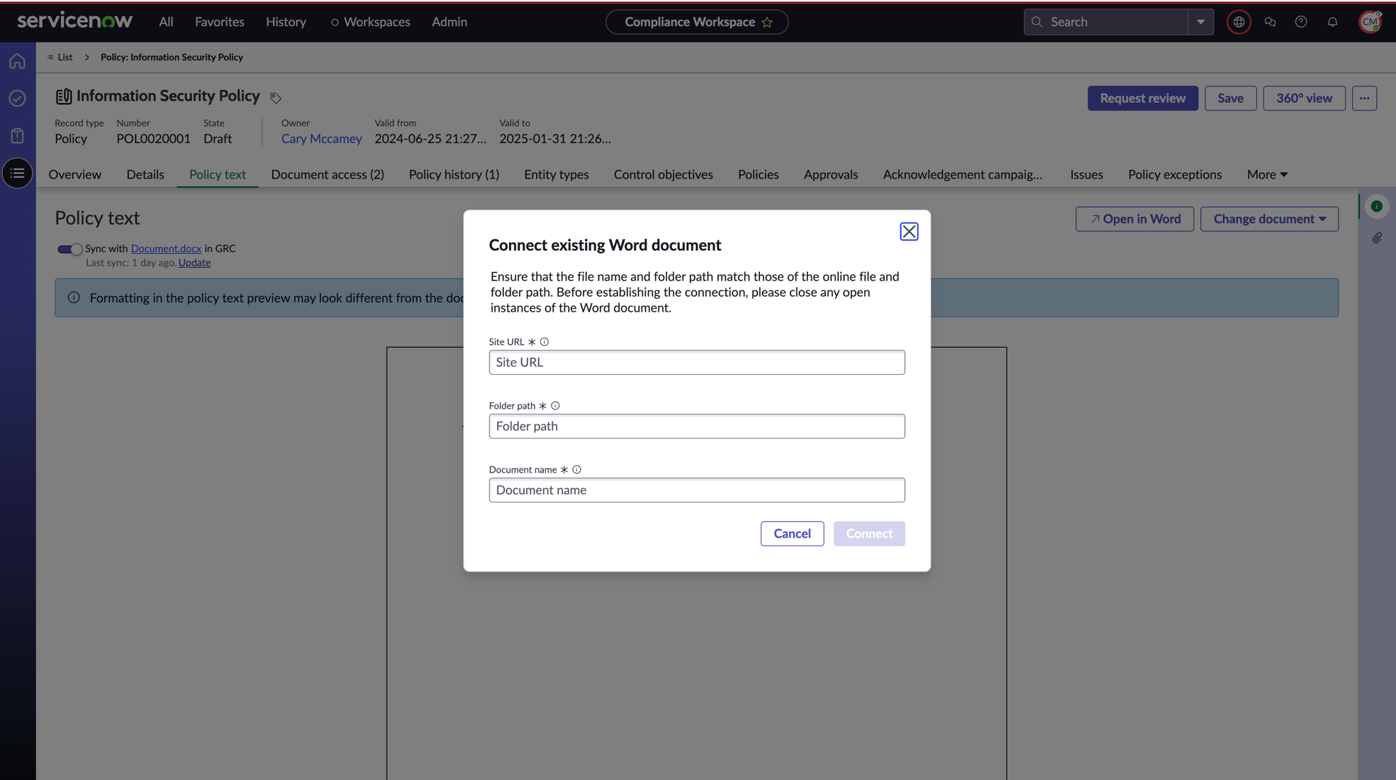

Policy authoring with SharePoint
Notes:
Create a new policy document on SharePoint
Connect to existing Word document on SharePoint by providing SharePoint site location and folder path
Perform policy editing, redlining, review and approval with policy workflow
Collaborate on policy document in SharePoint using O365 capabilities

Slide 81
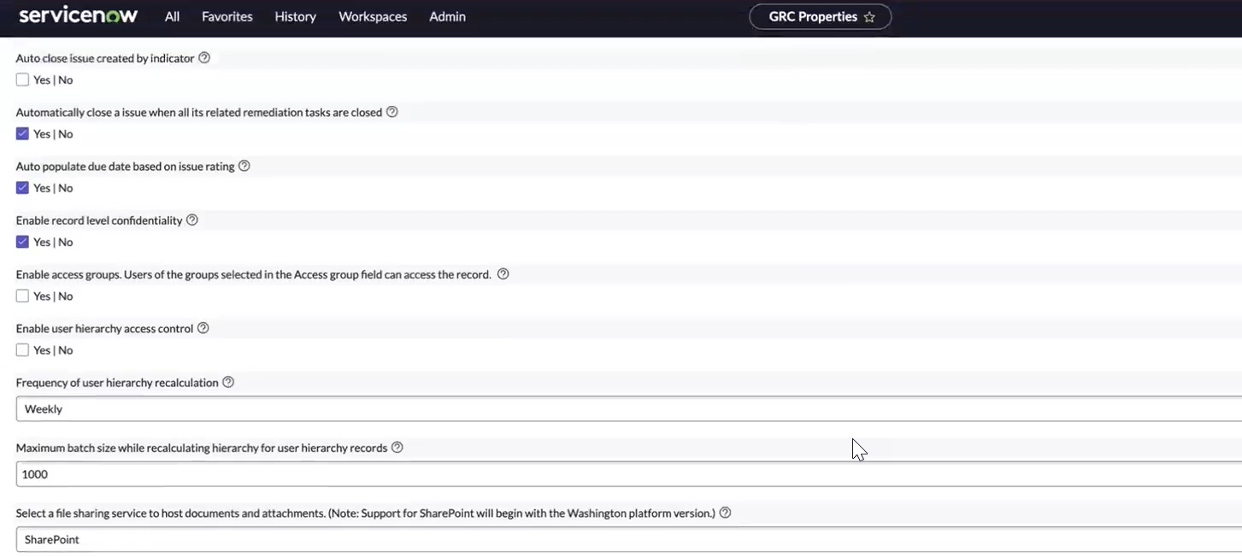

Policy authoring with integration
Please note, the below setting needs to be updated in ‘GRC Properties’ as part of the setup with the relevant file sharing service.

Slide 82
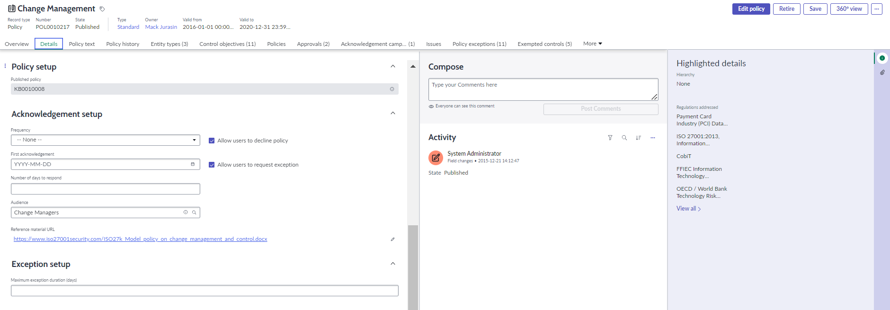
Policy acknowledgement campaigns
Policy acknowledgement campaigns can be used as part of communicating and training employees on the organization’s policies such as employee handbook or Information Security Policy. Employees are asked to acknowledge that they have reviewed and understood the company's policies
A policy acknowledgement campaign in ServiceNow is used to prepare for a policy acknowledgement request by defining the audience who must provide the attestation and details of the campaign duration.
Notes:
Ensuring compliance in many organizations is a time-consuming, error prone, and cumbersome manual process for compliance managers, employees, and business owners; executed in silos. This feature provides the ability to send out policies such as Acceptable IT Use, Insider Trading, etc. for review and acknowledgement by employees across the organization to meet compliance requirements. Results are tracked within the record and dashboards can be used to communicate to other levels in the organization. The acknowledgement request is generated by the policy owner or compliance manager. The Service Portal has been enhanced to include a new menu that allows employees to easily respond.

Slide 83
Policy acknowledgement campaign workflow
New
Closed
Canceled
(Optional)
Pending Acknowledgement
Campaigns are created in New state for published policy records Audience is identified after campaign set-up | Instances are created for all users in the audience list Policy is presented on the Employee Center with due date Employee responses are captured | Automation with scheduled jobs, campaign is closed when overdue Acknowledgement state resets when policy is expired | Cancelling the campaign cancels all associated instances
Policy owner or compliance users and above can set up campaign, set schedule and extend valid to date Compliance manager and above can identify campaign audience and add users for ongoing campaign | Audience defined in the campaigns receive requests Audience can consist of users, groups or a newly defined user filter Audience can accept, decline or request exception |  | Compliance manager or campaign owner can cancel the campaign

Slide 84
Policy acknowledgement campaigns
Step 1: Setup Acknowledgement Campaign
Acknowledgment Setup
Policy Acknowledgment Campaign
Audience
Reference Material URL
Frequency & response time
Decline / Request Exception?
Create Acknowledgment Campaign
Campaign Owner & Audience
Valid from and Valid to
No. of days to respond
Reference Material URL
Policy Acknowledgment setup can only be completed on a ‘Published’ policy and is completed in the Details tab in the Acknowledgement Setup section.
Policy exception campaign has ‘Valid from’ and ‘Valid to’ dates and ‘Number of days to respond’ are set for employees to reply by. The Audience and reference material can also be amended.
Notes:
Role required to set up campaign: compliance user
Audience groups are configured via the Audience area in the Policy and Compliance application: Policy and Compliance > Policy Acknowledgement > Audience (role required: Compliance Manager)
Define in the acknowledgement setup whether the audience is allowed to decline the acknowledgement request and/or request a policy exception.
Notifications can be configured in the Policy and Compliance Properties (role required: compliance admin)

Slide 85
Policy acknowledgement campaigns
Step 2: Request Acknowledgements from the audience
Policy Acknowledgment Campaign
Acknowledgments
Request Acknowledgments
Policy
Reference Material URL:
Due Date
Status:
Accepted
Declined
Exception-Requested
Exempted
Campaign Owner & Audience
Valid from and Valid to
No. of days to respond
Reference Material URL
Policy Acknowledgment Campaign is set up for specific duration of time and all the acknowledgments sent out are valid for that duration.
Acknowledgment tasks are created for each user defined in the ‘audience’ and have a due date on them by when the responses are due.
The responses are captured and presented on the campaign.
Notes:
Audience members can complete acknowledgement request in Now Platform or Service Portal
To view responses and status: Policy and Compliance > Policy Acknowledgement > Overview (role required: compliance reader)

Slide 86
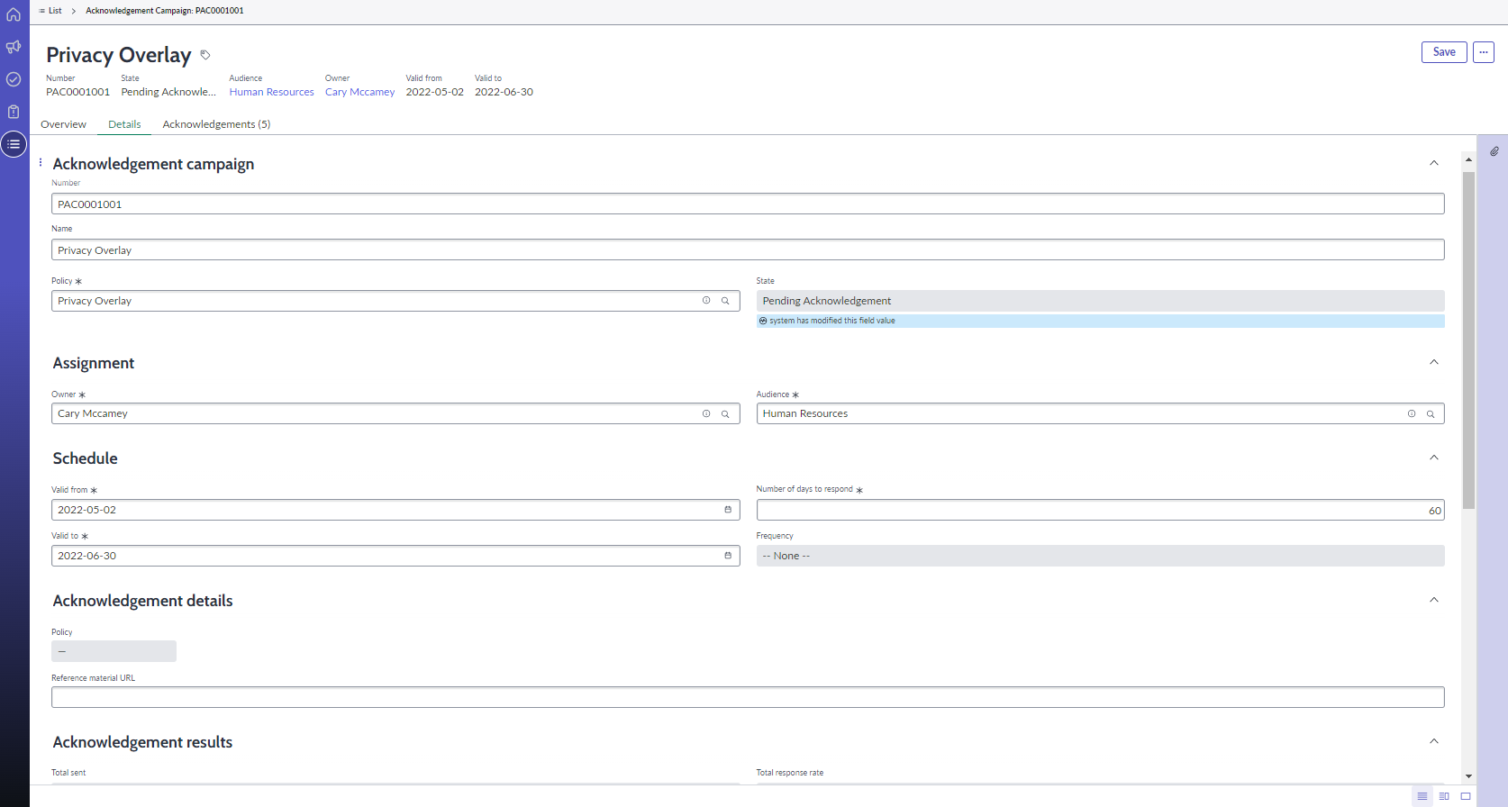
Policy acknowledgement campaigns
Notes:
A compliance user defines and finalizes a policy (e.g. acceptable IT use policy) which could be a part of a broader IT policy of the company to which compliance needs to assess.
A compliance user setup acknowledgement section for above policy by assigning audience, reference Material URL, and options to allow users to decline policy or request exception.
A compliance user creates acknowledgement campaign and selects valid from and valid to dates of the camping and number of days for audience to respond back to the acknowledgment tasks.
A compliance user sends out acknowledgement tasks to audience. The policy is routed and presented to a target audience on service portal where they can review and acknowledge to the policy.
The target audience (employees) are notified that a policy is awaiting review and acknowledgement with the due date.
After the employee has reviewed and acknowledged (accepted/declined/requested exception), the response would be captured.
Automation with scheduled jobs
Triggers acknowledgements when campaign's valid from date is approached
Closes pending acknowledgement campaign when it is overdue
Resets acknowledgement state when related policy exception is expired
Send notifications

Slide 87
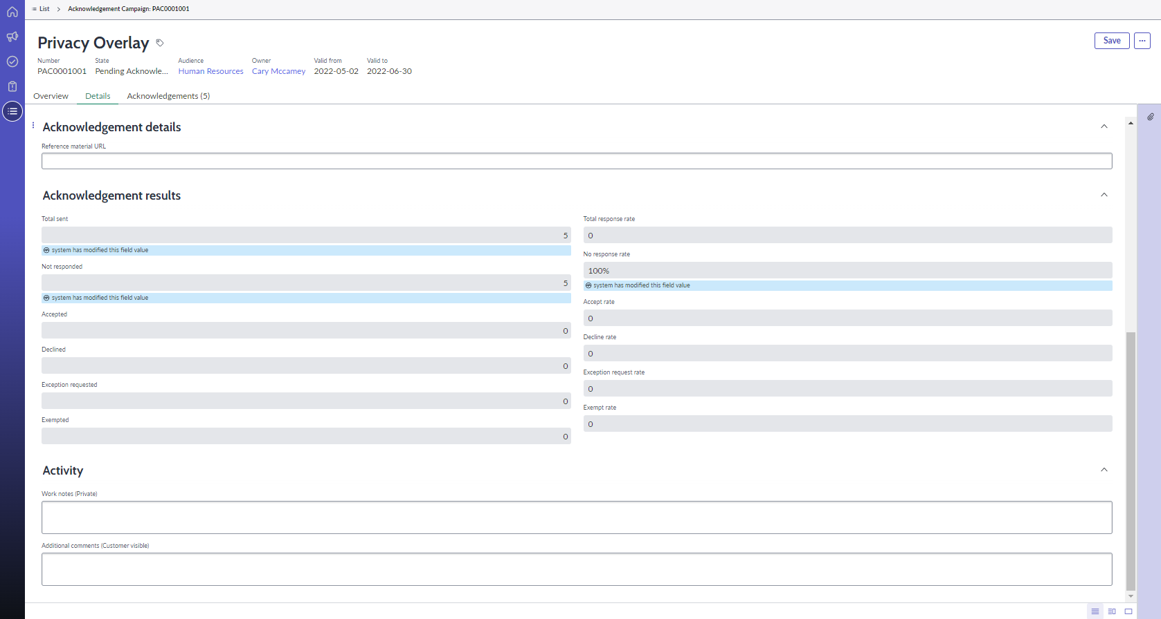
Policy acknowledgement campaigns
Notes:
Customer Pain/Challenge
For compliance purposes organizations must obtain the acknowledgement from a variety of departments that they understand and are adhering to various policies – in many cases it ultimately falls to employees to acknowledge. Currently that is accomplished in a manual fashion using email with tracking through spreadsheet. Evidence is stored on SharePoint sites or on local hard drives. This is a time consuming and error prone process with information scattered and not easily retrievable.
Business Need
Organizations need a user friendly, standardized process to seek employee review and acknowledgement for a broad range of functional policies managed by a variety of departments HR, Security, Finance, IT etc. Some examples of what employees may need to acknowledge is the code of conduct policy when an employee joins, insider trading policy on a regular basis, travel and expense policy that outlines acceptable expenses and travel restrictions, privacy policy that dictates how employee data is handled. Having a central repository for information is essential from an audit perspective and to eliminate spreadsheets, but still provide a means to track and report on progress.
Solution
Create an acknowledgement
Identify the audience and make the request available through the Service Portal
Monitor results from the record
Communicate results through a dashboard

Slide 88
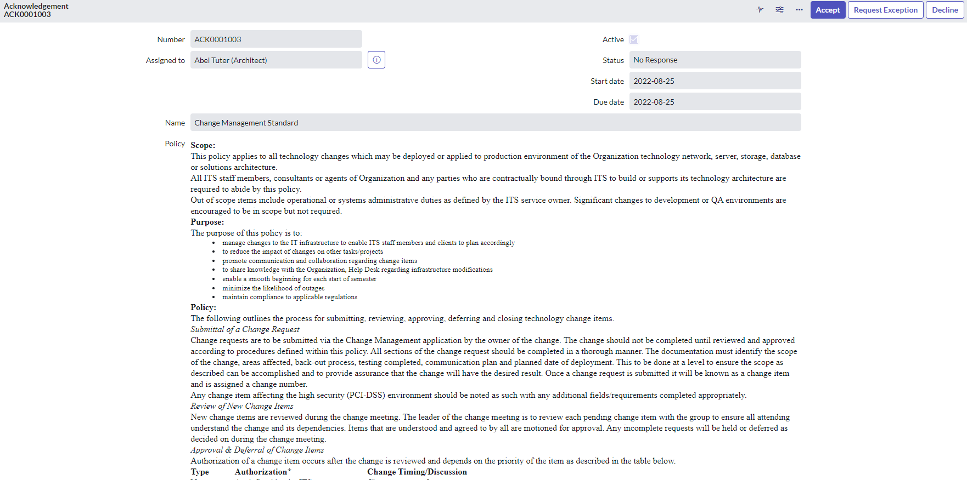
Policy acknowledgement request
Notes:
Depending on the setup – users can respond Accept, Request Exception, Decline

Slide 89
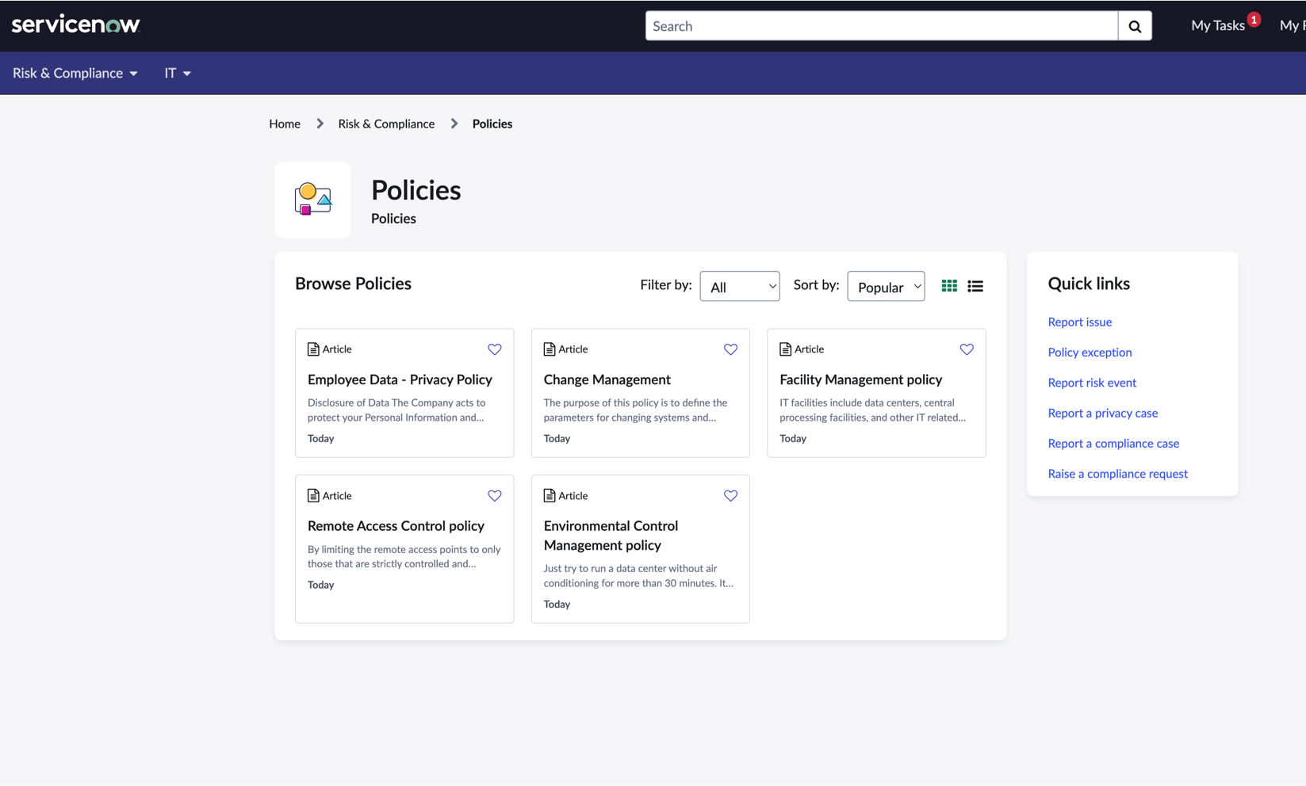
Viewing Published Policies in Employee Center
Ability for employees to view all published policies in one central place
Ability to filter and sort by various criteria
Ability to view quick links to report issues, request exceptions, report risk events etc.
Ability to view all policies and all requests in one place and sort by either KB article or request filter

Slide 90
Policy exception management
Provides temporary relief for control owners that are unable to meet compliance requirements e.g. inability to meet a control objective/control that stipulates that all critical servers OS’ be patched within 48 hours after the OS vendor releases patches as some servers are off-line for a limited period.
Allows exceptions to be requested for a specific Policy, Control Objectives (controls) and Issues
Request exceptions from the GRC application (GRC users)
Request exceptions from the GRC service catalog (non-GRC users)
Helps Compliance and Risk Managers to assess risk from potentially granting an exception prior to approving one
Also provides a logical link to risk handling/treatment (Accept/Mitigate/Reject) as part of the exception process
Can be leveraged from within other applications:
Human Resources: case
Vulnerability Response: vulnerable item
Project and Portfolio Management: risk
Notes:
Note: In versions prior to Version 10.1, the Risk assessment was called Business Impact Analysis and required that the GRC: Risk Management application be activated. Starting in Version 10.1, the dependency on Risk Management has been removed and the associated field names have changed.

Slide 91







Policy exception
Optional
Start
Request a policy exception
Requires GRC Business User
Verification rule
Where can a user create a policy exception request?
Self-service → Employee Center
Compliance Workspace
Policy Exceptions module
Control Objective record
Issue record
Additional options require configuration
Enable other apps by registering them with the Integration Registry
Approval rule
Analyze exception request
Approval options
Review impacted and mitigating controls
Set risk rating
Ask for information and/or review
Approve, reject or send for approval
Approved
Rejected
One-time extension
Notes:
Customers can modify:
The verification process: should this exception be considered? Business rule can be configured
the business owner approval workflow to match their requirements

Slide 92
Policy exception configuration
Associated Flows | Description
Generate initial approvals for policy exception Verification process - Should this exception request be considered? | Trigger based on the Substate field Substate field is set based on a business rule Generates verification based on information in the Verification Rules record Exceptions submitted via the Service Portal bypass this approval
Generate final approvals for policy exception Approval process - Should this exception request be approved? | Trigger is based on the State field changing to Awaiting Approval Generates approval(s) based on information in the Approval rules record
Notes:
The Business rule ‘Set Policy Exception Substate’ will set the substate to awaiting approvals if there are verification rules for this type of exception. If there are no verification rules, this flow is bypassed.
The final approvals flow will work with an approval rule or without a rule. If there is no rule, then the flow runs a script that obtains the Impacted Control owners and sets them as approvers.
Verification Process: https://docs.servicenow.com/bundle/utah-governance-risk-compliance/page/product/grc-policy-and-compliance/task/define-verification-rules.html
Approval Process:

Slide 93
Policy exception lifecycle
New
Review
Awaiting Approval
Analyze
Approved
Closed
State | Description
New | With integration registry, users can require policy exceptions directly with ServiceNow applications, which are routed to compliance manager Any user with sn_grc.business_user can request a policy exception from the Employee Center
Substate: Pending Verification | Optional. Verification rules can be used to verify accuracy and completeness of policy exception request
Analyze | Risk rating determined during Analyze state Compliance Manager can choose to add impacted controls, approve, request review, request more information, or request approval
Review | Requester or Risk Manger can submit more information in the Comments tab Compliance Manager reviews request and additional information if provided
Awaiting Approval | Policy exception request is sent to control owners and requester’s manager, unless approval rules were created which are optional.
Approved | Exceptions can be approved by the Compliance Manager, unless approval rules supersede Control Owner can request an extension in the Approved state
Closed | Compliance Manager can manually move exception to Closed

Slide 94
Policy exception lifecycle actions
State Value | Available Actions from State | Dependent Action
New | Update Request Approval Delete | N/A
Analyze | Update Request More Information Request Review Request Approval Delete | [Analysis and Risk Assessment Begins]
Review | Update Request Approval Delete | [Policy Exception Review Begins]
Awaiting Approval | Update Delete | [Approval Workflow Begins]
Approved | Update Request Extension Close Delete | [Extension Sub-flow Begins]
Closed | Update Delete | N/A

Slide 95
Policy exception management notifications
Name | When is it sent | Recipients | Description
Notify requester rejected | When the policy exception state moves to Rejected | Requester and watch list users | Inform the requester and users in the watch list the policy exception request has been rejected
Request Extension(approver) | When an extension is requested | Approver and watch list users | Inform the approver and users in the watch list an extension has been requested
Notify watchlist new content | When a comment is added in the activity field | Watch list users | Inform the users in the watch list a comment has been added
Policy exception closed | When a policy exception is closed | Requester and the approver | Inform the requester and the approver the policy exception has been closed
Notify approver for review | When a policy exception state moves to review | Approver | Inform the approver the policy exception moved to review state

Slide 96
Policy exception management notifications
Name | When is it sent | Recipients | Description
Notify requester approved | When the policy exception state moves to Approved | Requester and watch list users | Inform the requester and users in the watch list the policy exception request has been approved
Notify requester extension approved | When a policy exception extension request is approved | Requester and the watch list users | Inform the requester and the watch list users the policy exception extension request has been approved
Notify requester extension rejected | When a policy exception extension request is rejected | Requester and the watch list users | Inform the requester and the watch list users the policy exception extension request has been rejected
Notify to policy exception assign group | When a policy exception approval is requested, or the approval group changes | Approval group members | Inform the approval group members a policy exception approval is requested by one of the approval group member

Slide 97
Policy exception management notifications
Name | When is it sent | Recipients | Description
Exception period passed 80 percent | When the time passed the 80 % threshold between “Valid from” and “Valid to” | Requester, requester’s manager and watch list users | Inform the requester, his manager and the watch list users the active policy exception reached a threshold where an extension can be requested if necessary
Notify requester more info needed | When a compliance manager or the approver request more information | Requester and watch list users | Inform the requester and watch list users more information is needed to approve or reject the policy exception
Notify watchlist for BU approval | When a compliance manager or the approver request a business owner approval | Watch list users | Inform the watch list users a business owner will have to approve or reject the policy exception
Requester provided more information | When the requester send back the information | Approver and watch list users | Inform the approver and watch list users the requester has provided some information

Slide 98
Control Lifecycle

Slide 99
Control lifecycle
Control attestations are surveys that answer the question, “Has the control been implemented?” The attestation provides documentation that the control owner has a defined method to measure the control. Attestation generation is part of the control lifecycle.
Draft
Review
Attest
Monitor
Retired
Controls are created in Draft by default | Control owners are assigned by default to attest that a control is implemented | Controls automatically move into the Review state after attestation is complete | Indicators may be scheduled in the Monitor state | Controls can be retired when compliance is no longer required to the business
Requires sn_compliance.user to modify controls and move into Attest state | Only assigned respondent(s) can complete the attestation Sys admins cannot complete attestation for another unless by impersonation (not recommended) If respondent is not available, control should be returned to draft and reassigned. | Requires sn_compliance.manager to review control and move into Monitor or return to Draft | Controls are generally not edited in the Monitor state Updates are made based on indicator activity | Controls automatically retire is the scoped entity becomes inactive Compliance manager can manually retire a control
Notes:
The control owner responds to the control attestation and confirms that the control has been implemented.

Slide 100
Control Lifecycle Actions
State Value | Available Actions | Dependent Action
Draft | Update Attest Retire Delete | N/A
Attest | Update Return to Draft Retire Delete | [Control Attestation Begins]
Review | Return to Draft Monitor Retire Delete | [Control Attestation Review Begins]
Monitor | Return to Draft Attest Retire Delete | N/A
Retired | Return to Draft Delete | N/A

Slide 101
Control lifecycle: Draft
When a control is created (designed), it is in an initial state of draft. At this stage, the control can be updated as many times as necessary to fully define and document the control. A control in draft state is only considered as being identified and isn’t considered to be implemented or live yet.
Typically, it would be the Control Owner, who is normally the owner of the control, who can fill in the appropriate information to implement the control. Alternatively, it may get reassigned to those who are capable to provide more information on the control record, making it complete and ready for the next stage.
The mandatory fields are:
Name
Entity
Attestation respondents (Not mandatory for control to be created, but mandatory to move onto the next phase)

Slide 102
Control Lifecycle: Draft
There are several attributes captured in control that drive aspects of the process:
Frequency
Control Objectives
Category, Type, and Classification
This field determines the frequency that this control needs to be tested based on other fields such as the category, type, classification, key control, control objective, the risk this control supports, or its past behavior. For example critical controls may be tested on a quarterly basis, while less important controls are tested once a year.
The system automates the testing process on the specified schedule.
A control in ServiceNow can be considered an instantiation of a control objective against a particular entity. For example, the control objective might require certain password strength criteria, and the control enforces that objective against the Accounting application.
The tie in back to the control objective is how the control, based on its compliance status, can be leveraged to prove compliance at these policy and authority document levels.
These fields are usually used for reporting purposes, but a more robust program may drive the types of testing, as well as the frequency of testing, based on the way the control is catalogued.

Slide 103
Control lifecycle: Draft
There are several attributes captured in control that drive aspects of the process:
Attestation
Risks
Weighting
The attestation field determines which assessment the respondent will take to determine whether the control is working as intended.
The attestation respondent field defines who will receive the assessment, which is typically the Control Owner.
The Attestation frequency defines how often this process should occur and can be based on the created date or last completed date.
Controls within the ServiceNow platform not only help ease the compliance burden by introducing automation, a streamlined process, and helping prove compliance against multiple sources, but they can also be leveraged within a Risk Management deployment to mitigate risks.
The default value for this field is 10. In that case, all controls would be of equal importance. To make a distinction between a standard control and key control (one which has a higher impact on the business if it were to fail) the weighting can be modified and that would then be part of the calculation to determine the overall compliance score.
Notes:
Attestation frequency new for Yokohama release to distinguish control testing and attestation frequencies

Slide 104
Control lifecycle: Attest
Once the control has been defined, an initial attestation can be performed, also known as a test or assessment, to demonstrate whether the control has been implemented correctly. During the draft stage, an attestation is selected which contains a series of questions that the respondent must answer.
Different attestations may be created using the Attestation Designer or Smart Assessment Engine to deal with different types of controls. For example, a business process control such as enforcing background checks might require a different set of questions than a technical control that deals with password expiration. A sample attestation called ‘GRC Classic Attestation’ or ‘GRC Attestation’ is included as standard which is a control-self assessment that has three questions:
Is this control implemented?
Attach evidence
Explain

Slide 105
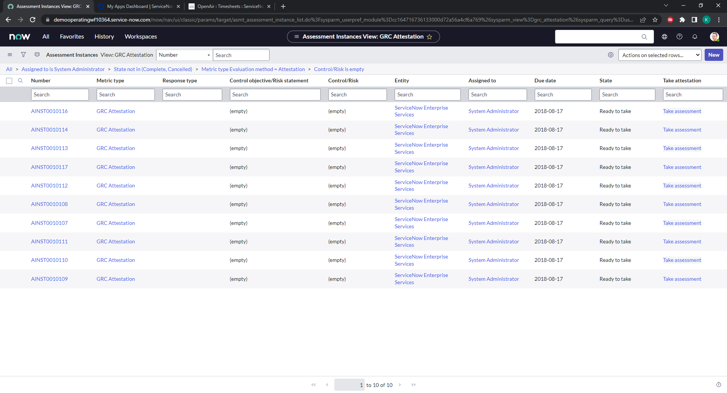
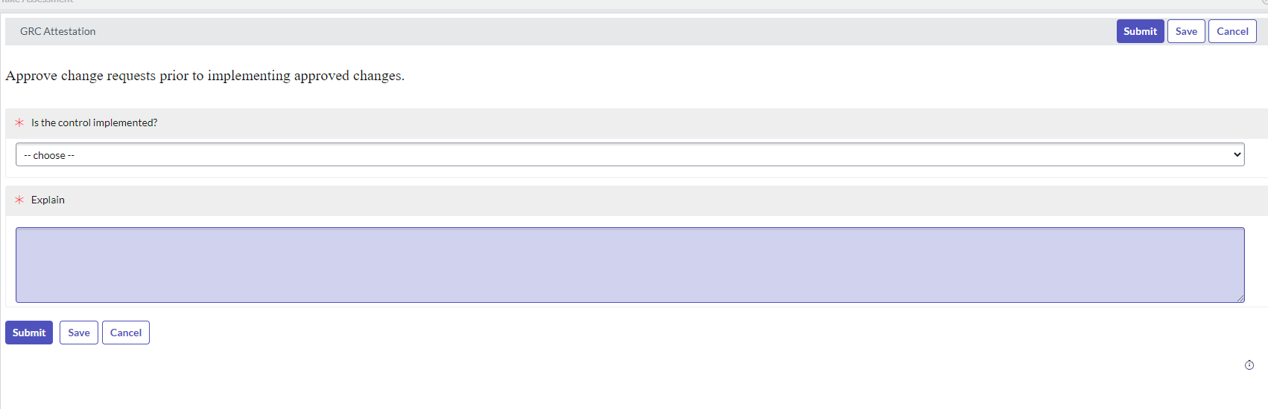
Consolidated control attestations
Allows control owners to respond to control attestations at scale.
Notes:
This feature helps control and risk owners respond efficiently to a large volume of controls attestations and risk assessments
It enhances productivity by helping recipients organize similar attestations and assessments by various criteria and respond to them at scale
How the feature works
Users can now group multiple attestation/risk assessment assigned to them
Group can be created with 2 response types
Same response
Only one set of question is presented to user, same response will be copied over to all children attestations
Different response
Set of questions belonging to each children attestation will be presented to user, respective answers will be copied over to child attestations
User can remove the child attestation from the group
Completing the group automatically completes the children assessment with responses captured on group level and copied over to children as per response type
How does it get invoked/enabled:
By installing Policy and Compliance Management or Risk Management app
No special steps needed to activate by the user.

Slide 106
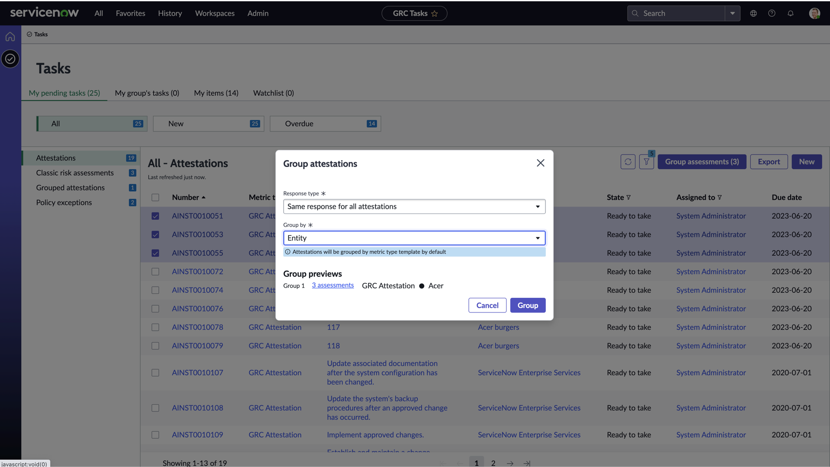
Attestation Grouping via Risk Portal
First line users can access Risk Portal from Employee Center
Ability to group attestations assigned to them from risk portal - task page​
Ability to group attestations to provide same response OR​
Ability to group attestations to view in single UI but provide different responses​​
Notes:
Improved UI for Vancouver release

Slide 107
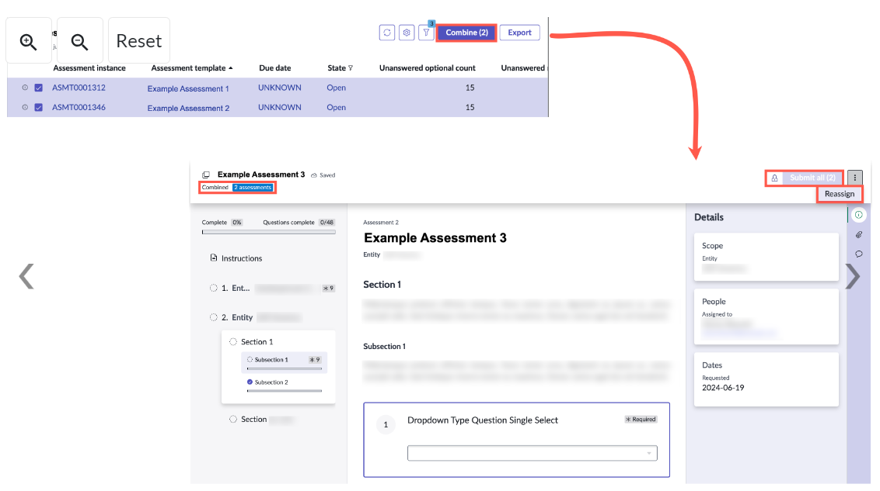
Control Attestation with Smart Assessment Engine
Combine Assessments
By selecting all applicable assessments and clicking on the combine button, assessments will be packaged together so that they can be responded to in one view by the assessor.
Notes:
Navigate to Workspaces > Compliance Workspace
Select the list icon and then navigate to Control attestations > Smart Assessments.

Slide 108
Control lifecycle: Review & Monitor
Review
Once a control has been attested, it moves on to the next stage of the workflow.
In this stage, the reviewers can perform a final review before moving the control to the ‘Monitor’ state.
Monitor
The monitor state is the last active state in the Control lifecycle. In the monitoring state, the control will be set to Compliant or Non-Compliant depending on the attestation response, as well as indicators. Indicators are established for continuous monitoring purposes.
In the case that the Risk Management Application is in use on the platform, the scoring of risk will be also be adjusted in real-time according to compliance controls in place and their control failure rate.

Slide 109


Compliance Scoring
Control Weighting
No Control Weighting
‘sn_compliance.cal_score_by_weighted_control’ – “True”
‘sn_compliance.cal_score_by_weighted_control’ – “False”
$$\frac{\sum{compliant control weight∗}}{\sum{all control weight∗}}$$
$$\frac{\sum{compliant controls∗}}{\sum{all controls∗}}$$
*excludes controls ‘In Draft’, ‘Retired’ states and controls that are ‘Not applicable’
Notes:
Compliance Scoring is automatically completed by the system.
To calculate the compliance score using the control weight, the property needs to be set to True.
Average score of controls based on weighting can be calculated by dividing the total weight of compliant controls by the total weight of all controls.
This is the most commonly used method but can be set to false if weighting is not required.
Controls in active states only are considered during the compliance score calculation, ‘In Draft’ and ‘Retired’ states as well as controls that are ‘Not applicable’, are not included.

Slide 110


Compliance Scoring: Weighted Scores
Entity
Compliance score (50%)
Control 1
Compliant
(Weight 10)
Control 2 Compliant
(Weight 10)
Control 3
Non-Compliant (Weight 20)
Control 4
Not applicable (Weight 10)
Control 5
Compliant Retired (Weight 10)
$$\frac{\sum{compliant control weight∗}}{\sum{all control weight∗}}$$
$\frac{10+10}{10+10+20}$ x 100 = 50%
Notes:
Control 1 and Control 2 are compliant and have a total weight of 20.
Control 1, 2 and 3 are active controls and therefore the total control weight is 40. The overall compliance percentage for the entity is 50%.

Slide 111


Compliance Scoring: No Weighting
Entity
Compliance score (67%)
Control 1
Compliant
Control 2 Compliant
Control 3
Non-Compliant
Control 4
Not applicable
Control 5
Compliant – Retired
$$\frac{\sum{compliant controls∗}}{\sum{all controls∗}}$$
$\frac{1+1}{1+1+1}$ x 100 = 67%
Notes:
Control 1 and Control 2 are compliant and so the total compliant control number is 2.
Control 1, 2 and 3 are all active controls and therefore the total control number is 3. The overall compliance percentage for the entity is 67%.

Slide 112
Compliance Score Roll-up
Compliance scoring is rolled up through the compliance and entity hierarchies
Authority document
Authority document = Avg (citation scores)
Citation = Avg (child citations + control objectives scores)
Policy = Avg (child policies + control objectives scores)
Control objective = Avg (control objectives + control scores)
Entity Type = Avg (entity scores)
Entity = Avg(Avg(directly associated control scores) + Avg(downstream entity scores))
Policy
Citation
Entity type
Policy
Control objective
Citation
Entity
Control objective
Control
Entity
Notes:
Control Objective compliance score is the average of any child control objective and control scores
Policy compliance score is the average of any child policy and control objective scores
Citation compliance score is the average of any child citation and control objective scores
At the highest level, the authority document is the average of the citation scores.
Compliance score is also rolled up to the entity level, taking the average of all control scores. *Please note the addition of adding the average downstream entity scores is new for Yokohama release*
Entity Type compliance is calculated by the average of all entity compliance scores.

Slide 113
Configuring Control Attestation

Slide 114
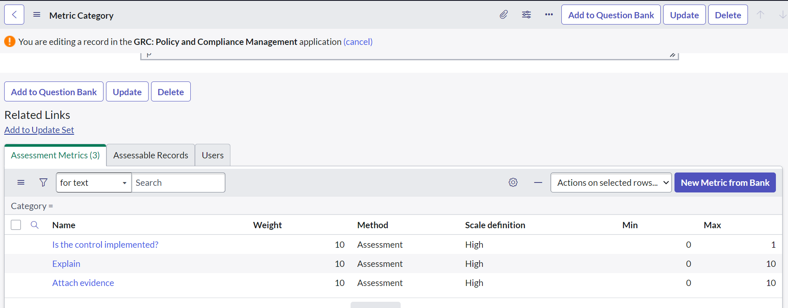
Attestation designer
Each Attestation Assessment is made up of metric categories (question categories) that contain one or more assessment metrics (questions). Questions can easily be configured and added to attestation assessments.
Notes:
Policy and Compliance > Administration > Attestation Types
Questions can be added directly into the metric category or into the question bank where they can be reused in other categories/assessments.

Slide 115
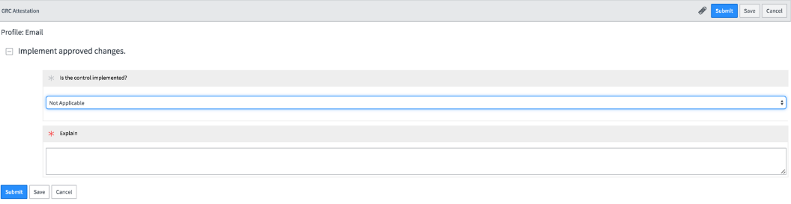
Example attestation assessment
Is the control implemented
Yes
No
Not applicable
If yes, Attach evidence
Explain
Notes:
Sample attestation ‘GRC Attestation’

Slide 116
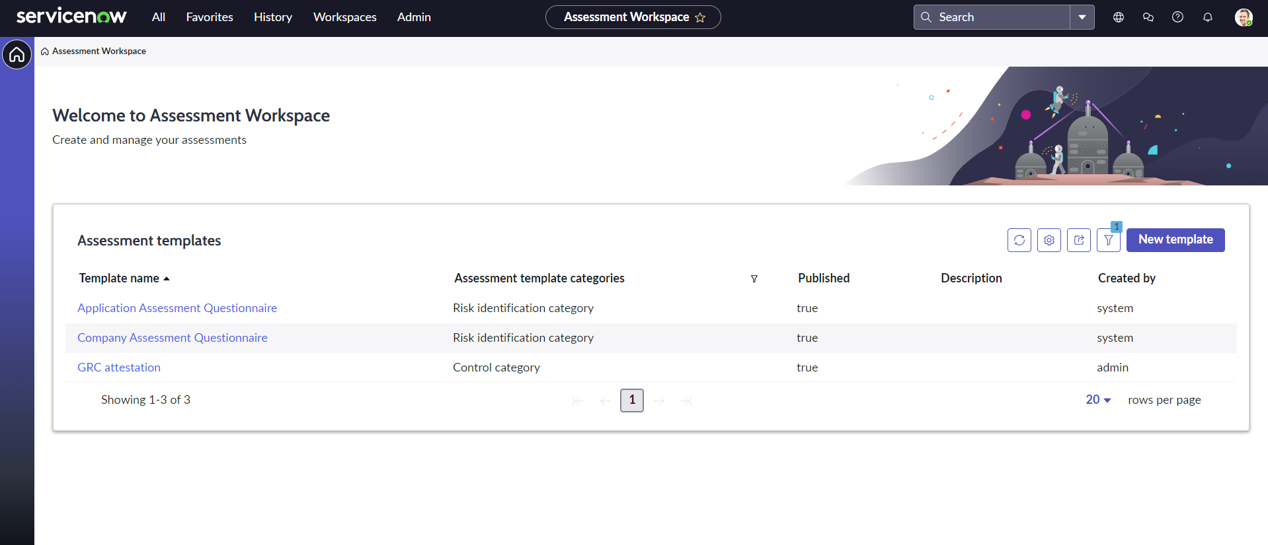
Control Attestation with Smart Assessment Engine

Slide 117
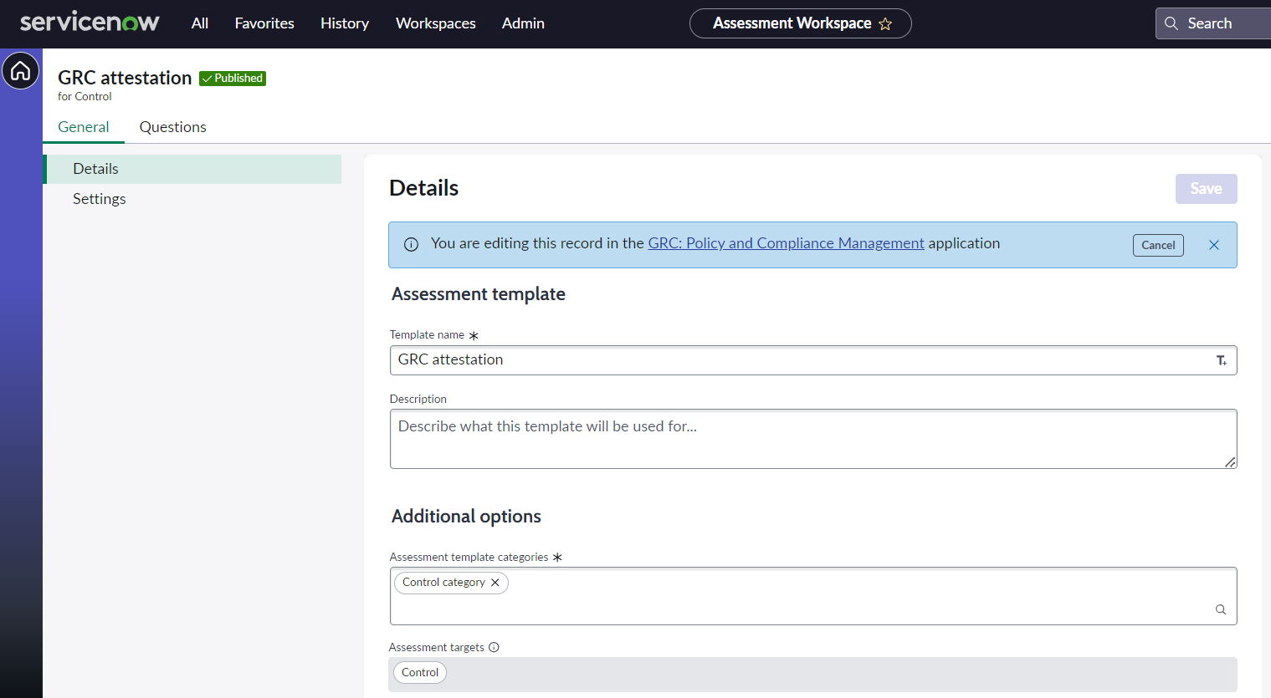
Control Attestation with Smart Assessment Engine
Details
In the general tab details about the assessment template can be added including:
Name
Description
Template categories (user groups that can use the assessment)
Assessment target (tables that assessments will access)

Slide 118
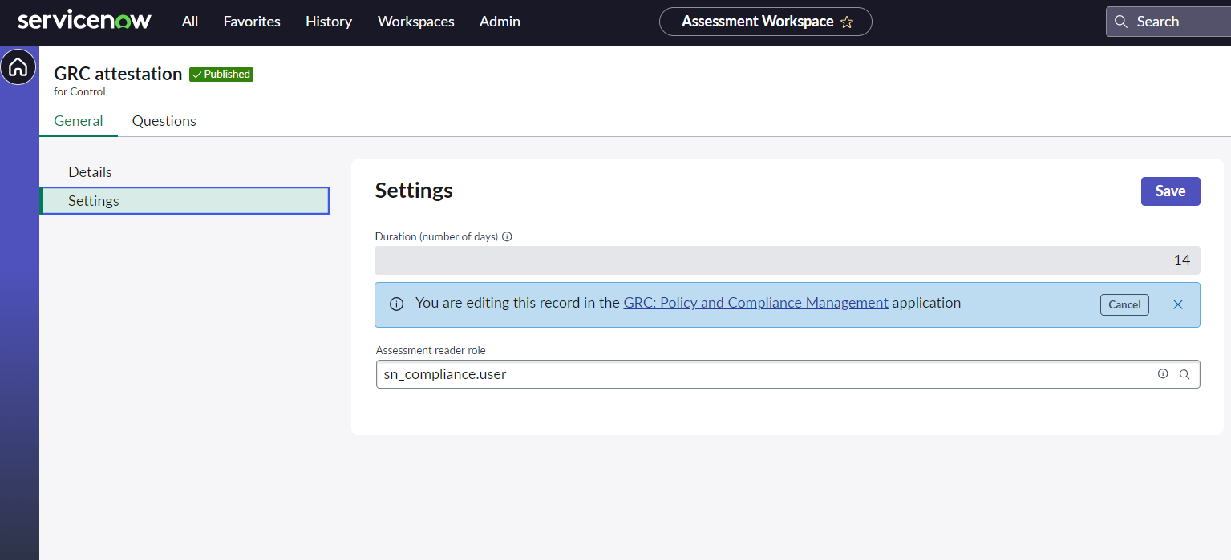
Control Attestation with Smart Assessment Engine
Settings
In the general tab settings can also be configured for the assessment template including:
Duration (in days)
Reader role for the assessment

Slide 119
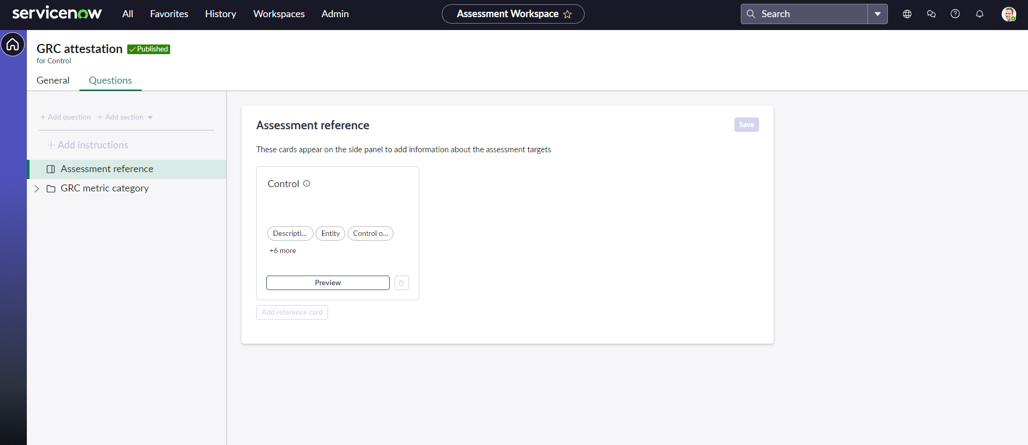
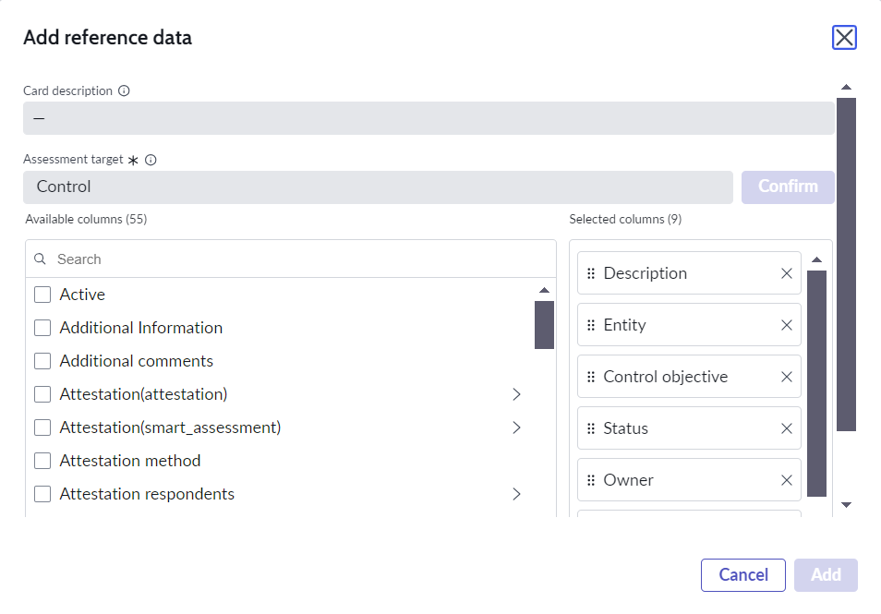
Control Attestation with Smart Assessment Engine
Assessment Reference
Reference data can be added to the control attestation template that can be viewed when the user is completing the assessment. This can be any field from the Control for example:
Description
Status
Owner etc.
Notes:
Available in the Questions tab

Slide 120
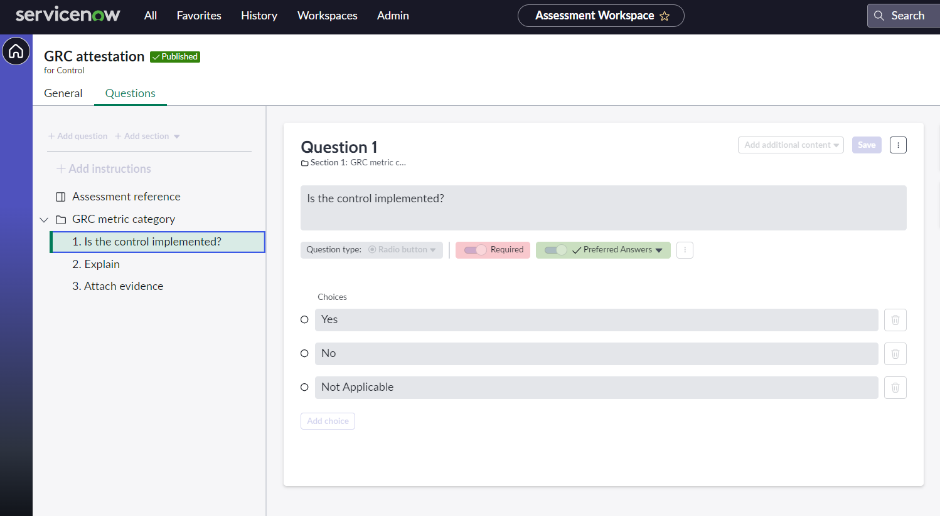
Control Attestation with Smart Assessment Engine
Questions
Questions and sections can easily be added to the assessment template.
Various types of questions are available including drop down, radio buttons, text, date , attachments and more with customizable attributes such as visibility, response, and justification requirements.
Notes:
*TIP* Use the description box on the section to add instructions for the assessors
Note: You can create an assessment only from a published assessment template.
Note: If there isn’t an associated active assessment, you can modify and publish these published templates again.

Slide 121
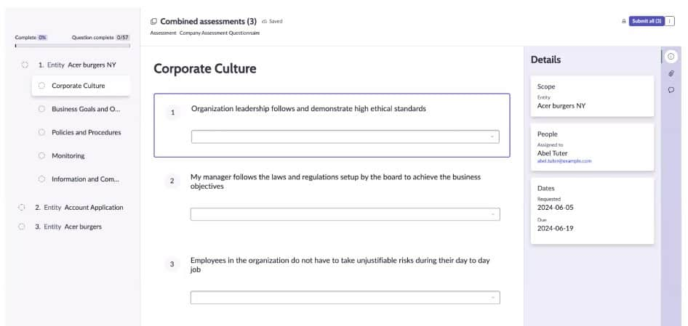
Control Attestation with Smart Assessment Engine
Assessment Example

Slide 122
Continuous Monitoring

Slide 123
Monitoring use cases across the enterprise
Cyber Risk & Security Controls
Continuously monitor indicators of risk associated with indicators of compromise, vulnerabilities, and threat vectors to grant real-time visibility to a CISO and their staff
Continuously Monitor IT Compliance
Drive massive efficiency into IT compliance by natively monitoring IT controls such as configurations, changes, and other operational IT data
Data Subjects Rights Requests
Portal where customers can request deletion of their personal information
Continuously Monitor IT Risk
Assess project risk, capture risk indicators associated with incidents, vulnerabilities, applications, and assets
Market Conduct Risk
Continuous monitoring on customer complaints & cases with automated regulator reporting
Customer Services
Digital / IT Transformation
Ensure DevOps app compliance
Embed controls in the SDLC and continuously audit compliance of your software development
Compliance
Ethics Compliance
Continuous monitoring on ethics cases and the regulatory impact
Resilience
Vendor
Privacy
RISK
Financial Compliance Monitoring
Continuously monitor financial controls associated with SOX or the financial close process
Workforce Resilience
Measuring effectiveness of workforce safety & resilience guidelines while assessing operational risks
Employee Experiences
Legal & Finance
Manage Privacy Risk & Compliance
Define governance and monitor regulatory compliance to privacy requirements globally while continuously assessing privacy risk across the organization

Slide 124
Continuous Control Monitoring
Gartner defines continuous controls monitoring (CCM) as “a set of technologies to reduce business losses through continuous monitoring and reducing the cost of audits through continuous auditing of the controls in financial and other transactional applications.”
CCM is shifting from the traditional testing approach of sampling data over a set frequency to monitoring all priority transactions and controls continuously.
In ServiceNow this can be achieved using the below features:
Indicators
Integration with Configuration Compliance
Notes:
A CCM programme should include risk detection, prevention, remediation, and compliance components, all focusing on people, processes, and technology.
Using CCM to monitor key business processes against business rules enables organizations to identify patterns and anomalies to help minimize potential risk exposures.

Slide 125
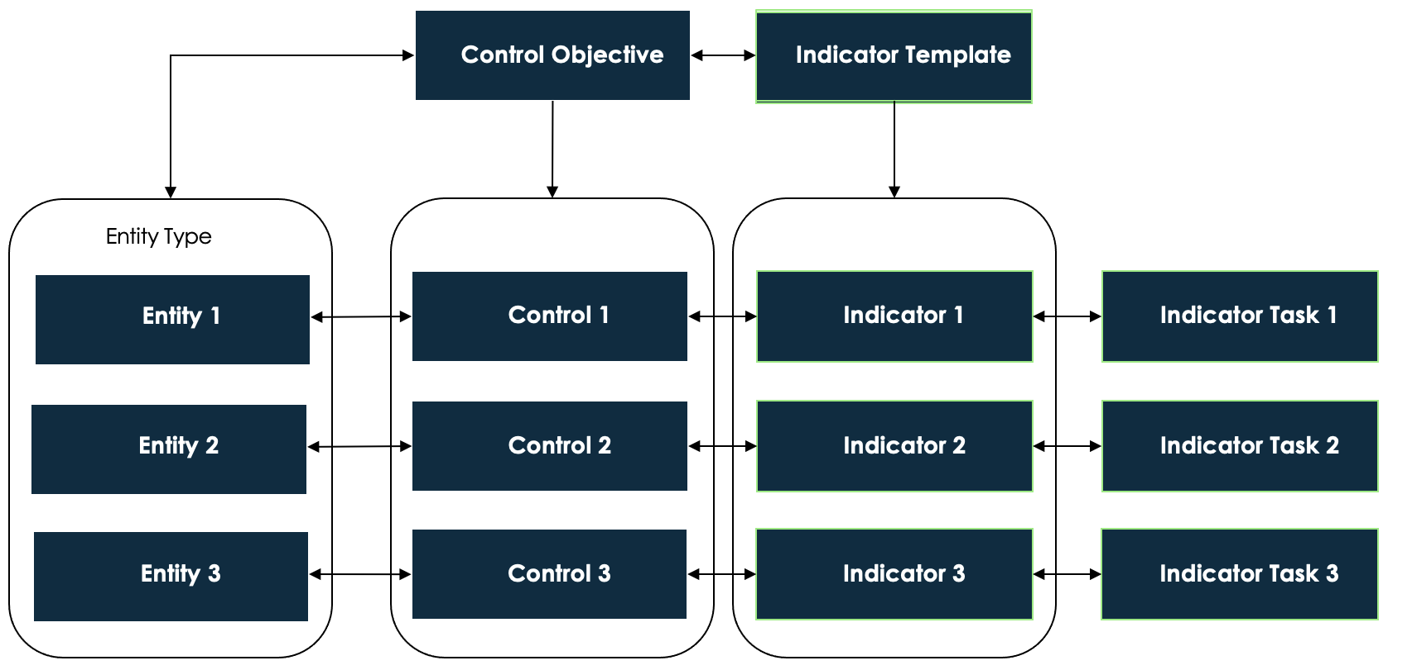
Indicators
In Policy and Compliance different types of indicator can be used in addition to or independently from Control Attestations in order to assess the Controls or to continuously monitor their compliance.
An Indicator Template for a Control Indicator is associated to the Control Objective. When the Objective is associated to an Entity Type, an individual Control is created for each Entity contained in the Entity type and an Indicator is created at the same time from the Indictor Template associated to the Control Objective.
An Indicator Task is created each time the Indicator is executed to evaluate or monitor the Control. When an Indicator Task fails to meet the desired threshold defined for Compliance, an issue is automatically generated for the Control that reflects the status ‘Non-Compliant’.
Notes:
New for Kingston

Slide 126
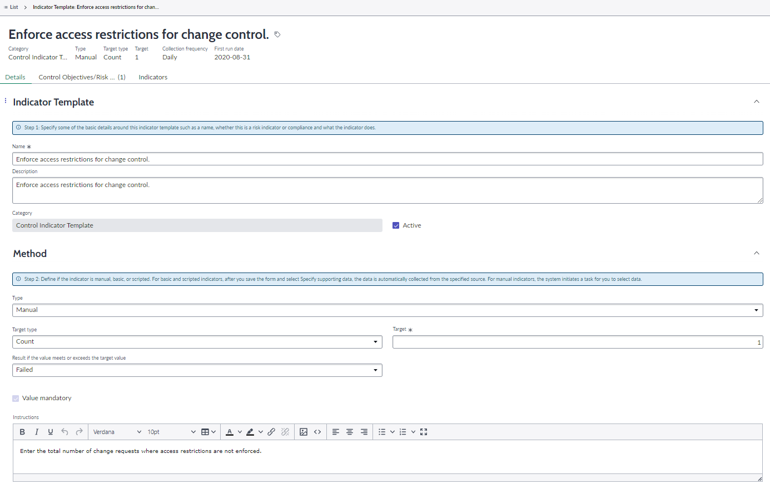
Indicator Template

Slide 127
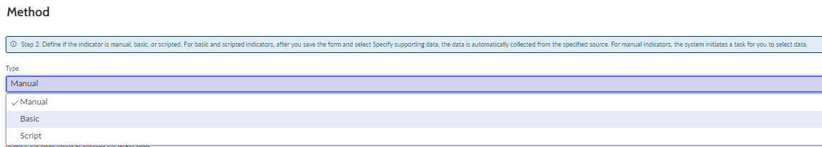
Indicator Template: Types of indicators
Select the Type from Manual, Basic or Script.
Manual: This type of indicator will generate an Indicator Task, for which the assignee will be required to manually provide the data. This should be used where data cannot be retrieved from the ServiceNow instance e.g. data comes from external system.
Basic: Automated indicators based on an indicator source. The indicator source specifies a table and a frequency at which the scores from this table are saved.
Script: This is an advanced type of Indicator; a custom script will be used to collect the data.
Notes:
https://docs.servicenow.com/bundle/tokyo-governance-risk-compliance/page/product/grc-indicators/task/t_CreateIndicatorTemplate.html

Slide 128
How to build Indicators
Determine what to measure
Create an indicator template
Determine how to measure
Create indicators
Complete indicator task
Number of complaints Response time to complaints Number of failed controls Attestation completion rates | Is the data required for the indicator stored internally or externally of ServiceNow? Internally → basic or scripted indicator Externally → manual indicator | Select type Identify the ServiceNow table the data is stored on (basic) Identify a threshold Provide instructions for data gathering (for manual) Document the frequency e.g. monthly, quarterly, annually etc. | Associate indicator template to control objective or risk statement Indicators created on scoping risk statements or control objectives with an entity type Relationship automatically created between control and indicator | Indicator triggered based on the frequency defined in the template For manual indicators, the assignee manually completes the data input required For basic indicators, data is automatically collected

Slide 129
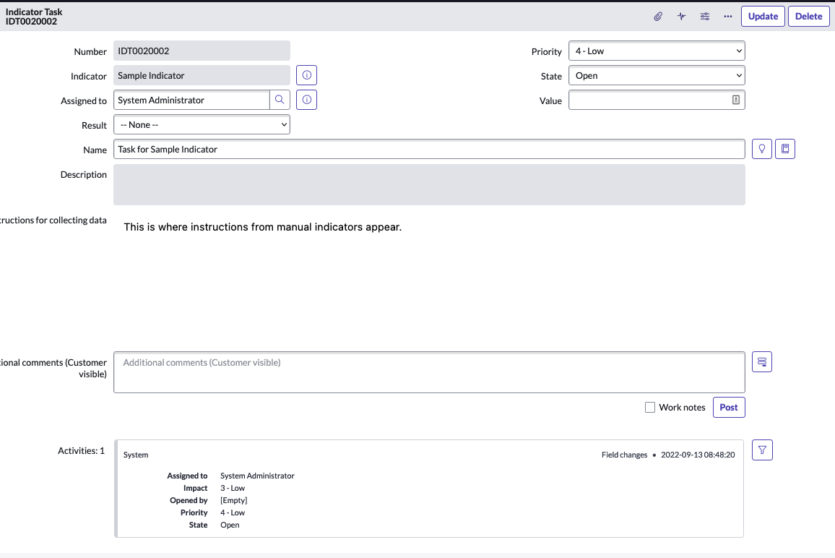
Indicator Task

Slide 130
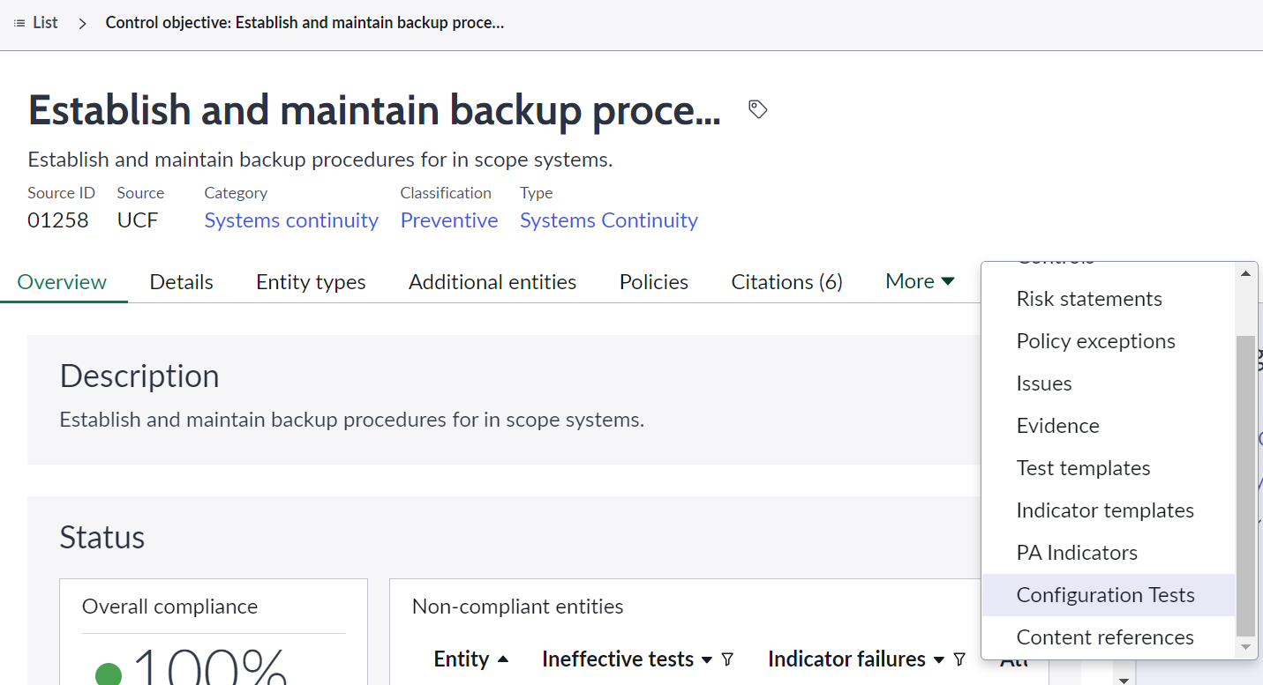
Continuous Monitoring: Configuration Compliance
Continuous monitoring for controls is a feature integration between the GRC: Policy and Compliance Management product and the Security Operations Configuration Compliance products.
This feature integrates the scan results from third-party applications, like Qualys, to determine the compliance status for each associated control.
Notes:
Configuration compliance required
https://docs.servicenow.com/bundle/tokyo-governance-risk-compliance/page/product/grc-policy-and-compliance/reference/continuous-configuration-monitoring.html

Slide 131
Continuous Monitoring: Configuration Compliance
The system admin activates the Configuration Compliance and Policy and Compliance Management plugins.
The compliance manager maps control objectives or controls to configuration tests, which generate controls, entities, and indicators related to those configuration tests.
The integration ingests the results of the third-party configuration test scan results at defined intervals.
If the configuration test scan results of the configuration tests indicate a failure, then the control is non-compliant and an issue is automatically generated.
If the next scan result of the configuration test indicates that the failure has been remediated, then the control is compliant and the issue is automatically closed.
Notes:
https://docs.servicenow.com/bundle/tokyo-governance-risk-compliance/page/product/grc-policy-and-compliance/reference/continuous-configuration-monitoring.html

Slide 132






Continuous Monitoring: Configuration Compliance
Understand impact to overall risk and compliance posture from misconfigured assets and prioritize remediation efforts
Security Operations team
GRC Compliance team
Integrate scanner
GRC: Policy and Compliance Management
Configuration Compliance
Control = compliant
Configuration tests
Control
Pass
Indicator (monitor control effectiveness)
Pass / Fail
Test results
Test results trigger an event
Fail
Control = noncompliant
Issue created
GRC Policy Management
Configuration
Compliance
Notes:
and control objectives and configuration tests linked for entities and controls to be automatically generated and test results linked to those generated controls.
Process:
Integrate vulnerability scanner
Collect configuration test data
Monitor for control effectiveness
Control failure automatically generates issue (If the next scan result of the configuration test indicates that the failure has been remediated, then the control is compliant, and the issue is automatically closed)
Analyze issue and close or generate policy exception
Continue to monitor with real-time dashboards

Slide 133
Continuous Control Monitoring Considerations
1
Identify potential processes or controls according to industry frameworks such as COSO, COBIT 5, ITIL etc.
Define the scope and establish priority controls for continuous monitoring (usually determined from critical business and IT processes)
Prioritise low hanging fruit: high value to organization, ease of implementation (readily available data) and cover multiple risk areas
Empower the first line of defense (control owners) to monitor and manage their controls
2
3
4

Slide 134
Policy & Compliance Roles

Slide 135
Policy and Compliance roles
Role Title | Description | Contains roles
Compliance User / Compliance Analyst [sn_compliance.user] | The Compliance User, often referred to as the Compliance Analyst, has permissions enough to fulfill virtually any policy or control related task. Users assigned this role are often responsible for: Creating and approving policies Requesting policy exceptions Responding to acknowledgement requests Creating control objectives and relating them to policies Testing and monitoring control effectiveness Attesting controls Remediating issues Assisting with risk assessments and audit tasks Note: Users with the Compliance User role can be assigned controls and have read-only access to the Risk Management application and modules. | sn_grc.reader sn_grc.user sn_compliance.reader

Slide 136
Policy and Compliance roles
Role Title | Description | Contains roles
GRC Business User [sn_grc.business_user] | This role is a part of the GRC Profiles application. It should be assigned to users who require access only to GRC applications in the context of performing tasks assigned to them for example: perform and approve risk assessments remediate tasks respond to/resolve issues perform indicator tasks mitigate risk tasks create an issue triage work on evidence request tasks This role is a part of the GRC Profiles application. Note: In GRC: Profiles (Version 12.0.5), the GRC Business User role is now assigned to any user account that performs a GRC operation for licensing purposes. Those users are added to the GRC: Business User group. You can remove this role from users as needed. | sn_grc.user_hierarchy_reader workspace_user sn_grc_workspace.task_reader canvas_user

Slide 137
Policy and Compliance roles
Role Title | Description | Contains roles
Control Owner | Attesting controls – delegates to a different control tester if needed Ensures that tasks are carried out in order to mitigate a non-compliant control Provides feedback concerning the control as well as its design and implementation | There is no control owner role in ServiceNow. Every user in ServiceNow can be defined as a control owner for any given control. This is considered as record-level permission.
Compliance Manager [sn_compliance.manager] | The Compliance Manager is responsible for managing the day-to-day compliance process. Users assigned this role are often responsible for: Creating authority documents, citations, control objectives, and controls. Reviewing specific regulatory requirements and trends Determining which regulations require a policy Approving policies and policy exceptions Setting up a policy acknowledgement campaign Scoping controls using entity types and entities Creating and assigning attestations Continuously monitoring control effectiveness Compiling and sharing reports highlighting data, such as non-compliant controls | sn_grc.reader sn_grc.user sn_grc.manager sn_compliance.reader sn_compliance.user

Slide 138
Policy and Compliance roles
Role Title | Description | Contains roles
Compliance Administrator [sn_compliance.admin] | The Compliance Administrator administers the Policy and Compliance Management application. Users assigned this role are often responsible for: Monitoring platform dependencies with other applications and modules Controlling all compliance data including deletion | sn_grc.reader sn_grc.user sn_grc.manager sn_grc.admin sn_compliance.reader sn_compliance.user sn_compliance.manager
Compliance Developer [sn_compliance.developer] | The Compliance Developer is responsible for maintaining various aspects of the platform, such as: Creating workflows, reports, dashboards, additional modules Editing scripts Other platform-specific content that can enrich the application | sn_grc.reader sn_grc.user sn_grc.manager sn_grc.admin sn_grc.developer sn_compliance.reader sn_compliance.user sn_compliance.manager sn_compliance.admin

Slide 139
Policy and Compliance roles
Role Title | Description | Contains roles
Attestation Creator [sn_compliance.attestation_creator] | The Attestation Creator is responsible for creating and maintaining attestations. Attestations are one of the platform components used to attest controls and it is essential for keeping them lean, precise, and up-to-date. | assessment_admin
Compliance Reader [sn_compliance.reader] | The Compliance Reader has read-only access to all modules of the Policy and Compliance Management application. This role is typically assigned to users who need to see what policies and controls are within the organization. Users with the reader role are also often responsible for reporting and monitoring activities. | sn_grc.reader survey_reader

Slide 140
Policy & Compliance Reporting

Slide 141
Base reports
Total Control Objectives by policy
Control Objectives by authority document
Compliance score by department
Compliance Score trends
Policy Exceptions by entity
Policy exceptions by policy
Policy exceptions by priority
Active policy exceptions
Policy exceptions by control objectives
Exempted Controls
Control Overview
Control Details
Exempted Controls by Entity
Control Compliance
Overall on Compliance(citation)
Compliance breakdown(citation)
Control issues by policy
Compliance breakdown
Compliance requirements
Policy Ack status
Past Due Acks
Pending Acks
Decline Acks
Exception Requested
Accepted Acks
Policy Ack status by policy

Slide 142
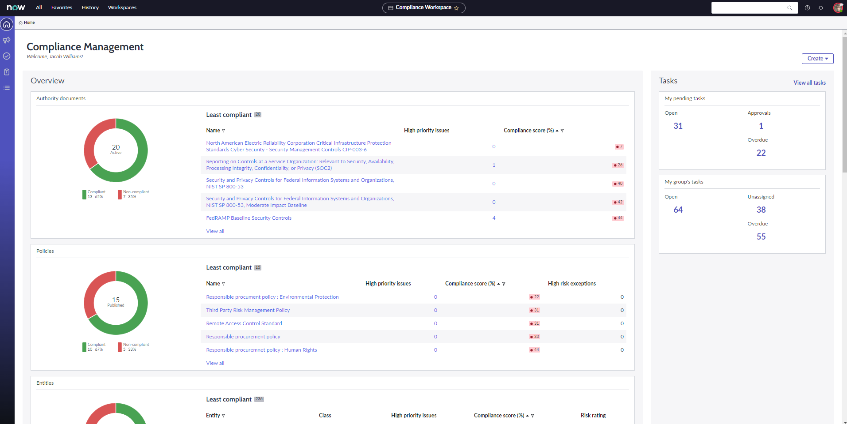

Compliance manager home page
Notes:
Personalized experience for corporate compliance manager for managing their work better
5 sections
Overview : compliance overview
Control assurance : control testing and monitoring overview
Tracking : summary of important issues, tasks, exceptions etc.
Compliance domains: summary of compliance posture per domain like privacy
Tasks : summary of my tasks and my group’s task
Quick links to create new records
Supported Roles
Corporate compliance manager

Slide 143

Compliance analyst home page
Notes:
Personalized experience for corporate compliance analyst for managing their work​ better
4 sections​
Overview​ : compliance overview
Control assurance​ : control testing and monitoring overview
Tracking​ : summary of important issues, tasks, exceptions etc.
Tasks : summary of my tasks and my group’s task
Quick links to create new records
Supported Roles​
Corporate compliance analyst

Slide 144

Task page
Notes:
Single pane view of all task:
My pending tasks
My groups tasks
My items
Awaiting my review / approval
Overdue tasks
New tasks in my queue
Things I am watching

Slide 145

Issues landing page
Notes:
Single-pane view of all issue triages and issues
Overview :
Issues breakdown by state, issue type, issue rating, and priority
Overdue issue aging (due date) by priority and issue rating
Issue triaging by state, issue type, issue rating, and priority
Issue triage aging (created date) by priority
Tracking :
Open, overdue remediating tasks
Open exceptions on issues
Evidence requested for issues
Performance :
Open vs. confirmed vs. closed issues trend
My issues, my group’s issues, watched items:
Issue triages and issues I manage, I review, I respond to, and I watch
Issue triages and issues assigned to my group, unassigned issue triages and issues

Slide 146

Module page
Notes:
Well-organized navigation menu listing the modules based on compliance persona’s needs:
Compliance library : list of authority documents, policies, control objectives, controls etc.
Scoping: scoped entity types, entities
Policy acknowledgements : list of acknowledgement campaigns and acknowledgments
Policy exceptions : list of all requested and approved exceptions
Control attestations : list of all control attestations
Control testing: test plans, control tests, compliance plans and engagements
Control monitoring: indicators
Evidence requests
Issues and issue triages
Regulatory alerts and taxonomy

Slide 147
Compliance Case Management
Notes:
New application for Vancouver release

Slide 148
Introduction
The ServiceNow Compliance Case Management application supports the reporting, investigation and resolution of compliance cases, such as complaints or breaches as well as allowing employees to raise compliance requests to be addressed by the compliance team. This enables organizations to understand their enterprise-wide compliance risk.
Features and benefits include:
Single source for reporting, investigating, and resolving compliance cases or events, such as requests, complaints, and breaches
Raising a compliance request, such as policy modifications, clarifications, and inquiries from the employee portal
Recording the regulations that were violated by the event impact, with the event lodgment date
Collaborate effortlessly with multiple teams to investigate and manage compliance cases and requests
Providing a highly configurable workflow that is based on a compliance case or request

Slide 149
Compliance Case Management
Compliance
Request/Inquiry
Compliance
Case
Employee Inquiry/Request
Business App
Security Breach
Hardware
Failure
Customer Loan
Payment Failure
Discrimination
Case
Employee raised an inquiry about a new engagement in a specific location and its regulatory impact
A system exposed employee data, resulting in a privacy breach
A hardware system went down after a Prod. update and customers are unable to access data
Customer loan payment due to Misappropriation by financial controller
A whistleblowing case logged internally by an employee on equal pay
Inquiry/Advice case
Security Incident
IT Incident
FSO Complaint
HR Case
Compliance team
SOC team
IT team
Finance team
HR team
All Compliance Cases
(Single repo to manage all type of cases to know the compliance risks)
Compliance team
Notes:
Compliance Request and Compliance Case are used for different use cases
Compliance Request/Inquiry:
Employees can raise compliance related inquiries to compliance team from Employee portal.
Compliance Case:
Employees can report any non-compliance event to compliance team from Employee portal.

Slide 150
Roles & Responsibilities
Role Title | Description | Contains roles
Compliance Case Business User [sn_comp_case.compliance​_case_business_user] | The compliance case business user can perform the following tasks: Create compliance cases and requests from the Employee Center Work on the case tasks. . | sn_grc_case_mgmt.grc_​case_business_user ​
Compliance Case Analyst [sn_comp_case.compliance_​case_analyst] | The compliance case analyst can perform the following tasks: Review the key stakeholders, impacted areas, related areas, causes and consequences, regulations, and issues they are assigned Review any unassigned cases ​ | sn_grc_case_mgmt.grc_​case_analyst sn_comp_case.compliance​_case_business_user ​
Compliance Case Manager [sn_comp_case.compliance_​case_manager] | Compliance case managers can review and work on the created cases, including the following tasks: Review the key stakeholders, impacted areas, related areas, causes and consequences, regulations, and issues that are assigned to the case analyst. Review all cases. ​ | sn_comp_case.compliance​_case_analyst sn_grc_case_mgmt.grc_​case_manager ​

Slide 151
Roles & Responsibilities
Role Title | Description | Contains roles
Compliance Case Admin [sn_comp_case.compliance_​case_admin] | Compliance case administrators can configure the Compliance Case Management application. They can perform the following tasks Create a case type Create a state model and transitions Create an assessment template Delete cases Review the key stakeholders, impacted areas, related areas, causes and consequences, regulations, and issues that are assigned to the case analyst | sn_grc_case_mgmt.grc_​case_admin sn_comp_case.compliance​_case_manager
GRC Employee User [sn_grc_emp_user.grc​_employee] | GRC employee users can ​create compliance cases and requests from the Employee Center. | N/A

Slide 152










Compliance Case Management Workflow
Employee Center:
Report a compliance case
API Integration
ServiceNow solutions
3rd Party solutions
Employee
Integrations
Triage & Investigate
Resolve
Post Case Review
Close
Compliance Case:
Policy/Regulatory violation
Compliance Case Analyst
Perform Investigation & assessments
Determine breaches and impacted / related areas such as Policies, Regulations​, Compliance Risks
Gather evidence & observations
Initiate remediation and preventative measures
Track regulatory violations to their lodgment​
Analyze the causes & consequences of the case
Identify & manage issues related to impacted areas to eradicate the causes
Collaboration:
Evidence & resolution plan
Finance
Employee
HR
Legal

Slide 153
Compliance Case lifecycle
New
Investigate
Triage
Resolve
Post Case Review
Close
New | A business user via the employee center or a compliance team member via the compliance workspace reports a compliance violation.
Triage | After a compliance case is reported, the compliance team triages the case from a validity standpoint. The team then assigns a case analyst to work on the case.
Investigate | The case analyst collaborates with multiple teams to gather evidence and capture further details about the case. They then create tasks and assign to a case task owner to investigate the case further.
Resolve | After the investigation is complete, the case analyst initiates the remediation actions and preventive measures to resolve the case. The case analyst also tracks the reportable regulatory violations to ensure their lodgment to the regulators.
Post Case Review | The case analyst analyzes the causes and consequences of the case and conduct​s a root-cause analysis. The case is then reviewed to identify and manage any issues.
Close | The compliance analyst works closely with the various teams to review and close the compliance case.
Notes:
*see task workflow on next slide

Slide 154
Case Task lifecycle
Draft
Work in Progress
Assigned
Review
Closed
Draft | The case analyst creates case tasks, providing a description of the task required. Assigning a case task owner moves the case task into the ‘Assigned’ state.
Assigned | The case task owner reviews the details of the case task and clicks on ‘Accept work’, moving the task into ‘Work in Progress.’
Work in Progress | If a case task is the Assessment type, the case task owner must take an assessment to determine the losses that were incurred from a case. If the case task is the Investigation type or Others type, the case task owner provides observations and submits the case for review to the case analyst by selecting the ‘Ready for review’ button.
Review | The case analyst reviews the case task and can either select ‘Complete’ moving the case task to Closed or send back to the task owner as ‘Work in Progress’ requesting revisions.
Closed | Case task is closed by the case analyst on successful completion.
Notes:
There are three types of case tasks:
Assessment: An Assessment case task requires the case task owner to take an assessment and provide responses. A case task of this type can only be reassigned.
Investigation: An Investigation case task requires the case task owner to provide observations.
Others: An Others case task also requires the case task owner to provide observations.

Slide 155


Report a compliance case
Click ‘Report a Compliance Case’ in the employee center
Employees can report any compliance case that requires the compliance teams’ attention.
APIs available to integrate with ServiceNow & 3rd party products​

Slide 156


Compliance case: investigate
Capture key details related to
case such as:
Impacted business units & locations
Breach status & breach significance date
Case Schedules
Impacted /related areas
Timeline displays
key schedules and milestones of the case lifecycle such as:
When was the case discovered vs its occurrence
Case SLA vs actual case closure date
Investigation plan vs actual dates

Slide 157

Compliance case: investigate
Collaborate with various teams using case tasks to:
Conduct assessments​
Investigation
Gather evidence ​
Capture observations
Record impacted / related areas that need to be addressed such as​;
Policies & Regulations​
Citations
IT Assets​
Business Units
Controls

Slide 158



Compliance case: Export to PDF
Export "Case/Request" records to PDF
Enables offline sharing with stakeholders like regulators, legal, etc. without system access
Tailor various PDF templates per case type, aligning each template with stakeholder preference
Generated PDF can be accessed from the list of attachments in the side-bar

Slide 159


Compliance case: PDF Templates
Tailor various PDF templates per case type

Slide 160



Compliance case: Managed email communication
Compliance teams can centrally initiate & monitor all email communication, for various scenarios such as:
Regulatory inquiries​
Regulatory reporting​
Legal consultation
Email templates help compliance officers to compose and draft emails for compliance cases and general requests

Slide 161

Compliance case task

Slide 162
Configuration options: compliance case
Highly configurable workflow based on the nature of the compliance case types:
Configure multiple Case Types and Sub Types
Each case type can be configured with a dedicated;
Workflow
Form view (Show/hide fields based on case types)
Assignment rules (To assign an analyst to a compliance case)
Assessment Templates for case tasks

Slide 163

Compliance Request Workflow
Employee Center:
Raise a compliance request
Employee Center:
Additional clarifications
Employee
Triage
Work In Progress
Approve/Reject
Compliance Request:
Employee Request
Compliance Request Analyst
Validate the requests raised
Identify the team to work on the request.
Identify related policies, controls, regarding the request.
Obtain additional approvals from various stakeholders [if needed]
Approve/Reject the request

Slide 164
Compliance Request lifecycle
New
In Progress
Triage
Awaiting Approval
Canceled*
Closed
New | A business user via the employee center or a compliance team member via the compliance workspace raises a compliance request.
Triage | The compliance team assigns a request analyst to work on the case. They triage the case from a validity standpoint. Once verified, the case moves to ‘In Progress’.
In Progress | The request analyst determines all the requirements for the raised request and identifies any supporting documents, such as the policies, controls, citations, and control objectives that are related to the request.
Awaiting Approval | The request is evaluated and either approved or rejected. Requests can be sent for approval to multiple users. The Any Approvers option enables the request to be closed as soon as it receives an approval or rejection from any of the assigned approvers.
Canceled | In this stage, a request may need to be canceled if it isn't a compliance request, with the justifications provided to the requester. A request can be canceled at any stage, including Triage, In Progress, and Awaiting Approval states.
Closed | After a compliance request is fully processed and approved or rejected, it enters the Closed stage. The request is considered resolved, and no further actions are required.
Notes:
*optional state

Slide 165


Raise a compliance request
Click ‘Raise a Compliance Request’ in the employee center
Details regarding the compliance request are captured and any necessary attachments are added to further support the request
Once the compliance request is submitted by the user, the compliance team can access it from the compliance workspace.

Slide 166

Compliance request: in progress
The request analysis reviews the request raised and gathers all required information such as areas related to the request:
Controls
Policy
Citations
Control Objective

Slide 167

Compliance request: awaiting approval
The approval cycle for the request type can be configured under admin configuration and define if approval requires:
All approvals
Any approvals
Notes:
Request analyst/assignee of the request can also auto approve/reject the request based on the analysis performed

Slide 168
Configuration options: compliance request
Highly configurable workflow based on the nature of the compliance request types:
Configure multiple Case Types and Sub Types
Each case type can be configured with a dedicated;
Workflow
Form view: show/hide fields based on request type
Assignment rules: to assign an analyst to a compliance request
Approval workflow: Any approvers, All approvers, % of users approve

Slide 169

Compliance case management dashboard Providing operational insights into the current state of compliance requests
Accessible from the Compliance Workspace and includes the following reports:
All open requests and requests which have not been assigned or picked up by compliance team
Requests by state, priority & most impacted business units.
Trend report to understand the volume of requests; opened, approved, rejected or cancelled in the last 365 days.

Slide 170
Questions?
Contact info or other content can go here

Slide 171
Appendix: Common Features

Slide 172
Service Level Agreements (SLAs)
Configure SLAs to track completion of some tasks
GRC tables available for SLAs
GRC: Profiles GRC: Advanced Core | Indicator task Issue Issue Triage Remediation task Evidence request
GRC: Policy and Compliance | Policy exception Acknowledgement campaign
GRC: Risk Management GRC: Advanced Risk | Risk response task (acceptance, avoidance,, mitigation or transfer) Risk mitigation task Risk event Risk event task
GRC: Regulatory Change Management | Regulatory task Regulatory change task Action task
Notes:
SLAs are records that specify the time within which a service must be provided.
The Service Level Management application helps to gather service requirements as well as monitor and report agreed service levels.
SLA definitions can be set up for any table that extends from the Task table as per table (custom workflow is required to be developed for tables that don’t)

Slide 173

Confidential Records
Sensitive GRC records can be marked as confidential and have specific access control defined.
‘Enable record level confidentiality’ is available under GRC properties at the record level to enable confidentiality.
Users with the GRC confidential user (sn_grc.confidential_user) role can access the confidential records.
Important: The Enable record level confidentiality property is turned off by default. When it is enabled, it can't be turned off again.
Notes:
https://docs.servicenow.com/bundle/utah-governance-risk-compliance/page/product/grc-common/concept/confidential-records.html

Slide 174
User Hierarchy
COO
Managers can see records of users who report to them
Requires configuration using the below properties:
GRC Properties
sn_grc.enable_user_hierarchy_access_control
sn_grc.user_hierarchy_sync_frequency
sn_grc.batch_size_to_sync_user_hierarchy
Supporting tables
sn_grc_user_hierarchy
Sn_grc_user_hierarchy_configuration
VP, Operations
Director, Facilities
Senior Manager, Facilities
Facility Manager
Notes:
https://docs.servicenow.com/bundle/utah-governance-risk-compliance/page/product/grc-common/concept/user-hierarchy.html

Slide 175
Common roles in IRM
Role Title | Description | Contains roles
GRC Admin [sn_grc.admin] | Provides administrative access to the GRC suite of applications and modules. | business_process_admin sn_grc.user_hierarchy_admin sn_grc_workspace.task_admin sn_grc.manager sn_data_registry.admin
GRC Manager [sn_grc.manager] | Provides management access to the GRC suite of applications and modules. | sn_grc.user business_process_manager cmdb_query_builder_read
GRC User [sn_grc.user] | Provides access to the GRC suite of applications and modules. | sn_grc.reader business_process_user sn_grc_pa.sn_grc_pa_viewer
GRC Business User [sn_grc.business_user] | This role is a part of the GRC Profiles application. It should be assigned to users who require access only to GRC applications in the context of performing tasks assigned to them. | sn_grc.user_hierarchy_reader workspace_user sn_grc_workspace.task_reader canvas_user
GRC Reader [sn_grc.reader] | Provides read access to the GRC suite of applications and modules. | pa_viewer cmdb_read sn_data_registry.reader
Notes:
https://docs.servicenow.com/bundle/tokyo-governance-risk-compliance/page/product/grc-common/reference/grc-common-roles.html

Slide 176
Common roles in IRM
Role Title | Description | Contains roles
GRC Business User – Lite [sn_grc.business_user_lite] | Users with this role can perform only a subset of the tasks of the GRC Business User e.g. read and update policy acknowledgement, control attestation, issues, remediation tasks, evidence requests. | sn_grc_workspace.task_reader canvas_user sn_grc.user_hierarchy_reader
GRC Developer [sn_grc.developer] | Provides the ability to perform script-based work such as, write scripted factors, scripted formulae for advanced risk assessment, scripted indicators, and so on in GRC | sn_grc.admin
GRC Confidential User [sn_grc.confidential_user] | Provides access to the GRC confidential records. | None
GRC User Hierarchy Reader [sn_grc.user_hierarchy_reader] | Provides read access to the records in the sn_grc_user_hierarchy table. | None
GRC User Hierarchy Admin [sn_grc.user_hierarchy_admin] | Users with this role can create and delete the records in the sn_grc_user_hierarchy_configuration table. | None
Workspace task reader [sn_grc_workspace.task_reader] | Users with this role can read the records in the configuration tables such as tab configuration, applicable tables, and so on. | None
Notes:
https://docs.servicenow.com/bundle/tokyo-governance-risk-compliance/page/product/grc-common/reference/grc-common-roles.html

