Slide 1
Digital Services Forum bi-weekly
Business Architecture - A Brief Overview of an Essential Discipline

Slide 2
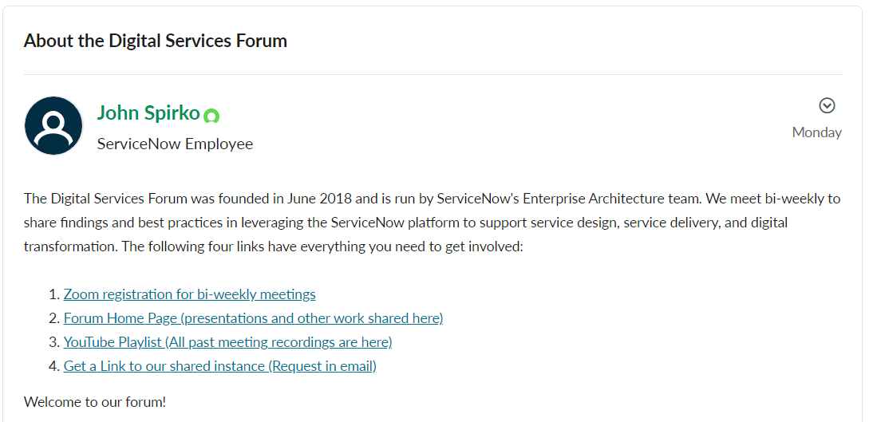
Welcome New Members !
If today is your first time with us, please share your name, company and what you do in the chat so you can be welcomed by our members.
Welcome to the group!
https://www.servicenow.com/community/digital-services-forum/about-the-digital-services-forum/ba-p/2437605
Notes:
Make sure you ask new members to put something in chat and welcome them
Past the links in the chat for reference

Slide 3
About the Digital Services Forum
Structure: Bi-weekly hour-long web meetings and special events
Vision: To be a leader in digital transformation thought leadership
Mission: Enabling members to drive their own digital transformations
Shared work: discussions, papers, shared instance, and videos
Hosted by: The ServiceNow Enterprise Architecture Team
Notes:
Meeting since June of 2018
Just over 1000 members
This year we made a few tweaks based on forum input

Slide 4
Agenda
CSDM and Business Architecture
  John Spirko, ServiceNow
    The Design Domain
A Brief Overview of an Essential Discipline
  William Ulrich, Business Architecture Guild
    Overview of Business Architecture
    How to Crawl, Walk and Run in Business Architecture

Slide 5
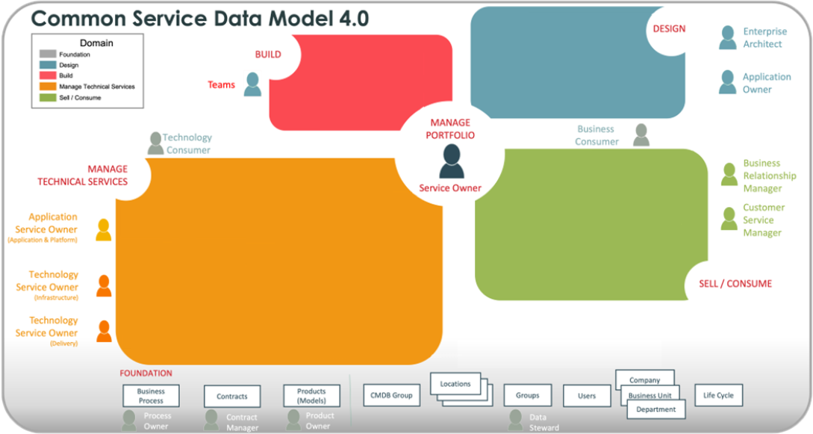
The business of information technology
Our organization expresses the need to support consumers and they buy or build applications to do so
The applications become useful when they’re configured or built
The result of what the organization bought and configured or built must be presented in an easy-to-use format back to the consumers.
Operational environments and infrastructure are required to support the building and running of these business applications
Notes:
This part of the CMDB is about the business context around the technology assets that we focused on earlier
The idea of this section is to move towards more of a structure to put a focus on the services that are being delivered

Slide 6
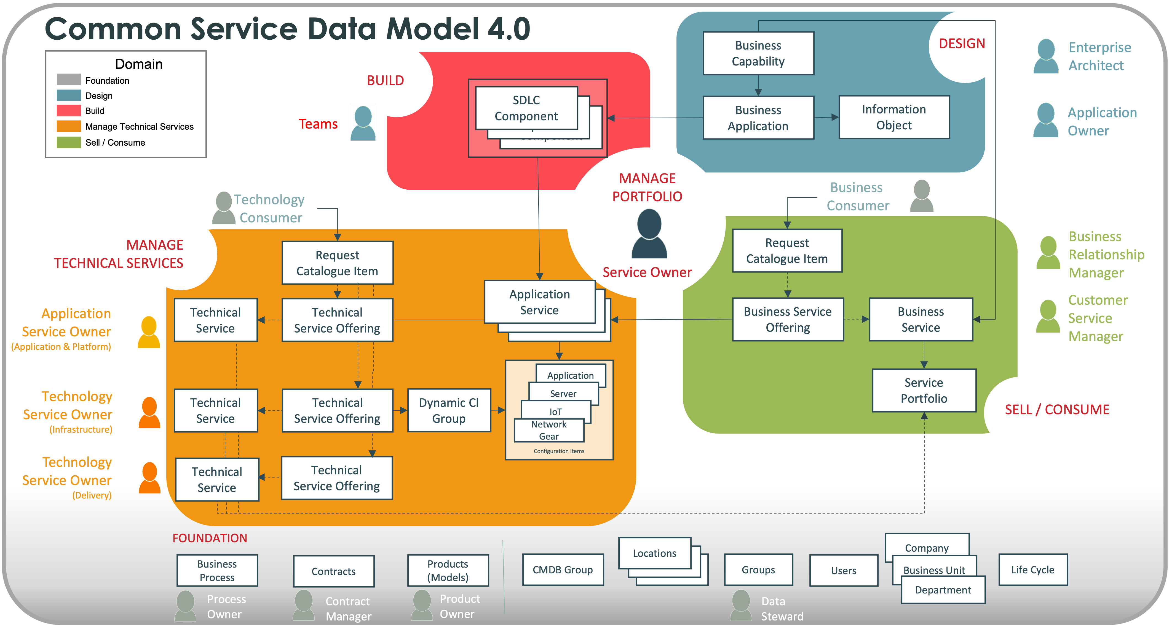
CSDM is a data model for the business of IT
Notes:
This part of the CMDB is about the business context around the technology assets that we focused on earlier
The idea of this section is to move towards more of a structure to put a focus on the services that are being delivered

Slide 7
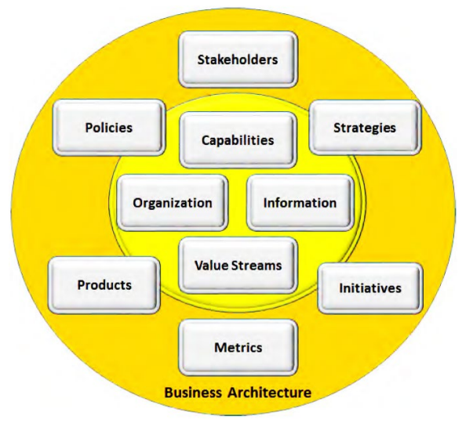
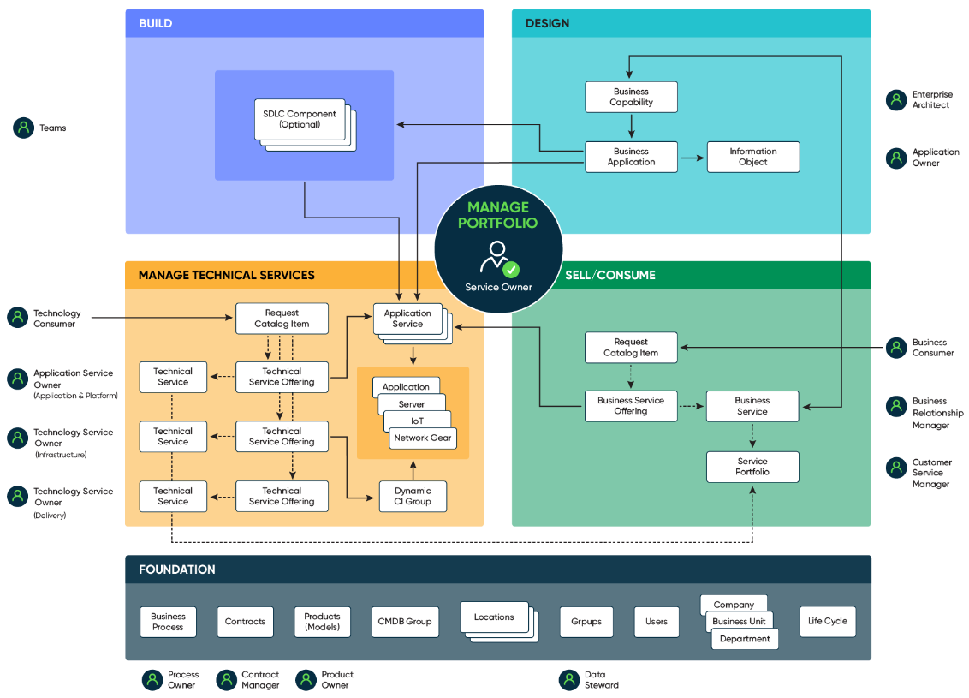
“Source: Business Architecture Guild: BIZBOK® Guide v12, Part 1 - Introduction”
Value Streams

Slide 8
Thank you

