Slide 1
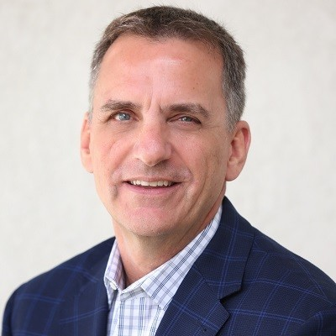


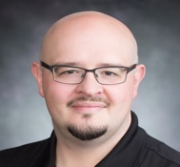
Digital Services Forum Leadership Team
John Spirko - Senior Executive Architect
Forum Co-Owner (EMI)
Rachel Trombetta – Senior Enterprise Architect
Forum Co-Owner (EAST)
Jason LaScola - Senior Executive Architect
Forum Co-Owner (EAST)
Charles Bartley - Senior Executive Enterprise Architect
Forum Co-Owner (WEST)
Notes:
Team
Alignment to businesses

Slide 3
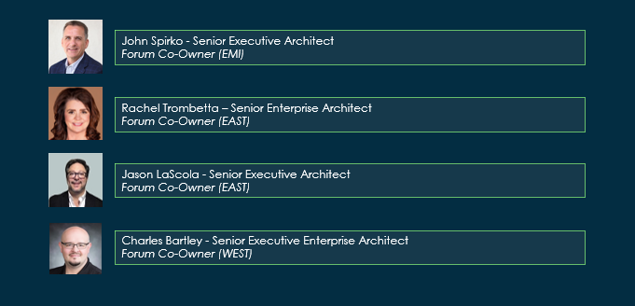
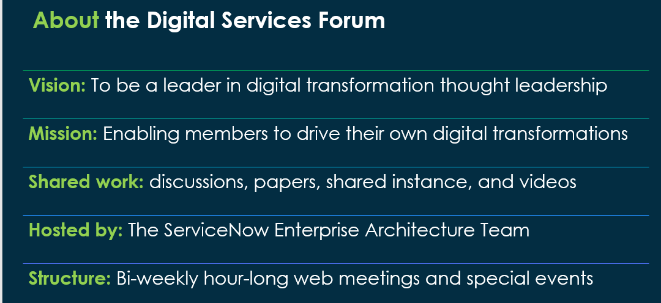
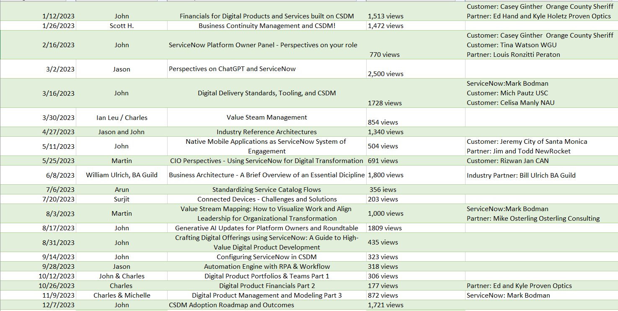
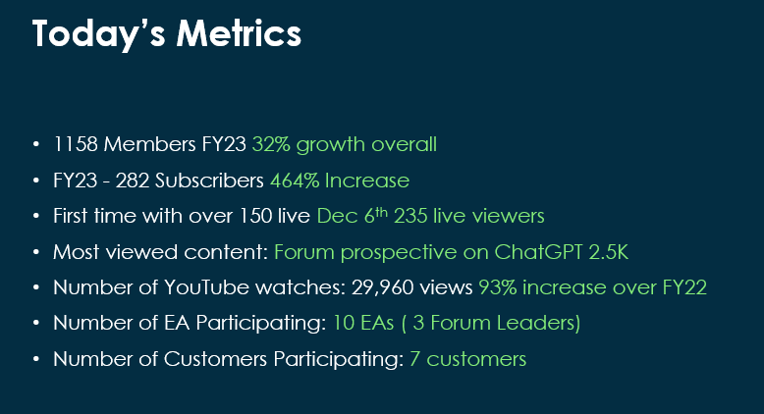

Slide 4
Thank you to the community
This isn’t possible without you participating.
Growth to over 1293 over 40%
Service Now Community Growth to 282 subscribers from 50
Youtube views over 30 thousand. Over 90% growth from 2022.
Number of customer participating 7
250 on a single call.

Slide 5
Year in review

Slide 6
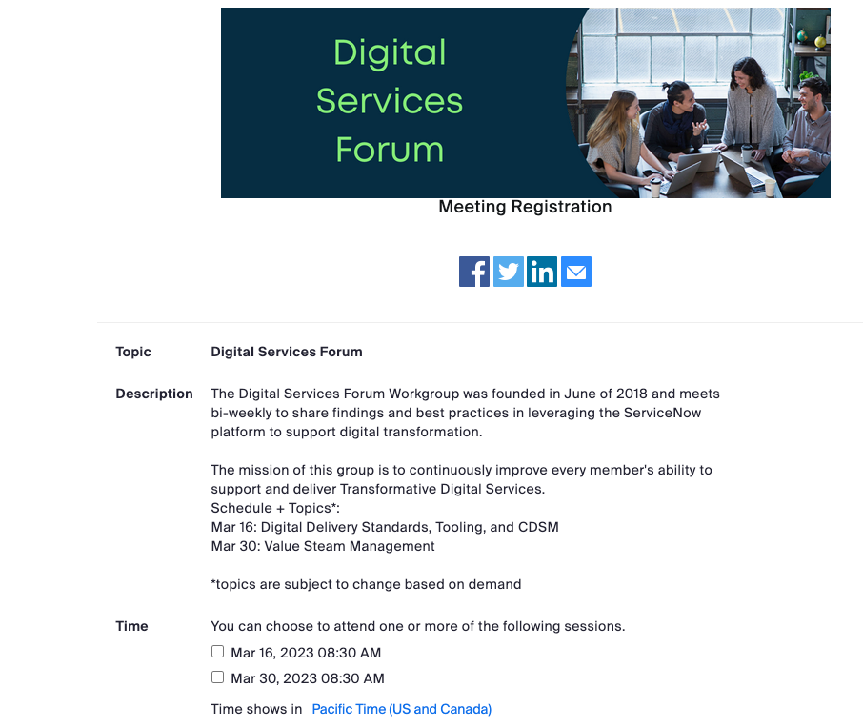
Digital Services Forum
What: ServiceNow dedicated community for ServiceNow Platform collaboration and Q&A
Mission: Enable members/customers to drive their own digital transformation
Hosted by: ServiceNow Enterprise Architecture Team
Attendance: 1000+ customers registered
Structure: Bi-weekly hour long web meetings on topics including:
  CSDM
  Operating Model
  Value Stream Management
YouTube channel stores previous Meeting recordings
ServiceNow Digital Services forum Community

Slide 7
FY 23 Brainstorm
Reach 1000 views on material Completed
Have 200 users live Completed
Promote to all Sales (not completed, but part of LEAP deck)
Create a Brand (WIP)
Tie into ServiceNow marketing or RUG events (Still getting support from SLED Marketing)
SWAG Nope
Guest Speaker based off of milestones met (Mark Bodman)
Number one on community Many times
X number of customers presenting. (WIP)
Highlight 6 EAs in FY23 ) (John, Charles, Jason, Surjit, Arun, Martin, Scott H, (EMEA too), WIP)
Customers Collaboration including assets
Joint Customer/EA session for Knowledge spawned by event. Failed
Polling during and after Sporadic

Slide 8
FY23 Brainstorm
Mailing list reaches 2500 1200
Sales testimonial that this helps
X Presales effort no longer needed to close deal.
Goals
  250 live (235)
  1500 members (growth from 816 to 1158 up 42%)

Slide 9
Big Asks
Knowledge 2023 Invites, speaking/forum/hangout/happy hour
If we pass 20k views xxx speaker
Partner? Engagement
Branching for IT to XXX

Slide 10
Marketing of calls

Slide 11
Forum Content Sources!
Now Community Forum
Link to Community Forum
Playlist on ServiceNow Community
Link to YouTube Playlist
Bi-weekly Events Posted on Forum
Link to upcoming meetings

Slide 12
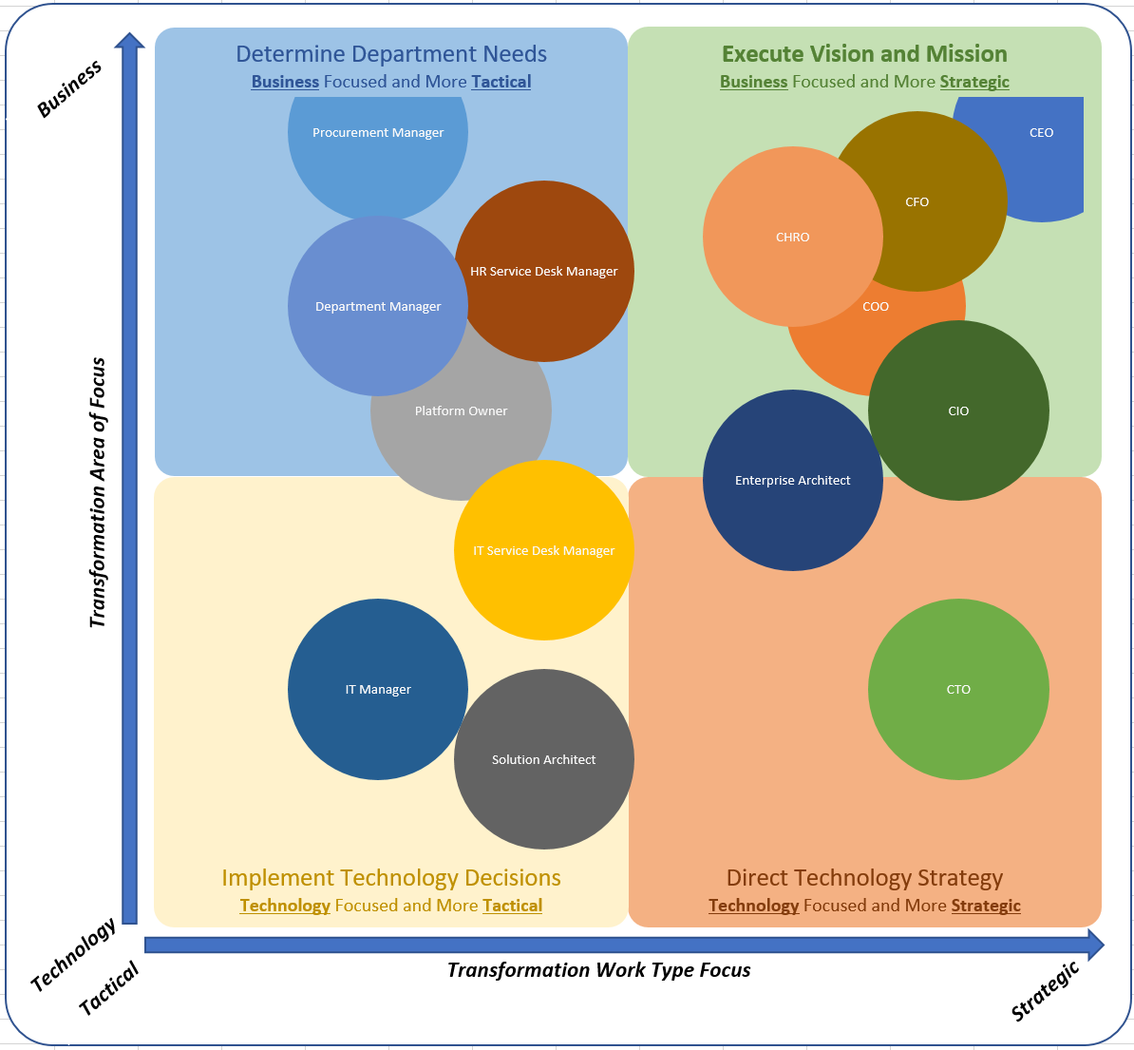
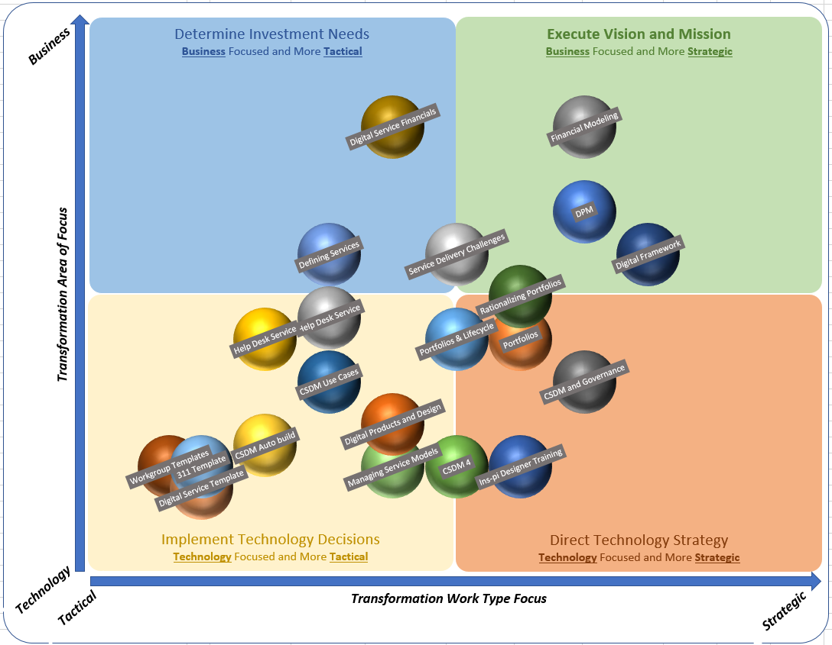
How can I contribute? Update it
Department Portfolios & Programs
CxO Strategies
Technology Portfolios
Notes:
How can we contribute

Slide 13
What are you most excited about with regards to the Digital Service Forum?
P7+eVFaV

Slide 14
What value do members get from joining and attending?
P7+eVFaV
Click on the link in the video description to join our forum!

Slide 15
How do you see the Digital Services Forum Evolving over time?
P7+eVFaV
Click on the link in the video description to join our forum!

