Slide 1
ServiceNow Operating Model and Governance
Prescriptive Guidance and Leading Practices
June 20, 2024
Brad Diamond
Senior Executive Enterprise Architect
Notes:
Good afternoon. My name is Brad Diamond, and I’m a Field CTO in our Enterprise Architecture team. I’ve been working in the ServiceNow ecosystem for over 13 years as both a customer and as a partner prior to joining ServiceNow in 2022.
Today I’m going to talk to you about the importance of having an effective Operating Model in place for the ServiceNow platform, and some of the Governance components that should be considered to make this effective.
I normally lead a 3 hour workshop on this topic (as there’s a lot to dig into) – but for today’s conversation, I’m going to keep my overview to under 20 minutes. ☺

Slide 2

Introduction
Development of Strategy Maps, Roadmaps
Industry & Customer Capability Mapping
Strategic Planning
ServiceNow Architecture Strategy
Customer Reference Architectures
Connecting senior executives to industry peers
20+ Years in IT
10+ Years working as in ITSM Practitioner within Financial Services
  ITIL v3 Expert
13+ years experience on the ServiceNow Platform
8 Years working in the ServiceNow Partner ecosystem
Joined ServiceNow in November 2022
ServiceNow Certifications
  CSA
  CIS-ITSM
  CIS-CSM
STRATEGIC CUSTOMER ENGAGEMENTS
No Cost $
Operational Models and Governance Best Practices
Training and Enablement Strategy
Platform Capability Overviews
Instance Strategy
Brad Diamond
Field CTO / Senior Executive Enterprise Architect
OPERATIONAL MODELS & GOVERNANCE
No Cost $

Slide 3





NASA has shifted from the only option to becoming an enabler
Late 1950’s to early 2000’s
2000+
Notes:
Private industries will send things to space
Nasa will be the governing body – sequencing, providing guidance
It is imperative to move towards a “decentralized model”

Slide 4
4 Common Themes From Successful ServiceNow Customers
Ensure you have internal experience successfully implementing ServiceNow
Experienced
Internal
Talent
A clear vision is critical along with the correct governance model
Active Senior
Leadership &
Governance
“Push for Adoption and understand what it takes. Don’t just let it happen.”
“Have to Have a Vision for where you want to end up”
Invest in using a certified ServiceNow partner to accelerate your adoption and ensure best practices are followed
Correct
Team
Size
Have enough resources to maintain and enhance the platform to move you quickly on your digital transformation journey
Partner
Involvement
“Learn from the Best and pay for the experience. It is worth it in the end.”
“The more You Put Into It, The More you get out of it”
Notes:
Over the past number of years, my group has engaged with hundreds, if not thousands of customers and through those engagements, we’ve seen what works well, and what doesn’t, so we’ve culminated that into our leading practices on the subject.
Why did we create this material? Because a lot of our customers over the years have had a similar migration path. They started as IT Service Management customers, and when they did so, they asked their ITSM Application support team to manage ServiceNow. The problem here is that ServiceNow is not just an application – rather it is a platform. So asking an application support team to manage a platform presents a challenge in that the team is not setup to scale as the demand from the organization starts to grow (especially outside of IT). And thus – our guidance is born.
First we’ll start with 4 common themes we see from our most successful ServiceNow customers.

Slide 5

8 Reasons Some Customers are not as Successful as Others
Lack of Defining KPIs, Measuring Outcomes
or Continual Improvement Processes
No Platform Governance or Federated Development
(relying solely on the platform team for everything)
Not staying out of the box & incurring technical debt through too many customizations
No Documented Vision or Strategic Roadmap for the Platform
Platform Team Not Staffed Correctly According to Best Practices
Assuming you can have a world class CMDB without using Discovery & Mapping
Trying to Go At It Alone
(without a partner or internal experience)
Lack of Senior Leadership Involvement
Notes:
Lack of KPI’s – if we are moving workload into the platform, we should be measuring it. How do we know if there were improvements if we don’t? What’s the value of the transformation/automation we’ve made?
No platform governance – When organizations move to ServiceNow, they typically hand application support to the ITSM team, who quickly become a bottleneck, as they were not structured to support a platform.
Documented vision – this is where we need to know our north star - what is the strategic purpose of the platform in your organizations
Lack of Sr leadership – as you’ll see, this is a prominent role when governance is done right. This leader will also be instrumental in setting that vision for the platform, as well as leading our strategy governance board.
Get good partners involved – at least to bring in a new capability. They will cut the implementation time down significantly, which gets you your ROI faster.
Need staff
Out of the Box – do not customize. This is what governance can help with. Roles designed to help here.

Slide 6



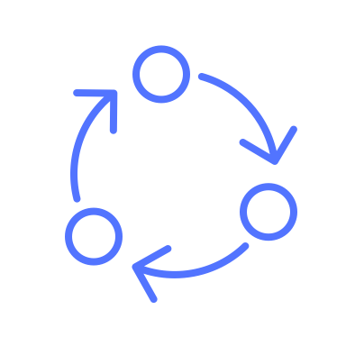


Common Components in an Operating Model:
The operating model key components define how an organization delivers value to its stakeholders and its strategic objectives. The following are common components of an operating model:
Strategy | Articulation of the organization's overall strategic goals and objectives. Alignment of business activities with the strategic direction.
Governance | Decision-making processes and structures. Oversight mechanisms, such as boards, committees, and reporting lines.
People/ Organization/ Culture | Workforce composition, including skills, expertise, and competencies. Talent management strategies, including recruitment/ training & development. Organizational culture and core values that shape behavior and decision-making. Employee engagement and the alignment of individual values with the company's values.
Processes | Standardized procedures and workflows for key business activities. Operational processes that support the delivery of products or services.
Delivery Model | Organizational design, including reporting lines, departments, and teams. Distribution of roles and responsibilities within the organization.
Tools & Technologies | Information technology infrastructure and systems supporting business operations. Tools and applications used for communication, collaboration, and data management.
Measures & Motivators | Measurement of performance against predefined benchmarks. Regular monitoring and reporting of key metrics to assess the health of the organization.
Financial Model | Budgeting and financial planning processes. Resource allocation and allocation of funds to different business areas.
Note: Specific details may vary depending on the nature of the business, industry, and organizational structure

Slide 7
Importance of Governance As Part of An Overall Operating Model
Defines how decisions are made and who is responsible for outcomes
Enables alignment to organizational goals & vision
Creates a structure to standardize future development
Provides a framework that can scale to support enterprise-wide growth
Holds platform owners and admins accountable for meeting enterprise standards and supports their ability to accomplish
Maintains the integrity and stability of the ServiceNow solution
Supports new business requirements and doesn’t become a bottleneck for innovation
Value
“Are we realizing the benefits?”
Goals
Delivery
“Are we getting them done well?”
People, Process, Technology and Data
Architecture
“Are we doing them the right way?”
Standards
Alignment
“Are we doing the right things?”
Governance
Notes:
Why is this important?
Governance will ensure we have alignment and focus to ensure we are working on the right things that matter
We will have standards (backed by policies) on how we are using the technology
We will have clearly defined roles and responsibilities for all stakeholders involved in the platform, this will also include standards regarding our data
Lastly – we will have an understanding of the value we are getting from the platform – are we aligned to our goals?

Slide 8







What needs to be done now?
How to setup for success
Engaged Leadership
A funded strategy and roadmap championed by a strong influential C-suite leader
Defined Services
Deliver against enterprise service definitions not just products and applications
Operating Model
Govern the delivery of service management via an appropriate operating model
Certified Resources
Hire and train ServiceNow certified resources to make key architecture and design decisions in conjunction with ServiceNow best practices
Capability Roadmap
Deliver incrementally leveraging platform and organizational capabilities
Distributed Development
Create teams closest to the user requirements and federate the development into a single instance
Notes:
So, how can I tell if I’m setup for success? Ask yourself, are these things in place?
Here’s a slide that you can use as a placemat with your executives for support.
1: Capability roadmap. Are we continually increasing the value of the platform?
2: Operating model. Is it working?
3: Engaged leadership. Do we have an executive (C-level) champion? Are they setting our direction?
4: Defined services. Rather than measuring against discrete products and applications, we will define and manage our services which will be comprised of many products and applications – and the relationships will be clearly understood.
5: Certified resources. This is a massive opportunity that most customers overlook. Train (and certify) your teams. The results will be astonishing.
6: Distributed development. This is the only way to scale the platform. Teams who understand the business requirements need to be front facing to them.

Slide 9
Result: Achieving Successful Outcomes
Proactively forecast demand for products & services as well as enhancements & defect repairs
Clarifies decision-making accountability & alignment across stakeholders
Provides transparency of costs, processes, projects & services
Ensures technology is fit-for-purpose & fit-for-use
Increases ability to benchmark & look for performance improvements across the business
Notes:
If we do this right – what’s the end result?
1 – Better visibility of what’s happening in the environment. All of it! Even if you’ve grown 5x
2 – No more finger pointing, or grey areas in your process
3 – Improved funding models
4 – Better leverage of technology and capabilities
5 – Overarching service improvement capabilities that will work

Slide 10

Step 1 – Preparing to Set Up ServiceNow Governance
Back to Agenda
Roles and Responsibilities

Slide 11
15 Critical Roles on the ServiceNow Platform Support Team
(individuals can have many roles)
Executive Sponsor
Platform Owner
Platform Architect
Platform Administrator
Developer(s)
Quality Assurance
Business Analyst
Trainer
Project Manager
Demand Manager
Data Manager
Security Administrator
Data Insights & Analytics
Solution Specific Architect
Service Catalog Manager
Notes:
Make some brief notes on the roles we want to highlight.
Executive Sponsor
Platform Architect
Data Manager
Solution Specific Architect

Slide 12

Step 2 – Defining a Governance Process
Back to Agenda

Slide 13
Operating Model Options & Considerations
Distributed Model | Centralized Model | Hybrid/Bimodal Model
Difficult to govern, everyone in the kitchen wants to be the chef | Governance is easy, but will limit the use of the platform – not enough cooks | Governance is achievable (one chef), but allows for broad use of the platform (many cooks)
Each team manages their own funnel | One team manages the funnel & accepts changes into the environment | Each team has their own funnel, but global/shared objects are reviewed/approved by central governance body
Living on a single instance can become challenging unless everyone agrees & follows the same practices | Limits the adoption of ServiceNow (typically centralized teams cannot move fast enough to deal with the demand) | Allows for independent development if/as appropriate, but still allows for governance & acceptance from centralized team
Notes:
Talk about how the hybrid model helps with the deficiencies of each of the centralized and distributed model.

Slide 14
Maturity Model
Organizational Complexity & Scope
3) Mature Governance for Complex Organizations
Each BU has a Delivery Team
Each BU has a Portfolio Team
2) Maturing Governance
Expand governance policies & standards
1) Initial Governance
Assign Executive Sponsor & Platform Owner
Create minimum set of governance policies & standards
Establish Strategy, Technical & Portfolio Governance boards
Build delivery team with diverse set of roles & skills
Create Center of Excellence & Innovation (CoEI)
Organizationally separate Technical Governance team into a Platform team & a Delivery team
Create Innovation team
Notes:
Our guidance is not limited to a single approach – rather we understand that organizations are going to mature as they start to leverage these concepts, so we wanted to make sure that we allowed for that as well, but creating three maturity levels, which can be based on where the organization is at in their journey. NB: Mature governance for complex organizations is typically reserved for international organizations leveraging Global Business Services to streamline internal fucntions.

Slide 15
Step 2a:
Operating Model Recommendation for Customers Just Starting Out with Governance

Slide 16
Initial Governance Operating Model Recommendation
Corporate Initiatives & OKRs
Establishes roadmap, funding model and key value measures
Includes LOB leadership
Sets overall direction for ServiceNow as an enabler of ESM
Determines new initiatives based on desired business outcomes
Ownership on ensuring roadmap is current and up to date
Maps outcomes to business needs
Manages and ensures stability of the ServiceNow platform
Aligns execution with Strategy
Establishes policy rules for instance, upgrade, data, security and release management
Ensures technology best practices are documented and followed
Delivers applications and functionality on time and within budget
Strategy Governance
Technical Governance
Portfolio Governance
Defines demand management intake process
Assesses business value of requirements based on LOE/cost, value, and risk
Provides an enterprise perspective for prioritization and inclusion into the ServiceNow release framework
Notes:
Explain the primary purpose of each governance board

Slide 17
Initial Governance Boards & key roles represented
** Participants will vary based on your organizational assessment & requirements. **
Strategy Governance Board
Technical Governance Board
Portfolio Governance Demand Board
  Executive Sponsor (chair)
  CIO / CTO
  Business Partners
  Platform Owner
  Platform Architect
  Enterprise Architect
  Service Owner(s)
  Program Manager
  Platform Owner (chair)
  Platform Architect
  IT Process Owner(s)
  Service Owner(s)
  Demand Manager
  Program Manager
  Project Manager
  Data Manager
  Data Insights & Analytics
  Solution Specific Architect
  Service Catalog Manager
  Business Analyst(s)
  Platform Administrator
  Security Administrator
  Quality Assurance
  Developer(s)
  Trainer
  Enterprise Architect
  User Experience Engineer
  Reporting/Analytics Developer
  Release Manager
  Resource Manager
Demand Manager (chair)
Platform Owner
Platform Architect
Solution Specific Architect
IT Process Owner(s)
Service Owner(s)
Program Manager
Project Manager(s)
Business Analyst(s)
Release Manager
Resource Manager
Notes:
Important to note that BOARD bring together diverse skill sets across the organization. Many roles are not part of the Core Dedicated Service Now Team

Slide 18
Minimum Viable Set of Governance Policies
Strategy Governance
  Customer Journey Roadmap Policy – Ensures a 12-18 month ServiceNow roadmap is created, reviewed and updated to remain current and aligned to time bound strategic objectives
Technical Governance
  Platform Management Policy – Process to evaluate and mitigate impact of changes and integrations to the ServiceNow instances to maintain platform stability and integrity
  Instance Management Policy – Defines how to right-size environments, replicate instances, develop security access control model and ensure proper maintenance
  Upgrade Management Policy – Process to plan for and execute upgrades including rules on customizations that hinder or slow down future upgrades
  Platform Data Governance Policy – Defines data ownership and stewardship roles, sets up data standards, data model, manages data synchronization and establishes a data dictionary
  Development Policy – Configuration vs customization policies, process to review requirements for customizations, API standards and UI standards
Portfolio Governance
  Demand Management Policy – Defines how ideas/demand are gathered, evaluated and prioritized relative to the business value they provide before resources are assigned and allocated
Notes:
These policies are going to ensure that our teams have something to stand behind as we look to standardize how we leverage the platform. This will be critical to ensuring consistency and stability.

Slide 19
Step 2b:
Mature Operating Model Recommendation

Slide 20

Mature Governance Maturity Model – Creation of a CoEI
As more solutions are brought onto the ServiceNow platform, & you expand outside of IT, it is important to expand the original governance model into 5 distinct CoEI pillars
  Strategy
  Platform
  Delivery
  Innovation
  Portfolio
The CoEI is concerned with execution & delivery of the solutions
The Governance layers are the ‘guard rails’ of how the CoEI executes
Technical Governance starts as one team but grows over time & is split into a Platform group & a Delivery group
Portfolio Governance adds an Innovation group. Over time this breaks off from the demand team & is a small Scrum based managing team to research new trends on the platform so that they don’t impact the day-to-day work on the platform
Tie roles to each pillar
Tie names to each role within each pillar
Define activities & boundaries of each pillar of the CoEI
Notes:
This is now where we split the platform support team into two: platform support and development. The theme here is that cloud analogy - much like your AWS or Azure teams, they are focused on the stability of the platform, patched, updated and ready to be consumed by development teams.

Slide 21
Mature Governance Operating Model for the CoEI
Strategy Governance
Technical Governance
Technical Governance
Portfolio Governance
Portfolio Governance
STRATEGY Process Ownership | PLATFORM Technology Standards & Stability | DELIVERY Builds Applications | INNOVATION Next-Gen Initiatives | PORTFOLIO Demand Management
Articulates the roadmap for how ServiceNow will be used Establishes processes for prioritization, budgeting, stakeholder alignment & resourcing Reports on expected outcomes, initiatives, alignment to overall strategy & progress Creates & executes an organizational change management plan | Primary platform management, stability, best practices & supportability as the foundation for all initiatives Made up of the Platform Support Team Owns technology strategy & establishes development, integration, security & data standards Responsible for upgrades, instance strategy & determines if/when customizations are allowed | Identifies & manages dev teams for specific initiatives Develops & iterates on delivery methodology & guidelines Operationalizes & transitions solutions Develops & maintains ServiceNow solutions Focuses on user experience Implements changes & corrections to production defects Ensures delivery staff is trained | Works with business to determine new initiatives to drive business value Tackles new initiatives that can disrupt the day to day activities of the CoEI Designs the transformational roadmap & architecture Determines where ServiceNow can replace existing solutions Looks into next generation capabilities i.e. chatbots, AI, etc. | Manages & tracks progress of ideas & assesses them before promoting them to demand Governs demand intake process Builds out demand request form & assessments for prioritizing demand Assesses demand on cost, value & risk Determines in/out of scope Responsible for managing resources/capacity vs demand
Notes:
This is the state where I want most organizations to get to. This is where we split our technical governance board into TWO functions: Platform and Delivery. The Delivery team can ultimately become many different delivery teams as the products/capabilities that they represent continues to expand beyond ITSM. A Delivery team can represent more than one product, this will be based on the level of demand and volume of work being generated from the business units.

Slide 22
Mature Governance Model Key Roles within the CoEI
Strategy
Platform
Delivery
Innovation
Portfolio
Executive Steering Board Executive Sponsor CIO / CTO Business Partners Platform Owner Platform Architect Enterprise Architect | Platform Support/Design Board Platform Owner Platform Architect IT Process Owner(s) Service Owner(s) Demand Manager Program Manager Project Manager Business Analyst(s) Platform Administrator Quality Assurance Trainer Enterprise Architect User Experience Engineer Security Admin Information Security CMDB Manager Data Insights | Development/Build Board Platform Architect Platform Owner IT Process Owner(s) Demand Manager Program Manager Project Manager(s) Business Analyst(s) Platform Administrator Quality Assurance Developer(s) User Experience Engineer Reporting/Analytics Developer Service Catalog Manager Release Manager Resource Manager CMDB Manager Security Admin Data Insights | Business Technology Board Executive Sponsor CIO / CTO Business Partners Platform Owner Platform Architect Enterprise Architect Demand Manager Service Owner(s) Program Manager Resource Manager | Ideation & Demand Board Demand Manager Platform Owner Platform Architect IT Process Owner(s) Service Owner(s) Program Manager Business Analyst Resource Manager
** Participants may vary based on your organizational assessment & requirements. **

Slide 23
Maturing Governance Framework with CoEI
Dedicated ServiceNow Team
Cross-Functional Governance Boards
Executive Sponsor
Strategy Governance
Platform Governance
Platform Owner
Center of Excellence & Innovation (CoEI)
Innovation Governance
Delivery Governance
Platform Team
Delivery Team
Portfolio Governance
Notes:
Ultimately, this is where we get to – our dedicated ServiceNow team rolling up to our executive sponsor, and then our cross-functional governance boards with key stakeholders from across the organization.
Governance Boards:
Ensure there is an Executive Steering Committee with business leadership

Slide 24

Step 3 – Managing Future Demand
Back to Agenda

Slide 25
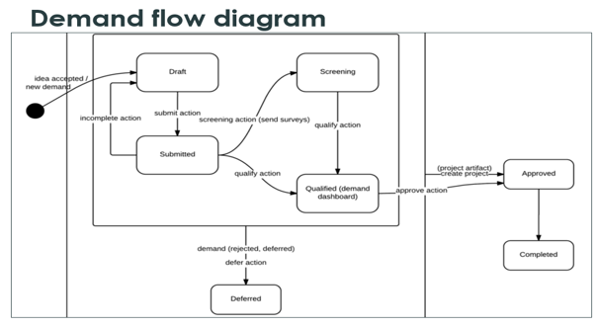
Demand Management Intake Practice
Create a Standard Demand Intake Form (should be short & easy to complete & include the following)
  Description
  Business Case
  Business Unit/Department of submitter
  Value to group requesting & value to the overall organization
  Executive Sponsor who approved
  Primary user roles this request will benefit (employee, customer, Service Desk, etc.)
  Impacted business units
There are 7 recommended statuses for a Demand Request lifecycle
  Draft – New demand request in process
  Submitted – Completed & submitted to demand owner
  Screening – Assessments sent to stakeholders
  Qualified – Assessments returned & consolidated & ready for the demand board to review
  Deferred – Retained for consideration at next demand board meeting (but not approved for next release)
  Approved – Slated for next release
  Completed – Either rejected/removed from consideration or it was approved & the work is done
Draft
Screening
Submitted
Approved
Qualified (demand board)
Completed
Deferred

Slide 26
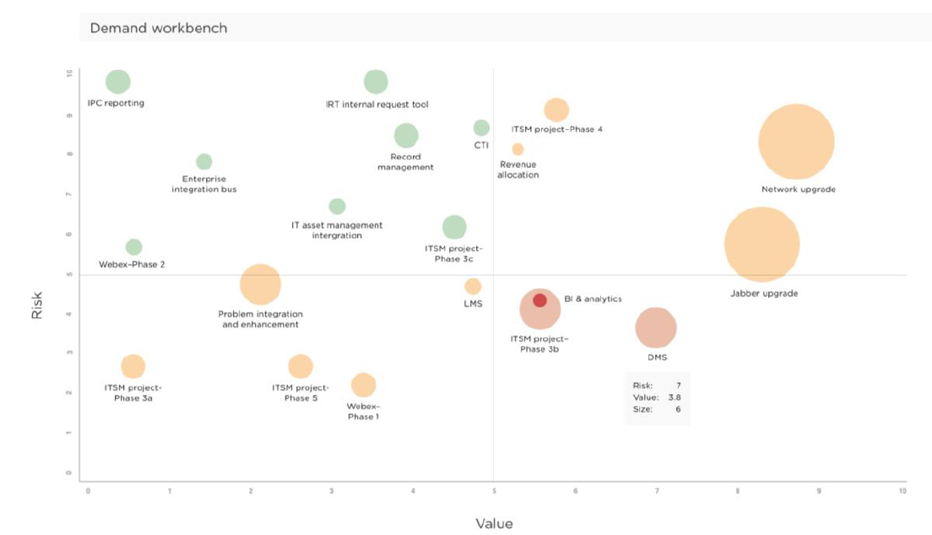
Enhance, Evaluate, Prioritize & Approve Demand via Assessments
Demand Manager enhances demand intake request with additional information
  Portfolio assigned
  Additional details surrounding requirements
  Grouping of similar demand requests
  Impacted stakeholders
Assessments sent out to the Demand Board to provide a quantitative score for size (estimated level of effort), business value alignment and technical risk (architectural impact)
Prioritize demand that cover as many user stories as possible
Create a demand resource plan to include more accurate cost estimates and avoid overcommitting limited development resources
Use ServiceNow SPM to manage your demand process with the Demand Workbench
Value
Risk

Slide 27
STEP 5 – Scaling with a Hybrid Operating Model
Back to Agenda

Slide 28

Example: Hybrid Delivery Model
Federated Responsibility
Enterprise Architecture
ServiceNow CoEI
Executive Sponsor
Executive Sponsor
Executive Sponsor
Platform Owner
Strategy
Portfolio Manager
Portfolio Manager
Portfolio Manager
Platform Architect
IT Operations – Services
HR Service Delivery
Finance Business Services
Experience Architect
Developer(s)
SecAdmin(s)
Business engagement and delivery
HRSD
Finance Workflows
ITSM
ITOM
Run Lead(s)
Product Owner* / Product Lead
Product Owner* / Product Lead
Product Owner* / Product Lead
Analyst(s)
Product Architect*
Business Services &
Process Analyst(s)
Product Architect*
Business Services &
Process Analyst(s)
Product Architect*
Business Services &
Process Analyst(s)
Team sizes and roles vary as per organizational needs, adoption of capabilities and maturity of the platform
Platform architecture and support
Developer(s)*
Business Services &
Process Leader(s)
Developer(s)*
Business Services &
Process Leader(s)
Developer(s)*
Business Services &
Process Leader(s)
Citizen Developer(s)
Reporting and Analytics Specialists
Citizen Developer(s)
Reporting and Analytics Specialists
Citizen Developer(s)
Reporting and Analytics Specialists
CoEI can delegate development or establish delivery capacity
SysAdmin(s)*
OCM, training and adoption expert(s)
SysAdmin(s)*
OCM, training and adoption expert(s)
SysAdmin(s)*
OCM, training and adoption expert(s)
# squads and squad sizes vary per organizational needs, adoption of capabilities and maturity of the product
Product owner knows the business and prioritizes demand. Increased responsibility on the product/platform architects.
Reporting lines may vary.
# squads and squad sizes vary per organizational needs, adoption of capabilities and maturity of the product
Product owner knows the business and prioritizes demand. Increased responsibility on the product/platform architects.
Reporting lines may vary.
# squads and squad sizes vary per organizational needs, adoption of capabilities and maturity of the product
Product owner knows the business and prioritizes demand. Increased responsibility on the product/platform architects.
Reporting lines may vary.
Innovation
* These resources can be partner or CoEI resources

Slide 29

ServiceNow Operating
Model
Executive Steering Board
Legend
Set platform vision
Resolve escalations and conflicts of interest
Governance
Platform Strategy
Guiding Principles
Prioritization
Business Objectives
Manage risk
Oversee business objectives & value realization
CoEI
Roadmap Review
Issue Resolution
Product Streams
Business Engagement and Delivery
Strategy
Platform Architecture and Support
Innovation
Platform Owner
Platform Administrator
Platform Architect
Project Manager / Scrum Master
ServiceNow Evangelist
Business Process Architect
Business Analyst
Program Manager
Reporting / Analytics Lead
Development
Lead
Data Manager
Developer
QA Lead
OCM Lead
Demand Manager
Value Management Lead
Security Admin
Integration Expert
Release Manager
UX Experience Engineer / Architect
Demand for Sequencing
Solution Review
Technical Governance Board
New Demand
Demand Boards
(per product team)
Review requests for customization
Enforce technical standards
Track technical debt
Review demand
Review backlog
Customization Review and Approval
Coordinate project alignment with platform
Product Team
(e.g., ITSM)
Product Team
(e.g., HRSD)
Product Team
(e.g., GRC)
Product Team
(e.g., App Engine)
Citizen
Development
Product
Owner
Product
Owner
Product
Owner
Product
Owner
Program Sponsor
Project
Manager
Developer(s)
Project
Manager
Developer(s)
Project
Manager
Developer(s)
Project
Manager
Developer(s)
Program Manager
Process
Analyst(s)
Product
Architect
Process
Analyst(s)
Product
Architect
Process
Analyst(s)
Product
Architect
Process
Analyst(s)
Product
Architect
Citizen Developers

Slide 30


Shift from doing everything…
Notes:
Carpenter building a shed: Soup to nuts
Carpenter building or remodeling a house: You will still do carpentry, but a portion of the job will be managing people – concrete, electric, plumbing; managing the work – when is the plumber coming in?; interfacing with the client – do I or does the plumber speak to the client?
Carpenter doing an office building – you’re doing NONE of the work; solely managing the work
If you had a 3rd party doing something while the system is live, then you have done management already. | Partner > Pro-Code >
So what would it take to have another group design and build on your instance?

Slide 31



To doing some of the thing, while managing others…
Who can do the concrete, plumbing, and electrical in a timely manner?
Do I let the plumber speak with the client or should I?
When does the plumber come in? Will the concrete be laid prior?
Notes:
Carpenter building a shed: Soup to nuts
Carpenter building or remodeling a house: You will still do carpentry, but a portion of the job will be managing people – concrete, electric, plumbing; managing the work – when is the plumber coming in?; interfacing with the client – do I or does the plumber speak to the client?
Carpenter doing an office building – you’re doing NONE of the work; solely managing the work
If you had a 3rd party doing something while the system is live, then you have done management already. | Partner > Pro-Code >
So what would it take to have another group design and build on your instance?

Slide 32

To primarily enabling and managing…
Notes:
Carpenter building a shed: Soup to nuts
Carpenter building or remodeling a house: You will still do carpentry, but a portion of the job will be managing people – concrete, electric, plumbing; managing the work – when is the plumber coming in?; interfacing with the client – do I or does the plumber speak to the client?
Carpenter doing an office building – you’re doing NONE of the work; solely managing the work
If you had a 3rd party doing something while the system is live, then you have done management already. | Partner > Pro-Code >
So what would it take to have another group design and build on your instance?

Slide 33
Thank You!

Slide 34
Agenda
STEP 1 - Preparing to set up ServiceNow Governance
STEP 2 – Defining a Governance Process
STEP 3 - Managing Future Demand
STEP 5 – Scaling with a Hybrid Operating Model
Why do you Need an Operating Model and a CoEI?
STEP 4 - Real World Customer Example
Operating Model & Governance

Slide 35
A Perspective on the Need for a ServiceNow Operating Model
Developing a Center of Excellence & Innovation

Slide 36
Platform Evolution in Strategic Customers
Our largest customers increasingly use ServiceNow to drive Digital Transformation across their business. ServiceNow can help organizations to execute on their strategies and out-disrupt, out-engage, out-evolve and outperform their competitors.
CEO
Driving the Digital Revolution
CFO
COO
Out-disrupt
Predict the market
Develop new models
Test and learn
Execute quickly
Customer Experience and Performance: C-suite reduce cost while improving customer outcomes
Reduce cost to serve / headcount reduction / move to digital channels
Rationalise supply chain and other cost levers
Outsource commoditized activity ‘as a Service’
Customer and Business Hyper-automation: drive a new operational reality
Deliver streamlined and end to end customer outcomes with compliance
Increase business efficiency and productivity
Embed and integrate risk and control into operational workflows
Improve operational performance and resilience
Line of Business Leaders
Risk Leaders
Heads of Digital Transformation
Out-engage
Customer centric
Seamless experience
End to end execution
Service orientated
CIO / CTO
Enterprise Architecture
Heads of Data
Head of Digital and Engineering
Delivering Enterprise Technology Management
Helping IT Leaders transform how technology is delivered
Services Data Model
End to end technology management
DevOps and Cloud
Speed up delivery of work safely and securely
Increase cadence of product innovation
Reduce cost of IT
Out-evolve
Innovation
New products and services
Hire the best talent
Connect the fragmented
Equipping digital functions to meet BUSINESS needs with powerful integration, data, workflow and analytics capabilities on a single low-code cloud based Enterprise Platform
Head of Operations
Outperform
Speed
Efficiency
Economy
Control
Running IT Operations
‘IT Ticketing Tool’
Notes:
Ticketing Tool
Running IT Operations – Head of Operations
Delivering Enterprise Technology Management – CIO/CTO, Enterprise Architecture, Heads of Data, Head of Digital Engineering
Customer and Business Hyper-Automation: Drive a new operational reality – Line of Business Leaders, Risk Leaders, Heads of Digital Transformation
Customer Experience and Performance: C-suite reduce cost while improving customer outcomes – CFO, COO
Driving the Digital Revolution - CEO

Slide 37
Establishing Governance and Roles/Responsibilities
Assign a ServiceNow Platform Owner
    Owns the scope, direction and goals of the governance program
    Owns the ServiceNow platform
    Owns the roadmap
    Make sure the Platform Owner has both technical and business skills and an understanding of the internal business processes
Identify Key Stakeholders
    Involve people who are adept in both technology and business when you set up your governance program
    Involve Enterprise Architecture (EA) group with governance setup as they probably have some existing standards to follow
    Build a stakeholder map and map names to each role
    A stakeholder can play more than one role – especially at the beginning as the ServiceNow adoption is just beginning
    Stakeholders consist of both a ServiceNow Platform Support Team and people outside of the ServiceNow platform

Slide 38
ServiceNow Platform Support Team Model
Executive Sponsor
Platform Administrator
Business Analyst
Project Manager
Platform Owner
Platform Architect
Developer(s)
Quality Assurance
Trainer
Demand Manager
Data Manager
Security
Administrator
Data Insights & Analytics
Solution Specific Architect
Service Catalog Manager
This diagram provides an overview of the roles that should be included in your ServiceNow support team. However, not every role requires a full time equivalent (FTE) and one person may fulfill multiple roles. The number of employees required to support the platform depends on the development team model and the number of services being supported.

Slide 39
Platform Support Team
5 Responsibilities for the Platform Team
    Keep the platform stable and ensure standards are followed
    Enhance existing application configurations
    Resolution and management of current application incidents
    Develop new services on existing ServiceNow applications
    Develop/implement new ServiceNow applications

Slide 40
Platform Support Team
ServiceNow Role | Responsibility
Executive Sponsor | Creates & enforces the strategic vision & direction for the platform Responsible for establishing the relevance of the platform within the enterprise Leads Strategy governance meetings as part of the executive steering committee Responsible for building out a funding model for the ServiceNow platform Partners with Platform Owner to ensure capabilities of platform are aligned to vision & strategy
Platform Owner | Senior leader who has overall accountability for the platform Supports creation of overall roadmap & shapes demand for enterprise platform consumption Ensures platform team alignment to business strategy, roadmap & platform governance policies Ownership & oversight of ServiceNow instances Oversight of escalations Maximizes value of the platform by identifying additional business outcomes to be exploited on the platform Presides over Technical governance board & involved in all governance components
Platform Architect | Technical leader who documents the platform & helps analyze the impact of new requirements Assures platform alignment to business strategy & governance decisions Consultative technical leadership to the Platform Support Team Creates & maintains detailed view of existing architecture Leads technical aspects of the platform support team Provides architectural controls Senior developer skills & receives technical escalations to resolve Works closely with Enterprise Architecture team

Slide 41
Platform Support Team (continued)
ServiceNow Role | Responsibility
Platform Administrator | Maintains stability & usability of the platform Performs application maintenance to include performance monitoring & error identification/remediation Manages support for incidents Manages update set creation & migration Leads upgrade planning & execution Manages instance security, user/group access, administration, access control lists etc.
Developer(s) | Designs, develops, configures & customizes ServiceNow applications & services Delivers new functionality across applications Supports entire development lifecycle Assists Platform Administrator with incident resolution
Quality Assurance | Validates the application functionality built by developer(s) & Platform Administrator Reviews requirement specifications & technical designs Creates test plans Coordinates test activities Ensures there are no major defects prior to promoting application into production

Slide 42
Platform Support Team (continued)
ServiceNow Role | Responsibility
Business Analyst | Liaison who captures business & user requirements Ensures requirements are understood, developed, tested & delivered to specification Owns relationship with project stakeholders to identify, prioritize, model & document business, process & data requirements Represents project stakeholders throughout planning, development & release processes Works with platform support team to develop release estimates Supports testing effort Works with stakeholders to drive adoption
Trainer | Creates materials & delivers training Assesses group & individual training needs Plans, develops & delivers comprehensive learning programs Responsible for training platform team & the entire organization on how to use the platform for the best employee experience
Project Manager/Scrum Master | Plans, manages & delivers releases Single point of contact for project status who tracks & communicates status while serving as escalation point Plans project scope & establishes measurable goals Establishes project timelines & manages to complete project on schedule & within budget
Demand Manager | Liaison between business & IT responsible for collecting new demand from business stakeholders Manages day to day demand management Enhances initial demand requests Responsible for demand Assessment process to prioritize & approve demand Presides over Portfolio governance demand board

Slide 43
Platform Support Team (continued)
ServiceNow Role | Responsibility
Data Manager/Data Steward (CMDB Manager) | Overall accountability for managing & maintaining data/IT configuration items for the platform Responsible for overseeing data standards & data governance Owner of CMDB Ensures CMDB is current, accurate & stable Maintains data dictionary Owns data model for the platform Defines KPI’s to manage the effectiveness of the data Responsible for data integrations such as Discovery or 3rd party solutions to enrich CI’s in the CMDB Promotes awareness & acceptance of the CMDB Ensures CMDB is linked to business objectives
Security Administrator | Protects resources in the platform such as ACL, properties & records Ensures instance is secure & hardened as needed (domain separation, edge encryption, etc.) Creates, follows & enforces security standards throughout the platform Standards should be created for things such as: managing failed logins, encrypted password protection, multi factor authentication, access control rules, audit logs of user interactions, 3rd party integrations, etc. Works across the different solution areas of the platform to make sure security protocols are followed Ensures users have the correct access (& limit their access only to what they need) Audits security logs of the platform to protect the platform
Data Insights & Analytics | Responsible for overall reporting, metrics, KPIs & measuring performance improvements & areas that are underperforming Builds out dashboards & reports to deliver to senior management Responsible for measuring the ROI of the ServiceNow platform

Slide 44
Platform Support Team (continued)
ServiceNow Role | Responsibility
Solution Specific Architect | Architect who is responsible for overseeing the specific solution (i.e. HR, CSM, Security, etc.) Work in conjunction with the Platform Architect (may report to the platform architect) They are responsible for architecting the new solution to meet the service owner’s requirements but remaining consistent to the standards set forth by the Platform Architect Makes sure any development on that specific solution is not created ‘in a vacuum’
Service Catalog Manager | Capture, document & publish Service Catalog entries in order to provide current information to the Service user community Identify services that should be included in the Service Catalog Document the service offering in terms familiar to the users Maintain published service offerings Monitors & reviews the execution of the Service Catalog at a high-level, ensuring it remains consistent with the organization’s current culture & ITSM strategy Responsible for ensuring all of the items in the Catalog are relevant, understands what is missing, & consolidates catalog items when it makes sense Goal is to increase self service & reduce number of emails & phone calls to request items Works closely with the Service Catalog Process Owner

Slide 45
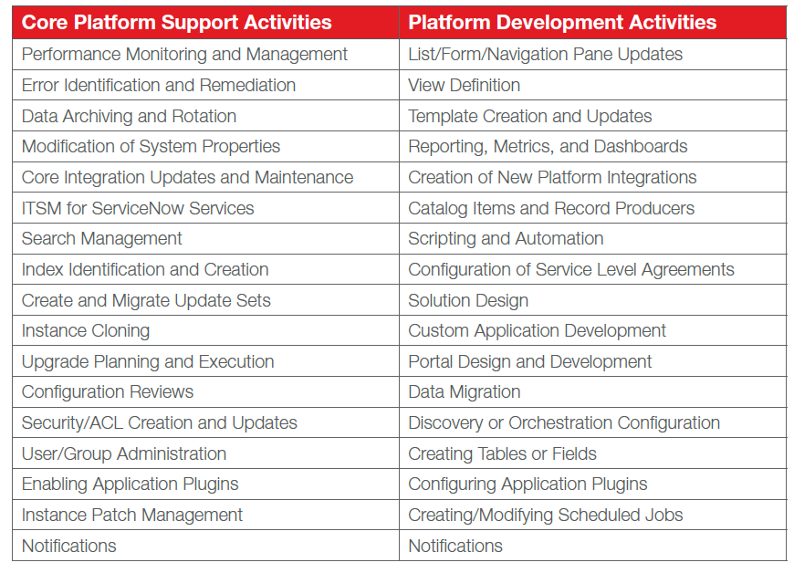
Platform Team Activities

Slide 46
10 Critical Roles Outside of the ServiceNow Platform Support Team
IT Process Owner(s)
Service Owner(s)
Enterprise Architect
Program Manager
Reporting/Analytics Developer
User Experience Engineer
Release Manager
Business Partner(s)
Resource Manager
Information Security

Slide 47
Roles Outside of ServiceNow Platform Support Team
ServiceNow Role | Responsibility
IT Process Owner(s) | Accountable for ensuring the process is fit for purpose Defines the process mission, vision, tactics, goals, objectives & KPIs Process examples include incident management, change management & service catalog Works closely with platform owner & demand manager
Service Owner(s) | Represents the service across the organization & plans for service future Service examples include employee onboarding Typically, a Director level within the business unit Works closely with platform owner & demand manager
Enterprise Architect | Responsible for creation, maintenance & management of IT architecture models Supports roadmap development & delivery through technical direction & decision making Supports positioning ServiceNow with overall technical landscape & ensures foresight in direction & platform consumption & integration Participates in governance processes & works closely with Platform Architect
Program Manager | A coordinator between multiple projects to ensure they benefit each other & align with overall business goals Different from project managers because they do not directly oversee individual projects Provides program leadership to execute the platform vision Supports resource planning, release planning, & provides guidance to project build teams
Reporting/Analytics Developer | Technical resources who are able to partner with business analysts, consumers of the platform & others to craft meaningful dashboards, reports & create analytical representation of the data A reporting group that sets overall reporting standards, frequency, consistencies across various technology solutions

Slide 48
Roles Outside of ServiceNow Platform Support Team (continued)
ServiceNow Role | Responsibility
User Experience Engineer | Highly-creative & ergonomically focused technical agent (part of development team) who provides direction & input on usability & look & feel Background in psychology, design & technology Responsible for maximizing the user experience & look & feel of the application
Release Manager | Works to promote code between environments Resolves any collisions or discrepancies Supports team development activities Works closely with Platform Support team when upgrades occur, or new applications are put into production
Business Partner(s) | Senior individuals that run the business processes Work closely with platform owner & demand manager on tying business to IT requirements Requests new demand from the platform team through Portfolio governance process
Resource Manager | Works closely with Demand Board & portfolio governance process to ensure resources are available & aligned to new demand Responsible for assigning right people to the right projects at the right time Assists in determining hiring needs Works closely with Business Technology board on new innovative initiatives to assign resources
Information Security | Ensures security protocols & best practices for the organization are followed inside of the ServiceNow platform Responsible for making sure Platform Security Administrator is up to speed on organization’s overall security governance process

Slide 49

Initial Governance Maturity Operating Model
Establish clear separation in decision-making processes between the 3 governance boards of
    1) Strategy
    2) Technical
    3) Portfolio
Tie roles to each governance board
Tie names to each role within each governance board
Define governance activities
Define initial governance policies
Define frequency of governance boards

Slide 50
Initial Governance Framework
Dedicated ServiceNow Team
Cross-Functional Governance Boards
Executive Sponsor
Strategy Governance
Technical Governance
Platform Owner
Platform Delivery Team with 15 Critical Roles
Portfolio Governance

Slide 51
Strategy Governance
The Executive Sponsor leads this governance process
Owns the ServiceNow roadmap
Determines funding model and process
Determines if have the appropriate partners internally and externally in place
Ensures the roadmap is current and accurate
Ensures roadmap aligns to business objectives and strategic outcomes
Determines process for revisiting and updating the roadmap
Usually meets quarterly or semi-annually after initial roadmap is created

Slide 52
Technical Governance
The Platform Owner leads this governance process
Governs the management and stability of the platform
Determines how the platform is managed, changed, developed and supported
Owns the overall technology strategy and establishes development standards, customization process (if allowed), integration standards, data standards and upgrade processes
Responsible for platform integration, technical releases, change management, data governance, upgrades, security, performance, risk, and overall technical architecture for the ServiceNow platform
Provides the constraints within which the platform team can operate and the level of delegated authority within which they can operate autonomously (citizen development)
Develops and maintains the applications (changes to existing application, new functionality to existing ServiceNow solutions or brand new ServiceNow solutions)
Usually meets monthly

Slide 53
Portfolio Governance
The Demand Manager leads this governance process
Manages and shapes demand
Governs demand intake process and builds out demand request form
Creates assessment process for prioritizing demand
Documents cost/level of effort, value and risk for each requested piece of demand
Determines threshold for what a Demand Manager can approve on his/her own and what is required to go to the Demand Board for approval
Determines demand prioritization criteria and scoring for new capabilities, functionality, configurations and customizations
Usually meets monthly

Slide 54
The Path to Value - From Strategy to Delivery of Outcomes
Demand to Release
Optimize portfolio(s) inline with Priorities & Constraints
Strategies
Align to Strategy & Goals
Ensure only right ideas proceed
Solution
Product, Program, Project, Epic
Roadmaps
Ideas /
Innovation
Demand
Portfolio
Waterfall
Agile
Hybrid
Change
Release
Run The Business
Service, Business Outcomes
Strategic
Governance
Technical
Governance
Portfolio Governance
Operational
Defects, Fixes
Enhance / Upgrade
Estimate Demand
Real-Time Visibility
Investment & Resource Management
Prioritizing highest potential Business Outcomes, Value Management
Notes:
Three layers of governance are important to the long-term success of strategic and operational goals:
Strategic Governance; Portfolio Governance; Technical Governance
Differentiate SN as arguably the ONLY company that has ALL the elements in ONE platform to enable ALL of this.
IT Business Management (ITBM) from ServiceNow, brings together traditionally disconnected “islands of change” notably Project and Portfolio Management (PPM), IT Financial Management, Agile Development and Application Portfolio Management with Service Management in order to provide a single system of record to support an organization’s end-to-end change and governance framework.
IT Business Management is delivered by a suite of applications on the ServiceNow Platform. These applications are independent of others like ITSM but because they can be on the same platform ITBM can also add value through seamlessly leveraging other products.
One way to think of what ITBM is all about is to think of IT as the management of a set of portfolios and the execution of the project portfolio:
Demand Portfolio; HR Portfolio; Project Portfolio; Financial Portfolio; etc.
Only ServiceNow can bring the end-to-end management of all IT’s portfolios together in one platform.

Slide 55
Governance Process
Questions
Decisions
Outputs
What modules do we implement?
Executive Steering Board
Senior IT & business leaders
Defined ServiceNow
vision & strategy
Budget & resource allocation
Strategy
What do we need to deliver for the business?
How do we secure data?
What‘s our budget for this project?
How do we do upgrades?
Demand Board
Platform & process owners
Prioritized Backlog
Scoped & sequenced
implementations
Portfolio
When should we customize?
What do we implement first?
Can we change the services we deliver?
Technical
Technical Board
IT leaders & technical architects
Technical policies
& standards

Slide 56
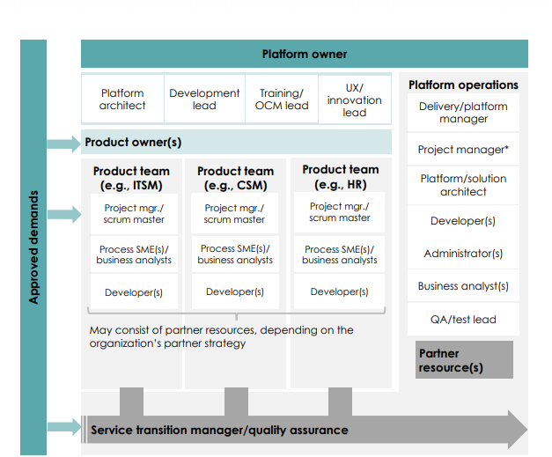
Platform Team Sizing & operating model – Key Considerations
Defining your team for delivery & support of ServiceNow capabilities
Team Sizing – sizing should be based on:
  The number of ServiceNow applications you have (or will have). This typically corresponds to a wider set of business objectives & requires more headcount to manage value delivery.
  Your enterprise’s general level of process maturity. If your enterprise is relatively less mature at processes, you’ll need more headcount to map & define those processes as you automate & digitize them.
  The volume, diversity, & complexity of demands you expect. The higher any of these are, the more headcount you’ll need to deliver
Team Structure - operating model considerations:
  Product owners & development teams may be housed inside or outside the ServiceNow team.
  When you start your initial implementation, it’s likely that you’ll have a simple model (for example, one product team) to support development. As you gain expertise & scale with ServiceNow, you will, in most cases, want to decentralize development to business lines.

Slide 57

STRATEGY
Responsibilities & Outcomes
Vision & Roadmap
Decision Body
Platform & Capabilities
Review portfolio & supplier ecosystem
Document clear roadmap, funding & activity sequencing
Communication Plan
Determine governing boards/bodies
Define & clarify roles of groups & potential implications
Create strategy plans
Develop funding, resource & budget plans
Align stakeholders
Execution Strategy
OCM Plan
Program Plan
Align roadmap & strategy to business initiatives
Determine the “what & why” needs to be done on the platform
Detail the change(s) planned & organizational readiness
Communication & engagement plans
Assess current state
Align projects with vision & goals
Oversee & control during program execution
Process Ownership
VISION . COMMUNICATION . FUNDING . TRAINING

Slide 58

PLATFORM
Responsibilities & Outcomes
Basic Platform Management
Policies & Standards
Platform Data Governance
Make platform decisions
Define support processes & metrics
Evaluate change impacts on the platform
Ensure configurations are fit for scale, performance & upgradability
Maintain integrity of ServiceNow platform
Define data ownership & stewardship roles
Set up data standards
Create data dictionary with field descriptions
Define master sources
Instance Best Practices
Development Best Practices
Application Stability
Right size environment
Replicate instances
Develop security access control model
Ensure proper maintenance
Responsible for upgrades
Ensure proper migration of system changes between environments
Identify best method for application creation based on requirements
Document integration standards
Stability & Modernization
CONTINUOUS IMPROVEMENT – COMPETENCY CENTER

Slide 59

DELIVERY
Responsibilities & Outcomes
Application Creation
Best Practices
Service Taxonomy & Portfolio
Develops solution
Responsible for fixing production defects
Responsible for enhancing existing solution
Follow consistent UI design specifications
Follow standards built from Platform team
Collaborate on demand assessment
Determine taxonomy & business services
Create service definitions & alignment
Project Management
Development Lifecycle
Best Fit Usage
Create project tasks
Manage user stories within a project
Visualize large projects with complex relationships & dependencies
Define tasks required for developing & maintaining software throughout lifecycle
Track software development & projects across business
Analyze solutions to determine best fit
Determine the “how” needs to be done on the platform
Configuration vs customization
Scalable for Projects
STAFFING . EXECUTION . ENABLEMENT . RETENTION

Slide 60

INNOVATION
Responsibilities & Outcomes
Enterprise Compliance
Future Proof
Business Alignment
Create control & test plans
Engage stakeholders on an ongoing basis
Adhere to policies & standards
Determine new technology trends
Analyze if new capabilities should be pursued (i.e. chatbots, AI)
Support CSI
Alignment of business value to strategic objectives
Analysis of business value & visibility to outcomes
Enterprise Service Bus
Enterprise Portfolio
New Initiatives
Promote agility & flexibility between applications in & outside of ServiceNow
Control deployment & versioning of services
Manage & interface internal & external portfolios
For new demand determine which parts live in platform, delivery & strategy
Determine the “how, what & why” for new initiatives that can disrupt the day to day activities of the CoEI such as IOT
Next-Gen Initiatives
CONTINUOUS IMPROVEMENT – COMPETENCY CENTER

Slide 61
Step 2c) GBS Global Business Services - Mature Governance for Complex Organizations

Slide 62





Expense Mgmt.
Engage the business
Build common understanding
of service
Budget Mgmt.
Quarter
Closing
Finance
Warranty
Claims
Flex Time
Hours
Onboard Customers
Charitable
Gift
Matching
HR
Customer Service
Administrate Policy
Changes
Employee Performance Reviews
Charging Station Reservations
IT
Contract Processing
Legal
Facilities
Repair
Requests
Relocation Mgmt.
Administrative Support
Mgmt.
Client Time Tracking
Notes:
Look at all processes, see the changing role of IT
IT shift from monopoly provider to ENABLER
IT delivers platform for digital transformation strategy
Build new digital workflows & services to transform work
Shared data, workflow, experience to unlock innovation

Slide 63

Expense Mgmt.
Infra-structure
IT Support
Engage the business
Technology is a key
enabler for GBS Organizations
Budget Mgmt.
Quarter
Closing
IT Projects
Finance
Flex Time
Hours
IT
Warranty
Claims
Charitable
Gift
Matching
HR
Onboard Customers
GBS
Customer Service
Employee Performance Reviews
Administrate Policy
Changes
Digital
Workflows
Charging Station Reservations
Contract Processing
Legal
Facilities
Repair
Requests
Relocation Mgmt.
Administrative Support
Mgmt.
Client Time Tracking
Notes:
Look at all processes, see the changing role of IT
IT shift from monopoly provider to ENABLER
IT delivers platform for digital transformation strategy
Build new digital workflows & services to transform work
Shared data, workflow, experience to unlock innovation

Slide 64
GBS Operation Models – Ideal Setup
GBS
IT
CIO
Shared Services
ServiceNow CoEI
Head of Shared Applications
Strategy & Roadmap
Strategy
Vision
Roadmap
Innovation
ServiceNow Platform Team
Product Development
Manage & prioritize backlog
Responsible for implementation
Responsible for testing
Technical Documentation
Enforce ServiceNow Best Practices
Delivery Assurance
Platform Architecture
Support & Operations
Instance Best Practices, Operations Standards & Policies
Ensure consistency, integrity & sustainability of the platform
Manage, monitor & optimize platform performance
Provide audit & compliance support
Manage Security & Data Segregation
Manage Platform users
Bug fixing & platform support
Business Partner for each BU
BU SPOCs
Process owners within the business
BU x
HR
IT
IT is operating the GBS ServiceNow platform & being a customer of GBS at the same time. But they don’t own it.

Slide 65
Mature Governance for Complex Organizations
Add Business Unit Delivery & Portfolio Teams
As more business unit have demand for ServiceNow capabilities, it is important to allow them some delivery autonomy while maintaining your overall standard. We call this “autonomy with control.”
Continue to leverage your CoEI & add capabilities to support business unit delivery. Example additional capabilities include:
    Certification of BU resources (system admin, developers, architect, etc.)
    Code/configuration review
    Training & enablement
    Environment management
It is critical at this stage to have fully operating policies around technical standards, integration standards, data management, code migration, & ensure you have mechanisms to enforce these policies.
You need to define the guardrails of what can be delivered by a Business Unit delivery team & what needs to get bounced up to a centralized delivery team.
Business units also likely need to develop a portfolio team to vet demand & may have a localized portfolio demand board.

Slide 66
Step 3a:
Overall Demand Management Process

Slide 67
Why a Demand Management Process
Provides visibility into all platform requests
Delivers control and standards by making fact based decisions when determining which requirements are part of a given release
Creates alignment – Grouping projects and enhancements by business objectives
Ensures the platform team and the delivery function have capacity to meet business partner demand
Provides planning and velocity – Looking ahead and predicting future demand
Ensures responsive to business partner requirements so that services provided are fit for purpose
Prevents the ServiceNow platform team from being perceived as ‘the bottleneck’ to expansion and innovation

Slide 68
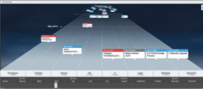
Managing Demand to Delivery
A Value Focused Approach
Demand Screening
Demand Assessment
Demand Fulfillment / Project Execution
New Solution
Demand Board
Release Backlog
Sprint 1
Sprint 2
Sprint 3
...
Stakeholders
New Process / Functionality
(existing solution)
Prioritization
Release Plan / Roadmap
Demand Funnel
Enhancement
(existing service)
Budget Approval
Release 1
Release 2
Candidate List
Release 3
Demand Manager
Defect
(existing service)
screened demand
detailed requirements
Demand Screening
Alignment with objectives
Value forecast
Demand Assessment
Progressive elaboration
Value defined
Demand Fulfillment
Demand fulfilled
Value Realized

Slide 69
6 Steps Needed to Build Out an Effective Demand Process
Establish a Demand Manager Role
  A PM type and liaison between business and IT
  Creates a standard demand intake form
  Creates a scoring mechanism to manage Demand
  Demand resource plan needs to be coordinated between the Demand Owner and Resource Manager
Establish a Demand Board
  Demand is assessed by business value of requirement, level of effort/cost and potential technical risk
  Demand Board should meet monthly
  Determine minimum thresholds for demand that requires demand manager vs. demand board approval
    Not all demand goes to the demand board
    Demand Manager should have latitude to approve on own (i.e. less than 8 hours of effort or a change that is required)
  4 Roles on the Demand Board
    Requestors – Provides initial demand information
    Demand Manager – Manages day to day demand management
    Business Stakeholders – Beneficiaries of demand
    Technical Stakeholders (Platform Owner and Platform Architect) – Ensures alignment with platform standards

Slide 70
6 Steps Needed to Build Out an Effective Demand Process
Create a Standard Demand Intake Practice and Establish Who Can Submit Demand
  Typically only 1) LOB Business partner/business analysts 2) Service Owners 3) ServiceNow Platform Team can submit demand
  All demand comes through a formal Demand Intake Form and is submitted to the Demand Manager
  Demand Intake Form needs to be simple to promote adoption
  There are 4 types of demand
    Enhancement to existing functionality/service - (new service catalog item or change existing workflow)
    Rolling out new feature/process to an existing ServiceNow product - (adding problem management to ITSM)
    Defect repairs to an existing service - (workflow is broken)
    New ServiceNow products - (Add HR Service Delivery product)
Enhance, Evaluate, Prioritize and Approve Demand with Assessments
  Scoring should include 1) Risk 2) Cost/T Shirt sized level of effort 3) Business Value

Slide 71
6 Steps Needed to Build Out an Effective Demand Process
Align Approved Demand to Business Outcomes
  Demands are assigned to a portfolio which are a collection of demands managed as a group
  Tie approved demand to business driver such as: Cost reduction, reallocation, increase revenue, improve employee experience, improve customer experience, risk reduction, accelerate innovation
  When demand is approved
    Create Project – Strategic demand for a brand new ServiceNow product
    Create Enhancement – Strategic demand to existing ServiceNow portfolio
    Create Defect – Operational demand
    Create a Change – Operational demand
Increase Velocity and Plan Future Demand
  Meet with business partners 2x a year
  Talk about new functionality in ServiceNow new releases, new ServiceNow solutions offered, etc.
  This enables Demand Board including Platform Owner to be proactive and shape demand rather than being reactive
  Share the roadmap and keep it current (working closely with Strategy and Innovation groups)

Slide 72
Step 3b:
Demand Management Intake Practice

Slide 73
Step 3c:
Enhance, Evaluate, Prioritize & Approve Demand via Assessments

Slide 74
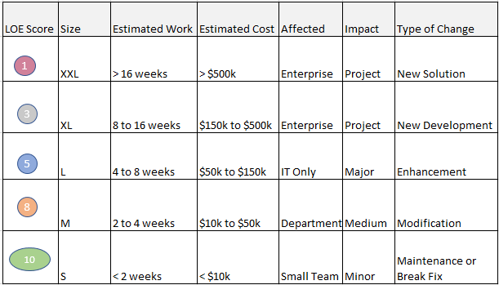
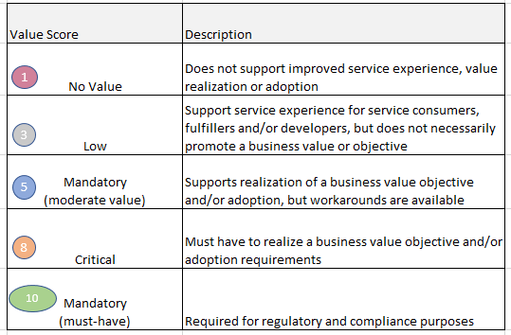
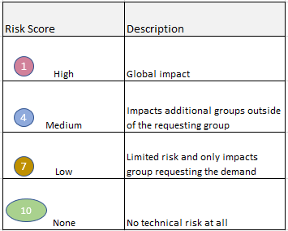
Enhance, Evaluate, Prioritize & Approve Demand via Assessments
Score for 3 areas:
Size (estimated level of effort)
Business Value alignment
Technical Risk
Size/Level of Effort
Value
Risk

Slide 75
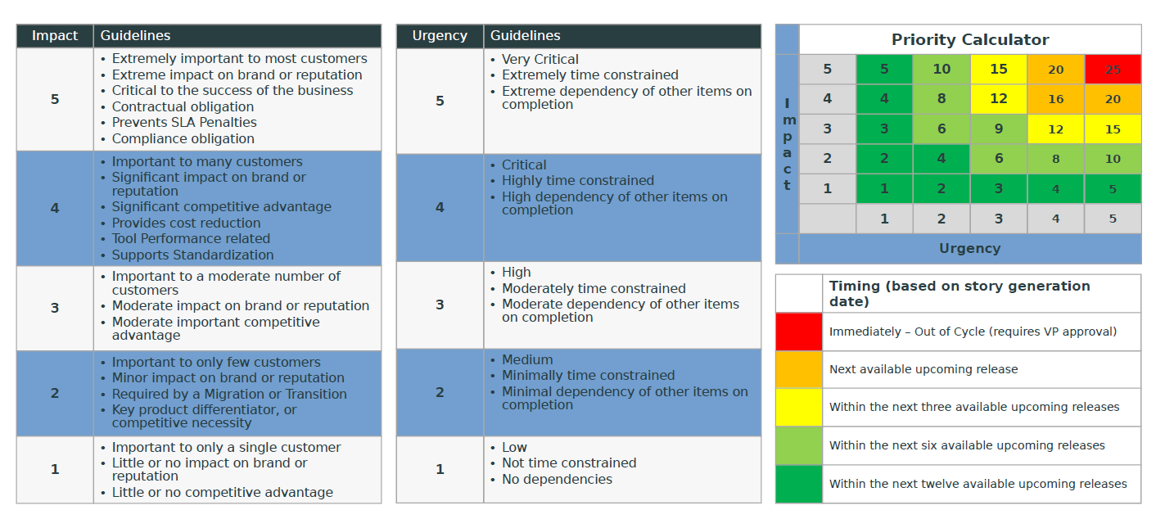
Enhance, Evaluate, Prioritize & Approve Demand via Assessments
Alternative approach to prioritize demand using Impact & Urgency (from an existing customer)

Slide 76
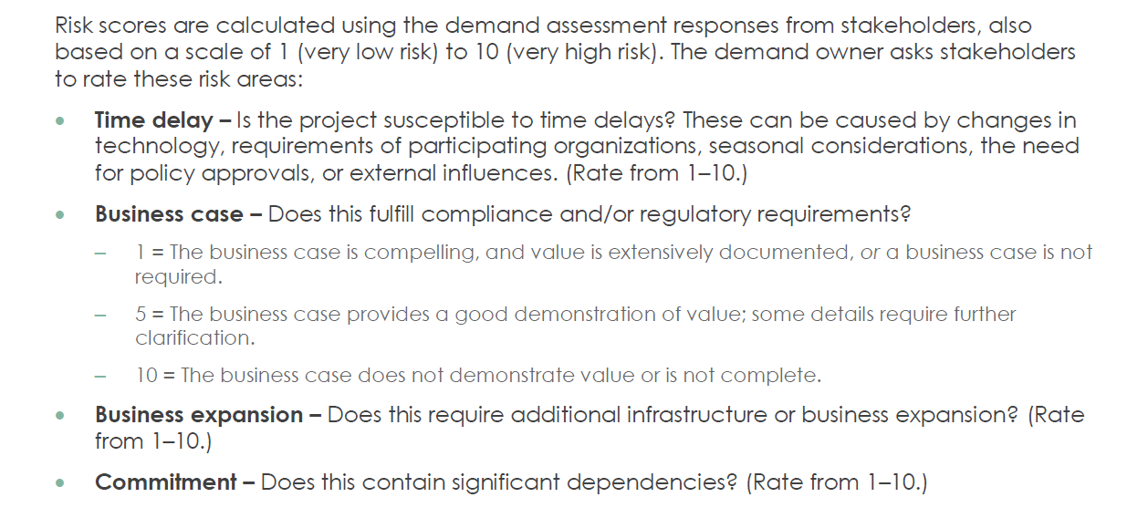
Enhance, Evaluate, Prioritize & Approve Demand via Assessments
Alternative approach to defining a Risk score

Slide 77
2 Demand Board Options
Centralized vs. Federated

Slide 78
Demand to Deploy – The ServiceNow Pipeline using ONE Centralized Demand Board (for smaller implementations or implementations of just 1-2 products)
Ideas are submitted by qualified individuals such as process owners, practitioners, and business partners
4
Platform Delivery team will also engage at this point to deliver on approved prioritized demand. release best practices will be employed to drive to delivery
1
Demand Management
Project Execution
Enterprise Architect
Project
Idea
?
Demand
?
Change
Release
Business Analyst
Enhancement
NO
NO
NO
ONE Demand Board accepts, intercepts, vets and prioritizes inbound demand – ultimately ‘demand shaping’ will become a priority for this group
ServiceNow roadmap, estimation, value and benefits realization are among the tools used by this group -> input from Strategy
If so desired – tasks that are workflow driven can be used to expedite the demand assessment process
Design Board may engage at the outset of build activities (or earlier) to ensure consistency, efficiency, and quality of solution
The PMO may be engaged to oversee project activities and supply PM/SM, BA, or other shared resources
Development standards, best fit usage, UI standards, data governance/strategy are among the tools used by this group
2
3

Slide 79
Demand to Deploy – The ServiceNow Pipeline using a Federated Demand Board and Support Model (for implementations of more than 2 products)
Strategy and Platform Governance board determines latitude for each demand funnel and engagement model
Demand Team vets, prioritizes and determines disposition
Platform Governance board determines configuration, release and testing standards
No
COE engages to coordinate smooth transition to Run
COE
Demand
Intake
Demand Review
Build
Team
Do?
Std?
When?
Release
Coordination
Knowledge Transfer/OCM
Run
New capabilities
New custom app
Global configuration items
Reporting and Analytics
Master Data (CMDB, locations etc.)
New LOB
Delegate to LOB
Escalate to CoC
LOB
Demand
Intake
Demand Review
Citizen Developer
Do?
Std?
When?
New/Change Request Catalog Item
New/Change Request Form/Field
Existing LOB
Each LOB can vet and prioritize ‘minor’ work, or defer to CoE
Platform Governance board determines configuration, release and testing standards

Slide 80
Step 4:
Real World Customer Example

Slide 81
Executive Summary
ServiceNow Embracing New Ways of Working
ServiceNow is leveraged globally for our organization to manage IT & Business processes with 36,000+ active users in the system
The increased use of the platform requires a new way of working to handle the demand & expectation of the stakeholders
Shifting to a Digital Enterprise (DE) & ServiceNow Operating Model will create partnerships & value-based delivery with improved speed on a highly stable platform
The adjustments to DE will delivery the following:
  A leadership Governance & Operating Model to manage Strategy, Technical, Delivery & Reporting
  Agile delivery model with small teams (squads) focused on a common client base
  A Citizen development model to define how stakeholders build & manage their own solutions using a Software Delivery Lifecycle (SDLC)

Slide 82
Where Did We Start
ServiceNow Enterprise Architecture team ran 4 hour workshop with our organization’s Platform Owner to discuss ServiceNow’s operating model & governance best practices
  1st Session – Discussion on the core roles & responsibilities within the Platform Team
  2nd Session – Discussion on recommended governance boards (Strategy, Technical & Portfolio)
  3rd Session – Discussion on how to manage ongoing demand from various departments within the organization on the ServiceNow platform
  Internal Sessions – Multiple collaborative working sessions using a Systems Thinking Approach to Introduce Kanban (STATIK) to determine the Agile organization

Slide 83
ServiceNow Governance & Operating Model
Governance by Design
Stakeholder
Strategy
Execution
Technical
Governance
Portfolio Delivery
Analytics, Reporting & Dashboards
Establishes the roadmap, funding, key value based objectives & measurements
Sets the overall direction for ServiceNow
Prioritizes new initiatives
Manages & ensures stability of the platform
Establishes guidelines for upgrades, data, security & release management
Documents best practices & reviews changes for completeness
Manages the Reporting needs
Focused on a balanced model of self service vs. in house developed reporting
Produces modern dynamic live dashboards over static distributions
Global SLA reporting
Manages demand intake process
Determines Now Squad vs. Citizen Development
Provides enterprise delivery reporting to keep all stakeholders informed
Notes:
Tech gov. solution review cycle…

Slide 84
Execution Details

Slide 85
Delivery Methods
All intake falls under two delivery channels
In-House Delivery (DE Squads)
Citizen Development
Definition: Leverage one of the internal squads to deliver your new requests, enhancements or bugs
Financial Implications: All in-house delivery is non billable
Pros: No costs (except for new licenses)
Cons: Partner must wait in the queue
When this model would work: Good for small requests or requests that are not time sensitive
Definition: Partner leverages their own in-house developer, or hires a 3rd party vendor, to do ServiceNow development.
Financial Implications: Partner must pay for all 3rd party expenses
Pros: Delivery can be quicker
Cons: Financial implications
When this model would work: When Partners need dedicated developers for their work or have a major time sensitive project to deliver
VS.

Slide 86






ServiceNow Digital Transformation Alignment through 5 DE Squads & Citizen Development
Squads | Description
 | Platform Squad Purpose: Manage the performance & availability of the ServiceNow Platform, integrations & shared functionality of the platform Example Focus Areas: License Management, Now Mobile app, Discovery, code promotion
 | ITSM/ITOM Squad Purpose: Partnered with ITSM Service Owner to improve the use of ITOM modules Example Focus Areas: Incident, Problem, Change, Configuration Management
 | Info Sec Squad Purpose: Partnered with Information Security to continue value realized from the platform Example Focus Areas: Security Modules
 | Dynamic Squad Purpose: Partnering with multiple smaller consumers of the ServiceNow platform to meet their needs Example Focus Areas: Consumers with limited budget or low monthly request volume
 | Reporting Squad Purpose: Reporting & Dashboards Scope: Self serve reporting solutions, Performance Analytics, standard reporting, analytics, consulting, access management (reporting module), ownership of business services, Service Catalog content
 | Citizen Development Purpose: Citizen Development that allows stakeholders to configure & develop solutions that limits risk to them Existing Use Cases: Organizations with a desire to move quickly & have budget to fund a dedicated team Examples of Changes: Configuration, workflow, new forms, enhancements & other changes that do not impact core platform modules

Slide 87
All intake falls under 2 delivery channels
ServiceNow DE Squads
1. In-House Delivery
Squad 1
Leverage one of the internal squads to deliver your new requests, enhancements or bugs
Scope
ServiceNow Platform
2. Citizen Development
Type A
Client leverages their own in-house developer(s), or hires a 3rd party vendor, to do ServiceNow end-to-end delivery.
Type B
Client brings their own developer into one of the ServiceNow Squads to expedite delivery while ServiceNow team manages & owns the stories.
Squad 2
Squad 3
Squad 4
Squad 5
Scope
Information
Security
Scope
ITSM
Scope
Low volume clients
with limited budget
Scope
Reporting & Service Catalogue

Slide 88
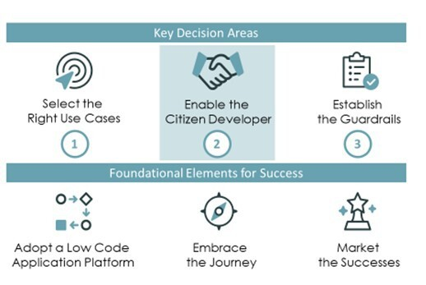
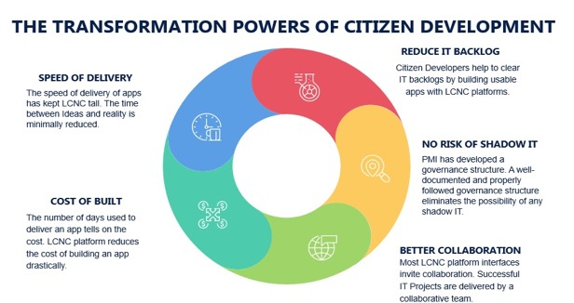
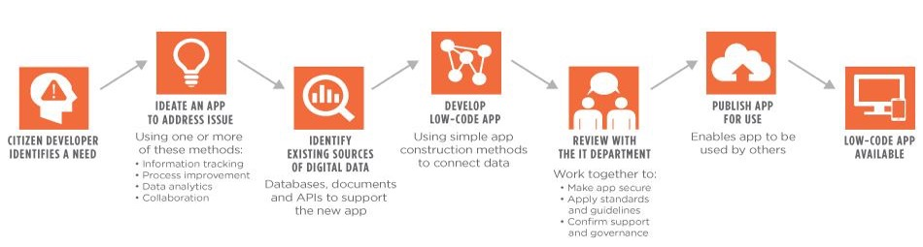

Slide 89
In-House ServiceNow Delivery – Now Squad Descriptions

Slide 90
Platform Squad
The Platform Squad’s purpose is to protect platform stability, ensure platform performance is optimal, & to maintain platform design structure. The squad will work & provide approval for all new integration requests. Incident resolution for major incidents will be handled by the platform squad cross-functionally with other squads on enhancements or new request that may impact multiple products on the platform. All systems administration activities such as access rights & performance health scans, will be managed by the squad.
Scope
7 Team Members
Platform Upgrades
License Management
Instance Health Scan & Performance Monitoring
Integration Accountability
Global Tables Accountability
Data & Access Governance
Discovery Maintenance, configuration & platform impact review for Cis
Platform Specific Integration monitoring & maintenance
Major Incident Management
Clone Backs
Consulting
ATF
Product Owner: 1
Scrum Master: 1
Systems Admin: 1
Business Systems Analyst: 1
Developer: 3

Slide 91
ITSM/ITOM Squad
The ITSM Squad’s purpose is to provide end-to-end support to the ITSM & ITOM Products. The Squad will ensure that the ITSM & ITOM Modules are maintained & performing optimally. The squad will also ensure that all new request forms & integrations are being delivered without impacting existing capabilities & performance. The squad will ensure that ATF is kept current & that all new capabilities are being incorporated within the ATF framework.
Scope
5 Team Members
Change Management Module
Incident Management Module
Problem Management Module
Configuration Management Module
CMDB
ATF
Enhancements
Bugs
Incidents
Product Owner: 1
Scrum Master: 1
Business Systems Analyst: 2
Developer: 1

Slide 92
Info Sec Squad
The Information Security Squad’s purpose is to support Information Security’s ServiceNow roadmap & operational needs. The squad will ensure that the Information Security Modules, Integrations, & Request forms are maintained & are performing optimally. The squad will also ensure that new modules & request forms are being delivered against the Information Security strategic roadmap. The squad will ensure that ATF is kept current & that all new capabilities are being incorporated within the ATF framework.
Scope
4 Team Members
Vulnerability Response Module
Security Incident Response Module
GRC Module
Other Information Security Forms
Enhancements
Bugs
New Forms
ATF
Product Owner: 1
Scrum Master: 1
Business Systems Analyst: 1
Developer: 1

Slide 93
Reporting Squad
The Reporting Squad’s purpose is to provide ServiceNow reporting & dashboard solutions, ownership of Business Services & Service Catalog content. The squad is committed to delivering the most efficient solution to our clients through exploring new technologies, leveraging existing technologies & driving improvements where needed.
Scope
8 Team Members
Self serve dashboards
Standard reports
Performance Analytics
Management of access to reporting module
Management of Business Services
Service Catalogue content
Incident resolution
Bugs
Enhancements
Product Owner: 1
Scrum Master: 1
Technical Lead: 1
Developers: 5

Slide 94
Dynamic Squad
The Dynamic Squad’s purpose is to provide ServiceNow value to low volume clients with limited budget. This squad will ensure that all enhancements & bugs for modules, applications & catalog forms are implemented in a timely manner to ensure their products are performing optimally. The squad will work on new requests, including forms & integrations, as it aligns to the platform & client’s strategic direction. The squad will also ensure that ATF capabilities are kept current for each client.
Scope
7 Team Members
Large client group not covered in other squads
If a client becomes large enough with the right amount of funding a dedicated squad will be created
Enhancements
Bugs
ATF
Product Owner: 1
Scrum Master: 1
Business Systems Analyst: 1
Developer: 4

Slide 95


An analogy
To set the context

Slide 96
Delivery Model Options and Considerations
 | Centralized | Decentralized | Hybrid
Model | Central ServiceNow platform team manages the demand funnel and delivers all functionality to the business | Each team manages their own demand funnel and delivers their own functionality | Each team manages their own demand funnel, but global/shared objectives and technical standards are reviewed/approved by shared governance bodies
Pros / Cons | Not enough cooks in the kitchen Governance is straight-forward Central ServiceNow platform team will become the bottleneck and limit the adoption/value of ServiceNow | Everyone is or wants to be the head chef in the kitchen Gives full autonomy and flexibility to business Difficult to govern and coordinate upgrades | One chef, but many cooks Governance is achievable Allows for independent delivery (as/if appropriate) with appropriate governance
When to Use (consider-ations) | Early maturity ServiceNow program Single instance implementation Decision-making is centralized | Multi-instance implementation or each team is managing “scoped” applications Decision-making is highly de-centralized | Relatively mature ServiceNow program Demand exceeds platform team’s ability to scale Strong sponsorship Decision-making is decentralized

Slide 97

Example: Centralized Delivery Model
Executive Steering and Business Programs
Executive Platform Sponsor
Executive Sponsor
Executive Sponsor
Executive Sponsor
Platform Owner
Portfolio Manager
Portfolio Manager
Portfolio Manager
Federated business workflows responsibility
ServiceNow Platform Team
IT Operations
SecOps
Finance Services
Product Lead
Product Lead
Product Lead
ITSM
ITOM
SecOps
Business
Apps
Business Services
Process Lead(s)
Business Services
Process Lead(s)
Business Services
Process Lead(s)
Service Owner, Process Manager
Service Owner, Process Manager
Service Owner, Process Manager
Demand Management
Product Owner
Shared Services Platform Team
Platform Architect
Business Services
Process Analysts
Business Services
Process Analysts
Business Services
Process Analysts
Platform Architecture
Developer(s)
Service/Process Consultants, Analysts, SMEs
Service/Process Consultants, Analysts, SMEs
Service/Process Consultants, Analysts, SMEs
Solution Architecture
SysAdmin(s)
SecAdmin(s)
Reporting and Analytics
Reporting and Analytics
Reporting and Analytics
Platform Operations
CMDB Admin
Admin, reporting and analytics specialist(s)
Admin, reporting and analytics specialist(s)
Admin, reporting and analytics specialist(s)
CMDB, Discovery, Service Mapping
Analyst(s)
OCM, Training and Adoption
OCM, Training and Adoption
OCM, Training and Adoption
# squads and squad sizes vary per organizational needs, adoption of capabilities and maturity of the platform
OCM and training specialist(s)
OCM and training specialist(s)
OCM and training specialist(s)
Value Management

Slide 98
Example: Centralized Delivery Model
Strategy governance
Executive Platform Sponsor
Executive Sponsor
Executive Sponsor
Executive Sponsor
Platform Owner
Portfolio Manager
Portfolio Manager
Portfolio Manager
Federated business workflows responsibility
ServiceNow Platform Team
IT Operations
SecOps
Finance Services
Portfolio governance
Product Lead
Product Lead
Product Lead
ITSM
ITOM
SecOps
Business
Apps
Business Services
Process Lead(s)
Business Services
Process Lead(s)
Business Services
Process Lead(s)
Service Owner, Process Manager
Service Owner, Process Manager
Service Owner, Process Manager
Demand Management
Product Owner
Platform Architect
Business Services
Process Analysts
Business Services
Process Analysts
Business Services
Process Analysts
Platform Architecture
Developer(s)
Service/Process Consultants, Analysts, SMEs
Service/Process Consultants, Analysts, SMEs
Service/Process Consultants, Analysts, SMEs
Solution Architecture
SysAdmin(s)
Technical governance
Reporting and Analytics
Reporting and Analytics
Reporting and Analytics
SecAdmin(s)
Platform Operations
CMDB Admin
Admin, reporting and analytics specialist(s)
Admin, reporting and analytics specialist(s)
Admin, reporting and analytics specialist(s)
CMDB, Discovery, Service Mapping
Analyst(s)
OCM, Training and Adoption
OCM, Training and Adoption
OCM, Training and Adoption
# squads and squad sizes vary per organizational needs, adoption of capabilities and maturity of the platform
OCM and training specialist(s)
OCM and training specialist(s)
OCM and training specialist(s)
Value Management

Slide 99
Example: Decentralized Delivery Model
Executive Sponsor
Executive Sponsor
Executive Sponsor
Executive Sponsor
Portfolio Manager
Portfolio Manager
Portfolio Manager
Portfolio Manager
Finance
HR
IT
Security
Enterprise Architecture
Finance
Workflows
HRSD
ITSM
ITOM
SecOps
Product Owner
Product Owner
Product Owner
Product Owner
Product Owner
Provides enterprise guidelines
Typically not platform specific
Common to have domain architect involvement
Product Architect
Product Architect
Product Architect
Product Architect
Product Architect
Scrum Master
Scrum Master
Scrum Master
Scrum Master
Scrum Master
Snr. Developer(s)
Snr. Developer(s)
Snr. Developer(s)
Snr. Developer(s)
Snr. Developer(s)
Developer(s)
Developer(s)
Developer(s)
Developer(s)
Developer(s)
Platform Run
Jnr. Developer(s)
Jnr. Developer(s)
Jnr. Developer(s)
Jnr. Developer(s)
Jnr. Developer(s)
Business/Process Analyst
Business/Process Analyst
Business/Process Analyst
Business/Process Analyst
Business/Process Analyst
Provides platform run services
Typically 1st line / 2nd line support
Outsourcing options available.
Provides platform run services
Typically 1st line / 2nd line support
Outsourcing options available.
Trainer / OCM Specialist
Trainer / OCM Specialist
Trainer / OCM Specialist
Trainer / OCM Specialist
Trainer / OCM Specialist

Slide 100
Example: Decentralized Delivery Model
Strategy governance
Strategy governance
Strategy governance
Strategy governance
Each team manages their own demand funnel.
Businesses are managing their own “scoped” apps.
Everyone is or wants to be the chef in the kitchen.
Difficult to govern, everyone in the kitchen wants to be the chef.
Gives full autonomy and flexibility to business.
Living on a single instance will be challenging unless everyone agrees and follows the same practices
Consider cost, resourcing and strategy roadmap!
Executive Sponsor
Executive Sponsor
Executive Sponsor
Executive Sponsor
Portfolio Manager
Portfolio Manager
Portfolio Manager
Portfolio Manager
Finance
HR
IT
Security
Finance Workflows
HRSD
ITSM
ITOM
SecOps
Portfolio governance
Portfolio governance
Portfolio governance
Portfolio governance
Product Owner
Product Owner
Product Owner
Product Owner
Product Owner
Product Architect
Product Architect
Product Architect
Product Architect
Product Architect
Scrum Master
Scrum Master
Scrum Master
Scrum Master
Scrum Master
Snr. Developer(s)
Snr. Developer(s)
Snr. Developer(s)
Snr. Developer(s)
Snr. Developer(s)
Technical governance
Technical governance
Technical governance
Technical governance
Developer(s)
Developer(s)
Developer(s)
Developer(s)
Developer(s)
Jnr. Developer(s)
Jnr. Developer(s)
Jnr. Developer(s)
Jnr. Developer(s)
Jnr. Developer(s)
Business/Process Analyst
Business/Process Analyst
Business/Process Analyst
Business/Process Analyst
Business/Process Analyst
Trainer / OCM Specialist
Trainer / OCM Specialist
Trainer / OCM Specialist
Trainer / OCM Specialist
Trainer / OCM Specialist

Slide 101
Example: Hybrid Operating Model
Federated Responsibility
Enterprise Architecture
ServiceNow CoEI
Executive Sponsor
Executive Sponsor
Executive Sponsor
Strategy governance
Strategy
Portfolio Manager
Portfolio Manager
Portfolio Manager
IT Operations – Services
HR Service Delivery
Finance Business Services
Portfolio governance
Portfolio governance
Portfolio governance
Business engagement and delivery
HRSD
Finance Workflows
ITSM
ITOM
Product Owner* / Product Lead
Product Owner* / Product Lead
Product Owner* / Product Lead
Product Architect*
Business Services &
Process Analyst(s)
Product Architect*
Business Services &
Process Analyst(s)
Product Architect*
Business Services &
Process Analyst(s)
Platform architecture and support
Developer(s)*
Business Services &
Process Leader(s)
Developer(s)*
Business Services &
Process Leader(s)
Developer(s)*
Business Services &
Process Leader(s)
Citizen Developer(s)
Reporting and Analytics Specialists
Citizen Developer(s)
Reporting and Analytics Specialists
Citizen Developer(s)
Reporting and Analytics Specialists
Technical governance
SysAdmin(s)*
OCM, training and adoption expert(s)
SysAdmin(s)*
OCM, training and adoption expert(s)
SysAdmin(s)*
OCM, training and adoption expert(s)
Innovation
* These resources can be partner or CoEI resources

Slide 102
Considerations for a CoEI
Design Review Board
RACI Model
Support Model
Governance & Standards
SDLC
Developer Enablement
Design Review Process
Framework for consuming core functionality
Who owns it?
Who builds it?
Who maintains it?
Developer Office Hours
Platform Service Mgmt
Escalation Process
Experience Standards
Development Standards
Communication Standards
SDLC Process
Source Code Integration
Code Review
ServiceNow Training
Standards Training
Path to Production Training

