Slide 1
Purchase Requisitions and Asset Management

Slide 2
Introduction
The ServiceNow Procurement application provides the ability to create Purchase orders/requisitions and to obtain items for fulfilling service catalog requests.
Procurement offers the ability to perform the following functions.
Track service catalog requests
Create and manage purchase orders/requisitions
Create and manage transfer orders
Receive assets
This document focuses specifically on the ‘Create and manage purchase orders’ and ‘Receive assets’ functions and how non-assets such as Professional Services may be included.

Slide 3
Problem Statement
ServiceNow states that Purchase orders specify assets to order from a single vendor and that information on a purchase order enables physical and financial tracking of the assets that were ordered.
However, we would like to utilize the Procurement application to include both assets (hardware, software, consumables) and non-assets such as Professional Services to support a closer process integration with our Procurement Team.
It is this inclusion of non-asset items that gives rise to potential issues as they are not intended to be included within a Purchase order when using the out-of-the-box Procurement application.
A consumable asset is one that is purchased in quantity and distributed. It is assigned to the consumable model category, and the asset record tracks the quantity that is available and total cost. When consumable assets are received, they are merged into an existing consumable record, if available.

Slide 4
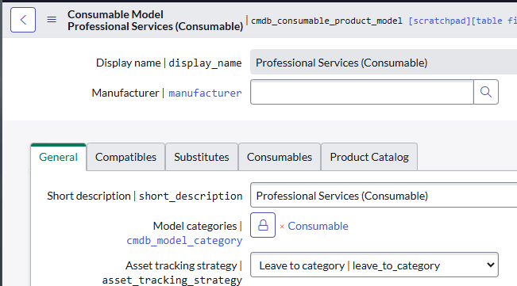
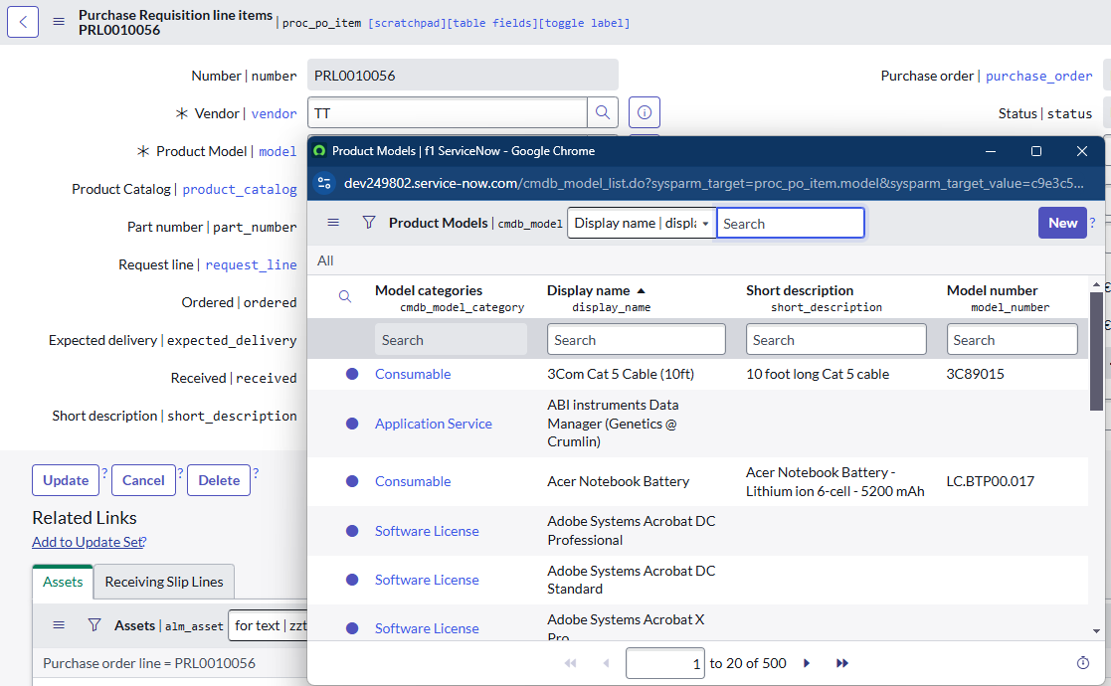
Product Models
To support the creation of Asset records for the items being ordered, each Purchase order/requisition line item requires a Product Model.
Each Product Model is aligned with a Model Category that has a default Asset tracking strategy (create/do not create asset)

Slide 5
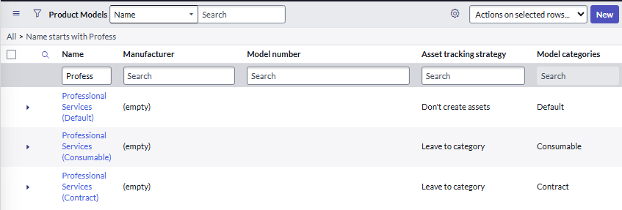
Product Models
To include non-assets within a Purchase order/requisition, it is a requirement that no asset record is created for any non-asset line item.
In exploring a potential solution to satisfy this requirement, the following Product Models were created, each using a different Model Category. Both Asset tracking strategy for the Consumable and Contract Model categories were left as ‘Leave to category’ and the Default Model category was set to ‘Don’t create assets’ to enforce blocking of the creation of any corresponding asset record.
*A consumable asset is one that is purchased in quantity and distributed. It is assigned to the consumable model category, and the asset record tracks the quantity that is available and total cost. When consumable assets are received, they are merged into an existing consumable record, if available.

Slide 6
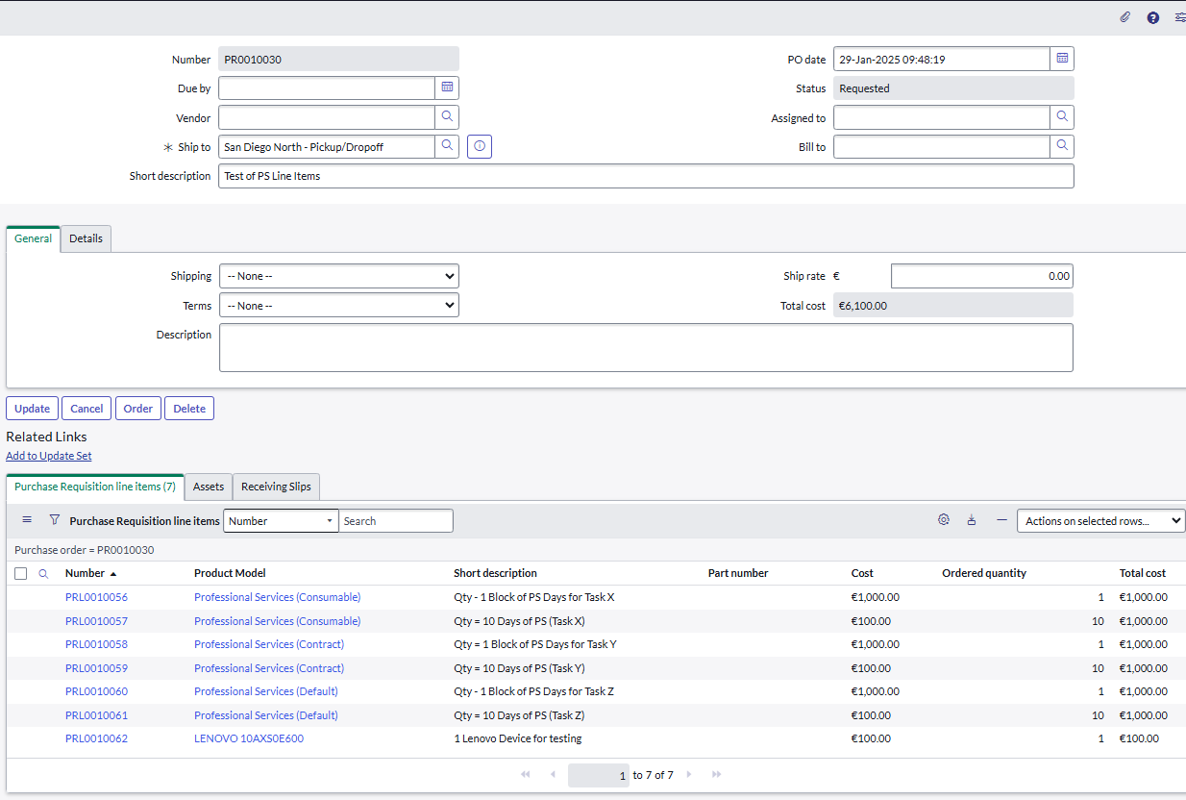
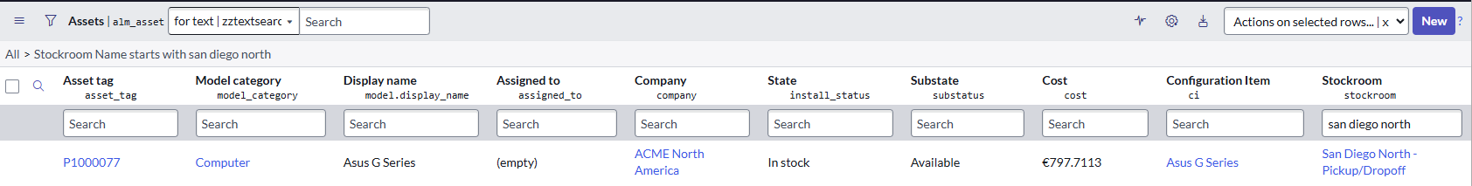
Purchase Order/Requisition Line Items
In exploring a potential solution to satisfy this requirement, the following Purchase order/requisition was submitted containing 1 asset line item and 6 non-asset line items with shipping to the ‘San Diego North – Pickup/Dropoff’ Stockroom.
Prior to submission, the San Diego North – Pickup/Dropoff’ Stockroom held 1 computer asset.

Slide 7
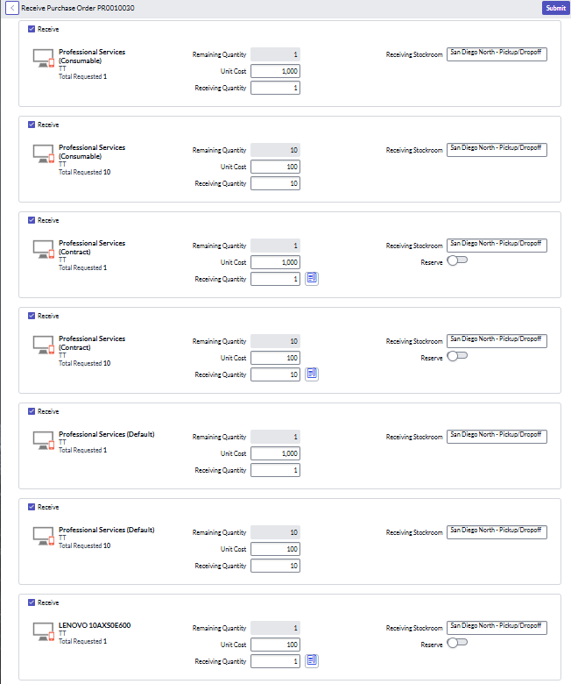
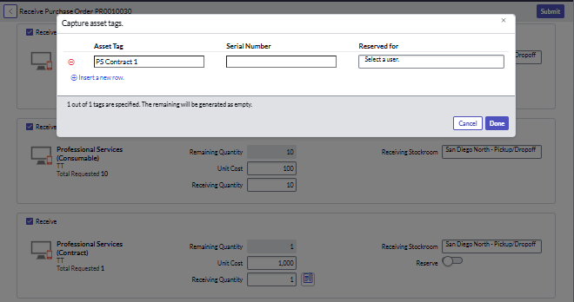
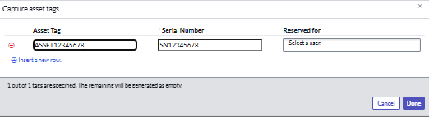
Receiving Purchase Order/Requisition Line Items
When receiving Purchase order/requisition line items, any line item showing the icon requires the Asset Tag value to be entered to complete the receipt process.
Depending on the Model category e.g. computers, the Serial number may also be required.

Slide 8
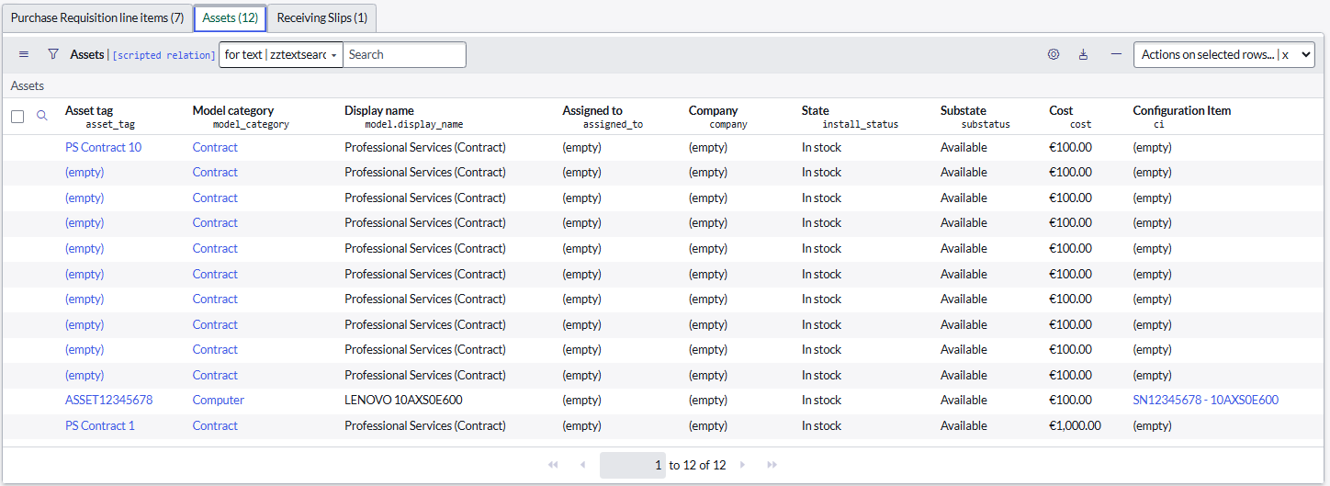
Receiving Purchase Order/Requisition Line Items
After receipt, the 7 order line items resulted in the creation of 12 asset records; 1 for the computer, 1 for the ‘Qty = 1 Block of PS Days for Task Y’ item and 10 for the Qty = 10 Days of PS (Task Y) ordered under the Professional Services (Contract) Product Model.

Slide 9
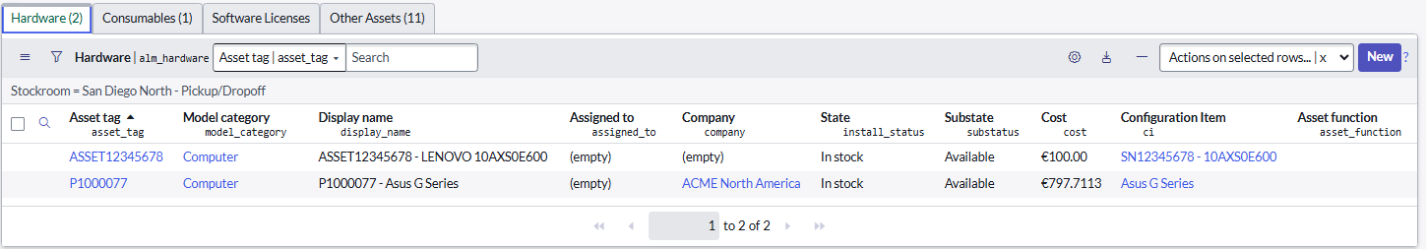
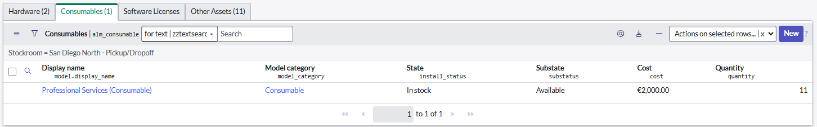
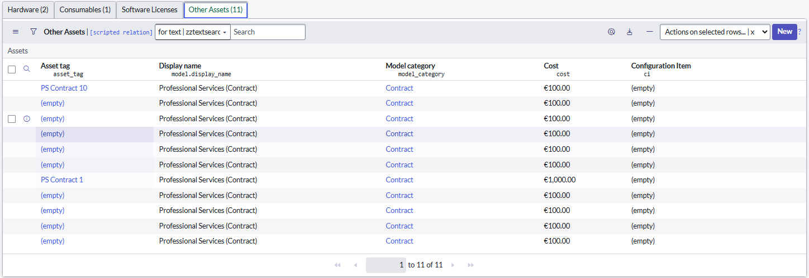
Stockroom
The below view shows the ‘San Diego North – Pickup/Dropoff’ Stockroom view of the line items received.
< 1 x computer added
Note: No asset records have been created for the line items using the Professional Services (Default) Product Model.

Slide 10
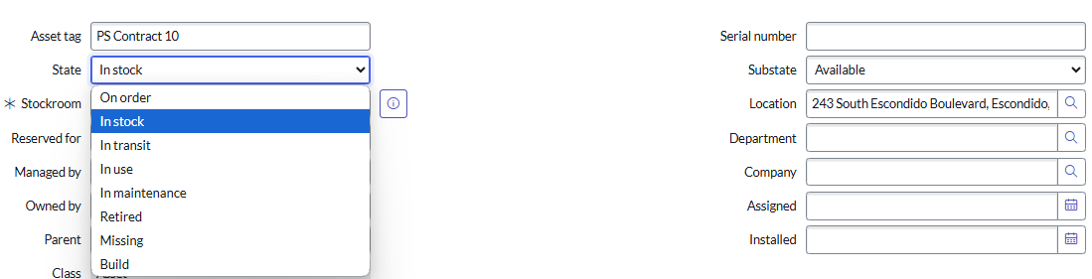
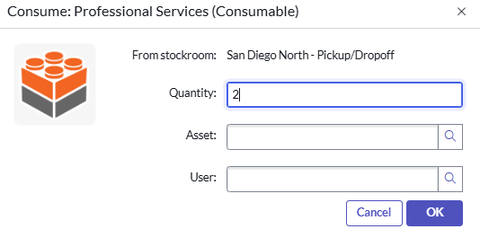
Asset Lifecycle
Assets use their State and Substate to track assets accurately and at a detailed level.
Non-assets such as Professional Services that have generated an asset record do not wholly align with the State/Substate model; the best fit is the ‘Consumed’ State (no corresponding Substate) but this may require assignment of the asset record to either an Asset or User record which may introduce further challenges.
Asset State/Substate model

Slide 11
Potential Solution
Based on the initial exploration for a solution to prevent the creation of an asset record for a non-asset line item, using a bespoke Product Model with a Model Category that has the Asset tracking strategy set to ‘Don’t create assets’ may provide a potential solution.
Caveats
Asset Management typically includes aspects of financial management such as capex/opex spend on hardware, software, consumables etc as well as ongoing asset value based on expected operational lifespan, depreciation and residual values at the end of their operational lifespan.
Leveraging the potential solution outlined above may require further investigation and analysis if financial management is to required for assets, specifically any impact of the inclusion of non-asset purchase order/requisition line items irrespective of whether they create or do not create an asset record.

