Slide 1
Hiring Experiences Process Workshop Presentation
Zurich release
Speaker
Asset Number: 0004306
November 2025

Slide 2
User instructions
PLEASE REMOVE THIS SLIDE BEFORE PRESENTING
Who: This deck is built for delivery of a ServiceNow product/capability. The delivery of this deck may be undertaken by Customers, ServiceNow Partners and ServiceNow Expert Services. Assigned Business Process Analysts, Business Process Consultant, Technical Consultants and/or Developers will normally be responsible for its delivery.
Why: We want to make it easier for you by spending more time on the implementation and build, not creating workshop materials. The purpose of this presentation is to outline the baseline process explaining the configurable options with the objective of determining the to-be process and corresponding configuration requirements, usually in the form of user stories.

Slide 3
User instructions
PLEASE REMOVE THIS SLIDE BEFORE PRESENTING
How:
Customers (self–implementation) – Use the deck as it is or add to your corporate template. Alternatively, utilize individual slides to enhance your internal communications.
Partner or Co-Delivery implementations – Use the deck and add your logo, following the instructions on a following slide.
ServiceNow Expert Services
Remove the PartnerLogo using the Slide Master (View > Slide Master > select the vertical line and the PartnerLogo at the bottom of the Master Slide and delete. If you see any other instances of PartnerLogo just follow the same process from that slide). If you have any issues, please submit a feedback on the Best Practices portal.
Tailor the presentation for the needs of your specific implementation.

Slide 4
FAQs
PLEASE REMOVE THIS SLIDE BEFORE PRESENTING
How can I provide feedback on this asset or other parts of the Best Practices portal? The Best Practices portal has several feedback buttons throughout; you can submit feedback using the thumbs up/thumbs down buttons. Click on those icons, and a small form will appear for you to leave specific feedback regarding the asset you are accessing.
If we use this deck or slides from this deck, are we breaking any copyright? No. We designed this deck to be used by our whole ecosystem.
What should I do if I don’t need all the content contained within this, or other assets? You can either hide or delete the slide(s). You may also want to move the slide(s) to the end of the presentation, review it when you have finished updating the asset for your own use, and then deleting any content you don’t need. Remember to regularly check the Best Practices portal to make sure you have the most up-to-date asset.

Slide 5

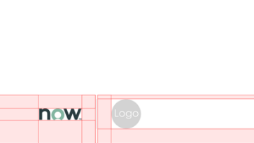


Adding your Logo
PLEASE REMOVE THIS SLIDE BEFORE PRESENTING
To provide credibility to ServiceNow documents, the ServiceNow and your logo should be visible, but not domineering.
Click View > Slide Master > Slide > Select Page 1
What to do:
Download logos from the Brand Center site.
Scale logos to an exact height of 0.45cm.
Place your logos after the ServiceNow logo, divided by a grey bar.
The same rule should be applied when more than one partner logo is required.
What not to do:
Do not scale logos beyond 0.45cm height.
Do not stack ServiceNow and Partner logos.

Slide 6
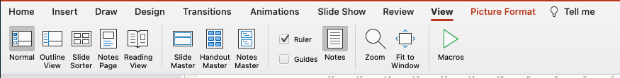
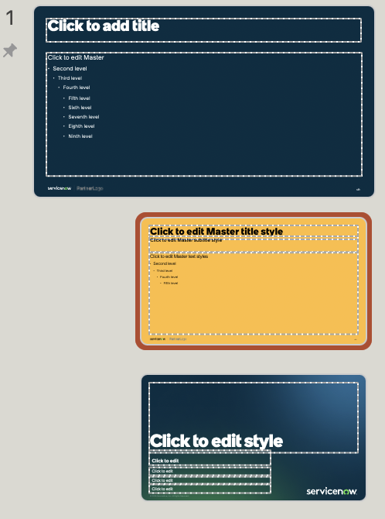

Deleting the PartnerLogo
2.
1.
PLEASE REMOVE THIS SLIDE BEFORE PRESENTING
What to do:
Click ‘View’ at the top of the screen.
Click on ‘Slide Master’ - this takes you to the slide master for the slide you are looking at.
Scroll up to Slide 1 in the master view. You may have to pull out the view on the left slide, so you can see all the slides. Slide 1 will be the slide that looks larger than all the rest. It’s kind of the master of that group of slides.
At the bottom of the slide there are 2 shapes that you can highlight. A small vertical grey line and the PartnerLogo text.
Once highlighted, simply press delete. That should remove the PartnerLogo from the slides.
3.
4.
5.

Slide 7
Agenda
01 | Hiring Experiences overview
02 | Hiring Core
03 | Manager Hub
04 | Talent Profile
05 | Job Requisition Management
06 | Recruitment Workspace
07 | Interview Management
08 | Applicant Center
09 | Opportunity Marketplace
10 | Wrap up & next steps
For each section, we will:
Introduce the topic and fundamental concepts
Provide a live walkthrough / demo
Gather requirements for development

Slide 8
Hiring Experiences requirements
Hiring Core
Manager Hub
Talent Profile
Job Requisition Management
Integration with ATS
Company job architecture
Purge policies
Cascade rules for cleaning data
Hiring tab
Talent profile definitions
Talent types
Job requisition process
New job opening request RP
Assignment & routing
Job description templates
Approvals
Hiring task templates
Applicant survey
Notification branding
AI use case: Create job requisition
MS Teams integration
Notes:
When do we say we have completed requirements gathering? It is when we have covered these topics and created user stories for them

Slide 9
Hiring Experiences requirements
Recruitment Workspace
Interview Management
Applicant Center
Opportunity Marketplace
Interface
Landing page
Navigation menu
Requisitions
Form
Default list view
Related lists
Form UI actions
”On Hold” reasons
Recruiter knowledge base
Talent acquisition dashboard
Outlook integration
Zoom integration
Scheduling preferences form
Schedule interview form
Interview phase templates
Interview invite email templates
Interview feedback form
AI use case: Interview scheduling
Portal
Branding
Header
Footer
Content & campaign
“No-login experience” with Time limited authentication
Applicant knowledge base
Opportunity types
Notes:
When do we say we have completed requirements gathering? It is when we have covered these topics and created user stories for them

Slide 10
Hiring Experiences
Overview

Slide 11
Streamline and accelerate hiring with transparent workflows and experience
Plan
Source
Interview
Hire
Hiring managers create and submit job requisitions.
Managers collaborate for job description templates, approvals, and recruiter input.
Job requisitions are shared with the ATS* for posting and applications.
Integrations share applications with managers, recruiters, and panelists to continue screening.
Applicants are invited to an external portal to track progress, schedule interviews, and stay engaged.
Interview slots are identified and proposed, applicants can self-schedule, and reminders are automated.
Selected applicants can communicate with the team during the hiring process – through to pre-hire and onboarding.
*Integration required

Slide 12
Hiring Experiences overview
Recruiter
Recruitment Workspace
Applicant
Talent Profiles & Pools
Hiring Manager
Applicant Center
Hiring Tab in Manager Hub
Outlook
Interview Management
Zoom
Job Requisition Management
Opportunity Marketplace
Now Assist*
Job Architecture
ATS
*Add-on SKU

Slide 13





Hiring personas
Hiring Manager |  | Recruiter |  | Applicant |  | Interviewer / Panelist |  | Recruitment Coordinator
Hiring managers request job openings, track jobs, collaborate with recruiters, view and compare applications, and provide feedback. |  | Recruiters can manage job requisition, view applications, collaborate with hiring managers and applicants, schedule and manage interviews. |  | Applicants can learn more about the company, track their job applications, view job details, and communicate with the hiring team. |  | Interviewers can view the job requisitions assigned to them, view applications, and interview applicants. |  | Coordinators schedule interviews, route unassigned tasks, ensures tasks are moving forward, and coordinates manual tasks when recruiters are overburdened.
Operational efficiencies (e.g., green buildings) |  | Balanced ESG investment portfolio |  | Rationalization of services, applications and infrastructure |  | ESG communication with all stakeholder groups |  | ESG to attract, engage and retain talent
"Better" product and service introduction |  | ESG in audit, governance, risk and compliance |  | Digital enablement of ESG programs |  | ESG branding for the whole company |  | Diversity, inclusion and belonging
Business model innovation and scale |  | Business resilience vs. ESG risks (operations, supply chain) |  | Ethical AI |  | ESG in customer purchases decisions and experience |  | Workforce health, wellbeing and safety

Slide 14
Hiring roles
Role name | Role | Description
Hiring Core Admin | sn_ta_hiring_core.admin | Super admin for the Hiring Experiences environment with full access.
Recruiter | sn_ta_hiring_core.recruiter | Creates and manages job requisitions, collaborates with hiring managers.
Interviewer | sn_ta_hiring_core.interviewer | Evaluates applicants assigned to job requisitions.
Recruitment Coordinator | sn_ta_hiring_core.recruitment_coordinator | Creates interviews and manages application workflow.
Hiring Manager | sn_ta_hiring_core.hiring_manager | Oversees job requisitions and collaborates with recruiters.
Applicant | sn_ta_hiring_core.applicant | Parent role for internal and external applicants; provides common info.
External Applicant | sn_ta_hiring_core.external_applicant | For external applicants; includes snc_external role.
Internal Applicant | sn_ta_hiring_core.internal_applicant | For internal applicants; includes snc_internal role.
Approver User | approver_user | Required for users who approve requests.
Talent Profile Admin | sn_ta_tp.talent_profile_admin | Sets up Talent Profile functionality.
Talent Profile User | sn_ta_tp.talent_profile_user | Uses Talent Profile features.

Slide 15
Hiring Core

Slide 16
ATS integration
Integrate your Hiring Experiences environment with your preferred ATS to create a seamless hiring workflow.
Send the job requisitions to your integrated ATS to get posted on the job boards
Bring all your historic job requisition data from your ATS to your ServiceNow instance with the import sets
Import the application and applicant details from your integrated ATS into the system for processing
Upload job application data from your ATS to your ServiceNow instance at regular intervals using import sets

Slide 17
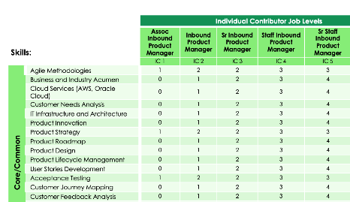
Company job architecture
Software engineering Senior software engineer IC4
Split out job families into role groups
Link (mandatory) skills for a job
Link between role levels and role groups to support employee growth
Configuration to auto-link common role progressions (IC3 > IC4)
Frontend
Full-stack
Backend
Notes:
Discuss how job architecture will be defined, stored, and managed.

Slide 18
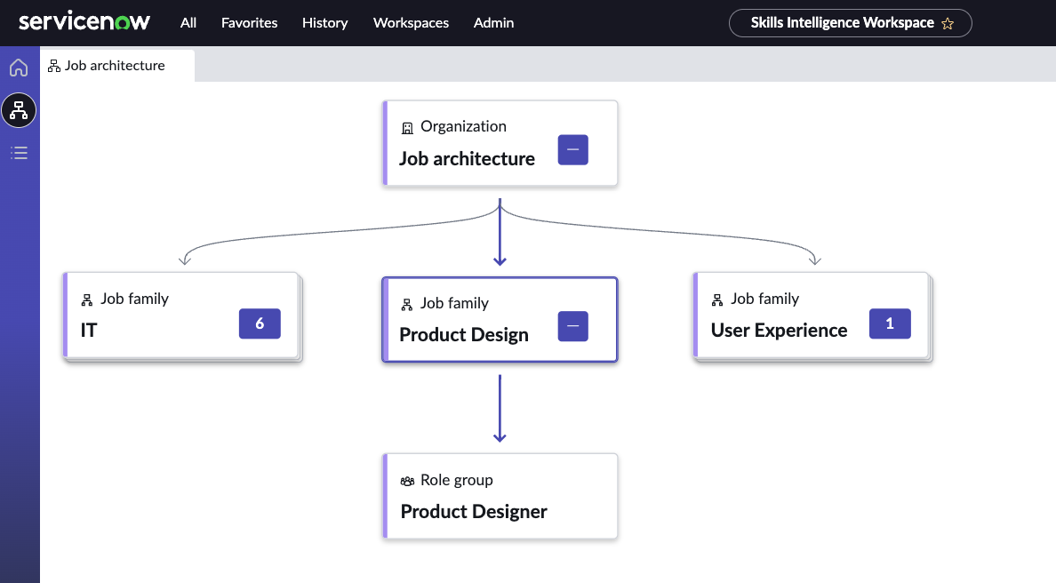
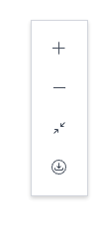
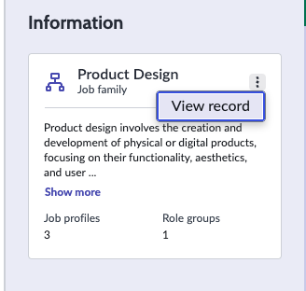
Company job architecture
Skills Workspace
Hierarchical view of job architecture:​
job categories (if entered)​
job families​
role groups​
Context panel showing related information​
Ability to get to detailed views for more insights​

Slide 19
Purge policies
Purge policies can be defined to ensure data is cleaned up according to your organizational requirements
Table | Match field type | Data retention
sn_ta_hiring_core_job_application | sys_updated_on | 3 years
sn_ta_tp_talent_profile | sys_updated_on | 3 years
sn_ta_hiring_core_job_applicant | sys_updated_on | 3 years
sn_ta_tp_talent_pool | sys_updated_on | 3 years
sn_ta_hiring_core_job_requisition | sys_updated_on | 3 years
sn_ta_tp_talent_profile (consent updates) | job_applicant.consent_updated | 1 year
Notes:
Rules to archive and delete data within specified time frames can be used instead of purge policies. Create archive and destroy rules to archive data and delete the archived records.

Slide 20
Cascade rules for cleaning data
Cascade rules determine a thorough cleanup of the outdated data and its related counterparts at source from the system
Scenario | Outcome
A job requisition is deleted. | All the job applications for that job requisition are deleted.
A job requisition is deleted. | All the job postings for that job requisition are deleted.
A job requisition is deleted. | All the associated records within the hiring team for that job requisition are deleted.
A job requisition is deleted. | All extracted skills associated with the job application are deleted.
A job requisition is deleted. | All the details from the applicant profile are deleted.

Slide 21
Manager Hub
Hiring tab

Slide 22
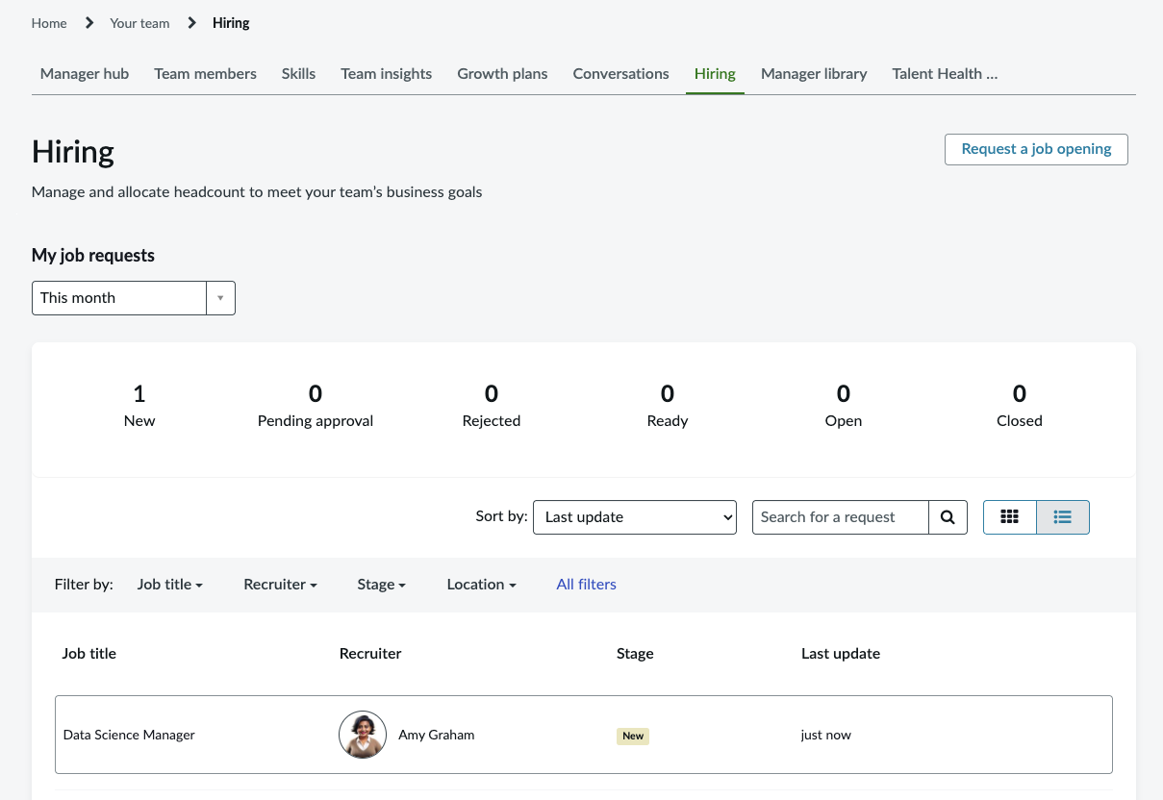
Hiring tab
Manager Hub
Hiring managers can:
View lists of their open and closed requisitions
Request new job openings
View recommended resources and knowledge base articles

Slide 23
Talent Profile

Slide 24
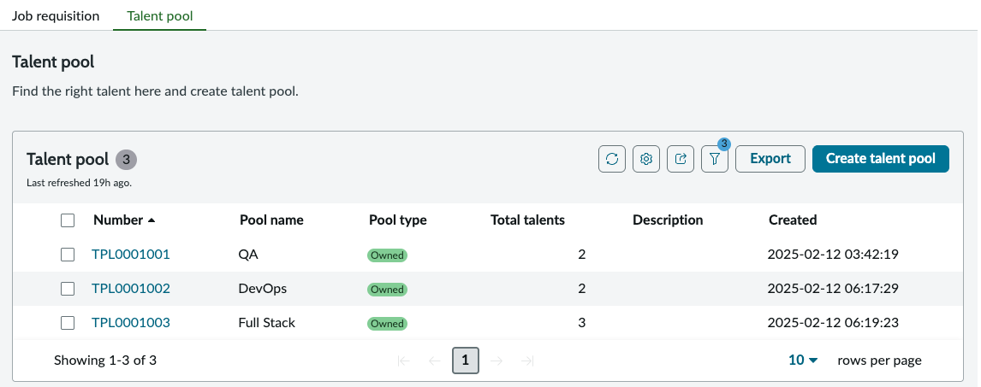
Talent profile overview
Recruiters create and manage talent profiles and pools to have a unified view of talent, track past interactions, and make informed sourcing, screening, and interview management decisions with hiring managers.

Slide 25
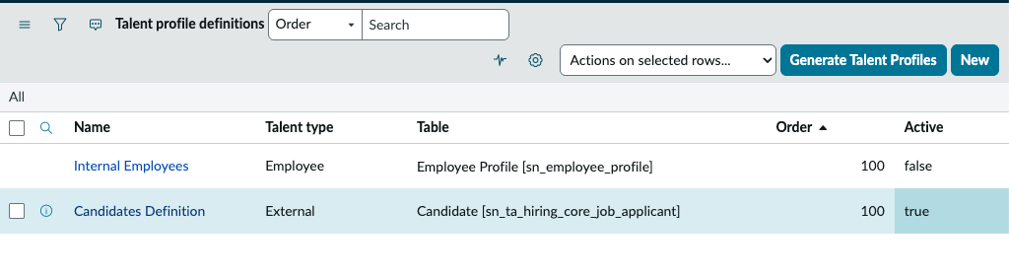
Talent profile definitions
Create talent profile definitions for various types of talent to generate comprehensive talent profiles.
Talent types:
External
Employee
Alumni
Contingent
Notes:
Requirement: Define each talent type that will be used by the organization and the attributes which define each talent type for the role to be assigned

Slide 26
Talent profiles
Create talent profiles to add to the talent profile repository for your organization. Talent profiles help optimize hiring processes.
Talent profiles can be automatically generated from the talent profile definition.

Slide 27
Job Requisition Management

Slide 28
Job requisition process
Create job requisition (manually, using Agentic AI or intake through ATS integration)
Create job description (manually or using a job description template)
Submit for approval
Open requisition
Assess applications
Align on scheduling preferences for upcoming interviews
Schedule interviews
Provide interview feedback on applicants
Offer job to an applicant
Applicant accepts job
Close requisition

Slide 29
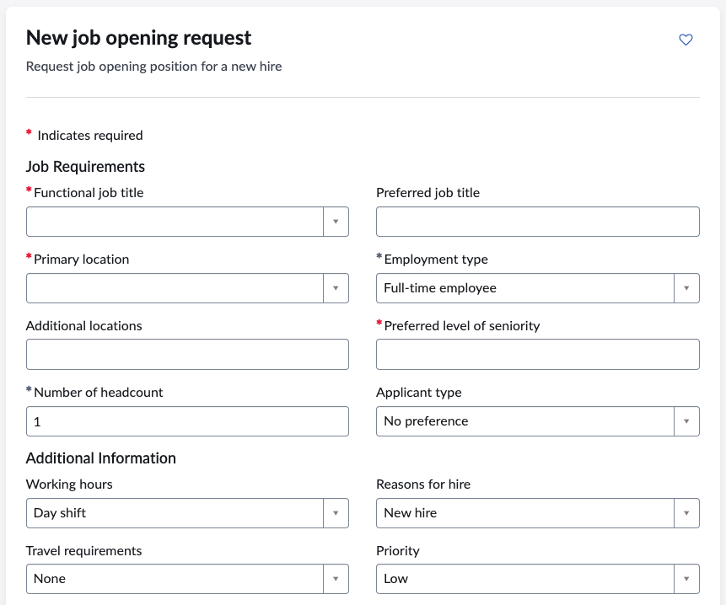
New job opening request
Record producer
Hiring managers can submit a request for a job requisition directly from the Hiring tab within Manager Hub.
Notes:
If customer is implementing Now Assist, demo the Create Job Requisition AI Agents

Slide 30
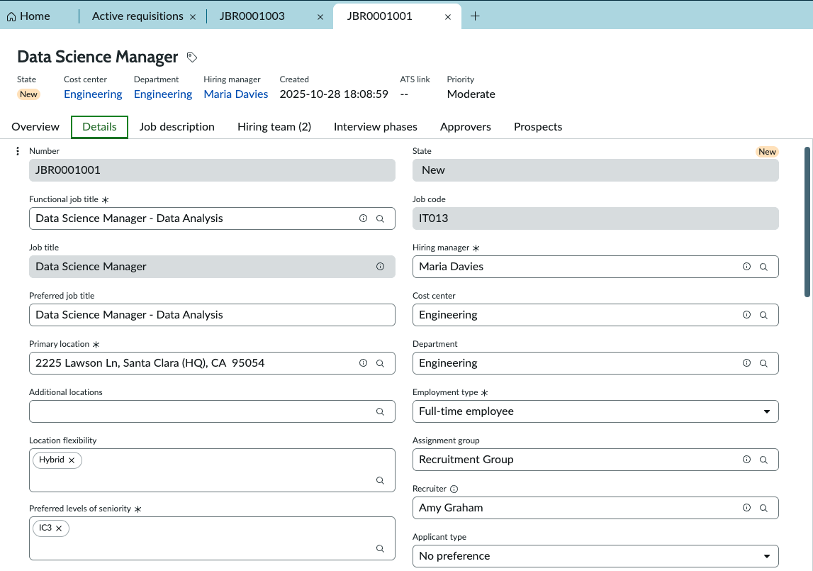
Job requisition assignment
Create assignment groups to allocate job requisitions efficiently among the recruiters.
The process of assignment might be automated or manual to:
Allocate a type of job requisition to a group
Automate the process of job requisition assignment
Decrease the time spent on determining which requisition should be assigned to which recruiter

Slide 31
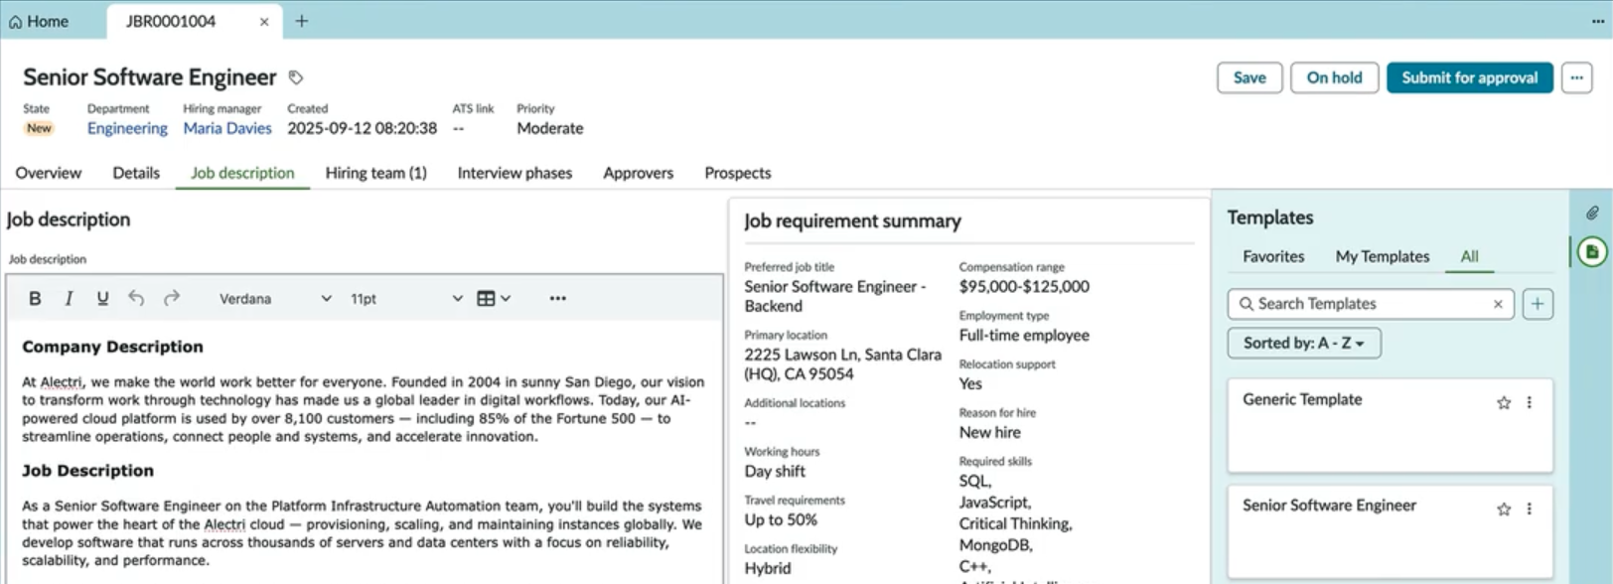
Job description templates
Create standard job descriptions that can be used for similar roles. The job descriptions make the process of requesting a job opening easier and more streamlined.
Define job description templates which are available globally to all recruiters.
Recruiters can create job description templates for themselves and add these templates to assignment groups to which they belong for other recruiters to use.

Slide 32
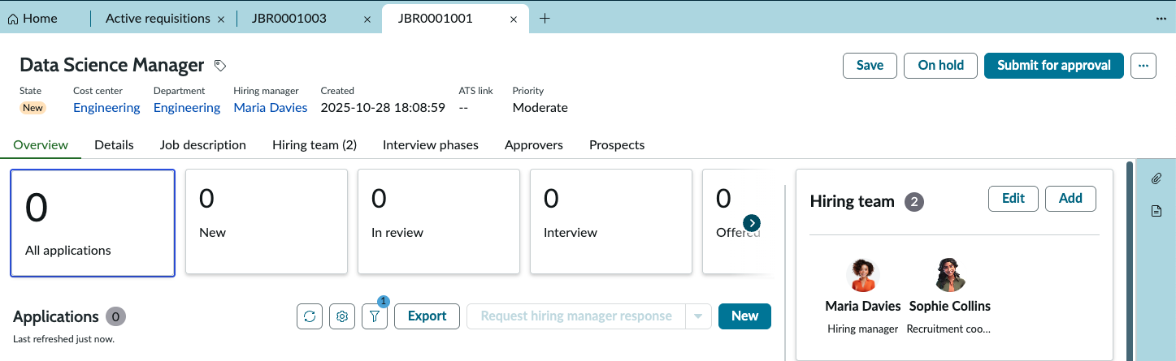
Job requisition approvals
Submit a job requisition for approval to higher management.

Slide 33
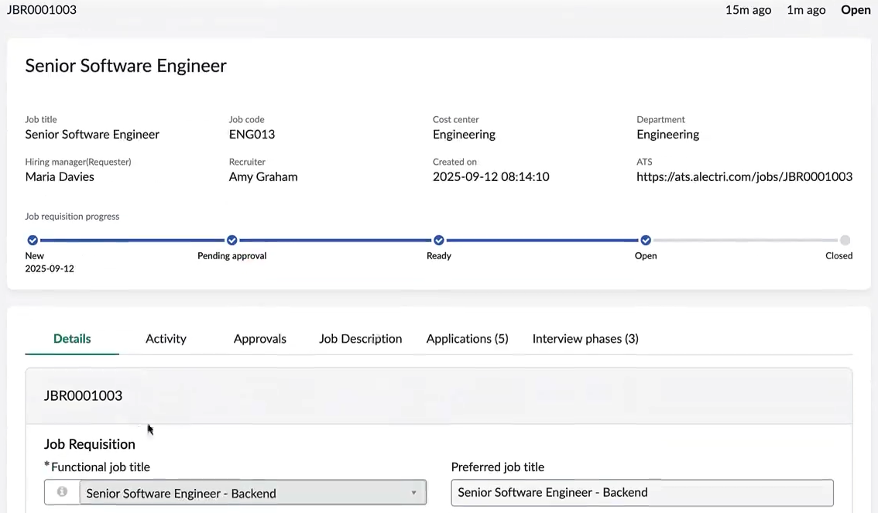
Job requisition view
Hiring Manager
Open requisitions can be viewed by the Hiring Manager on Manager Hub.

Slide 34
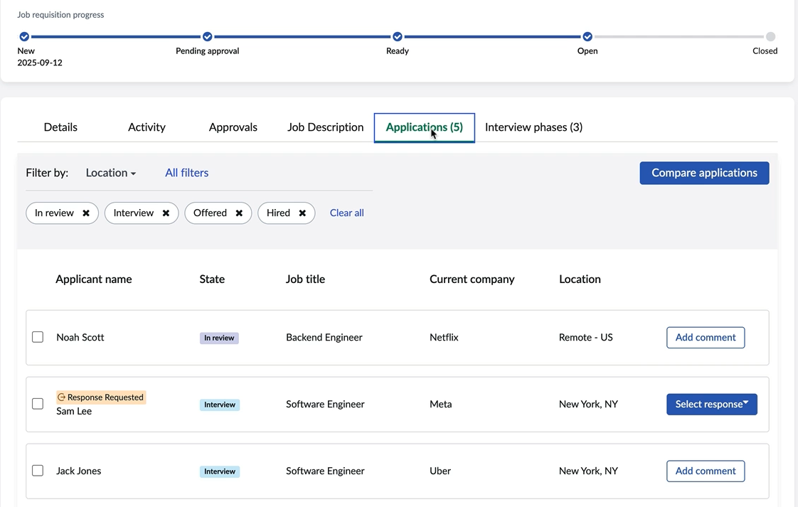
Job requisition view
Hiring Manager
View the current state of the job requisition as well as:
Details
Activity
Approvals
Job Description
Applications
Interview phases

Slide 35
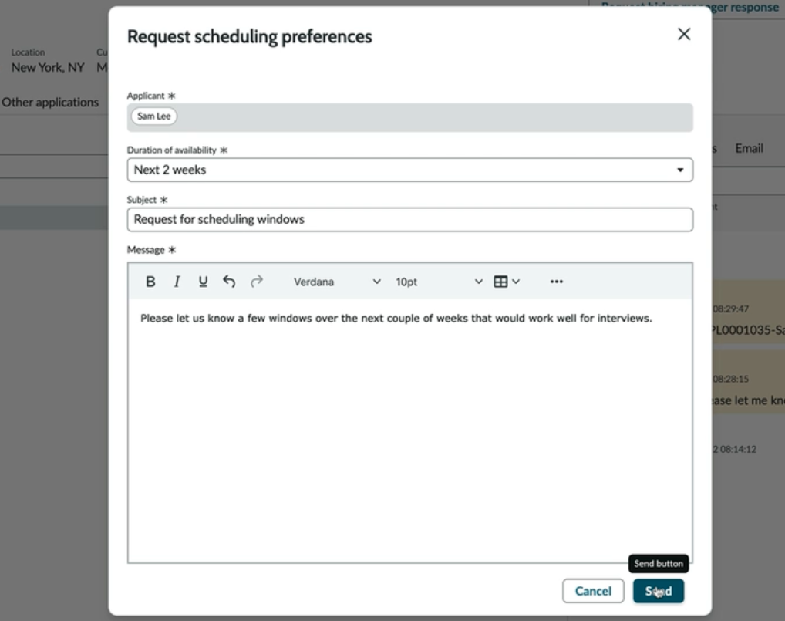
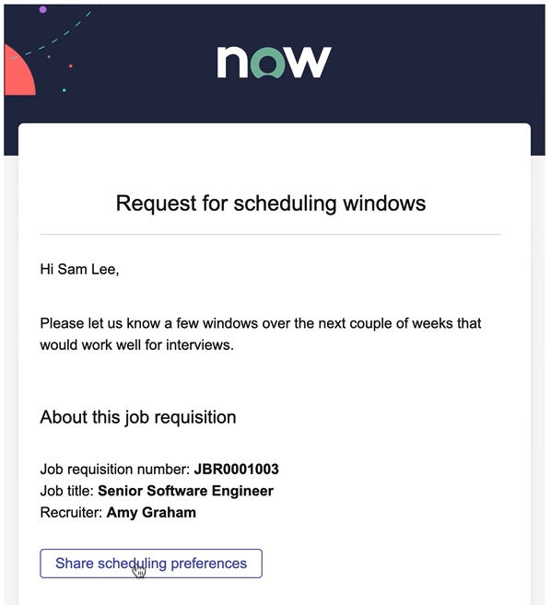
Scheduling windows request
Email to applicant
The recruiter can request applicant availability for interviews, which sends an email to the applicant, directing them to the Applicant Center where they can share their scheduling preferences.
Notes:
Emails & notifications can be branded for the company so that it's clear who the communications are from.

Slide 36
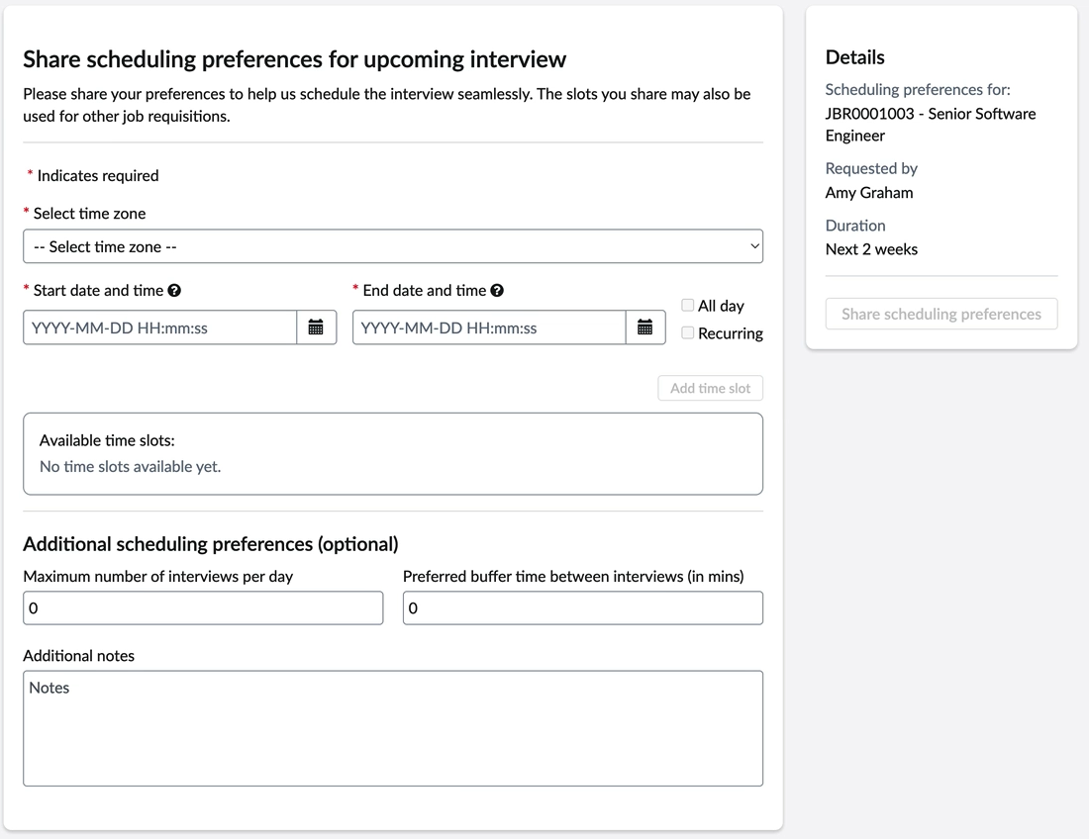
Applicant scheduling preferences
Applicant Center
The applicant can share their scheduling preferences for the upcoming interview directly on Applicant Center.

Slide 37
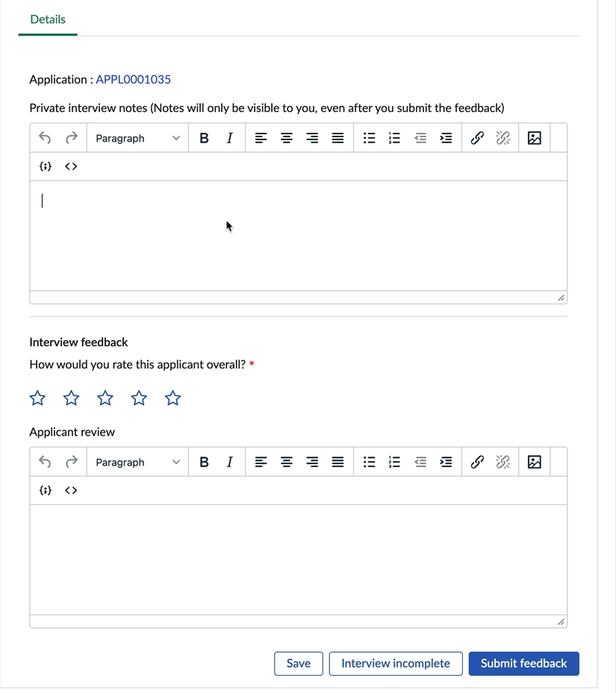
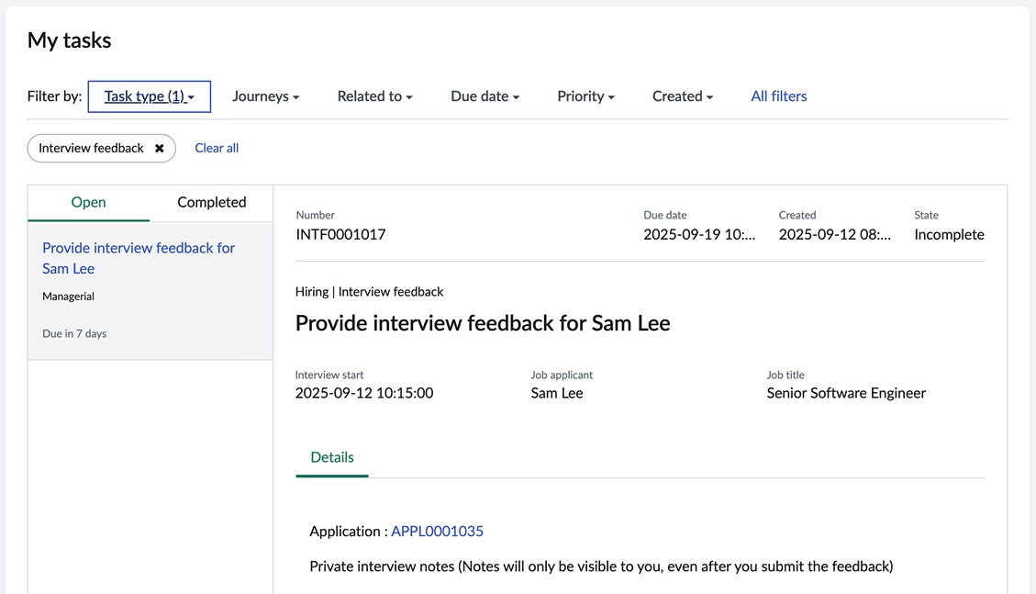
Provide interview feedback
Interviewers / Hiring managers
Hiring managers and other interviewers provide feedback on the applicant after the interview.

Slide 38
Compare applications
Hiring Manager
From a requisition on the Hiring tab, the Hiring Manager can view all applications for the role and compare applications for full visibility.

Slide 39
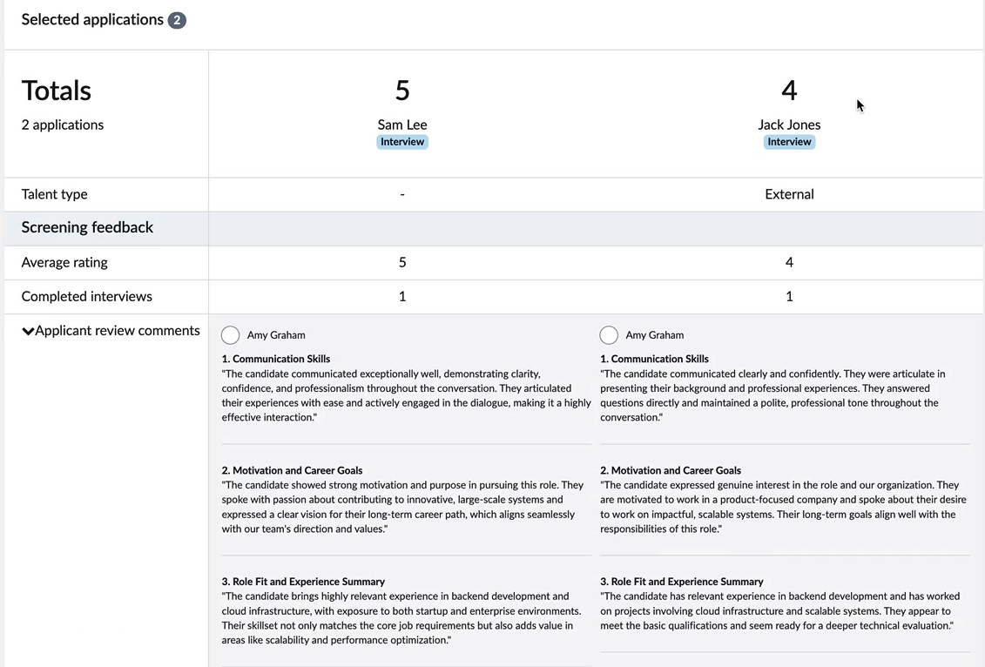
Compare applications
Hiring Manager
The Hiring Manager can view feedback and ratings for the applications selected, ensuring that information is compared fairly and accurately.

Slide 40
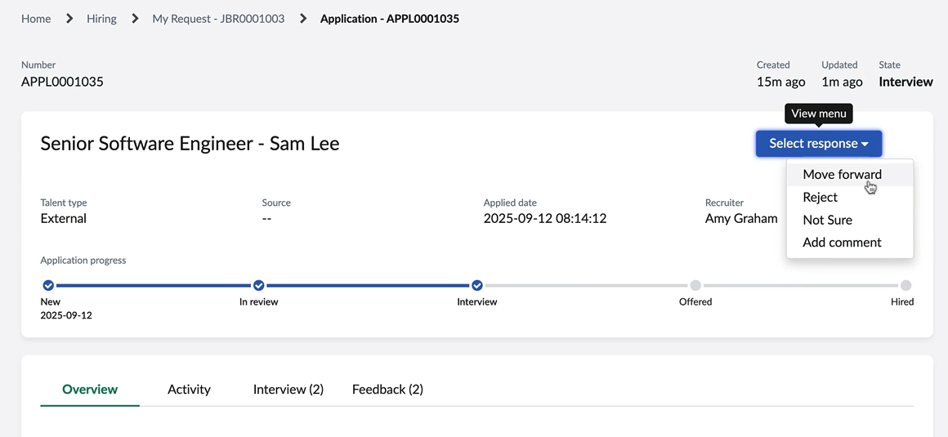
Feedback on an application
Hiring Manager
Once the Hiring Manager has decided, they can provide feedback on each application.

Slide 41
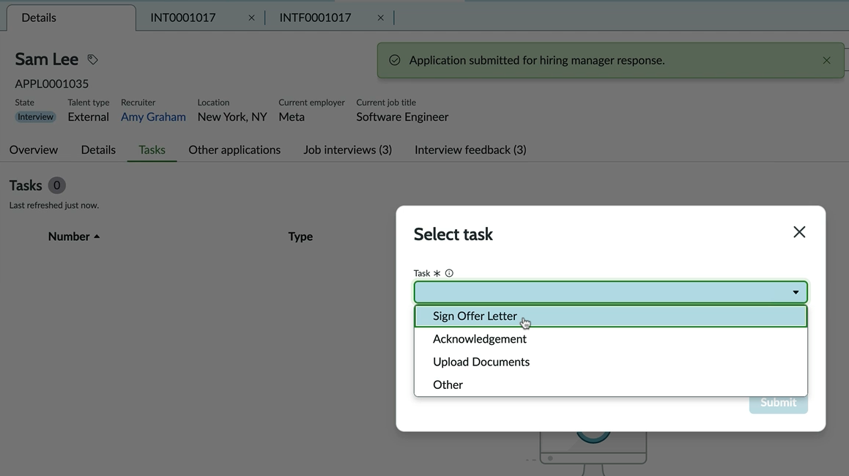
Hiring task templates
Recruiter
Create tasks for applicants or internal stakeholders within the Recruitment workspace and assign it to the respective personas.
For example, use the “Sign Offer Letter” template to offer the job to an applicant.

Slide 42
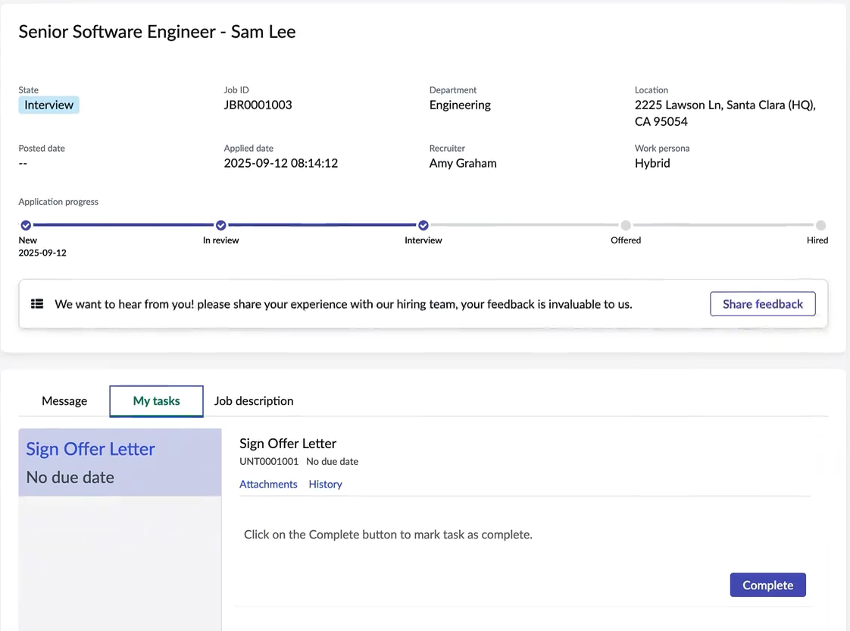
Hiring task templates
Applicant Center
Applicant can complete their tasks on the Applicant Center.

Slide 43
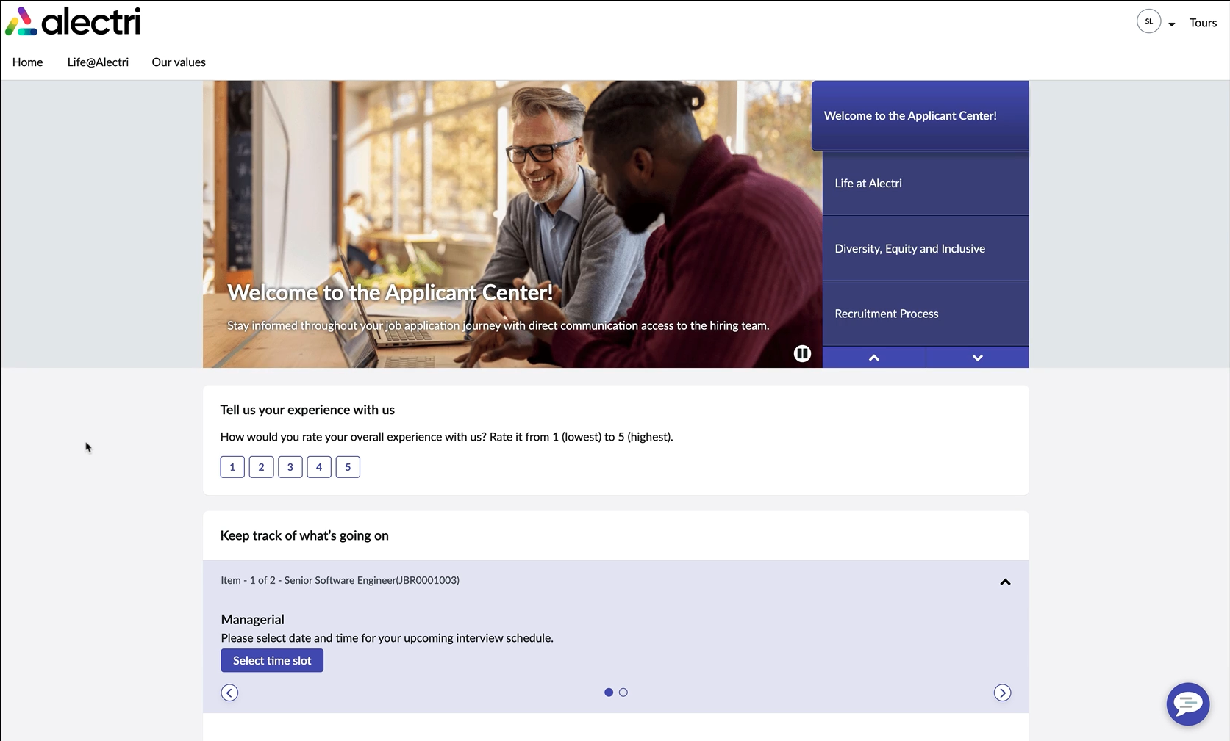
Applicant survey
Receiving feedback from applicants can improve the hiring process. Applicants can submit feedback using the Applicant Survey on the Applicant Center.

Slide 44
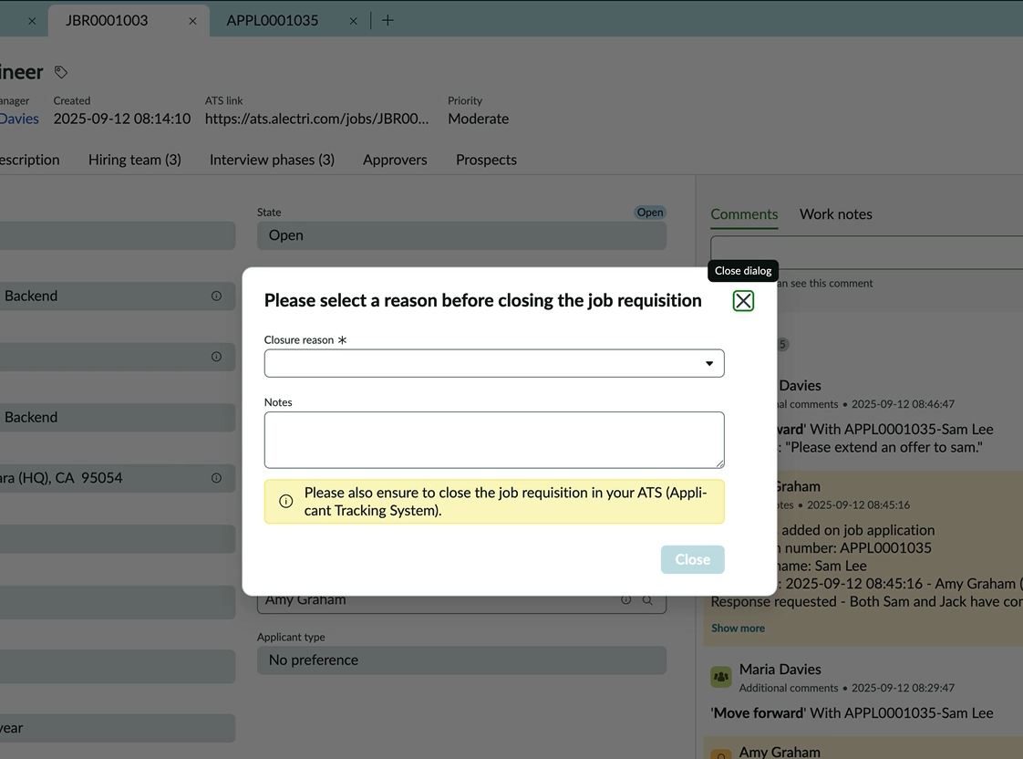
Close job requisition
Recruiter
Once the hiring process is complete, close the job requisition.

Slide 45
MS Teams integration
MS Teams integration is available to receive Virtual Agent notifications in the Microsoft Teams messaging app
Configure the Virtual Agent notifications to provide prompt updates for hiring managers and recruiters in Microsoft Teams

Slide 46
Recruitment Workspace

Slide 47
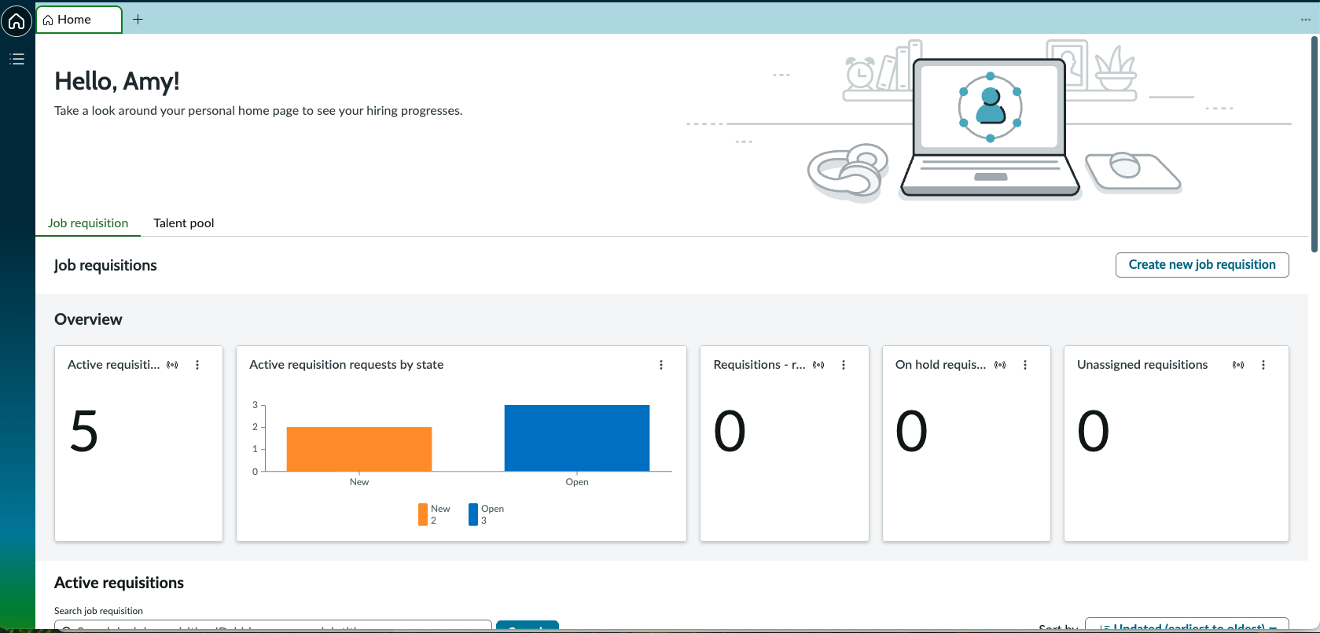
Recruitment Workspace homepage
Recruiter
The Recruitment workspace:
Centralizes job requisition tracking
Boosts hiring efficiency
Enhances applicant engagement
Enables recruiters to make smarter decisions with talent insights
Notes:
Recommendation: Create a knowledge base for recruiters to provide them with information specific to their role.

Slide 48
Job requisition tab
Overview
Interactive widgets in the Overview section:
Active requisitions
Active requisition requests by state
Requisition – recruitment coordination
On hold requisitions
Unassigned requisitions

Slide 49
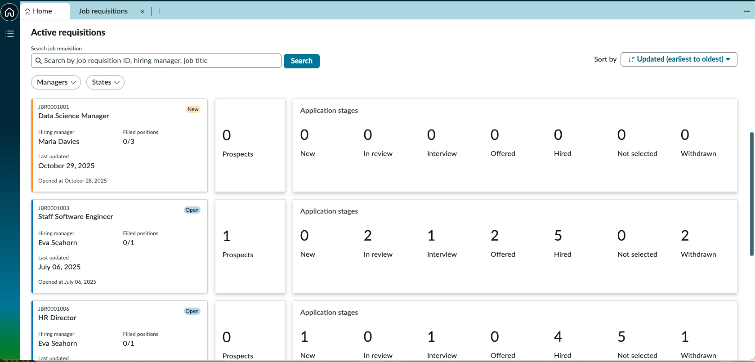
Job requisition tab
Active requisitions
Interactive view of requisitions which includes:
Ability to search by job requisition ID, hiring manager, and job title
Ability to filter on state, updated date, and created date
Link to the job requisition record
Summary of prospects & application stages

Slide 50
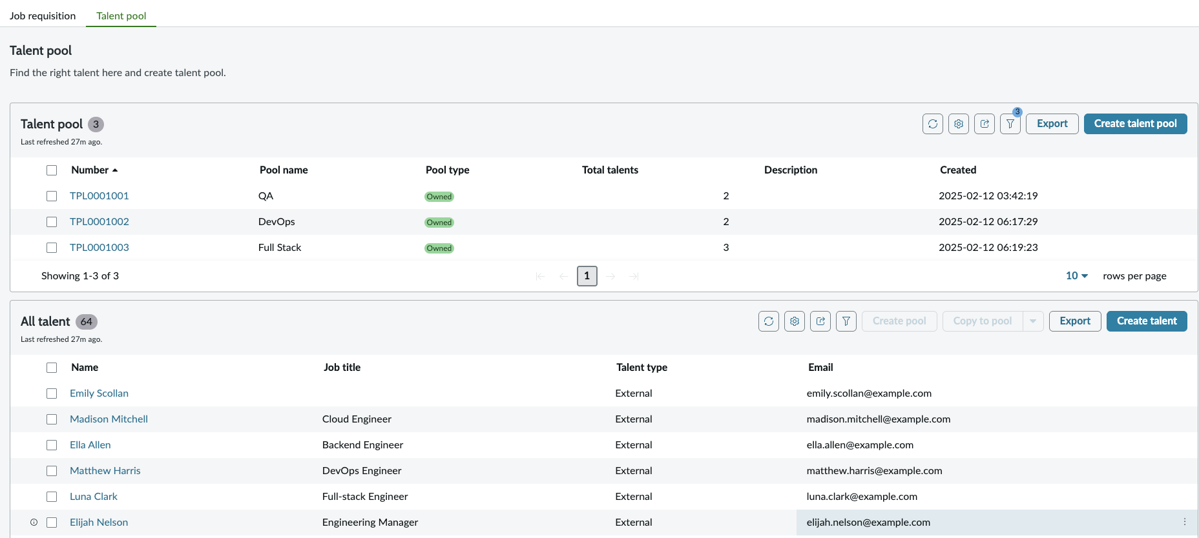
Talent pool tab
Create Talent pools to organize similar talent profiles in one place for hiring requirements.
Talent pools can be created by:
Creating a new talent pool and manually adding profiles
Selecting multiple profiles and creating a talent pool for those profiles

Slide 51
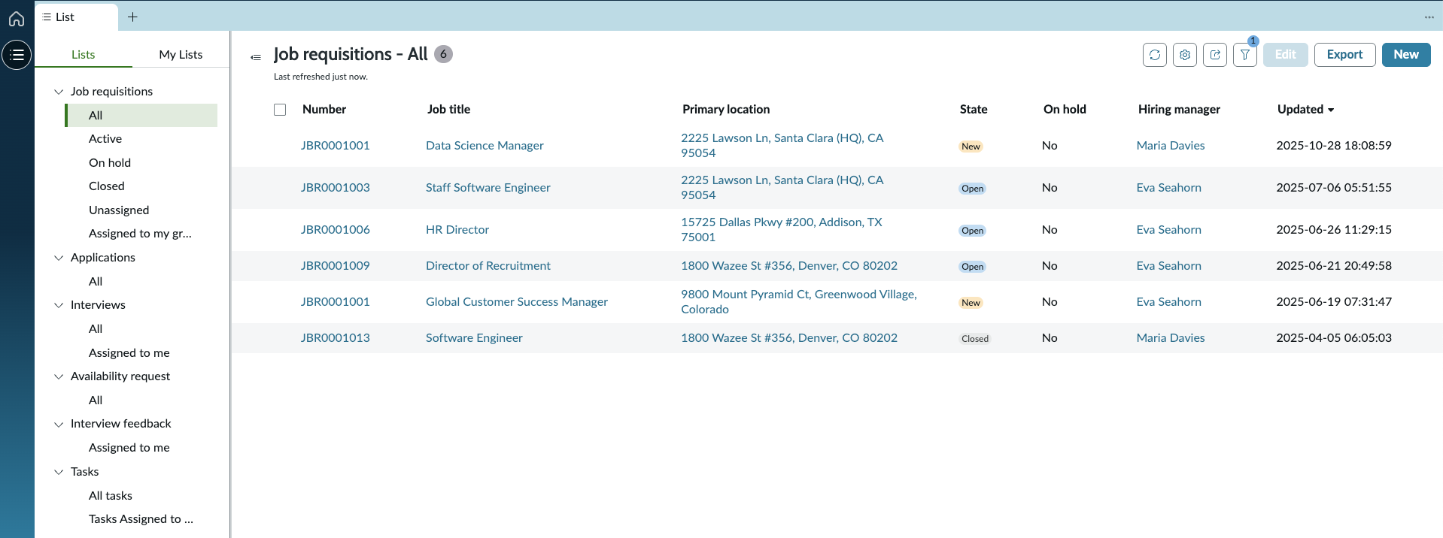
Navigation menu
Navigate using the menu to view:
Job requisitions
Applications
Interviews
Availability requests
Interview feedback
Tasks

Slide 52
Job requisition list view
View job requisition details in the list view:
Number
Job title
Primary location
State
On hold
Hiring manager
Updated

Slide 53
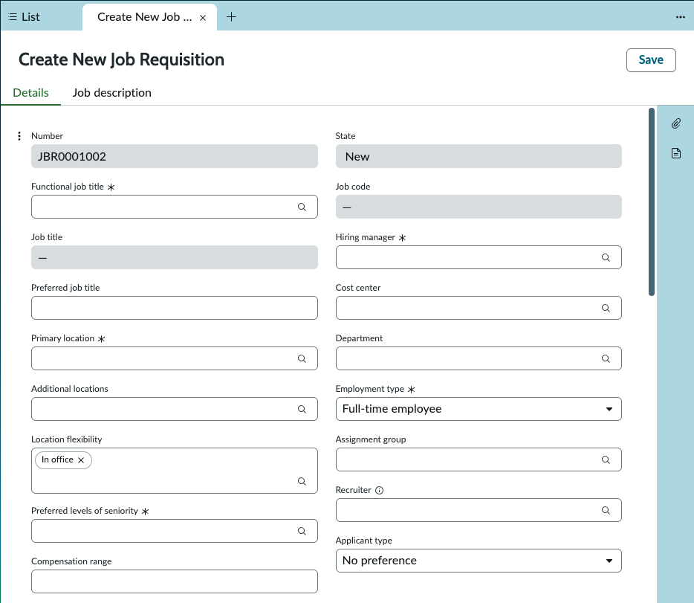
Create new job requisition form
As a recruiter, complete the create new job requisition form to request a job opening in your organization.
Notes:
Switch over to an instance and do a live demo of the form as you gather the requirements

Slide 54
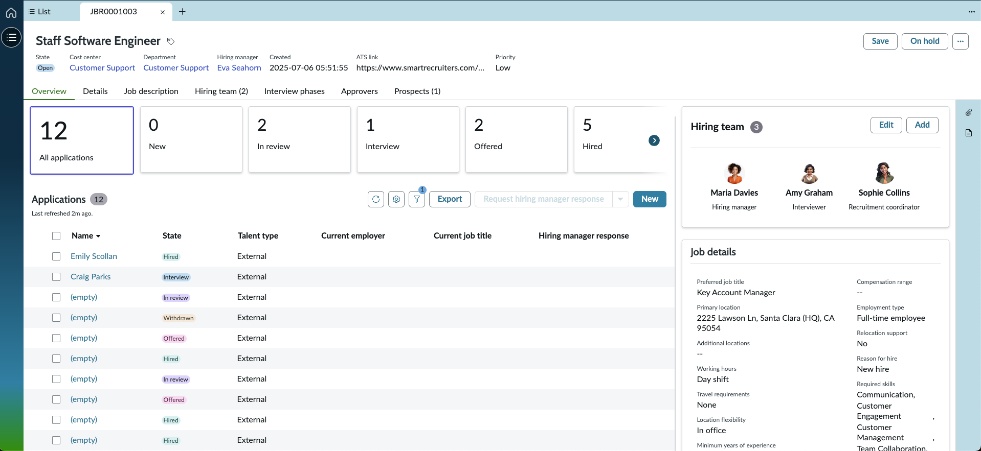
Job requisitions
Related lists
View details related to each job requisition, including:
An overview of the applications, hiring team, and job details
Details of the information provided in the initial job requisition
Job description
Hiring team
Interview phases
Approvers & approvals
Prospects
Notes:
Switch over to an instance and do a live demo of the entire form and answer any questions from the customer

Slide 55
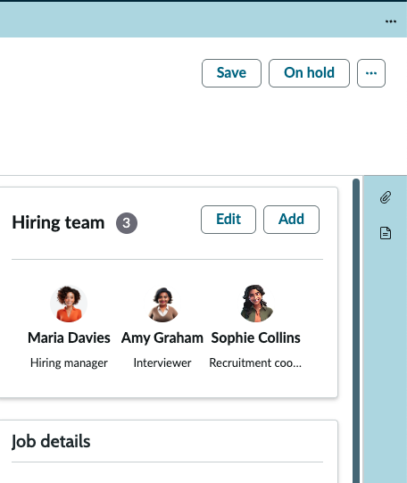
Job requisitions
UI actions
Move the job requisition forward at the appropriate time in the process using the UI action buttons in the upper right corner:
Save
On hold
Resume
Submit for approval
Cancel approval
Resend for approval
Open requisition
Duplicate
Close

Slide 56
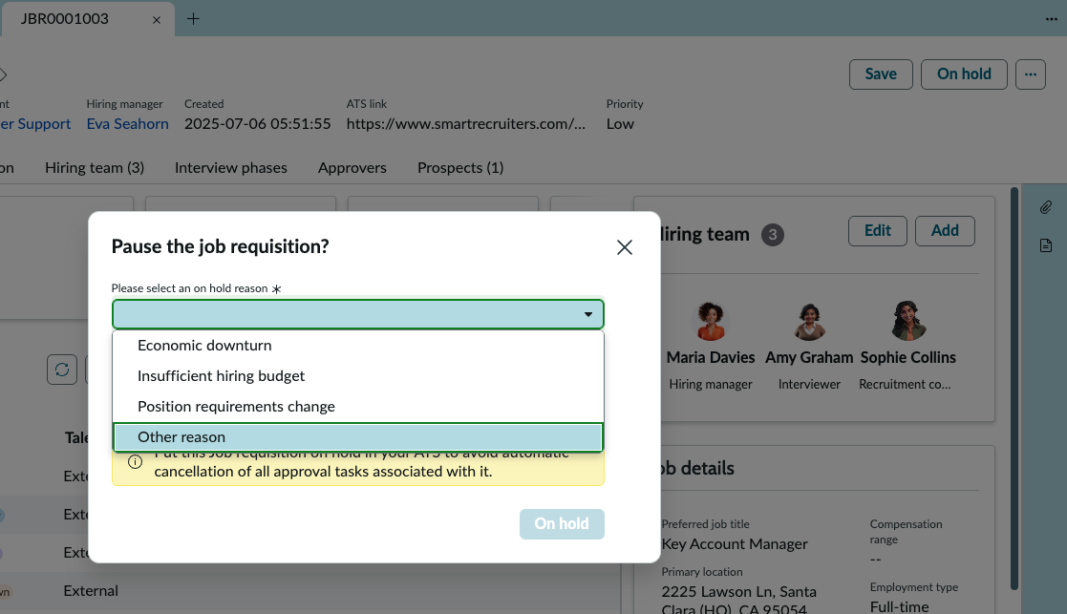
Job requisitions
On hold reasons
When placing a job requisition on hold, select a valid reason.

Slide 57
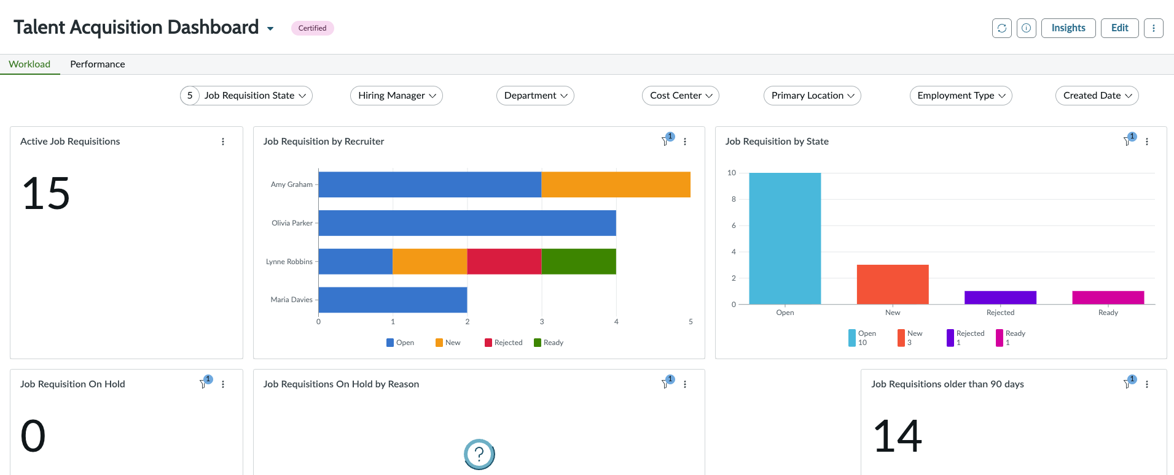
Talent acquisition dashboard
View performance analytics reports to gain an overview of the workload and performance details of the hiring efforts in your organization.

Slide 58
Interview Management

Slide 59
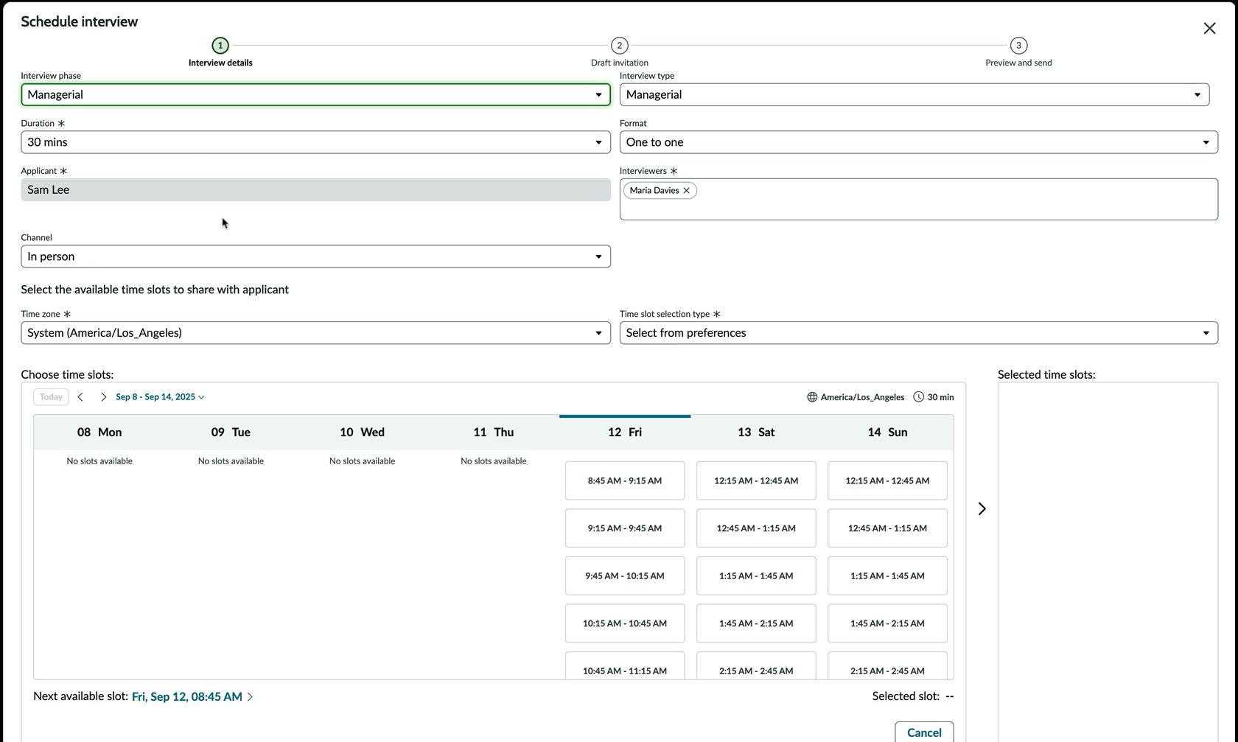
Outlook integration
Integrate with Outlook calendar to view valid interview times that are available for all interviewers and the applicant (who supplied their availability through the scheduling preferences form on the Applicant Center).
Notes:
If customer is implementing Now Assist, demo the Interview Scheduling AI Agent

Slide 60
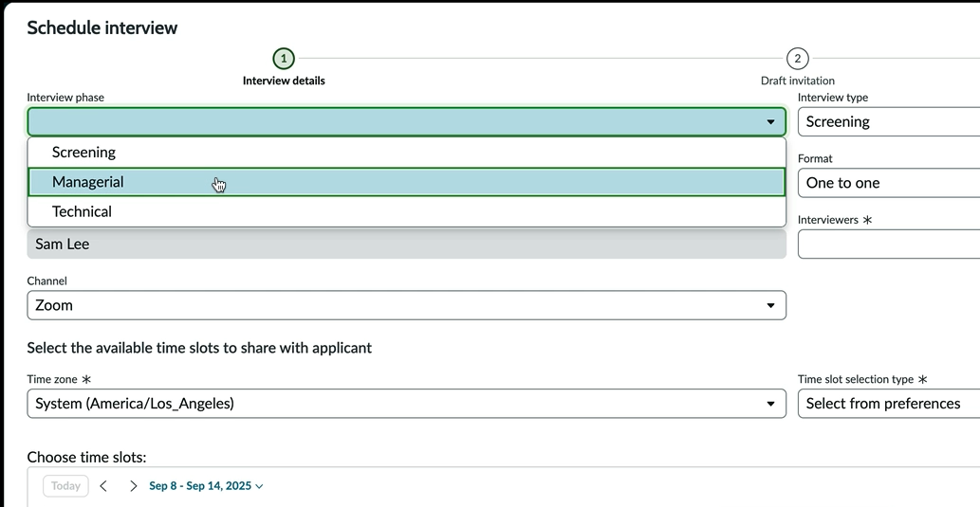
Zoom integration
Configure Zoom to seamlessly integrate meeting invites originating from Hiring Experiences with your Zoom account.

Slide 61
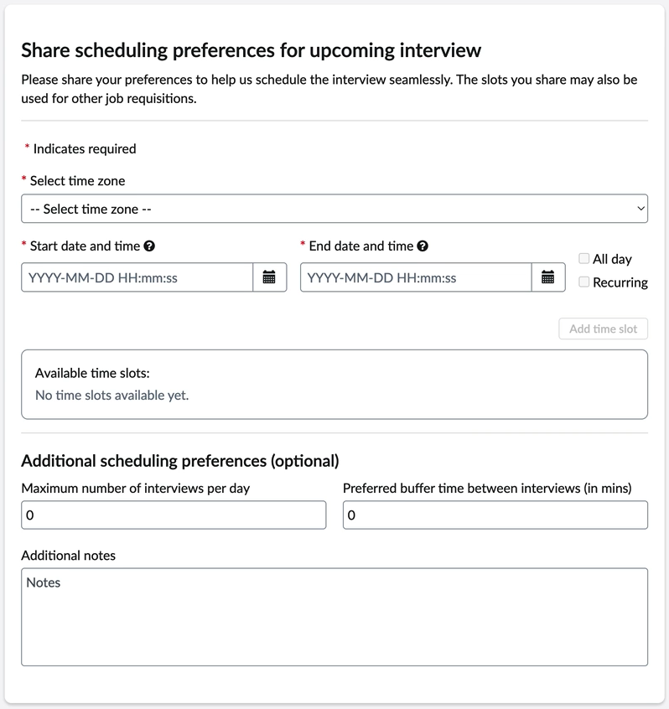
Scheduling preferences form
The scheduling preferences form provides the fields required to request an applicant or interviewer to share their scheduling preferences for upcoming interviews.

Slide 62
Schedule interview form
The schedule interview form contains the fields required to schedule an interview with an applicant.

Slide 63
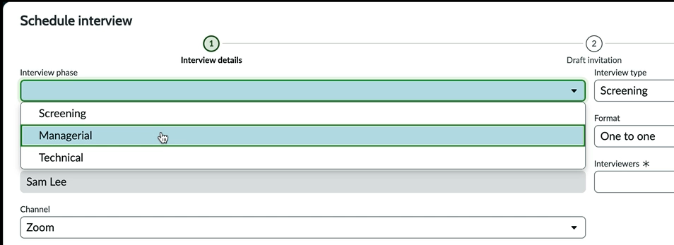
Interview phase templates
Types of interviews
Interview phase templates can be defined to ensure each type of interview is structured with the appropriate details, including:
Format of the interview (one-on-one, panel)
Channel (Zoom, phone call, in person)
Duration
Order
Notes:
OOB Types:
Screening
Technical
Managerial
Executive
Cultural fit

Slide 64
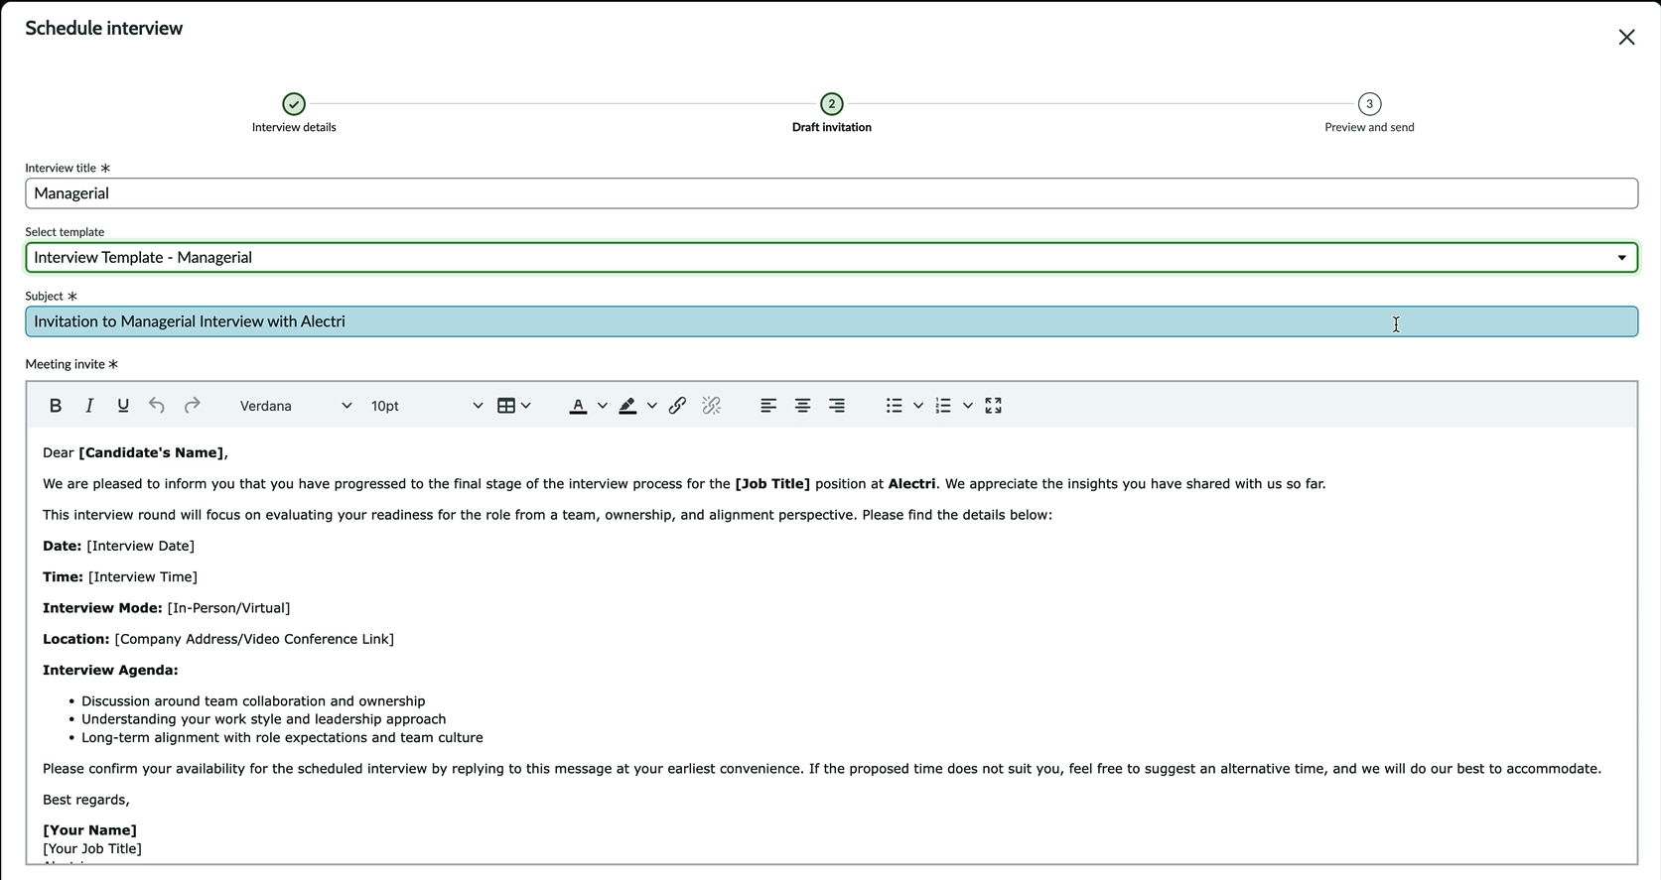
Interview invite email templates
Interview templates are available for recruiters to use to streamline the interview scheduling process.

Slide 65
Interview feedback form
Interviewers / Hiring managers
Hiring managers and other interviewers provide feedback on the applicant after the interview via the interview Feedback form.

Slide 66
Applicant Center

Slide 67
Applicant Center
Overview
Applicant Center offers a streamlined and tailored experience for applicants through a dedicated portal, enhancing their overall recruitment experience.
Notes:
Applicant center can be customized for the company to provide a personalized experience:
Company branding
Custom header
Custom footer
Content & campaigns

Slide 68
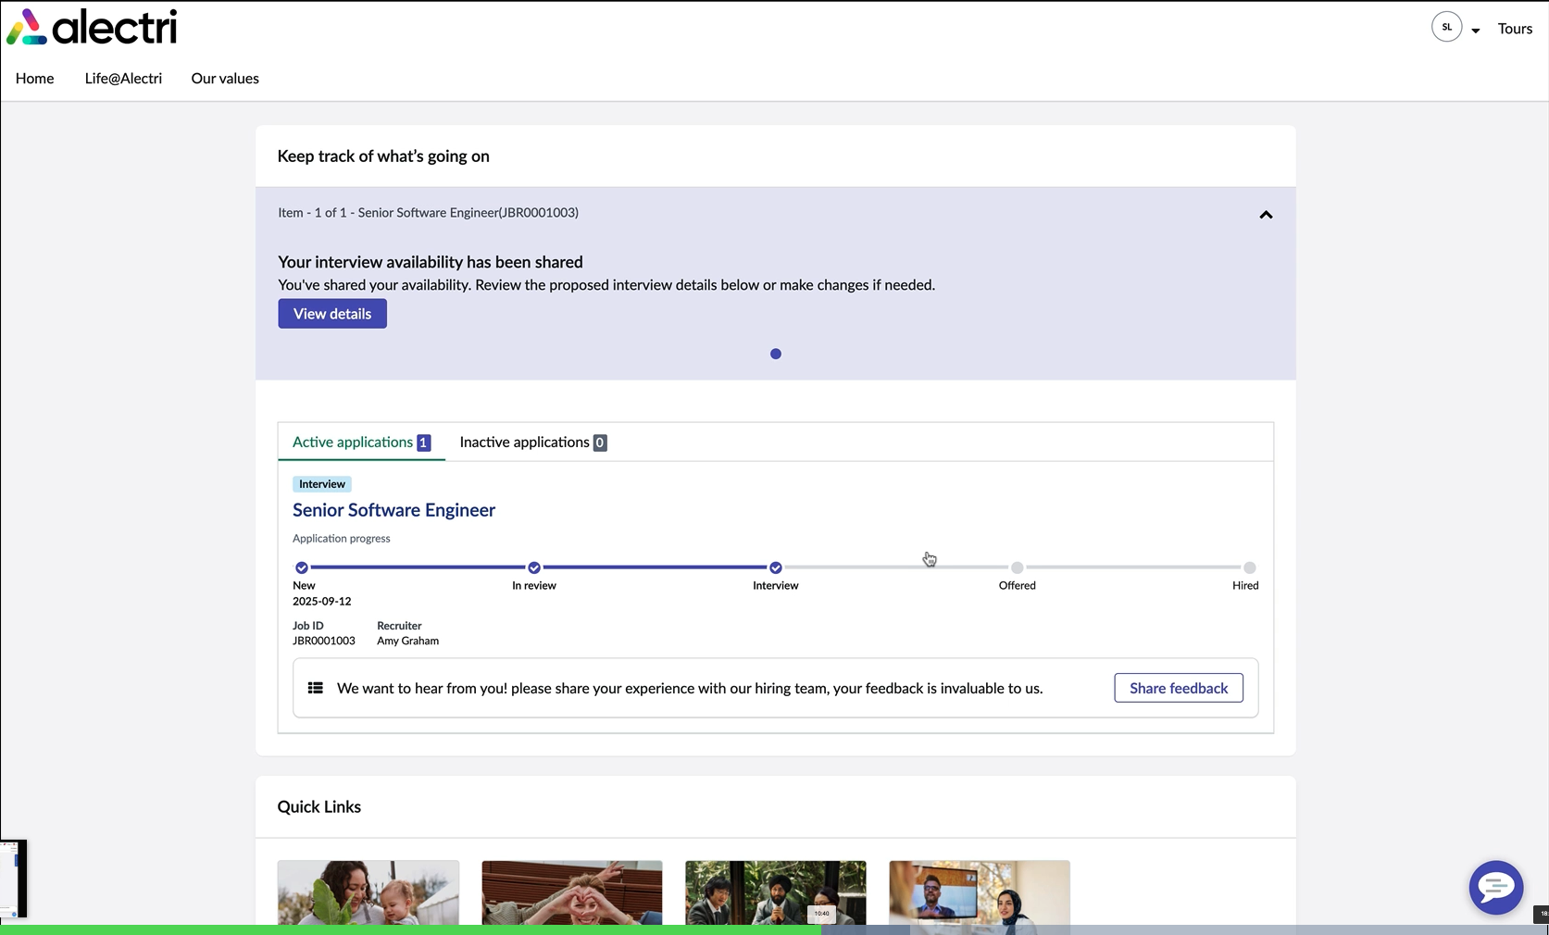
Applicant Center
Overview
Applicants have a clear view of where they are within the hiring process for each of their applications, as well as other resources such as the company values, culture, and a knowledge base with answers to their most common questions.
Notes:
Recommendation: Create a knowledge base for applicants to provide them with information for their common questions.

Slide 69
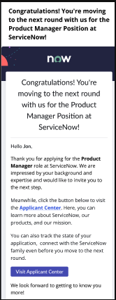
Applicant Center
Time limited authentication
The “No-login experience” With time limited authentication allows applicants to log into the Applicant Center without a password and explore the portal easily.

Slide 70
Applicant Center
Applicant scheduling preferences
The applicant can share their scheduling preferences for the upcoming interview directly on Applicant Center.

Slide 71
Applicant Center
Interview scheduling
Once the Recruiter has found a few time slots that work for all interviewers, the applicant can select the time slot they would like the interview to take place.

Slide 72
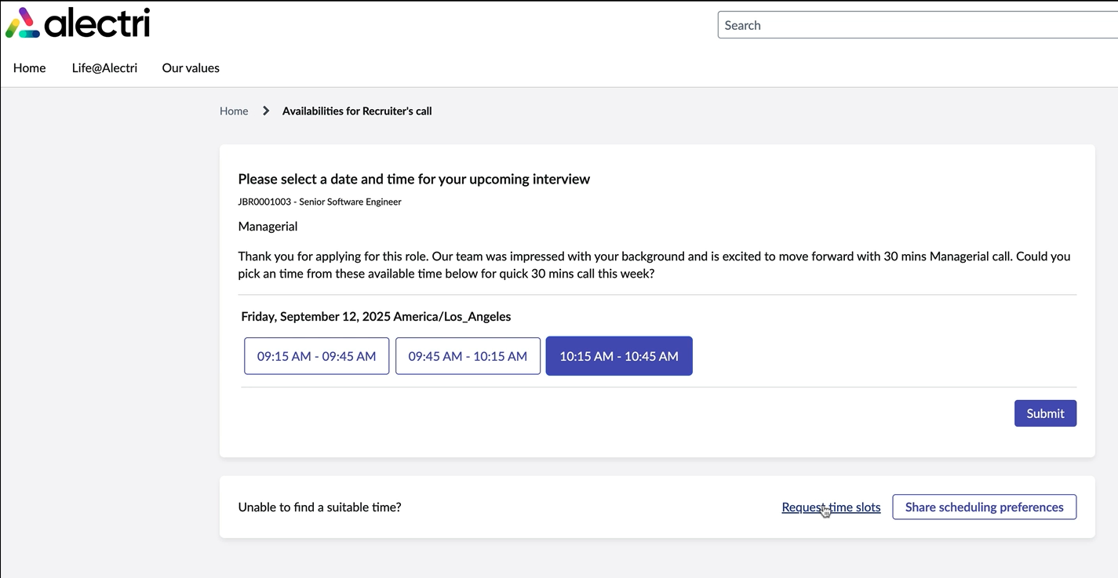
Applicant Center
Interview scheduling
Once the Recruiter has found a few time slots which work for all interviewers, the applicant can select the time slot they would like the interview to take place.

Slide 73
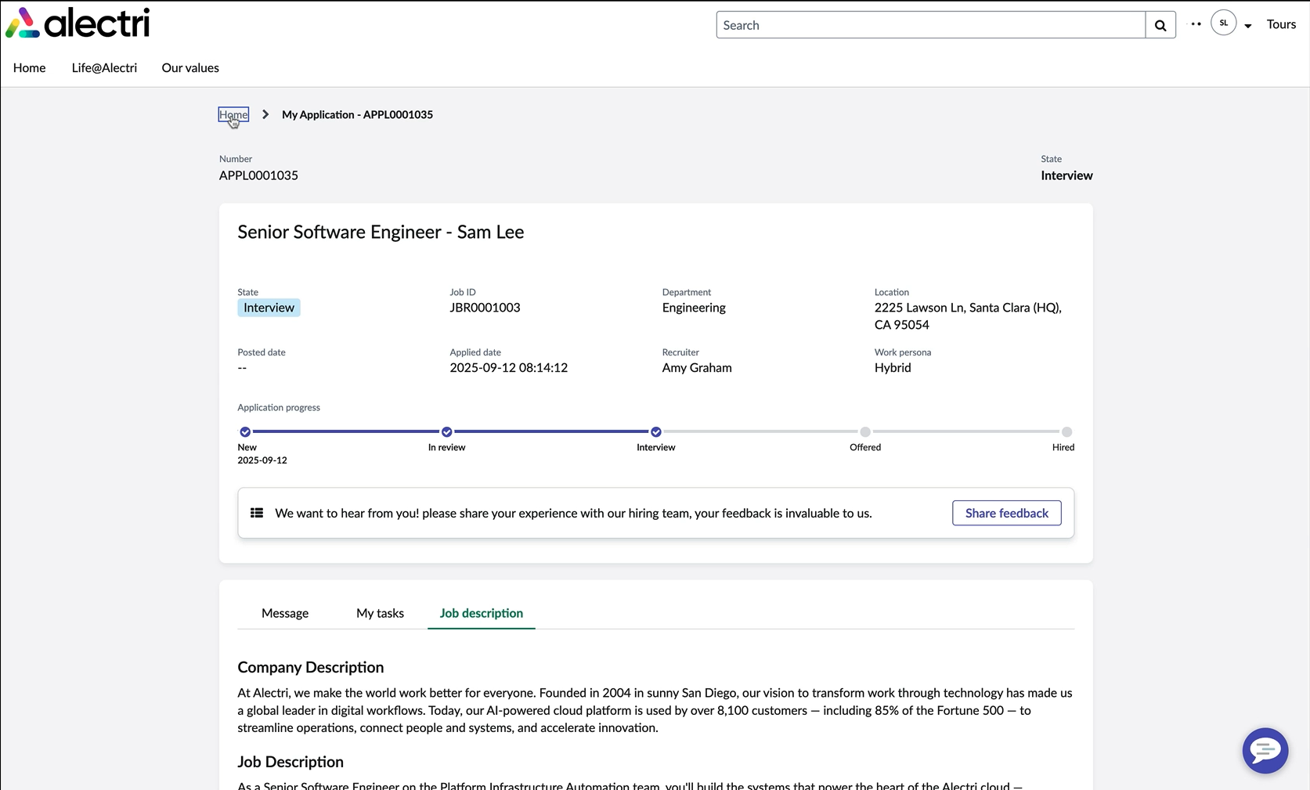
Applicant Center
Application visibility
Open an active job application to view the details:
The overview section shows details such as recruiter, location, and work persona
Message a recruiter from the Message tab
View any tasks that require action on the My tasks tab
Review the job description before the interview on the Job Description tab

Slide 74
Applicant Center
Hiring tasks
Applicants can complete their tasks on the Applicant Center, such as signing the offer letter.

Slide 75
Applicant Center
Applicant survey
Receiving feedback from applicants can improve the hiring process. Applicants can submit feedback using the Applicant survey on the Applicant Center.

Slide 76
Opportunity Marketplace

Slide 77
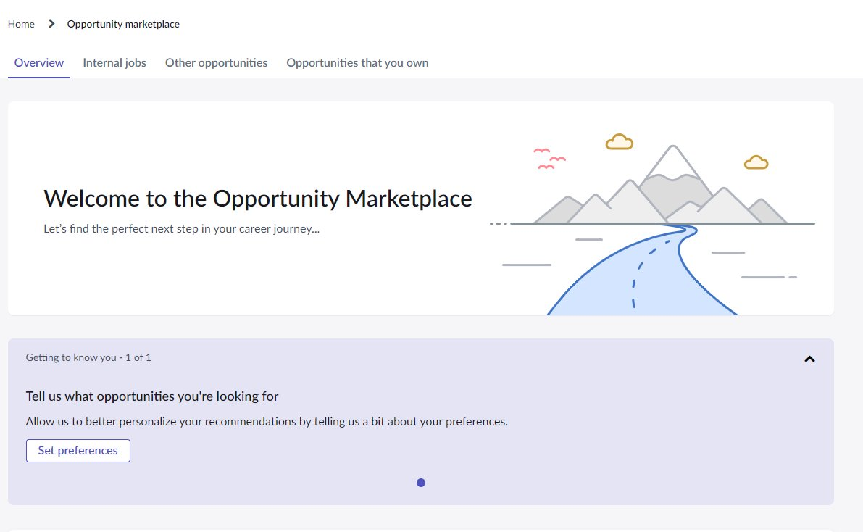
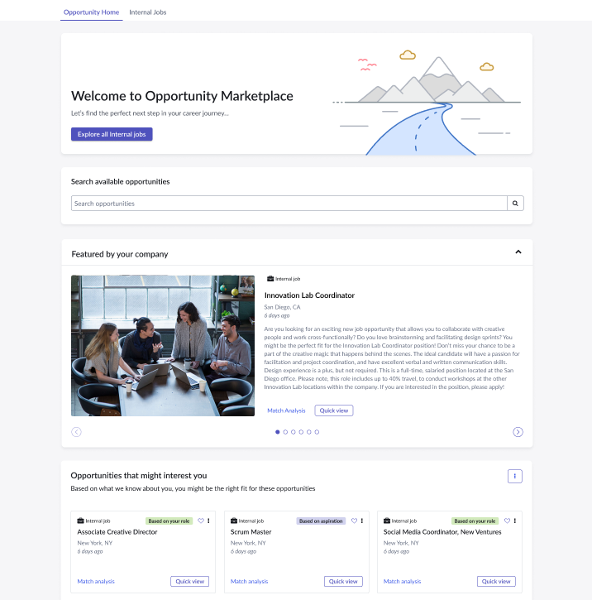
Opportunity Marketplace overview
Opportunity Marketplace allows employees to explore and apply for internal job postings and other available opportunities
Search and explore available opportunities
View jobs featured by the company
View system-generated job recommendations
1
2
3
Notes:
Search includes AI and a basic text search
Jobs are listed via an integration with one or more ATSs (Applicant Tracking Systems)
Multiple postings per requisition are possible (for example, for multiple locations)
Jobs can also be posted without a requisition
Opportunities can be created from an SPM project
When creating Opportunities, SPM users are able to select from their SPM Projects to generate their Opportunity
“Opportunities that might interest you” section:
View job recommendations based on current skills, experience, and aspirations
Recommendations are based on the weight of 80% of skills and 20% of preferences
Configurable Opportunity Types
Gigs (short term role)
Projects (multiple roles)
Volunteer (multiple roles)
Customer Defined Opportunity Types (define these as needed)

Slide 78
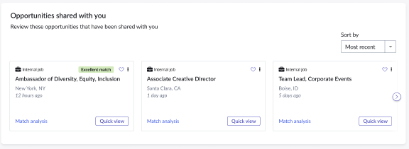
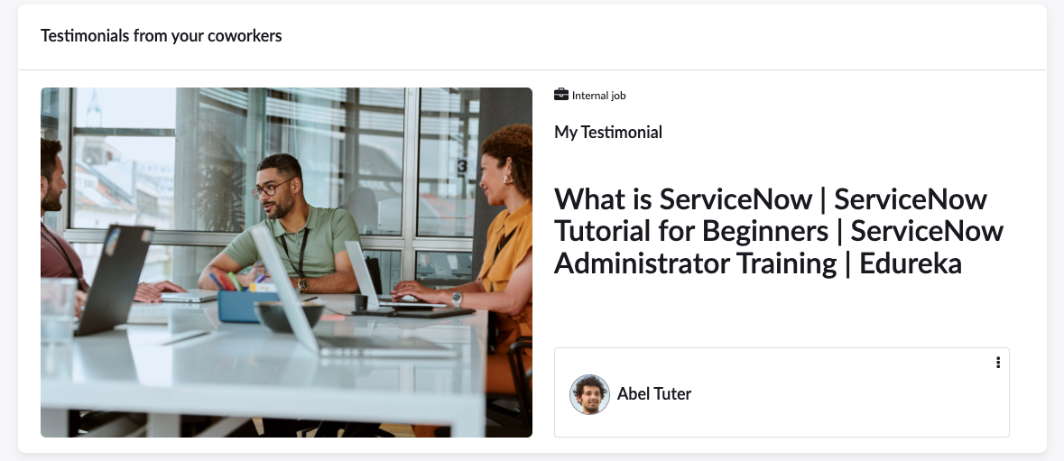
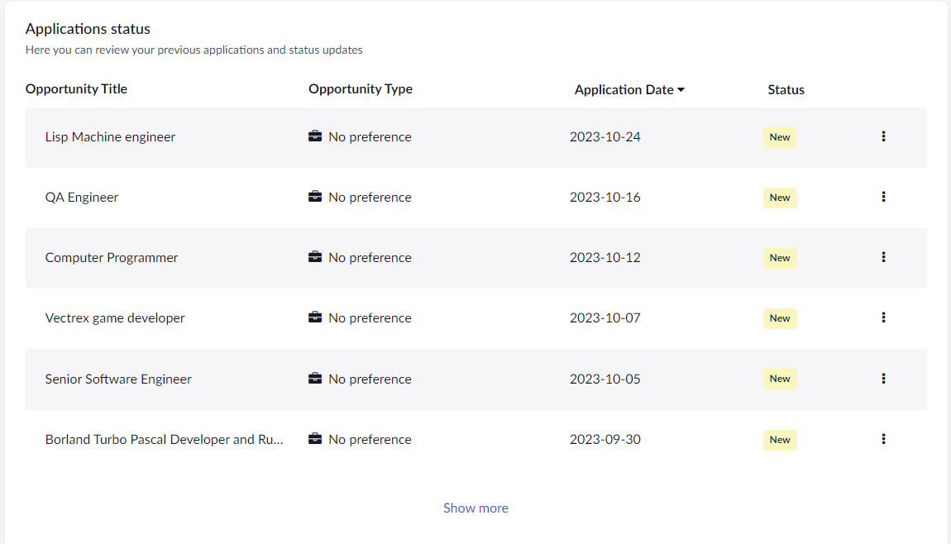
Opportunity Marketplace overview
View any opportunities that have been shared with you
View testimonials from other colleagues that highlight their success
View statuses of existing applications
Notes:
If any opportunities have been shared with you, an additional widget named “Opportunities shared with you” will appear
Testimonials are controlled by admins
Application status: Note ongoing application interactions between recruiter/hiring manager and employee are handled via external ATS

Slide 79

Internal jobs
Set up preferences for recommended jobs
Browse opportunities
View internal opportunities in a Summary view
Apply for opportunities
Refer an opportunity to a friend

Slide 80

Other opportunities
Review recommended opportunities​
Search for opportunities​
Apply for opportunities
Track opportunities that you have applied to​

Slide 81

Opportunities that you own
Create and post new opportunities​
Review progress of opportunities​
Review applicants for opportunities​
Accept/Decline applicants​

Slide 82


Preferences survey
Introductory survey allows employees to set marketplace-specific preferences
A wizard that invites employees to complete a quick survey to define their marketplace preferences, such as:
Work persona (remote, hybrid, etc.)
Travel frequency
Job levels
Work locations
Notes:
Wizard is available via quick action menu in the “Opportunities that might interest you” section for ongoing maintenance of preference following the initial experience

Slide 83

Search available opportunities
Enhanced opportunity home page that allows employees to search for opportunities of interest to them
Search and display of search results
Includes AI and a basic text search
Filter results
Favorite jobs for future reference
Use the Quick view to ….
System-generated ”Match analysis” compares employee’s skills and preferences with job opportunities
Use the quick action menu on an opportunity card to create an aspiration or to share the opportunity with a peer
1
2
6
3
4
5
Notes:
Opportunity Cards have a “Match analysis” link for employees to view:
Excellent match indicator
Skills where employee meets requirements
Skills where employee may need development
Identification of how opportunity matches the employee’s preferences

Slide 84
Questions?

Slide 85
Next Steps
Finalize requirements from this workshop | Complete homework Close out action items Schedule follow up workshops or meetings
Create stories | Write stories with acceptance criteria Create a backlog
Review & approve stories | Review stories and provide feedback or adjustments where needed Approve stories for development Begin configuration!

Slide 86
Thank you

Slide 88

Partner resources
Now Create
Product Docs
Now Learning
Partner Success Center
DemoHub
Find workshop decks, workbooks, and other documents with step-by-step delivery guidance based on leading practices.
Access Best Practices Portal Here
Use the ServiceNow Product Documentation site for solution details and step-by-step configuration guidance .
Access Product Docs Here
Visit Now Learning to take interactive trainings and learn more about the configuration of each product .
Access Now Learning Here
Bookmark the Partner Success Center for regular access to customer stories, first - call decks, industry insights, and more.
Access Partner Success Center Here
Prepare for interactive product demos using DemoHub narratives.
Access DemoHub Here

