Slide 1
HR Service Delivery Integration Delivery Options
Product Integration Options
Speaker Name
Asset Number: 0001323
June 2023
Notes:
Updated for May 2023 - Store Release

Slide 2

Presentation introduction
This deck contains HR Service Delivery specific information to be used in line with the Platform – Integration Workshop Presentation
To find the presentation:
Navigate to Now Create
Click ‘search’ under ‘Search for an asset’
In the search bar, type the name of the asset
If there are product-specific slides, they will be displayed side by side
G
Search for an asset
Search
What is an asset? ➔

Slide 3
User instructions
Author note:
Check which role would normally undertake the delivery of this PPT. If in doubt, check the task in the relevant Success Pack and look at the RACI tab. Also, add the purpose of the PPT
PLEASE REMOVE THIS SLIDE BEFORE PRESENTING
Who: This deck is built for delivery of a ServiceNow product/capability. The delivery of this deck may be undertaken by Customers, ServiceNow Partners and ServiceNow Expert Services. Technical Consultants/Developers will normally be responsible for its delivery.
Why: We want to make it easier for you by spending more time on the implementation and build, not creating workshop materials. The purpose of this presentation is to describe typical integration options and their use cases.

Slide 4
User instructions
PLEASE REMOVE THIS SLIDE BEFORE PRESENTING
How:
Customers (self–implementation) – use the deck as it is or add to your corporate template. Alternatively, utilize individual slides to enhance your internal communications
Partner or Co-Delivery implementations - use the deck and add your logo, following the instructions on a following slide.
ServiceNow Expert Services
remove the PartnerLogo using the Slide Master (View > Slide Master > select the vertical line and the PartnerLogo at the bottom of the Master Slide and delete. If you see any other instances of PartnerLogo just follow the same process from that slide). For ServiceNow staff, please contact the Now Create Team via the Teams channel
Tailor the presentation for the needs of your specific implementation

Slide 5
FAQs
PLEASE REMOVE THIS SLIDE BEFORE PRESENTING
How can I provide feedback on this asset or other parts of Now Create? Now Create has a number of feedback buttons throughout the portal. When opening an asset, before you download it, there is a feedback button in the bottom right of the screen. Click on it and a small form will appear for you to leave specific feedback regarding the asset you are accessing.
If we use this deck, or slides from this deck, are we breaking any copyright? No. We designed this deck to be used by our whole ecosystem.
What should I do if I don’t need all of the content contained within this, or other assets? You can either hide or delete the slide(s). You may also want to move the slide(s) to the end of the presentation, review it when you have finished updating the asset for your own use, and then deleting any content you don’t need. Remember to regularly check Now Create to make sure you have the most up-to-date asset.

Slide 6

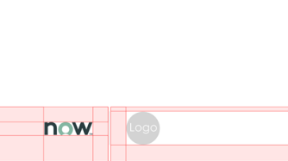


Adding your Logo
PLEASE REMOVE THIS SLIDE BEFORE PRESENTING
To provide credibility to ServiceNow documents, the ServiceNow and your logo should be visible, but not domineering.
Click View > Slide Master > Slide > Select Page 1
What to do:
Download logos from the Brand Center site.
Scale logos to an exact height of 0.45cm.
Place your logos after the ServiceNow logo, divided by a grey bar.
The same rule should be applied when more than one partner logo is required.
What not to do:
Do not scale logos beyond 0.45cm height
Do not stack ServiceNow and Partner logos

Slide 7
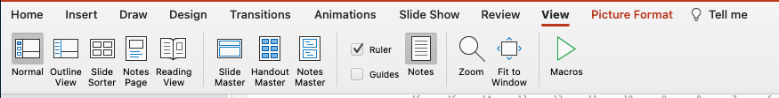
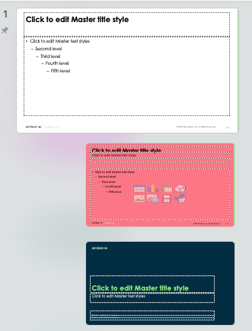

Deleting the PartnerLogo
1.
PLEASE REMOVE THIS SLIDE BEFORE PRESENTING
2.
What to do:
Click ‘View’ at the top of the screen
Click on ‘Slide Master’ - this takes you to the slide master for the slide you are looking at
Scroll up to Slide 1 in the master view. You may have to pull out the view on the left slide, so you can see all of the slides. Slide 1 will be the slide that looks larger than all the rest. It’s kind of the master of that group of slides.
At the bottom of the slide there are 2 shapes that you can highlight. A small vertical grey line and the PartnerLogo text.
Once highlighted, simply press delete. That should remove the PartnerLogo from the slides.
3.
4.
5.

Slide 8
Agenda

Slide 9
Agenda
Introduction and Guiding Principles
Enterprise Service Management Integration Framework
Microsoft Teams Integrations
Human Capital Management (HCM)
Workforce, Time And Labor Management
Contingent Worker Staffing
Learning Management System
Background Check System
E-Signature System
Tax Form Management System
Automatic Application Provisioning for New Hire
Telephony Integration Options

Slide 10
Introduction

Slide 11








Guiding principles
Don’t lose sight of the goal!
Focus on capturing data that will increase platform capabilities and streamline processes.
Use what ServiceNow brings and adjust the business before adjusting the platform.
Stick to the baseline.
Follow the 80/20 rule. What decisions will accommodate 80% of your situations. Don’t let exceptions derail the entire discussion and process.
Utilize rapid prototyping and iterative development to review and test the system to catch problems early on.
Information Security Carefully consider who needs access to sensitive information.
Change management Don’t ignore or avoid difficult decisions. Escalate when needed. Embrace change.
Challenge current practice and drive value by eliminating pain points.
Strive for standardization. Focus on configuration, not customization. Exceptions should be approved.
Notes:
USE: Confirm the Guiding Principles of the Implementation Project.
You may find it valuable to define the terms:
Administration – Ongoing Maintenance activities (e.g. User, Group, and Role Administration)
Configuration – Expected configuration changes to the out of the box (e.g. Table changes, Workshops, UI Policies)
Customization – Changes to business logic (e.g. Advanced Business Rules, Integrations)
Platform Changes – Changes that would impact upgrades (e.g. Changes to out of the box UI Pages)

Slide 12




Integration options for employee data
ServiceNow’s integration capabilities have enabled hundreds of Customers to leverage employee data and increase the value of the solution, while introducing efficiencies across the enterprise using HR Service Delivery

Slide 13
Enterprise Service Management Integration Framework

Slide 14
Introduction
Installing Enterprise Service Management Integration Framework contains common components that can be used to integrate your ServiceNow application with third-party systems
Integration sources
For managing integration behavior and inbound transform maps
To-dos table
For capturing to-dos from an external system
To-dos Portal widget
For displaying 3rd party to-do’s
External data staging table
For storing data sent to 3rd party systems from ServiceNow

Slide 15





Configuration
Download and install Enterprise Service Management Integration Framework from the ServiceNow Store
Set up Connection & Credential Aliases
Create a Source Record
Create a new Flow Designer flow(s) or leverage a prebuilt flow(s)
Create an Integration Service
Create Transform Maps for Schedule Pull services
Store
Connection
Flow Designer
Source
Integration Service
Transform Maps
Notes:
Download and install Enterprise Service Management Integration Framework from the ServiceNow Store
Set up Connection and Credential Aliases that will be used in Flow Designer flow to connect to 3rd party application.
Create a source record by specifying the third-party application with which you want to integrate
Build a flow in Flow Designer or leverage a prebuilt flow(s) and must follow the input and output structure of Template Integration Services
Create an integration service to connect with the third-party system, you can have multiple integration service per source
Create transform maps only for schedule pull services and not for On demand Push services, for pulling tasks use the Pull to-do transform map that comes OOTB

Slide 16


Inbound integration/3rd party to-dos
How data is pulled for the inbound integration
A schedule or event triggered in ServiceNow that runs a Flow Designer Workflow
The flow will pass the credentials to the 3rd party application
Retrieved data is parsed by the flow and loaded to HR Staging tables
Data in the staging table(s) is transformed using the appropriate transform map and then stored in the target HR/To-dos table
Flow Designer
Connection
Staging Table
Retrieve and Parse
Transform Data
HR records created

Slide 17


Outbound integration
How data is pushed for the outbound integration
A schedule or event triggered in ServiceNow that runs a Flow Designer Workflow
The flow adds the data to the HR external interface table
The flow will pass the credentials to the 3rd party application
The flow will pass the data to the 3rd party system, mapping can be done a number of ways.
A Job Tracker Entry will be added to the log to indicate success of the transaction
Flow Designer
External Int. Table
HR Data sent
Connection
Job Tracker Updated
External System Updated

Slide 18
Microsoft Teams integration
Preconfigured integrations

Slide 19





Introduction
Makes it easy for employees to find information and get service in the flow of work
Extends Now Virtual Agent Integration
Act on the notifications from within MS Teams like HR Case approval and comments
Initiate chat with an employee from an HR Case then copy the transcript as comment
Promote a chat to an MS Teams call directly from Agent Workspace
Show Your Hub dashboard to view pending tasks, requests and internal company announcements
Notes:
Capabilities
Actionable notifications – for approval and comments on tickets, employees can take action on the notifications from within Microsoft Teams
Provides agents the ability to initiate a Microsoft Teams chat with an employee from an HR case and then to copy the chat transcript back to the ticket as a comment.
An agent can promote a Chat to a Microsoft Teams Call, directly from Agent Workspace. Requires Notify Connector for Microsoft Teams (Store App) and Agent Chat (Plugin)
Employees can use an embedded "Your Hub" tab in Microsoft Teams to view widgets that show pending tasks, requests, and the internal company announcements

Slide 20
Configuration
Admin setup and tasks
Install HR Service Delivery integration with Microsoft Teams Application
Install plugin
Verify unique RCA entries
Import and commit update sets
Run fix script to display field decorator
Setup ServiceNow for Microsoft Teams in your instance
Connect to Steams tenant
Authorize multi-tenant Azure apps
Configure multi-tenant apps
Download manifest file and configure
Manage VA permission policies
Install SN for Teams app
Configure HR Service Delivery integration with Microsoft Teams
Customize UI Actions
Customize Business Rules
Customize Your Hub dashboard
Review notifications
Set up Chat to call
Notes:
Install HR Service Delivery integration with Microsoft Teams Application to integrate with ServiceNow instance for the collaboration between the agents and employees
Install HR Service Delivery integration with Microsoft Teams plugin
Delete Application Restricted Caller Access (RCA) for ServiceNow for Microsoft Teams source scope to ensure no duplicate before the upload
Upload Restricted Caller Access (RCA) which can be downloaded in the store (its an update set xml)
Download and execute the fix_script_start_chat_field_decorator_HR in the ServiceNow instance to display Start Microsoft Teams chat field decorator in the ticket to initiate a chat with the requester.
Setup ServiceNow for Microsoft Teams in your instance
Connect your ServiceNow instance to your Microsoft Teams tenant to enable the users to create their requests from within Microsoft Teams.
Authorize the multi-tenant apps to enable ServiceNow to make API calls to Microsoft to enable each of the ServiceNow for Teams application workflows.
Change the tenant to use multi-tenant apps in your environment.
Download the ServiceNow for Microsoft Teams manifest file from your instance and configure the manifest file in Microsoft Teams to use ServiceNow for Teams app.
Disable the NOW Virtual Agent app to avoid duplicate notifications from Microsoft Teams when you install and integrate ServiceNow for Microsoft Teams app with ServiceNow instance.
Enables users to interact with the agents from Microsoft Teams application.
Configure HR Service Delivery integration with Microsoft Teams
Customize HR Service Delivery integration with Microsoft Teams
Customize Start Microsoft Teams chat and Import Messages from Microsoft Teams UI Action to the tables you require
Customize Actionable Notifications business rule
Customize Your Hub dashboard to view the widgets that show pending tasks, requests, and the internal company announcements.
Review and disable any duplicate notifications to avoid notifying users multiple times for the same event.
Set up the chat to call functionality in your instance to enable the agents to collaborate with the requester to resolve the issue.

Slide 21
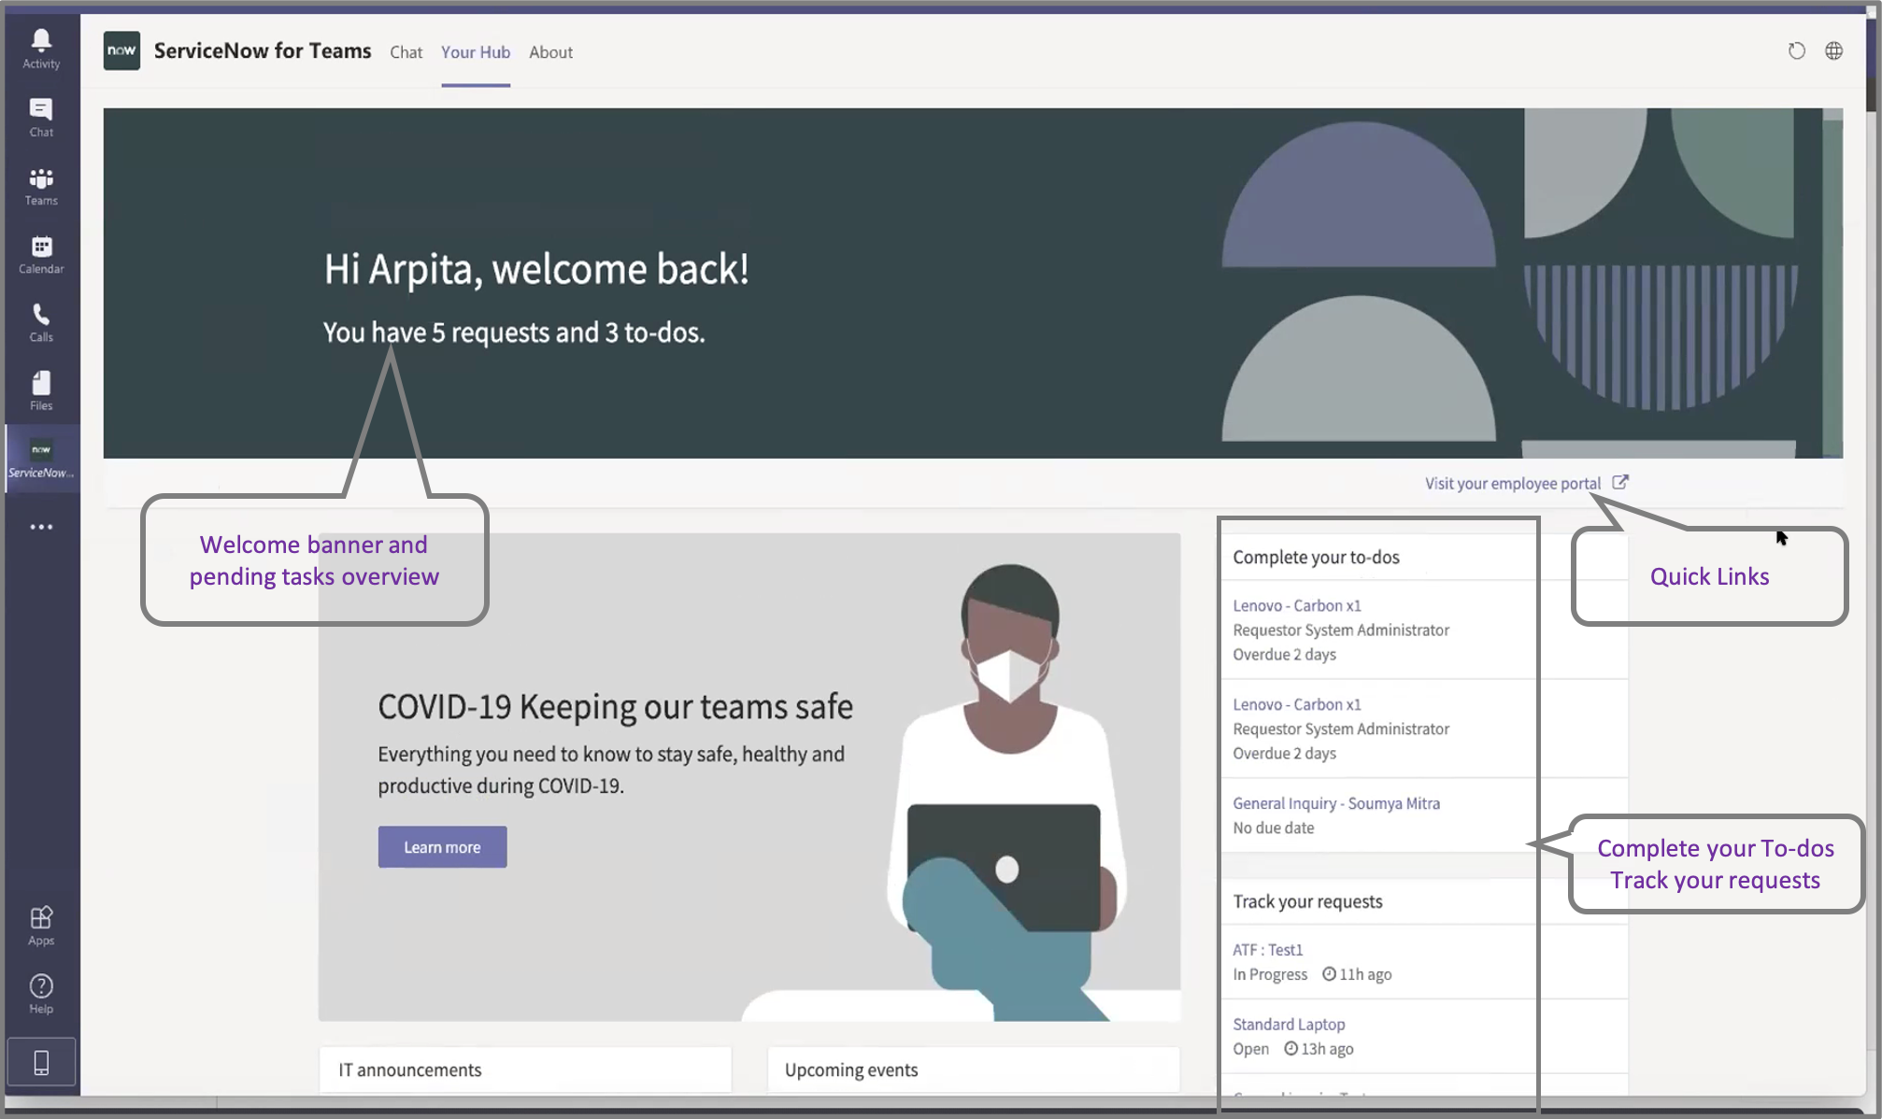
Your hub configuration
The following can be customized
Banner image
Display the count of the task to be completed
Quick links widget
OOTB redirects to ESC portal
Complete your to-does widget
Displays Short description, requester and due date
Track your request widget
Displays Short description and State
HR Data sent

Slide 22
Human Capital Management (HCM)
Preconfigured integrations

Slide 23
Integrating with an HCM
How data is pulled for the inbound integration
A schedule or event triggered in ServiceNow that starts the process of pulling data using HR services mapping configuration
SOAP/REST services can retrieve data using the credentials provided.
The data is parsed and mapped using the HR schema mappings and stored in the staging table(s)
Data in the staging table(s) is transformed using the HR transform maps and stored in the HR profile table

Slide 24
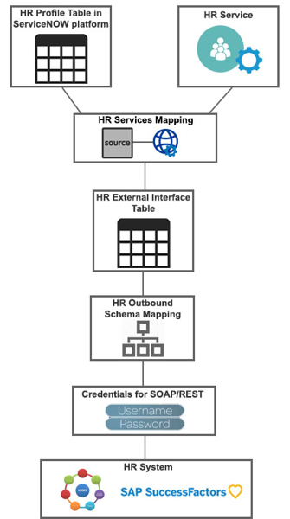
Integrating with an HCM
How data is pushed for the outbound integration
A schedule or event triggered in ServiceNow that starts the process of pushing data from the HR tables or HR service
The HR web services transfer the data to the HR external interface table
The HR service mapping configuration binds the source and web services
The HR outbound schema mappings map the data from the source tables to the fields in the target system
SOAP/REST services can retrieve data using the credentials provided

Slide 25
SAP SuccessFactors integration

Slide 26

SAP SuccessFactors service
The preconfigured integration uses SOAP and REST services to synchronize employee profiles and employee tasks, you can use as-is or Install or customize it to meet your needs.
Pull employee profile data
Departments
Locations
Job profiles
Worker profiles
Effective worker profiles
Synchronize employee to-dos between the two systems
Inbound – pull new and updated tasks, as well as existing tasks
Outbound – push new tasks, as well as existing tasks
Notes:
Other HRMS systems can be configured to work as well, but schema mapping will need to be completed for any required fields
Work will need to be done on the source system to open an API for ServiceNow to contact
Provide source credentials for the SuccessFactors service Provide the source, SOAP, and REST credentials for the SuccessFactors service so that it can be accessed for integration
Verify integration for employee profiles The integration to synchronize employee profiles is set up to pull employee profile data (departments, locations, job profiles, worker profiles, and effective worker profiles) from the SuccessFactors service to HR Service Delivery. You can verify the preconfigured settings and determine whether they meet your needs or if further customization is required
Verify integration for employee to-dos If you are synchronizing employee to-dos between HR Service Delivery and SuccessFactors, the integration is set up to pull new, updated, and existing to-dos and push new and existing to-dos between the two systems. You can verify the preconfigured settings and determine whether they meet your needs or if further customization is required
Schedule the integrations job for the SuccessFactors service Schedule the integrations job to synchronize data between HR Service Delivery and the SuccessFactors service on a daily, weekly, monthly, periodically, one-time, or on-demand basis

Slide 27




SuccessFactors integration architecture (functional)
Now Platform®
SuccessFactors
Workday
Integration with SuccessFactors application
Departments
Locations
Job profile
Employee profiles
Employee To-dos
IntegrationHub
Worker
Flow
Scheduled Job
Widget
Virtual Agent Conversation
HR Service
Delivery
Job Profile
SAP SuccessFactors
HR Spoke
Location

Slide 28
SuccessFactors preconfigured integration
The SuccessFactors built in integration offers several different services
Create/Update/Modify Approvals
Create/Update/Modify HR Tasks
Create/Update/Modify HR Cases
Create/Update/Modify Content Tasks
Department Import
Worker Profile Import
Locations Import
Job Profile Import
Refresh Session Tokens
Update Worker Profiles
Notes:
SAP SuccessFactors to ServiceNow field mapping: https://support.servicenow.com/kb?id=kb_article_view&sysparm_article=KB1124068

Slide 29
Workday integration

Slide 30

Workday HR spoke
Built by BristleCone Inc. to simplify and accelerate integration with Workday HR
Requires IntegrationHub Enterprise subscription package
Key Features
Sample flow that verifies the associated user
Webhook flow that manages the new hire updates
Remote tables to pull Workday data on demand
Provides a list of actions to automate Workday tasks when events occurs in ServiceNow
Built for Workday HR SOAP API version v33.2 and REST API v1
Spoke requirements
Register an Integration System User
Create a security group and assign it to the integration system user
Notes:
Workday is the gospel of truth for the core HR information. ServiceNow, as the System of Engagement and Action, needs the latest and greatest foundational HR data to perform subsequent actions, such as real-time create and update employee info/HR requests between ServiceNow and Workday. Once ServiceNow has the foundational HR data in place, customers can leverage the ServiceNow platform and its spokes to create more complex workflows beyond imagination.
Highlights of the Workday HR spoke:
A sample flow that verifies the associated user between ServiceNow and Workday – Verify User In Workday
A webhook flow that manages the new hire updates
Remote tables to pull Workday data on demand, such as:
View time off balance
View time off request
View my direct deposit info
Action highlights:
Look up worker profile
Request time off
Get time off balance
Request leave of absence
Add dependent
Change beneficiaries
Get tax withholding and tax election info
Look up direct deposit info
Look up payroll results
Change legal name
Change personal info
Get total rewards
Get reporting structure
Get To-do items
Change organization
No show
Offboard employee
Look up Payslip
Look up Custom Report

Slide 31
Workday HR spoke
Pull Workday data on demand (remote tables)
Get My Holiday Calendar
Get Payroll Results
View My Direct Deposit Information
View My Total Rewards
View Time Off Balance
Spoke Actions (highlights)
Look up worker profile | Change beneficiaries | Change personal info | No show
Request time off | Get tax withholding and tax election info | Get total rewards | Offboard employee
Get time off balance | Look up direct deposit info | Get reporting structure | Look up Payslip
Request leave of absence | Look up payroll results | Get To do items | Look up Custom Report
Add dependent | Change legal name | Change organization
Notes:
The Workday HR spoke provides actions to automate Workday tasks when events occurs in your ServiceNow instance.

Slide 32
HR Service Delivery integration with Workday
Built by BristleCone Inc. that pulls and syncs employee profiles and tasks from Workday into ServiceNow HR Service Delivery on a scheduled basis
The embedded spoke is only meant for use with this current out-of-the-box integration, and not for general purpose use
Key Features
Pull worker profile, job profile, department, and location information from Workday to ServiceNow on a scheduled basis
Install & Configure
Workday HR Spoke
Validate the default worker profile sync configurations
Schedule the Workday integration flow
Track Integration Jobs
Pull tasks from Workday and display as to-dos in ServiceNow Employee Service Center
Install & Configure
Workday HR Spoke
Set up Workday Pull To-Dos configuration
Set up Workday tenant time zone
Set up Workday Integration Flow
Track Integration Jobs
Notes:
Application setup
First, you must activate the HR Service Delivery integration with Workday application from ServiceNow Store. This automatically activates the Workday HR Spoke. Next, you must set up Workday HR Spoke
This spoke requires the IntegrationHub Enterprise subscription package
Workday is the system of record for the core HR Information. ServiceNow, as the System of Engagement and Action, needs the latest To Do tasks to display actions for users in the ServiceNow Employee Service Center To Do’s section. With this integration you can pull To Do actions, progress, and status from Workday HCM into the ServiceNow application for action
Also available on mobile

Slide 33
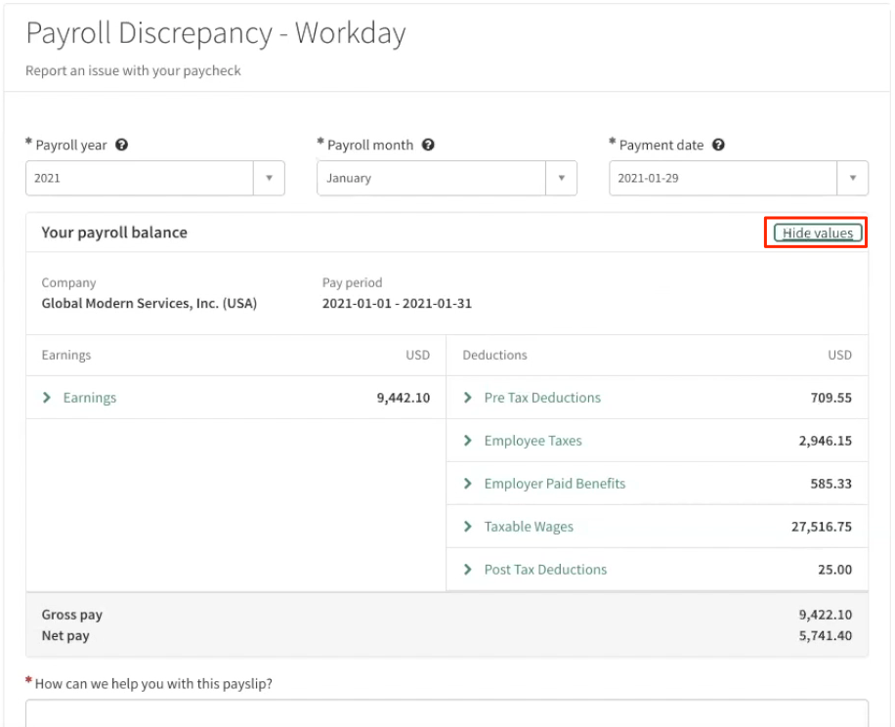
HRSD integration with Workday use case
Payroll discrepancy
Raise payroll discrepancy case
HR Service with record producer
Display payroll details
Pulled on demand
Not stored in ServiceNow
Masked values by default then the employee can toggle to make it visible
Configuration
Workday admin to create the report and identify the owner
SN Admin to add Workday Report Configuration for Look up pay slip with the report and owner provided by Workday Admin

Slide 34
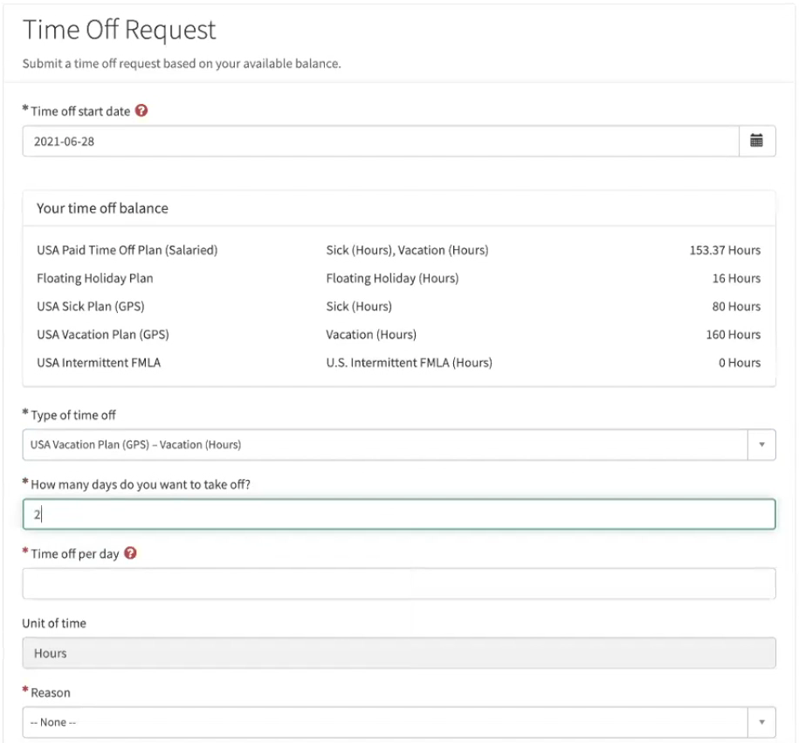
HRSD integration with Workday use case
Time off request
Initiate time off request
HR Service with record producer
Validation against work schedule and time off balance
Display time off balance
Pulled on demand
Not stored in ServiceNow
Configuration
Configure the report configurations for time off request reports
Import time off data
Import time off setup data
Get Holiday Calendars
Get Work Schedule Calendars
Notes:
Configuration
Configure the report configurations for time off request reports. Navigate to Workday Advanced Use Cases > Workday Report Configurations, click on new button, provide the Report name, Report owner username. Configure the time off request reports like Time offs, Time off types, Time off plans, Time off reasons, Absence tables, Absence table reasons, Absence table tier, Get holiday calendar wid and Get work schedule calendar wid.
Navigate to Workday Advanced Use Cases > Time Off Request > Time Off Types, click on “Import time off setup data” UI action to fetch the time off setup data from Workday. Verify the data imported into Time Offs, Time Off Types, Time Off Plans, Time Off Reasons, Absence Tables, Absence Table Reasons and Absence Table Tiers tables.
Navigate to Workday Advanced Use Cases > Time Off Request > Holiday Calendars, click on “Get Holiday Calendars” UI action to get the holiday calendars from Workday, verify the data imported into Holiday Calendars table.
Finally navigate to Workday Advanced Use Cases > Time Off Request > Work Schedule Calendars, click on “Get Work Schedule Calendars” UI action to get the work schedule calendars from Workday, verify the data imported into Work Schedule Calendars table.

Slide 35
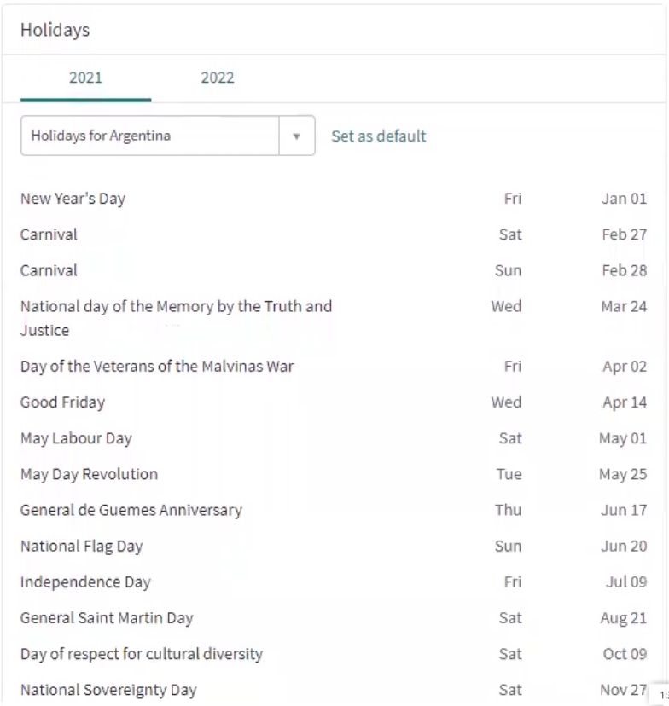
HRSD integration with Workday use case
Holiday calendar
Employee can see holiday calendars applicable to them
Mapped to Employee’s country
Employee can change to another country and set as default
Configuration
Workday admin to create the report and identify the owner
SN Admin to add Workday Report Configuration using the information provided by Workday admin above
Retrieve and verify Holiday Calendars from Workday
Add View Workday Holiday Calendar widget to any page on the portal
Notes:
Configuration
Configure the Workday Report configuration for holiday calendar, Navigate to Workday Advanced Use Cases > Workday Report Configurations, click on new button, provide the Report name, Report owner username and used for as ‘Get holiday calendar wid’. Make sure if this already configured for “Request Time Off” than skip this part of process.
Data set up for Holiday Calendar table. First make sure whether this has been done as a part of set up for “Request Time Off” use case and data has been already brought from Workday to Holiday Calendar table while setting up for “Request Time Off”. If Yes, then leave this part of process. If Not, then Navigate to Workday Advanced Use Cases > Time Off Request > Holiday Calendars and then click on “Get Holiday Calendars” UI action to get the holiday calendars from Workday into ServiceNow, verify the data imported into Holiday Calendars table.
Add widget “View Workday Holiday Calendar” to any page of the portal as required using service portal designer. Here on widget you can set any calendar as your default calendar which will always appear whenever widget loads by clicking on “Set as default”.

Slide 36
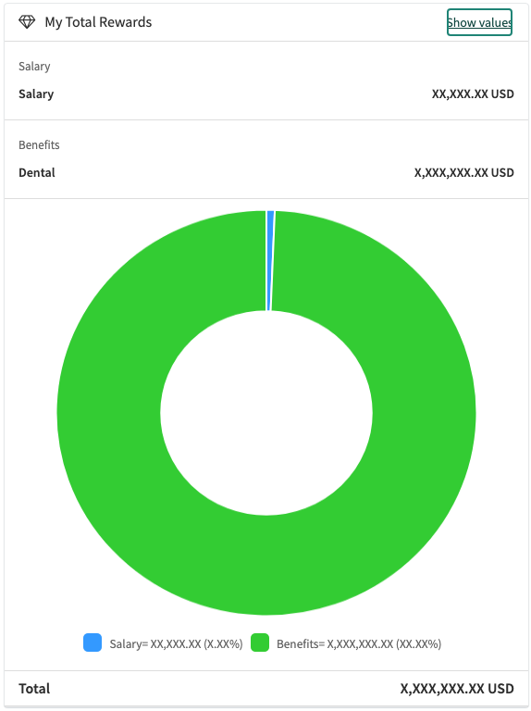
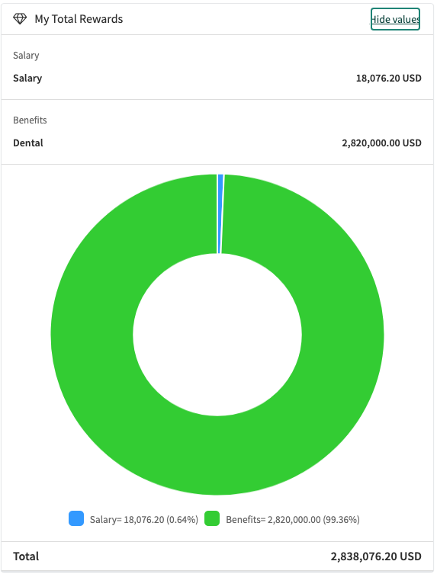
HRSD integration with Workday use case
Total rewards
Employee can view their total rewards in the portal
Not stored in ServiceNow
Masked values on the first load
Configuration
Setup Workday Report Configuration for Total rewards
Set currency code system property
Retrieve all plans in Workday
Configure Templates and Section
Add the View Workday Total Rewards widget to any page on the portal

Slide 37
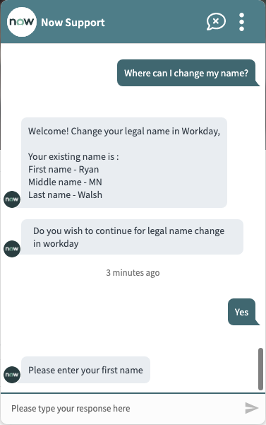
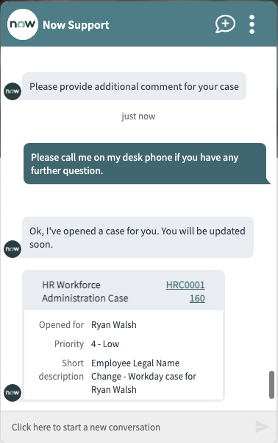
HRSD integration with Workday use case
Legal name change
Employee initiate change within Workday using Virtual Agent
Configuration
Published Workday Legal Name Change VA topic with NLU
Setup document categories from Workday
Setup the legal name change configuration
VA Topic Flow
Employee initiates VA conversation
VA displays name
Employee can provide first, last and middle name, upload supporting documents, description and provide additional details
VA creates a case
Workday will be updated
Notes:
Configuration
Make sure you have published the VA topic i.e. “Workday Legal Name Change (Template)” in virtual designer.
Also make sure NLU is enable in Virtual Agent. Navigate to Collaboration > Virtual Agent > General Settings > NLU Settings. Now make sure “Enable NLU in Virtual Agent” is enabled.
Set up of document categories from Workday in ‘Workday Reference ID List’ table of ServiceNow. For this go to Workday Advanced Use Cases > Legal Name Change > Document Categories and then click on “Get Reference IDs” UI action to get all the document categories from Workday into ServiceNow, verify the data imported into ServiceNow Reference ID List table.
Setup the legal name change configuration, Navigate to Workday Advanced Use Cases > Legal Name Change > Configuration, click on new button, provide the ‘Enable document upload’ and ‘Document category’
VA Topic Flow
Employee initiate VA conversation using over 30 utterances OOTB (e.g. Where can I change my name)
VA displays name for employee to verify and confirm to proceed
Employee will be asked to provide new First, Last and/or Middle Name, then upload supporting document, provide description and additional comments
VA will display summary of request and Employee will confirm creation of the Case, employee can also choose Effective change date or change immediately
Workday will be updated and then will be sync w/ SN based on frequency of the EE load job
HR Case will be created and if Workday update is successful it will automatically move to Close Complete

Slide 38
Workday integration
Additional information
For more information, visit:
The ServiceNow Store – Summary, key features, release notes, and screenshots
Workday HR Spoke
HR Service Delivery Integration with Workday
HR Service Delivery Advanced Integration with Workday
The ServiceNow Docs – Installation and configuration details
Workday HR Spoke
HR Service Delivery Integration with Workday
HR Service Delivery Advanced Integration with Workday
ServiceNow Community – Browse comments and FAQs, or post your own questions

Slide 39
Oracle HCM integration

Slide 40
Integration with Oracle HCM
Pulls and synchronizes employee profiles from Oracle Cloud HCM into HRSD on a scheduled basis
Built for Oracle HCM API version 11.13.18.05, but maybe compatible with later versions
The embedded spoke is only meant for use with this current out-of-the-box integration, and not for general purpose use
Key Features
Pull profile information from HR system of record to ServiceNow HRSD, including
Employee Profile
Jobs
Positions
Departments
Locations

Slide 41
Configuration
Store
Connection
Download and install Oracle HCM Cloud Spoke and HR Service Delivery Integration with Oracle HCM from the ServiceNow Store
Set up Connection & Credential Aliases
Verify Integration Source and activate Integration Services
Department
Location
Position
Workers
Review and configure Transform Map per Integration Service
Schedule Oracle Employee Sync via Flow Designer
Transform map
Integration Service
Flow Designer
Notes:
Download and install Oracle HCM Cloud Spoke and HR Service Delivery Integration with Oracle HCM from the ServiceNow Store
Set up Connection and Credential Aliases that will be used in Flow Designer flow to connect to 3rd party applications.
Go to Integrations Framework -> Source and verify the Oracle HCM Cloud and based on customer requirements enable/disable Integration Services that are available
Review and if required update the Transform Map per Integration Services, for example if additional HR Profile needs to be mapped from the Oracle workers table
Update and publish the Trigger Oracle HCM Integration flow

Slide 42
Oracle HCM integration
Additional information
For more information, visit:
The ServiceNow Store – Summary, key features, release notes, and screenshots
Oracle HCM Cloud Spoke
HR Service Delivery Integration with Oracle HCM
The ServiceNow Docs – Installation and configuration details
Oracle HCM Cloud Spoke
HR Service Delivery integration with Oracle HCM
ServiceNow Community – Browse comments and FAQs, or post your own questions

Slide 43
Advanced integration with Oracle HCM
Built by BristleCone Inc. to simplify and accelerate integration
Pulls employee information on Total Rewards, Direct Deposit, Holiday Calendar and Time Off balance for the employee into ESC
The embedded spoke is only meant for use with this current out-of-the-box integration, and not for general purpose use
Key Features
View information and raise a case for any query/help in ESC on
Direct Deposit
Total Rewards
Time off information
View Holiday Calendar

Slide 44



Configuration
Store
Connection
Download and install Oracle HCM Cloud Spoke and HR Service Delivery Advanced Integration with Oracle HCM from the ServiceNow Store
Set up Oracle HCM Cloud spoke
Configure HRSD Portal UI Components
Configure total rewards
BI report in Oracle HCM and update path in ServiceNow
Review the following Record Producer if widget has been added
Direct Deposit Inquiry
Time Off Balances
Configure holiday calendars
BI report in Oracle HCM and update spoke in ServiceNow
Total Rewards
Portal UI Component
Record Producers
Holiday Calendars
Notes:
Download and install Oracle HCM Cloud Spoke and HR Service Delivery Advanced Integration with Oracle HCM from the ServiceNow Store
Set up Oracle HCM Cloud spoke like Connection and Credential Aliases
Add the HR Portal Components, such as Direct Deposits, Holiday Calendar, Time Off Balances, and Total Rewards widgets that can be used with any HR application.
Create the total rewards BI report in the Oracle HCM system. Add the BI report path in the Oracle HCM system. This is required for the Get Total Rewards Action to pull Oracle HCM total rewards information into the ServiceNow instance.
Review the record producers to see if there is a macro variable added with the corresponding widget
Create the Holiday Calendar BI report in the Oracle HCM system. To run the View Holiday Calendar widget successfully, configure BI report and Connection & Credential Aliases in Oracle Cloud HCM Spoke.

Slide 45
Advanced Oracle HCM integration
Additional information
For more information, visit:
The ServiceNow Store – Summary, key features, release notes, and screenshots
Oracle HCM Cloud Spoke
HR Service Delivery Advanced Integration with Oracle HCM
HR Service Delivery Portal UI Components
The ServiceNow Docs – Installation and configuration details
Oracle HCM Cloud Spoke
HR Service Delivery Advanced integration with Oracle HCM
ServiceNow Community – Browse comments and FAQs, or post your own questions

Slide 46
Custom third-party integration

Slide 47
Custom third-party HCM integration
If a preconfigured integration isn’t available for the third-party HCM used by your organization, set up a custom integration.
To synchronize employee profiles, employee to-dos, and other data between the two systems, configure:
Source credentials
Inbound integration
Outbound integration
Scheduled job

Slide 48
Workforce, time and labor management
Preconfigured integrations

Slide 49

Ultimate Kronos Group integration
Use case
Provide employee assistance through conversations via Virtual Agent
Retrieve information on leave balances, work hours, list of punches, time-off requests, and upcoming shifts on-the-go
HR Data sent
Build conversations that are based on keywords that an employee enters
Apply Natural Language Understanding (NLU) models
Notes:
Key Features
Retrieve information on leave balances, schedules, work hours, list of punches, time-off requests, and upcoming shifts on-the-go.
Build conversations that are based on keywords that an employee enters.
Apply Natural Language Understanding (NLU) models, which enable the virtual agent to pick utterances for understanding, processing, and responding to what employees are saying during a conversation.
The UKG spoke provides a list of actions that wraps around the UKG Dimensions REST APIs. It provides the foundation to synchronize ServiceNow and UKG Dimensions bi-directionally.
Requires IntegrationHub Enterprise subscription package
Ships flows and sub flows to pull and post data to UKG Dimensions
Handles UKG special authentication requirements

Slide 50
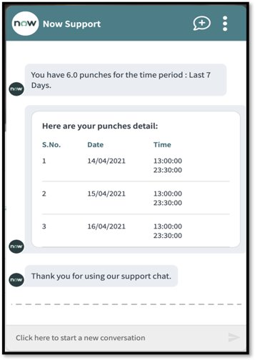
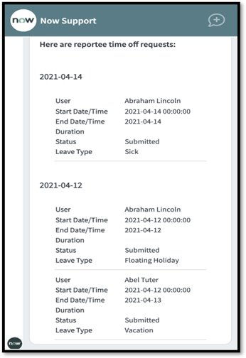
UKG virtual agent topics
Accessible to Employees
Retrieve My Accrual Balance
Retrieve My Hours Worked
Retrieve My List of Punches
Retrieve My Schedule
Retrieve My Time Off Requests
Retrieve My Upcoming Shift
Accessible to Managers
Reportee’s Location Today
Reportee’s Schedule Changes
Reportee’s Time Off Requests
HR Data sent

Slide 51
Ultimate Kronos Group integration
Additional information
For more information, visit:
The ServiceNow Store – Summary, key features, release notes, and screenshots
UKG Spoke
HR Service Delivery Integration with Ultimate Kronos Group
The ServiceNow Docs – Installation and configuration details
UKG spoke v3.2.0
HR Service Delivery with Ultimate Kronos Group
Set up HR Service Delivery Integration with Ultimate Kronos Group

Slide 52
Contingent Worker Staffing

Slide 53
Magnit integration overview
Magnit’s advanced vendor management system (VMS) staffing software allows managers to:
Recruit and review contingent worker profiles
Schedule interviews
Approve time for contractors
Manage their contingent staffing
The Magnit onboarding for contingent workers integration with ServiceNow:
Creates onboarding lifecycle event cases
Creates adhoc-HR case task for each contingent employee onboarding item from Magnit
Enables managers to complete tasks
HR monitors case progress
Notes:
Requires HR Service Delivery with Enterprise​
Plugin Dependency ​
Enterprise Service Management Integrations Framework
Lifecycle event for Enterprise Plugin
Magnit spoke

Slide 54


Magnit integration architecture (functional)
IntegrationHub
Contingent worker onboarded
Onboarding workflow triggered
Onboarding items assigned to contingent worker
HR Profile created for contingent worker
Onboarding lifecycle event case is created
Ad-hoc tasks are created and assigned
Magnit HR Spoke
Employee profiles
Departments
Locations
Job profile
User Onboarding Items

Slide 55






Magnit integration personas
Admin |  | Magnit Admin |  | HR Admin |  | Lifecycle Event Admin |  | HR Agent |  | Contingent Worker
Activates plugin from ServiceNow Store Sets up Magnit spoke |  | Pulls Magnit contingent workers, Creates scheduled job and Magnit task mapping records. Views HR profiles, HR lifecycle case, and HR tasks created |  | Confirms Location and Department details from Magnit are imported into ServiceNow HR tables |  | Confirms Lifecycle events (using related HR service and template) containing adhoc onboarding tasks are created for Magnit contingent workers |  | Agent manages and tracks onboarding case and tasks in ServiceNow |  | Employee can take action and view progress of the onboarding case and tasks in Employee Center
Operational efficiencies (e.g., green buildings) |  | Balanced ESG investment portfolio |  | Rationalization of services, applications and infrastructure |  | ESG communication with all stakeholder groups |  | ESG to attract, engage and retain talent |  | Freedom of expression / data privacy (government requests)
"Better" product and service introduction |  | ESG in audit, governance, risk and compliance |  | Digital enablement of ESG programs |  | ESG branding for the whole company |  | Diversity, inclusion and belonging |  | ESG risk factors impacting cyber threats
Business model innovation and scale |  | Business resilience vs. ESG risks (operations, supply chain) |  | Ethical AI |  | ESG in customer purchases decisions and experience |  | Workforce health, wellbeing and safety |  | IP protection and competitive behavior

Slide 56
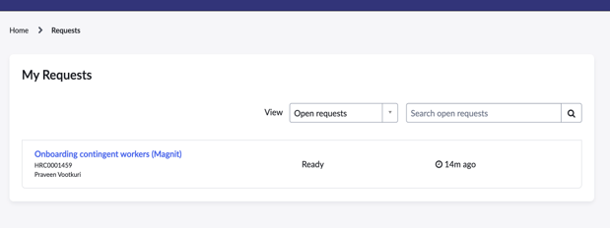
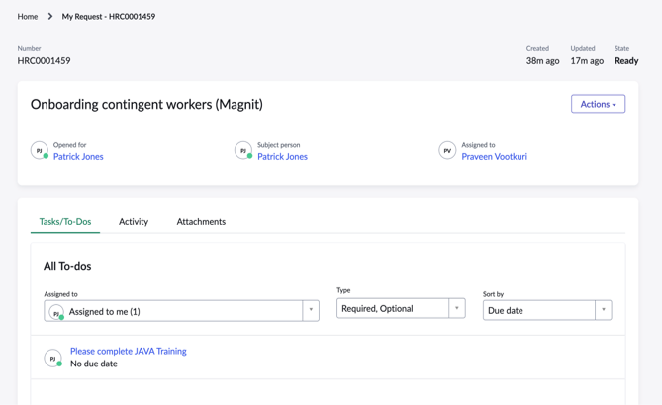
Magnit onboarding cases
When the integration is triggered, an onboarding case will appear under My Requests on Employee Center
Cases created via the integration are listed with the title Onboarding contingent worker (Magnit)
Magnit-generated cases behave like other lifecycle events cases
Related tasks display in the Tasks/To-Dos tab
When a task is marked as Closed complete, Closed incomplete or Cancelled, it will change state to Ready to send
This new state identifies the task that will sync with the Magnit system and update their status there as well
Once synchronized, the status will update to Sent

Slide 57
Magnit integration configuration
Download and install Magnit Spoke and HR Service Delivery Integration with Magnit from the ServiceNow Store
Validate Manager Profile in ServiceNow
Import data to be associated to the contingent worker
Location
Department
Job
Create HR Task Templates via Magnit Task Mapping Table
Verify integration source and activate integration service
Get Contingent Worker
Review and configure transform map per integration service
Validate connection in the User Onboarding Items table
Enable the flow: Synchronize attachments of onboarding items to sync attachments on HR Tasks back to the Magnit system
Store
Connection
Task Templates
Integration Service
Lifecycle event Case
Notes:
Download and install Magnit Spoke and HR Service Delivery Integration with Magnit from the ServiceNow Store
Validate Manager Profile in ServiceNow
Import Location, Department, and Job to be associated to the contingent worker
Create HR Task Templates via Magnit Task Mapping Table
Verify Integration Source and activate Integration Service
Get Contingent Worker
Review and configure Transform Map per Integration Service
Validate connection in User Onboarding Items table
Update and publish the Trigger Magnit Integration flow Manager profile must be available in the ServiceNow instance before pulling contingent worker information.
Location, Department, Job to be associated to the Contingent worker needs to be imported to the SN instance via bulk import. In case, the corresponding Ids are not imported, these values remain null for the contingent employee

Slide 58
Magnit integration synchronization
There are two types of integration syncs available:
Full pull
Synchronizes active Magnit contingent workers with ServiceNow
Delta pull
New Employees onboarded in Magnit since the last pull are synchronized to ServiceNow​
Lifecycle Event cases are created based on Employee details and respective onboarding items
Any change in the details of contingent worker in Magnit which are already present in ServiceNow are updated
If new onboarding items are associated to the employee after the last pull, new tasks are created
Ad hoc tasks are associated in ServiceNow based on the onboarding items in Magnit
Notes:
Manager profile must be available in the ServiceNow instance before pulling contingent worker information.
Location, Department, Job to be associated to the Contingent worker needs to be imported to the SN instance via bulk import. In case, the corresponding IDs are not imported, these values remain null for the contingent employee
Magnit admin needs to create relevant HR Task Templates and associate them to Onboarding items available in Magnit instance. This is done via ‘Magnit Task Mapping’ table
Below mentioned properties needs to be created for the Magnit source. These are one-time configurations:
full_pull_wait_time: This is the wait time between receiving correlation Id and calling the full pull action
delta_pull_wait_time: This is the wait time between receiving correlation Id and calling the delta pull action

Slide 59
Magnit integration resources
For more information, visit:
The ServiceNow Store – Summary, key features, release notes, and screenshots
Magnit Spoke
HR Service Delivery Integration with Magnit
The ServiceNow Docs – Installation and configuration details
Magnit Spoke
HR Service Delivery Integration with Magnit
ServiceNow Community – Browse comments and FAQs, or post your own questions

Slide 60
Learning management system
Preconfigured integrations

Slide 61

Cornerstone to-do integration
The preconfigured integration uses REST services to pull learning to-dos from Cornerstone OnDemand to ServiceNow HRSD. You can use as-is or customize it to meet your needs.
Sync users, pull learning objects and to dos from Cornerstone and present them as employee to dos in the Employee Service Center
Mapped to HR Pulled To-Do table
Employee will be directed to Cornerstone OnDemand to complete the to-do
To setup the integration
Configure source credentials for learning system in Cornerstone spoke
Configure scheduled job frequency and transform maps as needed

Slide 62
Background check
Preconfigured integrations

Slide 63











Integrating with a background check system
Third-party background check system
HR System
Employee, Candidate or agent
2
1
Evaluates request and updates case with applicant ID and status
HR agent creates case to request background check
3
4
Creates task for employee to sign up on third-party site
Sends email to employee
Clicks link in email and completes application on-site portal
5
Background check in progress
6
Updates case with status
Under Review
7
8
Background check complete
Updates case with status and link to details
Notes:
An HR agent first creates a case to request the background check, and the ServiceNow platform sends the request to the third-party system.
That system evaluates the request, updates it with the applicant ID and status, and sends it back to the ServiceNow platform.
The platform then creates a task for the employee to sign up on the third-party site, and sends an email with a link to the site’s portal.
The employee clicks the link in the email and completes the application on the site portal.
The third-party system starts the background check, and notifies the ServiceNow platform that the check is in progress.
When the background check is complete, the third-party system sends a notification to the ServiceNow platform and the record is updated to include the status of the background check, and a link to the details.
Watch - https://youtube/Suh67ITavKg for more info

Slide 64

First Advantage service
The preconfigured integration uses SOAP services to request background checks, you can use as-is or customize it to meet your needs.
Mapped to Request Background Check by First Advantage HR Service
To setup the integration
Configure source credentials for background check system
Configure integration with background check system
Configure company-specific background check packages for use
Update the Pre-Hire activity set to add (or update) Background Check activity to use the Request Background Check by First Advantage HR Service
Can be used as a stand-alone case raised by HR Agents manually

Slide 65

Accurate Background service
The preconfigured integration uses REST services to request background checks, you can use as-is or customize it to meet your needs.
Mapped to Request Background Check by Accurate HR Service
To set up the integration
Configure source credentials for the background check system
Configure integration with a background check system
Configure company-specific background check packages for use
Update the Pre-Hire activity set to add (or update) Background Check activity to use the Request Background Check by Accurate HR Service
Can be used as a stand-alone case raised by HR Agents manually
Notes:
Provide source credentials for the Accurate service Provide the source and REST credentials for the Accurate service so that it can be accessed for integration.
Verify integration for the Accurate service The integration is configured to push background check data between the HR service in HR Service Delivery and the Accurate service. You can verify the preconfigured settings and determine whether they meet your needs or if further customization is required.
Add background check packages for the Accurate service Add one or more background check packages to your instance so they can be accessed when a request for a background check by Accurate is made. For example, you can add a package for a background check only and a package for both a background check and drug screening.
Other HR Service mapped to Accurate integrations are
Accurate Background Check - Get Order Updates
Accurate Background Check - Get Report Data
Accurate Background Check - Place Order

Slide 66

Sterling Talent Solutions service
The preconfigured integration uses REST services to request background checks, you can use as-is or customize it to meet your needs.
Mapped to Request Background Check by Sterling HR Service
To setup the integration
Configure source credentials for background check system
Configure integration with background check system
Configure company-specific background check packages for use
Update the Pre-Hire activity set to add (or update) Background Check activity to use the Request Background Check by Sterling HR Service
Can be used as a stand-alone case raised by HR Agents manually
Notes:
Provide source credentials for the Sterling service Provide the source and REST credentials for the Sterling service so that it can be accessed for integration.
Verify integration for the Sterling service The integration is configured to push background check data between the HR service in HR Service Delivery and the Sterling service. You can verify the preconfigured settings and determine whether they meet your needs or if further customization is required.
Add background check packages for the Sterling service Add one or more background check packages to your instance so they can be accessed when a request for a background check by Sterling is made. For example, you can add a package for a background check only and a package for both a background check and drug screening.

Slide 67
Custom third-party background check
If a preconfigured integration isn’t available for the third-party background check system used by your organization, you can configure your own custom integration.
To setup the integration
Configure source credentials for background check system
Configure integration with background check system
Configure company-specific background check packages for use
Update the Pre-Hire activity set to add (or update) Background Check activity to use the HR Service you configured in the HR Integration Service Mapping module
Can be used as a stand-alone case raised by HR Agents manually

Slide 68
E-signature system
Preconfigured integrations

Slide 69
Document template integration
Enable the use of DocuSign® and Adobe® Sign applications for signing documents generated from document templates
Supports HTML, PDF, and Word document template
Configure multiple signatories with different signing types to effectively collaborate on a single document
3 signing types (serial, parallel, hybrid)
Preconfigured HR service, flow, and HR case template, for both the ad hoc document flow and DocuSign® or Adobe® Sign template flow
Document tasks are created for each signatories
Can be actioned using Employee Center/Portal, ServiceNow Platform, and Now Mobile
Notes:
Signing Types
Serial – signatories will sign in chronological order
Parallel – signatories can sign simultaneously (default)
Hybrid – combination of Serial and Parallel, for example Signatory 1 will have to sign first then Signatory 2 and Signatory 3 will sign simultaneously

Slide 70
How it works?
Set up DocuSign® and Adobe® Sign spoke
Create HTML, PDF, or Word document template
Create participant with sign action
Map signatures in the document template per participant
Automatically create document task per signatory
Attach unsigned document
Create case
Configure HR Service to use the document template
Legend
Signatories sign or reject
Attach signed document and close case
System admin
HR Agent
Doc writer or HR Admin
ServiceNow
Employee
Notes:
System Admin to Setup DocuSign or Adobe Sign spoke in collaboration with the e-signature application’s admin
Requires Integration Hub Enterprise subscription package
Document writer or HR Admin to
Create an HTML document template with a Signature type equal to either DocuSign or AdobeSign
Create participants with an action set to Sign for each signatory and set the signing order if parallel (default type) won't suffice. Next slide shows details.
Update the HTML document to map where the signature will be located per participant
HR Admin to configure HR Service
Update case option to include Automatic Document Task generation
Update the template to populate the HTML document
Employee or HR Agent create case for that HR Service, which will trigger the flow. In AdobeSign, an agreement is created for each signing case, and in DocuSign, an envelop is created for each signing case.
Signatories will be assigned with document tasks automatically based on the order of participants that has been configured (serial, parallel, hybrid)
There are 3 user experience that the documents can be signed
Employees via Employee Center or Service Portal
HR Agents via SN Platform/Backend
Employees or HR Agents via Now Mobile application
Unsigned document is attached to the case and once all of the signatories finished signing then the fully signed document will be attached on the case.

Slide 71
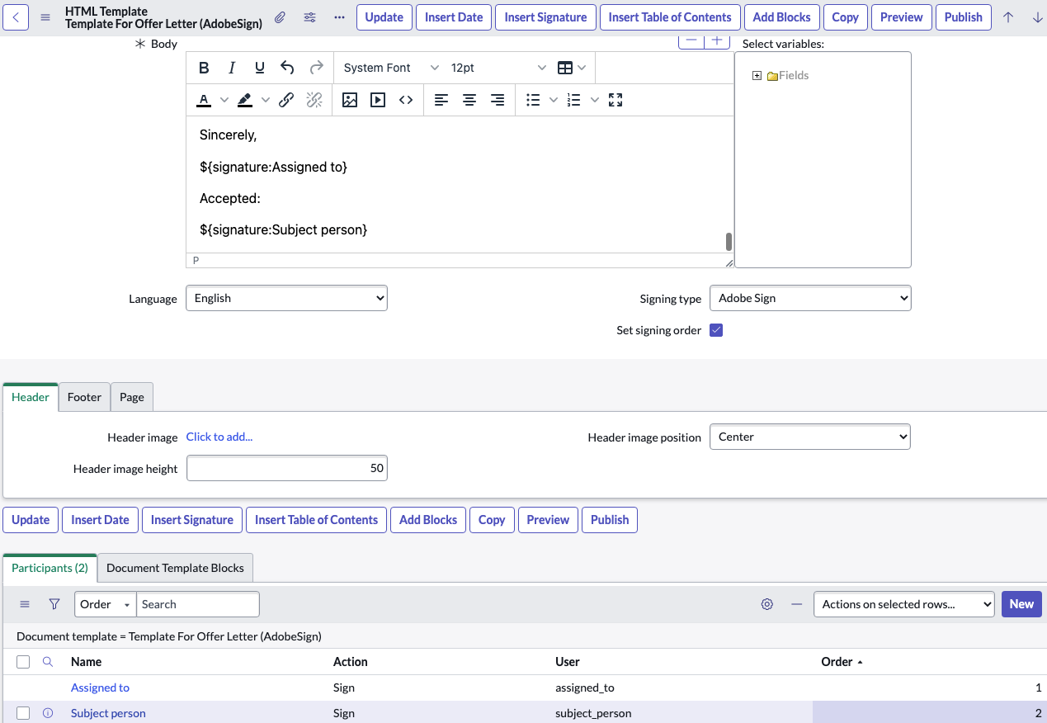
HTML document template
Configuration
Create HTML document template with DocuSign® or Adobe® Sign signing type
Create participant(s) with 'Sign' as action and option to set signing order for each signatories
Set signature location in the document per participants
For additional details, refer to the ServiceNow product documentation for the AdobeSign integration or DocuSign integration

Slide 72
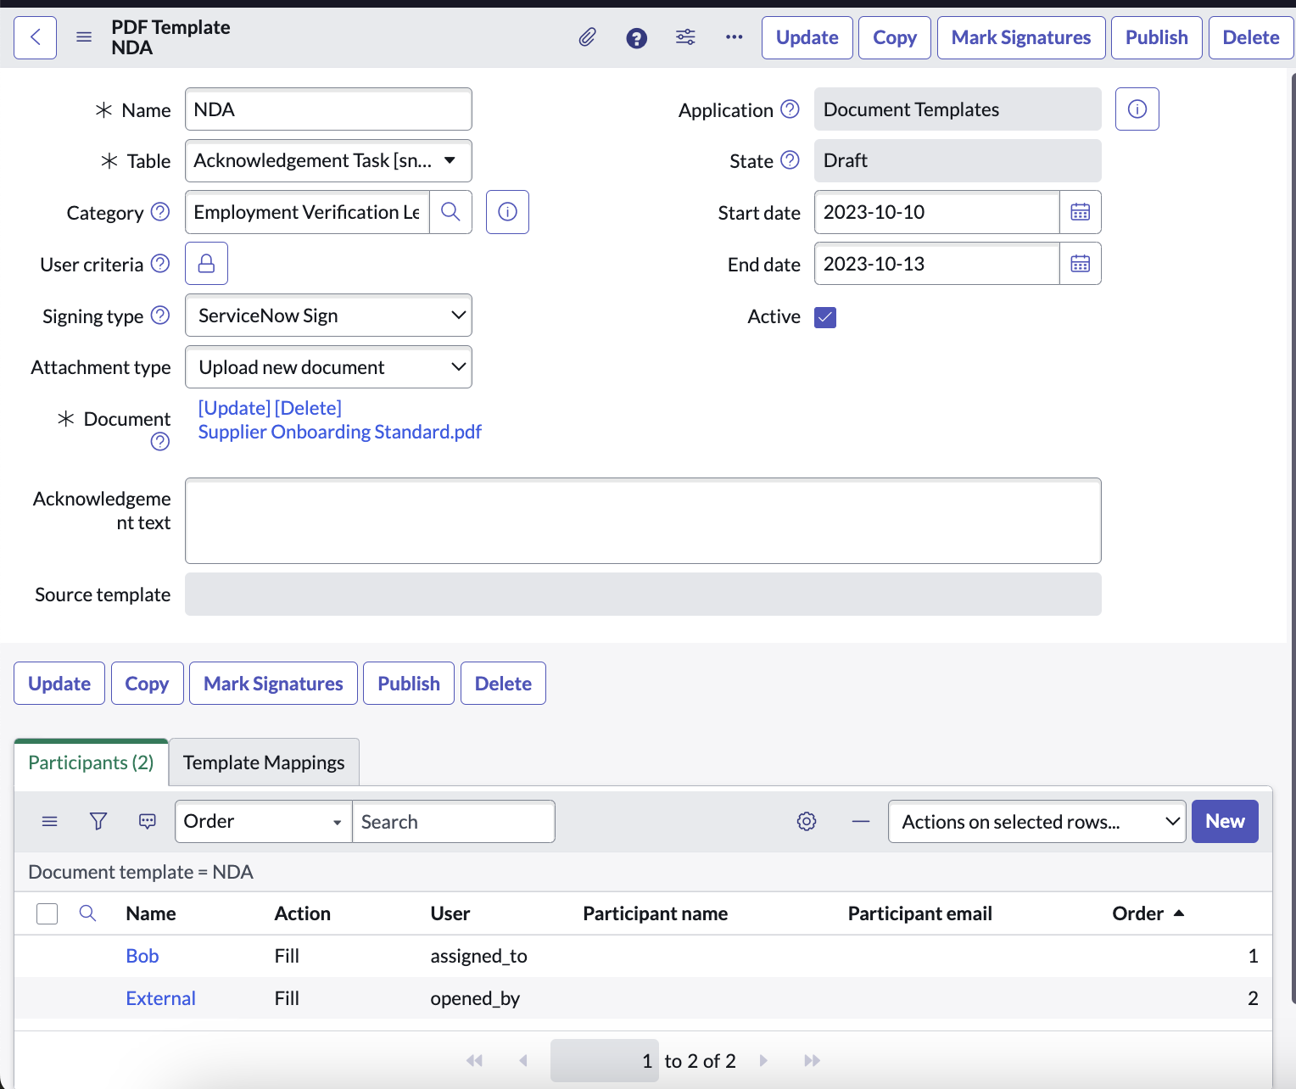
PDF document template
Configuration
Create PDF document template with DocuSign® , Adobe® Sign, or ServiceNow Sign signing type
Create participant(s) with 'Fill' as action and option to set signing order for each signatories
Set signature location in the document per participants
For additional details, refer to the ServiceNow product documentation for the PDF Documents

Slide 73
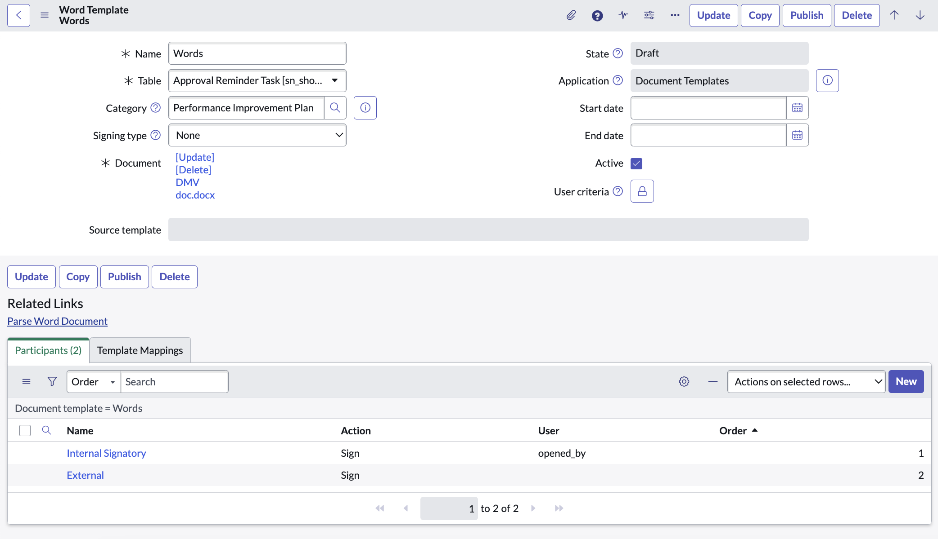
Word document template
Configuration
Create Word document template with DocuSign® or Adobe® Sign signing type
Create participant(s) with 'Sign' as action and set signing order for each signatories
Parse Word Document to automatically create mappings for signatories
For additional details, refer to the ServiceNow product documentation for the AdobeSign integration or DocuSign integration

Slide 74
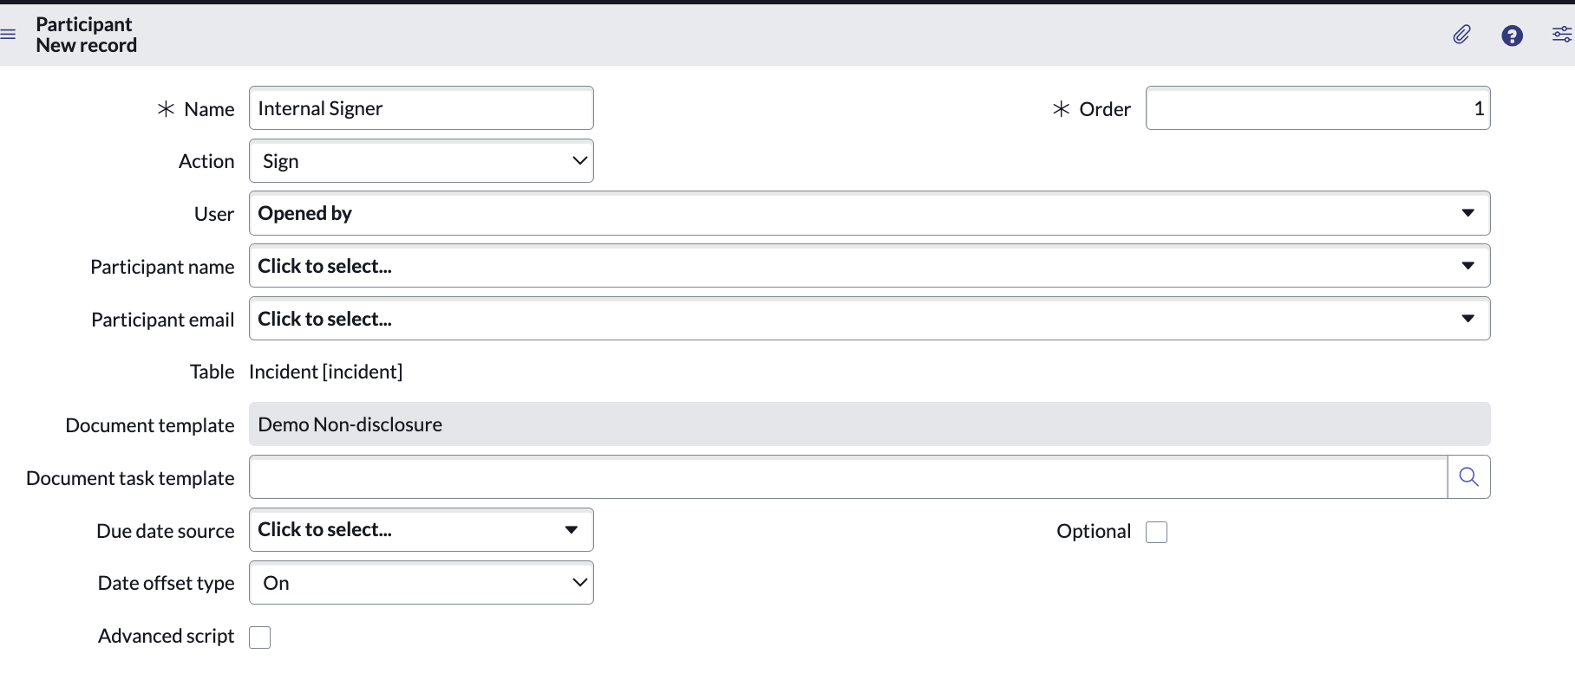
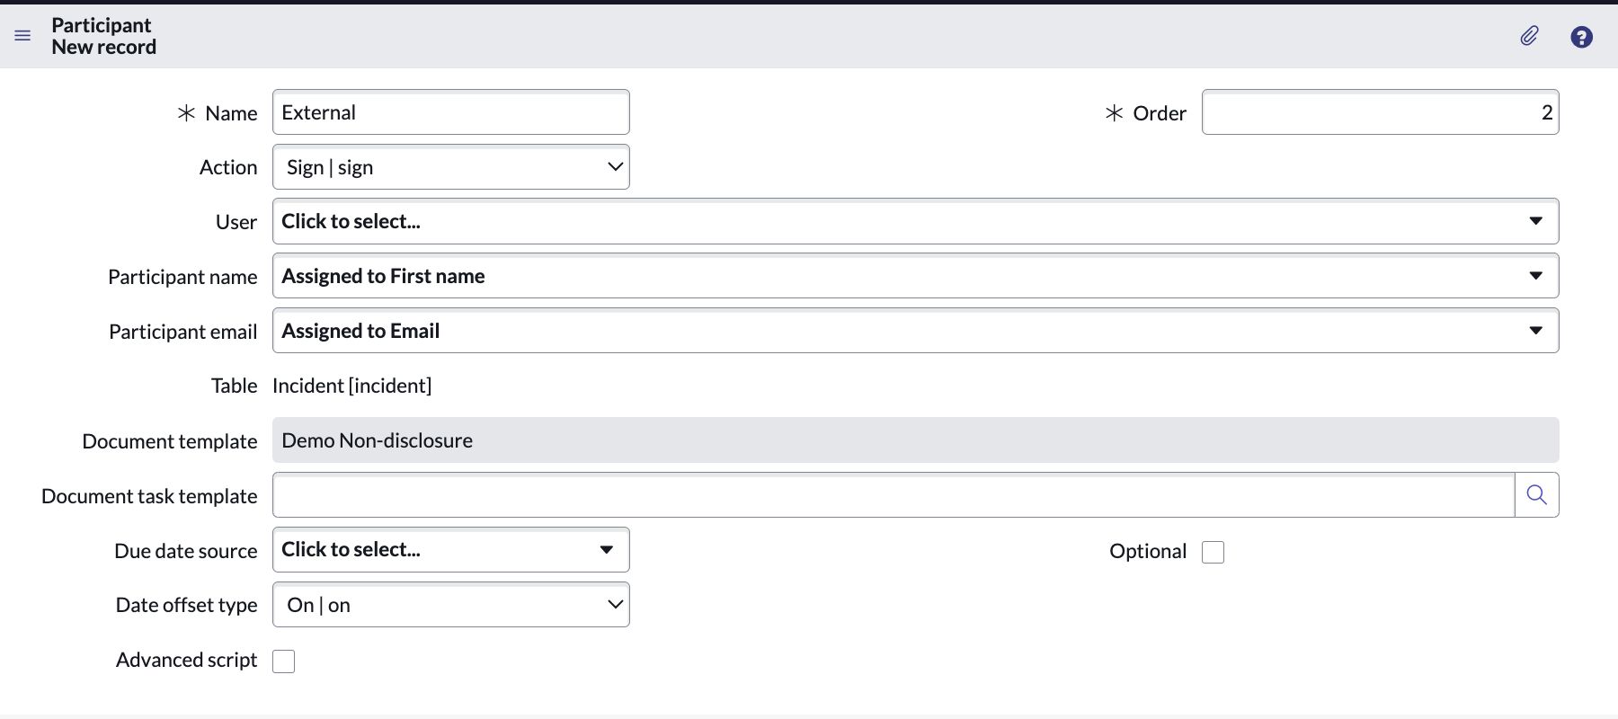
Document template
Configuration
Participants are the users directly interacting with the template
Typically, this will include internal and external parties
If the user field is filled out, the participant is treated as internal. If only name and email are filled out, they are treated as external users
Name and email are required for external users
After participants are defined, adjust the template mappings to connect to the mapping field (participants when applicable)

Slide 75
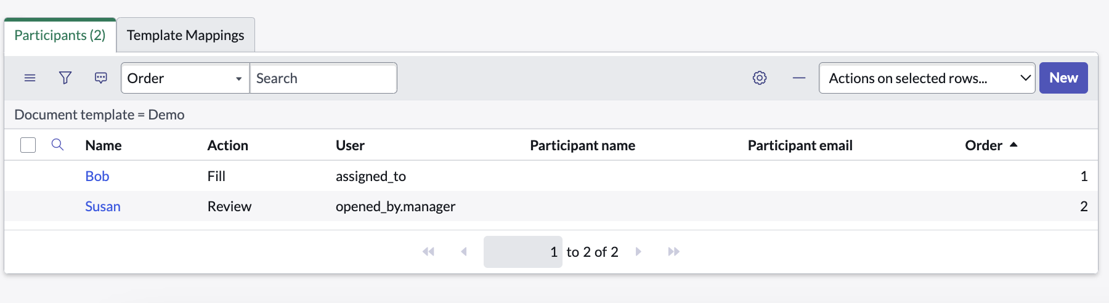
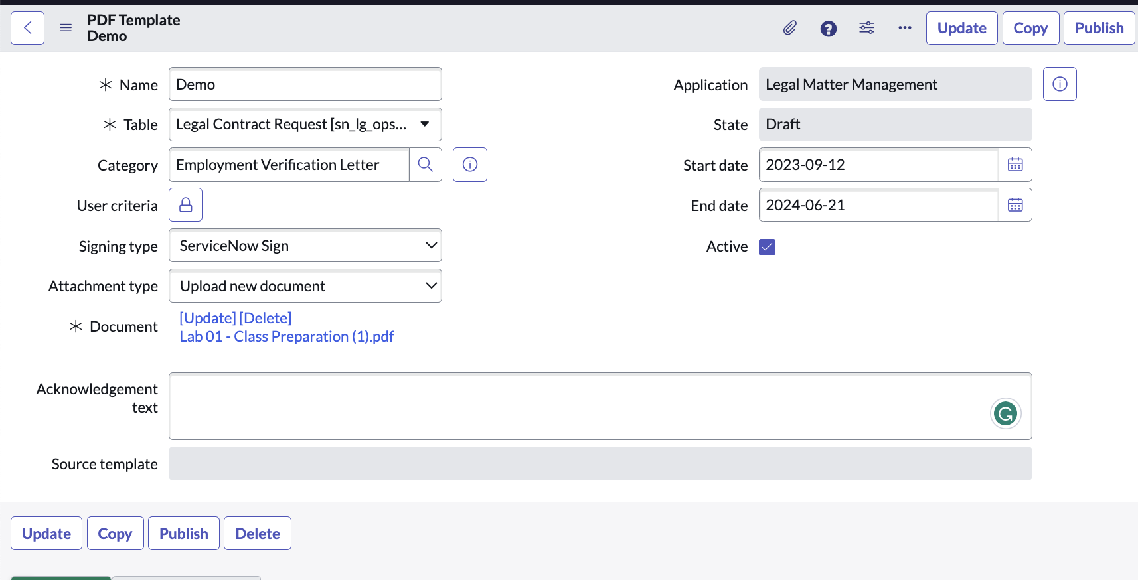
Document template
Configuration
Add participants to whom the document will always be sent, e.g., User = Assigned to – manager
If using ServiceNow Sign, the participant options are Fill or Review
Users are treated as internal
If using Adobe Sign or DocuSign, the participants only have one action type = Sign
When creating a new PDF document template, add start and end dates to manage versions clearly
Notes:
Note: Since start and end dates are optional fields, existing templates will not be affected if they do not have dates associated.
Users can swap between Adobe Sign and DocuSign without any problems. However, since participants have different actions associated with ServiceNow Sign, any change involving ServiceNow Sign will require the deletion and re-adding of participants.

Slide 76
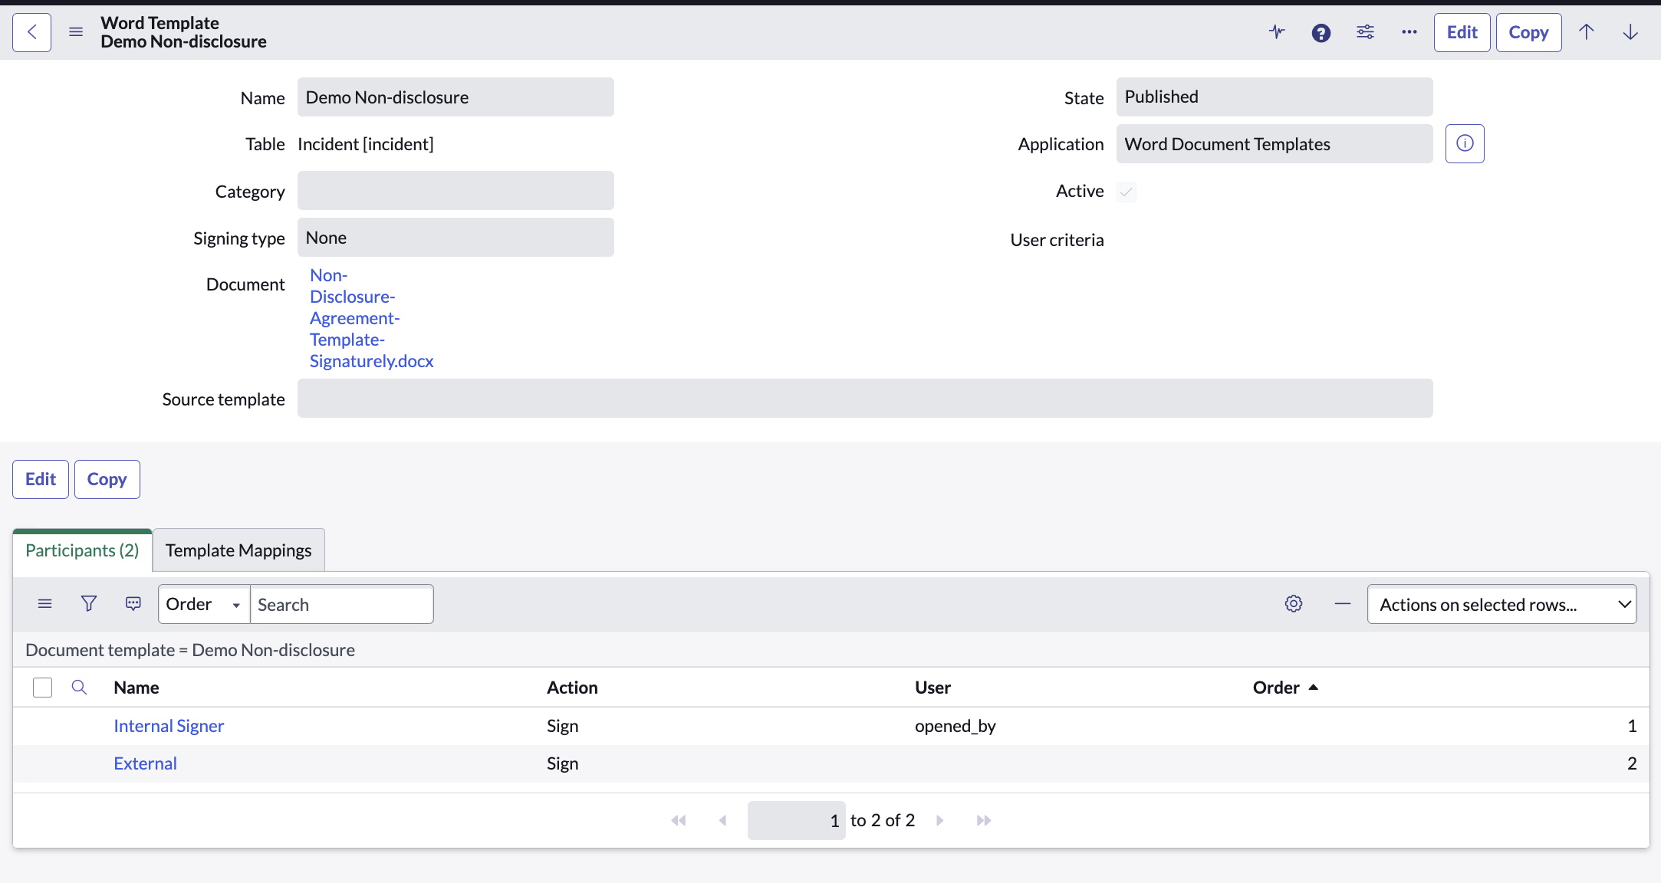
Document template
Configuration
Once admins are satisfied with the mappings, publish the template
The template record becomes read-only
If a change is needed, select Edit to edit the record
Admins can also Copy the record
This will copy the entire template, including attachments, participants, and template mapping

Slide 77
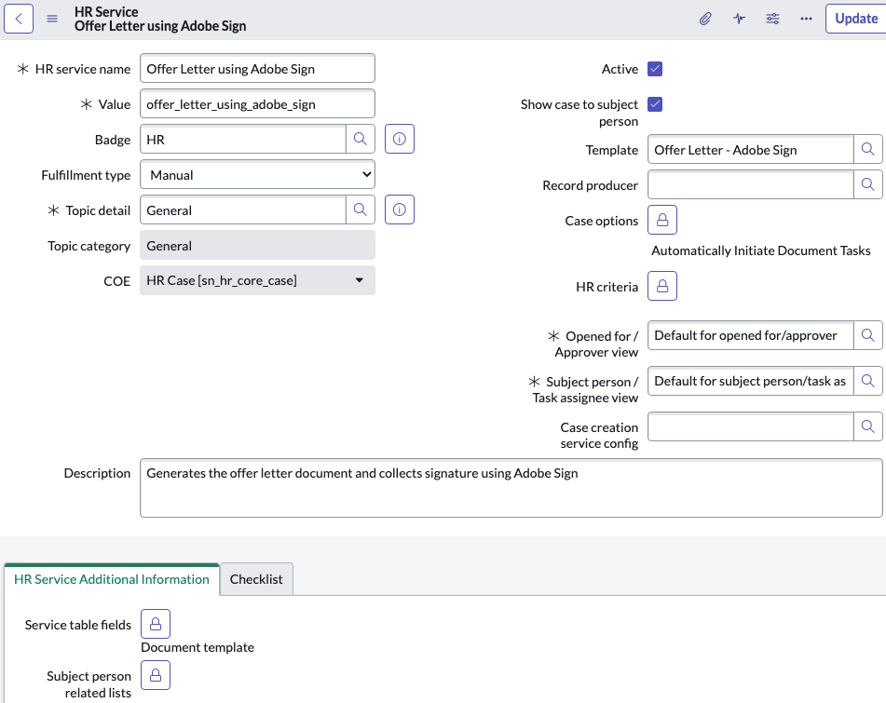
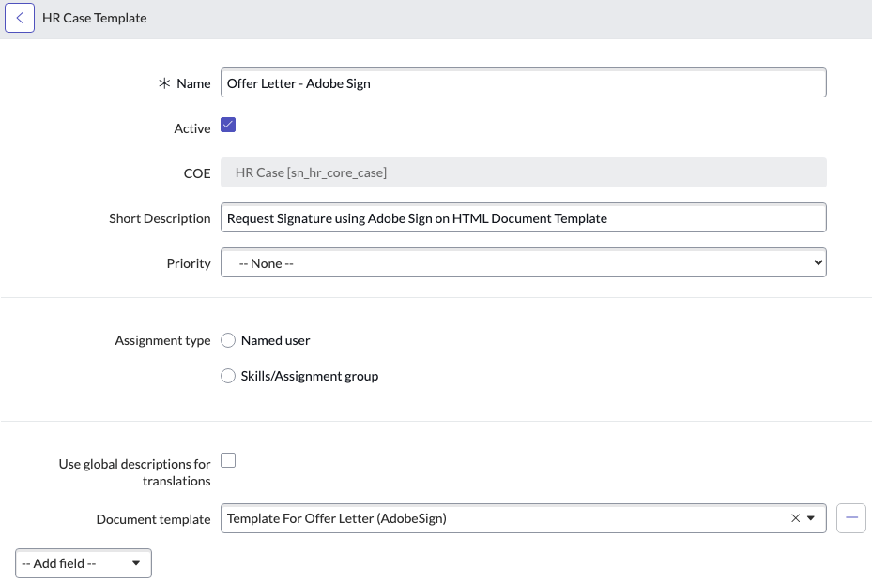
HR service – automate review tasks
Configuration
Set the case option to automatically initiate document tasks and add the Document Template field
Update Template field to set the document template with signing type as the e-signature system
Notes:
Automatically creates a 'Sign' task for each signatory based on defined order of participants in the HTML document template when the case is moved to Ready state - if the case option is set to Automatically Initiate Document Tasks. Otherwise the HR Agent have to manually create the task when previewing unassigned document.

Slide 78
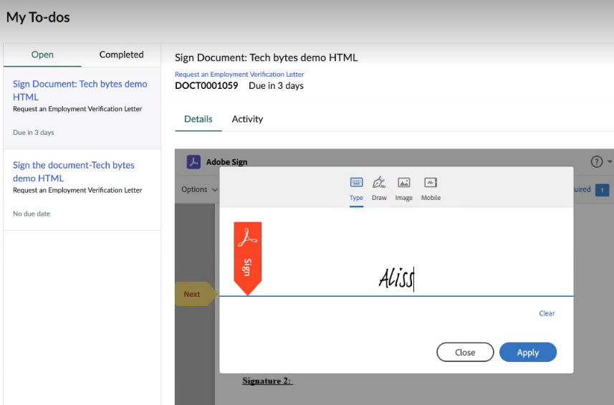
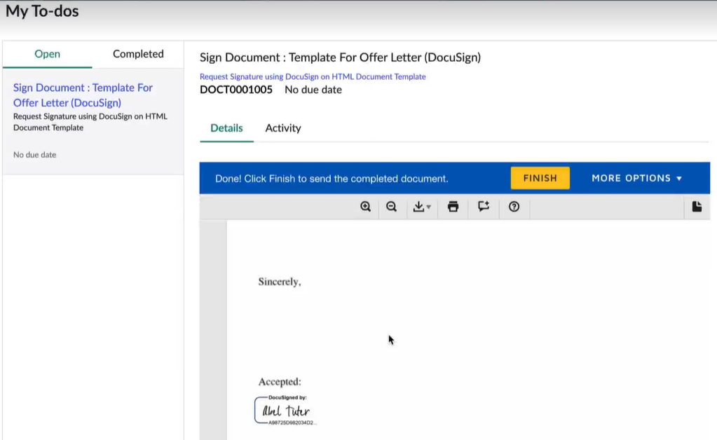
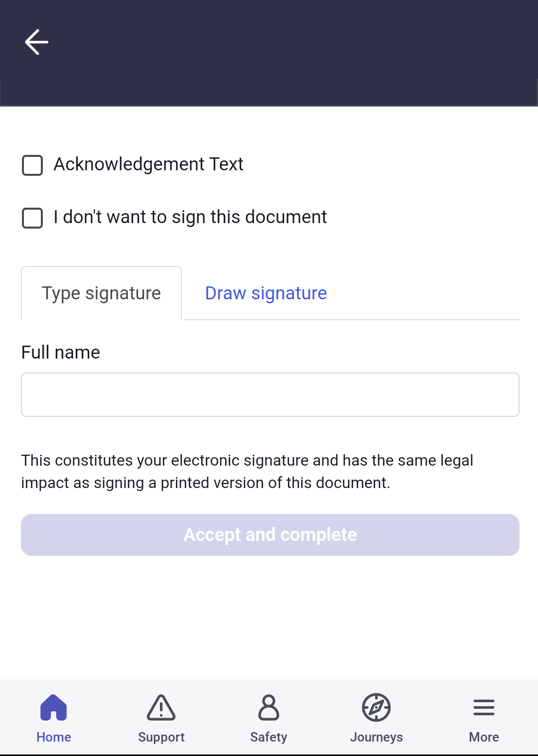
Document task completion - Approvals
Signatories can view, sign or decline to sign the document
Employee Center’s My to-do page
SN Platform
Now Mobile app
Signed document
Attached to the task after the signatory signs the document
Attached to the case after all the signatories signs the document

Slide 79
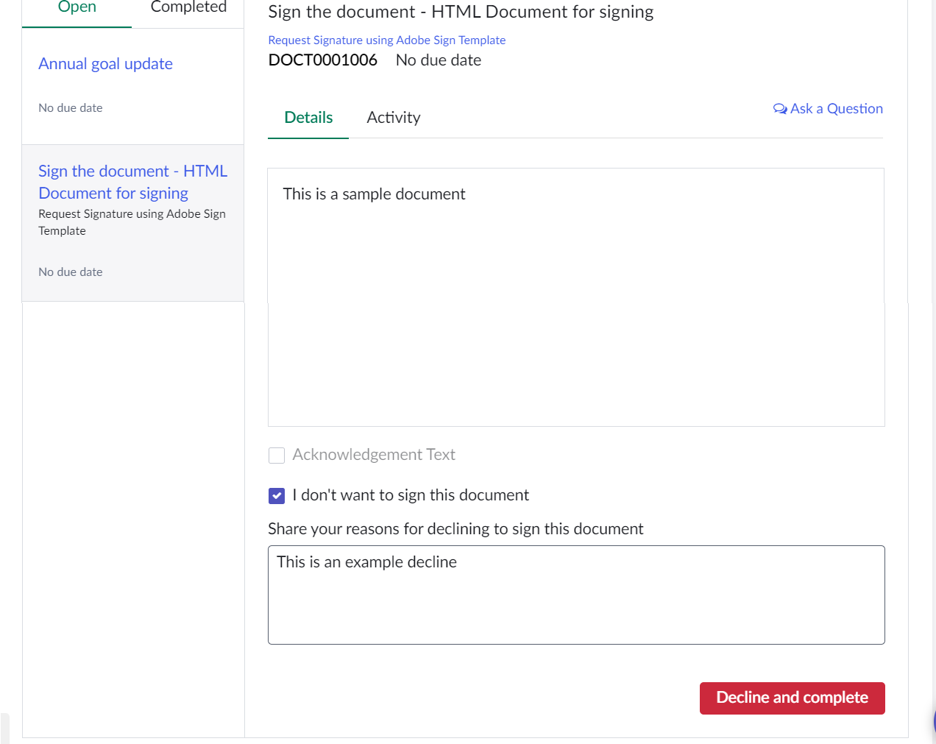
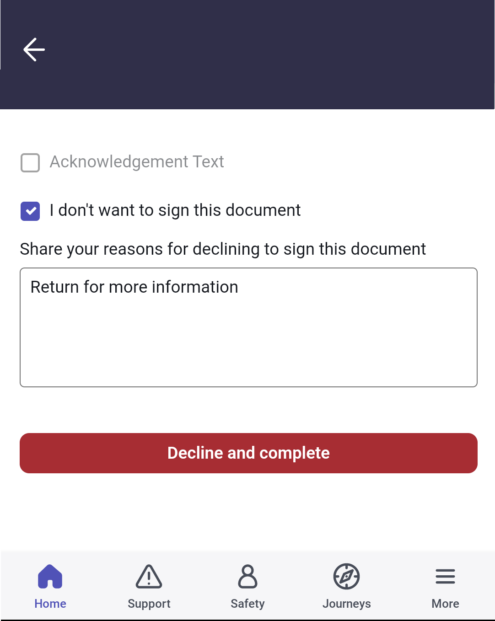
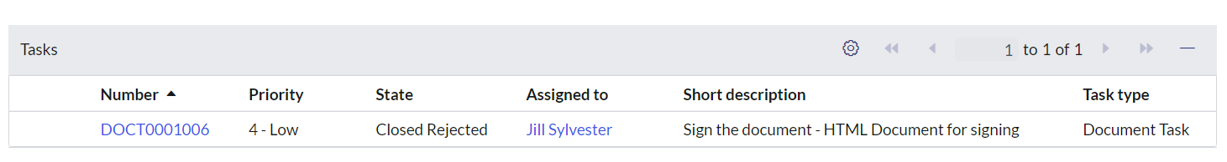
Document task completion – Review Options
Task states available
Declined
Expired
Voided (DocuSign only)
Rejected task appears in the case profile
Re-approval can be initiated once document revisions are complete
Notes:
Declined – once the signatory opts to decline signing the document
All pending tasks will be marked as rejected
All completed tasks will remain completed
All tasks that are not yet created will not be processed
Review can be re-initiated once document has been updated by requestor
NOTE: Decline reason will appear for fulfiller in work notes for fulfiller and on the portal for employee
Expired – when a document is not signed by the due date. This can be configured in DocuSign or AdobeSign by the admin
All pending tasks will be marked as expired
All completed tasks will remain completed
All tasks that are not yet created will not be processed
Voided (DocuSign only) - when the sender cancels the request before it is completed

Slide 80
Tax form management system
Preconfigured integrations

Slide 81
CIC Plus service
Enable US-based new hires to provide relevant tax information as part of the onboarding process.
Assumptions: ​
Customer should have IDP integration & Employee data should be populated in IDP and Service Now from the HCM system
Employee can be identified uniquely through employee number
End-to-End Integration
Activities done in CIC Plus
Onboarding Case
Auto creation of CIC Plus URL Task
Employee Clicks On URL
IDP SAML Authorization
Create Employee if not done through bulk (REST)
Redirected to CIC Plus
Employee Completes Forms
Call Back to ServiceNow (REST)
Auto Close Task
Background tasks
Manual tasks

Slide 82
Setup the CIC Plus integration
HRSD pushes employee information to IDP and ServiceNow, CIC Plus invokes the REST endpoint to fetch employee information. Employee connect to CIC Plus via the onboarding task and authenticated through SAML.
Setup:
Create a user with sn_hr_core.usa_employee_only role
Gather the following from CIC Plus
SAML configuration details
Company ID
Provide the following to CIC Plus
IP address range for whitelisting
Platform instance URL
Credentials of the user with sn_hr_core.usa_employee_only
IDP
SAML authentication
Push employee data
HCM
CIC Plus
Service
Now
Get employee data & push employee form status
Notes:
CIC Plus is only for US based forms
Once completed in CIC Plus, forms are sent to relevant US Government agencies

Slide 83
Automatic application provisioning for new hire

Slide 84

Okta integration for new hire onboarding
Automatically provision relevant applications for new hires as part of onboarding process.
Setup
Setup the Okta spoke v1.1.1 spoke
Fetch the Okta groups into your instance
Configure the required business roles
Create mappings between Business Roles and Okta groups
New hires must have a user record in Okta

Slide 85
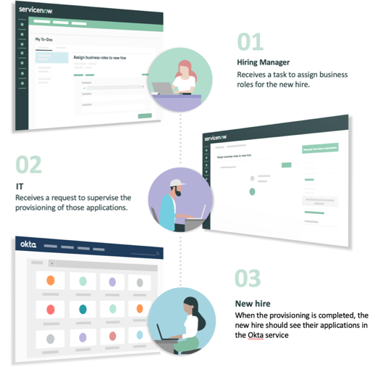
How it works
When the onboarding case is created, the Hiring Manager receives a task to assign roles and entitlements for the New Hire
Once the task has been completed, an IT Request will be generated containing information about the roles selected
IT Request is auto closed if provisioning is successful
If provisioning is unsuccessful the IT Admin will have to manually provision the roles to the new hire and close the task
When the provisioning is complete, the new hire should see their applications in the Okta service

Slide 86

Microsoft Azure AD integration for new hire onboarding
Automatically provision relevant applications for new hires as part of the onboarding process.
Setup
Setup Microsoft Azure AD spoke
Configure the remote directory sync to fetch the groups into your instance
Configure the required business roles
Create mappings between Business Roles and Azure AD groups
New hires must have a user record in the Microsoft Azure system
Notes:
For instructions on how to set up the spoke, see Set up Microsoft Azure AD spoke
Credential: Create a new Credential of type ‘Oauth 2.0’. Add default OAuth entity profile available for Azure AD.​
Connection : Create a new Connection of type ‘HTTP(s) Connection’. ​
Add the connection URL for the Azure AD instance​
Associate the credential created above to this connection​
Associate the default ‘Connection and Credential’ alias available for Azure AD​
Remote directory sync setup
Create Directory Integration record using connection and credentials created for Azure AD setup.​
Provide Directory Provider name as Microsoft AzureAD and Publish this record.
For instructions on how to configure the business roles and map them to the relevant groups, see Configure a business role.
Create the required Business Roles. The form contains following fields:​
Name: Name of the business role​
Parent Business Role: The role will inherit all the mappings of the parent Business Role selected​
Audience: The role is selectable for the New hires who fall in the list of audience provided​
Default: This role will be selected by default for any new hire, falling In the audience defined
Create mappings between Business Roles and Azure AD groups.​

Slide 87
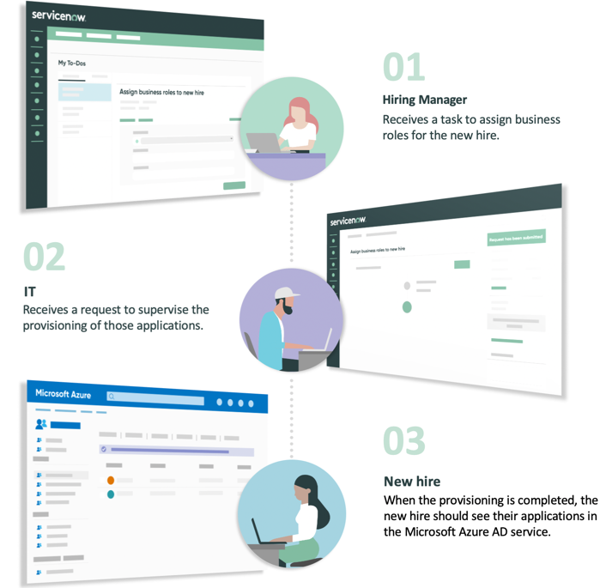
How it works
When the onboarding case is created, the Hiring Manager receives a task to assign roles and entitlements for the New Hire
Once the task has been completed, an IT Request will be generated containing information about the roles selected
IT Request is auto closed if provisioning is successful
If provisioning is unsuccessful the IT Admin will have to manually provision the roles to the new hire and close the task
When the provisioning is complete, the new hire should see their applications in the Microsoft Azure AD service

Slide 88

SailPoint integration for new hire onboarding
Automatically provision relevant applications for new hires as part of onboarding process.
Setup
Setup mid server
Install the SailPoint IdentityIQ for Service Catalog v2 app from the ServiceNow Store
Lifecycle event for new hire onboarding have the following components
Lifecycle event activity: Account and Application Access (in the Day One activity set)
HR Task Template: Assign Roles in SailPoint
New hires must have a user record in the SailPoint system
Notes:
For the installation guide and further information, see SailPoint IdentityIQ for Service Catalog v2, make sure to use version 2.0.10 or later
Setup : Complete setup details in SailPoint setup module (SailPoint Store Doc). ​
Provide Identity IQ endpoint URL​
Provide username and password to login in SailPoint env.​
Provide mid server name​
Enable LCM in IIQ​
Provide SailPoint Identity attribute to correlate with SN account.​
Provide ServiceNow account attribute to correlate with SailPoint IdentityIQ.

Slide 89
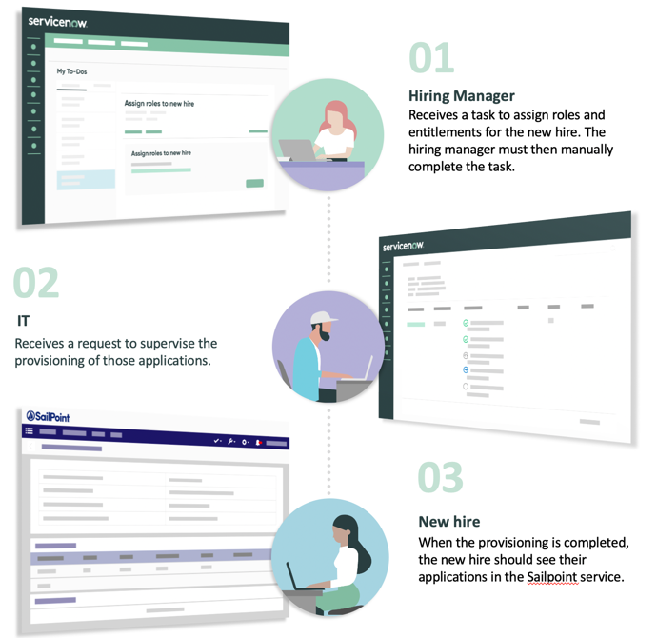
How it works
When the onboarding case is created, the Hiring Manager receives a task to assign roles and entitlements for the New Hire
Once the task has been completed, an IT Request will be generated containing information about the roles selected
IT Request is auto closed if provisioning is successful
If provisioning is unsuccessful the IT Admin will have to manually provision the roles to the new hire and close the task
When the provisioning is complete, the new hire should see their applications in the SailPoint service

Slide 90
Telephony integration options

Slide 91





Computer telephony integration options
Increase HR agent productivity and provide a better customer experience to your callers by using features such as screen pop or automated call logging so that the case creation process in ServiceNow is streamlined
Leverage one of the telephony integration apps available in the ServiceNow App Store (additional costs may apply)
Starfish Click-to-Communicate (Avaya, Cisco, Skype)
Sensiple (Skype)
InGenius (Avaya, Cisco, Genesys)
3CLogic (Avaya, Cistco, Genesys)
CTI for Amazon Connect
Build a custom integration using ServiceNow Professional Services

Slide 92
Questions?
Contact information goes here

Slide 93
Thank you

