Slide 1
Now Platform Utah & Q1 2023 Store release delta training
ITOM Visibility
ITOM Product Management

Slide 2
ITOM Visibility value growth
UTAH +
AWS Kinesis Discovery
AWS Autoscaling Groups Discovery
Automated Service Suggestions for Service Mapping
Certificate Fulfillment workflows (Microsoft)
Cloud Native Operations (Visibility)
Dell EMC XtremIO Storage
MID Server Autoscaling
Cloud Operations Workspace K8s dashboard
Improved event handling for AWS Event-driven Discovery
K8S auto scheduler with IAM role support
XtremIO Storage support
ISAM v9 support
PCF Bosh and v3 support
Mongo Instance support
Installed software discovery on containers
Azure Change Events processing (new approach)
ACC-V – ”Assigned to”
ACC-V – File system & memory module discovery
ACC-V – Local User discovery
ACC-V – GCP relationship discovery
Tag Governance Key & value policy – expose CI variable for use in scripts
Pattern Designer Enhancements app
Family releases and Store releases
TOKYO +
K8S Discovery auto schedule creation for GCP and AWS
ACC-V - Air-gapped network support
ACC-V - Software last used date for macOS
ACC-V - Intel EMA and vPro support
Certificate Fulfillment workflows (Entrust)
Cloud Operations Workspace – Resources inventory dashboard
IPv6 Discovery (agentless)
Oracle Middleware verification
ACC-V – Discover software from portableapps.com
ACC-V Discover software editions for MS Exchange and Adobe Acrobat
ACC – OS support for Windows Server 2022, macOS Monterey, RHEL 9 and CentOS Stream 8 & 9
K8s Discovery auto schedule creation for Azure
AWS ElastiCache
AWS Keyspaces (Cassandra)
MemoryDB (Redis)
AWS Opensearch
AWS RedShift
Cohesity Backup Server
SAN DIEGO +
ACC Virtual Agent Conversations
ACC Advanced software usage metering
ACC Live CI View
ACC Remediation Playbooks
ACC SIR
Cloud Operations Workspace
ML Service Mapping Load Balancer Connection Suggestions
Service Mapping Plus -Application Service Readiness Dashboard
ACC IPv6 support
Containerized MID Autoconfiguration
Cloudian Storage support
MSSQL components support
ROME +
ML Service Mapping - connection rules
ACC-V / ACC IHub Spoke
Certificate Fulfillment workflows (DigiCert)
Data Collection for Oracle GLAS
Containerized MID Server
Tag Governance Auditing
Service Mapping - Zoom In / Zoom Out
Global IP Address exclusion list for Discovery
Deduplicate IP addresses in Discovery schedules
Infinidat support
Oracle RAC support
Citrix Xen Hyper-V support
NetApp support
QUEBEC +
ML-based Service Mapping
MID Server JRE Upgrade​
MID Server RPM/DEB Package​
Command Audit Log​
SAM Better together ( BYOL, Redhat Publisher pack )​
Cloud Resource Dashboard​
Standalone ESXi Discovery​
Azure Resource Graph Support​
CAPI to Pattern Migration
PARIS +
Service Mapping with CMDB Groups​
Service Graph Connectors​
Huge payload​ support
Pattern Orchestration
Application Fingerprinting
Azure Management Groups​
Firewall Audits and Reporting
Dynamic CI Groups
Multisource CMDB
Q2 & Q3 2020
Q4 2020 / Q1 2021
Q2 & Q3 2021
Q4 2021 & Q1 2022
Q2 & Q3 2022
Q4 2022 & Q1 2023

Slide 3
ITOM Visibility - Overview of Major New Features and Enhancements
New Feature/ Enhancement | What | Business Outcomes
Kubernetes Explorer | Single pane of glass to visualize Kubernetes resources. | Manage visibility of Kubernetes in the same place you manage visibility of cloud resources.
Software discovery inside containers | Discover installed software on containerized resources. | Improve security posture and manage software license compliance for containerized resources.
Autoscaling containerized MID Server | Scale up and scale down containerized MID servers based on CPU & RAM usage. | Reduce administrative overhead and accelerate time to value.

Slide 4
ITOM Visibility - Overview of Other New Features and enhancements
New Feature/ Enhancement | What | Outcomes
Cloud Operations Workspace enhancements | Cosmetic updates: Added reminder on Cloud Operations Workspace home page to update store apps Renamed Cloud Resources Inventory Dashboard to Cloud Resources Explorer Cloud Resources Explorer: Added new report on Cloud Resources Explorer dashboard showing on-premises resources vs. cloud resources Cloud Discovery Schedule setup: Added ability to select MID Server for all cloud providers Added ability to create Cloud Credentials | Improved experience for administrators.
AWS cloud events processing improvements | Processing AWS cloud events in parallel. | Process large volumes of cloud events faster.
Azure changes processing | New method for processing of Azure cloud events by using a pull approach. | Increased performance with less throttling issues. Easy to set up with just a few clicks on ServiceNow instance.
Tag Governance - Key & Value policy update | The “CI” variable can now be used in scripts within the Key & Value policy type. | Increased flexibility for auding tag keys and values.

Slide 5
ITOM Visibility - Overview of Other New Features and Enhancements
New Feature/ Enhancement | What | Outcomes
Pattern Designer Enhancements app | Troubleshoot patterns by validating credentials for specific commands, including Unix and Windows commands, SNMP queries, SNMP walk, Registry queries, HTTP GET calls. | Improved troubleshooting experience for administrators to pinpoint command and pattern execution failures.
Discovery and Service Mapping patterns | February: Source Network Address Translation (SNAT) support for A10 load balancers Discover software inside containers March: Azure Changes processing Improvements to software discovery inside containers | Speed time to discover these technologies and add them to the CMDB.

Slide 6
Major Feature Details
Utah and Q1 2023 Store

Slide 7


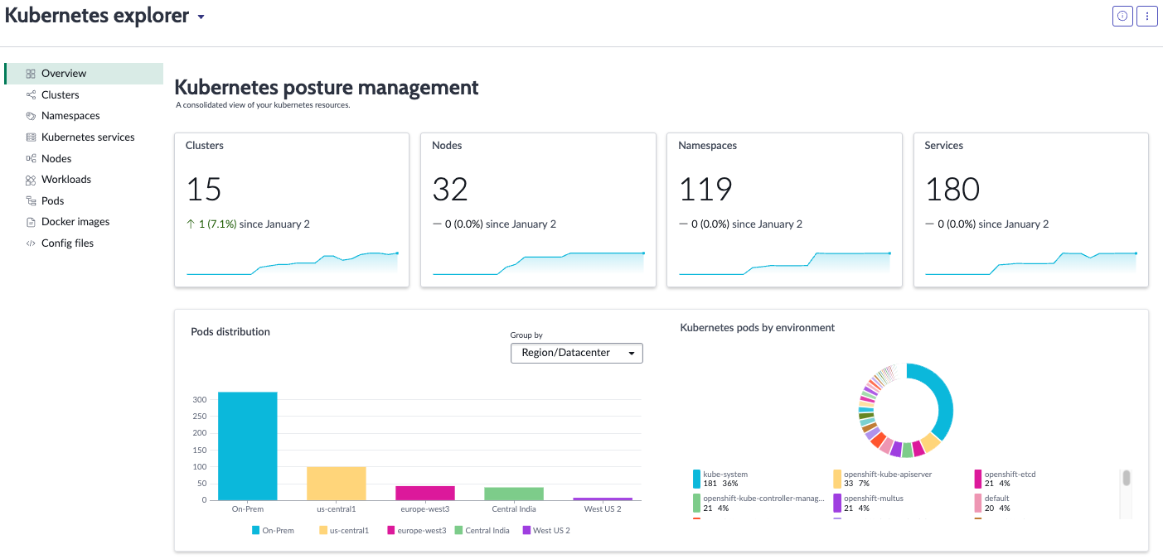
Kubernetes Explorer
Next Experience
Increase visibility of Kubernetes resources with a single pane of glass
1
Manage visibility of Kubernetes in the same place you manage visibility of cloud resources
Visualize Kubernetes resource trends over time
Easily drill down into Kubernetes components to manage specific resources
2
3
Cloud Operations Workspace Store app

Slide 8
Kubernetes Explorer| Fact Sheet
Why we added it
How you activate it
Licensing Implications
Manage visibility of Kubernetes in the same place you manage visibility of cloud resources.
Increased K8s reporting capabilities.
Go to Applications > All, search for “Cloud Operations Workspace”. Install version 1.4.0 or higher.
Included with Discovery regardless of licensing model.
Technical
Who should be interested
Before / After
Requires Utah release
New ”application” called Kubernetes Explorer available from the Cloud Operations Workspace home page.
Visualizes existing discovered K8s resources from any method
  Agentless or CNO
Discovery admins
CMDB Admins
Cloud-native app owners
DevOps teams
Before
  K8s Dashboard was separate from Cloud Operations Workspace and had limited reporting capabilities.
After
  K8s data visualization now available on Cloud Operations Workspace with increased reporting capabilities.

Slide 9
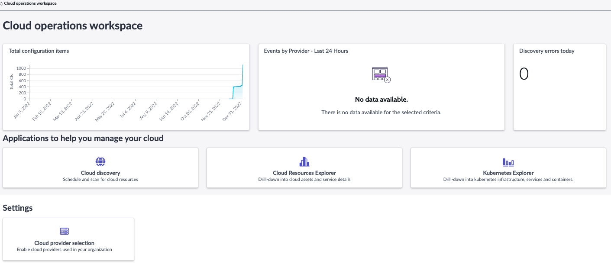
Cloud Operations Workspace Home Page
New application called “Kubernetes Explorer”

Slide 10
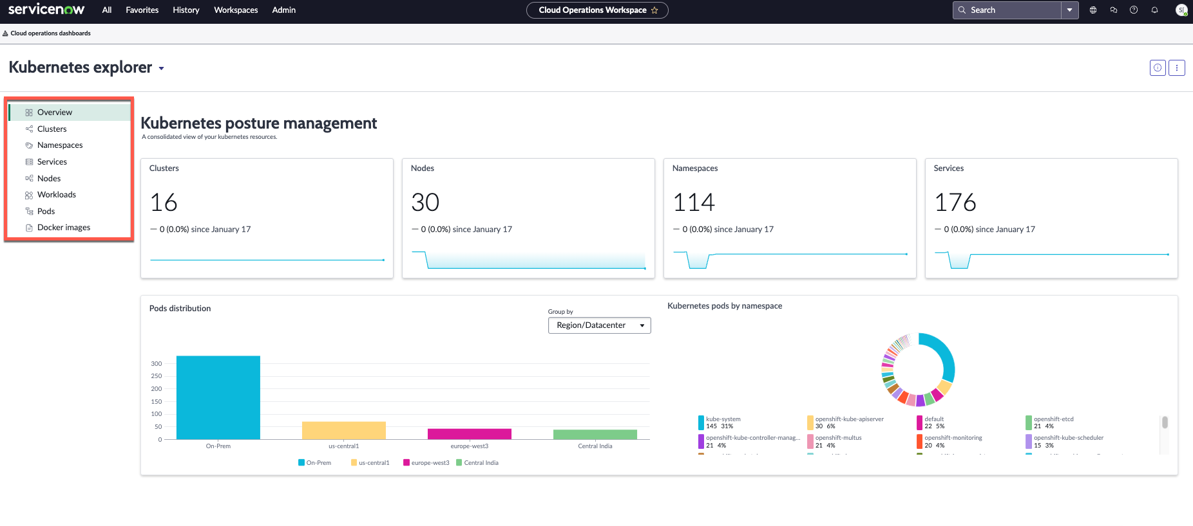
Kubernetes Explorer Dashboard
Visualize Kubernetes trends across many areas
Visualize Kubernetes trends across many areas
Visualize Kubernetes trends across many areas
Visualize Kubernetes trends across many areas
Drill down to see resources for these K8s components

Slide 11
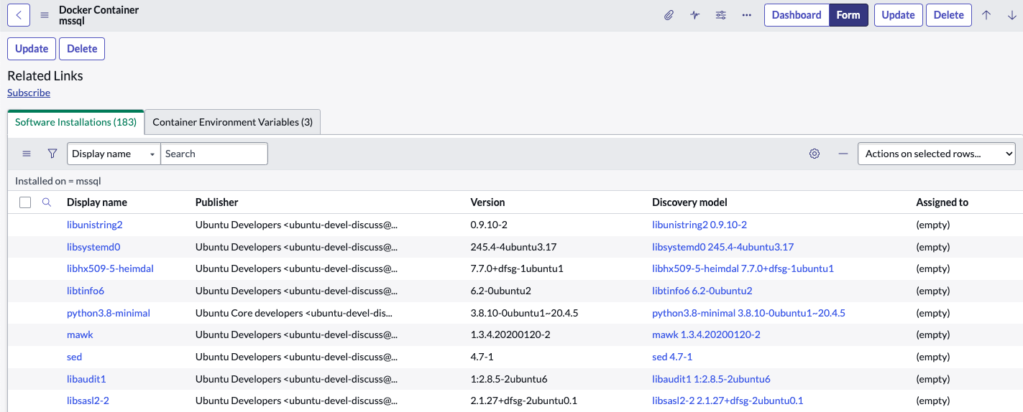
Software discovery inside containers
Improve security posture and manage software license compliance for containerized resources
1
Identify software vulnerabilities in containers
Manage software license compliance for containerized deployments
Get insights on how containers impact business processes
2
3
Discovery and Service Mapping Patterns Store app (February 2023)

Slide 12
Software discovery inside containers| Fact Sheet
Why we added it
How you activate it
Licensing Implications
Gain visibility of installed software inside containers for Security and Software license compliance use cases.
Go to Applications > All, search for “Discovery and Service Mapping Patterns”. Install version 1.0.98 or higher.
Included with Discovery regardless of licensing model.
Technical
Who should be interested
Prerequisites:
Utah release is required.
A Linux MID Server is required.
  Must be large size to be able to process container image scans (8 GB RAM and higher)
Aqua Trivy v0.35 or above.
Run Docker/Kubernetes discovery before Container Image Scan feature is enabled.
sn_itom_pattern.container_image_scan property set to true to enable feature.
Initial release is February 2023.
An update will be released in March 2023 (features TBD)
We plan to include Acqua Trivy with ServiceNow going forward
Before / After
Security teams
Software Asset Management teams
Discovery admins
CMDB Admins
Cloud-native app owners
Before
  Lack of visibility of installed software inside containers.
  Issues with understanding software license compliance, container security posture, and impact on business processes.
After
  Installed software visibility for containers.
  Improved security posture and license compliance, with a clearer view on how containers impact business processes.

Slide 13
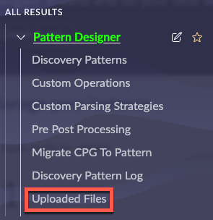
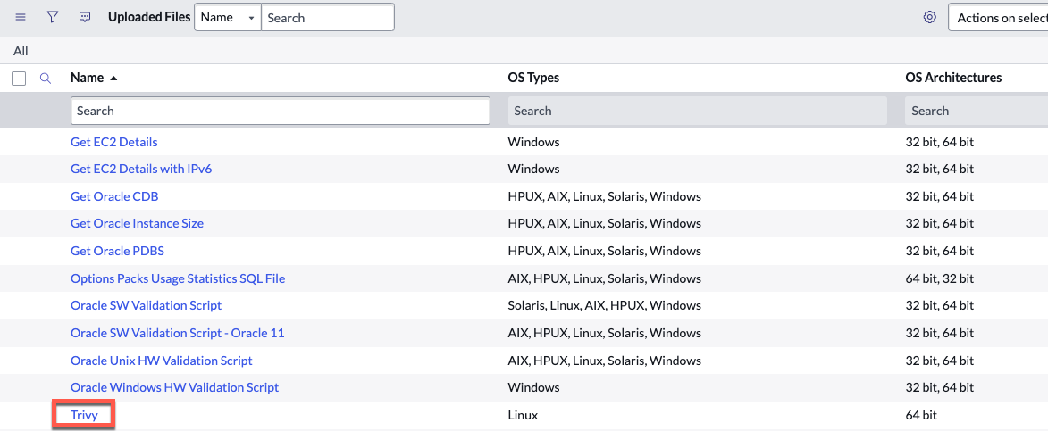
Upload Aqua Trivy file
Before enabling the feature, download Aqua Trivy from this link and upload the xml file

Slide 14
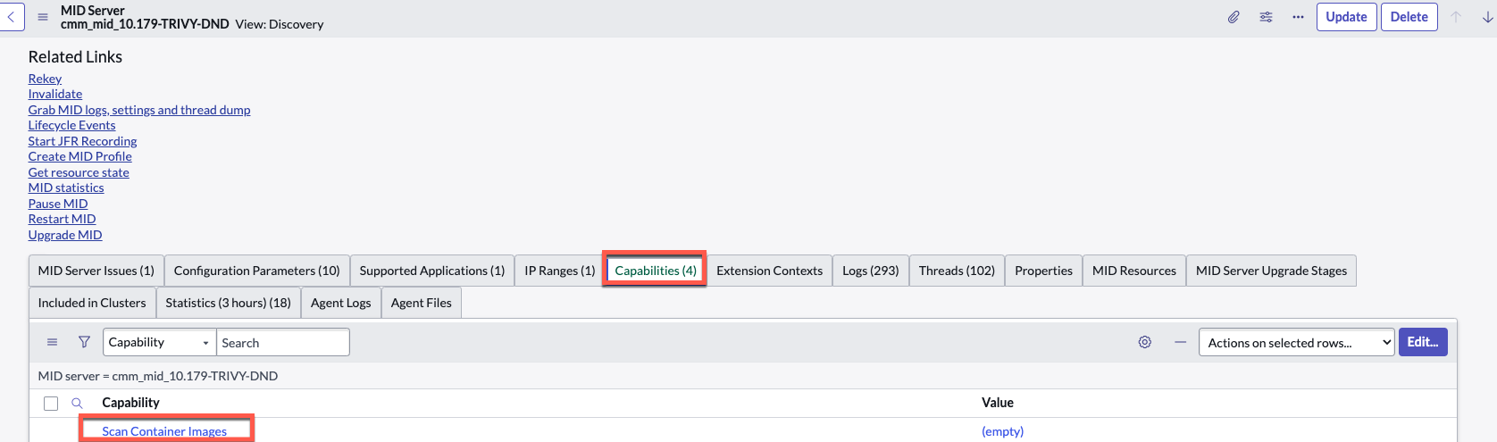

Configure MID Server(s)
A Linux MID Server is Required.
For each MID, add the “Scan Container Images” capability. Alternatively, the “All” capability also works
Go to Discovery > MID Servers and click “Pattern Sync to Mid” to ensure the Aqua Trivy file is copied to all MIDs

Slide 15
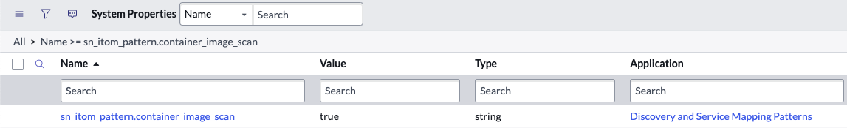
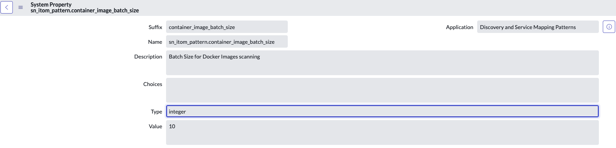
Setup Container Image Scan feature
Container Image Scan feature is enabled when the related property value is set to true (sn_itom_pattern.container_image_scan)
Batch size for the image scan is configurable and defaults to 10 (see related property sn_itom_pattern. container_image_batch_size): setting this number higher will decrease MID server performance

Slide 16
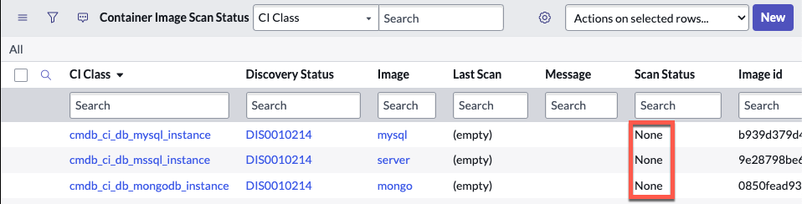
Container Image Scan Status
The “Scan Container Images” scheduled job runs every 1 minute:
scans batches of container images in the “Operating-system-level Virtualization Image” table (cmdb_ci_oslv_image) based on batch size
creates records for each of those images in the “Container Image Scan Status” table (sn_itom_pattern_container_image_scan_status)
The newly created Container Image Scan Status table records will initially have “Scan Status” set to “None”.
The “Scan Container Images” scheduled job will then run the “Scan Container Image” pattern for those records with Scan Status set to “None”, based on the defined batch size

Slide 17
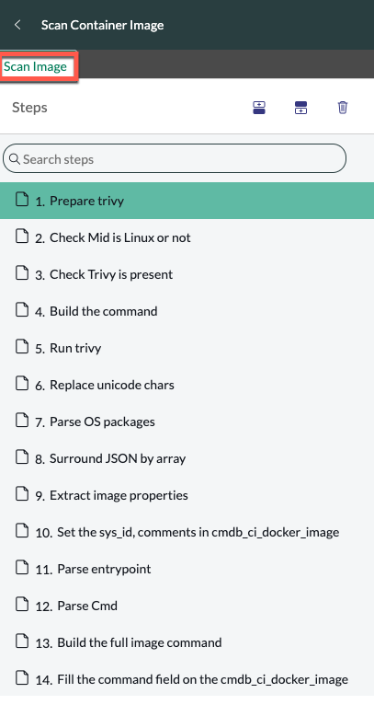
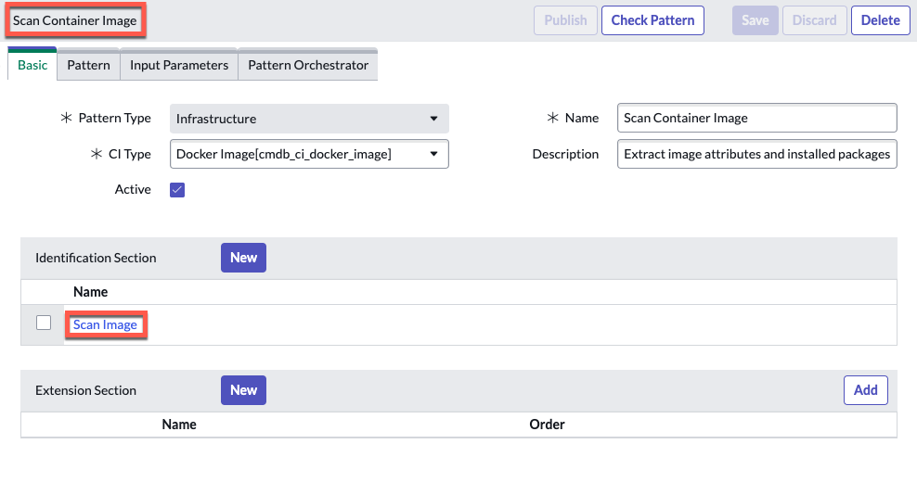
Scan Container Image Pattern ​
"Scan Container Image" pattern:
runs the Aqua Trivy command to get installed packages on the images
uses pre/post sensor scripts along with pattern flow to populate/ update image information.
".

Slide 18
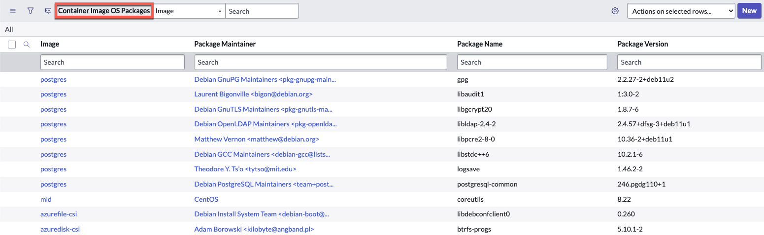
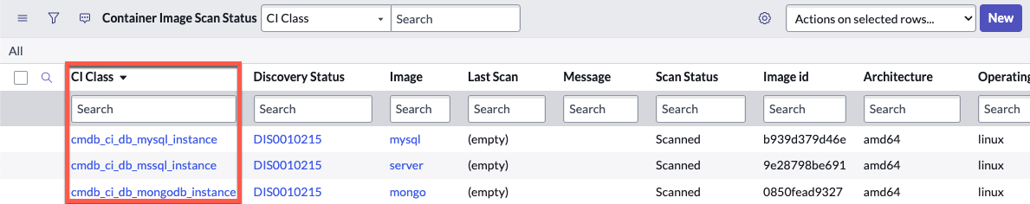
Populate OS Packages and CI Class
A pre-sensor script populates OS package information for each image into the “Container Image OS Packages” table (sn_itom_pattern_container_image_os_packages)
A post-sensor script then updates the CI class for each scanned image in the “Container Image Scan Status” table (sn_itom_pattern_container_image_scan_status table​)

Slide 19
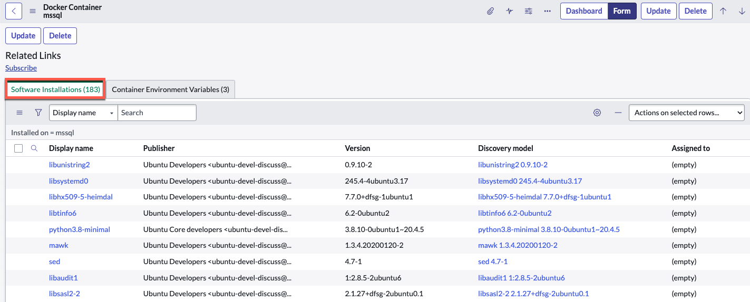
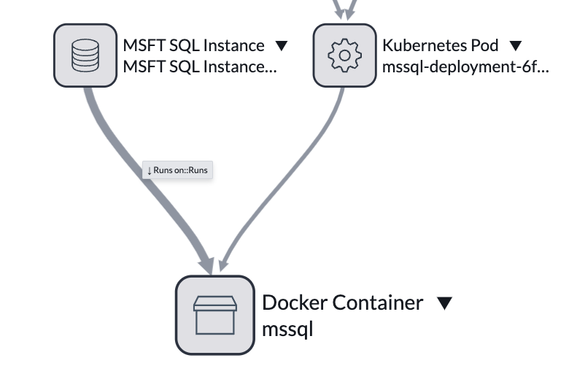
Create Application CI, add Hosting Relationship, and Populate Installed Software
A post-sensor script:
relates Image OS packages to each container running the package
creates application CIs
adds hosting relationship runs on::runs​
finally, software installation records are created or updated in the Software Installation table (cmdb_sam_sw_install)
Image OS packages are updated to each container of the image, application records are created for containers in the image CI Class table​, together with hosting relationship runs::runs.​ Then, software installs are create or updates in cmdb_sam_sw_install ​
Another scheduled job (“Update installed packages and application CIs in containers​”) runs periodically to process newly discovered containers of already scanned images:
It executes pre post scripts to apply image software packages to its containers
then creates application CIs per container based on image CI Class

Slide 20
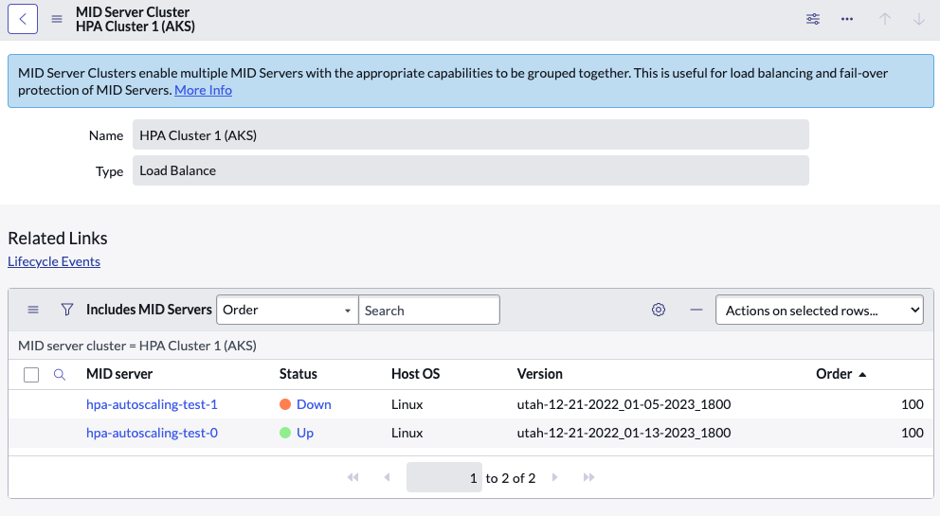
Autoscaling containerized MID Server
Utah Family
Automatically scale up and scale down containerized MID servers to support your workloads
1
Leverage CPU and RAM usage to automatically scale up/down containerized MID servers
Flexibility to choose which MID Server Clusters are auto scaled and how
Define minimum and maximum number of MID servers to be deployed for each cluster
2
3
Utah release

Slide 21
Autoscaling containerized MID Server| Fact Sheet
Why we added it
How you activate it
Licensing Implications
Automatic scale up/down of MID Servers on K8s was not supported.
Reduce administrative overhead.
Accelerate time to value.
Activated OOB with Utah release.
Available as part of any ServiceNow subscription.
Technical
Who should be interested
Only works with ServiceNow Discovery
HPA Autoscaling based on CPU and Memory (RAM) utilization​.
MID Server Mutual Authentication (mTLS) must be enabled on the instance and mTLS certificate PEM file must be obtained.
K8s secret for the PEM file must be created.
Deployment Request can be created either via:
  K8s StatefulSet workload, either including Headless Service YAML or HPA v1 configuration YAML file.
  K8s Deployment workload (not recommended, keep only for existing customers);
  Run the YAML file on Kubernetes.
  In order to delete MID servers permanently, need to delete them manually from both K8s and instance.
Before / After
ServiceNow admins
Before
  Struggle to dynamically set no. of containerized MID Servers needed.
  Manual intervention as the only way to scale up/down MID Server.
  When MID Server set to status “Down”, risk of losing data.
After
  Only CPU/RAM and no. replicas have to be set in advance.
  Containerized MID servers are automatically scaled up/down.
  Before a MID is set to status “Down”, status “Draining” saves data.

Slide 22
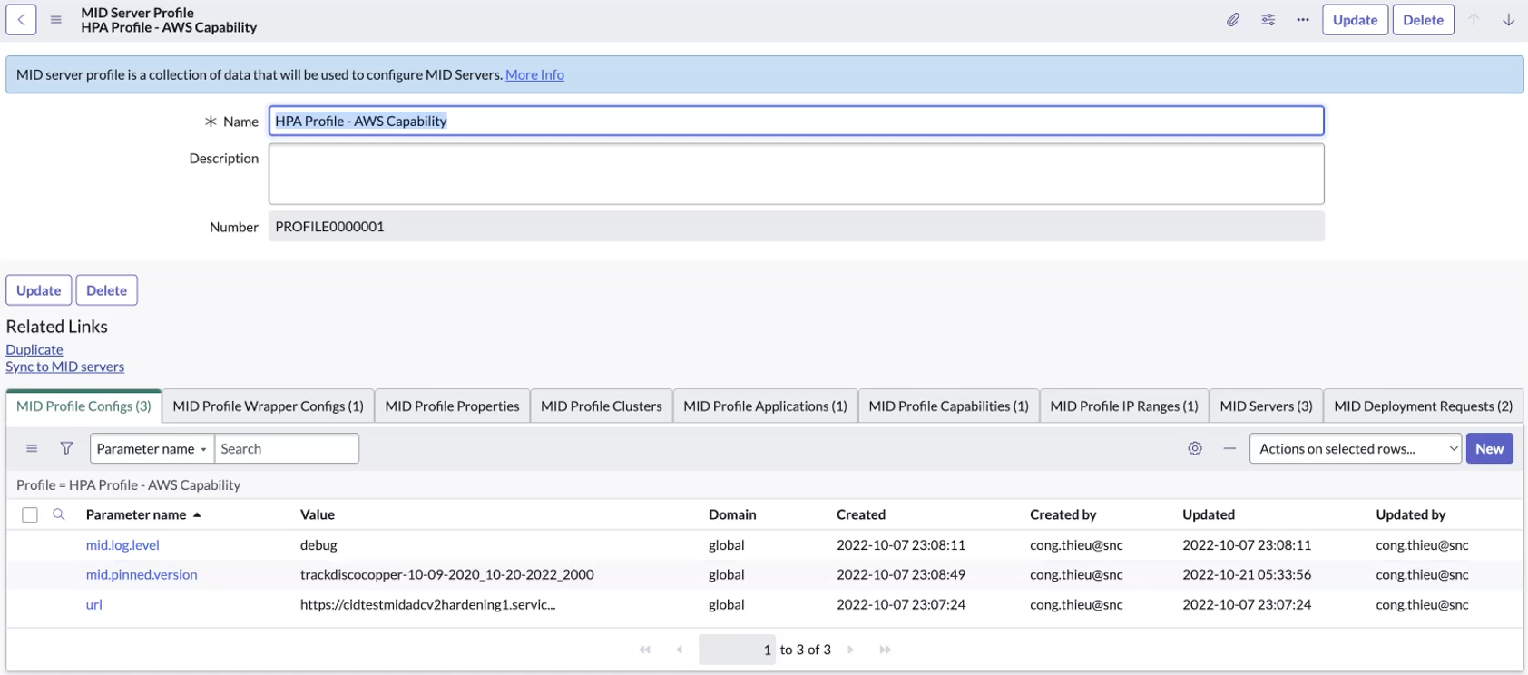
MID Server Auto scale Profile creation
A MID Server Autoscaling Profile can now be created, then linked to specific MID Server Profile Clusters

Slide 23
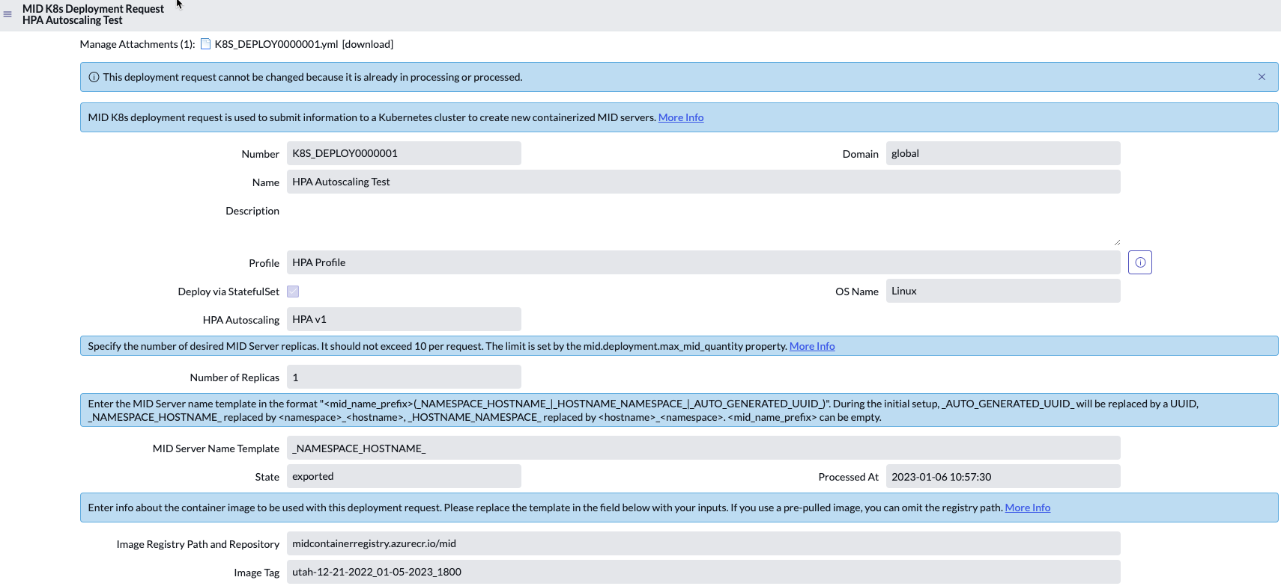
MID K8s Deployment Request using Autoscaling Profile
MID server K8s Deployment Request can be now created using Horizontal Pod Autoscaling (HPA) Profile
Deployment can be done via StatefulSet
Set default number of replicas
Insert Docker Image Tag to deploy your MID server in your K8s environment

Slide 24
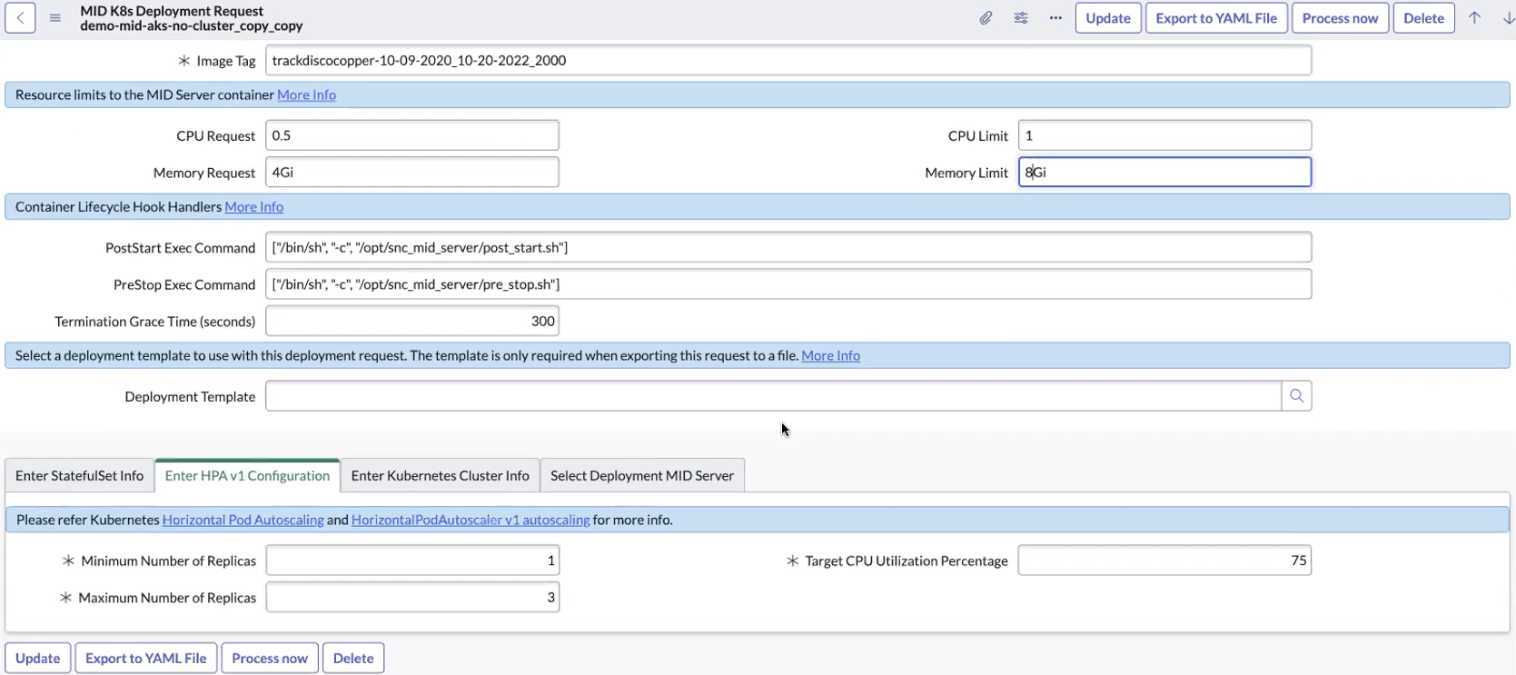
MID K8s Deployment Request using Autoscaling Profile
Set default Resource parameters (Request and Limit) for the MID Server Container
Select target CPU usage limit that triggers autoscaling
Set Minimum and Maximum number of Replicas to be deployed

Slide 25
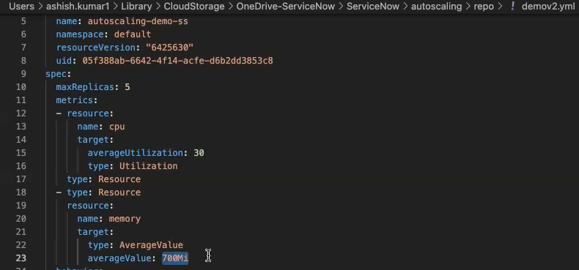
Configuring YAML file for RAM to trigger Autoscaling
By configuring the exported YAML file, it is possible to set the RAM resource average value that then triggers autoscaling

Slide 26
Autoscaling Containerized MID Servers
When a new Discovery starts, only the default MID server is up
As Discovery proceeds and the CPU usage increases, MID servers are autoscaled

Slide 27
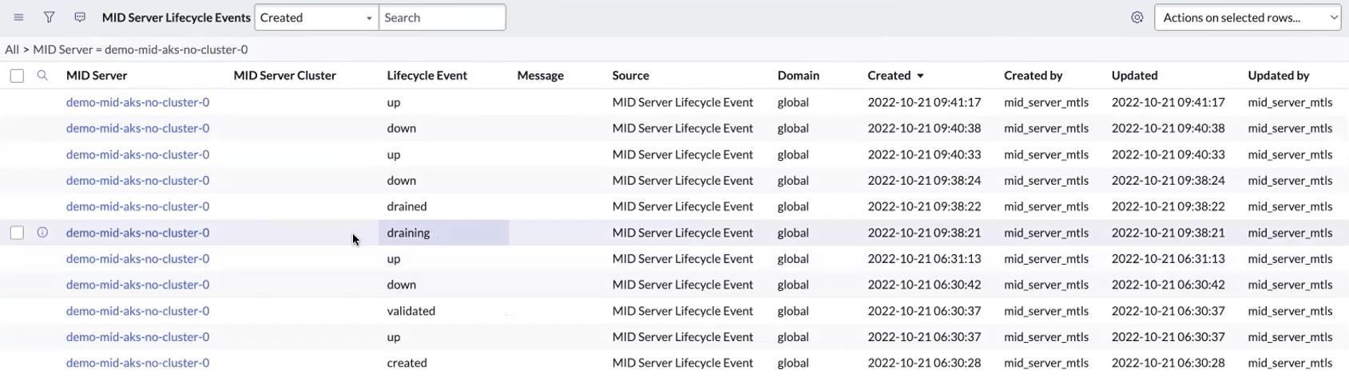
MID Server ”draining” status
Before a MID Server goes from status “Up” to “Down”, there is now an intermediate status: “Draining”
Status “Draining” allows the MID server to wait for the work in progress to be completed, then returns results and queued work to the instance

Slide 28
Other New Feature Details
Utah and Q1 2023 Store

Slide 29
Cloud Operations Workspace enhancements
Next Experience
February 2023 Store (app version 1.4.0)

Slide 30
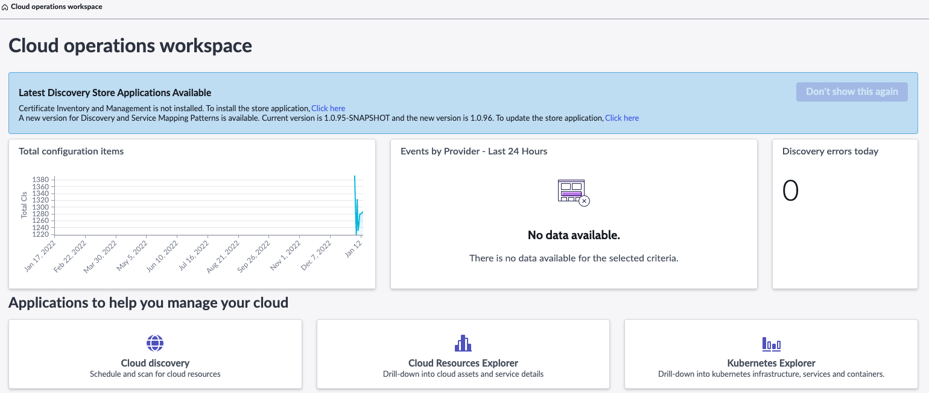
Cloud Operations Workspace cosmetic updates
New reminder to update Store applications on the Cloud Operations Workspace home page
Formerly called “Cloud Resources Inventory Dashboard”

Slide 31
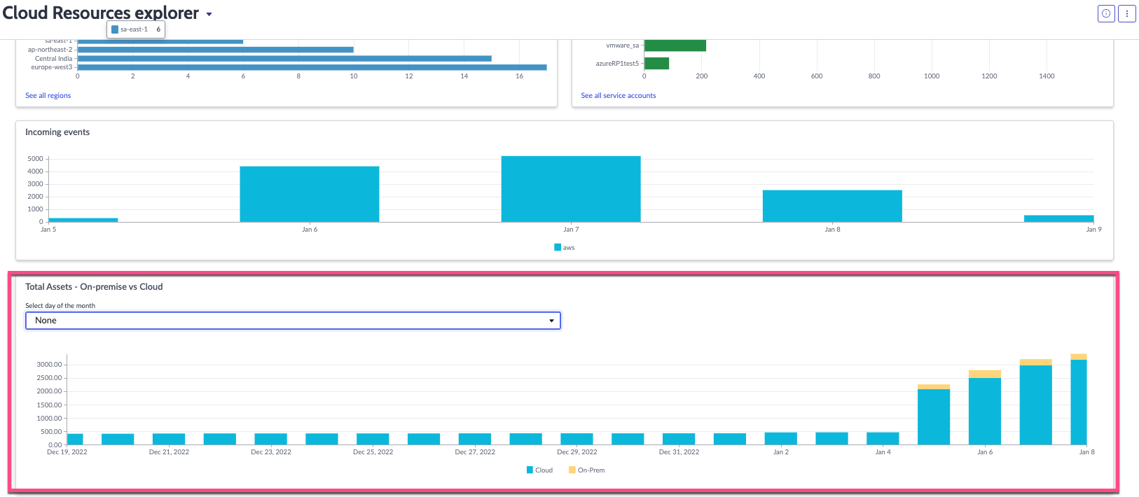
Cloud Resources Explorer – new report
New report added to compare on-premises to Cloud resources over time

Slide 32
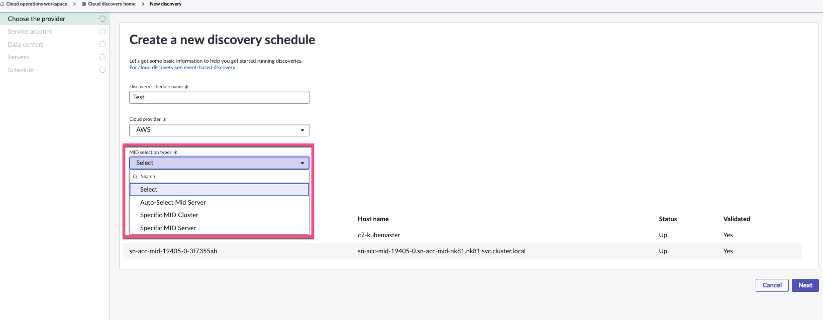
Discovery Schedule setup – ability to select MID Server
New ability to select a specific MID Server or MID Cluster. You can also choose to Auto-Select a MID Server

Slide 33
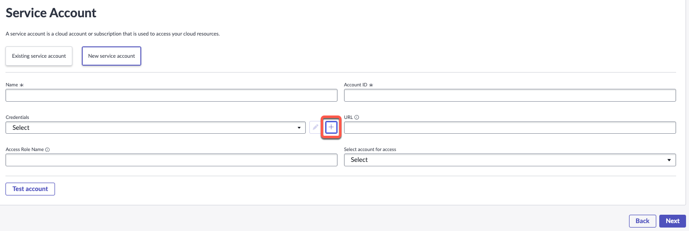
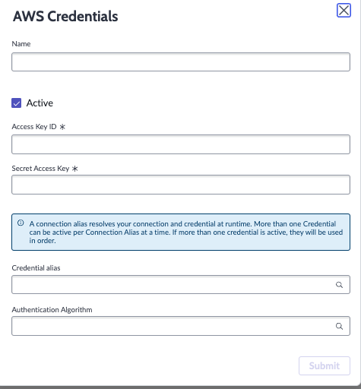
Discovery Schedule setup – Create Cloud Credentials
New ability to create cloud credentials during Cloud Discovery schedule setup

Slide 34
AWS Cloud Events Processing improvements
Utah Family
Utah release

Slide 35
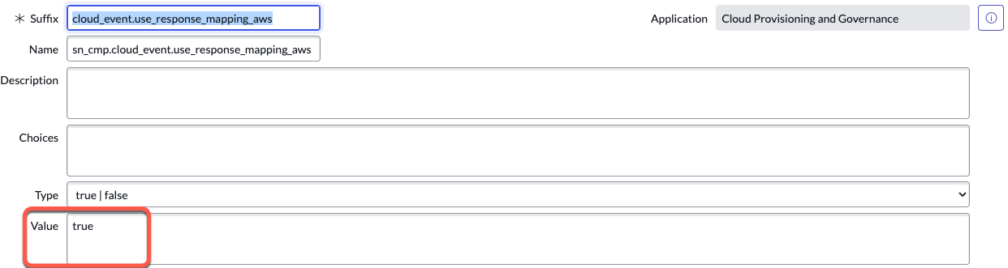
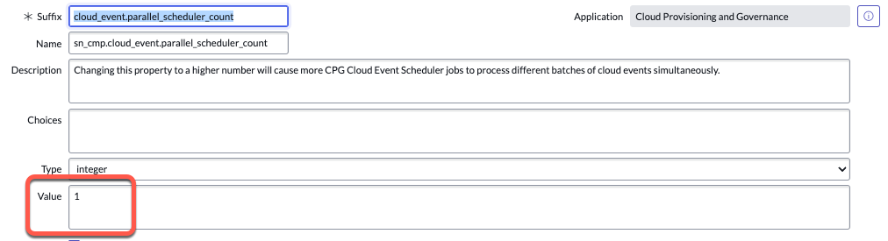
AWS Events Processing Improvements
Utah Family
Process large volumes of AWS Cloud Events in parallel
Tokyo introduced the System property “cloud_event.use_response_mapping_aws” to expedite CMDB updates
When this is set to “True”, and suitable response mappings are available, the CI is updated based on response mappings instead of triggering pattern-based discovery
Utah introduces a new System property “sn_cmp.cloud_event.parallel_scheduler_count”
*Changing this value to a higher number will cause more Scheduler jobs to process batches of AWS cloud events simultaneously.
We’ve tested up to 8 scheduler jobs and saw vast performance improvement for large event volumes
Notes:
One scheduled job is capped for 500 records at the query, so if we know or calculate the inflow every 10 seconds we can use that as a parameter.
[Example, we see around 1700 events in ready state at a given time, we can try with 4 jobs]
Based on the number of nodes, we have to keep in mind number of background workers available and leave enough workers for other processes as well.

Slide 36
AWS Events Processing Improvements
Utah Family
How AWS Cloud Event Processing works in Utah
Configure AWS Config Service to send SNS notifications to the ServiceNow Instance
  Event notifications are sent to the ServiceNow Cloud Events Rest API
The API writes AWS Cloud events to the ”Cloud Events” table (sn_cmp_cloud_event) with event time and resource ID attributes.
  No pre-processing occurs at this point.
Each event is assigned a Process ID (PID) which decides the scheduler job that the event will be processed in.
  Events with common resource IDs are assigned to the same PID to ensure the correct processing order. Otherwise, PIDs are assigned round-robin.
  A scheduled job (Cloud Events Sorter) runs every 10 seconds to check for events in the “Cloud Events” table that do not have an assigned PID, and it assigns a PID.
The Cloud Event Scheduler runs every 10 seconds and processes events in the Cloud Events table that are in the “Ready” state with an assigned PID.
  Uses Response Mapping method to update the CMDB (cloud_event.use_response_mapping_aws = true)
Organizations with large AWS event volume can run more Cloud Event processing jobs in parallel by setting a higher value in the “sn_cmp.cloud_event.parallel_scheduler_count” system property.
Notes:
One scheduled job is capped for 500 records at the query, so if we know or calculate the inflow every 10 seconds we can use that as a parameter.
[Example, we see around 1700 events in ready state at a given time, we can try with 4 jobs]
Based on the number of nodes, we have to keep in mind number of background workers available and leave enough workers for other processes as well.

Slide 37
AWS Events Processing Improvements
Utah Family
Determining Right # of scheduler jobs
Admins should look at the “Cloud Events” table for AWS events in the “Ready” state and watch for this becoming higher and increasing over time.
One scheduled job is capped for 500 records at the query, so if we calculate the inflow every 10 seconds we can use that as a gauge.
For example, if we see around 1,700 events in the “Ready” state at a given time, we can increase to 4 scheduled jobs to handle the volume.
We are looking at ways to help customers monitor this more effectively.
Notes:
One scheduled job is capped for 500 records at the query, so if we know or calculate the inflow every 10 seconds we can use that as a parameter.
[Example, we see around 1700 events in ready state at a given time, we can try with 4 jobs]
Based on the number of nodes, we have to keep in mind number of background workers available and leave enough workers for other processes as well.

Slide 38
Azure Changes Processing
March 2023 Discovery and Service Mapping Patterns Store (app version 1.0.99)

Slide 39
Azure Changes processing
Moving to a Pull method for Azure Cloud Events
How it works:
A scheduled job runs every 10 minutes and makes a call to the Azure Datacenter Resource Block.
The Azure Datacenter Resource Block calls the Cloud API to check for new cloud events in Azure.
Response Mapping occurs to process changes.
Events are processed and the CMDB is updated.

Slide 40
Azure Changes processing
Why are we moving from a “Push” method to a “Pull” method?
Before: Targeted discovery for each individual event received was not performant enough and was causing throttling issues.
  After: Pull incrementally based on the frequency configured.
  After: Shallow CI with partial details will be created and the CI will be be updated by full discovery.
Before: Push events were tied to a Resource Group and users had to add alert configurations at individual resource group level.
  After: Changes can be processed at the management account level.
Before: Configuration was required on the ServiceNow Instance to create a Webhook in Azure.
  After: No configuration is needed in the Instance or on Azure.
Before: Events API doesn’t provide enough information for IRE to process.
  After: The Resource Graph Changes API provides the needed information required to create a unique CI.

Slide 41
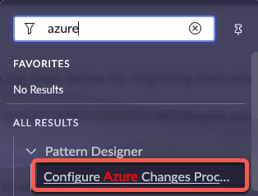
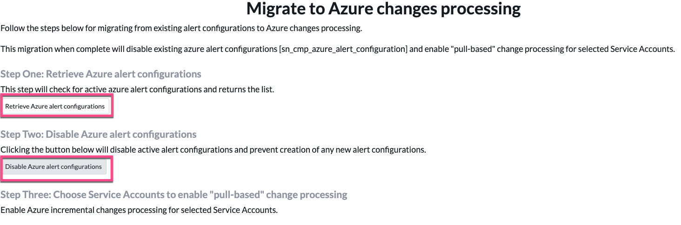
Azure Changes processing
Migration Wizard
New wizard under Pattern Designer to migrate to new approach
Migration Process
Retrieve existing Azure Alert configurations
Disable Azure Alert configurations
Configure specific service accounts you want to pull changes from

Slide 42
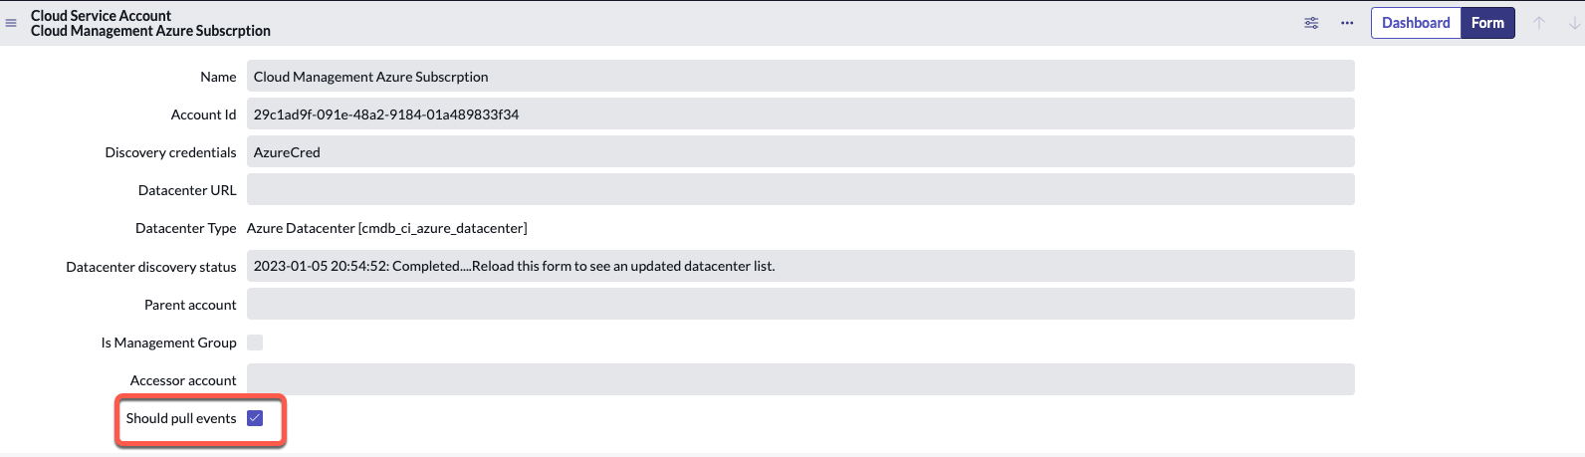
Azure Changes Processing
Enable Pull events on specific Azure Service Accounts
Open each Azure service account you want to pull events from and check this box

Slide 43
Tag Governance - Key & Value policy update
February 2023 Store (app version 1.1.3)

Slide 44
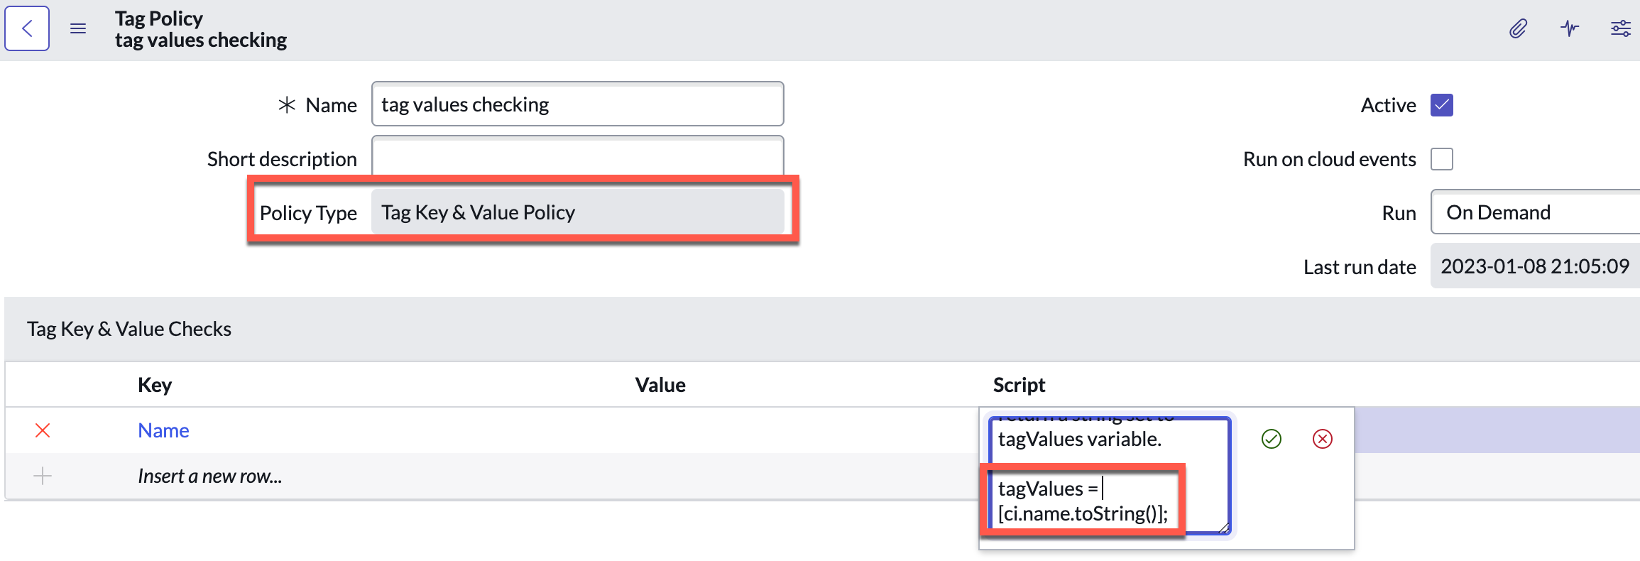
Tag Governance - Key & Value policy update
New update to the Tag Key & Value Policy
CI variable is now available for use in scripts

Slide 45
Pattern Designer Enhancements app
February 2023 Store (app version 3.0.0)

Slide 46
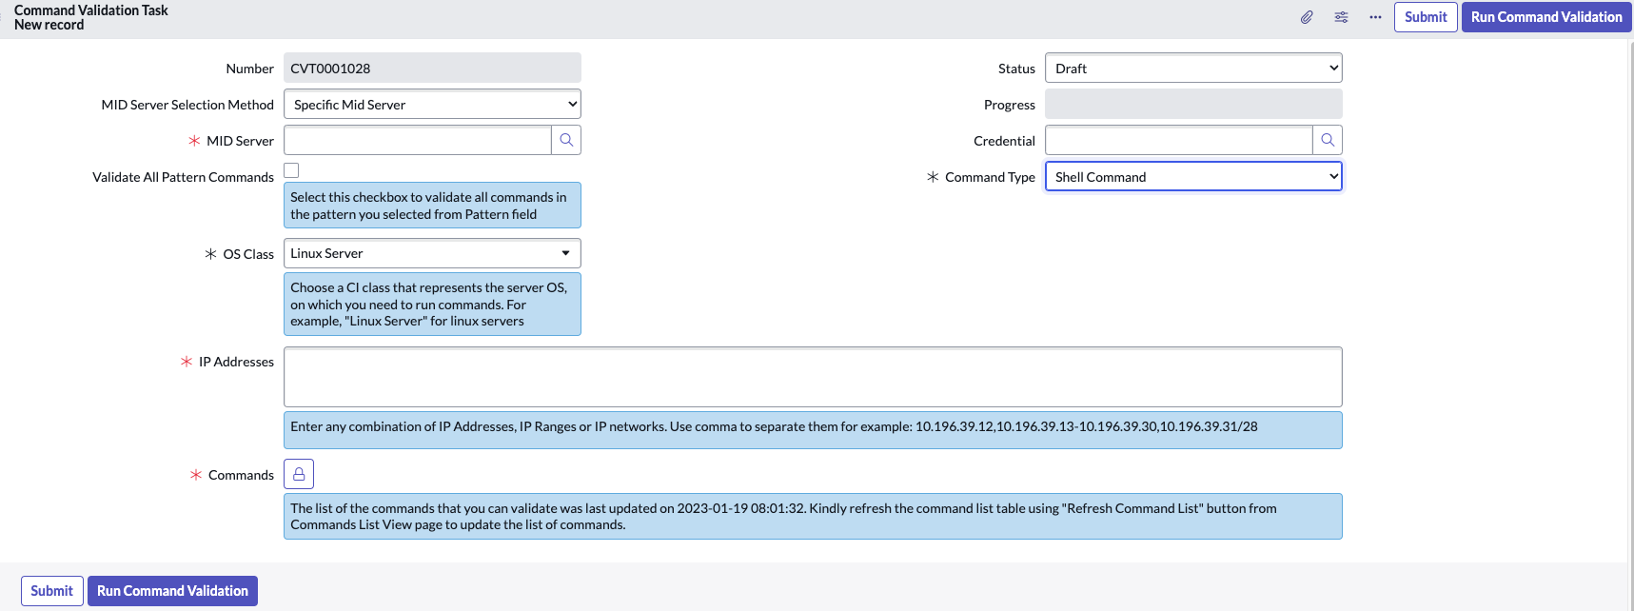

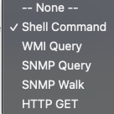
Create new Command Validation Task
Supports these MID Server Selection options
Supports these command types
Choose the OS Class to be validated
Can be populated with:
Comma separated IP Addresses
IP Range
IP Network
Comma separated IP Addresses, IP Range, and IP Network.
For more info, visit this KB article: https://support.servicenow.com/kb?id=kb_article_view&sysparm_article=KB1123625

Slide 47
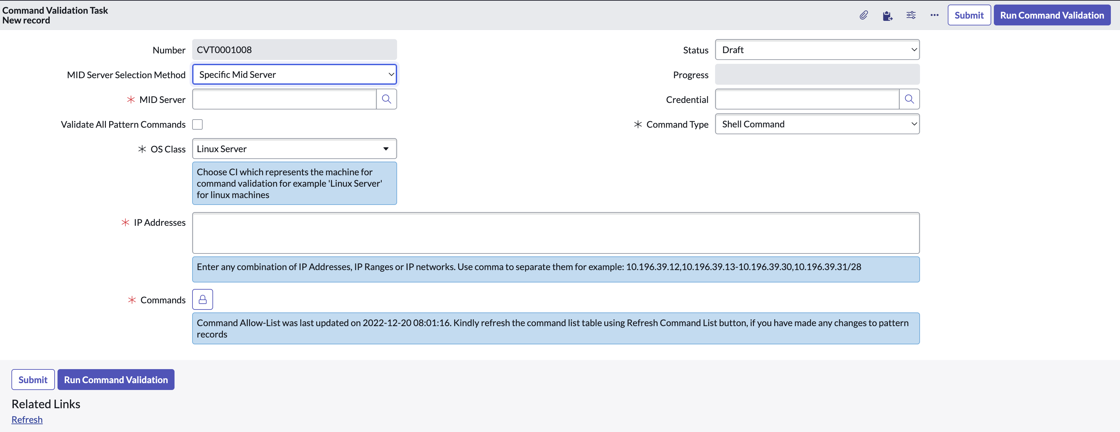
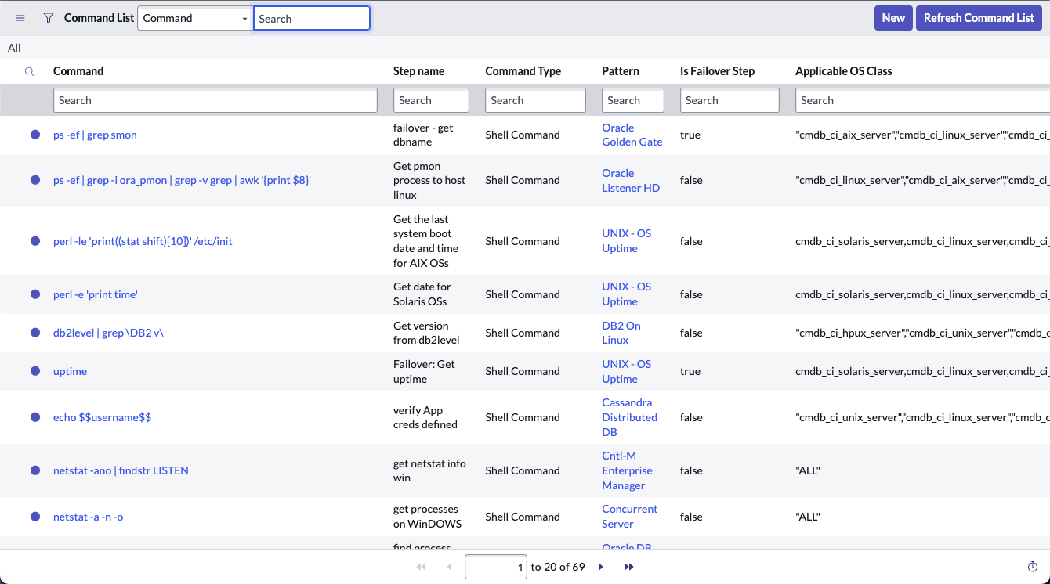
Create new Command Validation Task – Commands
For enhanced security, the Commands field gives access only to the command list for the selected OS Class and Command Type (users can’t type in arbitrary Commands)

Slide 48
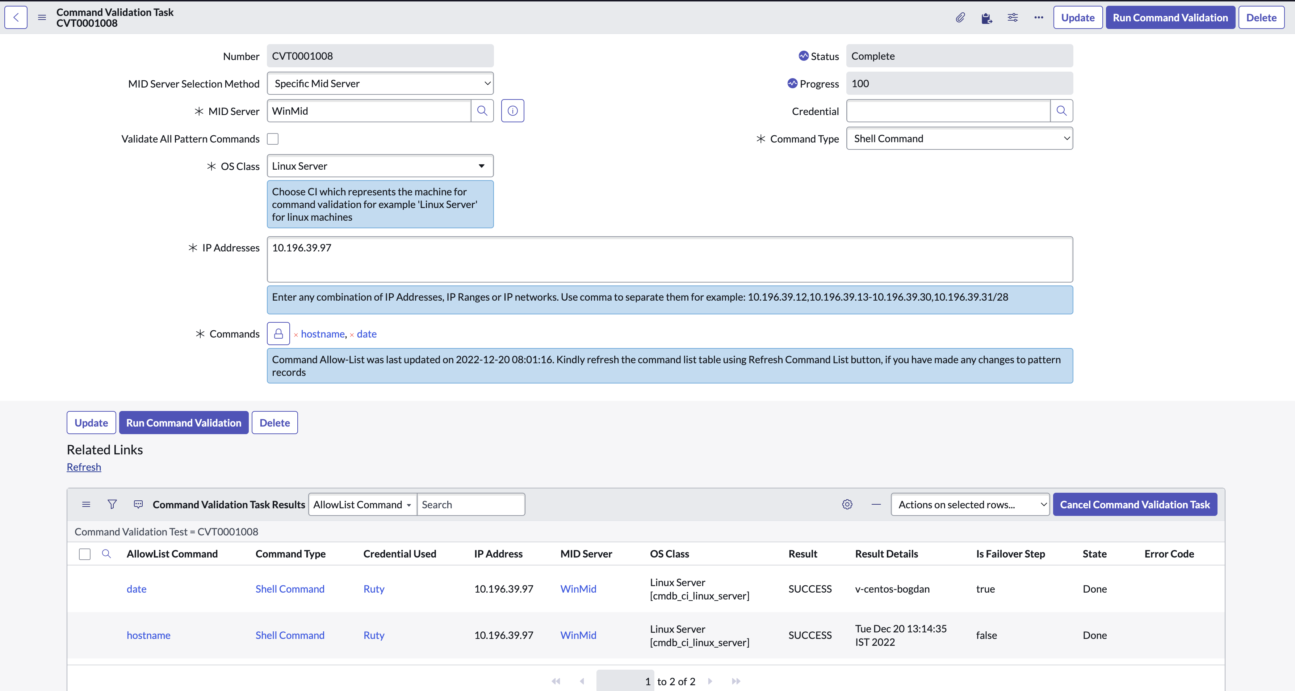
Command Validation Task Results - Commands
Command Validation Task results are detailed for each command. Under AllowList Command it is possible to access specific command details (e.g. pattern, step, CI type)

Slide 49
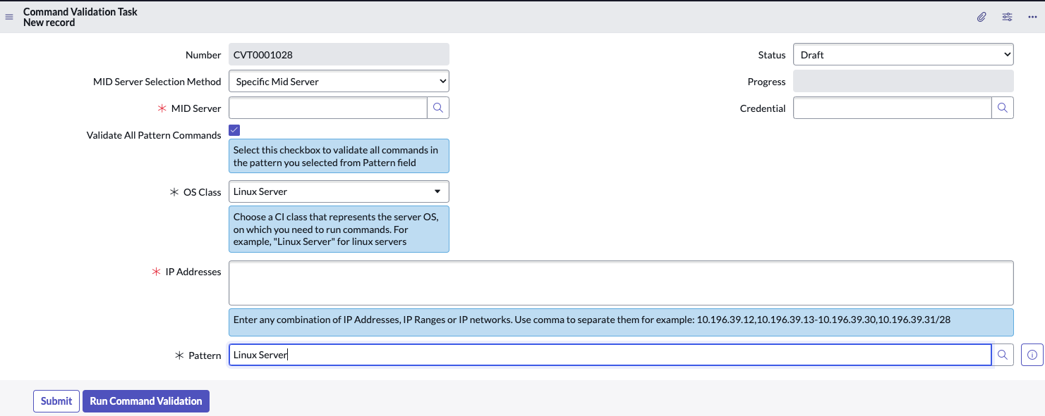
Optionally validate all commands for specific pattern
Option to run Command Validation Task for all Commands of a specific pattern
Option to run Command Validation Task for all Commands of a specific pattern

Slide 50
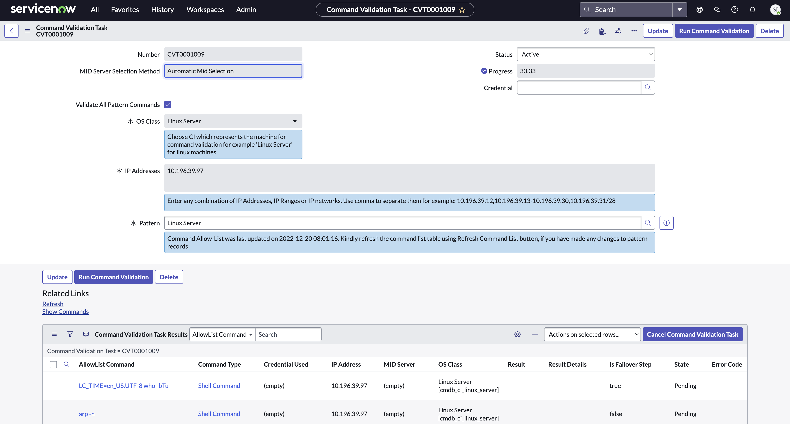
Command Validation Task Results - Pattern
Once completed, verify which Pattern Commands are not successful and need intervention if critical for pattern execution

Slide 51
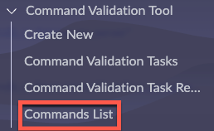
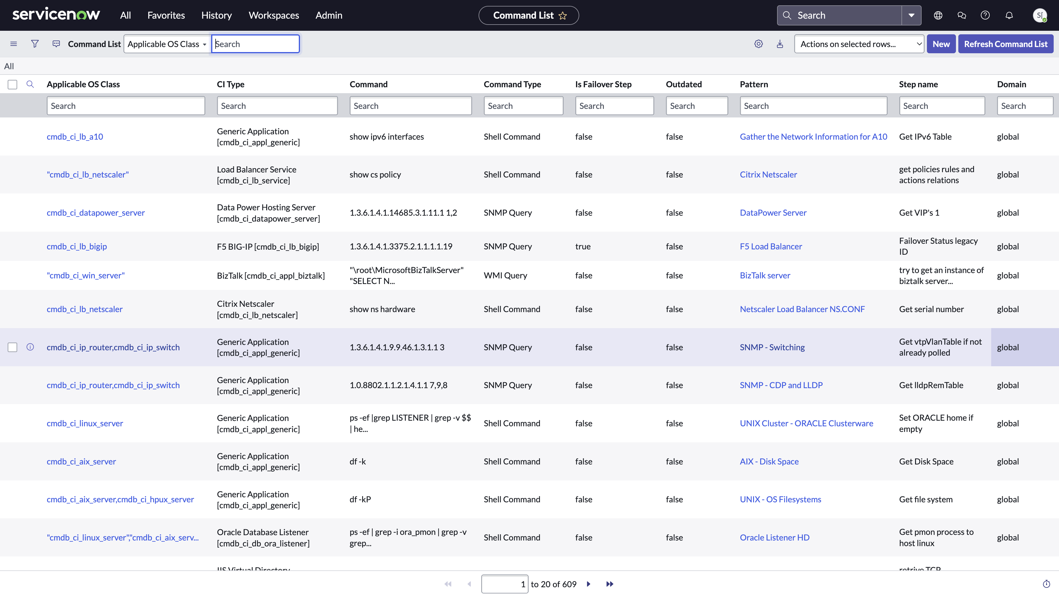
Command List
The Command List gets updated daily
Only commands for Application Patterns, Infrastructure Patterns and their shared libraries are included in the Command List, Cloud resources Commands are not included yet

Slide 52
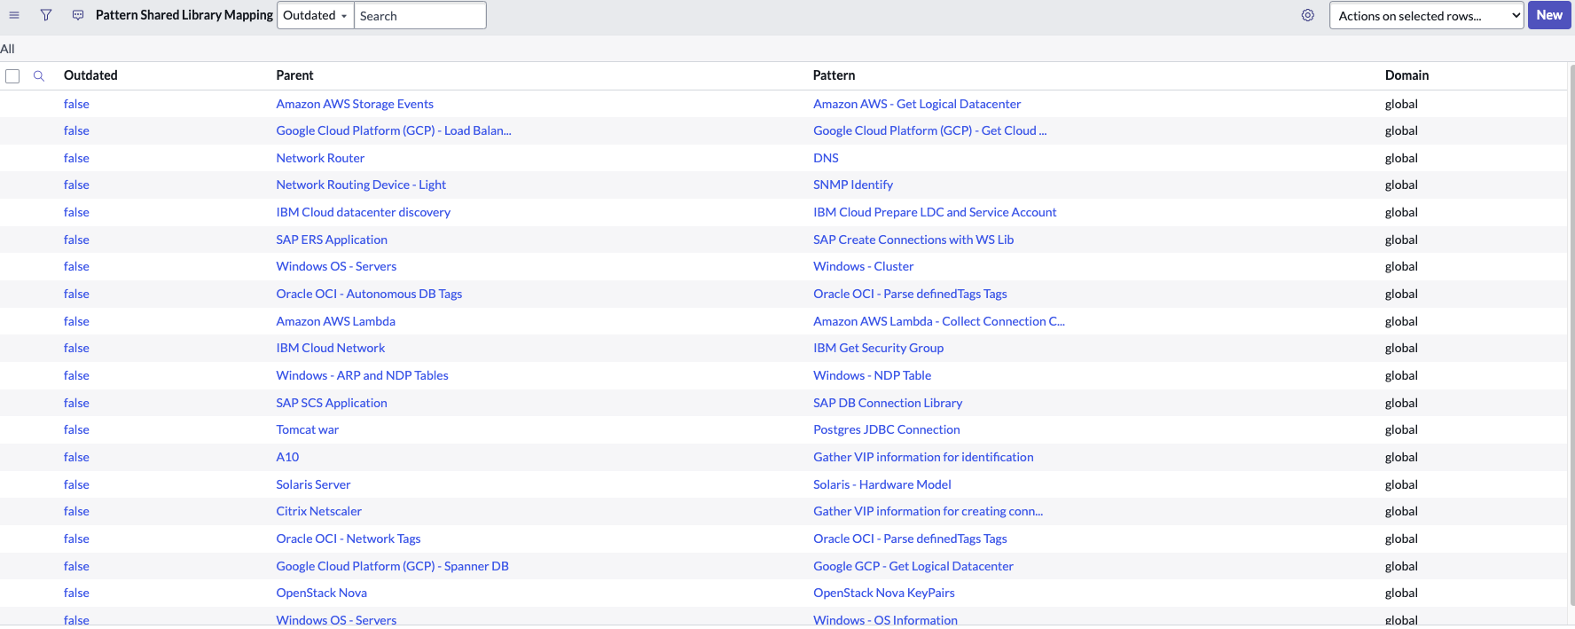
Pattern Shared Library Mapping table
This new table (pd_pattern_to_shared_library_mapping) is now available to determine which shared libraries belong to what pattern. It is also used when populating the Command List table

Slide 53
Thank you

Slide 54
Appendix
AWS Cloud Events processing performance testing results

Slide 55
Test details
Test
  Compare the metrics registration time between Tokyo and Utah
  What do we test?
  Discover single service account(10K,100K,200K) with incremental workload
  Discover multiple service accounts(15 SA) with incremental workload
  Single Mid Server
  MID Config:
  Linux Mid Server hosted in AWS EC2.
  MID host:
    16GB RAM, 64-bit OS
    8 cores
    8GB Heap Memory

