Slide 1
Performance Analytics
Self-Implementation Guide

Slide 2
Why Performance Analytics
Anticipate trends
Prioritize resources
Maximize automation &
self service
Guide continual service improvement
Improved KPIs
Monitor performance to identify areas for improvement; detect service bottlenecks before they occur.
Bring clarity to what matters and quickly re-direct service coverage where it’s needed most.
Pinpoint where automation and self-service can increase efficiency.
Take action on KPIs using Analytics Hub, time charts, forecasts, breakdowns, and dashboards.
Increased Productivity
Reduced MTTR
Increased customer satisfaction
Operational Impact at ServiceNow

Slide 3

Timeline of self-implementation
Initiate
Plan
Create
Execute
Deliver
Close
  Performance Analytics Readiness Checklist
  Readiness steps
  1 – 5
  Review available out-of-the-box content
  Plug-in requirements
  Assure required training
  Activate the plug-ins
  Review admin console
  Review results
  Communications
  plan
  Set targets
  Expand KPIs

Slide 4
Initiate
Preparing your organization for rolling out Performance Analytics

Slide 5
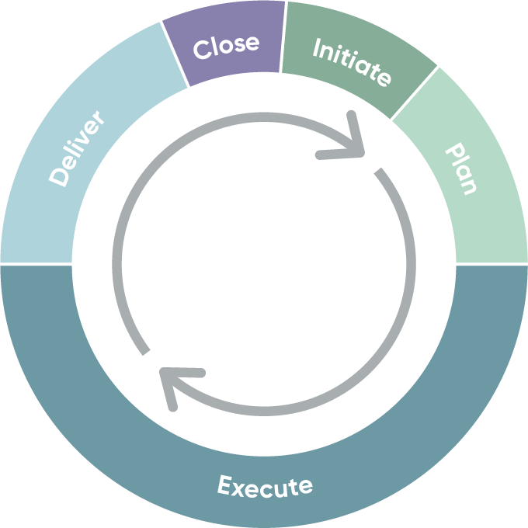

Performance Analytics quick start methodology
Initiate
ServiceNow Performance Analytics delivers real-time insight into business performance to help you meet and exceed your goals. Performance Analytics helps you make better decisions faster and answers questions via instant insight into current patterns and trends.
The Performance Analytics readiness checklist (see slide 8) guides the Initiate phase and helps you gain:
Immediate value via access to out-of-the-box Key Performance Indicators and dashboards precisely tuned for your ServiceNow applications
Quick deployment as you implement without integration and modeling provides results in weeks instead of months or years
Increased automation through uncovering and removing tedious, repetitive work from your organization
In-platform access that lets you replace maintaining manual spreadsheets with automated data collection
Trusted data that provides a single source of truth to stop questioning the validity of ad-hoc spreadsheets and anecdotal information
The Now Create Methodology described below is a proven methodology developed from thousands of ServiceNow implementations. Each phase is covered in the following sections of this deck.
1. Initiate
Define your goals/objectives, collect prerequisite information, and define the key processes for implementation success.
3. Execute
Perform configuration and unit testing.
4. Deliver
Review results with stakeholders; create and
rollout a Communications and Training Plan;
go-live; and provide post go-live support.
Now
Create
2. Plan
Hold workshops to understand your process
and platform needs, finalize the engagement
timeline, and refine your configuration
requirements, and training
5. Close
Handoff from implementation team to
the platform maintenance team.

Slide 6
Key risks to implementation success
Common problems (risks) | Impact | Correction
Lack of adoption leadership | Poor communication; misaligned expectations; poor adoption; organizational dissent; conflicting priorities; scope creep; requirements churn; and comprised results | Make sure you have a structured and active implementation leadership framework in place.
Lack of organizational sponsorship | Poor communication; moving expectations; missed expectation; organizational opt out; conflicting priorities; scope creep; requirements churn; compromised results | Make sure that all affected organizations are onboarded at the start of the implementation, understand goals, and share the vision.
Managing scope of capability | Project is seen as a technology project that doesn’t require process change; capabilities are introduced without a clear link to value—sometimes for capability’s sake; conflicting priorities; scope creep; requirements churn; compromised results; long implementation timelines | Develop a clear value strategy that all stakeholders adhere to and that delivers clear, measurable value incrementally. Executives and stakeholders must keep a close eye on scope to make sure it is balanced with the organization’s capacity to change.
Over-engineered processes | Processes are adopted for process’s sake or to a level of granularity that impacts usability; the trade-off between process rigor and value is not kept in balance; user opts out; compromised results | Only follow processes if they demonstrate value and your organization can adopt them. When your approach allows for processes to be refined and tightened, your organization is more likely to adopt the changes see the impact they make.

Slide 7
Intended use
Your use of this checklist depends on the status of your Performance Analytics implementation project plan:
If you have a scoped project plan from ServiceNow Expert Services or a ServiceNow certified partner – The checklist helps you align with the ServiceNow best practices that will expedite readiness and enhance the design phase. Use it in addition to the recommendations provided by ServiceNow Expert Services or the ServiceNow certified partner that created your project plan. If you don’t have an implementation project plan, but you’re interested in what you need to prepare – The checklist highlights the standard steps to prepare for implementation, outlines the design phase homework, and provides insight into some of the major decisions you’ll make during implementation design. If you’re self-implementing – Work with ServiceNow experts with advanced knowledge of Performance Analytics processes and technical properties to plan your implementation and execution. If you don’t have this expertise internally, we recommend a ServiceNow certified partner or ServiceNow Expert Services for planning and assistance with execution. Note: If you’ve already completed some of the activities on this checklist (such as defining your business objectives), skip those activities but document them.
Key readiness steps
1. Confirm prerequisites
2. Define vision, objectives and success
3. Assess your team readiness
4. Create structure for governance
5. Plan for OCM activities
6. Plan for implementation design
Notes:
.

Slide 8
Checklist
Step 1: Confirm prerequisites
See slide 9 to complete this step.
Review Performance Analytics features and functionality
Confirm the underlying platform functionality
Step 2: Assess team readiness
See slide 10 to complete this step.
Identify and prepare your implementation and maintenance resources
Review testing resources
Step 3: Create structure for governance
See slide 11 to complete this step.
Create an implementation governance committee
Establish a technical governance subcommittee
Step 4: Plan for OCM activities
See slide 12 to complete this step.
Build an OCM plan
Plan for a pilot
Step 5: Understand requests and processes
See slide 13 through 15 to complete this step.
Identify content needs & assignments
Data Layer Development needs and assignments
Visualize Layer Development and assignments
What’s next?

Slide 9
Step 1: Confirm prerequisites
Take the time to understand Performance Analytics and confirm the readiness of the underlying platform functionality required to use Performance Analytics.
Review Performance Analytics features and functionality
Performance Analytics overview - Take note of the application’s features, functionality, and benefits.
Performance Analytics Community forum - Direct access to experts and peers!
Performance Analytics product docs - Technical resources that provide additional functionality detail.
Performance Analytics Office Hours - bi-weekly webinar
Confirm the underlying platform functionality
Consider your use cases for Performance Analytics, such as IT support, HR and/or customer service. You don’t have to confirm all use cases until the design phase, but you should assess how you’ll want to use Performance Analytics. The underlying platform functionality required depends on these use cases.
Confirm that you’re currently using the Now Platform® on the New York release (or later) or will be when you begin implementation. Here are resources for upgrading, if needed. If you’re a new ServiceNow customer, you must set up the core platform.
Confirm that foundational ServiceNow capabilities are already deployed and in use. This is based on your use cases.
The applications with which Performance Analytics needs to interact are based on your use cases.
  If you’re unsure which applications you need, you’ll discover them during the design phase before configuration.
  If you need to add application(s) to your current ServiceNow environment, take this into account during the design phase so they can be designed, configured, and in production before you use Performance Analytics.

Slide 10
Step 2: Assess your team readiness
There are multiple teams involved and specific skills required to implement and maintain Performance Analytics. Make sure you have the right team in place or begin with a plan to engage them. Don’t finalize your resourcing and project plans until you’ve assessed your team’s readiness.
Identify and prepare your implementation and maintenance resources
Identify an executive sponsor. This person will be the project’s primary champion who markets it throughout the organization to ensure capacity, funding, and priority. Confirm your executive sponsor is committed and fully engaged.
Identify an analytics program owner. This should be a senior manager with the authority to ensure that the in-platform analytics program is rolled out and used in all departments within the scope of the program.
The analytics function manager ensures adequate skills and training, collaborates to optimize the technical environment for dashboard, and manages analytics improvement initiatives.
Identify the analytics content owner who identifies business needs for a dashboard, supports the dashboard business functionality, and ensures data outcomes are in line with consumer expectations.
Identify the technical owners for the Performance Analytics implementation and post go-live support.
Confirm your technical team has the needed skills for implementation
and maintenance:
Ask all technical team members who will be involved in implementation and post go-live maintenance to complete ServiceNow Fundamentals training prior to design.
All team members should take Performance Analytics Essentials and
all technical contributors should take Performance Analytics Fundamentals training.
ServiceNow systems administrator – Experienced in ServiceNow implementation and has taken Performance Analytics training from Now Learning
Testing resources:
Development resources (JavaScripting skills)
System administrators and developers – Introduce to Now Learning and Now Creators to encourage skills development

Slide 11
Step 3: Create structure for governance
Governance for your Performance Analytics journey should include implementation governance and post-implementation governance. Implementation governance supports successful implementation, and post-implementation governance supports the long-term success of Performance Analytics in your environment. Your implementation governance team should form your post-implementation (maintenance) governance team.
Create an implementation governance committee
Assign your designated ServiceNow platform owner, business process owners, IT service desk lead, partner representative, project manager, and other business stakeholders as required. Your executive sponsor should chair this committee.
Define a meeting cadence, standard agenda, and decision process. In addition to standard project tracking, meetings
should include:
  Project objectives (e.g., improvements to process performance, technical usability) clearly identified and prioritized.
  A review of organizational change management (OCM) activities. See slide 12 (next slide) for OCM plan development.
Work with your executive sponsor and ServiceNow platform owner to develop a responsibility assignment matrix (RACI) to establish
a common, documented understanding of decision rights for
the project.
Confirm that your governance team is prepared to define measures of success for enterprise, IT, and operational objectives. These measures of success should come from the goals and metrics discovered in Step 2.
Establish a technical governance subcommittee (Optional)
Assign technical stakeholders, including staff responsible for support, administration, security and integration. Your designated ServiceNow platform owner should chair this subcommittee with support from your analytics program owner.
Define a meeting cadence, standard agenda, and decision process. In addition to standard project tracking, meetings should include:
  Identification of technical obstacles and strategies for resolution.
  Reviewing requests for new Performance Analytics KPIs or indicators. These should require a business justification process before you implement them.
Your technical governance subcommittee should report to your governance committee or steering group. They should establish the rights to make decisions between your governance committee and technical governance subcommittee using a RACI.
Practitioner insight: The governance structure you establish for implementation should set an initial baseline for the governance you’ll need for post go-live maintenance, especially to manage demand. See our Success Checklist for additional details.

Slide 12
Step 4: Plan for Organizational Change Management activities
Consider organizational change management (OCM) activities throughout planning and implementation for successful adoption and long-term success.
Build an OCM plan
Confirm that you have leadership and executive sponsor support for OCM, including a budget for an OCM program lead and/or ServiceNow expert support. This should also include an explicit definition from leadership about what good OCM should look like for your organization.
Conduct an OCM readiness assessment* to measure how ready your stakeholders are for the organizational change needed to support Performance Analytics. This should be conducted before design discussions. Based on your readiness assessment, use our Success Checklist* to create an OCM plan and develop an OCM impact analysis and risk assessment.
*Tailor these resources to your use of Performance Analytics and your business environment.
Plan for a pilot
Initiate a limited scope pilot after the design phase and before the larger-scale Performance Analytics implementation. This is important for showing quick wins for effective OCM—and pilot feedback will enhance the quality of the larger scale Performance Analytics implementation. Detailed activities for a pilot are outlined in the OCM Success Checklist.
Here are our recommendations for a Performance Analytics pilot:
Confirm the scope and dates for the pilot during the design phase.
Start discussions with two to four small teams that would highly benefit from Performance Analytics and that are interested in Performance Analytics and can commit to a pilot in one area.
Confirm the chosen team is willing to share feedback and the value they gained from the pilot and assure KPIs are aligned from top to bottom and include input from all personas.
Put a structure in place to document the lessons learned from the pilot.

Slide 13
Step 5: Understand requests and processes
Source: Community Page
Begin with out-of-the-box content. The chart below describes the activities and personnel required to begin.
If you’re engaging a ServiceNow-certified partner or ServiceNow Expert Services for creating an implementation project plan, provide the items in it.
Activities | Analytics Function Manager | Analytics Content Owner | Analytics Developer | Analytics Admin | Platform Application Developer | Platform System Admin | Analytics Consumer
R: Responsible, A: Accountable C: Consulted, I: Informed
Identify content needs
Identify need for new dashboard or content | I | A/R | I |  | I | I | C
Identify dashboard consumers, and whether existing dashboards will be used | I | A/R | I |  |  |  | R
Identify Responsive Business goals for dashboard | I | A/R | I |  |  |  | R
Identify KPIs & breakdowns relevant to business goals and persona |  | A/R | C |  |  |  | R
Identify data points needed for KPIs |  | C | A/R |  | C | C
Identify additional development requirements (forms, fields, scripts, business rules) |  | I | A |  | R | C
Identify platform admin requirements (roles, permissions, database views, metrics) |  | I | A |  | C | R
Notes:
Start with the OOTB content and build from there.
Best practice KPIs and dashboards
Unlock value with out‑of‑the‑box content for measuring your ServiceNow® processes and solutions. Start quickly and accelerate performance with purpose‑built metrics and dashboards.
Involve all the stake holders from front-line worker to executive

Slide 14
Step 5: Understand requests and processes (cont’d)
Activities | Analytics Function Manager | Analytics Content Owner | Analytics Developer | Analytics Admin | Platform Application Developer | Platform System Admin | Analytics Consumer
R: Responsible, A: Accountable C: Consulted, I: Informed
Data Layer Development
Develop needed forms, fields, scripts, business rules |  | I | A |  | R | C
Apply required admin modifications |  | I | A |  | C | R
Identify required Indicator and Breakdown Sources (Create new sources as needed) |  | I | C | A/R | C | C
Develop/test indicators and breakdowns |  | I | A/R |  | C | C
Build/update and test collection jobs |  | I | C | A/R |  | C
(If sub-prod) Complete update set and promote to production using change control |  |  | I | C | C | A/R
Notes:
Start with the OOTB content and build from there.
Best practice KPIs and dashboards
Unlock value with out‑of‑the‑box content for measuring your ServiceNow® processes and solutions. Start quickly and accelerate performance with purpose‑built metrics and dashboards.
Involve all the stake holders from front-line worker to executive

Slide 15
Step 5: Understand requests and processes (cont’d)
Activities | Analytics Function Manager | Analytics Content Owner | Analytics Developer | Analytics Admin | Platform Application Developer | Platform System Admin | Analytics Consumer
R: Responsible, A: Accountable C: Consulted, I: Informed
Visualize Layer Development
Create new dashboard(s), or identify existing dashboard(s) |  | C | A/R | C |  | I
Create and apply targets and thresholds as needed |  | A/C | R
Create new widgets or apply |  | C | A/R | C |  | I
Run historical test job to populate new indicators and breakdowns |  |  | I | A/R |  | I
Final review to ensure new content meets business needs |  | A/R | I | I |  |  | C
Share dashboard with appropriate users | I | A/R | C | I |  | I
Learn more about Performance Analytics tasks and roles in Governance in Performance Analytics and Dashboards.
Notes:
Start with the OOTB content and build from there.
Best practice KPIs and dashboards
Unlock value with out‑of‑the‑box content for measuring your ServiceNow® processes and solutions. Start quickly and accelerate performance with purpose‑built metrics and dashboards.
Involve all the stake holders from front-line worker to executive

Slide 16
What’s next?
Now that you’ve completed all preparedness items, your next steps are based on your status when you began the checklist.
1) If you have a scoped project plan from ServiceNow Expert Services or a ServiceNow certified partner: Share the outputs from the checklist with ServiceNow Expert Services or your certified partner to make sure the activities in your project plan reflect your checklist findings.
2) If you do not have a project plan yet but are interested in what’s required to prepare: Use the outputs from the checklist to inform your decisions when choosing a services partner and to make sure you get the most value out of Performance Analytics.
OR
3) Move forward with self-implementation: If you have internal ServiceNow experts with advanced knowledge of Performance Analytics processes, then use the checklist outputs to expedite implementation kick-off and to enhance the design phase. If you don’t have this internal expertise, contact a ServiceNow certified partner or ServiceNow Expert Services to initiate project planning.
Related resources:
•Best Practices for Performance Analytics Excellence
•Play to Win: Performance Analytics Empowers Your Business
•Performance Analytics: The Blueprint for Success
Performance Analytics Essentials - https://nowlearning.service-now.com/lxp?id=overview&sys_id=289a949bdb2b009015531cbd139619d1&type=course
Performance Analytics Community - https://community.servicenow.com/community?id=community_forum&sys_id=b5291a2ddbd897c068c1fb651f9619e2
Notes:
Jamie / Sam to revisit this copy
Resources:
Best Practices for Performance Analytics Excellence
Play to Win: Performance Analytics Empowers Your Business
Performance Analytics: The Blueprint for Success
Performance Analytics Essentials - https://nowlearning.service-now.com/lxp?id=overview&sys_id=289a949bdb2b009015531cbd139619d1&type=course
Performance Analytics Community - https://community.servicenow.com/community?id=community_forum&sys_id=b5291a2ddbd897c068c1fb651f9619e2

Slide 17
Plan
Train and design for configuration

Slide 18
Plan phase of self-implementation
Plan
Important steps during the plan phase include:
Holding workshops to understand your process and platform needs
Finalizing the engagement timeline
Getting all roles set up as required
Assuring that all necessary training gets completed
1. Initiate
Define your goals/objectives, collect prerequisite information, and define the key processes for implementation success.
3. Execute
Perform configuration and unit testing.
4. Deliver
Review results with stakeholders; create and
rollout a Communications and Training Plan;
go-live; and provide post go-live support.
Now
Create
2. Plan
Hold workshops to understand your process
and platform needs, finalize the engagement
timeline, and refine your configuration
requirements, and training
5. Close
Handoff from implementation team to
the platform maintenance team.

Slide 19
Available out-of-the-box content
Below are the top use cases seen across all customers currently using PA. Keep this in mind as you analyze your own instance; however, remember that your top use cases will be unique to your own organization.
Choose the OOTB content that best aligns with your business goals:
Change Management (com.snc.pa.change)
Incident Management (com.snc.pa)
Incident SLA (com.snc.pa.sla)
ITSM Dashboards (com.snc.pa.itsm_dashboards)
Major Incident Management (com.snc.pa.incident.mim)
Problem Management (com.snc.pa.problem)
Request Management (Requested Item) (com.snc.pa.request)
Request Management (Requests) (com.snc.pa.request2)
Service Level Management (com.snc.pa.sla.overview)
General Performance Analytics Solutions:
Configuration Management (CMDB) (com.snc.pa.cmdb)
Guided Tours dashboard
Knowledge Management (com.snc.pa.knowledge_v2)
NLU Performance Dashboard
Service Desk Chat (com.snc.pa.chat)
Service Portal (sn_portal_db, on ServiceNow Store)
Access more on OOTB content:
https://docs.servicenow.com/csh?version=latest&topicname=r_AvailableContentPacks.html

Slide 20
Out-of-the-box content
Analytics and Reporting Solutions and in-form analytics contain preconfigured dashboards. These dashboards contain actionable data visualizations that help you improve your business processes and practices.
Use the Performance Analytics widgets on the dashboard to visualize data over time, analyze your business processes, and identify areas of improvement. With Analytics and Reporting Solutions, minimal setup is required to get value from Performance Analytics. Users also have the option of creating their own objects.
Note: Analytics and Reporting Solutions provide all the configuration records required to analyze default applications. Customize these records for use in your production environment. For more information, see Configure Analytics and Reporting Solutions.
Practitioner insight:
Set up and test Analytics and Reporting Solutions on a non-production instance before enabling them in production. You can set up Performance Analytics on a non-production instance without a subscription.

Slide 21
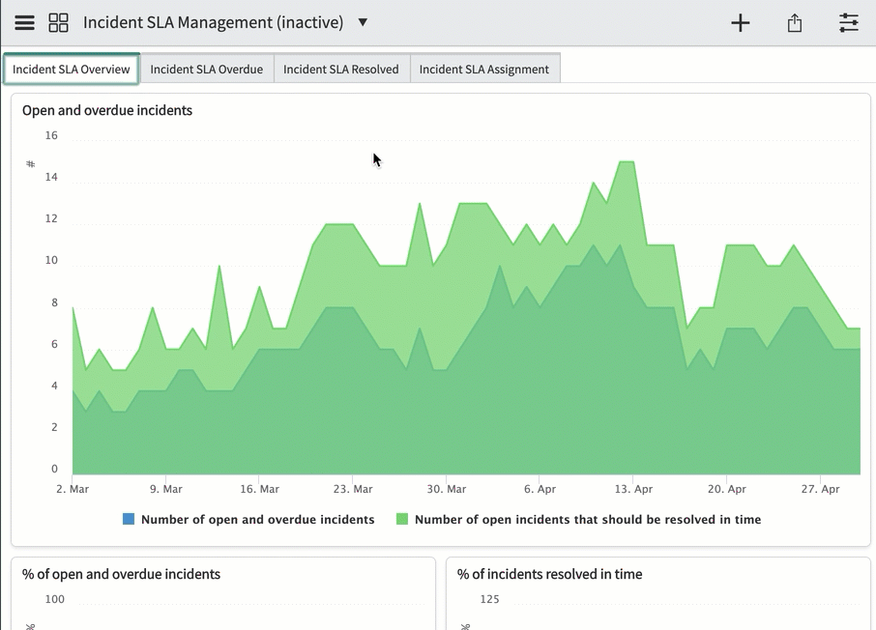
Example use case – SLA management
To enable the solutions for Incident SLA Management, an admin can navigate to Performance Analytics > Guided Setup. Click Get Started then scroll to the section for Incident SLA Management. The guided setup takes you through the entire setup and configuration process.

Slide 22

Requirements for activating plug-ins
Required Roles: admin
Plug-in Requirements:
Performance Analytics is installed on all instances by default but is locked from creating new Performance Analytics Indicators. Unlocking this functionality requires an instance Admin to activate the "Performance Analytics Premium for Service Management" plugin.
Once this plugin is activated, Performance Analytics is fully usable. This guide will also discuss installing additional plugins that provide pre-built content that greatly reduces Performance Analytics’ time-to-value.
Optional plugins that provide additional functionality are also available.

Slide 23
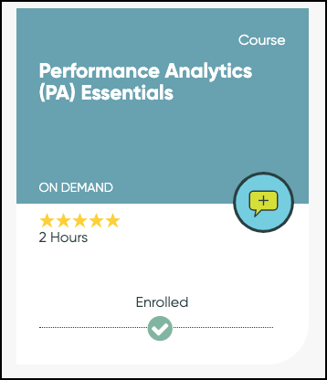
Assure required training
All project participants should take the Performance Analytics (PA) Essentials training.
The course:
Introduces key concepts and terms related to Performance Analytics
Is free & Self-Paced
Offers optional Micro-Certification to check for Understanding

Slide 24
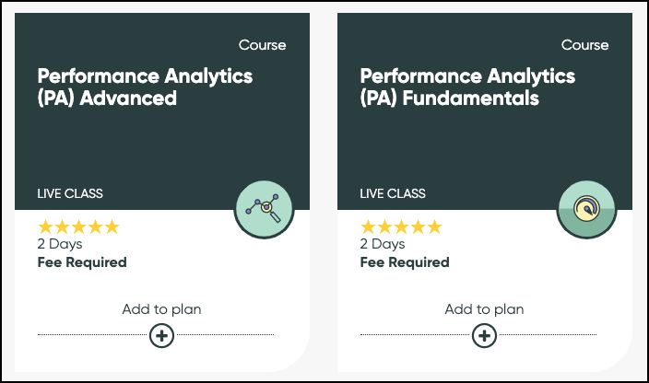
Assure required training
Technical project participants should take the Performance Analytics Fundamentals and Performance Analytics Advanced courses.
These instructor-led courses employ hands-on labs to introduce key concepts and terms related to Performance Analytics.
Feel free to explore additional free, self-paced, topic-based training as needed, including Responsive Dashboards Overview (Orlando), Performance Analytics (PA) Widgets, KPI Composer Overview, Formula Indicator Overview

Slide 25
Execute
Implementation Steps: Process of activating plug-ins

Slide 26
Execute phase of self-implementation
Execute
Performance Analytics ships with out-of-the-box content (indicators, breakdowns, widgets, and dashboards) for every ServiceNow solution. These content packs contain some initial best practice key performance indicators (KPIs) and dashboards you can use to get started quickly, but you can also create your own objects. •Identify the content packs you want •Activate them •Configure them •Start the collection •Review the dashboards
1. Initiate
Define your goals/objectives, collect prerequisite information, and define the key processes for implementation success.
3. Execute
Perform configuration and unit testing.
4. Deliver
Review results with stakeholders; create and
rollout a Communications and Training Plan;
go-live; and provide post go-live support.
Now
Create
2. Plan
Hold workshops to understand your process
and platform needs, finalize the engagement
timeline, and refine your configuration
requirements, and training
5. Close
Handoff from implementation team to
the platform maintenance team.

Slide 27
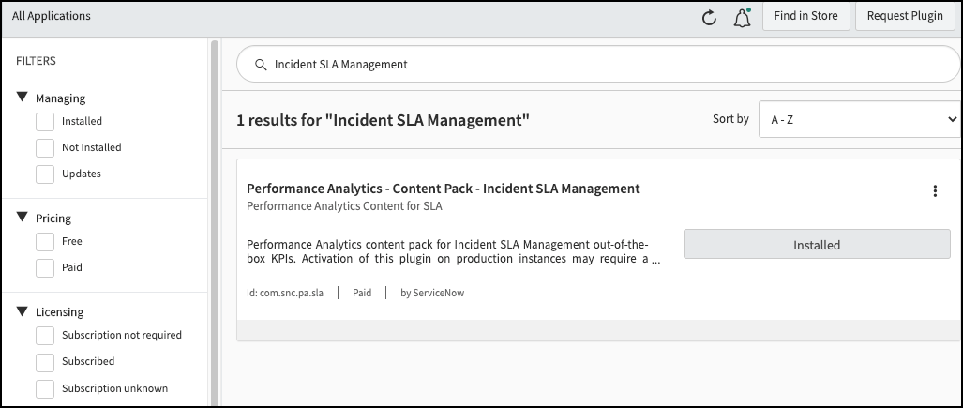
Activate the plug-ins
    In the previous phase, we activated the main Performance Analytics plugin, now we will activate specific Content Pack plugins based on what we selected in the analysis phase.
    Go to the instance plugin list by navigating to System Definition > Plugins
    In this example, we will install the "Performance Analytics – Content Pack – Incident SLA Management" plugin

Slide 28
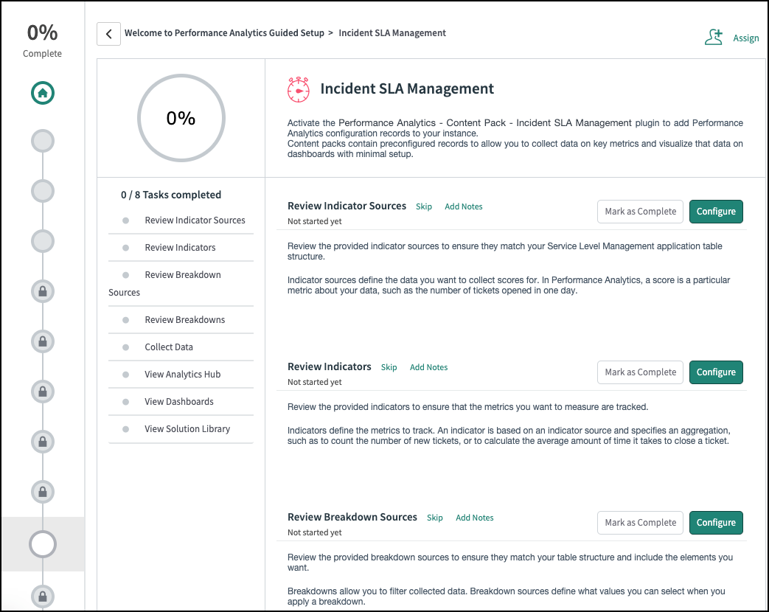
Activate the plug-ins (cont’d)
Navigate to Performance Analytics -> Guided Setup
Select "Incident SLA Management"
Proceed through each step to review the configuration and modify as needed

Slide 29

Performance Analytics admin console
  Navigation path: Performance Analytics > Admin Console
  Users with the admin or pa_admin roles use the Performance Analytics admin console as the starting point for configuring Analytics and Reporting Solutions. From the admin console, you can perform the following actions:
  Activate the Solution from the plugins list or through a guided setup, if one is available. (You cannot activate Solutions that are only available on the ServiceNow Store from the admin console.)
  Check whether Performance Analytics is fully activated on this instance.
  Run diagnostics.
  Look up KPIs to configure.
  Use Dependency Assessment to find the related indicators, breakdowns, and sources for your Solution.

Slide 30
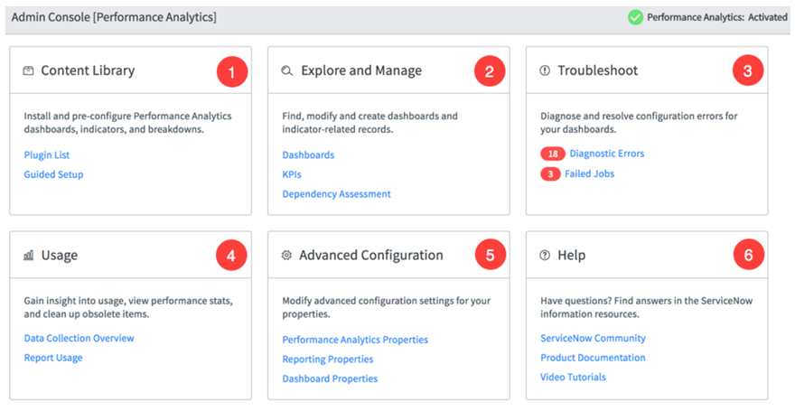
Performance Analytics admin console (cont’d)
  Navigation path: Performance Analytics > Admin Console

Slide 31
Collect data for analytics and reporting
  Whenever you activate an Analytics and Reporting Solution, you automatically install Data Collector jobs for that Solution. These Data Collector jobs collect analytics information for the indicators and breakdowns in the Solution. After the jobs run, you can see the data in the widgets and dashboards for the Solution.
  The plugin or ServiceNow Store application for an Analytics and Reporting Solution usually installs the following two jobs:
  Historic Data Collection: Run the historic Data Collector job when you first install an Analytics and Reporting Solution. By default, the historic Data Collector job collects the last 60 days of data for the indicators specified in the job. If you want to go back further in time, you can configure the job to collect more historic data. A historic Data Collector job overwrites all data for the period of collection. Therefore, run it only once, when you first install the Analytics and Reporting Solution. Run a periodic Data Collector job for all subsequent data.
  Periodic Data Collection (usually daily): This job populates the Performance Analytics tables with data going forward. Schedule the periodic data collector to run with the same periodicity as the frequency of the indicators for which it collects data. Most indicators have a Daily frequency, so most Data Collector jobs also run daily. After you schedule the job, verify that it is Active, or it will not run.
  Run historical data collection for an Analytics and Reporting Solution: After you activate an Analytics and Reporting Solution, run a historical data collection job. This job gives you immediate insight from your existing data.
  Schedule data collection for an Analytics and Reporting Solution: Enable the periodic data collection job for your Analytics and Reporting Solution. Check that the time that it runs is correct.

Slide 32
Deliver
UAT, go-live, and post go-live support

Slide 33
Deliver phase of self implementation
Deliver
To prepare for going live, run historical data collection
•Review results with stakeholders
Schedule regular data collection
•Verify timing
Create and rollout Communications Plan
•Build Communications Plan
•Review against best practices and refine
•Rollout Communications Plan
Support
1. Initiate
Define your goals/objectives, collect prerequisite information, and define the key processes for implementation success.
3. Execute
Perform configuration and unit testing.
4. Deliver
Review results with stakeholders; create and
rollout a Communications and Training Plan;
go-live; and provide post go-live support.
Now
Create
2. Plan
Hold workshops to understand your process
and platform needs, finalize the engagement
timeline, and refine your configuration
requirements, and training
5. Close
Handoff from implementation team to
the platform maintenance team.

Slide 34
Review results
Once the data the is collected, review the dashboard with key stake holders to validate the numbers displayed are what is expected.
Some Indicators may need to be adjusted to match specific nuances for the organization.
Additional Breakdowns may be requested to address configurations in your implementation to support your organizational requirements.

Slide 35
Communications plan
Build a communications plan
What is it?
An organizational change management (OCM) communication plan is a documented strategy for how you will tell your organization about the changes that are occurring as part of the ServiceNow implementation.
How should it be done?
A good OCM communication plan details how you’ll provide detailed information about your ServiceNow project—and why it’s beneficial—to the right people at the right time.
Impact on the organization and success of the project
An effective, targeted communication plan is critical to ensure that the people in your organization aren’t just simply aware of your project and how it will change their work but are convinced to actively support and commit to the change.

Slide 36
Plan requirements
What you need in a communications plan
In your plan, define the: | Why is this important? | Start by asking yourself:
Target audiences | Understanding your audiences lets you target communications to specific groups and improves the chance that you reach them | What different groups do we need to communicate with? About what?
Appropriate message and tone | You need to sell your project’s value without causing anxiety and concern about the change. (Make sure to distinguish between strategic, tactical, and operational audience/messaging) | What’s the most important thing I need to communicate? Are there any sensitivities I need to avoid?
Delivery formats | You’ll reach more of your intended audiences by using multiple channels, like town hall meetings, videos, internal project websites, etc. | What channels should we use when communicating with this audience?
Timeline and cadence | Timely communications can help people see and internalize your messages | What do we communicate with this audience? How frequently?
Responsibilities and assignments | Clearly defining who is responsible for certain communication tasks ensures they get done | Who is responsible for leading communications with this audience?
Evaluation plan | Always evaluate the effectiveness of your messages to identify how to improve them | How can we track how effective our communications are?

Slide 37
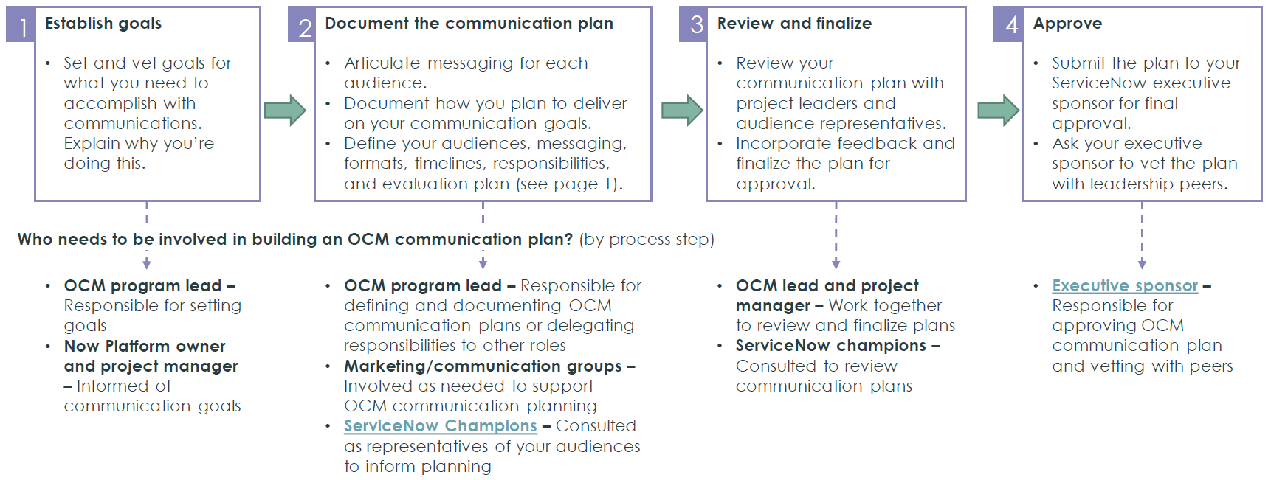
Best practices
To follow best practice for building an OCM communication plan, take these four steps to make sure you involve the right people at the right time and finish with an approved plan that considers all the components. Remember to communicate that Performance Analytics is not a one-and-done proposition, but a never-ending, continual, and continually measured process.

Slide 38
Recommended format
The most effective OCM communication plans are built in a project plan format that includes information across all plan components in one place and can be easily updated to track communications efforts over time. We recommend the format below (includes examples).
Activity | Communication objectives/message | Audience | Delivery format | Time frame | Responsibility (ownership) | Status
Initial announcement | Create buzz and drive awareness Announce kickoff event | Entire company | Email | ASAP, followed up with biweekly emails | Communications team and OCM program lead | Planned
Kickoff for all hands (event) | Exec sponsor speaks to the project’s value Provide overview of what to expect Introduce theme and have some swag | Departments affected by the change | Townhall style meeting and webinar for remote workers | At beginning of project | Executive sponsor | Planned

Slide 39
Close
Rollout complete, now improvement loop begins

Slide 40
Close phase of self implementation
Close
The implementation team hands off to the platform maintenance team, now improvement begins.
Set up feedback loops including:
Measuring value realization KPIs
1. Initiate
Define your goals/objectives, collect prerequisite information, and define the key processes for implementation success.
3. Execute
Perform configuration and unit testing.
4. Deliver
Review results with stakeholders; create and
rollout a Communications and Training Plan;
go-live; and provide post go-live support.
Now
Create
2. Plan
Hold workshops to understand your process
and platform needs, finalize the engagement
timeline, and refine your configuration
requirements, and training
5. Close
Handoff from implementation team to
the platform maintenance team.

Slide 41

Key performance indicators and setting up feedback loop
Set Targets
You are now measuring several key performance indicators (KPIs) for the organization. To drive real process improvements, stakeholders must agree to and set targets for those KPIs.
Before expanding KPIs beyond out-of-the-box content, additional training is highly recommended, including:
Responsive Dashboards Overview (Orlando)
Performance Analytics Widgets
KPI Composer Overview
Expand Your KPIs
After leveraging out-of-the-box Content Packs for common KPIs, groups can expand to more organization-specific KPIs.
Consult the KPI Composer to understand how to expand Performance Management beyond what is available out-of-the-box.

Slide 42
Appendix

Slide 43

Customer Success Best Practices
ServiceNow’s Best Practice Center of Excellence provides prescriptive, actionable advice to help you maximize the PAlue of your ServiceNow investment.
Definitive guidance on a breadth of topics
Created and vetted
by experts
Proven to help you transform with confidence
Strategic
Best practice insights
from customers, partners,
and ServiceNow teams
Critical
processes
Practical
Actionable
Management
Expert
insights
Technical
Based on thousands of successful implementations
across the globe
Common
pitfalls and challenges
Tactical
Distilled through a
rigorous process to enhance your success
PAlue-
added
Expert-PAlidated
Designed for:
Executive sponsors
Platform
owners
and teams
Service
and process owners
Get started today.
Visit Customer Success Center.
Contact your ServiceNow team
for personalized assistance.
Notes:
ServiceNow customers aspire to exceptional business outcomes. They expect not only great products, but prescriptive guidance and insight to accelerate their journey to PAlue. ServiceNow’s Best Practice Center of Excellence delivers this guidance through our Customer Success Center, a free resource aPAilable to all our customers and partners.
On the CSC, you’ll find best practices answering top customer questions on a range of topics from how to define your strategic roadmap to tactical questions like how to assess CMDB health. We comprehensively answer technical and management questions, whether you want to know how to manage customization or how to build your ServiceNow team. No matter what your role is, you’ll find resources that save you time and money.
We create these insights by working with ServiceNow experts from customers, partners, and our own teams. Think of these resources as the collective advice of the ServiceNow ecosystem, extending the power to your team. Customers like you are using these practical, actionable resources to save time and give them decision-making confidence.
I invite you visit the Customer Success Center today. Let’s make a plan on how you and your team can use it on your journey.

