Slide 1
Welcome!
Agenda
Data courier process and OCM
Development of the integration
Questions

Slide 2
Data Courier and OCM

Slide 3
Where Were We
What needed to change?
Change Documentation:
What Build to Move?
Conflicting Changes
Word documents
Excel spreadsheets
Screenshots (100+ pages for large projects)
Varied formatting between teams
Screenshots not searchable
Documentation and Content Management ticket differences
Build conflicts preventing migration
Unable to search for build included in other changes
Documentation was often images

Slide 4
Integrating Content Management
Reduce Dependency on Excel build trackers
Phase 1
Phase 2
Phase 3
Phase 4
Start where you are
Integrate the data and processes
Build tracker transition
Death to the build tracker
Data courier process using excel docs attached to change requests.
Build info is pulled into ServiceNow – build info is related to all Data Courier change requests
Transition the existing build information into ServiceNow
Digitized a process stored on excel documents

Slide 5
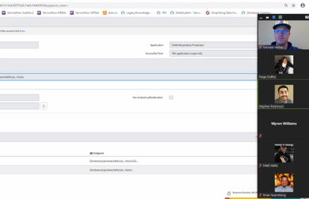
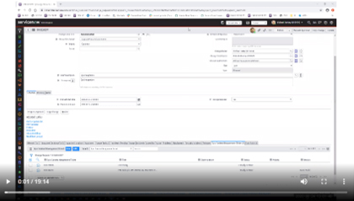
Initial Focus Groups and Webinars
Multiple demonstrations and webinars are held for analysts to gather feedback and to validate development.

Slide 6
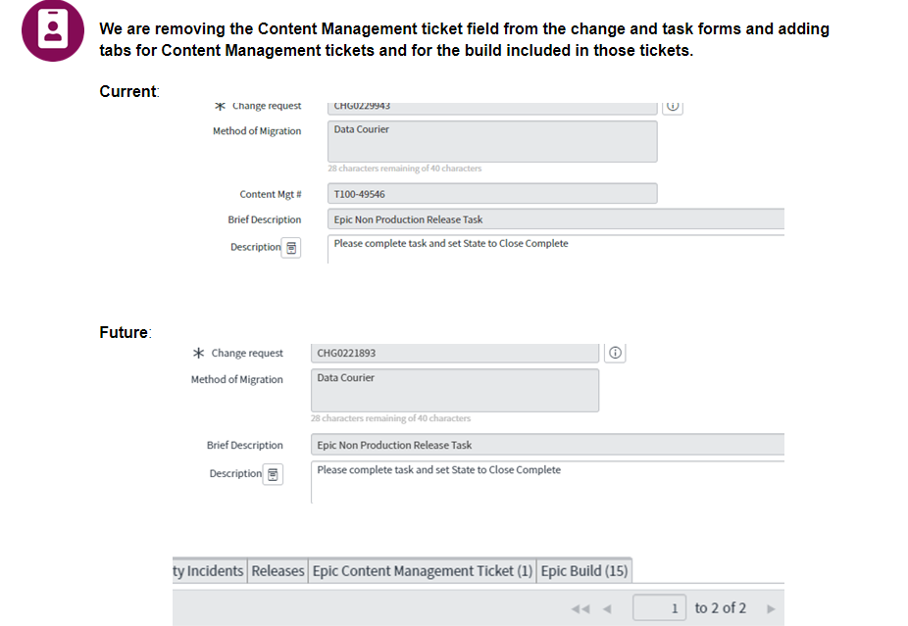
Communication and Documentation
Communicate early and often to iterate with feedback throughout process
Create articles containing clearly defined, step-by-step instructions and screen shots available in the Knowledge Base (KB). Recorded webinars are attached to related articles.

Slide 7
Killing the Build Tracker
Reduce Dependency on Excel build trackers
Phase 1
Phase 2
Phase 3
Phase 4
Start where you are
Integrate the data and processes
Build tracker transition
Death to the build tracker
Data courier process using excel docs attached to change requests.
Build info is pulled into ServiceNow – build info is related to all Data Courier change requests
Transition the existing build information into ServiceNow
Digitized a process stored on excel documents

Slide 8
Building the Integration

Slide 9

Implementation Resources
What will it take
Developers should have strong platform and scripting knowledge
Plan on dedicating multiple sprints
REST API
Epic Web API
JavaScript
  JSON
  client-side

Slide 10
At a high level
Build out the application in Epic App Orchard
Explore the Epic Web API and build REST calls
Build your app in Studio!
Integrate with Change Management

Slide 11
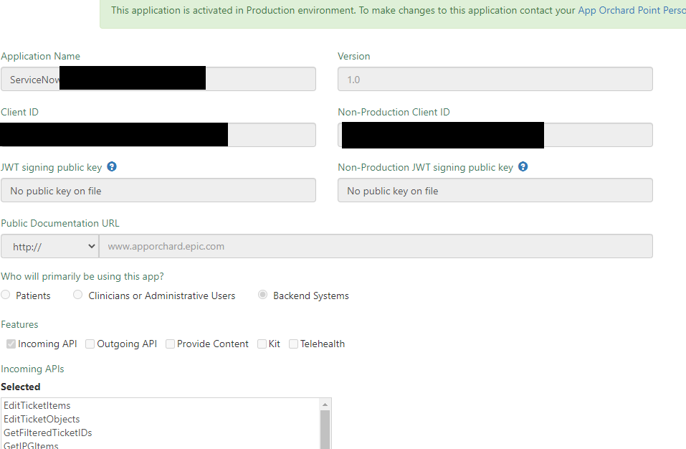
Epic App Orchard
Create an App
1
Create and configure the app in Epic App Orchard – this lets us connect from ServiceNow
2
Give it the scopes you need for the API calls you want to use – plan for future enhancements

Slide 12
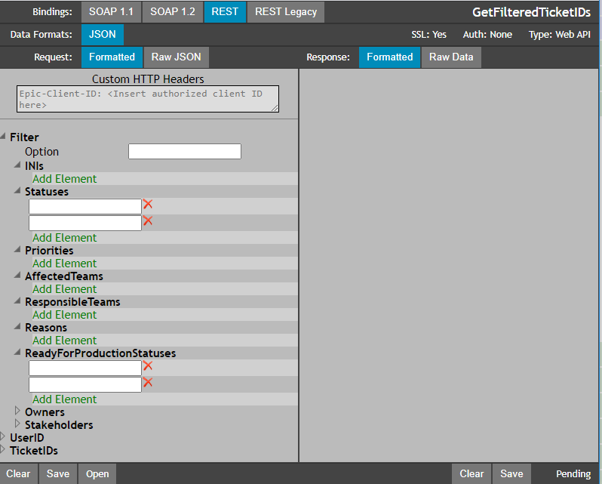
Explore the Epic Web API
Some takeaways
1
Understand the data structure that is returned
2
JSON can become more complex the bigger the build
3
Parse the data and don’t be afraid to make multiple REST calls on the same ticket to get what you need

Slide 13
Studio!
Building the app
App is still in v1 – several future enhancements planned
9 tables
7 scheduled jobs
4 business rules
4 HTTP methods
3 UI actions
1 script include

Slide 14
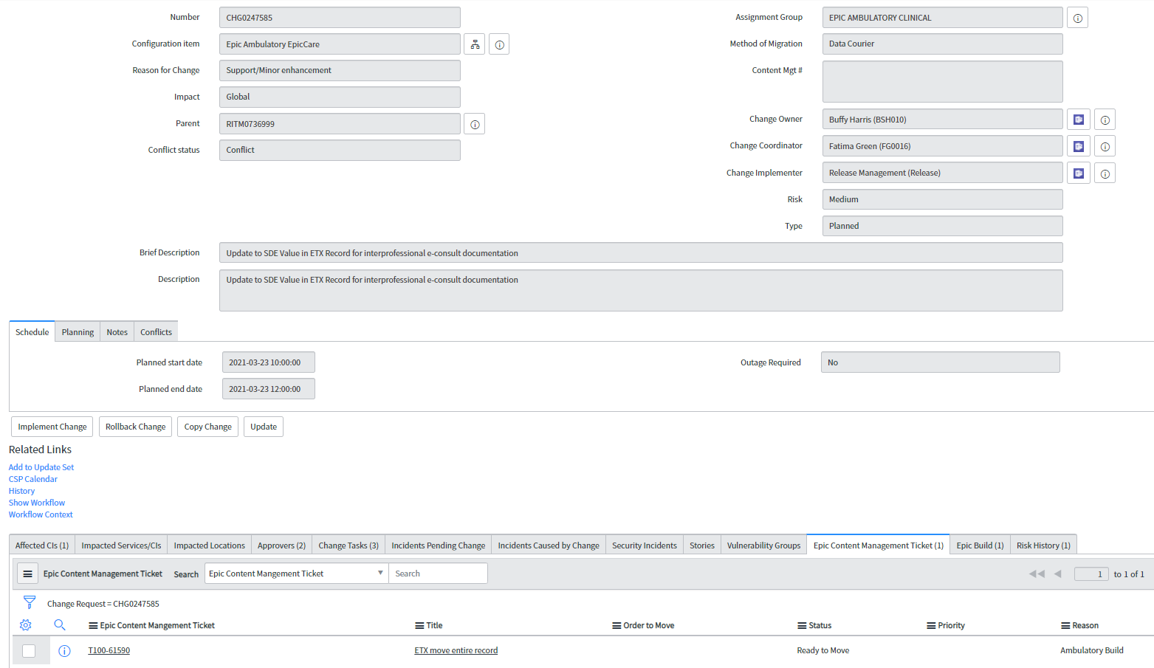
Integrate with Change Management
1
Content Management tab contains information specific to the ticket
2
The build tab contains all the related build items
3
Driven by m2m relationships between change and our content management tickets

Slide 15
25,340
296
Content Management tickets created in 2020
Average number of tickets created per week by the integration

Slide 16
21,169
2
705
Data Courier change tasks in 2020
Minutes saved per task
Hours saved by analysts

Slide 17
Thank you

