Slide 1
Servicenow - EPIC Community Council
Christopher Killion – Med Solution Consulting Manager
Amita Abraham – Med Industry Marketing
April 24, 2018

Slide 2
Agenda:
Introduction from ServiceNow and Glyn Tomkins - Share vision for the community council
Customer presentation & discussion (WakeMed)
Healthcare Interest Group Portal Introduction
K18 Healthcare Udpate
Objective:
Bring together a group of thought leaders to share how they are leveraging ServiceNow in an Epic environment
Discuss problems and solutions related to Epic
Solicit feedback and guidance on ServiceNow can help build synergies with EPIC EMR

Slide 3
Customer’s vision for the ServiceNow Epic cohort
ServiceNow's Epic customer base to come together to collaborate.
    Define common challenges
    Share innovative solutions
    Collaborate for better outcomes for our patients, their loved ones and each other
Who is the target audience:
  Collaborative, innovative thought leaders in your organisations who like to solve problems not just in the confines of the technology but more holistically
    Process – People - Tools
Customer-led: ServiceNow-Enabled
What it is not:
  Not a place for ServiceNow to sell to the cohort! There will be no sales pitches here.
    We (the customers) won’t allow them to!
  Not intended for a highly technical audience

Slide 4
WakeMed Health & Hospitals
-Operational Change Request Management
Bhavesh Patel, Director IS Program Management Office
(See Customer Deck: WakeMed)

Slide 5
Healthcare Community Portal

Slide 6
Healthcare Community Portal
Better collaboration between Servicenow healthcare customers
Moderated by Servicenow healthcare team
Resource for real-time questions and answers from other healthcare customers
Portal to spread Servicenow mind share
Address similar challenges

Slide 7
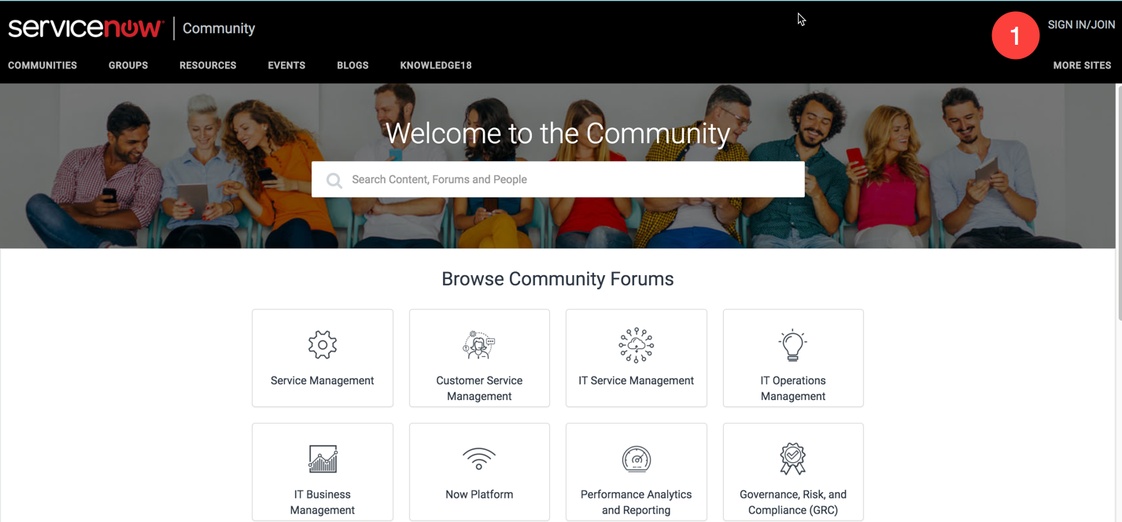
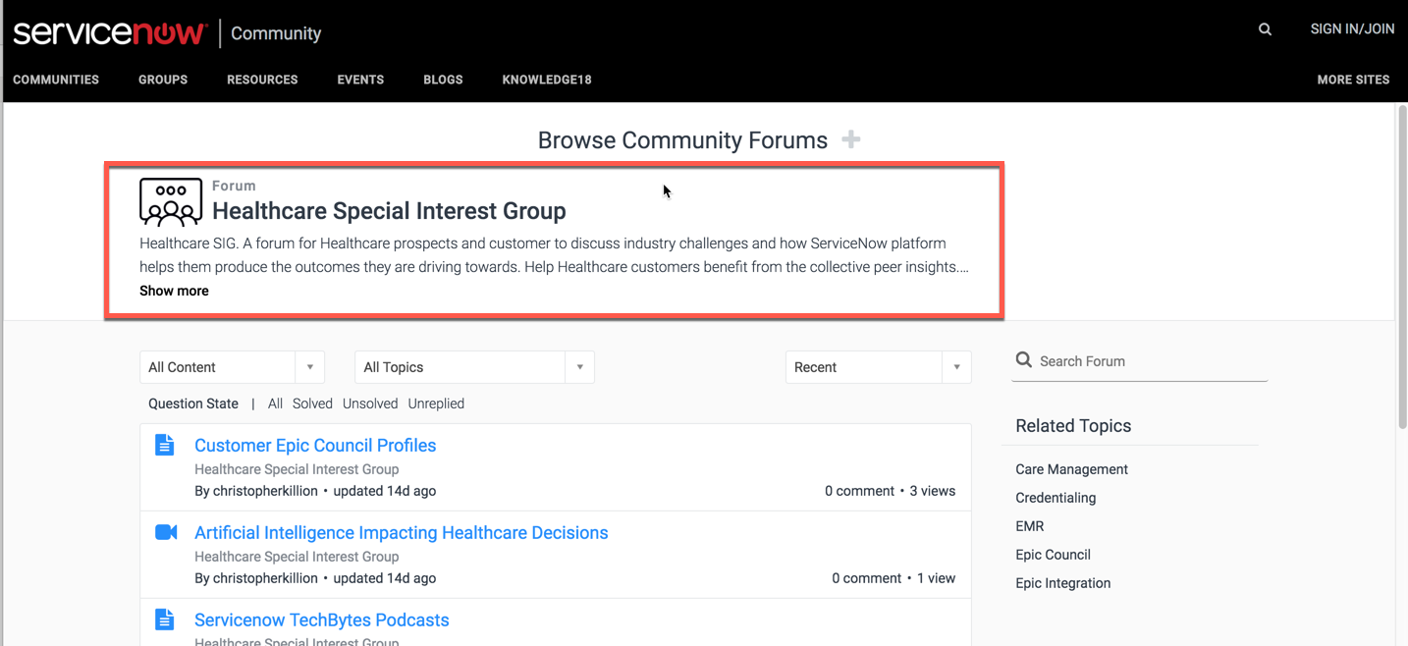
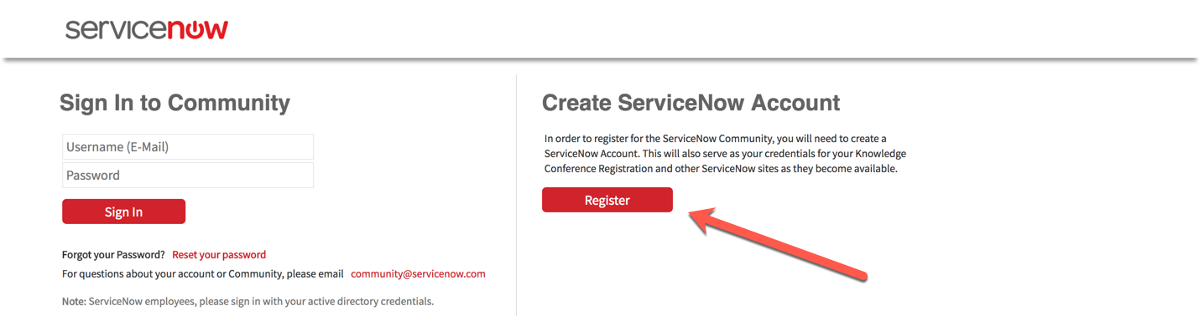
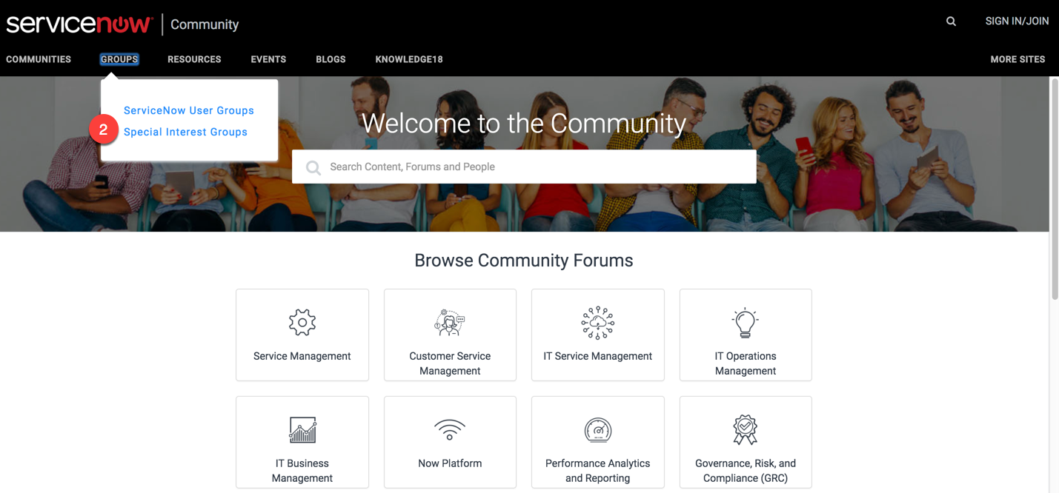
Healthcare Community Portal
https://community.servicenow.com/community

Slide 8
Servicenow EPIC Council ‘Look Ahead’
Servicenow Actions:
Healthcare Special Interest Group Community Portal
Topics to Consider – Epic Help Button | Internet of Things
Summary of meeting (Recording and Materials)
Council Actions:
Interact with NEW Healthcare Community Portal
Volunteer to present on our next EPIC Council meeting on June 27, 2018 @ 1:00p CDT

Slide 9
Questions and Contact Info
Glyn Tomkins | Duke Health | glyn.tomkins@duke.edu
Bhavesh Patel | WakeMed Health | bhpatel@wakemed.org
Christopher Killion | Servicenow | christopher.killion@servicenow.com
See you at K18!

