Slide 1
4th ServiceNow Benelux Usergroup Meeting
February 4, 2013
Eindhoven, the Netherlands

Slide 2

WELCOME!

Slide 3
Agenda
9.45 - 10. 00 Welcome by Maarten le Noble, Chairman SNUG
10.00 - 10.30 PWC’s custom HR app by Gerrit Zevenbergen, Application Manager PricewaterhouseCoopers
10.30 - 11.00 Coffee Break
11.00 - 11.45 New functionalities in Dublin release by Niels ter Keurs (ServiceNow)
11.45 - 12.30 Round table sessions
12.30 - 12.35 Wrap-up
12.35 Lunch & networking opportunity

Slide 4
House Rules
No Smoking inside the building
In case of emergency
Telephones on mute, please!
Restrooms

Slide 5
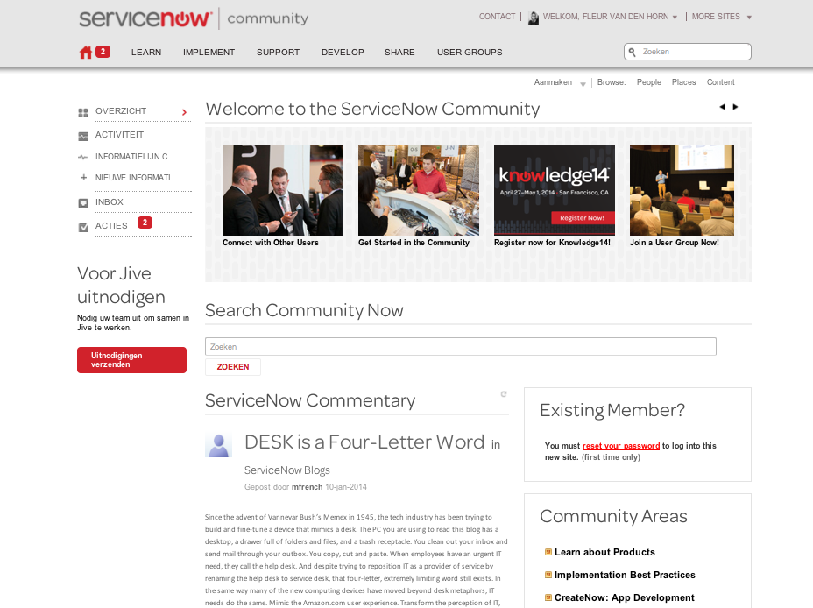
Community site
Launched
January 13th
All user profiles have been migrated
All content has been migrated
All SNUG leaders have been trained

Slide 6
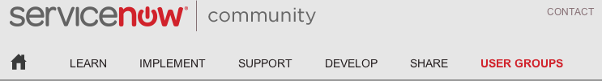

Community: new areas & expanded
Learn: Learn all you need to know about ServiceNow product offerings.
Implement: Share and get best practices to start on the right foot with ServiceNow.
Support: Get answers when things in your instance aren’t working quite as expected.
Develop: Collaborate and build custom applications on the ServiceNow Service Automation Platform.
Share: Find and download apps, app extensions, dashboards, etc.
User Groups: Come together to network with peers in your area, transfer knowledge across organizations and industries, and share best practices.

Slide 7
Getting started
Login to new community site
http://community.servicenow.com
Reset your password (only for first time)
Update your profile and privacy settings
Join the Benelux User Group
Explore the site and new features
Start connecting with your peers

Slide 8

Make sure to visit us today to register or see a live demo!
Questions? maarten.lenoble@kpn.com (SNUG Owner) fleur.vandenhorn@servicenow.com (Community support)
Thank you!

Slide 9

10.00 - 10.30
PWC’s Custom HR App by Gerrit Zevenbergen

Slide 10

10.30 – 11.00
Coffee Break

Slide 11
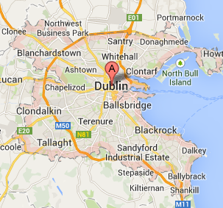
11.00 – 11.45
What’s new in the Dublin release?
Niels ter Keurs, Service Now

Slide 12

11.45 – 12.30
Round Table Sessions

Slide 13
Choose a topic:
- Using ServiceNow within a Shared Service Center - Jan Debipersad
- Using the App-creator - Bas Klabbers

Slide 14

12.30 – 12.35
Wrap-up

Slide 15

Agenda 2014
  February 4 : SNUG-meeting Eindhoven
  April 27 - May 1 : Knowledge14 San Francisco (Benelux Event)
  May 20 : SNUG-meeting
  October : NowForum London
  November 11 : SNUG-meeting

Slide 16

Thanks!
The Presenters: Gerrit & Niels
The Round-table hosts: Jan & Bas
Kees & Fleur
Servicenow for sponsoring Lunch & Location
FRED KOUWENBERG!!!

Slide 17
Help!
Who will help me to plan the next meeting(s) and make our User Group a GREAT succes?
Please send e-mail to maarten.lenoble@kpn.com

Slide 18
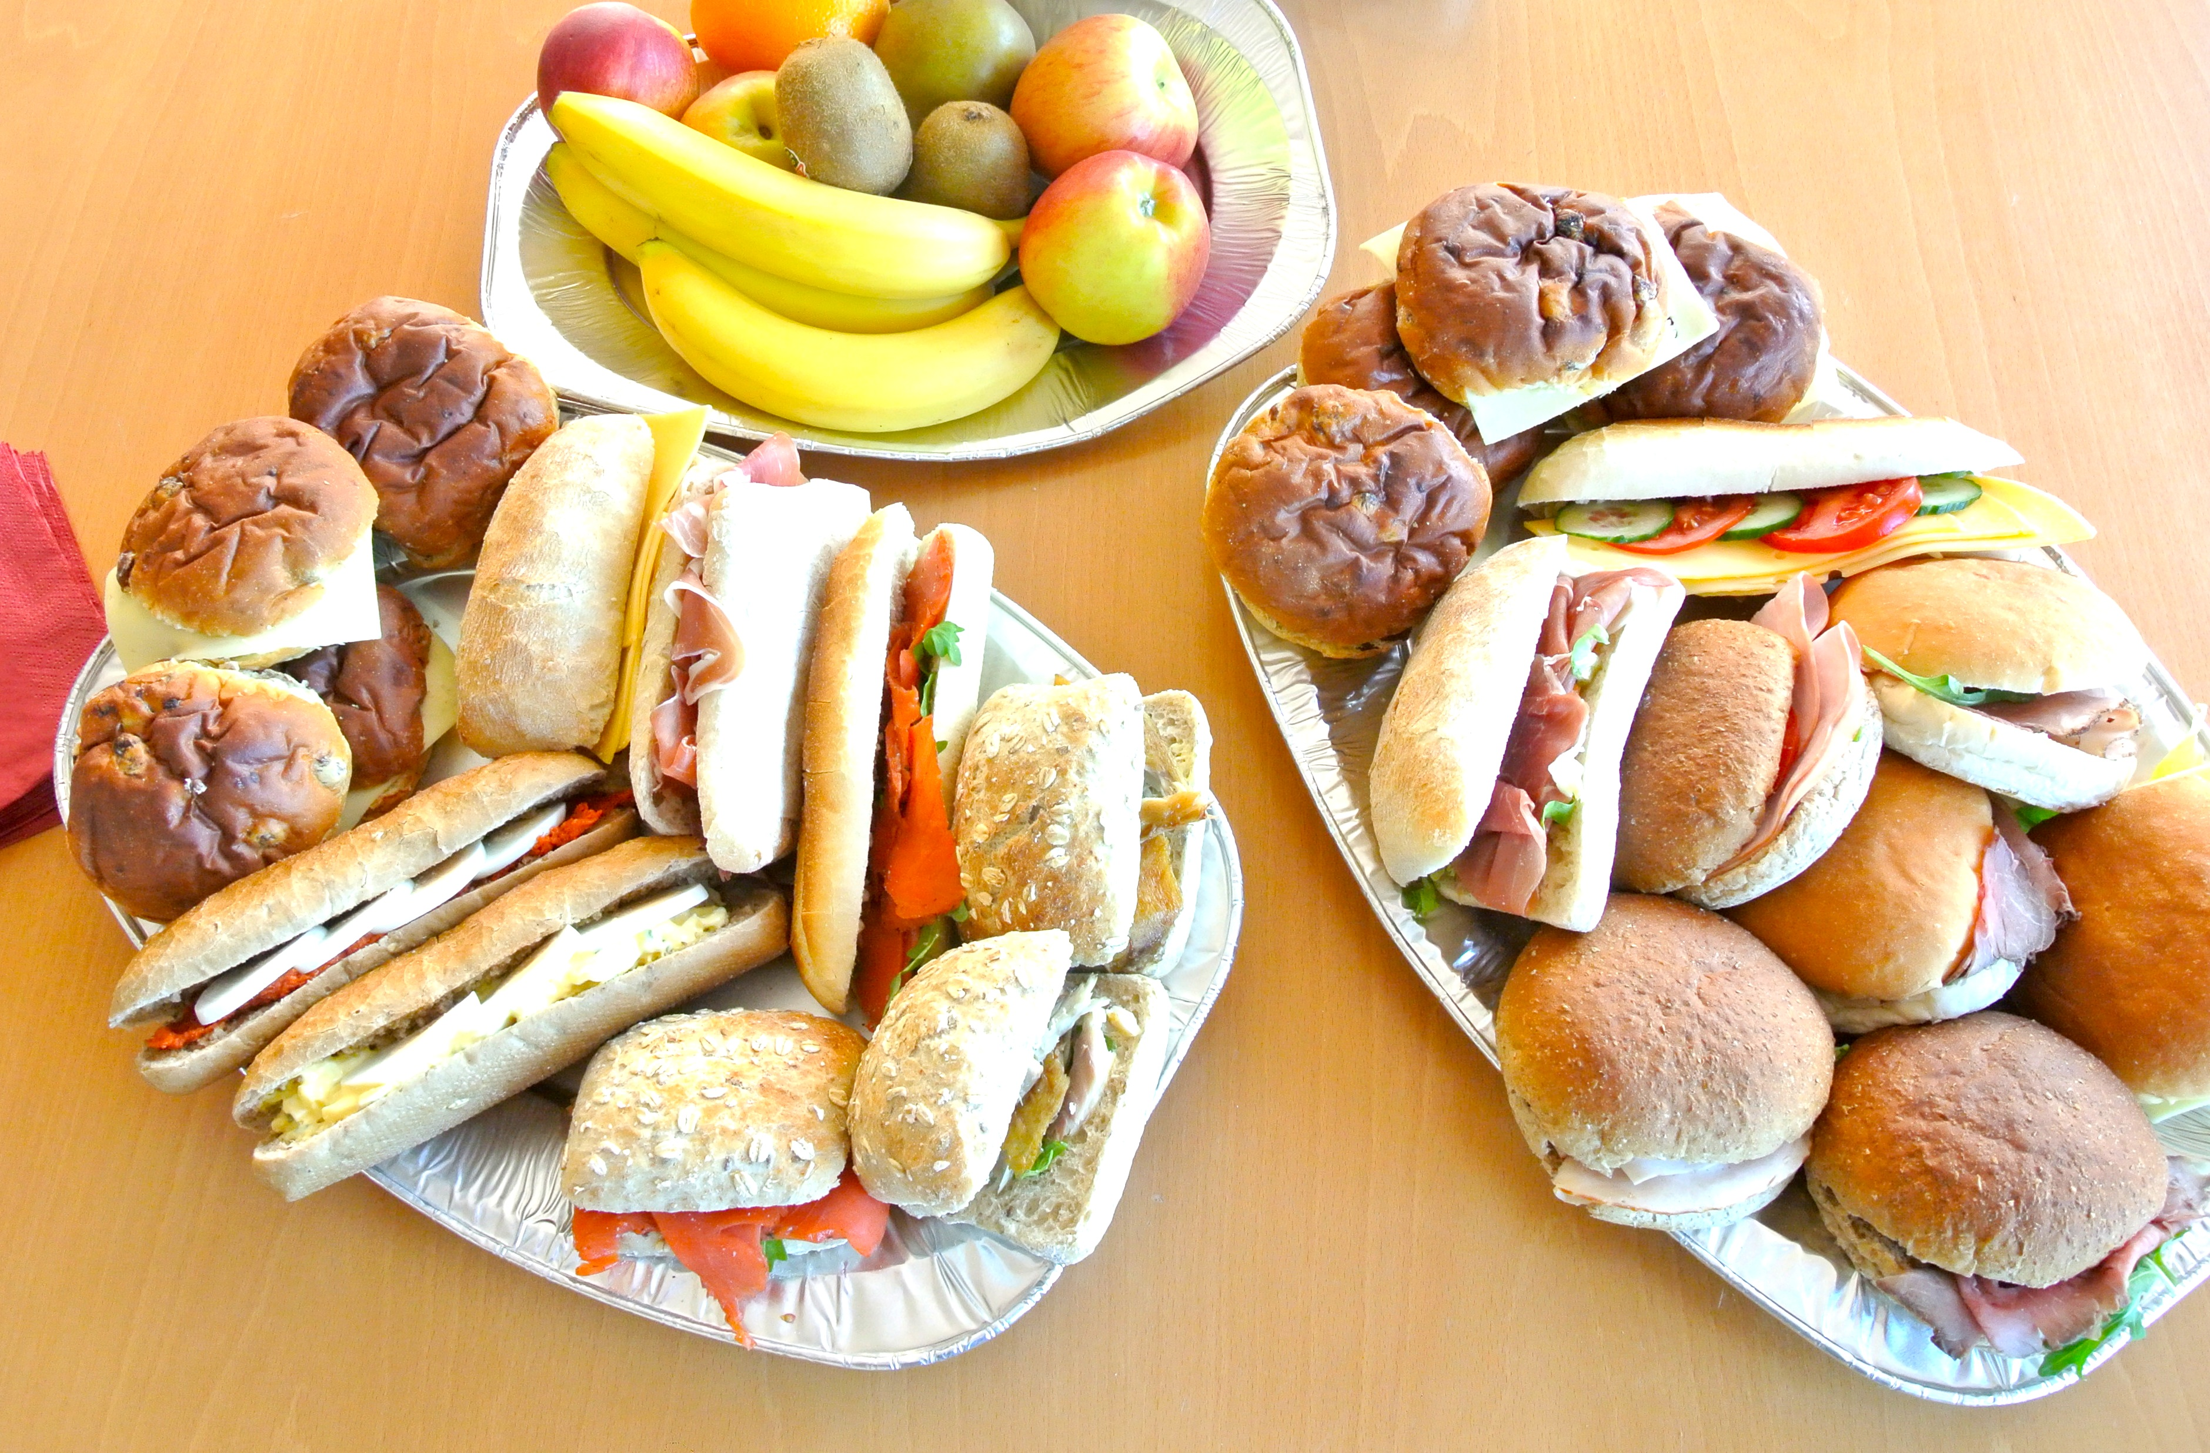
12.35
Lunch & networking opportunity

