Slide 1
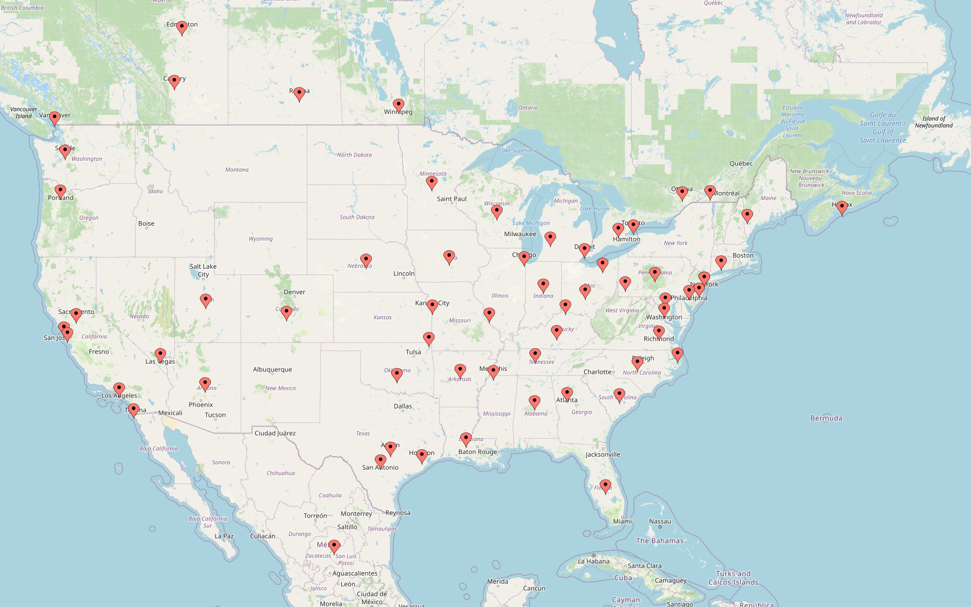
SNUG - In a City Near You!

Slide 2
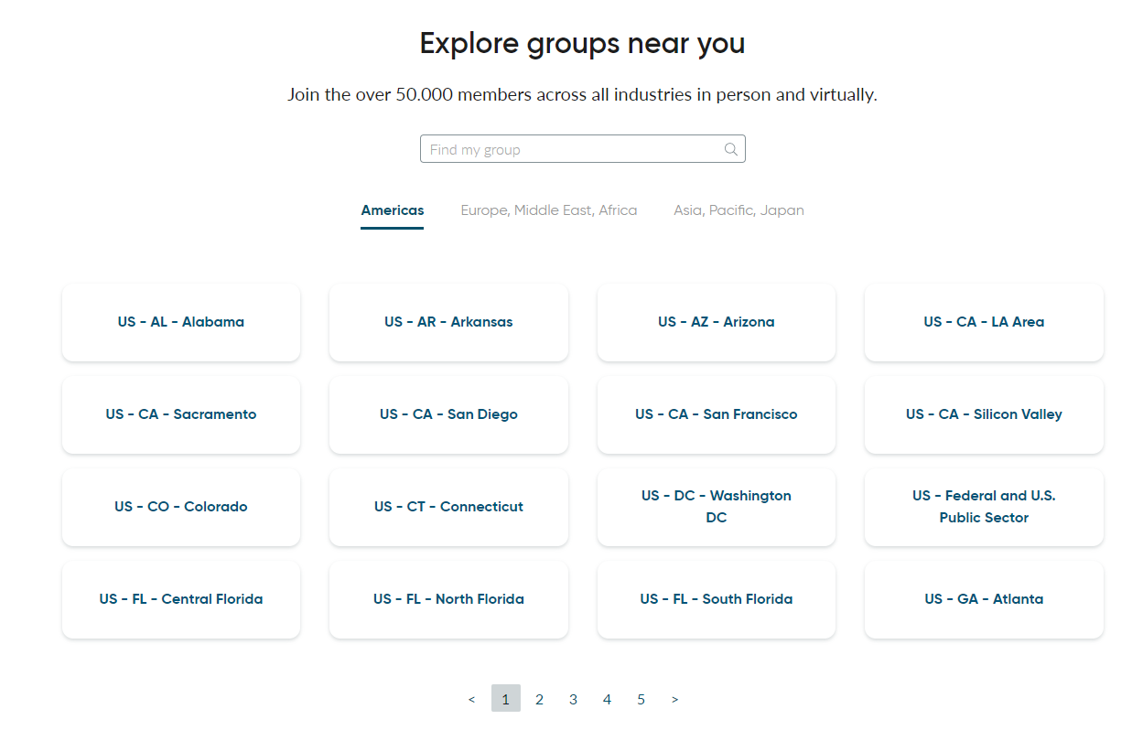
SNUG - Community

Slide 3
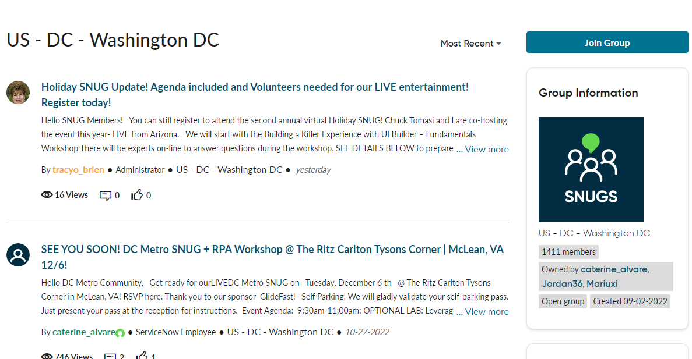
SNUG – Join Today!

