Slide 1
The Applied Materials HRSD Lessons Learned
December 2022

Slide 2
World’s #1
Semiconductor and Display
Equipment Company
Applied Materials is the leader in materials engineering solutions used to produce virtually every new chip and advanced display in the world.
$25.8 billion
revenue
$2.7 billion
R&D spending
>28,000
patents
AMAT stock
listing on
NASDAQ
Headquartered in California’s
Silicon Valley
~27,000 employees
93 locations
In 17 countries

Slide 3


Introductions
Dexter Lewis
Applied Materials ServiceNow Product Owner
  Ten years of ServiceNow Implementations and management
  Twenty-Five years of IT and Global Service Management experience
  Likes: Tenkara fishing, Outdoor cooking, Gaming if time permits, and of course, ServiceNow
Matt Petersen
Applied Materials ServiceNow Lead Business Analyst
  Seven years of ServiceNow Implementations
  Twelve+ years of Global Service Management
  Likes: all things music, travel, sports, and spending time with my wife and our six-pound Yorkie, Peep

Slide 4
VISION
Utilize an HR Strategic Framework to inspire a vision to maximize the HR impact and deliver a positive employee experience (org structure, capability, resourcing, digitalization)
PROBLEMS
Lack of integrated approach to managing employee experiences and enhancements
Country portals for each region that are owned and managed locally
Multiple manager portals that are not customer-grade or even current
Lack of consistency and brand throughout all portals
Massive amounts of content and collateral disbursed across many enterprise systems
Search tool forces users to hunt through disconnected sites/pages/engines
Current portals are not mobile enabled
Lack of digitization meant new hires and managers to sneakernet documents
Employees’ feedback has not been consistently solicited or responded to
Notes:
Talk Track:
Based on what we found with your systems and processes, we rolled the numerous challenges into 4 key categories.

Slide 5




CRITERIA TO ASSESS & SELECT SCOPE
Optimizing the Process
Optimizing the Technology
Optimizing the Experience
Criticality for the Business (Impact)
Impact on the Employee & Manager Experience
Supporting the Business
Compliance requirement
Request by HR COE
Impact ease of use for managers and Employees
Impact existing Employee & Mangers Engagement/Retention
Align to benchmark practices
Productivity Improvement levels
Implementation Efforts (ROI)
Reduce Manual work
Drive process optimization & standardization
Leverage Existing digital platform
Drive self service
Complete what has already been started
Existence of process owners & readiness to standardize & optimize

Slide 6
Project Scope / Objectives
Simplify & support our employees’ work and life with a connected, integrated, and engaging online experience
Implement and deploy the ServiceNow HR Service Delivery ("HRSD") module globally on both desktop and mobile
Drive simplicity, consistency in process and policy, and usability
Create an intuitive workplace experience that is easy to navigate and integrates internal and external platforms and data sources
Process optimization and automation (ex. pre-boarding, onboarding, employee lifecycle events, and off-boarding)

Slide 7
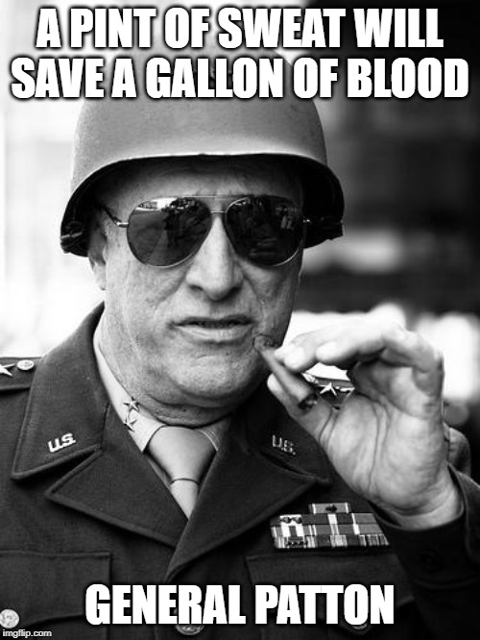

Lessons Learned: Engagement and Governance
Document the Rules of Engagement
Document the Rules of Engagement
  Lesson: Plan on building a rule of engagement document laying out how non-production instances are used, the promotion of code and reviews, a RACI, governance calls, and communication between HR Admins and Platform Admins.
  Challenge: Operational alignment between organizations as our desire for HR to self-serve and the securing of data away from ServiceNow admins.
Prepare to have multiple levels of governance and apply lessons learned
Prepare to have multiple levels of governance and apply lessons learned
  Lesson: Make time during each phase, sprint, and release to pull the team together to document and apply lessons learned. Also, lean heavily on consultants to educate on best practices and implement processes to control customizations.
  Challenge: With over a dozen workstreams from HR, IT, Legal, Data Security, Branding, Knowledge, and many more, it soon became evident that a single governance model would not suffice to align everyone and control scope.

Slide 8
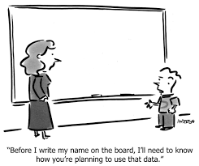
Lessons Learned: Information Security
Prepare for the challenges of GDPR (General Data Protection Regulation) and the potential impact to functionality, reporting, and timelines
  Lesson: Engage early with your legal and data security teams. Personal data (ex., Name, email address, location, home address) controls and usage, if not understood and managed, can lead to disaster legally and financially. Learn that it doesn’t matter if you use the data; simply collecting it can cause concerns. Be prepared to answer, “Why do you even need the data?” Assume you are guilty until proven innocent.
  Challenge: Bringing in additional personnel data to support HR needs and the requirement to measure user engagement leads to significant delays while going through reviews and approvals, some at country levels like the German Works Council. The ability to anonymize data became central to the discussions.

Slide 9
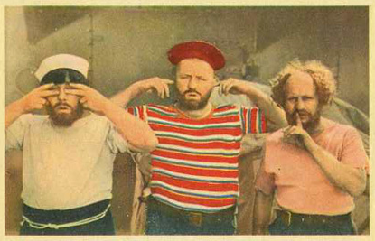
Lessons Learned: Information Security
Understand the increased sensitivity of Employee Relations
  Lesson: Established a governance model for meetings and communication. This included specific distribution lists, a review of meeting attendees, an agenda needing approval from an executive, and close attention from the project management office to ensure frequent reinforcement of the sensitive nature of the information.
  Challenge: While HR information is sensitive, we learned that the employee relations team worked with information more secure than typical HR information. It was not just the data, but even the processes would not be discussed outside of a handful of individuals. Most project members, from Project Managers to Developers, could not attend requirements gathering calls.

Slide 10
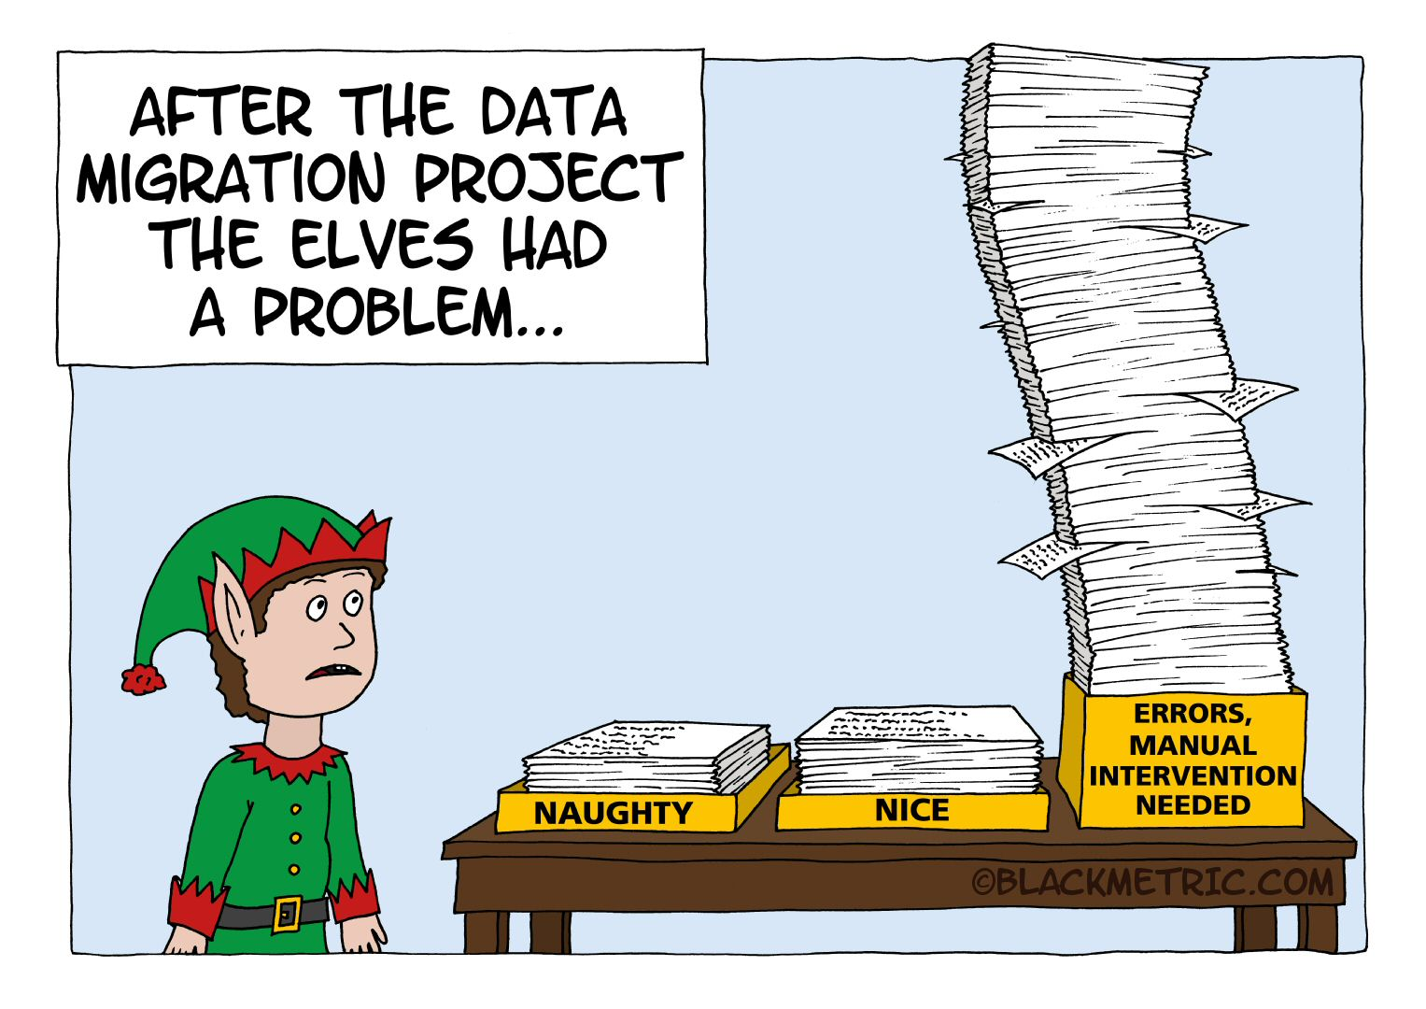
Lessons Learned: Legacy Data
Don’t Migrate Legacy Data if it can be avoided
  Lesson: It can be done; however, it causes issues in many areas: additional effort, data structure mismatches, the value of use when in the system, etc. In one project, data migration was deemed critical and consumed roughly 25% of all resources and time. Educating users about the impact on the overall project and understanding that the need for legacy data reduces with each passing day in the new system.
  Challenge: Many team members wanted consistency in reporting and analysis of cases in the old system and new; a desire to have a single pane of data.
Notes:
Need more governance when opening sub-prod environments to end users

Slide 11
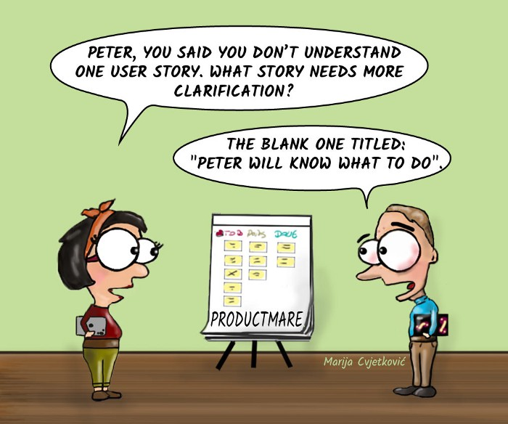
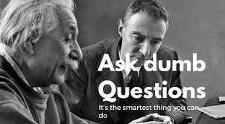
Lessons Learned: Educating
More time should be spent on educational services about Agile, SDLC, and in some cases, even ITIL
  Lesson: Plan on educating project stakeholders that have not operated in an agile project in the past. Plan on a “Sprint 0” designed for educational purposes.
  Challenge: Project stakeholders did not know Agile methodologies and struggled to understand the concepts around stories, points, sprints, and success criteria, leading to confusion and frustrations.
Ask Dumb Questions
  Lesson:
    Because someone wants to but is afraid
    Once asked and answered, you’re no longer dumb
    Ask enough dumb questions, and you become an expert
  Challenge: As IT and HR became closer partners, it became evident that the difference between IT technical-focused and HR human-focused support meant we lived in different worlds.

Slide 12
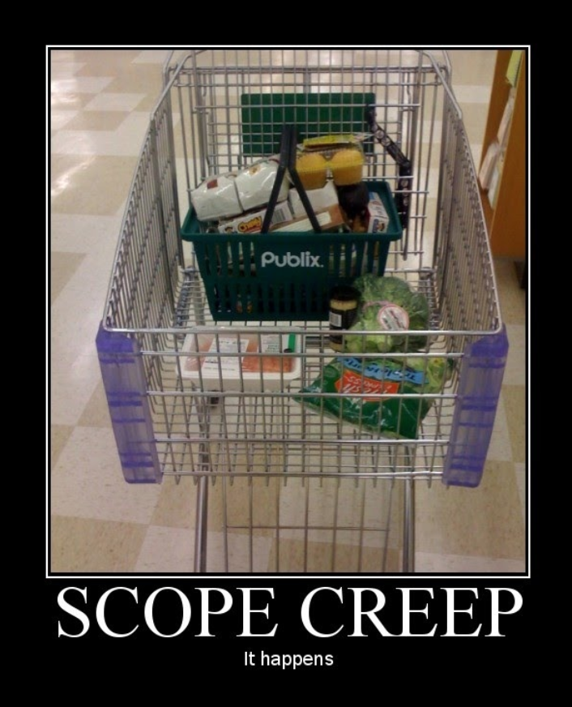
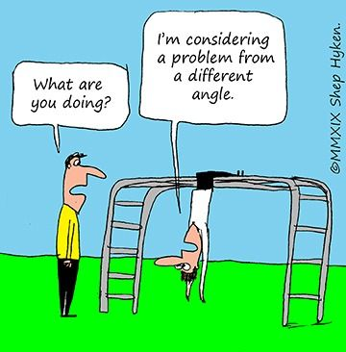
Lessons Learned: Educating
More time should be spent on educational services about ServiceNow
Plan on Scope Management as users are educated
  Lesson: End-users of the product did not know ServiceNow and became frustrated transitioning to the platform. More time should be spent on educational services about ServiceNow, its use, and its overall capabilities.
  Challenge: As users become educated on the capabilities, new possibilities can be envisioned, leading to excitement and increased engagement and continuous challenges in managing scope.
Accept only Requirements as opposed to Solutions
  Lesson: Lean into best practices and put into place a review cycle of all customizations. Leverage your partners and consultants extensively!
  Challenge: People love Innovation, but they hate Change. Identical business processes will not have identical solutions or UI between legacy and new systems. Each person comes into a problem locked into their way of solving and then lobbies for that particular solution rather than considering multiple perspectives.
Notes:
Need more governance when opening sub-prod environments to end users

Slide 13

Lessons Learned: Build a Bench
Assure that the implementation team has a solid and deep bench
  Lesson:
  - Establishing a multinational holiday and time-off calendar allowed the project management team and scrum masters to better plan and adjust. Ensure all team members practice entering any planned days off with as much notice as possible.
  - Skilled ServiceNow practitioners are a complex skill set to find and maintain. Before engagement, validate that the implementation partner and yourself address this risk.
  Challenge: At times, we had resource constraints due to rotating schedules, holidays, sickness, world events, and consultant exits.
Notes:
Need more governance when opening sub-prod environments to end users

Slide 14

Some Final Thoughts
ServiceNow offers a solid foundation and a well-framed
house where their customers can build and grow.
Can it do this?
The answer is
almost always
YES.
Out of the box design can meet most of your needs – maybe even all, with only minor tailoring or enhancement.
Dare to envision
what is possible.
All businesses are different, and your workflow or data needs may vary.
Tailor & enhance and build from your foundation upwards.
When you have your Eureka moments (and you will), tailor and enhance rather than customize.
Give your CMDB lots of love
and attention.
Keep design simple.
Don’t build a Cadillac if a Kia can get you where you want to go.
Put the tool to
work for you.

Slide 15

Questions

Slide 16


