Slide 1
Knowledge Article Architecture
Structuring articles to support services and UX in ServiceNow

Slide 2
Knowledge Article Architecture
Judgment call:
Attachments vs. new articles
Knowledge blocks
Search
Responsive links

Slide 3
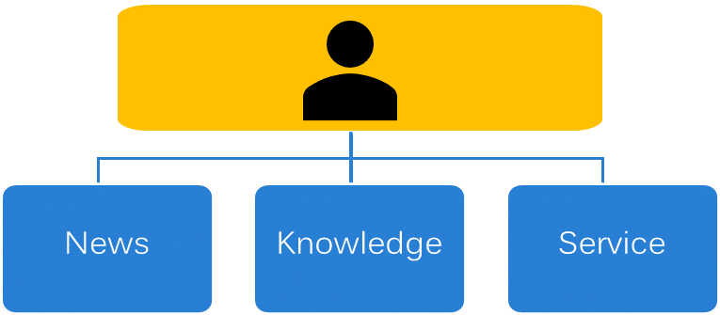
HR Home: Supporting HR Ops & Delivery
HR Home Support Model
Having accurate, current knowledge on HR Home gives us the opportunity to provide a positive customer engagement experience for users.
It also reduces the burden on service.

Slide 4
Adding New Content
How will users need to find and use your content?
What happens to the UX?
What about updating the content?

Slide 5
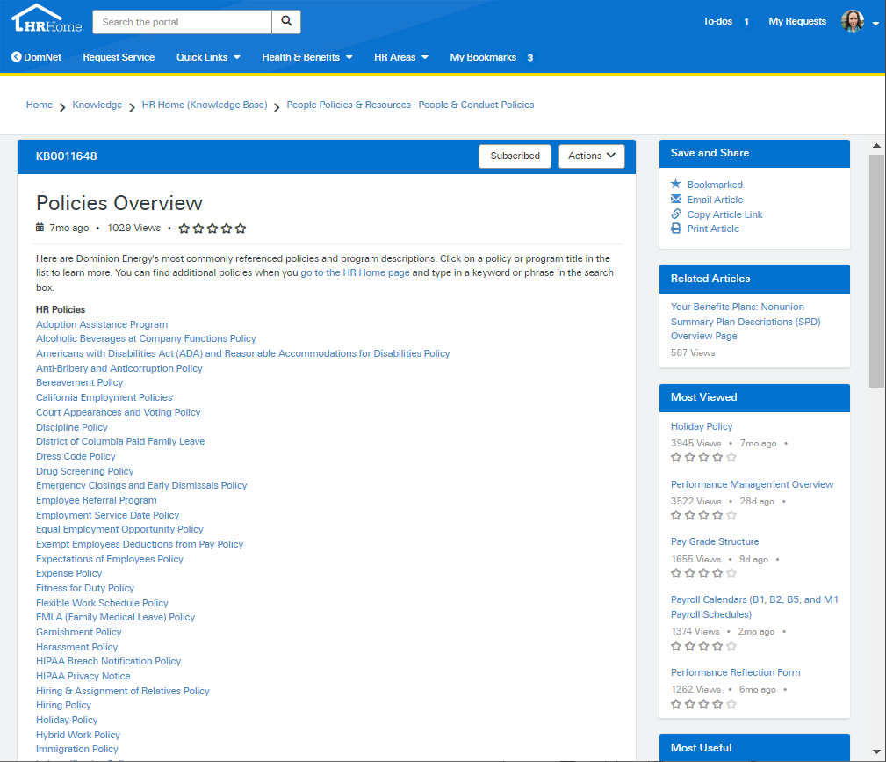
Adding New Content

Slide 6
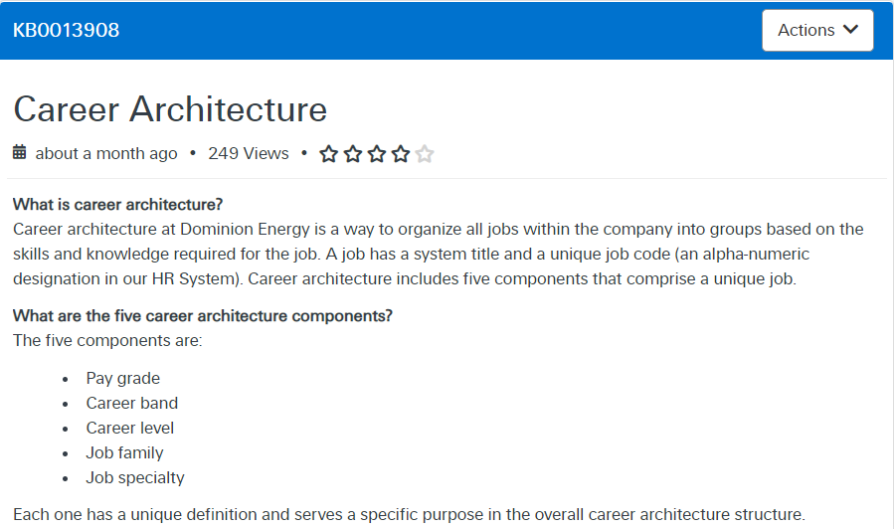
Adding New Content

Slide 7
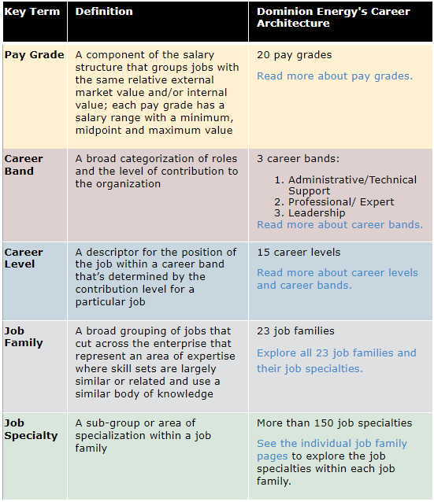
Adding New Content

Slide 8
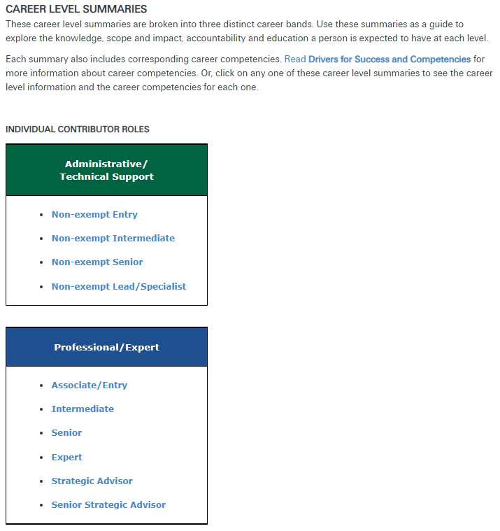
Adding New Content

Slide 9
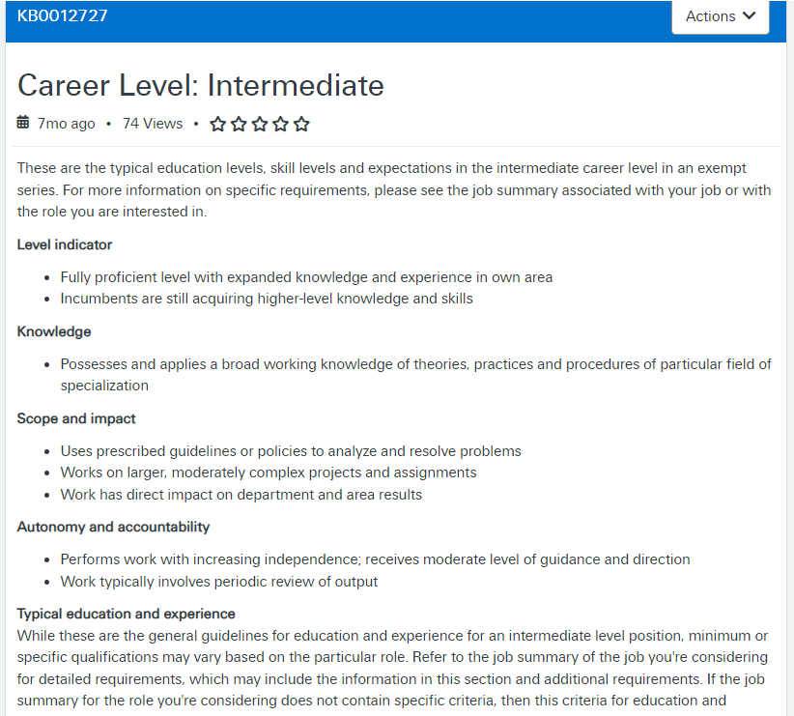
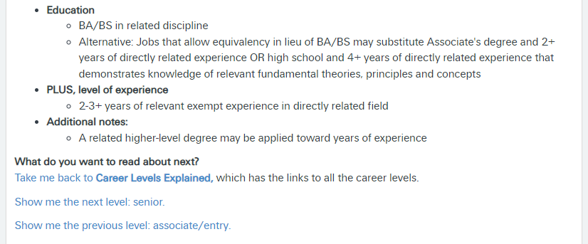
Adding New Content
.

Slide 10
Adding Attachments
GREAT for adding content when:
Too long
Too much effort for your KMs
Frequently updated
Copyrighted or professionally branded
Needed in context
Your content is searchable.
Little or no effect on UX.

Slide 11
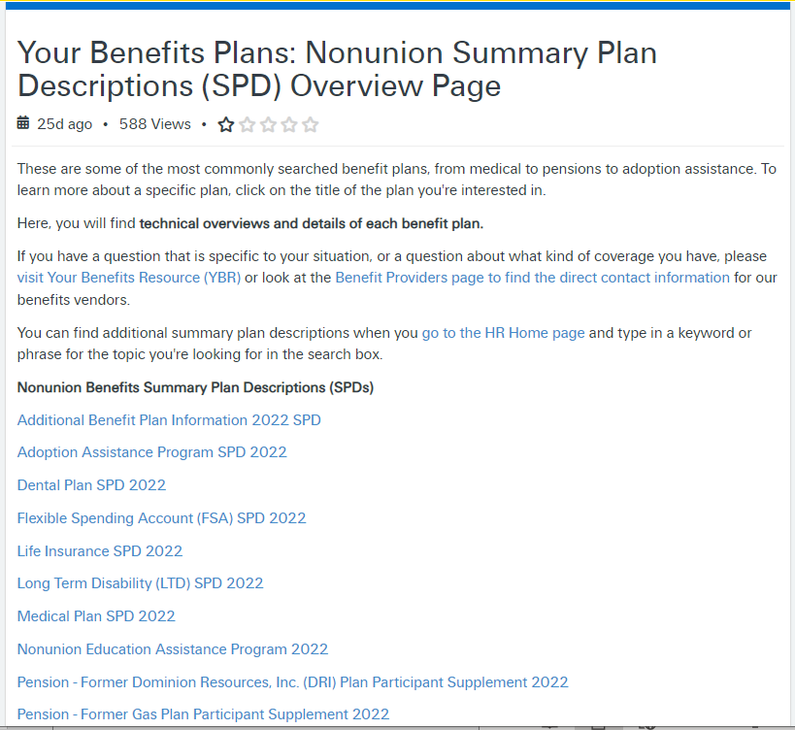
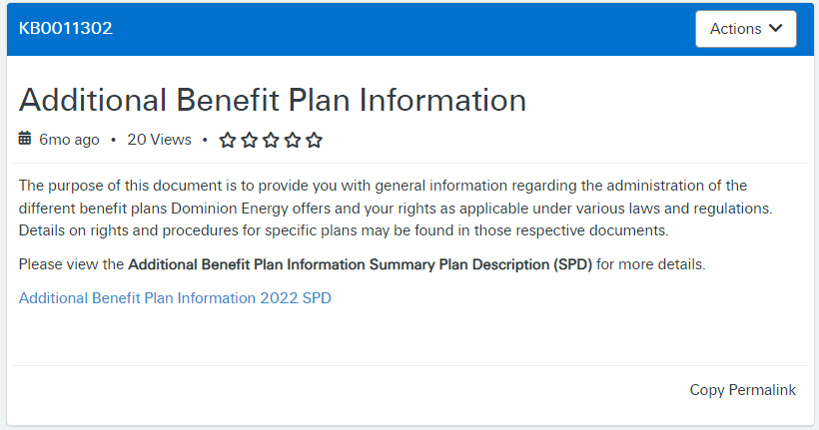
Adding Attachments

Slide 12
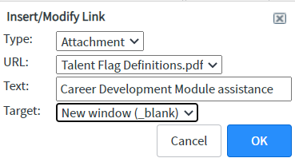
Adding Attachments
Download file or open in browser
Link tool automatically creates responsive link
Add “&view=true” to open as PDF in browser window

Slide 13
Questions?
Lauren Methena
Find me on LinkedIn
Lauren.K.Methena@dominionenergy.com

