Slide 1
ORNL – The Discovery Process
BRIAN ARLINGTON
GROUP LEAD - SERVICE MANAGEMENT
Oak Ridge National Lab

Slide 2
Agenda
Background
CMDB vs. service management platform
Why ServiceNow?
Strategy & recommendations
In progress and roadmap

Slide 3
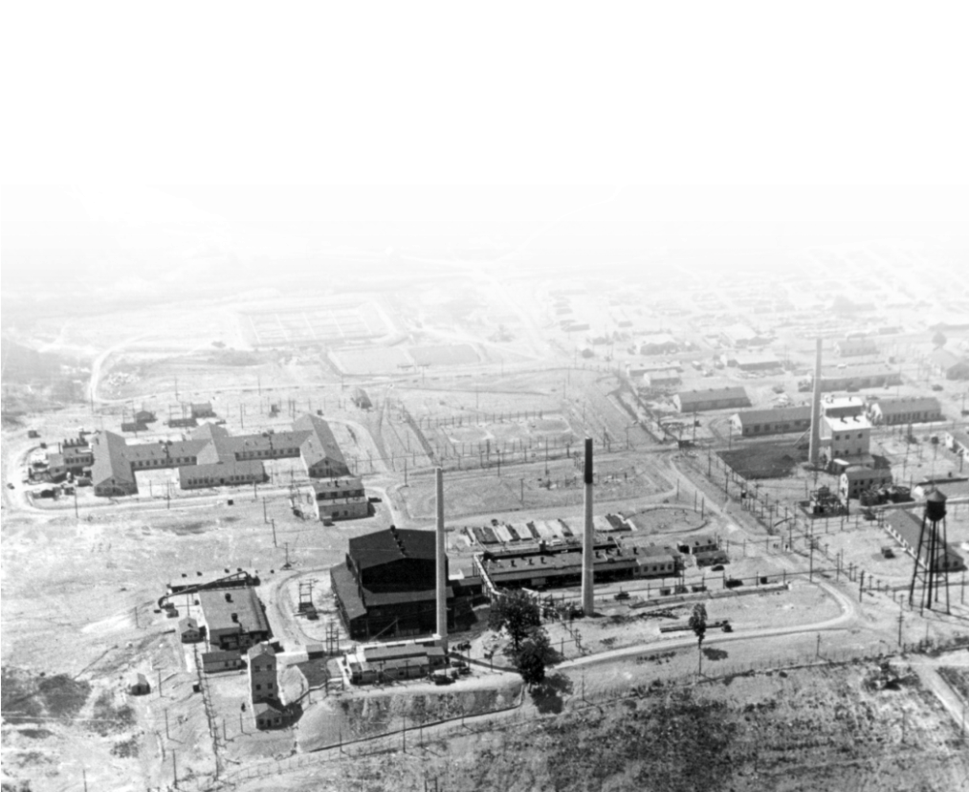
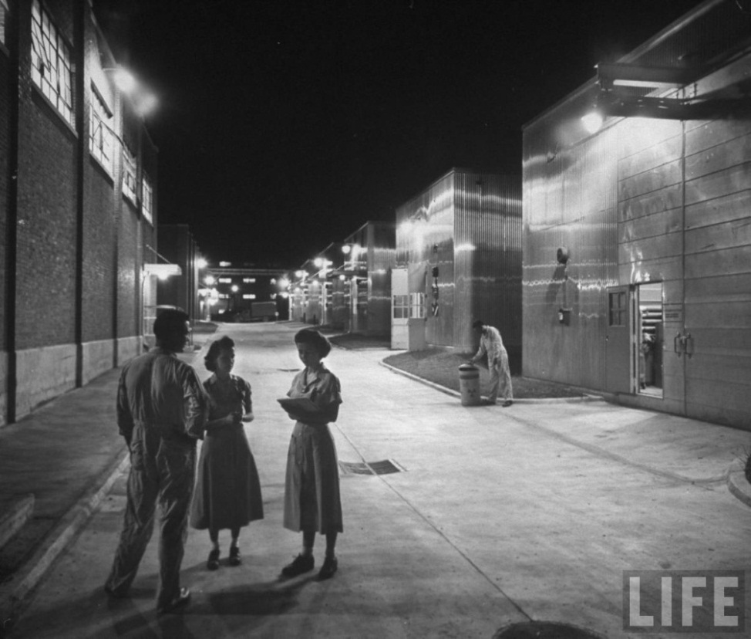
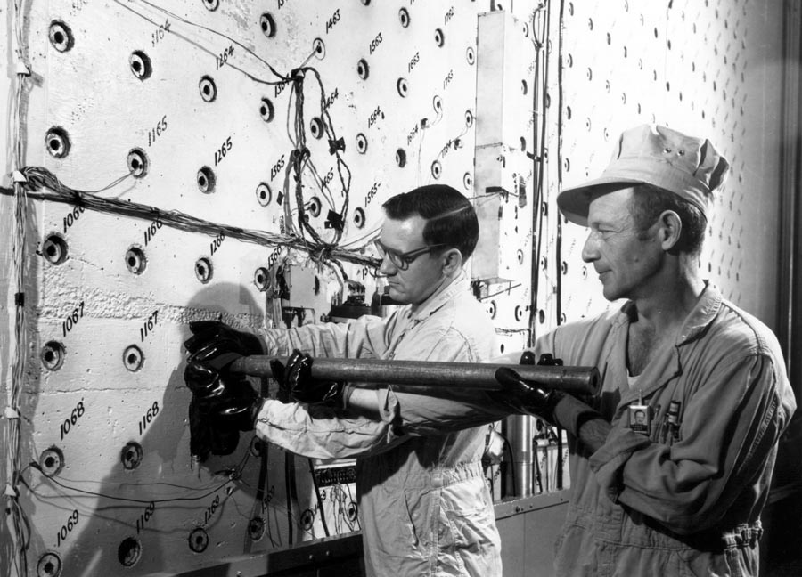
Oak Ridge National Laboratory (ORNL)
Evolved from the Manhattan Project
Chemical processing techniques
were developed to separate
plutonium from
irradiated fuel
Notes:
The Oak Ridge area was selected as a site for the World War II Manhattan Project to develop the atomic bomb for its remoteness, the ready availability of power and water (thanks to the presence of the Tennessee Valley Authority), and the climate, which allowed construction close to year round.
To support the three facilities constructed as part of the “Clinton Engineer Works” (K-25: gaseous diffusion of uranium; Y-12: electromagnetic separation of uranium; X-10: production and separation of plutonium), the area went from sparsely populated farmland to a city of 70,000 in about 18 months. The Clinton Pile (later known as the Graphite Reactor) was built in about 11 months – construction started in February 1943, and the reactor went critical on November 4. It operated for 20 years and today is a National Historic Landmark. (in this photo, it is the black building just to the left of center. Several of these buildings are still standing.)
R&D conducted in Oak Ridge was critical in the development of the first atomic weapons. The plutonium production methods used at Hanford were piloted at Clinton Laboratories (the name “ORNL” was not used until 1948).
Picture on the right: Life Magazine, January 1, 1951 (Isotope Circle)

Slide 4
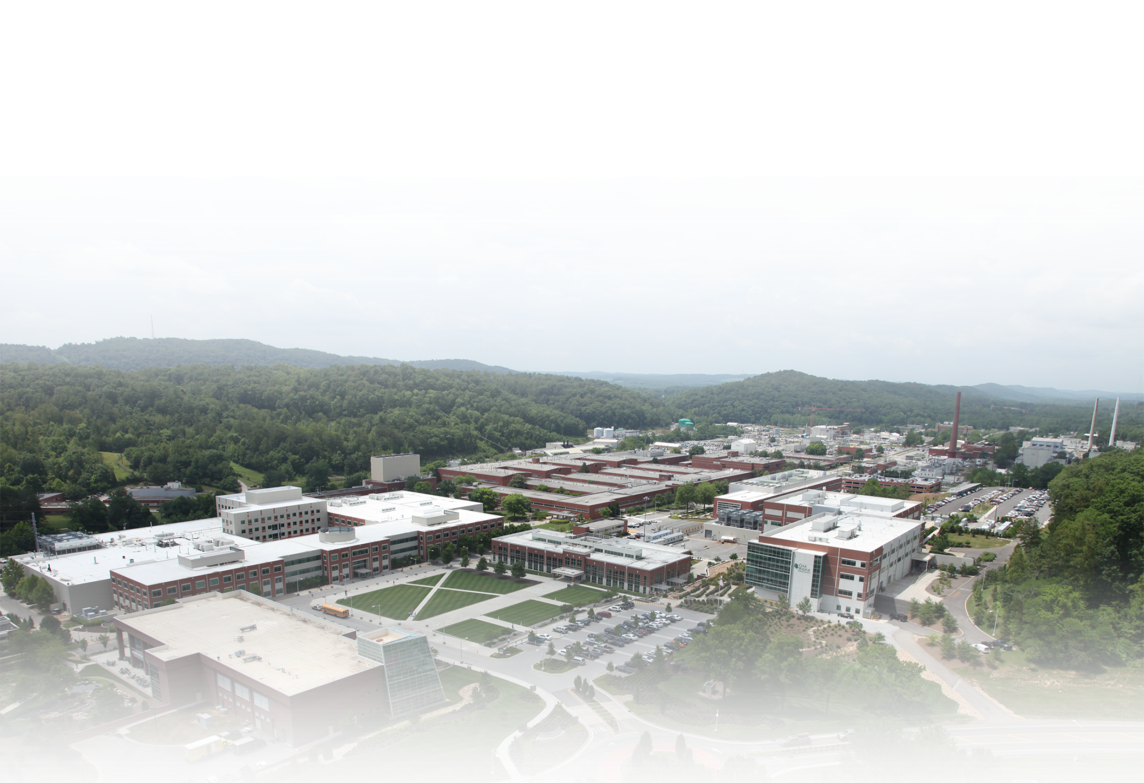
ORNL is DOE’s Largest Science and Energy Laboratory
$1.6B
budget
4,400
employees
3,000
research
guests
annually
$500M
modernization
investment
Nation’s
largest
materials
research
portfolio
Most
powerful open
scientific
computing
facility
World’s
most intense
neutron
source
World-class
research
reactor
Nation’s
most diverse
energy portfolio
Managing
billion-dollar
U.S. ITER
project
4
Notes:
4
TODAY: ORNL has well-defined research capabilities (developed through its performance of mission assignments) that are applied to meet the needs of the Department of Energy and other customers, including the Department of Defense, the Department of Homeland Security, NASA, the Nuclear Regulatory Commission, and other federal agencies, as well as other public and private-sector entities. Our $1.5B budget comes to us in projects of various sizes for these customers.

Slide 5
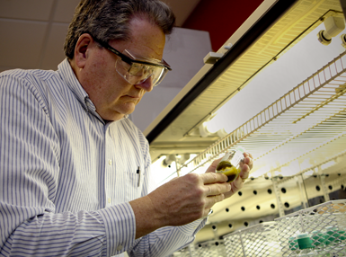

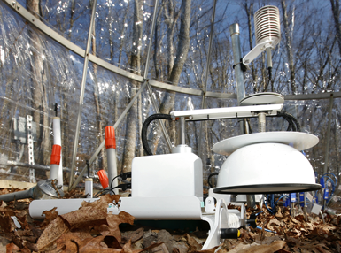


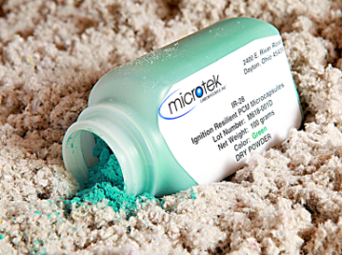

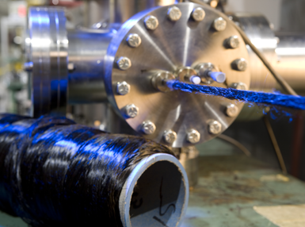



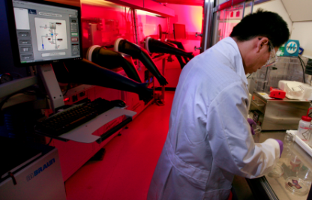
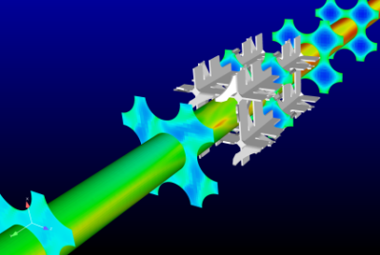
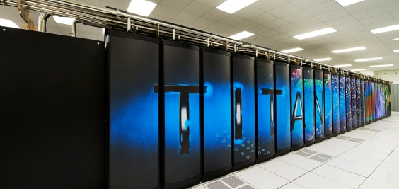
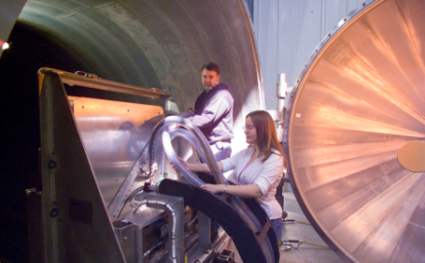
Integration of Our Signature Strengths Supports Customers
Clean energy
Scientific discovery and innovation
Global security
ITER
Materials science
and engineering
Nuclear science
and technology
Computational science
and engineering
Neutron science
and technology
Notes:
5
Integration of our signature strengths supports DOE and other customers

Slide 6
The CMDB Project
Genesis Risk Management Initiative
Initiative Owner:
Brian Arlington
Core team
  Brian Arlington
  Steve Raley
  Tim Guilliams
  Brian Beal
  Travis Burnette
  Carlos Cunningham
  Karen Harvey
  Steve Parham
  James Trater
Extended team
  Janel Easterling
  Bruce Johnston
  David Wantland
  Paige Stafford
  John Gerber
  Chad McCormick
  Les Manning
  Others…
Notes:
Mike Introduce the cyber incident and the formation of the genesis projects
I will quickly talk about the formation of the CMDB team and the skill mix of the team
Defining the skill set for the core group and the extended team

Slide 7
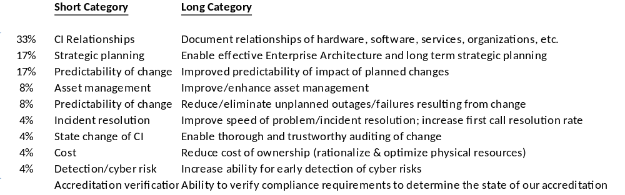
ITSD LT Prioritized Objectives (Oct-Nov 2011)
Five prime objectives:
  Knowledge of configuration item (services, HW, SW, people) relationships
  Better tools for long term IT planning
  Better predictability of change impact
  Improve and speed of problem identification & resolution
  Increased and early cyber threat awareness
Notes:
Met with multiple stake holders and developed the objectives of a functioning CMDB
Then the functionality outlined and presented to the IT Leadership team to set priorities
Where we identified the 5prime objectives and then set off to build a plan that included 3 phases:
Document the AS-IS – Document where the data is or isn’t today and how to access such data
Tactical Solution– which the objective was gain some value from the learning ASAPO instead having to wait for project completion
Long Term Solution - What is the long term solution that gives us the most comprehensive answer to these objectives

Slide 8
CMDB History
Q1-2 FY12 Q3-4 FY12 Q1-2 FY13
As-Is
Tactical solution
Long term solution
SMEs teamed
Data mapping
Existing Systems Inventory
Infrastructure scope
Product evaluations
As-Is data/systems maps
Interim strategy
Tactical approach defined
Functional requirements
Learning phase
SDE vs. new tools
Tool limited scope
Broader SM investigation
Issues identified
Additional FRs gathered
Tactical deployment complete
Lessons learned
SM limited operational
Need for discovery
Alternatives assessed
ServiceNow pursuit
POV executed
Opportunities identified
Long term strategy solidifies
ServiceNow solution
= ITSDLT checkpoint
= Internal solicitations
= ServiceNow interactions
Notes:
Here is the outline that we developed – notice the datapoints along the top, those are touch points with the stake holders, Leadership team and servicenow to solicit feedback along the way
First we gathered the data, then deployed an interim solution by implemented the ITSM module of a tool already in production within the lab
The learning from our Tactical solution- Q3 -4 FY12
Solution was Microsoft centric – our environment contains ~25% other than windows
Gained a better idea of our internal data and what it will take to integrate to CMDB
Realized the importance of agentless discovery
Then we went back into discussions with ServiceNow and decided to put up a POV site with an emphasis on the discovery agent and effort required for integrations

Slide 9
ServiceNow
BACKGROUND:
The recommendation for the ServiceNow platform follows a rigorous evaluation:
  CMDB requirements (as part of the Genesis program)
  An evaluation of existing tools and processes within ITSD
  An evaluation of competitive market solutions
  An investigation of trends with other relevant federal sites/labs
Discovered that process solutions are tightly intertwined with CMDB solutions
The effort also broadened the thoughts around service desk capabilities beyond IT and the concept of a flexible service platform lab-wide
The cloud aspects of the solution align with our cloud-first strategy and provides an opportunity to experience
Notes:
We then met with the leadership team and internal Stakeholders and made the recommendation for the ServiceNow platform.
We realized the tight integrated CMDB and with the common P,I,C process made for a much more robust process internally
We thought there may be possibilities of using the platform for groups other than IT within the lab
And in case you aren’t aware there is a federal directive for new implementations to look at cloud solutions over development.

Slide 10

Service Management Roadmap 2013-2015
2013 2015
J F M A M J J A S O N D J F M A M J J A S O N D
Agiliance/Risk Vision
Process Dev (I,P,C)
Service Catalog
SLAs
DES
CSR
SSR
VSWeb
Service Mgmt.
Platform
CMDB
Process Integ
Service Catalog
Self Service
Asset Mgmt.
GRC
CMDB
Config
SRS
SDE
SPUDS
MHP
eProp
IT Asset Mgmt.
New
Planned Activity
Potential
Sun-setting
Solution Center Process
Supporting

Slide 11
SMP Strategy
Deploy a scalable Service Management Platform capable of supporting all service desk requirements across the lab today and into the future.
Converging Drivers:
  Increased demand for service desk capabilities across the lab(Solution Center, IT Helpline, LRN, GSD, HMMIS, IPPM, Library …)
  Impending de-support of the current BMC tool Service Desk Express
  Need for core capabilities of Configuration Management (CMDB) for improved Cyber Risk Management
  Avoid more costly alternatives:
    Upgrades to existing tools (SCCM)
    Costs of similar capability products
    Prepare the technology platform for many ITSD service related improvements (such as AIM supported PC Lifecycle Management)

Slide 12
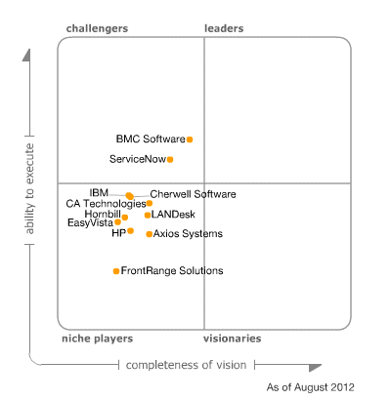
Solution Evaluation Steps
Gartner ratings reviewed
Several top tier tools were investigated (demo, webinar, etc.)
First hand experience with another ITSM tool during the
tactical phase
Traced ORNL requirements to capabilities
Assessed trends in other labs
Deeper look into ServiceNow

Slide 13
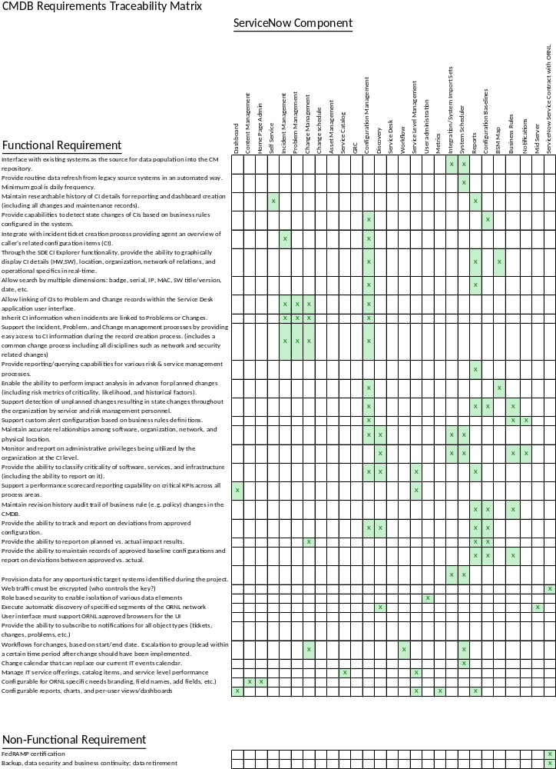
Requirements vs. Capabilities
Functional requirements from:
  Interim strategy
  Cyber/Risk Mgmt. inputs
  LT identified
35 Requirements
--- COMPARED TO ---
Capabilities of the
ServiceNow solution
(by module)
No functional gaps uncovered (pending cyber concerns with cloud infrastructure).

Slide 14
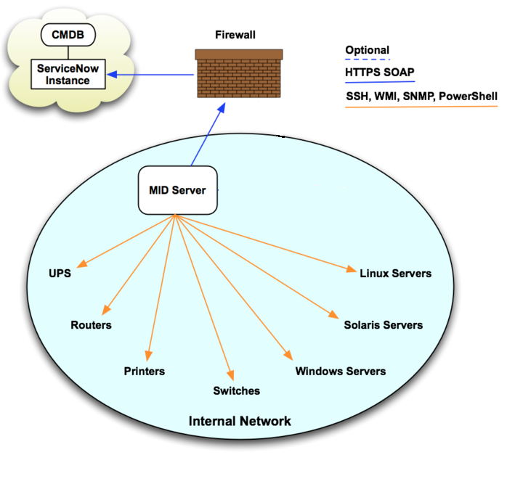
Cloud Architecture
port 443 only
Unix/MAC
SSH Private Key: Certificate-based identification, No Passphrase, limited to only MID server IP.
Windows:
Admin Account: Project account used for WMI queries on Windows systems. Account logins to be monitored by Cyber.
Network Gear:
SNMP: Read Only Community string and password set by networking.
/ Mac
POV credentials on DEV subnet

Slide 15
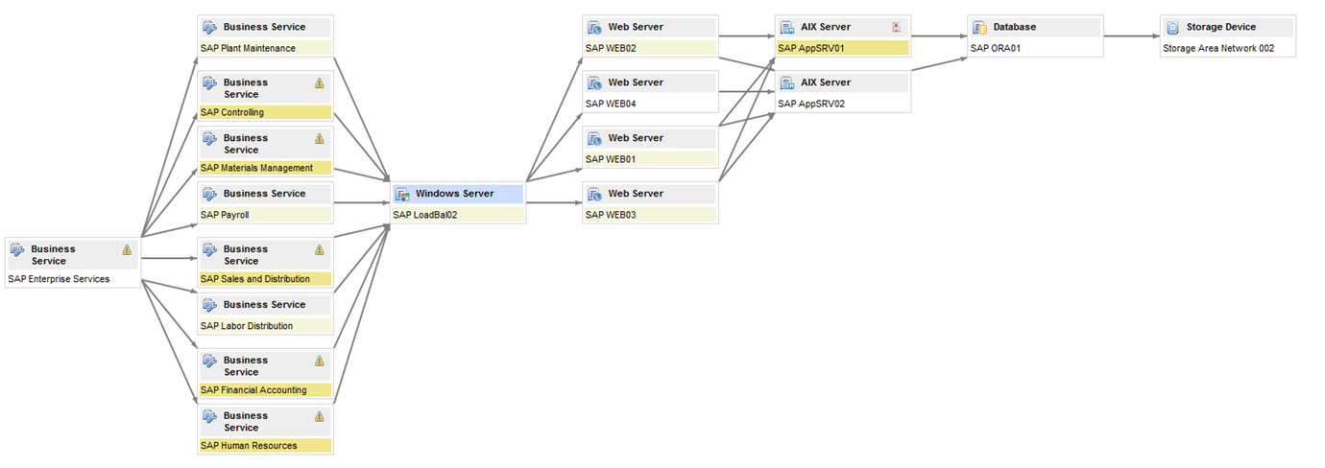
ServiceNow
Auto-discovery and relationship mapping
TARGET CAPABILITIES
Business Services Server Relations Database Storage device

Slide 16
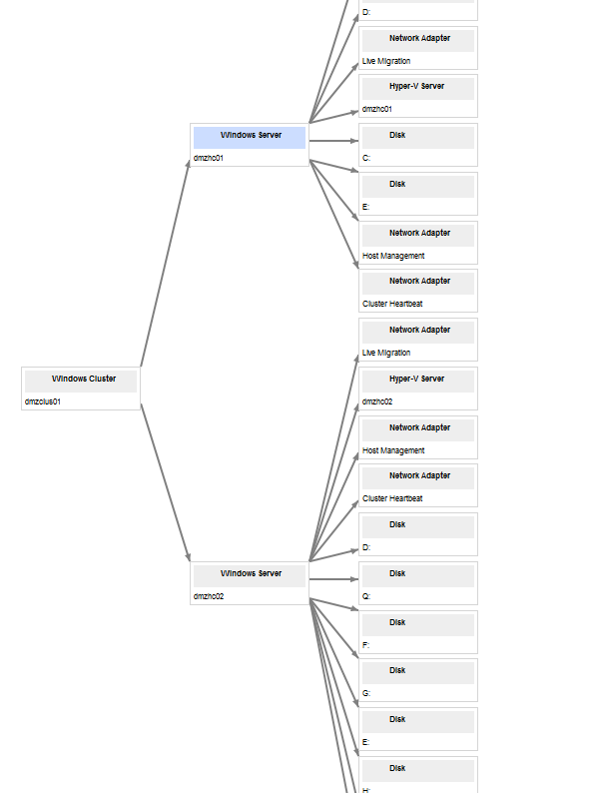
ServiceNow
Auto-discovery and relationship mapping
Evaluation Results
Agentless technology
Tested in our DEV network
51 major devices and relationships
discovered in 8 minutes
POV ACTUAL RESULTS

Slide 17
ServiceNow
Key features/capabilities
Cloud based (SaaS); FISMA certified for moderate security; FedRAMP certification anticipated in 2014 or early 2015
Simplified automation for integration with legacy data
Support for all ITIL processes out-of-the-box; also supports non-IT business processes such Solution Center, HR, training, etc.
Online agent chat for enhanced collaboration capabilities
Ease of administration; simple license model
Social media features available
Potential for legacy systems replacement and retirement (SDE, SPUDS, MHP, …)
Auto-discovery; all systems and a high percentage of system relationships mapping

Slide 18
Results & Summary
Contribution to the Genesis program:
  Overall costs are significantly less than comparable market leaders
  Speed to value (Risk management) is significantly faster than originally anticipated
Capabilities are beyond that of just CMDB, and reaching beyond just IT
This platform offers the potential for replacement of and decommissioning of multiple aging IT service related apps/tools

Slide 19
Strategic Recommendation
Embrace ServiceNow as the ORNL Service Management platform (larger than just CMDB and long term)
Engage ServiceNow services to assist with the following sequence of implementation steps to deliver production systems for:
  CMDB with Discovery and legacy integration
  Core SM processes (Incident, Problem, Change, Solution Center)
  Service Catalog creation for high priority offerings
Exploit ServiceNow as the backbone for ORNL Services Management; broader than CMDB and broader than ITSD

Slide 20
Service Management Roadmap 2013-2015
2013 2015
J F M A M J J A S O N D J F M A M J J A S O N D
Agiliance/Risk Vision
Process Dev
Service Catalog Dev.
Service Level Metrics
CSR
DES
SSR
VSWeb
Service Mgmt.
Platform
CMDB
Service Cat
Process Integ.
User Portal
Asset Mgmt.
GRC
CMDB
Config
SRS
SPUDS
MHP
SDE
eProp
IT Asset Mgmt.
Planned Activity
New
Current
Solution Center Integ.
Sun-setting

Slide 21


Agiliance/Risk Vision
Process Dev
Service Catalog Dev.
Service Level Metrics
CSR
DES
SSR
VSWeb
Service Mgmt.
Platform
CMDB
Service Cat
Process Integ.
User Portal
Asset Mgmt.
GRC
CMDB
Config
SRS
SPUDS
MHP
SDE
eProp
IT Asset Mgmt.
Planned Activity
New
Current
Solution Center Integ.
Sun-setting

Slide 22
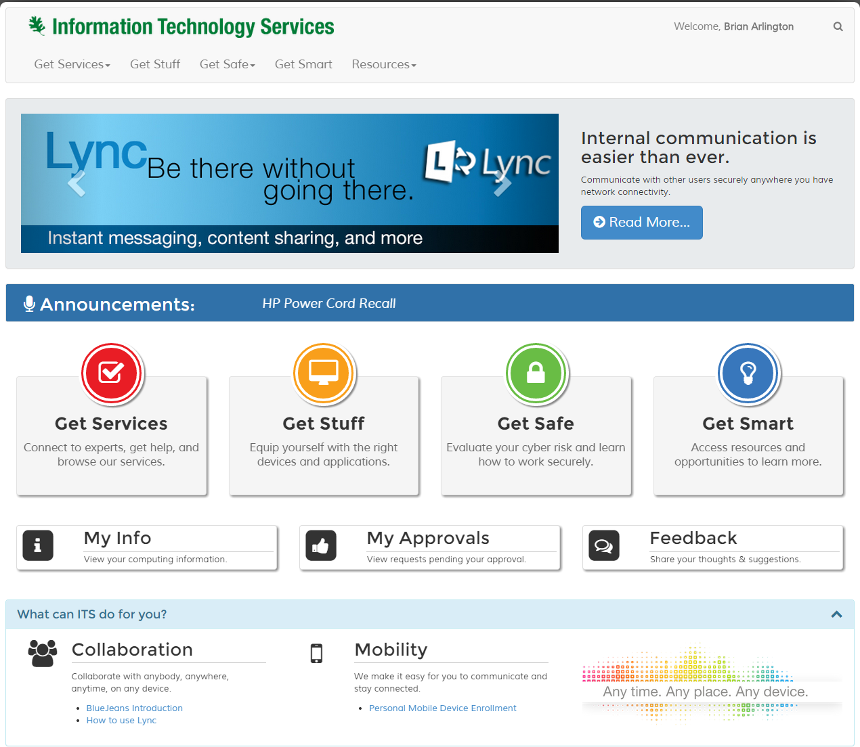

Slide 23
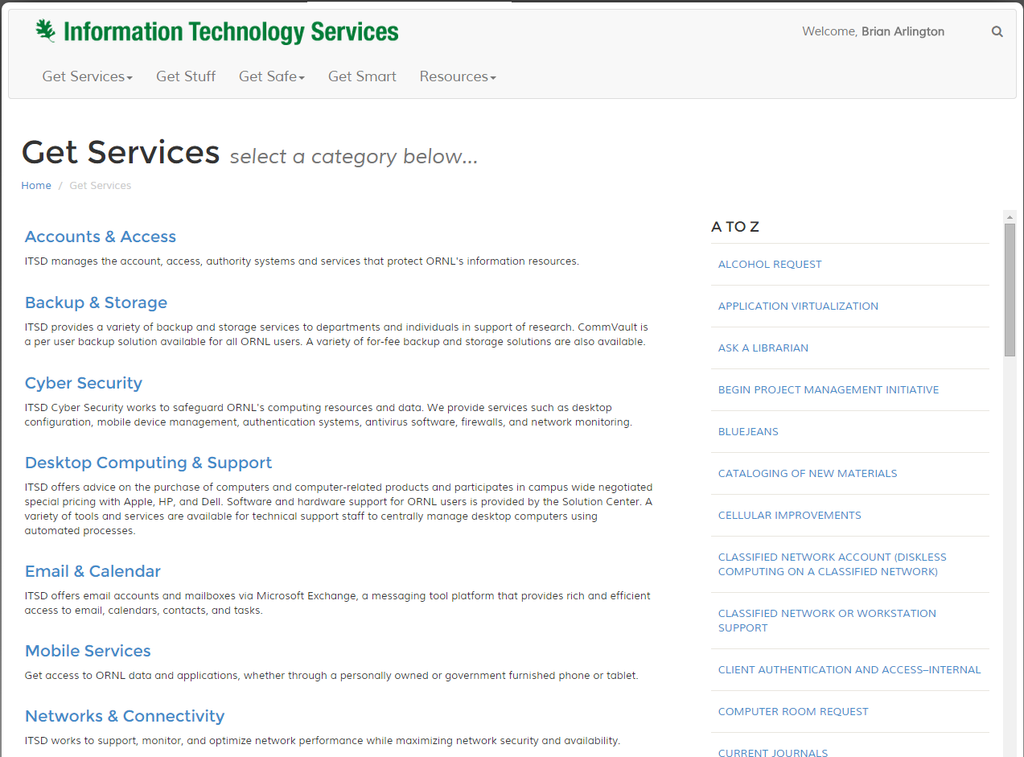

Slide 24
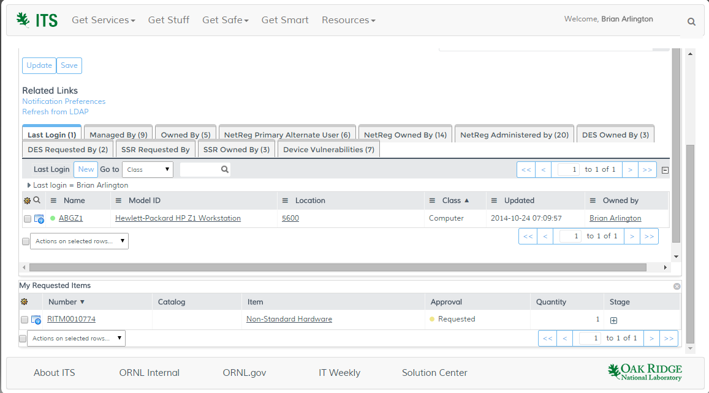

Slide 25
Top Takeaways
1
Discovery and CMDB first… but perform due diligence in preparation
2
CMDB enhances the Problem – Incident – Change processes
3
Don’t forget the 5 P’s – Proper, Planning, Prevents, Poor, Performance

Slide 26
Thank you
Brian Arlington
Group Lead Service Management
Oak Ridge National Lab
arlingtonbk@ornl.gov

Slide 27
Q&A

