Slide 1

Brainstorm Use Cases
JOHN JASINSKI
GoodPracticePlugins
9/8/16
Notes:
for Governance, Management, Risk and Compliance, as a foundation, for IT Service Management and overall Enterprise Service Management

Slide 2
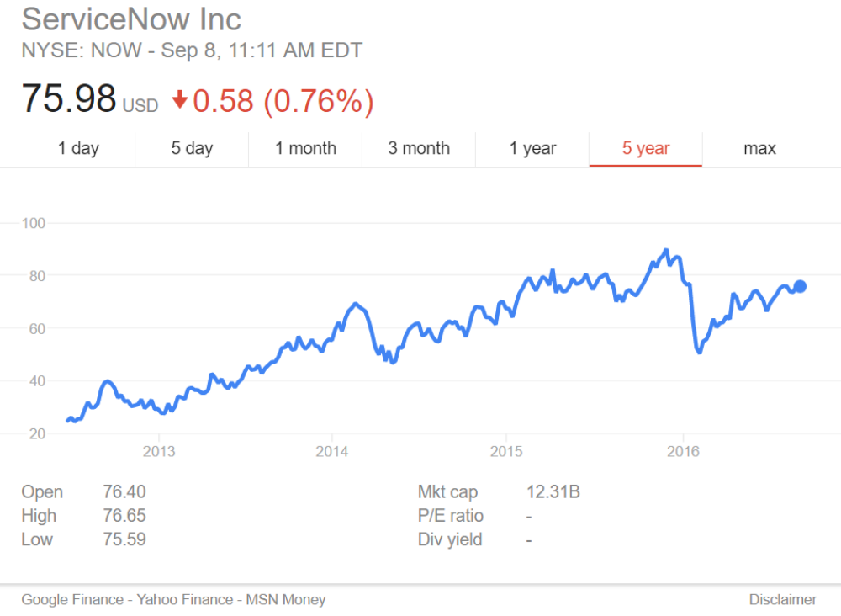

Slide 3
Who knows ITIL?

Slide 4
Don’t just see what’s next, create it

Slide 5
Back story
SAP at General Electric
Pink Elephant – Atlas (ITIL in a box)
BMC Remedy (SMPM / ITIL)
Gartner Magic Quadrant (ServiceNow- 3x)

Slide 6
Product people ask for ideas
Theme: Accelerating management practices
Engaging: Good Practices with ServiceNow
Accelerators / Plugins
Use Cases - Brainstorms
  ITIL
  Kepner-Tregoe
  PMBOK
  HR
  Facilities
  Legal
  Marketing
  Lean
  Six Sigma
  Asset
  Catalog
  Custom Apps
  Processes - 37
  Self-Assessments
  Process Assessment
  Assessors Guide
  Assurance / Audit
  Goals Cascade
  RACI
  Integrations – Archer
  GEIT

Slide 7
Use Case | Requirements source (ISACA COBIT library)
Process Reference Model | Enabling Processes (37) – good practice
Risk – APO12 | APO12.01.2 – “Record relevant data”
Continuity – DSS04 | DSS04.01.1 – identify critical processes
Architecture – APO04 | APO03.02.5 – “Process Architecture Model”
Self-Assessment | Self-Assessment
Process Assessment | Process Assessment Model
Assessors Guide | Assessors Guide
Assurance / Audit | Assurance / Audit templates
Goals & Metrics Cascade | Enabling Processes – Ch.2 – Pgs 13-18, and App. A & B.
RACI | Framework – page 76; and Enabling Processes
Examples | COBIT 5 Online tool kit
Continual Improvement | Implementation
Management – APO01 | APO01.01.4 – Align organization with architecture models
GEIT | GEIT Primer
Resources link: | www.isaca.org/cobit

Slide 8
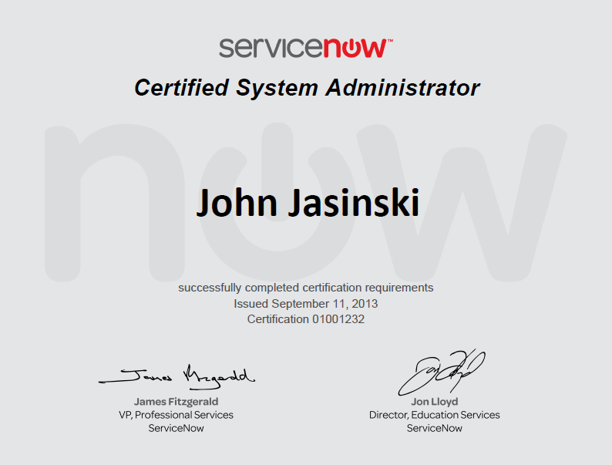

Slide 9
Productivity

Slide 10


Slide 11
Use Case | Requirements source (ISACA COBIT library)
Process Reference Model | Enabling Processes (37) – good practice
Risk – APO12 | APO12.01.2 – “Record relevant data”
Continuity – DSS04 | DSS04.01.1 – identify critical processes
Architecture – APO04 | APO03.02.5 – “Process Architecture Model”
Self-Assessment | Self-Assessment
Process Assessment | Process Assessment Model
Assessors Guide | Assessors Guide
Assurance / Audit | Assurance / Audit templates
Goals & Metrics Cascade | Enabling Processes – Ch.2 – Pgs 13-18, and App. A & B.
RACI | Framework – page 76; and Enabling Processes
Examples | COBIT 5 Online tool kit
Continual Improvement | Implementation
Management – APO01 | APO01.01.4 – Align organization with architecture models
GEIT | GEIT Primer
Resources link: | www.isaca.org/cobit

Slide 12
NDA
NON-DISCLOSURE AGREEMENT
DNA – Does Not Apply
What you learn in User Group meetings should be shared –
go back and tell others – tell your boss
Pay attention – this is going to go fast

Slide 13
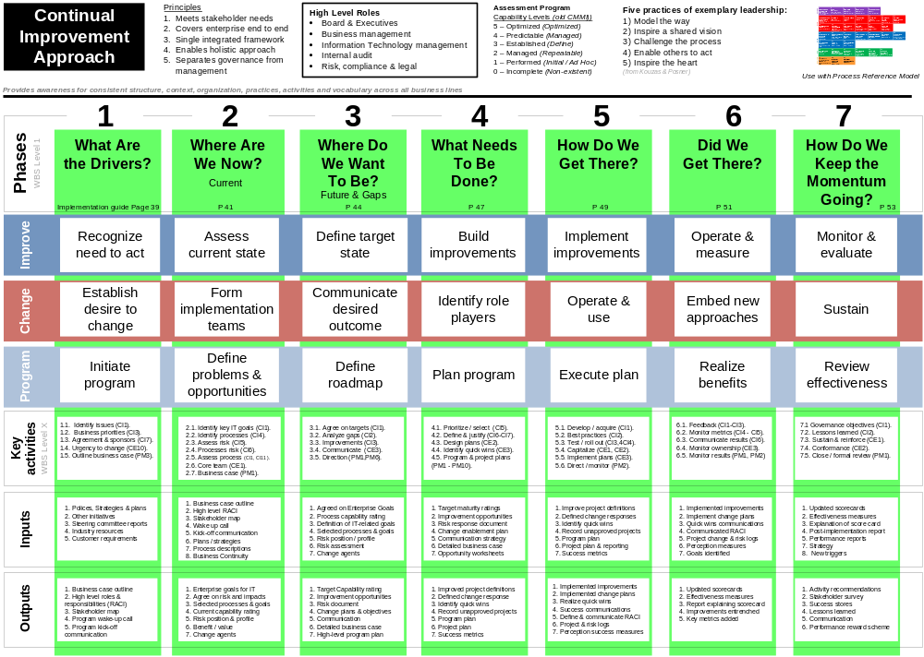
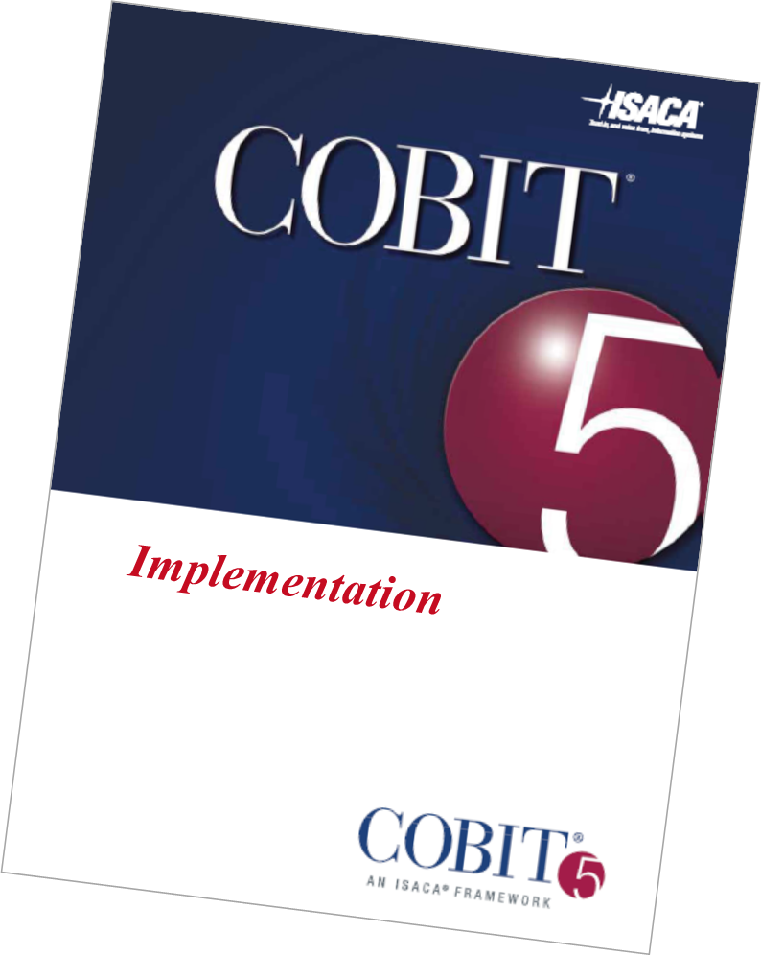
How to do it …
Project

Slide 14
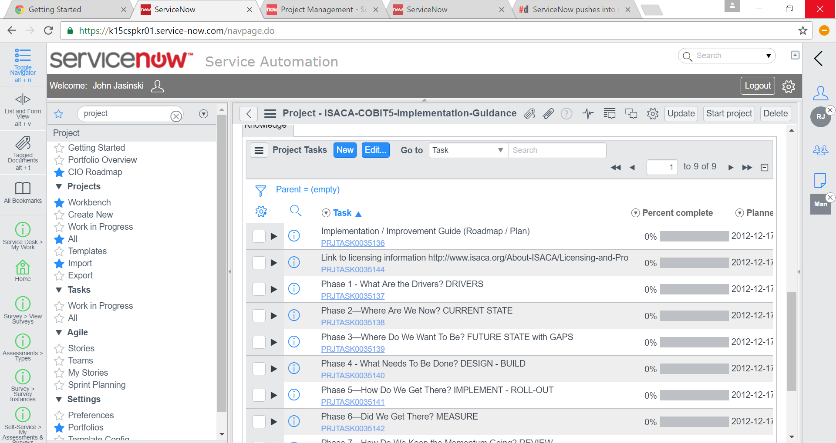

Slide 15
Process variation / root cause
85 / 15%
"The problem is at the top; management is the problem.”

Slide 16
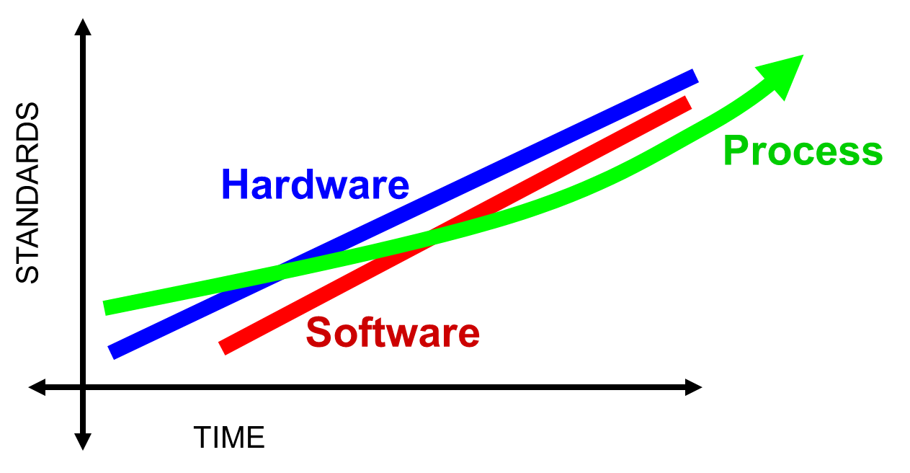
Standardization
Can process improvement accelerate faster than Moore’s Law?

Slide 17
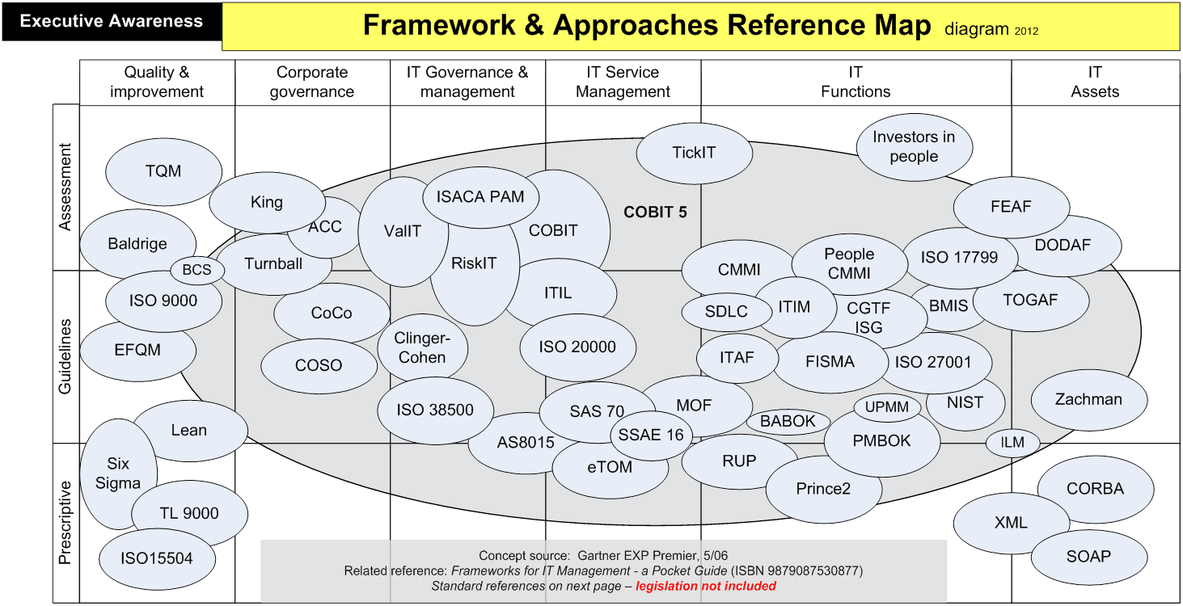

Slide 18
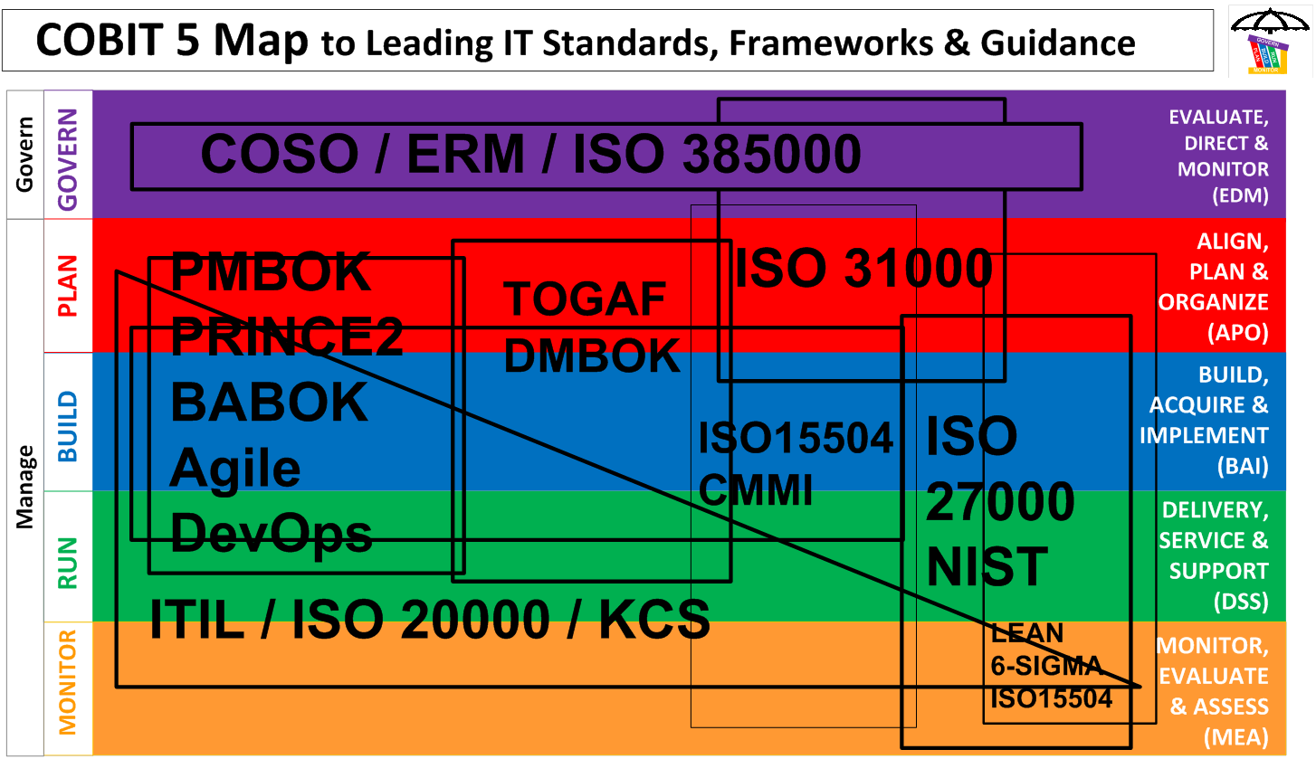

Slide 19
COBIT
ITIL
IT Security (ISO/NIST)
Projects (PMBOK)
LEAN
COBITITILISOPMBOKNISTLEAN

Slide 20





Where GRC Commonly Plays with Others
COBIT
ENTERPRISE SERVICE MODEL
BUSINESS MANAGEMENT
Governance
Vendor
Financial
Resource
Demand
Project
Analytics
Service Providers
SERVICE MANAGEMENT
Departments
Legal
Finance
Field Svc
IT
Marketing
HR
Facilities
Asset
Case
Catalog
Change
CMDB
Incident
Knowledge
Problem
OPERATIONS MANAGEMENT
APPLICATION DEVELOPMENT
Discovery
Orchestration
Service Mapping
Cloud Mgmt
Event
Professional
Creators
SDLC
Test
App Creation
Service Creator
‘Citizen’
Creators
SERVICE AUTOMATION PLATFORM
Single Architecture
Shared Resources
Single Data Model
Custom App Dev

Slide 21
Process first, then tool.”
Your boss said this

Slide 22
Do you use process reference model(s)?
If yes, what model(s)?

Slide 23

Process?
What are the models?

Slide 24

Tool?

Slide 25

Agenda / Admin
Back Story
Overview
Details
How It Works with ServiceNow
Resources
Notes:
Template default agenda is set to have 5 items.
For fewer than 5 points: delete place holders that aren't used from the master ->slide master view.
For more than 5 points: Use the default Title and Content slide layout.

Slide 26
Objective and Purpose
Introduce COBIT 5 –
the only governance and management framework for business IT-related Processes
for awareness …
and how you can use it

Slide 27
COBIT
Control
Objectives for
Business
IT-related processes

Slide 28
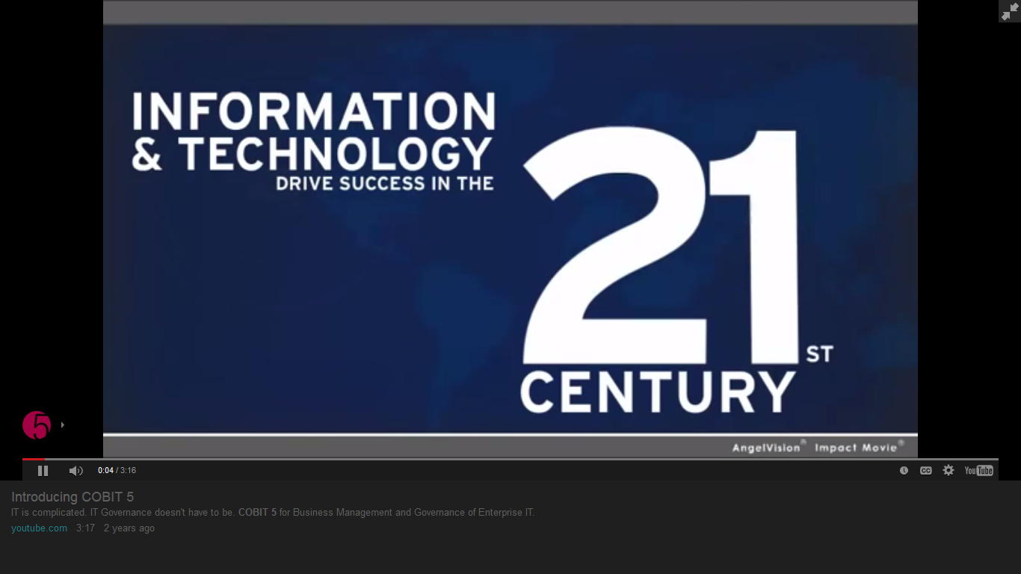
YouTube – Introducing COBIT 5 from ISACA 3 minutes 2012
http://www.youtube.com/watch?feature=player_detailpage&v=q7xexHtwSGI

Slide 29
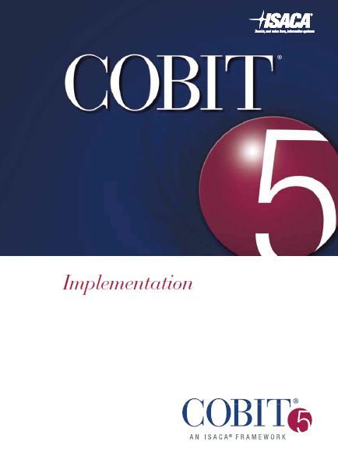

Enabling Processes
Framework
Implementation
Framework
Processes
Improvement
Three core books
isaca.org/cobit

Slide 30
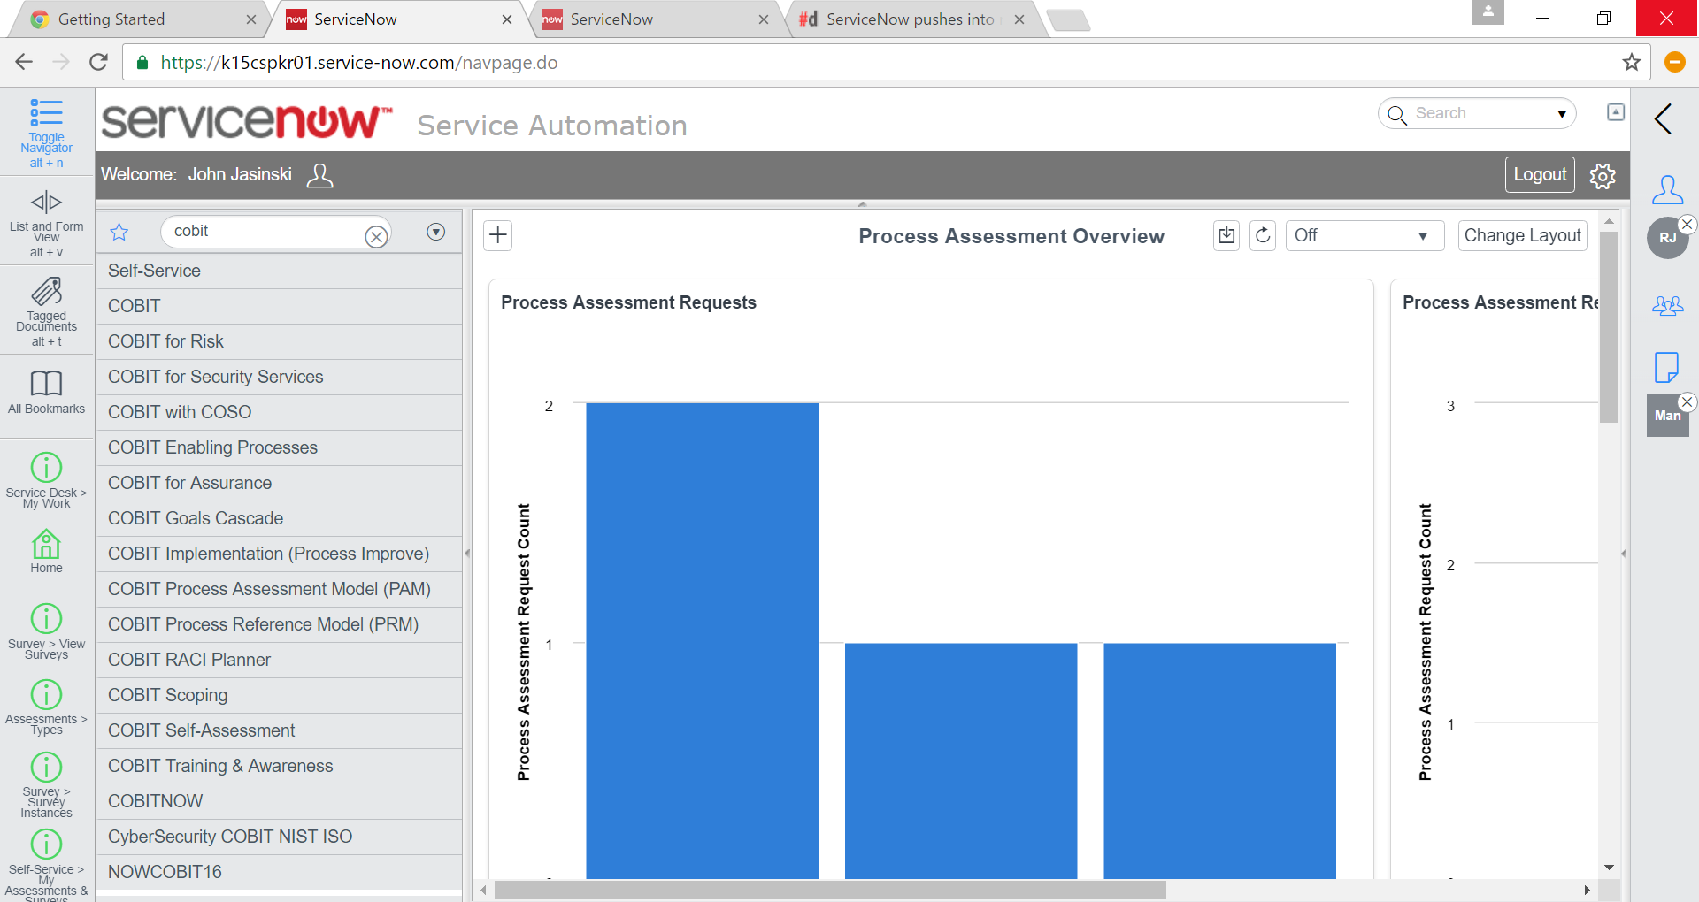

Slide 31
COBIT is important to you because it specifies a reference model for the WORK YOU DO
Are you doing the right things,
the right way?

Slide 32
This is not theory
Reference model based on real world
Context and structure for existing and potential practices and activities

Slide 33
Framework – Free
Open Source
isaca.org/cobit

Slide 34
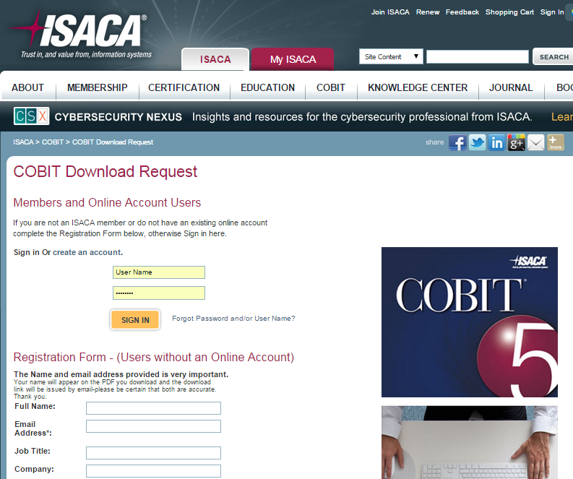
http://www.isaca.org/cobit/Pages/Cobit-Registration.aspx

Slide 35
COBIT covers all processes dependent on IT – for any line of business, sector or size
All departments and functions

Slide 36
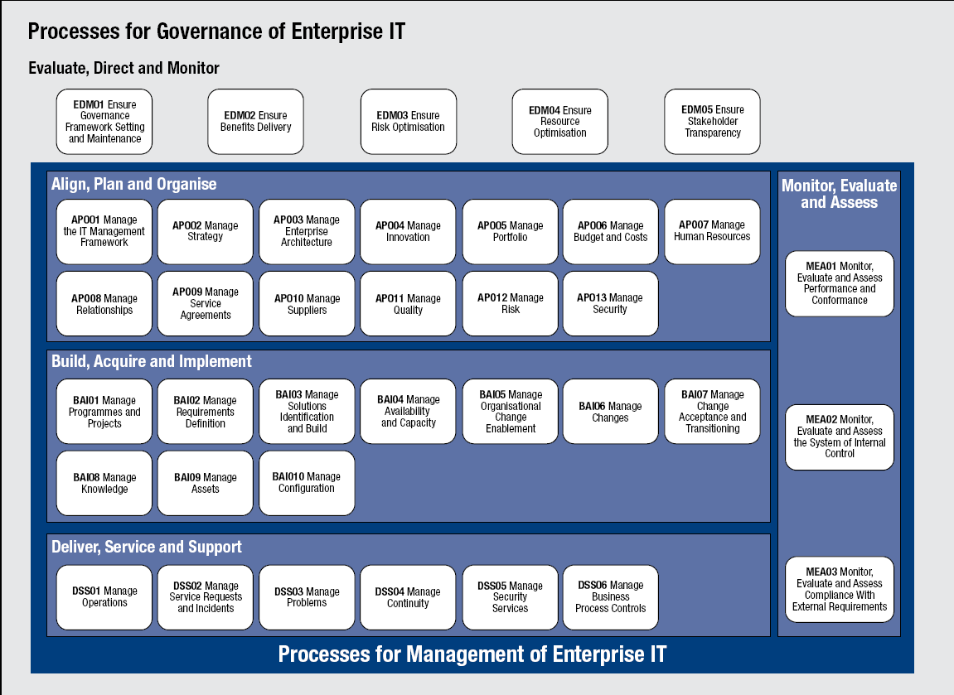

Slide 37
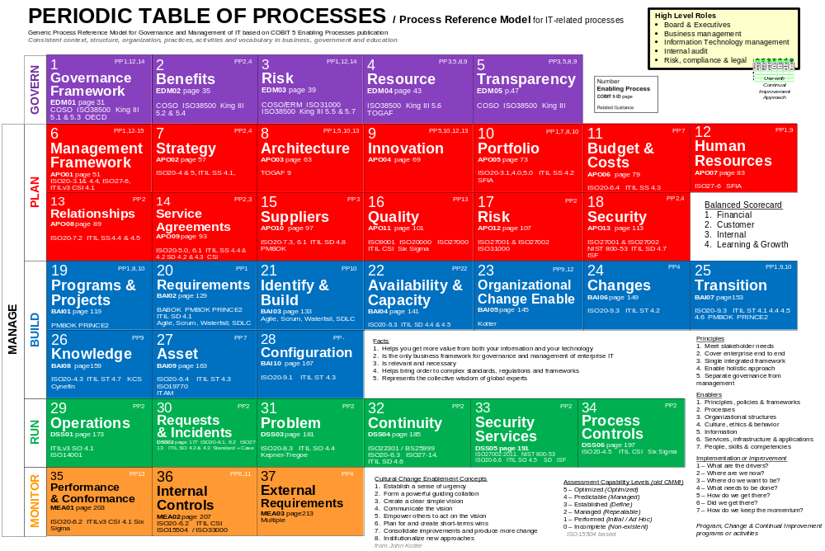

Slide 38
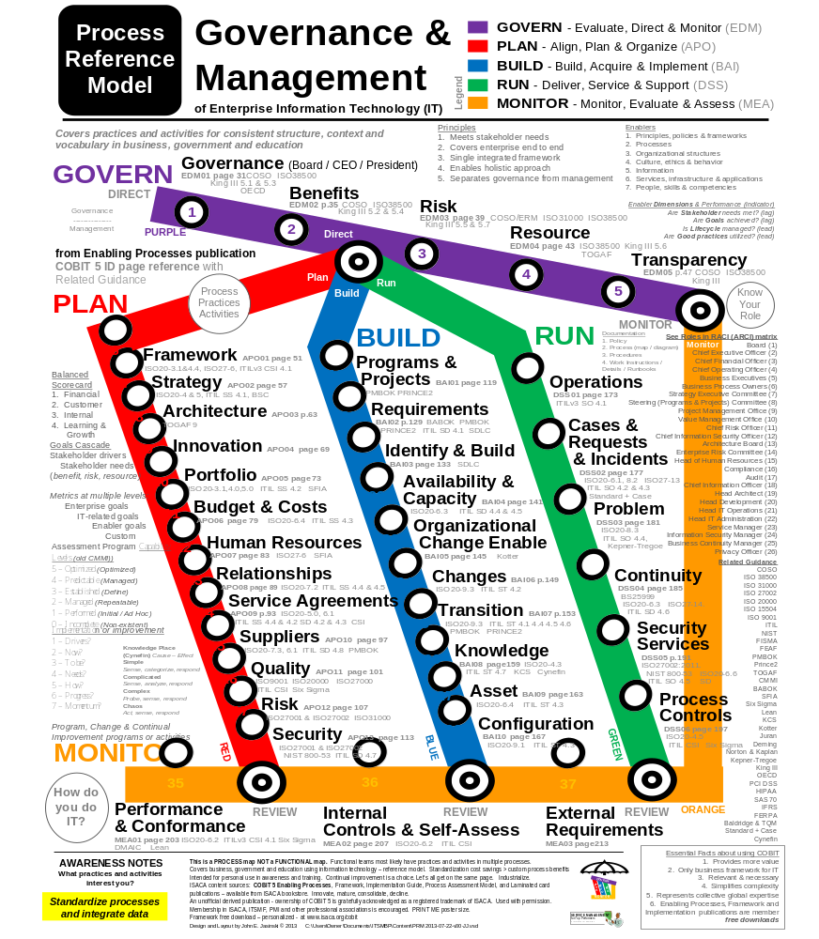

Slide 39
Facts for COBIT
Helps get more value from information & technology
Is the only business framework for IT-related processes
Is relevant and necessary
Helps bring order to complexity
Represents the collective wisdom of global experts

Slide 40
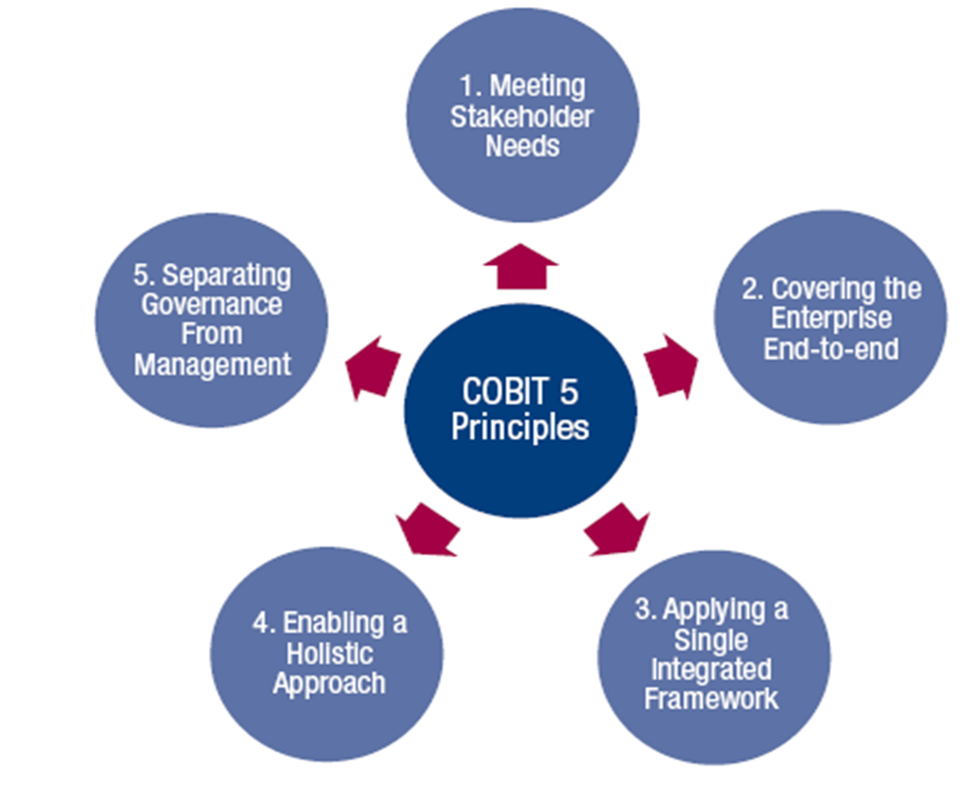
Principles
Source: COBIT® 5, figure 2. © 2012 ISACA® All rights reserved.

Slide 41
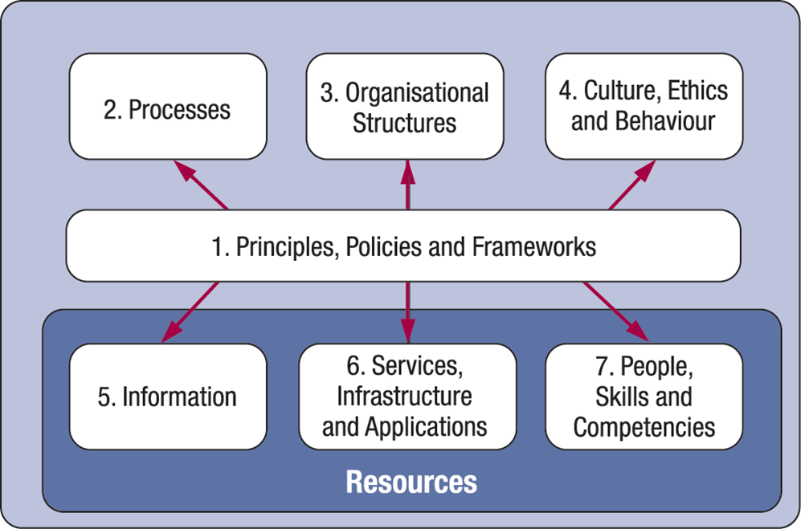
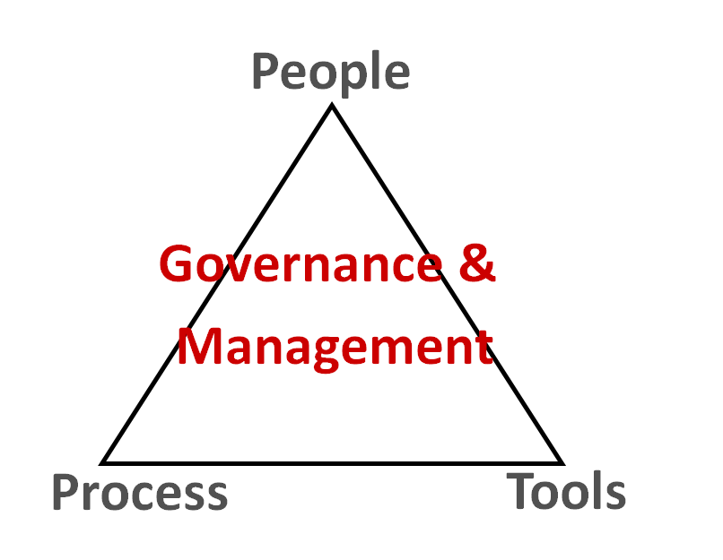
Enablers
Source: COBIT® 5, figure 12. © 2012 ISACA® All rights reserved.

Slide 42
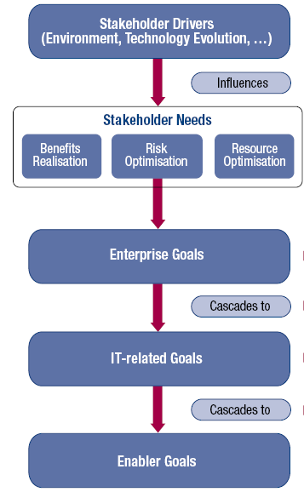
Goals Cascade with Metrics
Stakeholder needs have to be transformed into an enterprise’s practical strategy
The COBIT 5 goals cascade translates stakeholder needs into specific, practical and customised goals within the context of the enterprise, IT-related goals and enabler goals
Source: COBIT® 5, figure 4. © 2012 ISACA® All rights reserved.

Slide 43
By the Numbers
1 Reference Model
5 Facts
5 Principles
7 Enablers
4 Balanced Scorecard
4 Enabler Dimensions
37 Enabling Processes
17 Enterprise goals
17 IT-related goals
124 Process goals
2 Major domains covered 5 Domains for processes
26 Roles defined – RACI
210 Management Practices
1,108 Activities
  420 Outputs Work Products
  379 Metrics
54 Enterprise metrics
59 IT-related metrics
266 Enabling metrics

Slide 44
Need More?
12+ Number of major standards, frameworks and guidance that map to COBIT
100% Coverage of ITIL, ISO 20000, ISO27000, NIST, ISO 38500, ISO 31000, ISO15504, TOGAF, PMBOK, Prince2, Scrum
3 Training courses offered world-wide Foundation, Implementation and Assessment
28 Certifications held by DEV team
95 Global Expert Reviewers
300,000+ Person hours of development
150,000+ COBIT 5 Frameworks downloads – open source
Do you even know anyone who knows the numbers for your approach?
Do you have a process architect?
How does your approach compare?
WHAT DO YOU HAVE?

Slide 45




Good practice automation – standardize processes and integrate data
Framework | Practices | Standards | Tool
What?
How?
You’re doing it today. Question is how well?

Slide 46
?

Slide 47
How about a real world example?

Slide 48
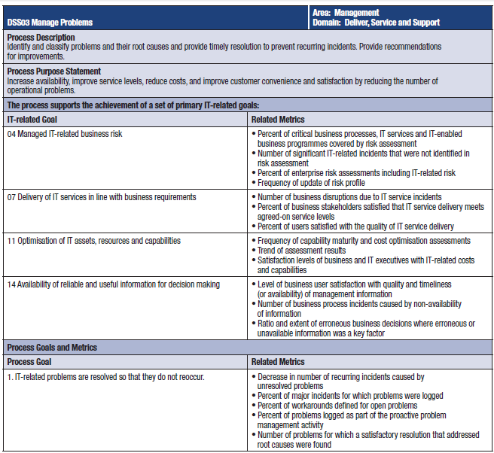
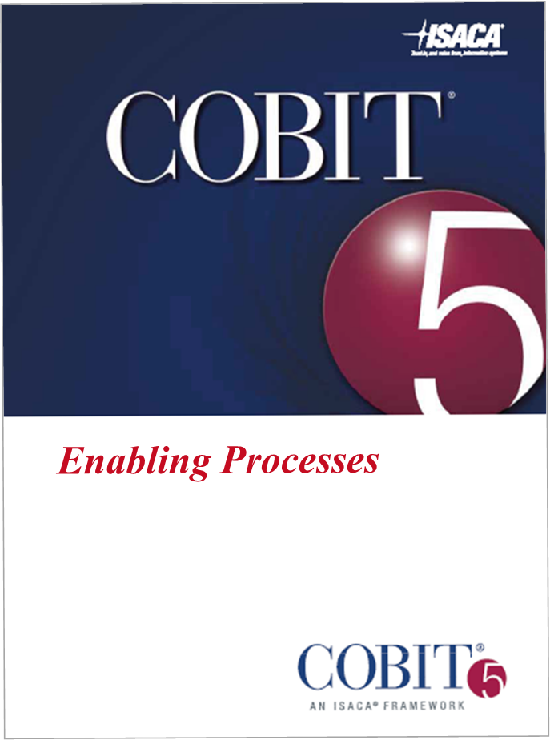
Problems
Goals mapped to Metrics page 181

Slide 49
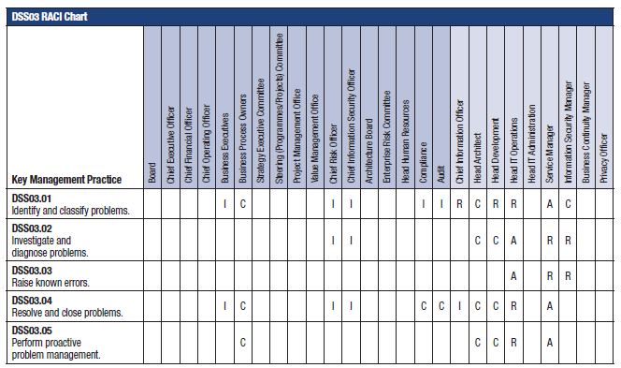
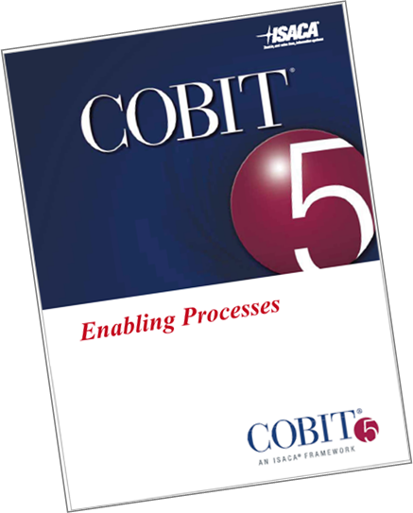
RACI
Who does what

Slide 50
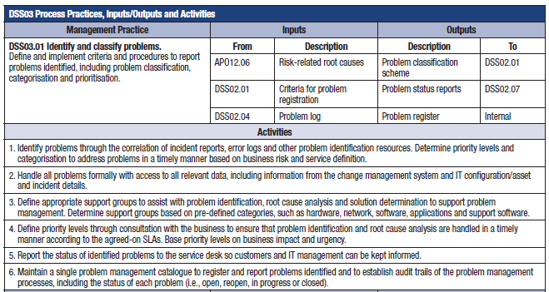
Details
Practices and
Activities includes
Inputs and Outputs
Problem
DSS03.01

Slide 51

Related Guidance
Problem DSS03
DSS03 Related Guidance
Related Standard | Detailed Reference
ISO/IEC 20000 | 8.3 Problem management
ITIL V3 2011 | SO4. Problem management

Slide 52
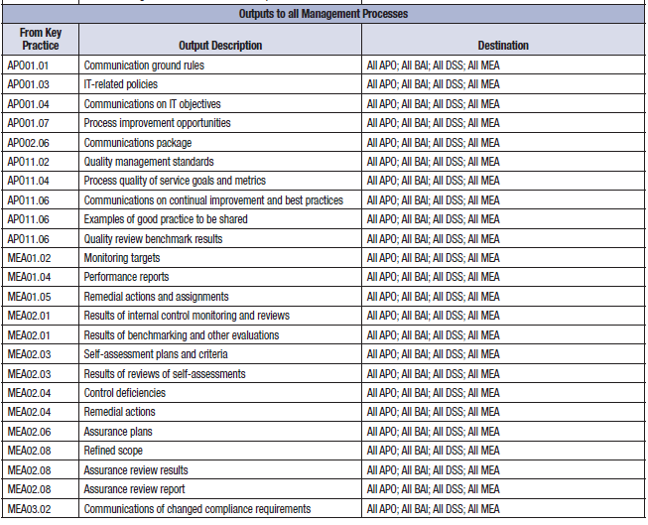
Important Outputs to all processes

Slide 53
How can you use COBIT 5 with ServiceNow?
Provides overall reference model for 37 processes
Goals Cascade with metrics
Business management practices and activities
Roles & responsibilities RACI, inputs and outputs
GRC related – compliance, assessments, audit and risk
Security, risk and compliance
Promotes consistent structure, context and vocabulary

Slide 54
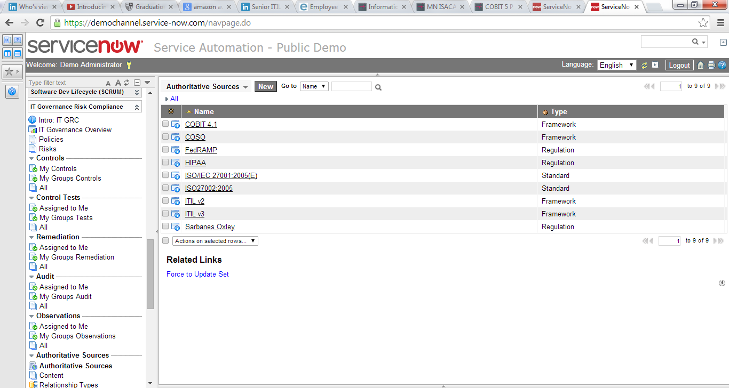
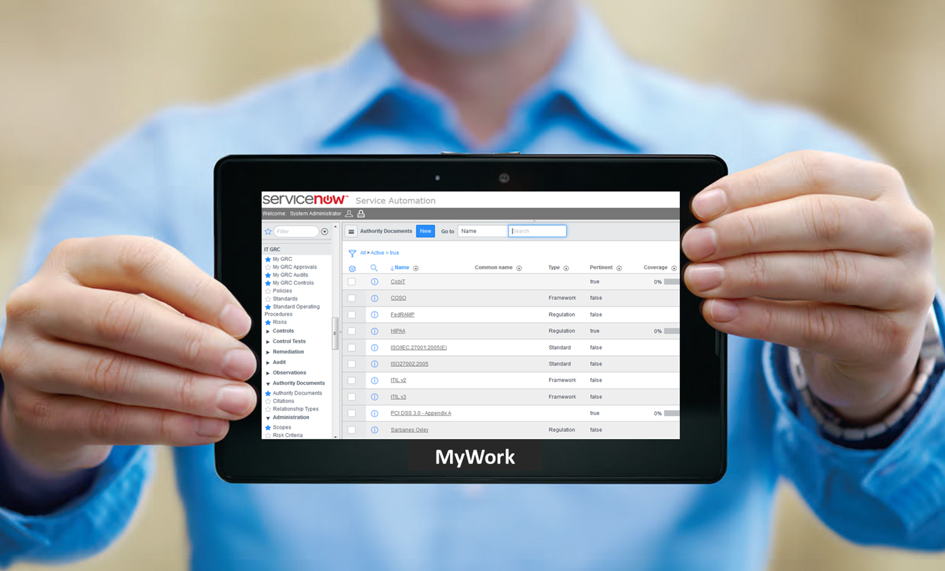
Example - GRC

Slide 55
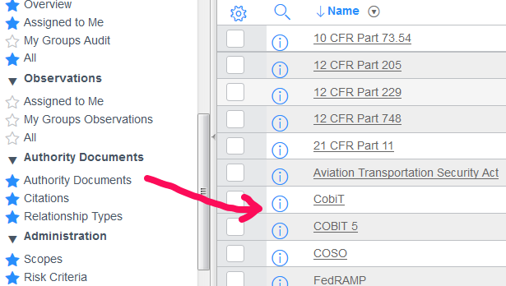
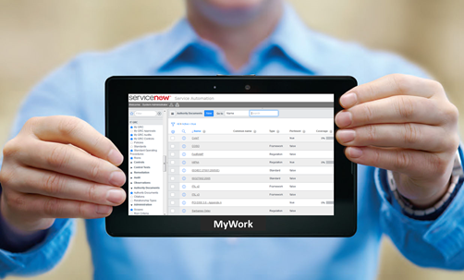
GRC

Slide 56
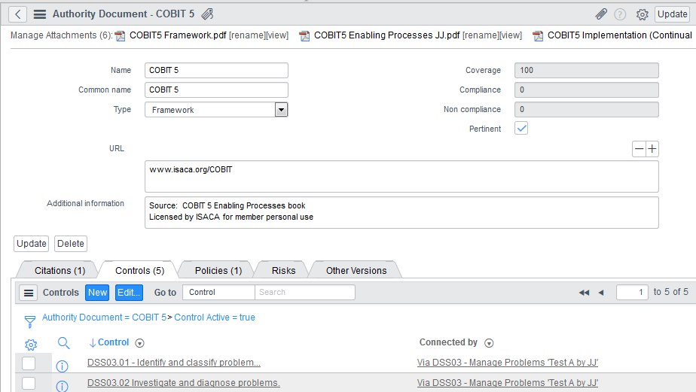

GRC
Goals
Metrics
Surveys
RACI
Assessments
Inputs
Outputs

Slide 57
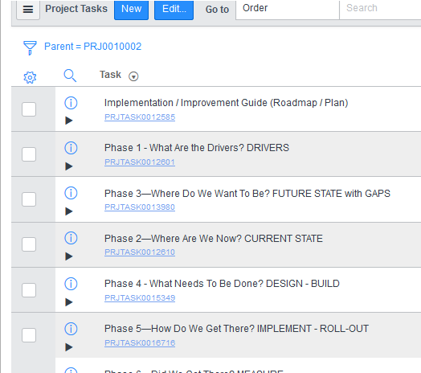
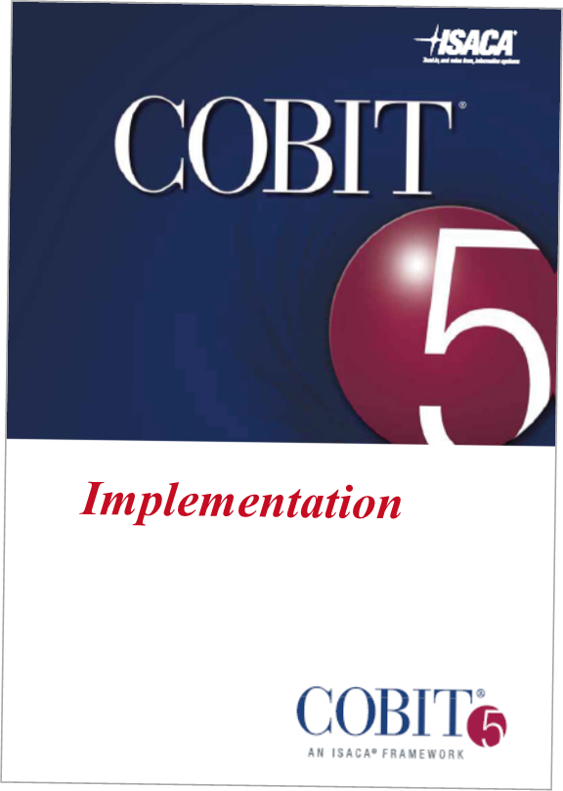
Project
Example
Using ServiceNow – Project for tracking process improvement activities, tasks, status and progress reports
Guidance

Slide 58
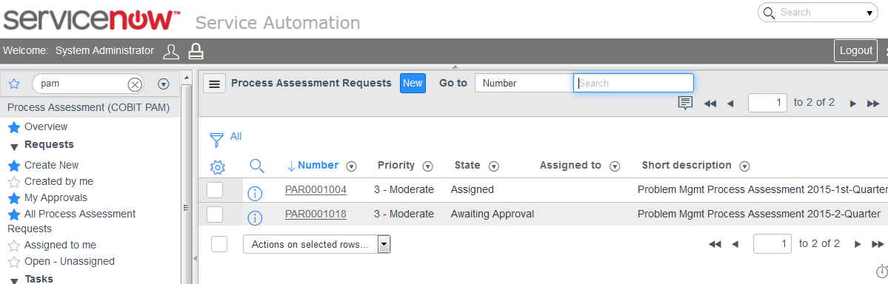
Assessment
Example

Slide 59
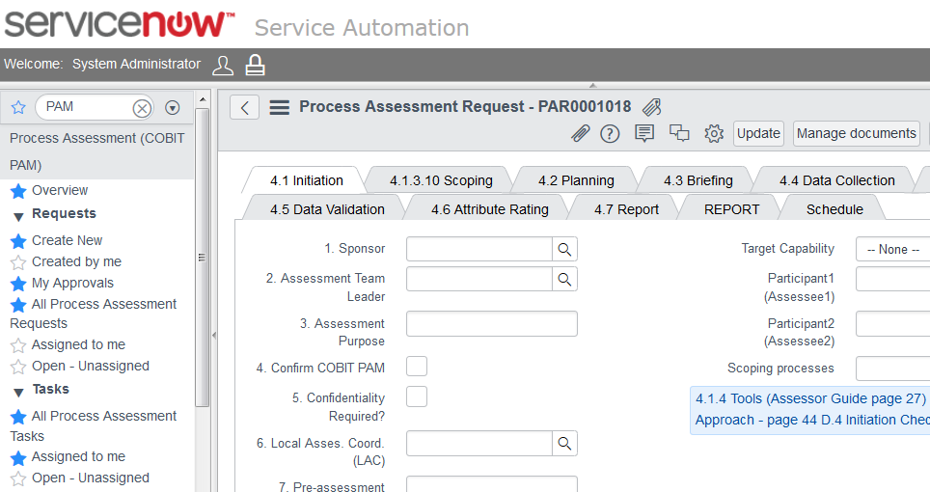
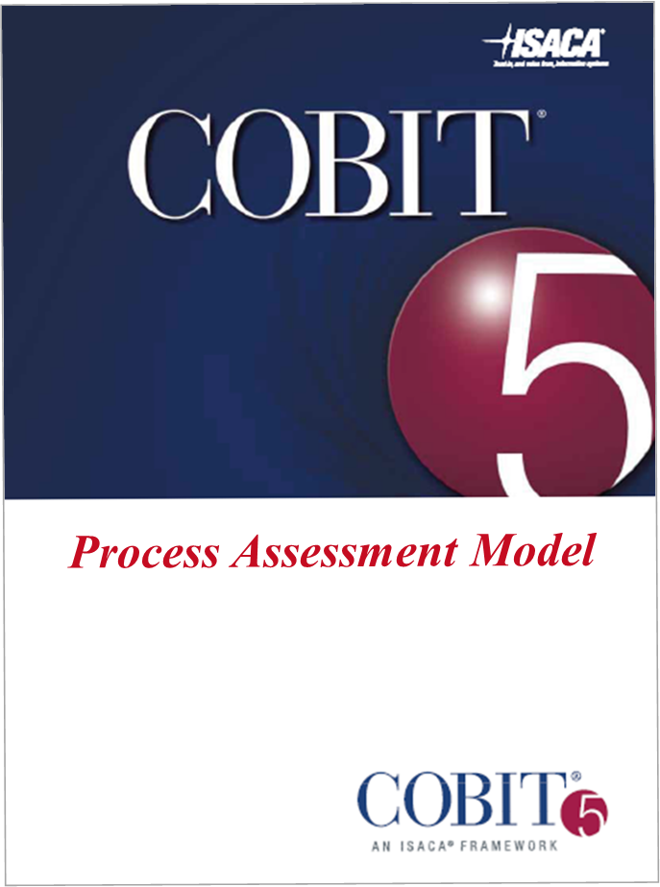
Assessment

Slide 60

Good books …
Assessment
Automating Assessment / Audit / Assurance
Create Project Plan for Assessors in ServiceNow Project – seven Phases
Use GRC – Audit / Project
Use Audit for Control Tests
Use KB for documents
Use Survey for questions
Use Workflow for tasks
Use Data for evidence
Use Reporting to display results

Slide 61
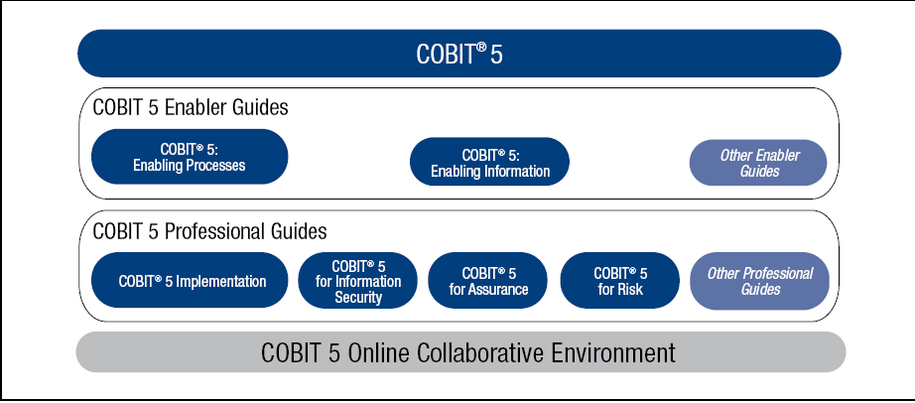
COBIT 5 Product Family go to Bookstore
Source: COBIT® 5, figure 11. © 2012 ISACA® All rights reserved.

Slide 62
Enabling Processes
Framework
Implementation
Processes
Three core books
isaca.org/cobit

Slide 63
Self-Assessment
Process Assessment Model
Assessors Guide
Self-Assessment
Processes Assessment
Assessors Guide
isaca.org/cobit

Slide 64
Assurance
Risk
Assurance
Risk
isaca.org/cobit

Slide 65
Assurance
Information
Information Security
Info Security
Information
isaca.org/cobit

Slide 66
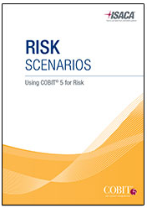

More Books …
Risk Scenarios - GRC – Risks
IT Control Objectives for Sarbanes-Oxley
Configuration Management
Controls in the Cloud
Vendor Management – Vendor Performance

Slide 67
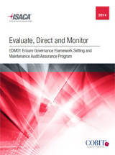
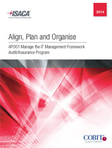
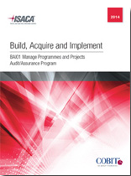
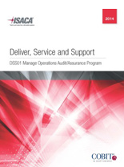
Assurance Audit templates
Assurance / audit
COBIT and ISO15504 process based assurance guidance
34 processes covered – all governance and management domains
http://www.isaca.org/Knowledge-Center/Research/Pages/Audit-Assurance-Programs.aspx

Slide 68
How to do it …
Project

Slide 70
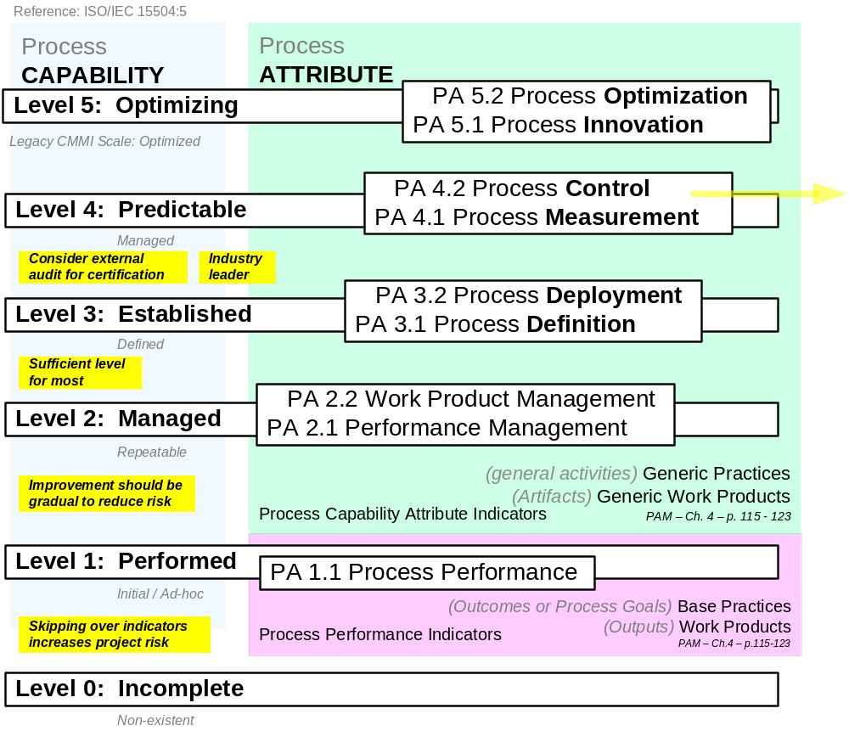
Capabilities
Assessment

Slide 71
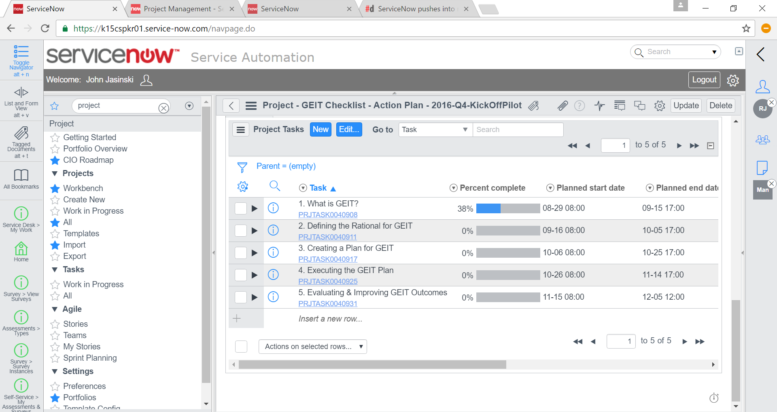
Governance of Enterprise IT (GEIT)

Slide 72
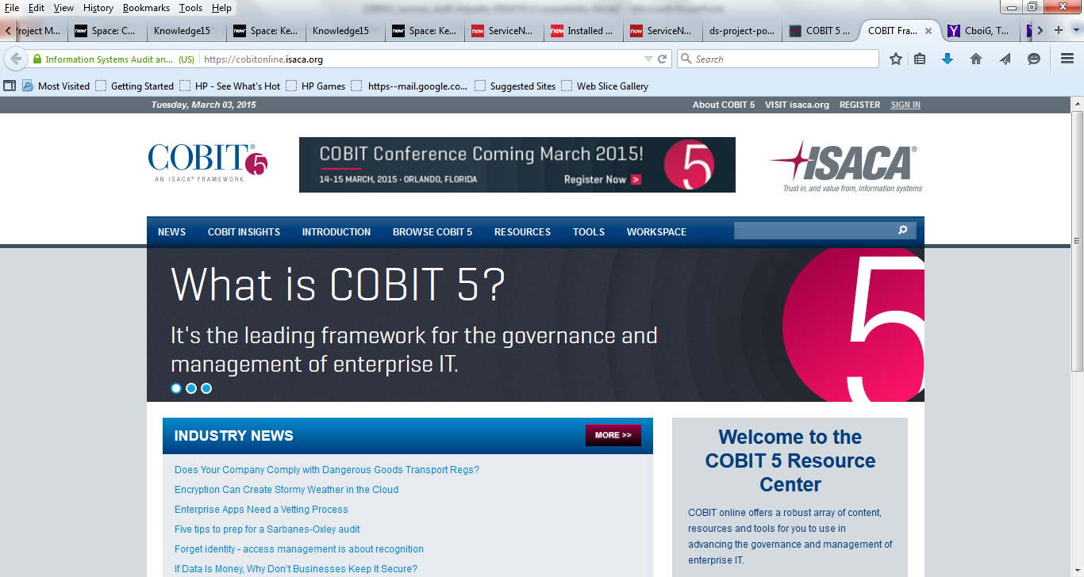

Slide 73
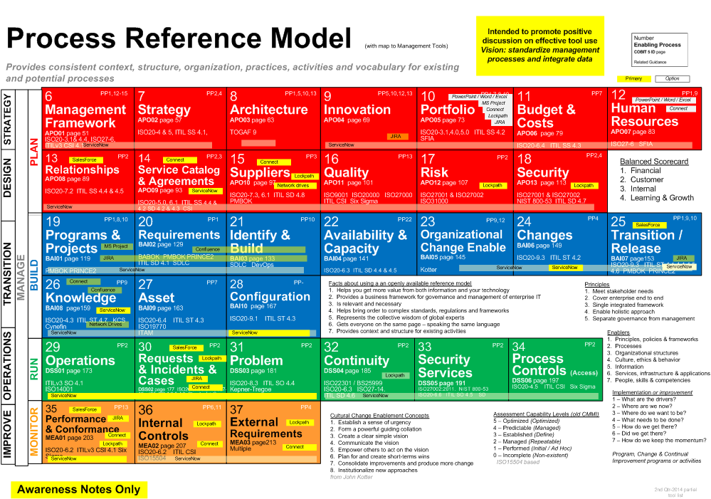

Slide 74
ServiceNow Navigation Pane Map to COBIT
Incident
Requests in Service Catalog
Problem
Configuration
Asset
Change
Project / Portfolio
SDLC
Release
Knowledge
SLA
Vendors
Finance
Human Resources
Reporting
GRC

Slide 75
COBIT processes
IT management framework
Strategy
Enterprise architecture
Innovation
Portfolio
Budget and costs
Human resources
Relationships
Service agreements
Suppliers
Quality
Risk
Security
Programs and projects
Requirements definition.
Solutions identification and build
Availability and capacity
Organisational change enablement
Changes
Change acceptance and transitioning
Knowledge
Assets
Configuration
Security services
Business process controls
Performance and conformance
Internal control
Compliance with external requirements
Ensure governance framework setting and maintenance
Ensure benefits delivery
Ensure risk optimisation
Ensure resource optimisation
37

Slide 76

Using COBIT could save you 15% or more on operating costs

Slide 77
Where GRC Commonly Plays with Others
COBIT
ENTERPRISE SERVICE MODEL
BUSINESS MANAGEMENT
Governance
Vendor
Financial
Resource
Demand
Project
Analytics
Service Providers
SERVICE MANAGEMENT
Departments
Legal
Finance
Field Svc
IT
Marketing
HR
Facilities
Asset
Case
Catalog
Change
CMDB
Incident
Knowledge
Problem
OPERATIONS MANAGEMENT
APPLICATION DEVELOPMENT
Discovery
Orchestration
Service Mapping
Cloud Mgmt
Event
Professional
Creators
SDLC
Test
App Creation
Service Creator
‘Citizen’
Creators
SERVICE AUTOMATION PLATFORM
Single Architecture
Shared Resources
Single Data Model
Custom App Dev

Slide 78
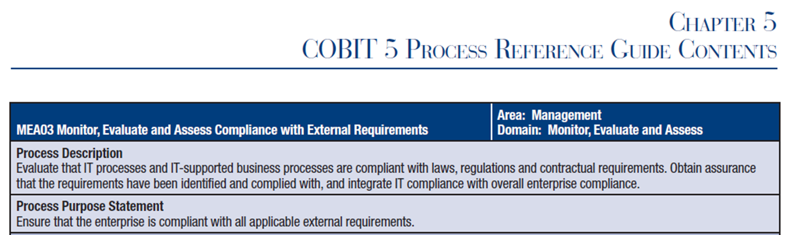
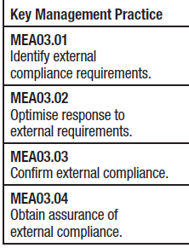
Document
Policy creation
Monitor & verify
Report
COBIT and Compliance
MEA03 – External Requirements
ServiceNow will be offering
Unified Compliance Framework (UCF)
content into GRC with Fuji release

Slide 79
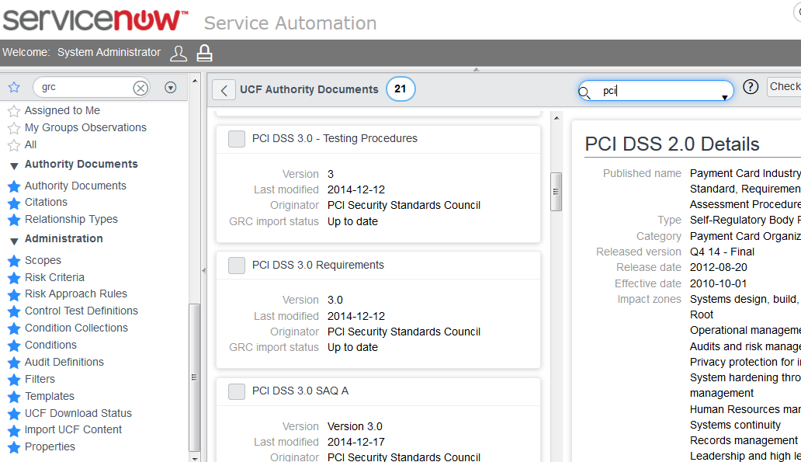
GRC / UCF

Slide 80
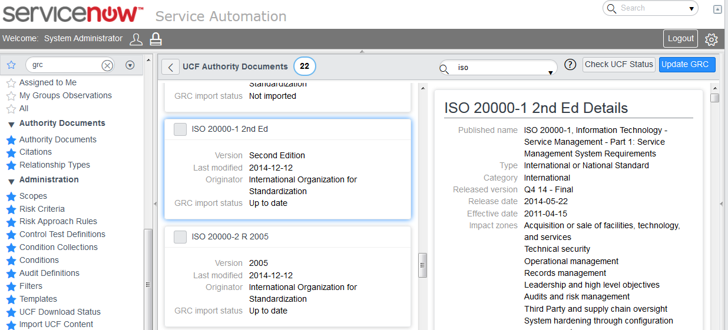
GRC / UCF

Slide 81
Do this – add to your resume:
COBIT 5 Awareness

Slide 82
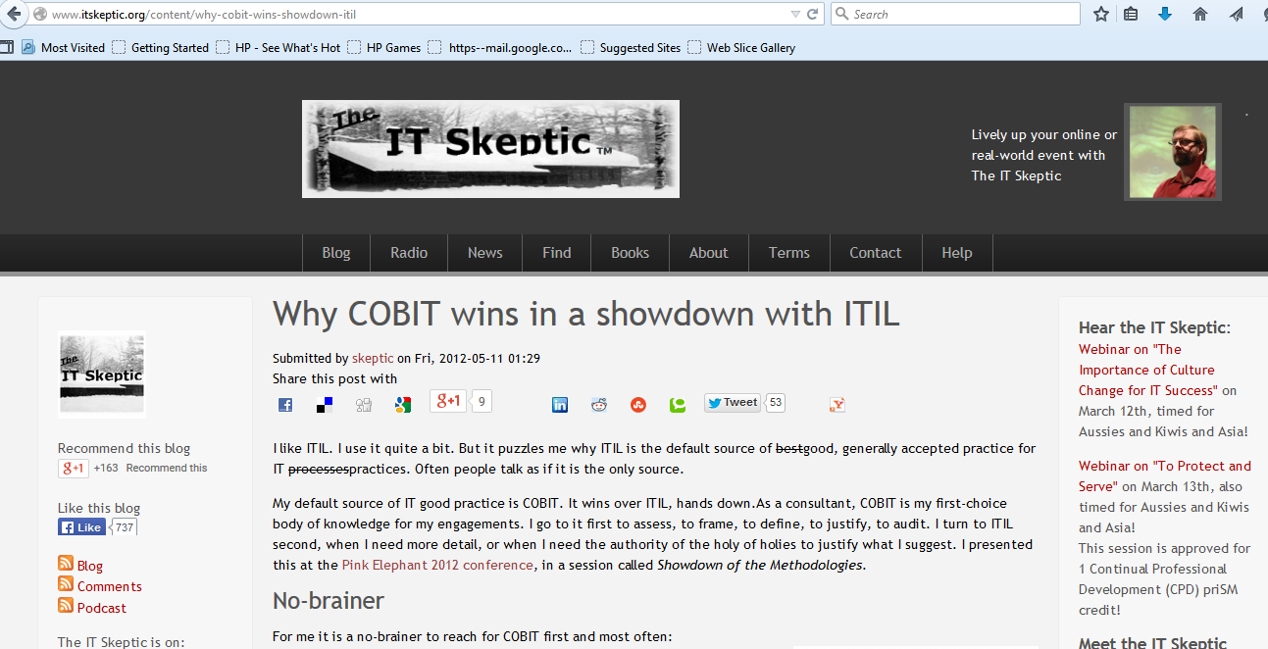

Slide 83
COBIT – How will it evolve?
Could COBIT be packaged specific to your business, industry or vertical market?
Could COBIT evolve into ISO?
Regulatory mandate? Vertical specific? Your wrapper?
What might next release contain? More broad and deeper?
COBIT 6?

Slide 84

Resources for COBIT
http://www.isaca.org/COBIT/Pages/Product-Family.aspx
Do your homework

Slide 85


Slide 86
Commercial use license - 1,000+ users
$7200.

Slide 87
goodpracticeplugins
Don’t just see what’s next, create it
COBIT 5 = c5plugin
Six Sigma - blackbeltplugin
ITIL - servicemanagerplugin
ISO - auditplugin
SFIA = sfiaplugin
NIST - nistplugin
Continual Improvement - csipplugin
Myers-Briggs-personnelplugin

Slide 88
Talking points
Standardize processes and integrate data
Standardization cost savings > customization benefits
Unique enterprises use openly available good practices
Cost Analysis - easy as ABC - Adopt – Buy - Create
Accelerate the industrialization of information and technology

Slide 89


Slide 90

Questions?
Survey - please

Slide 91
Final thoughts…
Leaders -
model the way
share the vision
challenge the process
empower others to act
inspire the heart
Notes:
Model the way – standardize process and integrate data
Inspire a shared vision – promote the system of record
Challenge the process – strive to simplify and standardize
Enable others to act – example: Turn on GRC Plugin, create a GRC Group
Encourage the heart – work could be so much easier – maybe fun
From The Five Practices of Exemplary Leadership® Model by James M. Kouzes and Barry Z. Posner

Slide 92
Takeaways
1
Define Your Reference Models
2
Know Your Processes and Empower Process Owners – TURN IT ON !
3
Standardize Processes and Integrate Data

Slide 93
goodpracticeplugins
Don’t just see what’s next, create it
COBIT 5 = c5plugin
Six Sigma - blackbeltplugin
ITIL - servicemanagerplugin
ISO - auditplugin
SFIA = sfiaplugin
NIST - nistplugin
Continual Improvement - csipplugin
Myers-Briggs-personnelplugin

Slide 94
Don’t just see what’s next, create it

Slide 95
Thank You
John Jasinski
Trusted Advisor
GoodPracticePlugins
JohnEJasinski@comcast.net
612-669-1885

