Slide 1
Now Platform® Madrid release
Q1 2019

Slide 2
Introducing Now Platform® Madrid release
One platform, three workflow experiences

Slide 3
Your digital transformation agenda
Reimagine your
customer engagement
Increase customer satisfaction
Resolve issues faster
Personalize and predict
Elevate your
employee experience
Enable employees with self-service
Improve HR productivity
Smooth employee on-boarding
Transform your
operational productivity
Standardize IT globally
Manage demand and resources better
Improve service availability
Reduce enterprise risk
Drive operational excellence through automation

Slide 4
What’s new in Madrid
Build enterprise workflow apps fast.
    ServiceNow® Mobile Studio
    Automated Test Framework with Quick Start Tests
Now
Platform®
Notes:
\

Slide 5
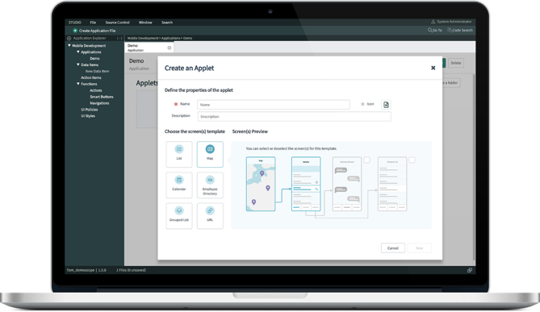
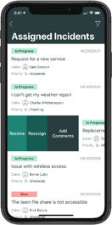

ServiceNow® Mobile Studio
Quickly build and deploy native, mobile-first experiences
Outcomes
Configure with no-code packaged components and templates
Develop apps with integrated native capabilities (e.g. maps, camera, etc.)
Create apps that run anywhere with offline read and write capabilities
Now
Platform®

Slide 6
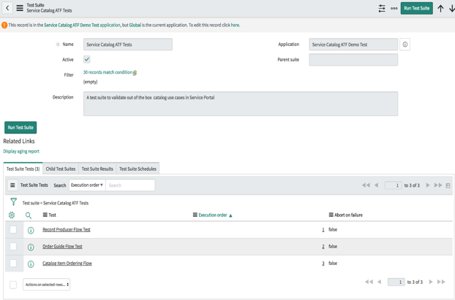
Quick start tests
Automate regression testing, accelerate upgrades
Outcomes
Accelerate test suite creation and increase upgrade speed
Reduce customization risk and technical debt by automating regression testing with upgrade safe tests
Simplify upgrade testing and reduce required testing resources
Now
Platform®
ATF quick start tests for Service Catalog

Slide 7

What’s new in Madrid
Transform the IT experience.
    Agent Workspace
    Project Portfolio Dashboards
    Analytics Hub
    ITSM Mobile App
    Similarity Framework
IT
Workflows

Slide 8
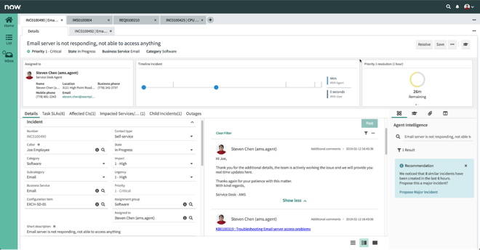

Agent Workspace
Your command center for prioritizing and taking action
Outcomes
Interact with users consistently across channels
Activity streams keep latest updates in view
Accelerate resolution with machine learning* and contextual help
IT
Workflows
ITSM
*Agent Assist uses machine learning capabilities in Agent Workspace, requires a subscription to ITSM Pro.

Slide 9
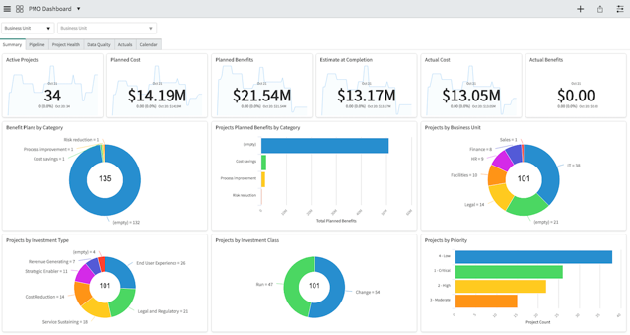
Project Portfolio Dashboards
Consolidation of data for fast, informed decision-making
Outcomes
Visualize most important KPIs
Pipeline reports to anticipate future bottlenecks
Insight into project health to keep things on track
IT
Workflows
ITBM

Slide 10
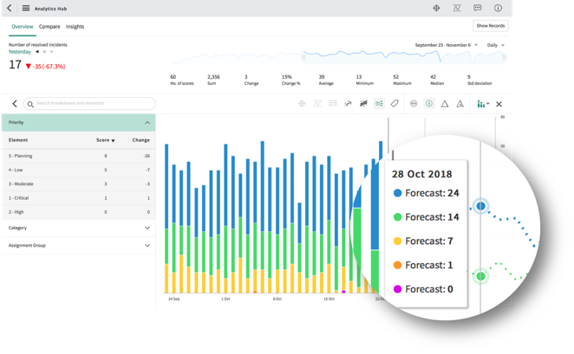
Analytics Hub
A single space to explore, compare, and forecast
process improvements
Outcomes
Perform self-service analysis and drill into score breakdowns
Compare results against targets, benchmarks, and continual improvement initiatives
Identify trend anomalies and predict future performance
IT
Workflows
PA

Slide 11
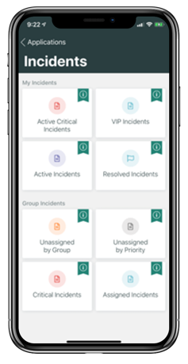
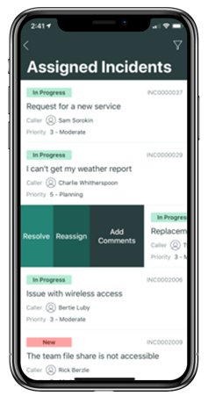
IT Service Management for Now Agent
Native mobile interface makes working form anywhere easy
Outcomes
Quickly view and respond to tasks on the go
Manage team assignments with simple gestures
View requests and approve with a swipe
IT
Workflows
ITSM

Slide 12
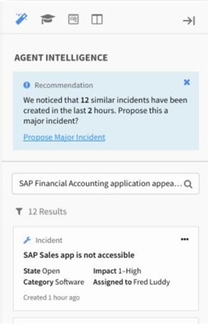
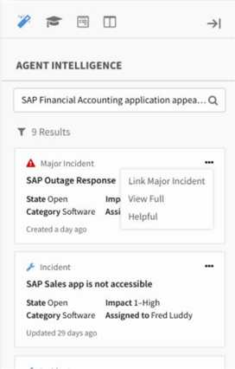
Similarity Framework
Recommend actions within the context of the customer’s
business
Outcomes
Identify similar incidents, cases, and alerts
Propose new major incidents or link to related existing ones
Use predictions in ServiceNow workflows
Now
Platform®
IT
CSM

Slide 13
What’s new in Madrid
Deliver high-performance business services, with visibility and AIOps.
    Alert Intelligence
    SAP Publisher Pack
IT
Workflows

Slide 14
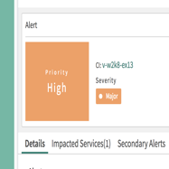
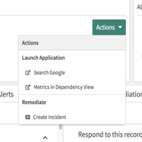
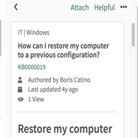
Alert Intelligence
Significantly reduce mean time to resolution (MTTR)
Outcomes
Get prioritized alerts
Get insights such as past incidents, similar alerts, KP articles, and metrics
Collaborate and launch remediation workflows from the same console
IT
Workflows
ITOM

Slide 15
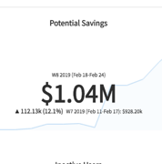
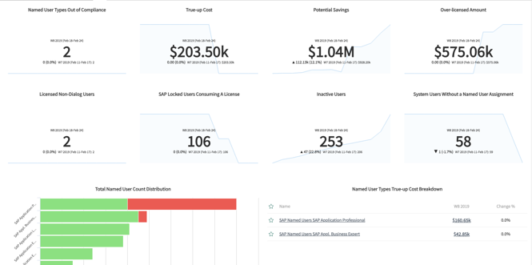
SAP Publisher Pack
Take control of costly enterprise resource planning
user licensing
Outcomes
Optimize the SAP user install base by right-sizing license allocations
Mitigate the risk of non-compliant users
Demonstrate ROI back to the business with real savings
IT
Workflows
SAM

Slide 16
What’s new in Madrid
Respond faster to security incidents, vulnerabilities, and enterprise risk.
    Exploit Enrichment
    Continuous Risk Monitoring
IT
Workflows

Slide 17
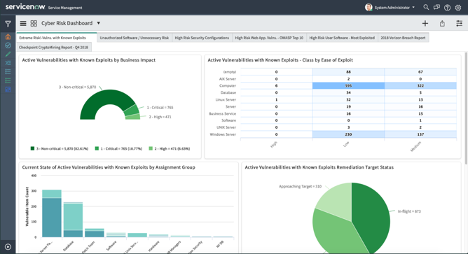
Exploit Enrichment
Enhance vulnerability prioritization with known
exploit intelligence
Outcomes
Prioritize vulnerabilities associated with an exploit
Aggregate info from multiple sources
Included in dashboards and risk score
IT
Workflows
Sec
Ops

Slide 18
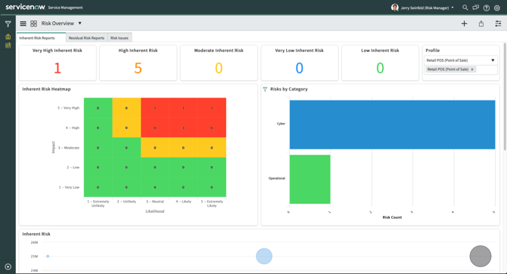
Continuous Risk Monitoring
Quickly identify high impact vulnerabilities based on
business impact
Outcomes
Ingest vulnerability data using Vulnerability Response
Key risk indicators (KRIs) identify vulnerabilities and generate issues in real-time
Role based dynamic dashboards update automatically
IT
Workflows
GRC

Slide 19

What’s new in Madrid
Deliver a next generation employee experience and unlock enterprise-wide productivity.
    Campaigns – Tasking and Analytics
Employee
Workflows
Notes:
.

Slide 20
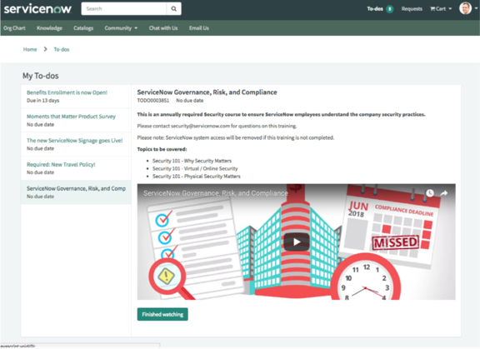

Campaigns – Tasking and Analytics
Assign measurable to-dos to employees as part of a
campaign
Outcomes
Link communication content with desired outcomes
Measure and analyze campaign performance, ensuring effective and relevant communications
Identify employee content consumption trends over time
Employee
Workflows
HR

Slide 21

What’s new in Madrid
Delight customers with proactive service from issue to resolution.
    Advanced Work Assignment
    FSM Mobile App
    Agent Workspace
Customer
Workflows

Slide 22
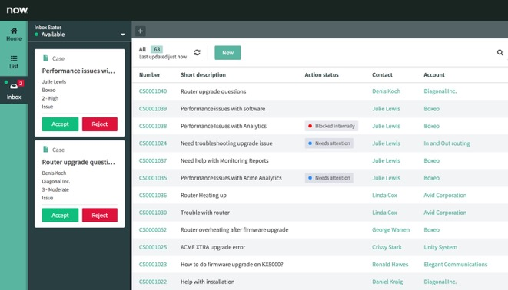
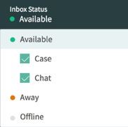

Advanced Work Assignment
Automate omni-channel assignments to reduce complexity
Outcomes
Auto-assign based on availability, capability, and skills
Push chats and cases to agents for faster response
Configure priorities and timers to meet response goals
Customer
Workflows
CSM

Slide 23
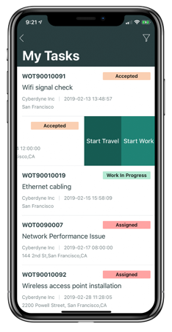
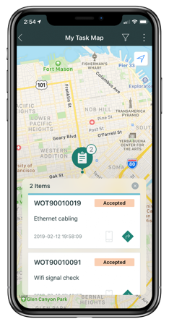
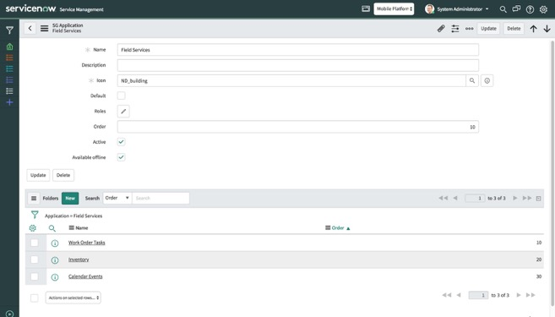
Field Service Management for Now Agent
Boost technician productivity
Outcomes
Provide faster and easier mobile experience
Integrate maps, geo-location tracking, and swipe actions
Enable offline read/write when disconnected
Customer
Workflows
CSM

Slide 24
Agent Workspace
Improve agent experience with optimized workspace layout
Outcomes
Multi-task efficiently with tabs and child tabs
Quickly view key customer details, timeline, and service level
Solve cases faster with machine learning* and contextual help
Customer
Workflows
CSM
*Agent Assist uses machine learning capabilities in Agent Workspace, requires a subscription to CSM Pro.

Slide 25
Thank you
That’s What Marketing Wants You To Know About
Notes:
Thank you for your time today and good selling.

Slide 26
^{Other Cool Things}

Slide 27
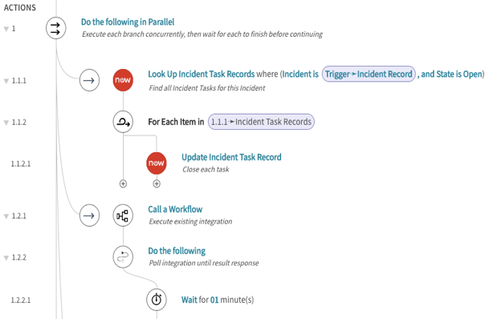
Reimagine business process automation: empower process analysts and developers with the right tools
Flow Designer
Allow developers to build advanced flows while continuing to embrace existing investments
Decision Management enables process analyst to decouple Business Policy from Flow Logic
Allow anyone to build actions once, run them anywhere in the system

Slide 28
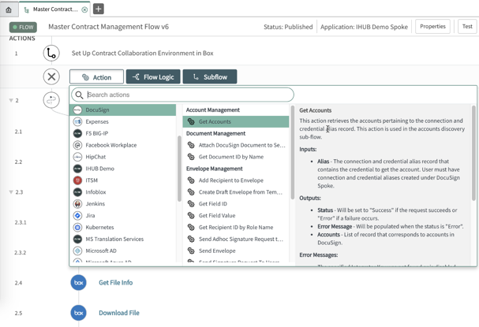
Simplify integrations with a growing library of reusable spokes for a robust integration framework
IntegrationHub
Growing list of pre-built, reusable spokes for Slack, MS Teams, Active Directory, Facebook Workplace, Box, etc. with monthly additions on ServiceNow Store
Build and access integrations with enterprise apps with SOAP support (e.g. SAP, Workday, etc.)
Enable developers to accelerate development with the codeless payload builder

Slide 29
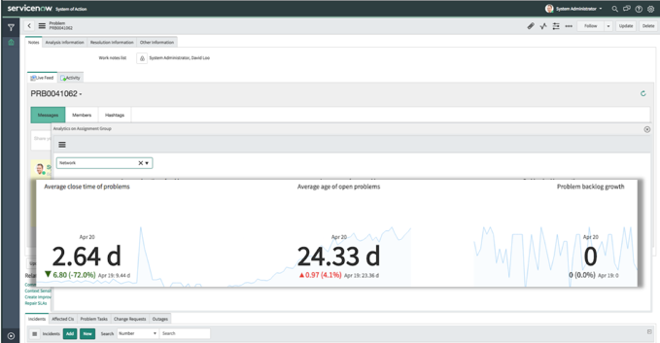
Stop repeat incidents by eliminating them at the source
Problem
Management V2
Structured flow for diagnosing and resolving issues
Quickly generate knowledge articles from known errors
Auto-updates for incidents and changes keeps teams informed

Slide 30
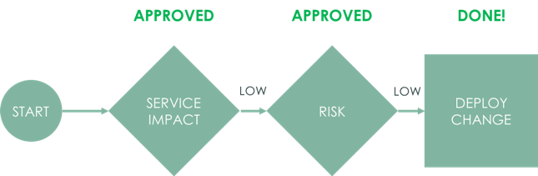
Take change from slow and manual to smarter, integrated, and automated
Change
Automation
Enhancements
Integrate change with DevOps using out-of-the-box REST APIs
Accelerate change by automating approvals based on risk thresholds
Enable better governance with a clear audit trail

Slide 31
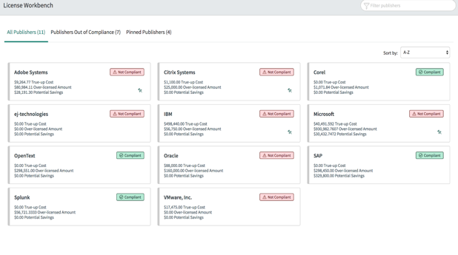
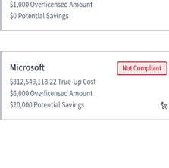
Prioritize urgent publisher licensing issues
License
Workbench
Surface summary intelligence to understand license positions by vendor
Drill down into each publisher for non compliance root case analysis
Take remediation actions where they are needed most

Slide 32
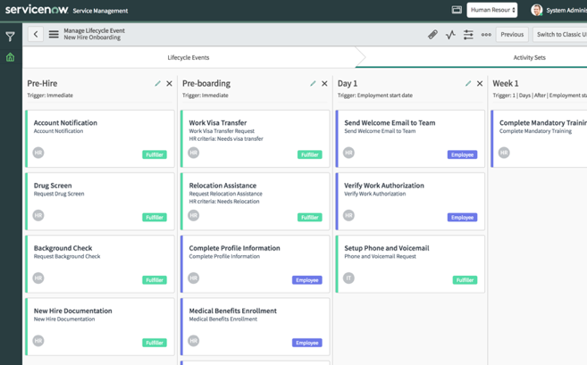
Visually depict Activity Sets and Activities
Lifecycle Events
Builder
Simplify configuration and maintenance using an improved, low-code Administrator User Interface
Guides the building of lifecycle event and models it to look like the actual business process, so it is easy to test and maintain
Tailor the size and color of configuration columns

Slide 33
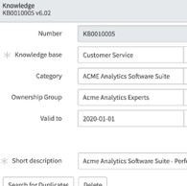
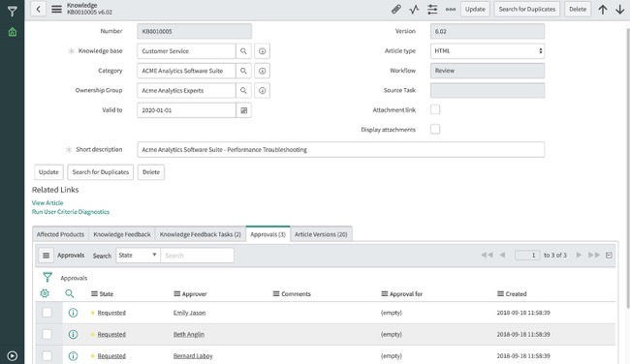

Improve article quality and response timeliness
Group
Ownership
Configure ownership groups to support knowledge teams
Assign articles to groups to ensure timely responses
Control feedback management and publishing workflow

Slide 34
Underdog Features
Email Approval/Survey
Service Portal
Continual Improvement Mgmt
Creating an incident in Microsoft Outlook
Clone Roll Back
The user can accept or reject the approval request from the email client.
Support for multiple knowledge bases and catalogs in a single Portal
Coaching Loops save time by automating real time personnel coaching on workflow tasks
Easy button for O365
Undo a clone for up to 7 days.

Slide 35
Thank you

