Slide 1
ServiceNow Underdog Features
Wisconsin SNUG - March 2023
Dan Sinnett
Advisory Solution Consultant – Financial Services

Slide 2
Safe harbor notice for forward-looking statements

Slide 3
If I knew then what I know now
Literally Everyone

Slide 4
61 Underdog Features
and counting

Slide 5
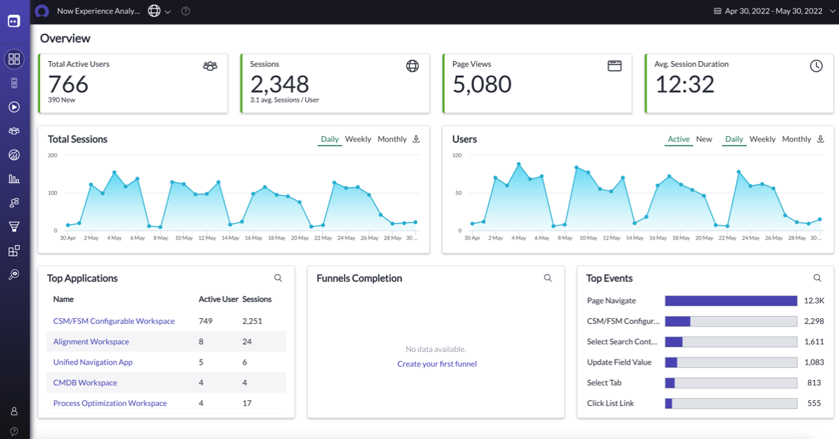
User Experience Analytics
Availability
All current versions
Installation
Install plugin
Documentation
Doc site link

Slide 6
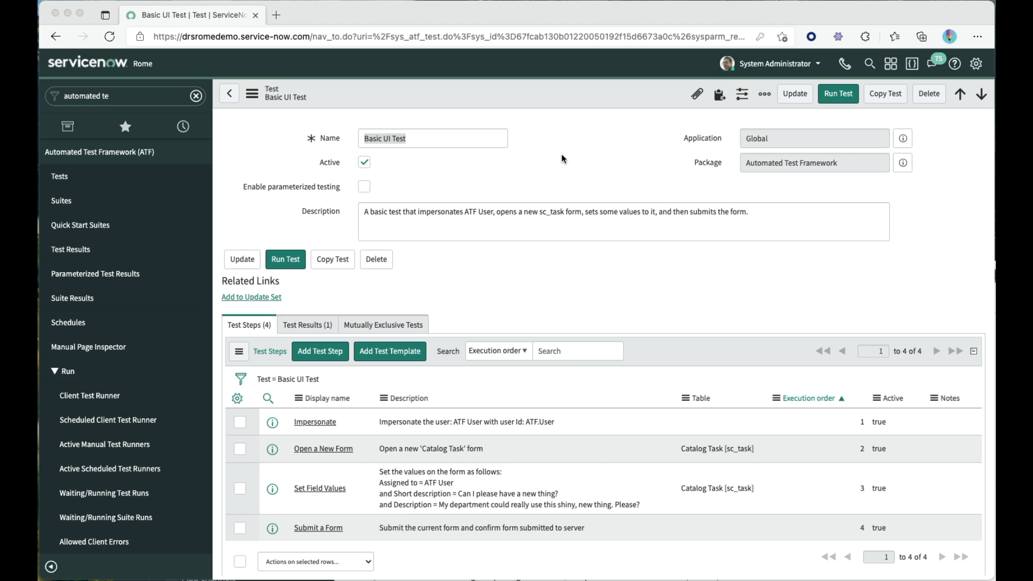
Automated Test Framework
Headless
Availability
All current versions
Installation
Enabled by default
Documentation
Doc site link

Slide 7
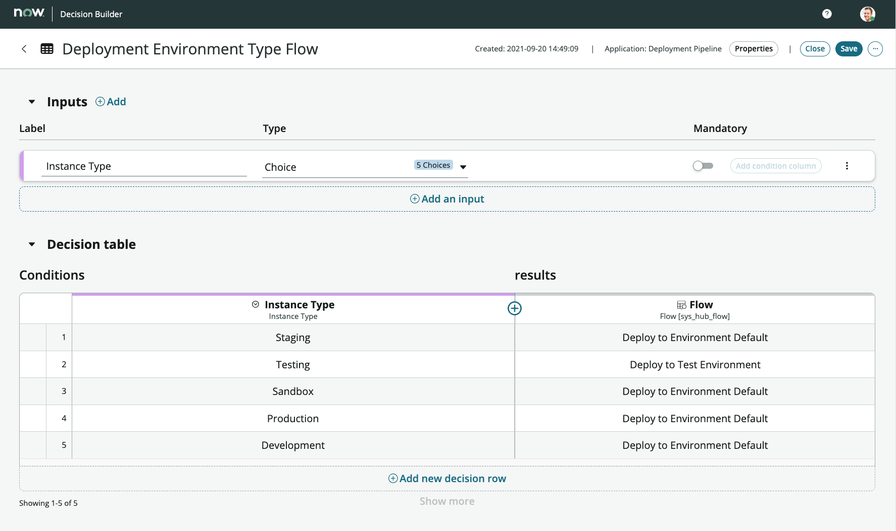
Decision
Builder
Availability
All current versions
Installation
Install plugin
Documentation
Doc site link

Slide 8
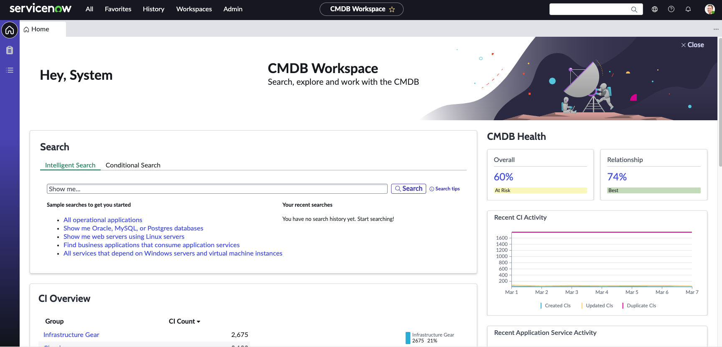
CI
Auto-Attestation
Smart Detection
Availability
Tokyo
Installation
Install plugin
Documentation
Doc site link

Slide 9
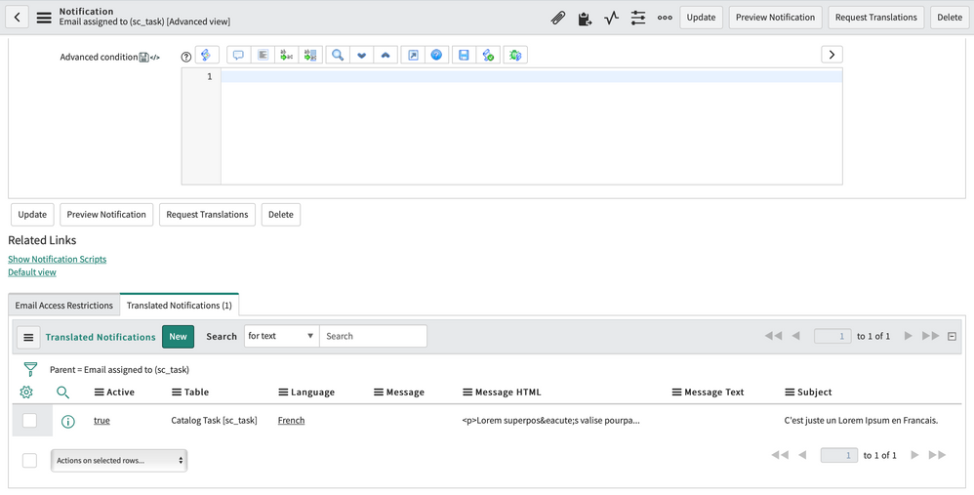
Multi-lingual Email Notifications
Availability
Tokyo and later
Installation
Install plugin
Documentation
Doc site link

Slide 10






Notify
ServiceNow
WebEx Teams
Microsoft Teams
Zoom
Twilio
Voice
SMS
Availability
All current versions
Installation
Install plugin
Documentation
Doc site link

Slide 11
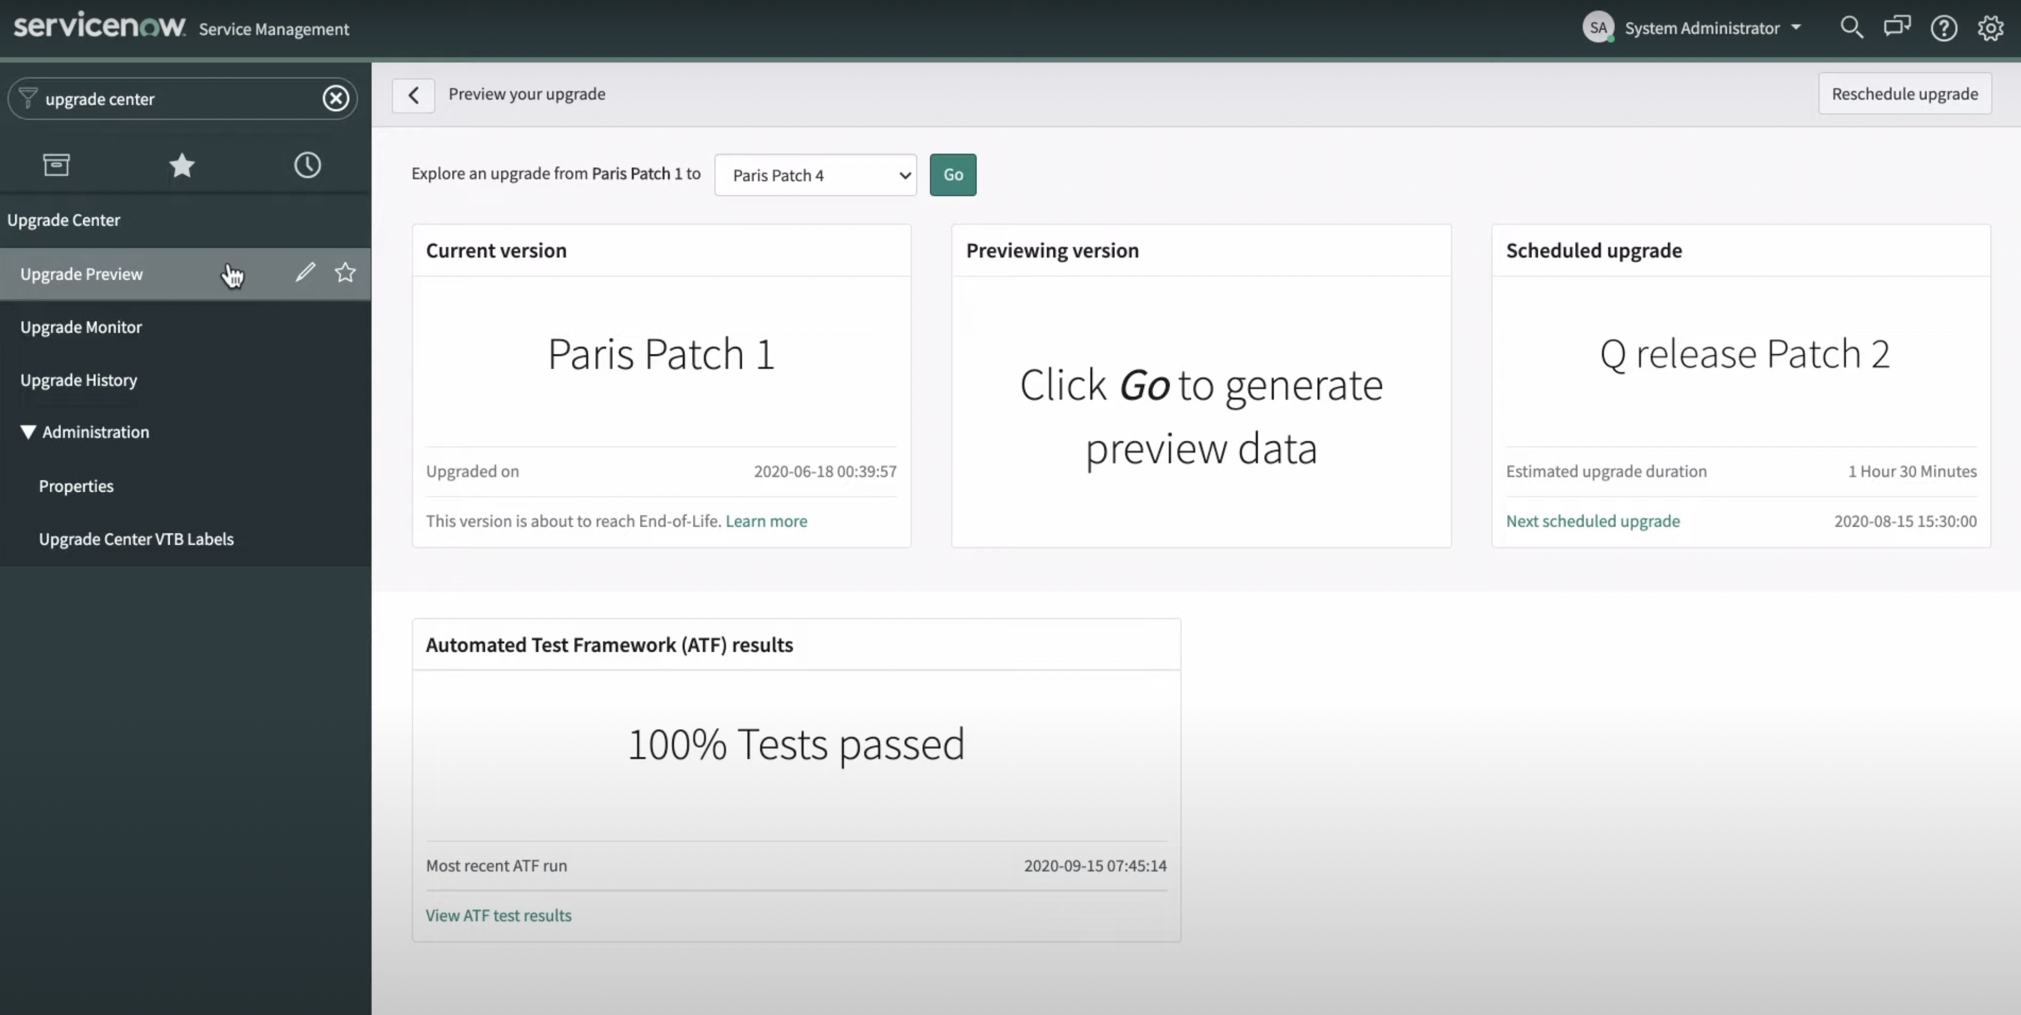
Upgrade Center
Availability
All current versions
Installation
Installed plugin
Documentation
Doc site link

Slide 12
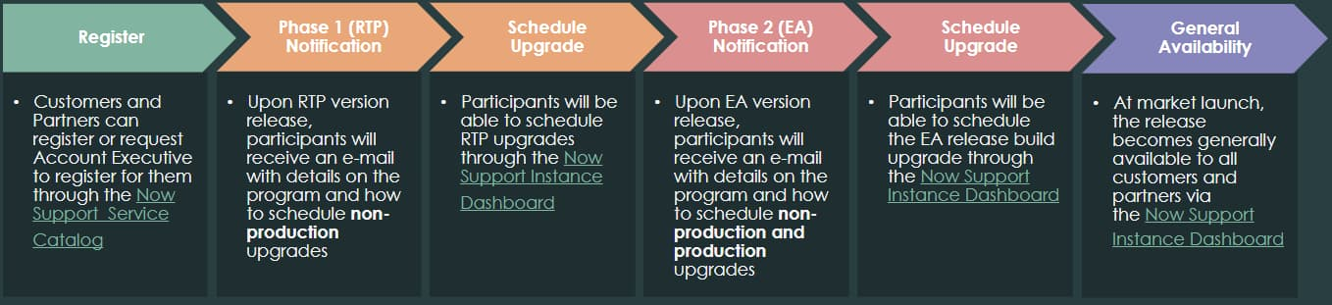
Release Testing Preview
Availability
Every release
Installation
N/A
Documentation
Support KB link

Slide 13
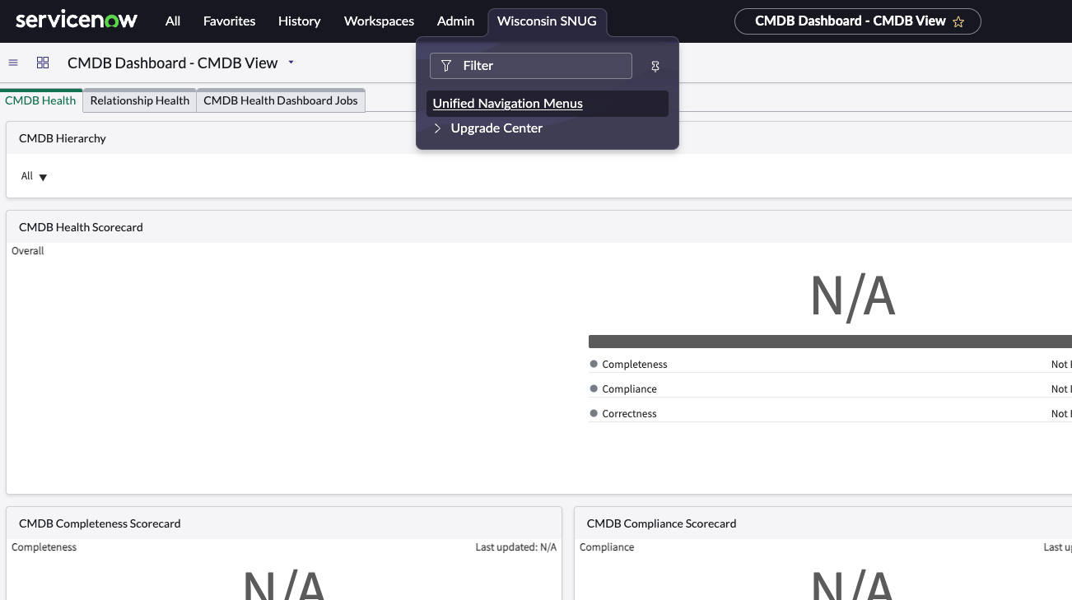
Unified Navigation Custom Menus
Availability
Utah
Installation
Install plugin
Documentation
Doc site link

Slide 14
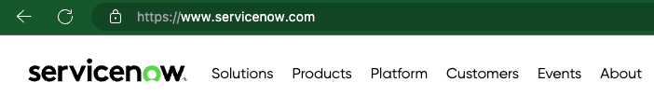











Knowledge
Availability
All current versions
Installation
N/A
Documentation
Links on slide
NowLearning

Slide 15
Thank you

