Slide 1
Application Portfolio Management [APM]
Product Architecture Blueprint
Ref: 0001191
Ref: 0001191​

Slide 2
Product Architecture Blueprint
1
Introduction to APM and its value
2
Overview how APM works and how it interacts with the rest of the system
3
Fact Sheet

Slide 3
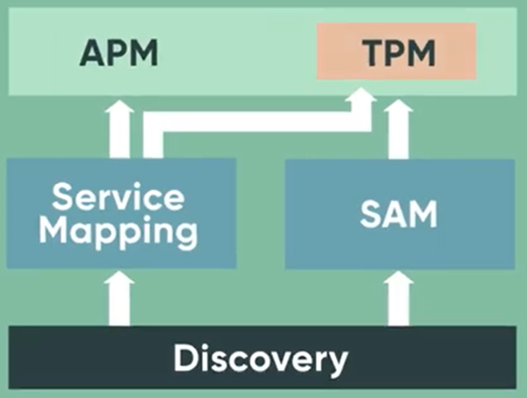
What is Application Portfolio Management [APM]?
Application Portfolio Management [APM] is part of a set of applications for managing IT resources in the context of the Business Capabilities they support.
Application Portfolio Management [APM] and the supporting applications help you manage your application software in alignment with the Business Services that they support and the Business Capabilities that they are used for.
Key use case: creating that authoritative list of applications, their related entities, and agreed upon attributes.

Slide 4
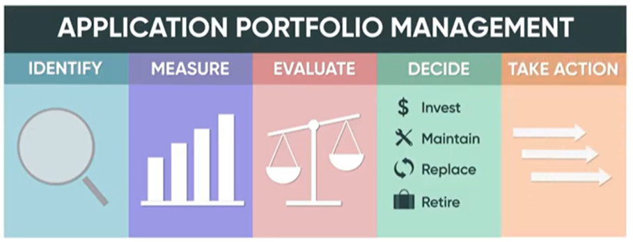
Why Use Application Portfolio Management [APM]?
Application Portfolio Management [APM] is used to gain a comprehensive understanding of the applications within your organization, so you can identify redundancies and rationalization initiatives, decrease budgetary costs, manage business capabilities, and track technology lifecycles.
Many companies accumulate lots of Software Applications over time each of which provides value at one time or another. Over time Software Applications become obsolete, functionality is duplicated, or is no longer aligned with the company's goals.
ServiceNow’s APM helps you find out what applications you have, gather metrics for each application, assess the value of each application, decide on a course of action for each application, and act on your decision.

Slide 5
How does APM work?
Application Portfolio Management [APM] is part of a set of applications for managing IT resources in the context of the Business Capabilities they support e.g., Customer Web Site Application or an Email Service.
  Discovery is the base ServiceNow Application to gather information on infrastructure and software which gives you a basic ‘horizontal’ picture of your infrastructure but doesn’t capture all their relationship or business applications that they support.
  Service Mapping compliments Discovery by providing a ‘vertical [i.e., top-down]’ picture of your Business Service by identifying all supporting hardware and software configuration items.
  Application Portfolio Management [APM] uses the Discovery and Service Mapping information to understand your Applications and to identify your Application Services and the underlying technologies they use.
  Software Asset Management [SAM] uses Discovery to build an inventory of Software Models and vendor life-cycles to build an inventory and optimize your use of software licenses and verify compliance with your license entitlements.

Slide 6

How does APM work?
  APM’s Technology Portfolio Management [TPM] feature uses SAM to automate the inventory of technologies and manage their vendor and internal life-cycles.
  In the ServiceNow framework, a Technology is a specific software or hardware model deployed to create a business application.
  Application Portfolio Management [APM] then ties it all together via the Business Services Software Models [i.e., Business Applications list]:
  The Manage Related Software feature identifies the software that supports each Application Service and key software for the instance.
  Application Portfolio Management [APM] and the supporting applications help you manage your application software in alignment with the Business Services that they support and the Business Capabilities that they are used for.

Slide 7


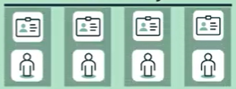

How does APM work?
APM User
Software Asset Management
APM Analyst
CI Normalized
Updates
APM / TPM
Predictive Intelligence
Uses
Understand Applications
Identify Application Services and Underlying Technology
Manage Application Lifecycles using the Business Application Services Catalog Item
Unrecognized
Data
CMDB
CI Updates
CI Updates
?
Uses
Service
Mapping
?
Discovery
source: APM - The Big Picture.mp4

Slide 8
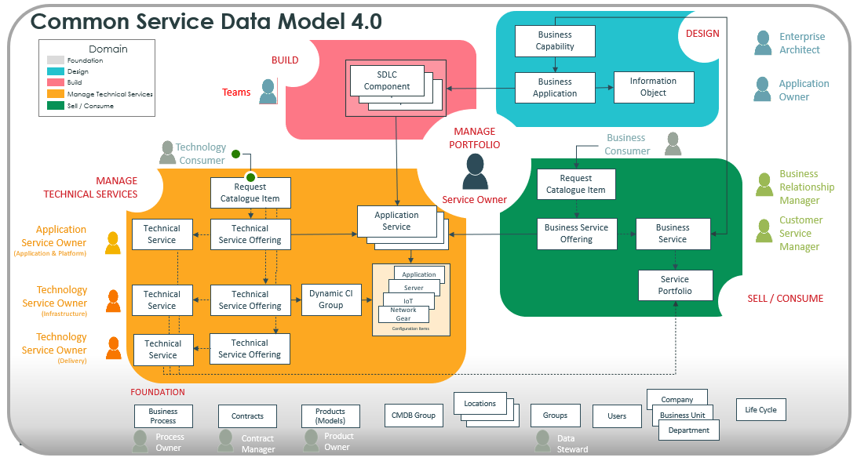
Common Service Data Model Use Case: APM
CSDM tables used by APM
  APM references the following CSDM elements:
    Business Capability [cmdb_ci_business_capability]
    Business Application [cmdb_ci_business_app]
    Information Object [cmdb_ci_information_object]
    SDLC
    [cmdb_ci_sdlc_component]
    Application Services
    [cmdb_ci_service_discovered]
source: Common Service Data Model product view: Application Portfolio Management

Slide 9

Using APM:
APM Roles
APM User: Access to create/update applications, view landscape, and roadmap
Business Stakeholder: Users with this role can approve, view or read records of tables that are used to retrieve data for reports and dashboards. Customers can assign this role to any user who is a business stakeholder to review and approve reports.
APM Admin: Create or update application records and access administration activities
APM Analyst: Access applications landscape, dashboards, roadmaps, strategy program workbench, and associated pages

Slide 10
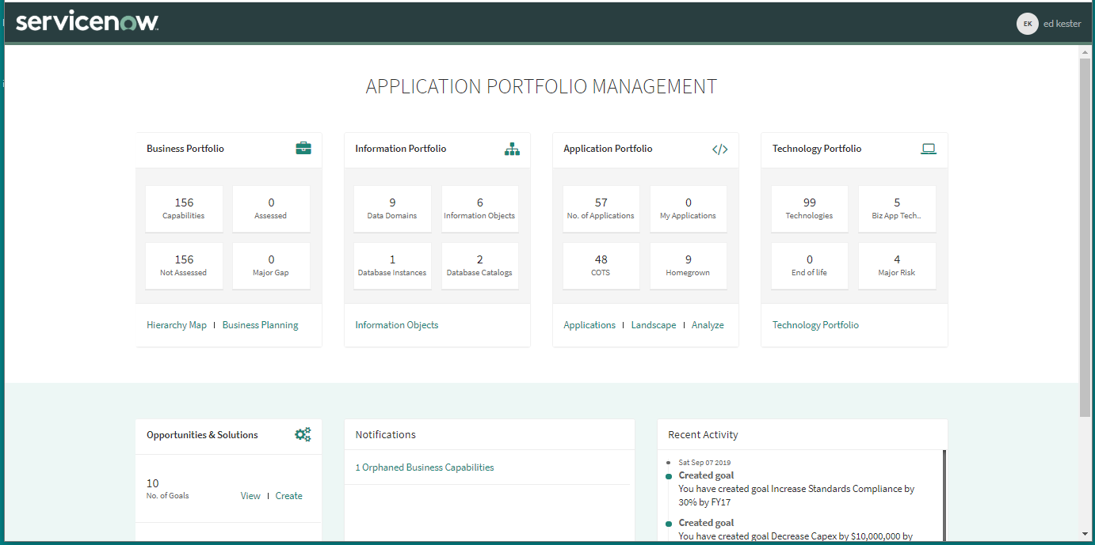
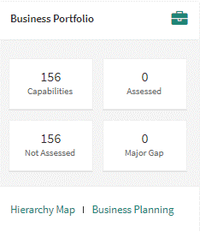
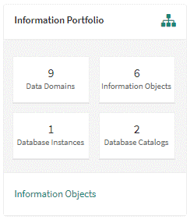
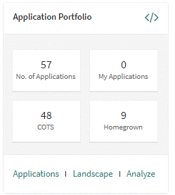
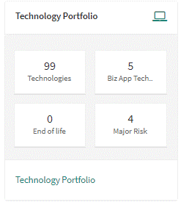
Using APM:
APM Home Page
View the number of business capabilities defined by your organization that have been assessed and are yet to be assessed, and the number of business applications that support the capabilities but are at a major risk.
Capture the information from the assets of your organization as information objects.
Track the applications that support your business capabilities and manage them effectively to fulfill the goals of your organization.
View the number of hardware models and software models that are linked to your business applications.
source: https://docs.servicenow.com/csh?topicname=application-portfolio-management-home.html

Slide 11
Using APM:
Hierarchy Map: The Business Capability Map give information on various business capabilities including applications that directly or indirectly support each one resulting in a ‘technology risk’ view of the application.
Business Planning: Home page for creating a business goal and a plan to achieve that goal.
Information Objects: Used to capture the logical data for the business application, the data ‘type(s)’ of the application. e.g., PII data, employee data, etc.
Applications: What apps you have, architecture type, number of users, contract end date, age.
Landscape: The Big Picture. e.g., number of users for the top 10 application categories, count of applications, etc.
Analyze: Allows you to look at your apps with respect to their indicators. e.g., apps with business scores < 6, plots of business value vs. risk, etc.
Technology Portfolio: The lifecycles for each technology use by the app.
APM Home Page:
Form Links
Portal to your apps and business capabilities they support

Slide 12
Fact Sheet
Name | Application Portfolio Management [APM]
Short description | Align applications with business goals and priorities. Application Portfolio Management enables you to build a comprehensive inventory of business applications in use to help you assess your portfolio.
Product family | Strategic Portfolio Management [SPM]
Dependencies | none
How to get it | Plugin (com.snc.apm)
License information
Further information | Data Sheet

Slide 13
Thank you

