Slide 1
Constraining Representations Yields Models That Know What They Don't Know
ICLR 2023
João Monteiro¹, Pau Rodríguez², Pierre-André Noël¹, Issam Laradji¹, David Vázquez¹
1-ServiceNow Research
2-Apple

Slide 2
Constraining Representations Yields Models That Know What They Don't Know
Goal:
  Impose class-dependent “structure” in learned representations
    Some groups of features fire up more or less strongly depending on high-level properties of the data
  Past work’s shown this property very often emerges to an extent
    e.g., https://arxiv.org/abs/2206.10611
Source: Font Century Gothic, font size 6pt

Slide 3
Constraining Representations Yields Models That Know What They Don't Know
We address the question: can we build that property into our models rather than hope it emerges? If so, we are able to:
  Define confidence metrics based on how close to a common structure/pattern representations are
  Add constraints to attackers: they need to match the full structure of a wrong class rather than simply flipping the argmax of the output layer
Source: Font Century Gothic, font size 6pt

Slide 4
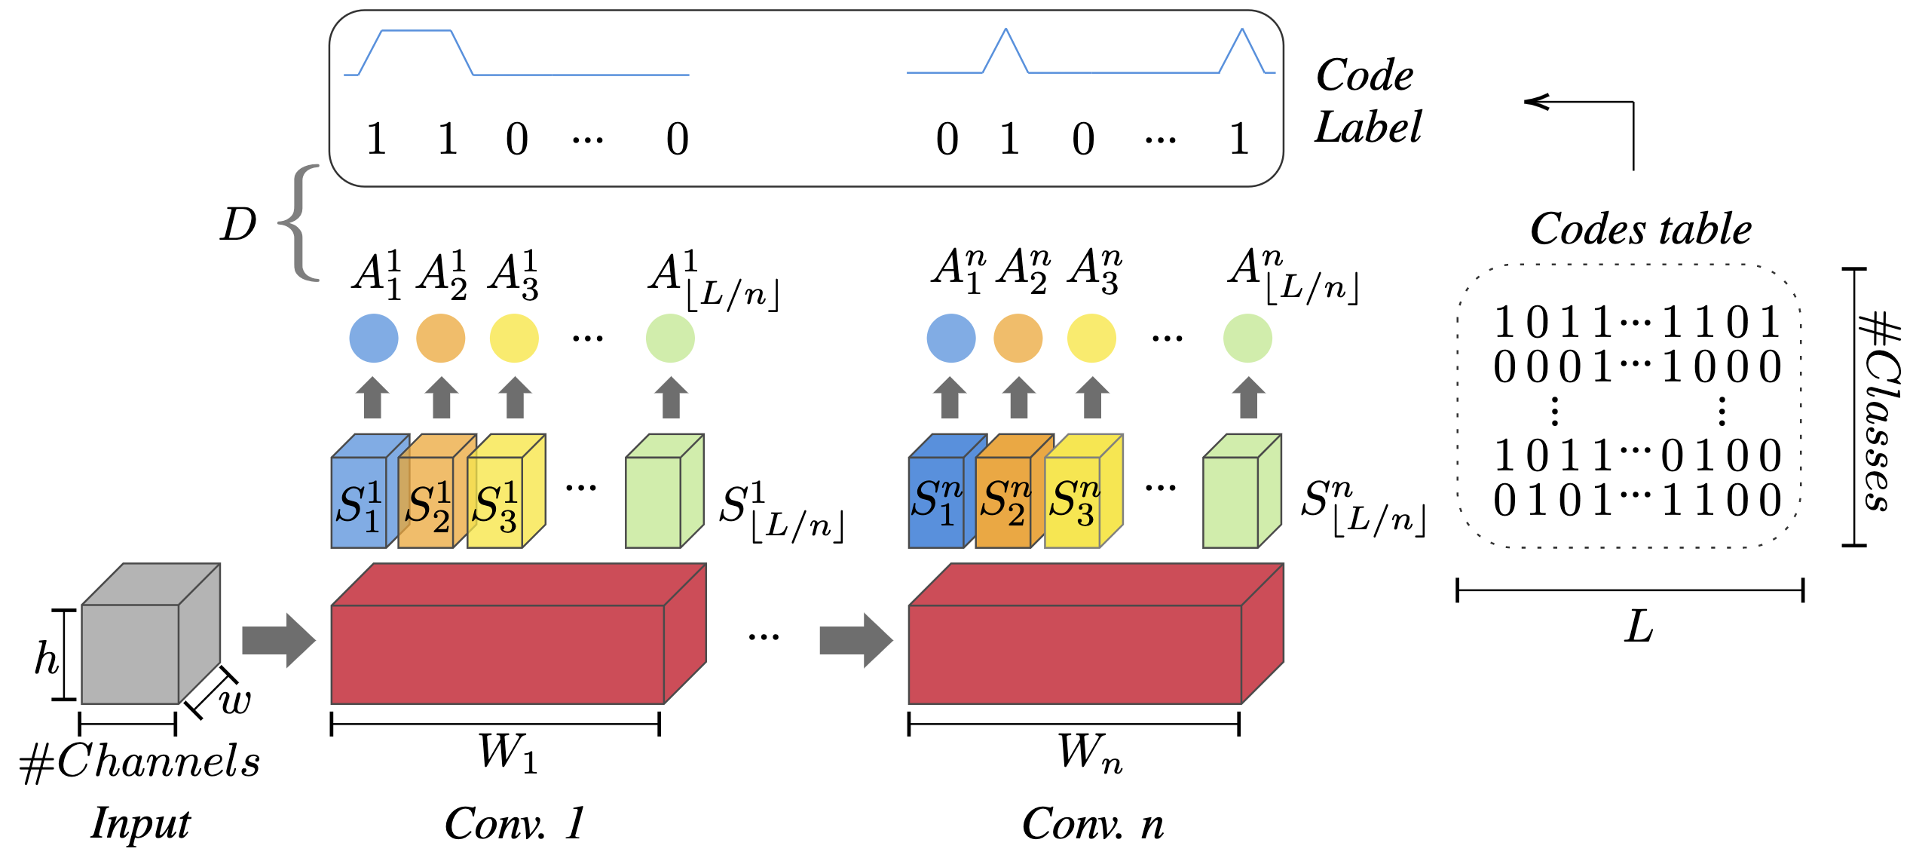
Total Activation Classifiers (TAC)
Training: Match profiles to class codes, i.e., a unique binary string that represents a class
    Cat → “101110”
    Dog → “010100”
Testing: Predict the class for which activation profiles and codes best match
  Vector distances play the role of confidence measures
Codes are chosen a priori and (almost) pairwise orthogonal
Slice and reduce outputs from layer stack to collect activation profiles
Source: Font Century Gothic, font size 6pt

Slide 5
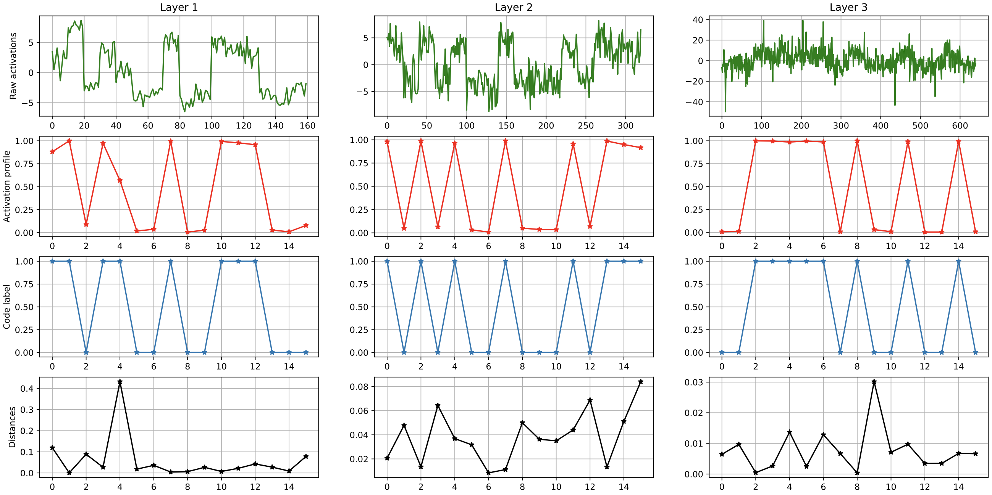
Can we train a TAC? Yes, we can!
TAC’ed WideResNet trained on Cifar-10 to ~95% accuracy
  Activation profiles (2nd row) nicely match the underlying ground-truth class code (3rd row)
Source: Font Century Gothic, font size 6pt

Slide 6
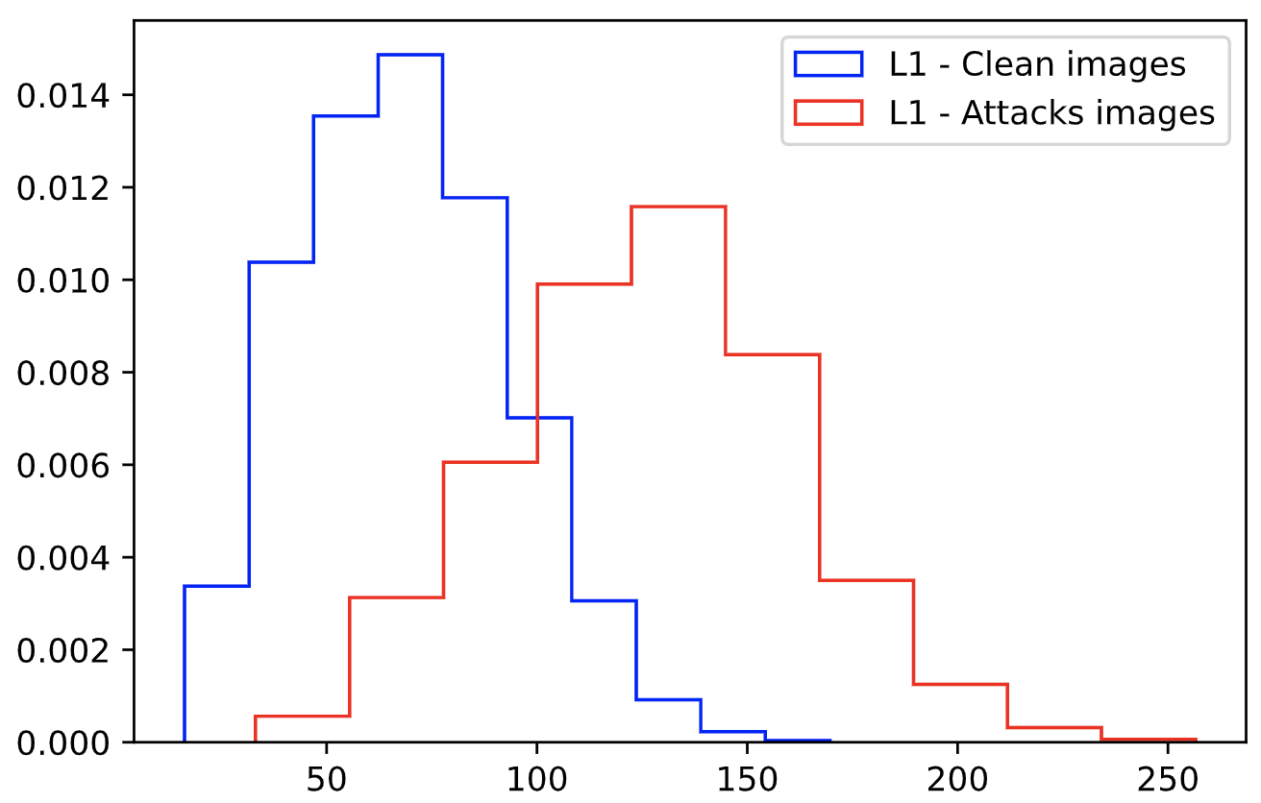
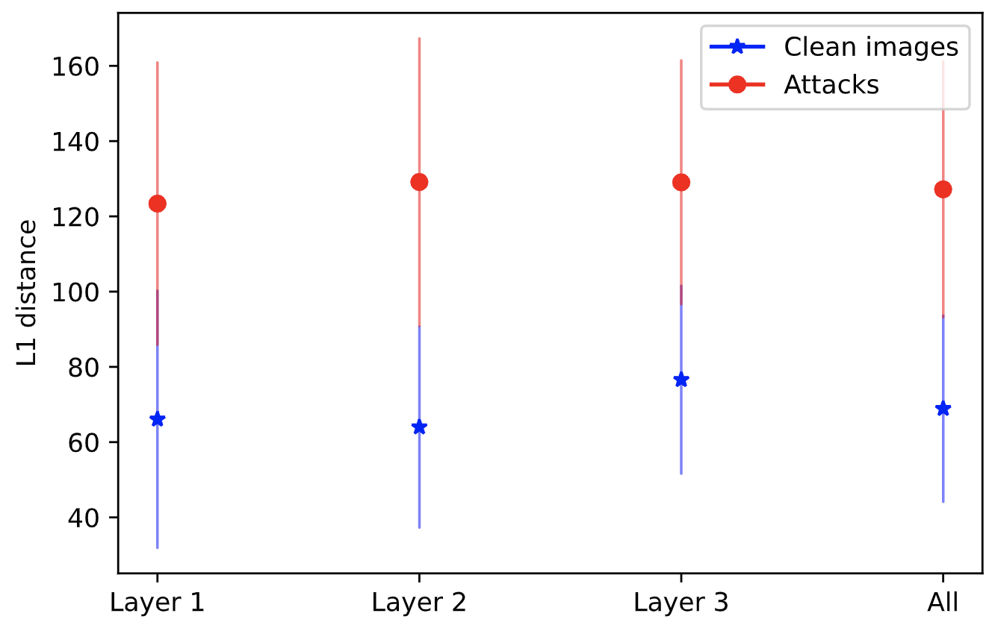
Are confidence scores derived from TAC any useful? It looks like so!
Adversaries have trouble matching codes as well as clean data so we can detect them
Source: Font Century Gothic, font size 6pt

Slide 7
Are confidence scores derived from TAC any useful? It looks like so!
Highlights of results:
  To be able to scale TAC, we add it on top of pre-trained classifiers
    It behaves as a monitoring module for existing classifiers
Source: Font Century Gothic, font size 6pt

Slide 8
Are confidence scores derived from TAC any useful? It looks like so!
Highlights of results:
  To be able to scale TAC, we add it on top of pre-trained classifiers
    It behaves as a monitoring module for existing classifiers
It works well on the rejection setting, when a model needs to predict its predictions errors
  Images and Text classification; convolutional and transformer architectures
Source: Font Century Gothic, font size 6pt

Slide 9
Are confidence scores derived from TAC any useful? It looks like so!
Highlights of results:
  To be able to scale TAC, we add it on top of pre-trained classifiers
    It behaves as a monitoring module for existing classifiers
It works well on the rejection setting, when a model needs to predict its predictions errors
  Images and Text classification; convolutional and transformer architectures
We also observed TAC’s scores to be effective for detecting classes unseen during training:
  A safe cat/dog classifier should output “I don’t know” if you give it an image of an airplane
  Monitoring with TAC enables that better than some recent alternatives
Source: Font Century Gothic, font size 6pt

Slide 10
Extra application: TAC monitor as a robust surrogate to the base classifier
Confidence +
Predictions
Predictions
Public model
Private TAC (Monitor)
Data
Attack access model:
  A private TAC can correct predictions and raise the accuracy of the vulnerable public model
    From ~0 to SOTA-level robust accuracy
    If TAC is exposed, then the attacker wins again
Source: Font Century Gothic, font size 6pt

Slide 11
Future directions and extensions
Data-dependent codes:
  Unsupervised approach to define the codes table:
    Contrastive style: positive pairs should match the same code. Negative pairs should match different codes
  Once we observe labels, use preferred black-box linear assignment solver (e.g., Hungarian matching) to assign classes to codes
    Fine-tune if needed
Source: Font Century Gothic, font size 6pt

Slide 12
Future directions and extensions
Data-dependent codes:
  Unsupervised approach to define the codes table:
    Contrastive style: positive pairs should match the same code. Negative pairs should match different codes
  Once we observe labels, use preferred black-box linear assignment solver (e.g., Hungarian matching) to assign classes to codes
    Fine-tune if needed
Ensemble classifiers obtained across layers
  We currently don’t take advantage of the fact that, with TAC, we can define multiple (correlated) classifiers from different layers
  Empirical evidence in recent work showing that agreement through depth implies confidence:
    https://arxiv.org/abs/2106.09647
Source: Font Century Gothic, font size 6pt

Slide 13
Thank you!
Source: Font Century Gothic, font size 6pt

Slide 14
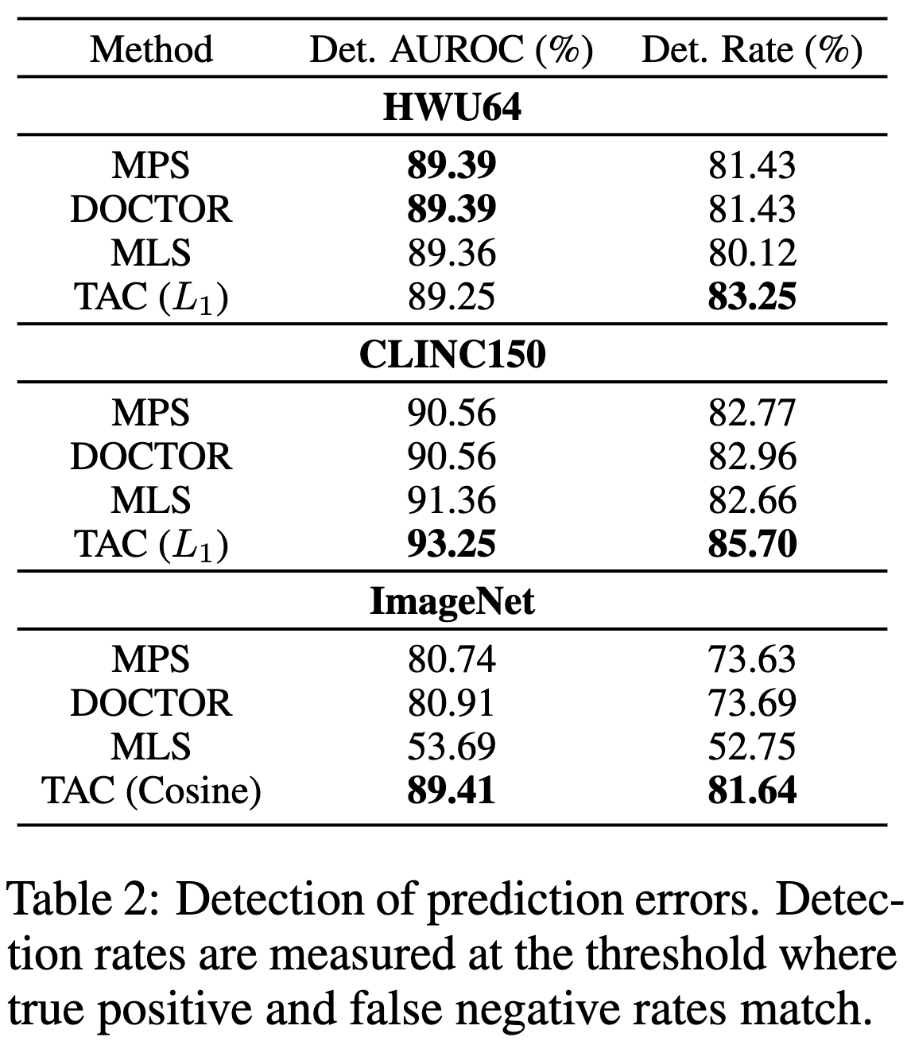
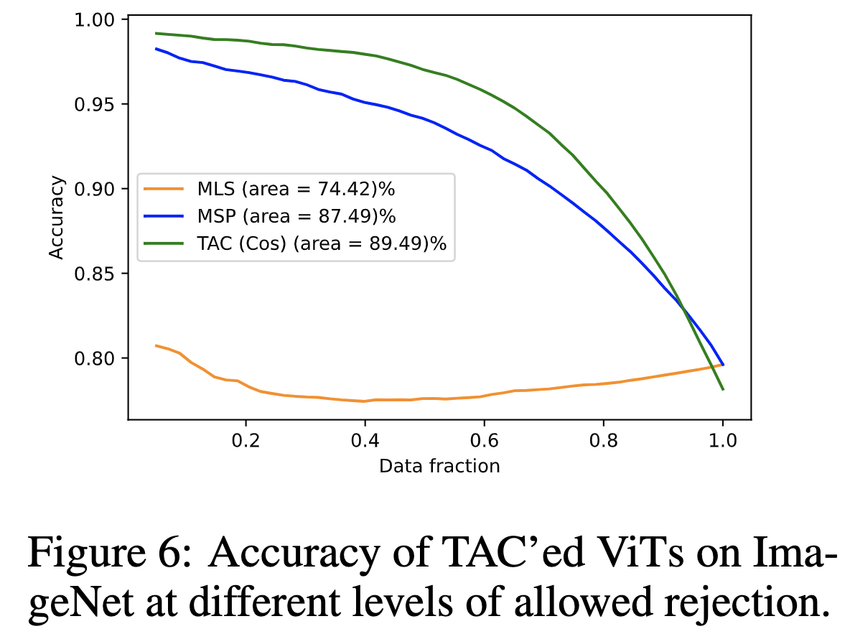
Some detailed results: Rejecting classifiers
Source: Font Century Gothic, font size 6pt

Slide 15
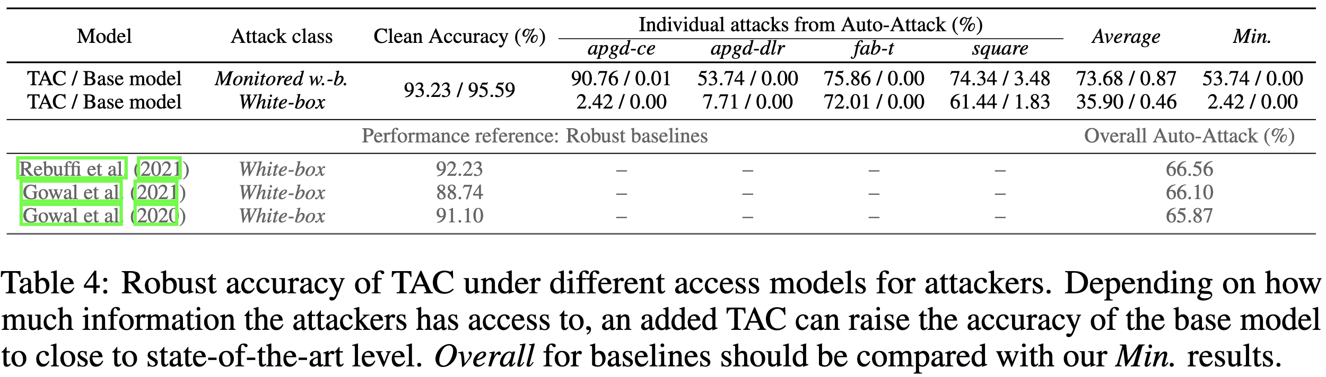
Some detailed results: TAC monitor to improve robustness
Source: Font Century Gothic, font size 6pt

