Slide 1





Regions of Reliability
In the Evaluation of Multivariate Probabilistic Forecasts
Étienne Marcotte
Valentina Zantedeschi
Alexandre Drouin
Nicolas Chapados
Notes:
Hello, I'm Étienne Marcotte
And I'm here to present Regions of Reliability, a joint project with
(list of collaborators)

Slide 2
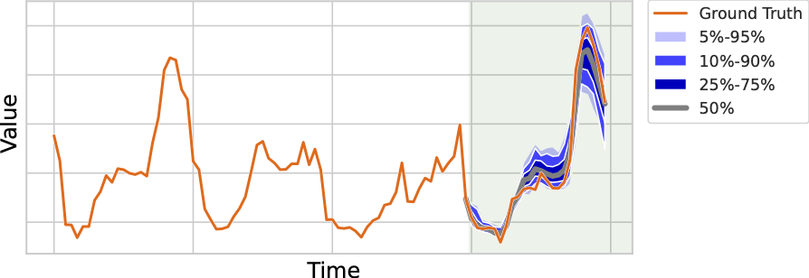
Evaluating Probabilistic Forecasts
: forecast distribution
: ground truth realization
Scoring rule: measures the correctness of a forecast distribution given a sample from the ground truth
Examples:
Proper scoring rule: satisfies this basic regularity condition
Negative-log likelihood
CRPS
Energy score
Question: Are proper scoring rules reliable in the finite-sample regime?
Notes:
A common task in timeseries is to produce a probabilistic forecast D^f, which contains the possible future values of the timeseries and the dependencies between timesteps
The question is: how do we evaluate the quality of said forecast once we have access to the ground-truth realization y?
Click
This evaluation is often done using scoring rules, which are functions which measures the correctness of a forecast given a ground-truth realization
A scoring rule is said to be proper if, in expectation, the smallest value is achieved with the ground truth distribution
Click
In this work, we assess whether they are reliable in realistic settings where samples from the forecast and ground truth distributions are finite in size

Slide 3
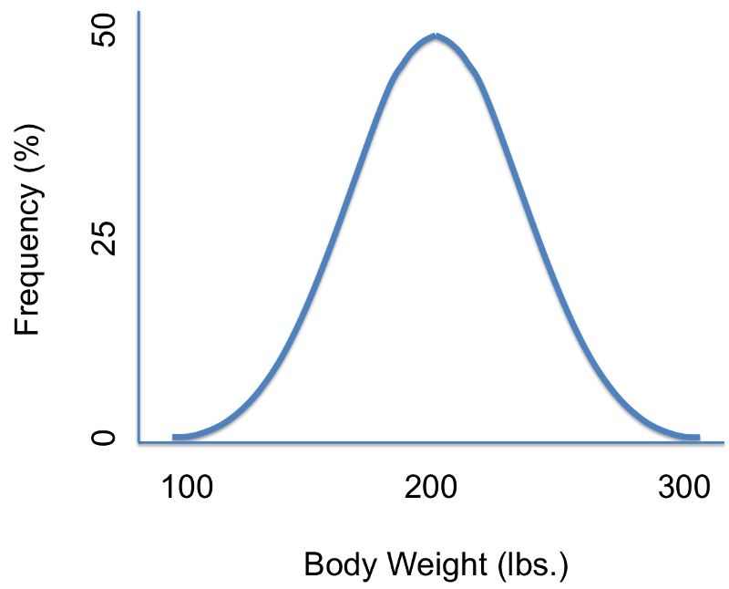
Simulated Benchmark
Ensures access to a ground truth distribution
We produced simulated ground truth distributions of various kinds
Forecasts with specific errors w.r.t. the ground truth:
We evaluate the sensitivity of 5 proper scoring rules w.r.t. 19 test cases,
using a statistical power analysis
We vary the number of variables of the distributions and the
sample size used when computing the scoring rules
Incorrect marginal distributions
Incorrect correlations
Notes:
To do so, we propose a simulated benchmark, which ensure we have full control over the forecast and ground truth distributions
This benchmark includes 19 multivariate test cases
They correspond to various forecast errors, such as incorrect marginal or incorrect correlations
We propose a methodology to measure the statistical power of scoring rules in detecting such errors

Slide 4
Regions of Reliability
RoR_{0.8}
RoR_{0.5}
Notes:
For each scoring rule and test case, we measure this statistical power over various number of variables and forecast sample sizes to obtain the figures shown here
We define the regions of reliability as the conditions under which the power is above some values.
Click
For example, the yellow area is RoR 0.8, where the power is greater than 80%
In our paper, we produce a total of 300 such figures

Slide 5
Results Overview
Key result 1: most scoring rules have significant
    power for detecting errors in
    marginal distributions
✅
Key result 2: all scoring rules are terrible at
detecting mistakes in modeling
multivariate dependencies
❌
Real world: these findings transfer to more
complex and temporal
real world datasets
Proportion of our experiments that are in RoR_{0.5}
Notes:
And so, for conciseness, we present this summary that shows for each scoring rule and each test case, the proportion of our experiments which reaches a statistical power of at least 50%
Click
Our first key result is that the scoring rules are quite reliable at detecting errors in marginal distributions
However, our second key result is that they are not reliable at detecting errors in multivariate dependencies, which is the main point in doing multivariate probabilistic forecasting
Click
We also checked that these findings transfer to real world datasets

Slide 6
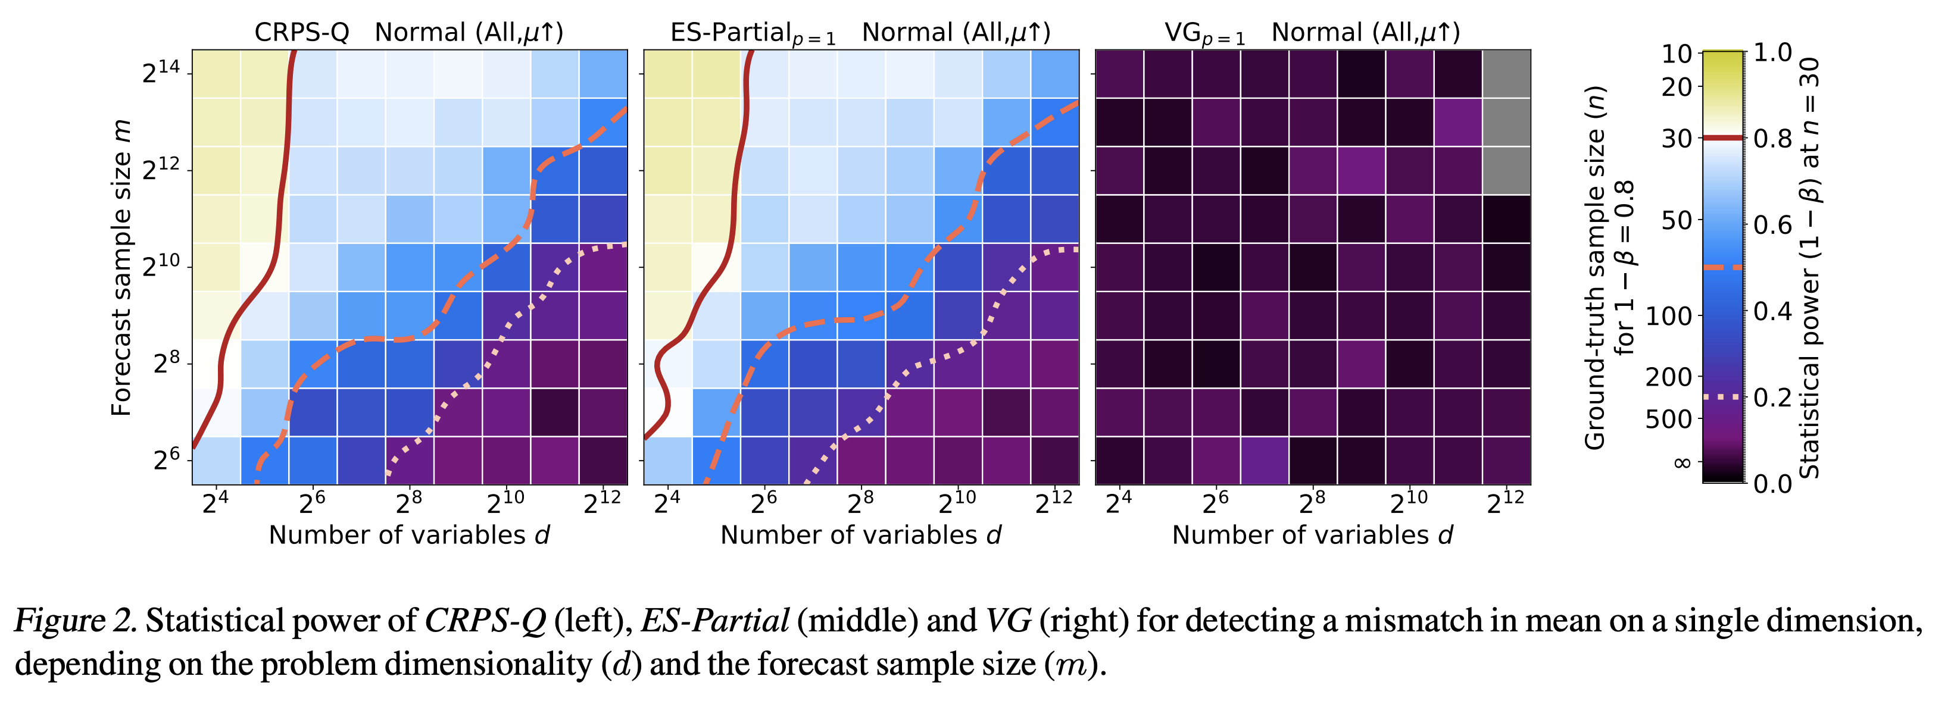


Takeaways from these results
Common benchmarks:
Most push scoring rules way out of their region of reliability
Examples:
  Electricity: d = 8880
  Taxi: d = 29136
  Traffic: d = 23112
  Wikipedia: d = 60000
16384
m $∈[100, 1000]$
⚠️
n $∈[5, 7]$
4096
Practical recommendations:
Use the negative-log likelihood for scoring when possible
If a scoring rule fails for some (d, m, n), proceed with caution
Do not assume that combinations of scoring rules will work better than a single one
Use as many rolling windows (n) and forecast samples (m) as possible
Notes:
In light of our results, we see that commonly used timeseries multivariate probabilistic forecasting benchmarks are used way outside the regions of reliability of their scoring rules
Click
We give practical recommendations to improve the reliability of evaluations in our paper, such as using the negative-log likelihood for scoring if possible, and using much larger forecast samples if not.
Finally, we hope that this work will foster new research toward improved scoring rules for multivariate probabilistic forecasting

Slide 7
Thank you!
Please come by our poster!
Poster session 6, Thursday 27 Jul 1:30 p.m. — 3 p.m.
Notes:
Thanks for listening to my presentation, and please come by our poster if you want to know more!

